Slide 1
Platypus
By: Zach Kress

Slide 2
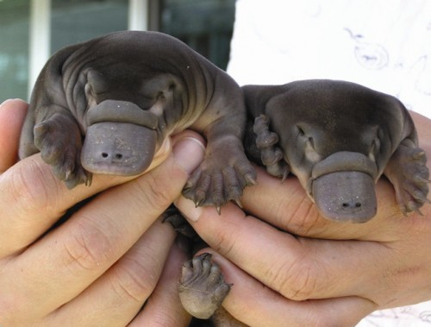
Classification
Kingdom: Animalia
Phylum: Chordata
Class: Mammalia
Order: Monotremata
Family: Ornithorhynchidae
Genus: Ornithorhynchus
Species: O. anatinus
http://babyanimalz.com/2010/04/baby-platypus/

Slide 3
General Info
Flat tail, covered with brown fur
Fur is waterproof.
It’s a mammal with a beak.
Platypus have the ability to walk on land and swim under water.
It is Endothermic.
They lay eggs.
It has claws that give off a venomous poison.

Slide 4
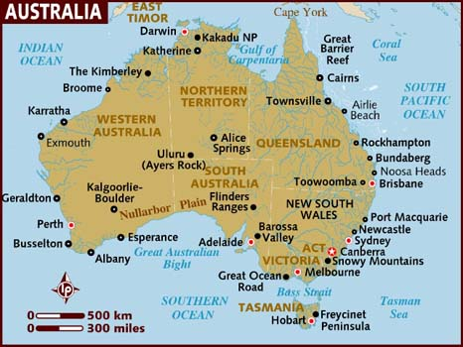
Habitat
It lives on land and in water.
It lives in Eastern Australia.
It lives in Queensland.
http://www.google.com/imgres?q=australia&um=1&hl=en&sa=N&biw=1441&bih=581&tbm=isch&tbnid=1A4pcrYIZaEv1M:&imgrefurl=http://www.lonelyplanet.com/maps/pacific/australia/&docid=a1HpLIHE5rXkDM&imgurl=http://www.lonelyplanet.com/maps/pacific/australia/map_of_australia.jpg&w=466&h=350&ei=MzG9T7zbFY6rsALut73JAg&zoom=1&iact=hc&vpx=514&vpy=2&dur=640&hovh=194&hovw=259&tx=107&ty=48&sig=112537361077342180155&page=1&tbnh=164&tbnw=219&start=0&ndsp=12&ved=1t:429,r:2,s:0,i:144

Slide 5
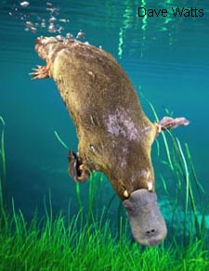
Diet
They are a carnivorous mammal.
They eat Insects, larva, shellfish.
They can consume their body
weight in 24 hours.
http://users.tpg.com.au/readmana/plat3-watts.jpg

Slide 6
Reproduction
A baby platypus is called a platypup.
Females seal themselves inside one of the burrow's chambers to lay their eggs.
A mother typically produces one or two eggs and keeps them warm by holding them between her body and her tail.
They are one of two mammals that are oviparious.

Slide 7
Human Impact
They are least concerned on the extinction.
They are plenty of them.
They are not hunted by humans.

