Slide 1
Snow Leopard
By: Lexie Kindt

Slide 2
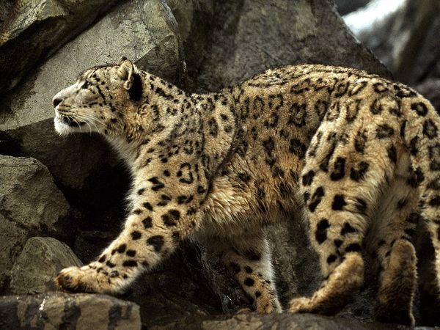
Classification
Kindom: Animalia
Phylum: Chordata
Subphylum: Vertebrata
Class: Mammalia
Order: Carnivora
Family: Felidae
Subfamily: Pantharinae
Genus: Uncia
Species: U. Uncia

Slide 3
Location
The Snow Leopard is Native to the Central Asian Mountains
They are very rare
Hunted for their warm, beautiful fur and organs which are used in Chinese medicine
Snow leopards occupy alpine and subalpine areas generally 3,350 and 6,700 meters above sea level in Central Asia

Slide 4
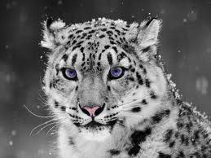
Adaptations
To minimize heat loss
Stocky bodies
Thick fur
Small ears
Wide paws to walk on snow
Short muzzle and domed forehead to breathe thin air

Slide 5
Eating/Hunting
Carnivores and actively hunt their prey
Also opportunistic feeders, eating whatever meat they can find
Capable of killing most animals
Prefer to ambush prey from above
Eat a significant amount of vegetation, like grass and twigs

Slide 6
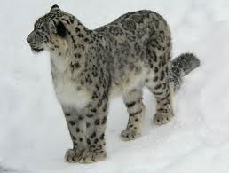
Appearance
fur color ranges from light gray to smoke gray, shading to white on the belly
head, neck, and lower limbs are covered with spots
fur is very thick
very large and furry paws
functioning both as snow shoes and padding against sharp rocks
tails are extremely long in comparison to other cats, measuring almost as long as the body.
use the tail both for balance and covering their body, nose, and mouth during times of sub-zero temperatures

Slide 7
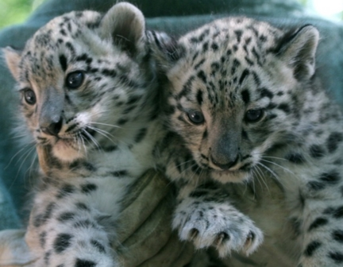
Reproduction
Mating season is between December and March
births occur after 100 days of gestation
young are born in a rocky shelter lined with the mother's fur for warmth
the litter can include from one to five young, average of two or three
babies are blind for about nine days
after three months they follow the mother for food and are dependent on her for at least the next year
sexual maturity is reached at the age of two years

Slide 8
Behavior
Socially, snow leopards tend to be independent
Pair up only during mating season
Unlike other cats, snow leopards cannot roar
Primarily nocturnal
Known for muscularity and agility, able to jump 50 feet horizontally and 20 feet vertically

Slide 9
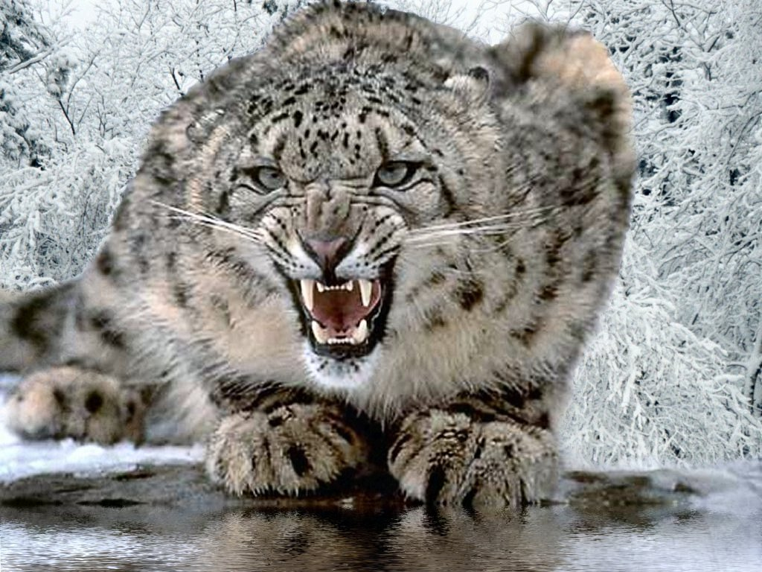
Conservation
Threatened existence
Fur coat consists of about 8 leopards and costs $60,000
Approximately 500 living in zoos

Slide 10
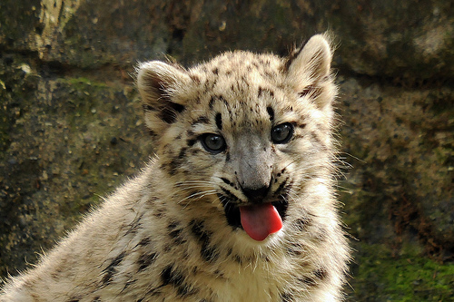
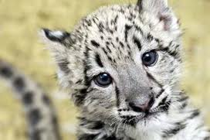
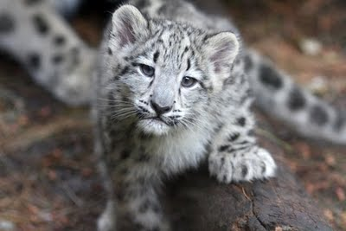

Slide 11
Works cited
"Google." Google. Web. 23 May 2012. <http://www.google.com/search?hl=en>.
"Panthera Uncia." Wikipedia. Wikimedia Foundation, 23 May 2012. Web. 23 May 2012. <http://en.wikipedia.org/wiki/Panthera_uncia>.
"Uncia Unciasnow Leopard." ADW: Uncia Uncia: INFORMATION. Web. 23 May 2012. <http://animaldiversity.ummz.umich.edu/site/accounts/in formation/Uncia_uncia.html>.

