Slide 1
Komodo Dragons
By Brandon Schulte

Slide 2
Classification
Kingdom: Animalia
Phylum: Chordata
Class: Reptilia
Order: Squamata
Family: Varanidae
Genus: Varanus
Species: komodoensis

Slide 3
Miscellaneous
Ectothermic
it has over 50 different strands of bacteria in its mouth which it uses to stun or kill prey that gets away within 24 hours the prey usually dies from blood poisoning
It is said there are between 3000 to 5000 in the wild.
It has also been known to swim to different islands
Its record length is around 1o feet and its record weight is over 300 pounds

Slide 4
Habitat
It lives on the Indonesian islands: Komodo, Rintja , Flores, and Padar.
Its distribution ranges from the beaches to the ridges of the islands

Slide 5
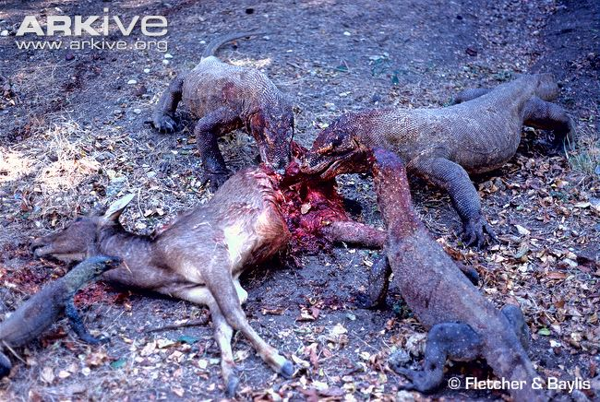
Diet
It is a carnivore/scavenger
Its favorite prey is deer
It is also known to eat water buffalo, boars, humans, and newborn komodo dragons

Slide 6
Reproduction
It has internal fertilization
It has oviparity
It doesn’t live in groups
It doesn’t have a lifetime mate
It doesn’t take care of its young
There are no real marks to tell if a komodo dragon is male or female

Slide 7
Human Impact
Humans have legally and illegally hunted the species
Local villagers would poison deer to kill off the dragons
They are endangered
Laws have been passed to not hunt it and some have been put into captivity

Slide 8
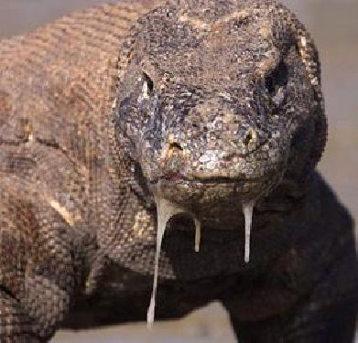
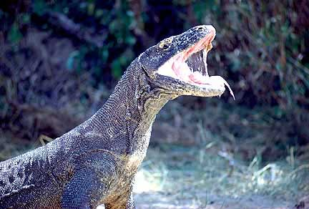
Pictures

Slide 9
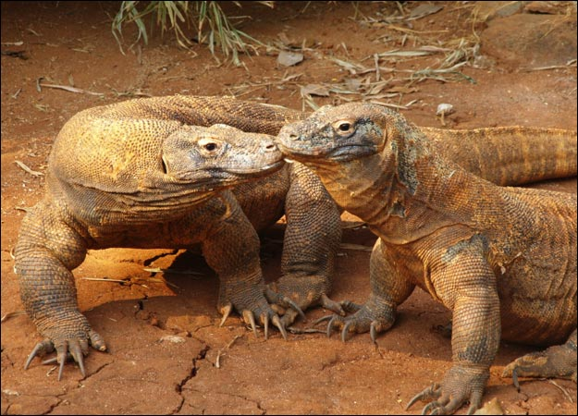
Pictures

Slide 10
Sources
http://animals.nationalgeographic.com/animals/reptiles/komodo-dragon/
http://nationalzoo.si.edu/Animals/ReptilesAmphibians/Facts/FactSheets/Komododragon.cfm

