Slide 1
Four-Toed Hedgehog
By DeAnna Robinson

Slide 2
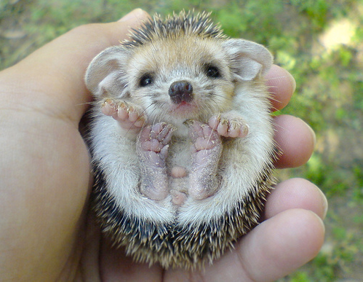
Classification
Kingdom
Animalia
Phylum
Chordata
Class
Mammalia
Order
Erinacemorpha
Family
Erinaceidae
Genus
Atelerix
Species
Albiventris

Slide 3
General Info.
There are 16 species of hedgehog.
Hedgehogs have 5 toes on their front paws with short nails. On their back paws they have 4 toes with long, constantly growing nails.
Hedgehogs are easily recognized by their spines, which are hollow hairs made stiff with keratin. Their spines are not poisonous or barbed and unlike the quills of a porcupine, cannot easily be removed from the animal.
When under extreme stress or during sickness, a hedgehog can also lose its spines.

Slide 4
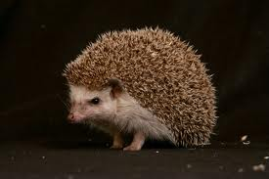
General Info. continued
The male Hedgehog is called a 'Boar' and is slightly larger than a female Hedgehog which is called a 'Sow'.
There are approximately 5,000/7,000 spines on an average adult hedgehog.
Hedgehogs are endothermic.
The hedgehog’s back and sides are covered in 25mm (1”) long spines (which are really modified hairs).
Hedgehogs tend to hibernate between
November and mid March.

Slide 5
Habitat
Hedgehogs are native to mainland Britain and are also found throughout northern and western Europe. Related and similar species are also found as far as north Africa, the Middle East and central Asia.
Hedgehogs build nests of moss and leaves under vegetation around parks, gardens and farmland. They prefer woodland edges, hedgerows and suburban gardens where food is plentiful.

Slide 6
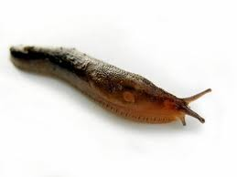
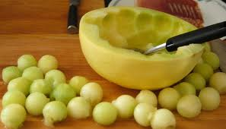
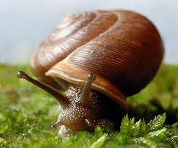
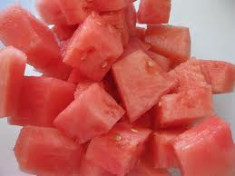
Diet
Hedgehogs are not solely insectivores but are almost omnivorous.
Hedgehogs feed on insects, snails, frogs and toads, caterpillars, worms, beetles, snakes, bird eggs, carrion, mushrooms, grass roots, berries, melons and watermelons.
Its favorite food is slugs and worms, they may eat 40 or more slugs a night.
A single hedgehog can keep an average garden free of pests by eating up to 200 grams of insects each night.

Slide 7
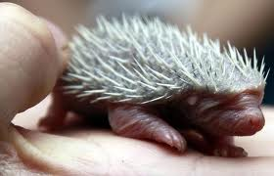
Reproduction
A female will mate several times before getting pregnant.
The average litter is 4 – 7 newborns for larger species of hedgehog and 5 – 6 for smaller ones.
When born, the babies are blind and dependent on their mother (altricial).
Fertilization is internal.
Hedgehogs are viviparous.

Slide 8
Human Impact
Hedgehogs have the same problem as many other small mammals who live around humans.
Cars are a great danger to them. Another common human caused problem is pesticides.
when a hedgehog eats an insect who has been hit with this poison they usually form digestive problems and may even die.

Slide 9
Bibliography
http://www.google.com/search?tbm=isch&hl=en&source=hp&biw=1280&bih=929&q=hedgehog&gbv=2&oq=hedge&aq=0&aqi=g10&aql=&gs_l=img.3.0.0l10.1735.5590.0.9400.9.5.3.1.1.0.83.396.5.5.0...0.0.2CdTU9LPQcs#hl=en&gbv=2&tbm=isch&q=baby+hedgehog&revid=457558506&sa=X&ei=qvC7T56aEqSosQLgvY2LDA&ved=0CBQQgxY&bav=on.2,or.r_gc.r_pw.r_qf.,cf.osb&fp=bf8041e9ec62a404&biw=1280&bih=929
www.animalcorner.co.uk/britishwildlife/hedgehog.htm
local.brookings.k12.sd.us/krscience/zoology/webpage%20projects/sp10webprojects/hedgehog/Hedgehog.html
http://www.google.com/search?hl=en&q=hedgehog&bav=on.2,or.r_gc.r_pw.r_qf.,cf.osb&biw=1366&bih=551&wrapid=tlif133779924689010&um=1&ie=UTF-8&tbm=isch&source=og&sa=N&tab=wi&ei=XzK9T-7RF-7KsQKPqpgs#um=1&hl=en&tbm=isch&sa=1&q=hedgehog+spines&oq=hedgehog+spi&aq=0&aqi=g3g-m3g-S4&aql=&gs_l=img.3.0.0l3j0i5l3j0i24l4.45789.53826.3.55105.14.11.0.0.0.2.281.1109.1j6j1.8.0...0.0.au8TQEgktZA&bav=on.2,or.r_gc.r_pw.r_qf.,cf.osb&fp=ecb48fed32b13b7f&biw=1366&bih=551
http://www.britishhedgehogs.org.uk/FAQS/general.htm

