Slide 1
ZEBRA PROJECT
BY BIANCA ☺

Slide 2
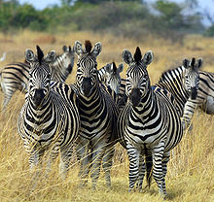
FACTS OF LIFE
Zebras are several species of African equids (horse family) united by their distinctive black and white stripes.
Zebras have never been truly domesticated.
There are three species of zebras: the plains zebra, the Grévy's zebra and the mountain zebra.
Kingdom: Animalia
Phylum: Chordata
Class: Mammalia
Order: Perissodactyla
Family: Equidae
Genus: Equus
Subgenus: Hippotigris and Dolichohippus
Species:
Equus zebra
Equus quagga
Equus grevyi

Slide 3
ZEBRAS
The plains zebra and the mountain zebra belong to the subgenus Hippotigris, but Grevy's zebra is the sole species of subgenus Dolichohippus.
All three belong to the genus Equus, along with other living equids.
Grevy's zebra and the mountain zebra are endangered. While plains zebras are much more plentiful, one subspecies, the quagga, went extinct in the late 19th century, though they have now been rebred from zebra DNA.

Slide 4
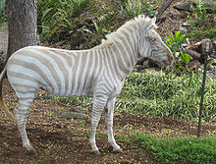
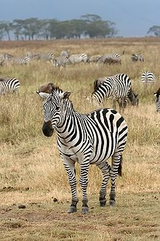
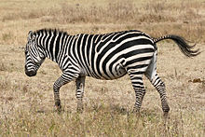
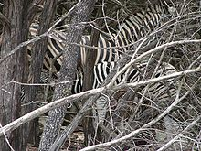
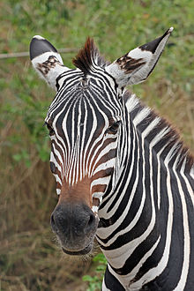
PICTURES MORE SO

Slide 5
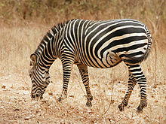
FOOD!!!!!!!
Zebras feed almost entirely on grasses, but may occasionally eat shrubs, herbs, twigs, leaves and bark. Their digestive systems allow them to subsist on diets of lower nutritional quality than that necessary for other herbivores.

Slide 6
INTERESTING TIDBIT
When attacked by packs of hyenas or wild dogs a zebra group will huddle together with the foals in the middle while the stallion tries to ward them off.
Unlike the other zebra species, Grevy's zebras do not have permanent social bonds. A group of these zebras rarely stays together for more than a few months. The foals stay with their mothers, while adult males live alone. Like the other two zebra species, bachelor male zebras will organize in groups.
Like horses, zebras sleep standing up, and only sleep when neighbors are around to warn them of predators

Slide 7
REPRODUCTION STUFF
Female zebras mature earlier than the males, and a mare may have her first foal by the age of three. Males are not able to breed until the age of five or six. Mares may give birth to one foal every twelve months. She nurses the foal for up to a year. Like horses, zebras are able to stand, walk and suckle shortly after they are born. A zebra foal is brown and white instead of black and white at birth.
Plains and mountain zebra foals are protected by their mothers, as well as the head stallion and the other mares in their group. Grevy's zebra foals have only their mother as a regular protector, as Grevy's zebra groups often disband after a few months.

Slide 8
HUMANS AND ZEBRAS
Humans like to hunt zebras for their fur and meat. One whole species of zebra was wiped out before cloning of DNA repopulated them. Some zebras are breed in zoos so that the numbers in population can go up, without the threat of the real world.

Slide 9
WHERE THEY ARE FOUND ON EARTH
In the wild, zebras are found in Africa. It is thought though that the first of the zebras where from Portuguese.
Zebras are also found in zoos around the world.
Some wealthy people in the early 1900’s tried their hand at domestication of zebras, and a few worked well, but the zebras unpredictable behavior and tendency to panic under stress provided this to be futile.

Slide 10
SOURCES THAT I USED DURING THIS POWERPOINT ☺
^ "Online Etymology Dictionary". Etymonline.com. http://www.etymon2.^ Orlando, Ludovic; et al. (2009). "Revising the recent evolutionary history of equids using ancient DNA". PNAS 106: 21754–21759.
3.^ a b c Prothero D.R, Schoch R. M (2003). Horns, Tusks, and Flippers: The Evolution of Hoofed Mammals. Johns Hopkins University Press.
4.^ NPS.gov
5.^ Hunt, Kathleen (1995-01-04). "Horse Evolution". TalkOrigins Archive. http://www.talkorigins.org/faqs/horses/horse_evol.html. Retrieved 2008-10-10.
6.^ J. E. Cordingley, S. R. Sundaresan, I. R. Fischhoff, B. Shapiro, J. Ruskey, D. I. Rubenstein (2009). Is the endangered Grevy's zebra threatened by hybridization?. Animal Conservation. 12: 505–513.
7.^ "Zebras". The Gale Encyclopedia of Science. 2008. http://www.encyclopedia.com/topic/Zebras.aspx. Retrieved 2011-05-16.
8.^ a b Zebra stripes evolved to keep biting flies at bay, BBC News, Victoria Gill, 9 February 2012
9.^ "How do a zebra's stripes act as camouflage?". How Stuff Works. http://science.howstuffworks.com/question454.htm. Retrieved 2006-11-13.
10.^ Waage, J. K. (1981). How the zebra got its stripes: biting flies as selective agents in the evolution of zebra colouration. J. Entom. Soc. South Africa. 44: 351–358.
11.^ How the Zebra Got Its Stripes, J Exp Biol 215, iii., Kathryn Knight
12.^ Hayes, Capt. Horace (1893), Points of the Horse, pp. 311–316, London: W. Thacker
13.^ Young, T.P., et al. (2005). "Competition and compensation among cattle, zebras, and elephants in a semi-arid savanna in Laikipia, Kenya. 121:351–359". Biological Conservation 121: 351–359.
14.^ "How the Zebra Got his Stripes". Gateway Africa. http://www.gateway-africa.com/stories/How_the_Zebra_Got_his_Stripes_San.html. Retrieved 2008-10-10.
15.^ Dirks, Tim. "Fantasia (1940)". Tim Dirks. http://www.filmsite.org/fant.html. Retrieved 2008-10-10.
16.^ "Zebra Art". Artists for Conservation. http://www.natureartists.com/zebras.asp. Retrieved 2008-10-10.
17.^ Cohen, M.J. John Major, Simon Schama (2004), History in Quotations:Reflecting 5000 Years of World History, p. 146, Sterling Publishing Company, Inc., ISBN 0-304-35387-6
Churcher, C.S. 1993. Mammalian Species No. 453. American Society of Mammalogists.
Estes, R. (1991). The Behavior Guide to African Mammals, Including Hoofed Mammals, Carnivores, Primates. Los Angeles, The University of California Press.
McClintock, Dorcas. "A Natural History Of Zebras" September 1976. Scribner's, New York. ISBN 0-684-14621-5
line.com/index.php?term=zebra.

