Slide 1
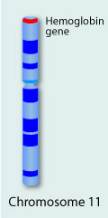
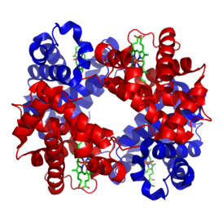
Beta-Globin gene Activity
Image from: http://learn.genetics.utah.edu/content/disorders/whataregd/sicklecell/
Image from: http://en.wikipedia.org/wiki/Hemoglobin
From a kit by 3 D Molecular Designs

Slide 2
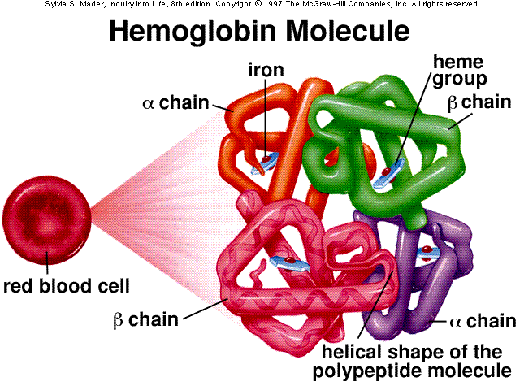
http://gassama.myweb.uga.edu/hemoglobinmolecule.gif

Slide 4
Amino acid sequence
aa Code amino acid mRNA codes DNA Codes M= ________ ________ ______
V= ________ ________ ______
Methionine
AUG
TAC
GUU GUC GUA GUG
CAA CAG CAT CAC
valine

Slide 5
TEMPLATE strand = strand from which the RNA is actually transcribed.
CODING (SENSE) strand =
strand whose base sequence specifies the amino acid sequence. (IT MATCHES THE mRNA MESSAGE EXCEPT IT HAS T’s instead of U’s)
http://users.rcn.com/jkimball.ma.ultranet/BiologyPages/A/AntisenseRNA.html

Slide 6
http://www.3dmoleculardesigns.com/3DMD.htm

Slide 7
http://www.3dmoleculardesigns.com/3DMD.htm

Slide 8
http://www.3dmoleculardesigns.com/3DMD.htm

Slide 9
http://www.3dmoleculardesigns.com/3DMD.htm

Slide 10
http://www.3dmoleculardesigns.com/3DMD.htm

Slide 11
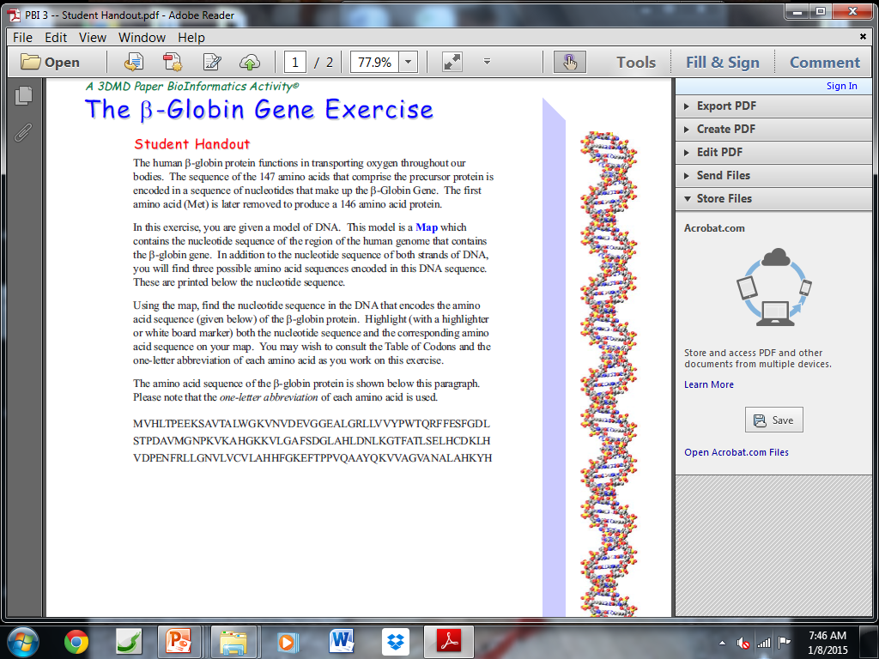
http://www.3dmoleculardesigns.com/3DMD.htm

Slide 12
Sickle Cell disease (anemia)
http://learn.genetics.utah.edu/content/disorders/whataregd/sicklecell/images/sicklecell.jpg

Slide 13
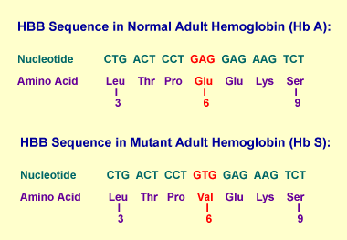
http://www.ornl.gov/sci/techresources/Human_Genome/posters/chromosome/Gifs/HBBmutseq_2.gif

Slide 14
5 kinds of hemoglobin subunits
Alpha (σ)
Beta (β)
Gamma (ϒ)
Delta (δ)
Epsilon (ϵ)

Slide 15
Adult hemoglobin σ₂ β₂ - 2% of adult hemoglobin ₌ σ₂ δ₂
Embryonic hemoglobin σ₂ ϵ₂
Fetal Hemoglobin σ₂ ϒ₂
Greater affinity for oxygen than adult hemoglobin
last seven months of development in uterus
in the newborn until roughly 6 months old
Sickle cell hemoglobin σ₂ β₂
Mutation in β chain

