Slide 1
2014 SDSTA Conference
MODELING BIOLOGY Kelly Riedell Brookings High School
NABT SD Outstanding Biology Teacher 2008
My webpage: http://kr021.k12.sd.us
Copies of all activities mentioned, examples, weblinks, other resources are posted here:
http://local.brookings.k12.sd.us/krscience/protected/2014SDSTA.htm

Slide 2
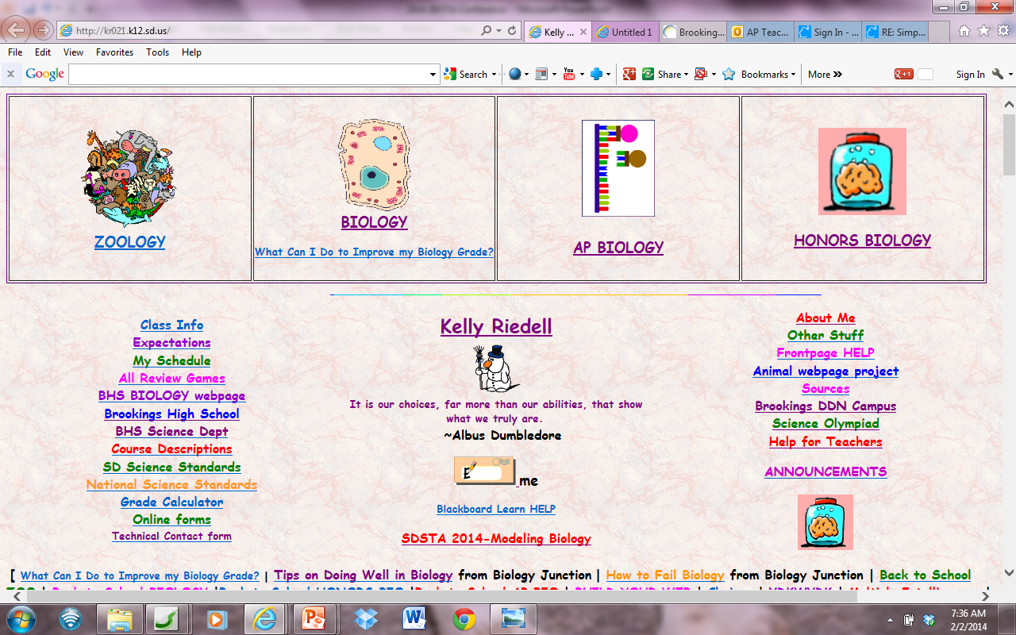

Slide 3
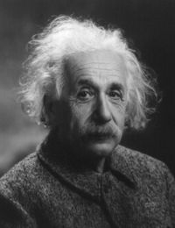
NGSS PRACTICES
- Developing and Using Models
- Constructing Explanations and Designing Solutions
- Obtaining, Evaluating, & Communicating Information
AP BIOLOGY
SCIENCE PRACTICE 1: The student can use representations and models to communicate scientific phenomena and solve scientific problems.
“If you can't explain it to a six year old, you don't understand it yourself.”
~ Albert Einstein
Image from: ://www.goodreads.com/author/show/9810.Albert_Einstein

Slide 4
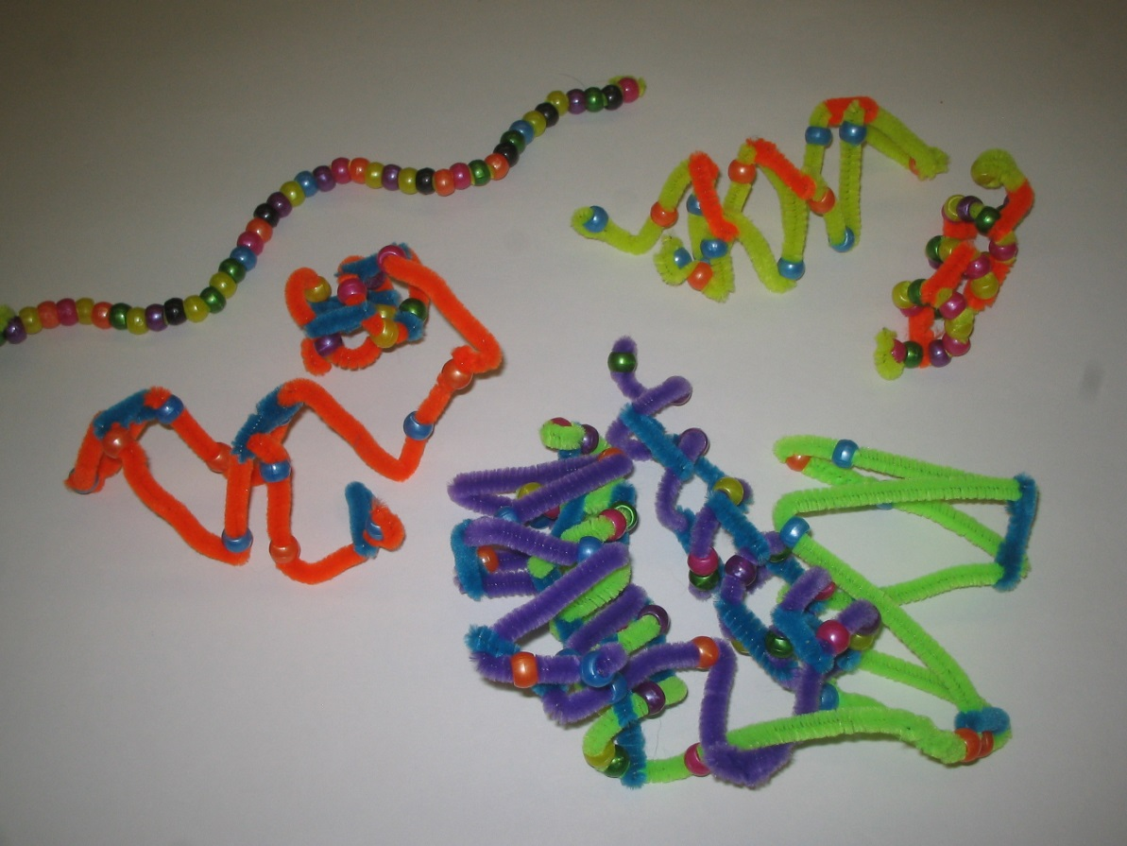
BUILD A MODEL TO:
Demonstrate understanding
Explain it to someone else
See how it works
Make connections
Really “get” vocab
“Show what you know”
Communicate ideas
“STEAM”
Primary, secondary, tertiary, quaternary structure of proteins

Slide 5
-Transport - Cell signaling
- Vocab Pictionary

Slide 6
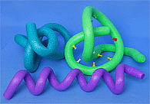
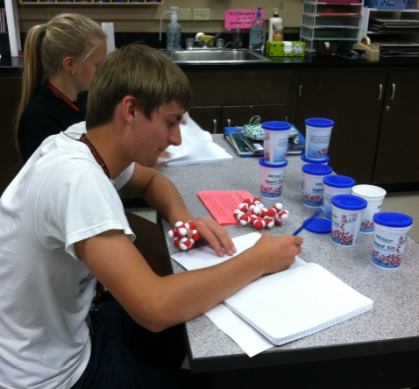
PURCHASED KITS
TOOBERS ©

Slide 7
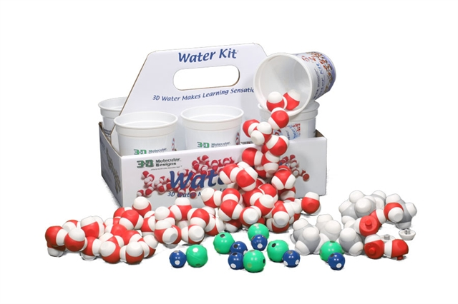
3D MOLECULAR DESIGNS
6 group set- $288
6 cut set- $232

Slide 8
Milwaukee School of Engineering
LENDING LIBRARY
http://cbm.msoe.edu/teachRes/library/

Slide 9
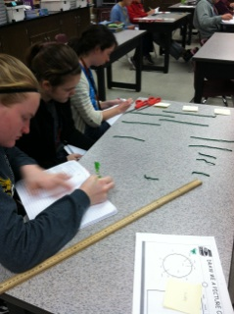
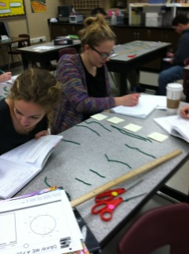
DESKTOP ELECTROPHORESIS

Slide 10
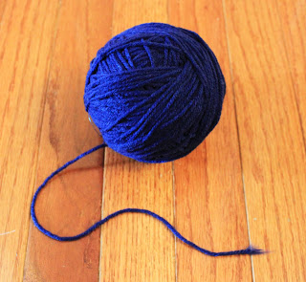
LAY OUT 3 YARN PIECES ON YOUR DESK DON’T STRETCH ! TRIM ALL YOUR YARN PIECES SO THEY ARE THE SAME LENGTH- 50 cm
Image from : http://thecreativeimperative.blogspot.com/2011/06/american-flag-wreath-sort-of.html

Slide 11
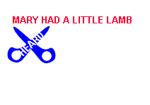
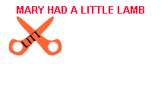
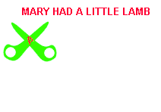
RESTRICTION ENDONUCLEASES
Use the “restriction enzymes” provided to: Cut one piece of yarn with EcoRI –Cuts at 8 cm AND 22 cm
Cut one piece of yarn with HindIII– Cuts at 18 cm AND 35 cm
Cut one piece of yarn with BOTH EcoRI AND HindIII

Slide 12
SET UP YOUR DESKTOP AS A GEL
EcoRI + HindIII
Use sticky notes to LABEL THE + and – poles
Use sticky notes to LABEL your lanes
Load your “gel” with
your “DNA” that has been cut with “restriction enzymes”
Complete RFLP analysis
and draw a picture of
the results in your BILL
EcoRI
HindIII
–
DNA
↓
+

Slide 13
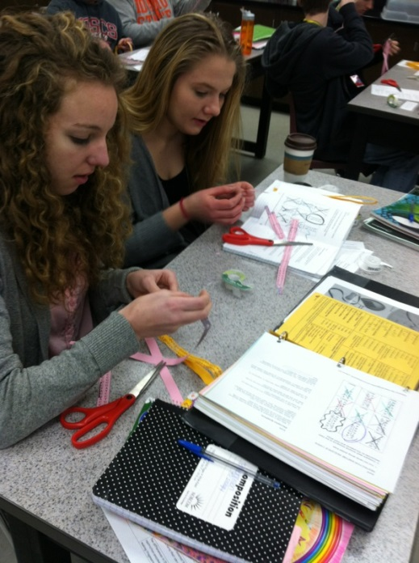
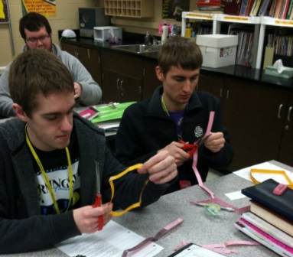
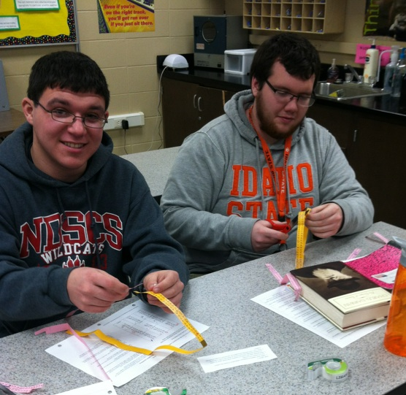
CUT AND PASTE PLASMIDS
ACTIVITY FROM: http://www.biologycorner.com

Slide 14
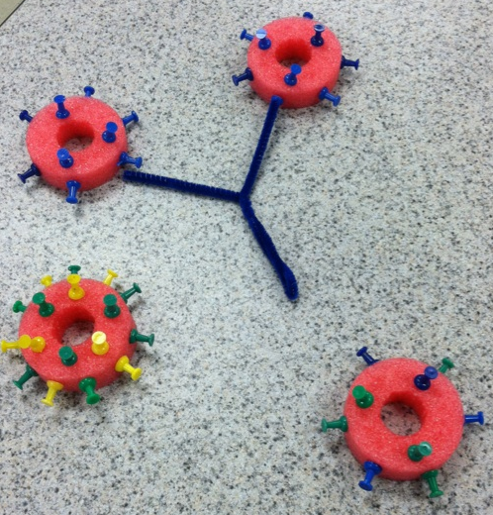
http://www.ebay.co.uk/itm/4-x-Swimming-Pool-Noodle-Float-Aid-Woggle-Bargain-Red-Yellow-Pink-Blue-/180763754831
POOL NOODLES
OPERONS
IMMUNE SYSTEM- Blood types
MITOSIS Homologous chromosomes
KRISTIN DOTTI CATALYST LEARNING CURRICULA
http://catalystlearningcurricula.com/

Slide 15
Blue pins= A antigens
Green pins= B antigens Yellow pins = Rh antigens
Make a RED BLOOD CELL
that shows the glycoprotein
pattern for a person with A⁺
blood type

Slide 16
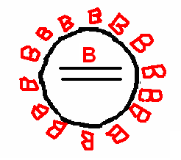
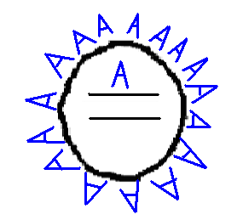
Pipe cleaners = ANTIBODIES
Blue = Anti-A Green = Anti-B
Show what would happen if a Type B person was given Type A blood.
Body image modified from:http://www.new-fitness.com/images/body_shapes.jpg

Slide 17
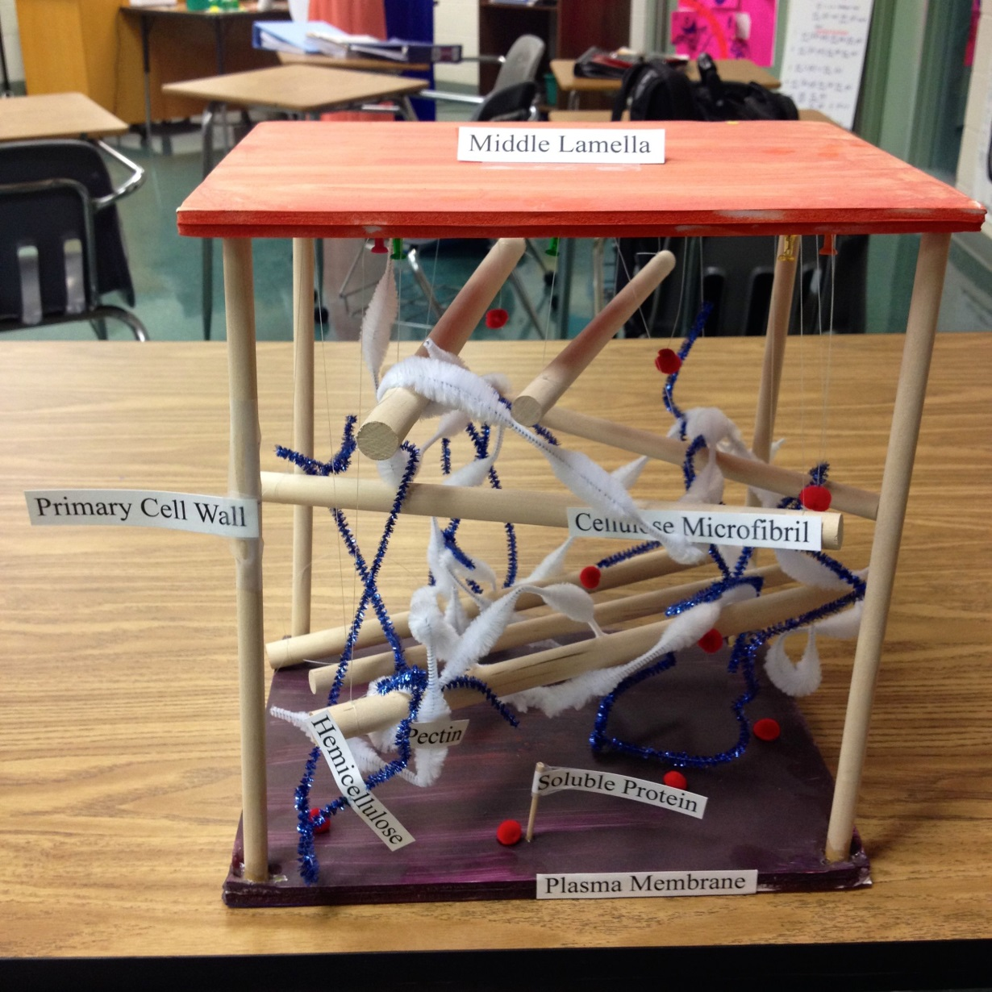
“RECYCLED JUNK”
CE
L
L
W
A
L
L
Image from: DAVID KNUFFKE AP BIO TEACHER COMMUNITY

Slide 18
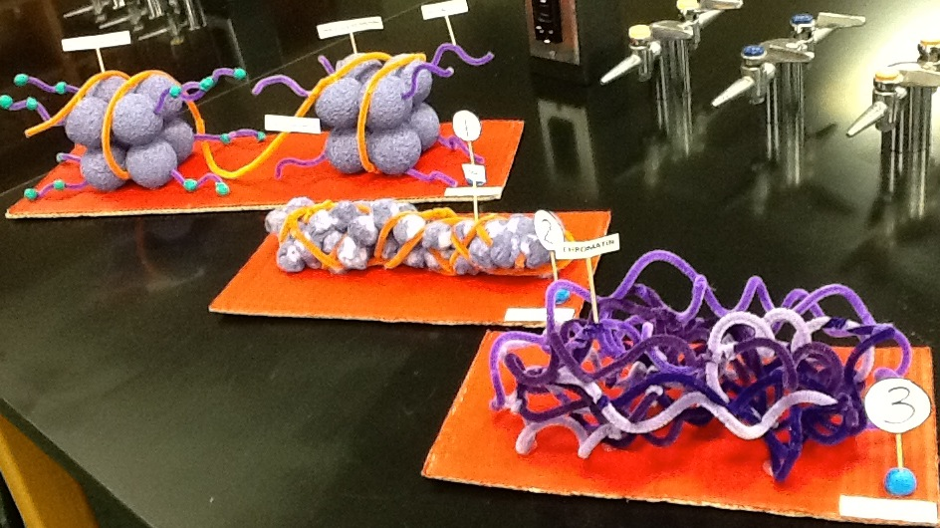
“Chromatin condensation”
Image from: DAVID KNUFFKE AP BIO TEACHER COMMUNITY

Slide 19
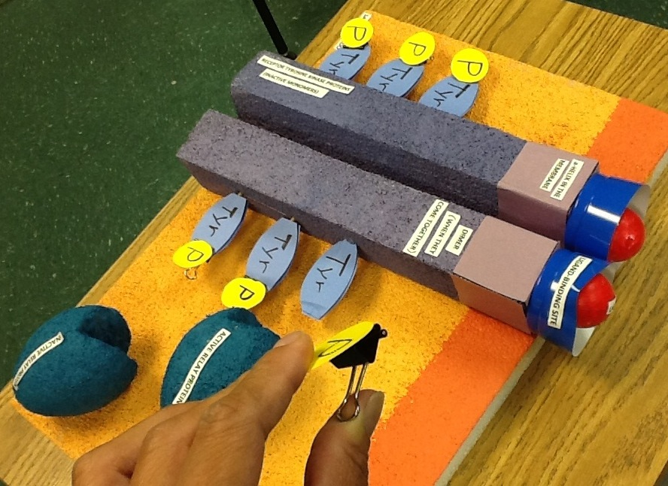
“Tyrosine Kinase”
Image from: DAVID KNUFFKE AP BIO TEACHER COMMUNITY

Slide 20
Three short lessons are provided:
1. Emergent properties – by Melissa Manning, Peggy Skinner, and Marilyn Smith
2. Visualizing evolutionary processes - by Derek Mainhart and David Knuffke
3. Information presentation with a focus on effective graphing – Mainhart & Knuffke
http://media.collegeboard.com/digitalServices/pdf/ap/apcentral/Biology_VisualizingInformation.pdf

Slide 21
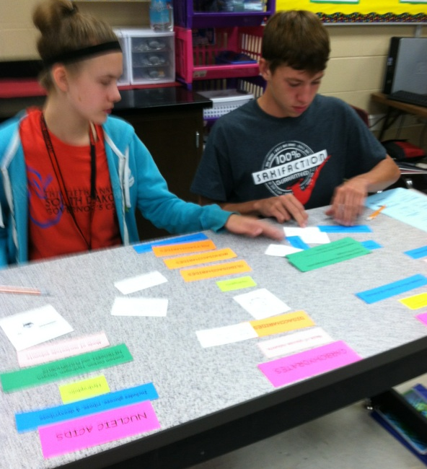
CONCEPT MAPPING
VENN DIAGRAMS

Slide 22
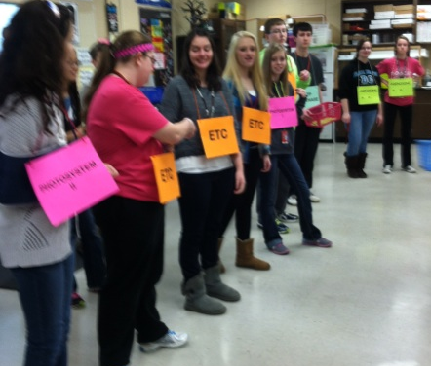
BIOLOGY THEATER

Slide 23
MAKE A MOVIE
Translation video 1
Translation video 2
Image from: http://www.eliseallen.com/?attachment_id=2327

Slide 24
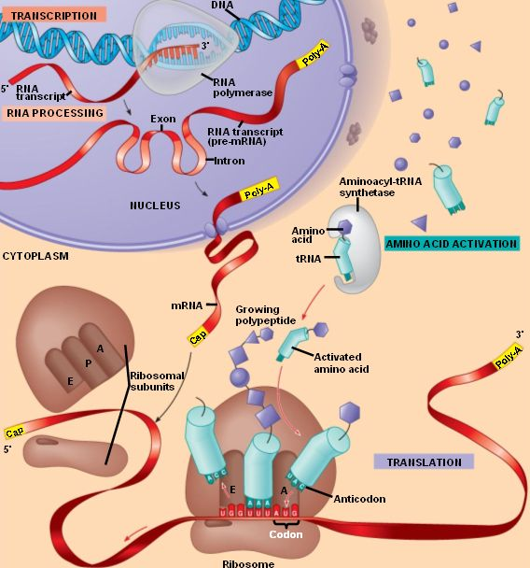

Slide 25
Use the diagram provided and make a video tracing the flow of chemical information from the gene to the protein product.
You must include a description/explanation of everything in the picture.
2-3 people in your group
Everyone in group must talk in video
Be sure to include important enzymes
EXTRA CREDIT: Tell TWO more things that might happen to the polypeptide chain produced in the picture before it can function as a protein in or out of the cell.

Slide 26
WHITE BOARDS

