Slide 1
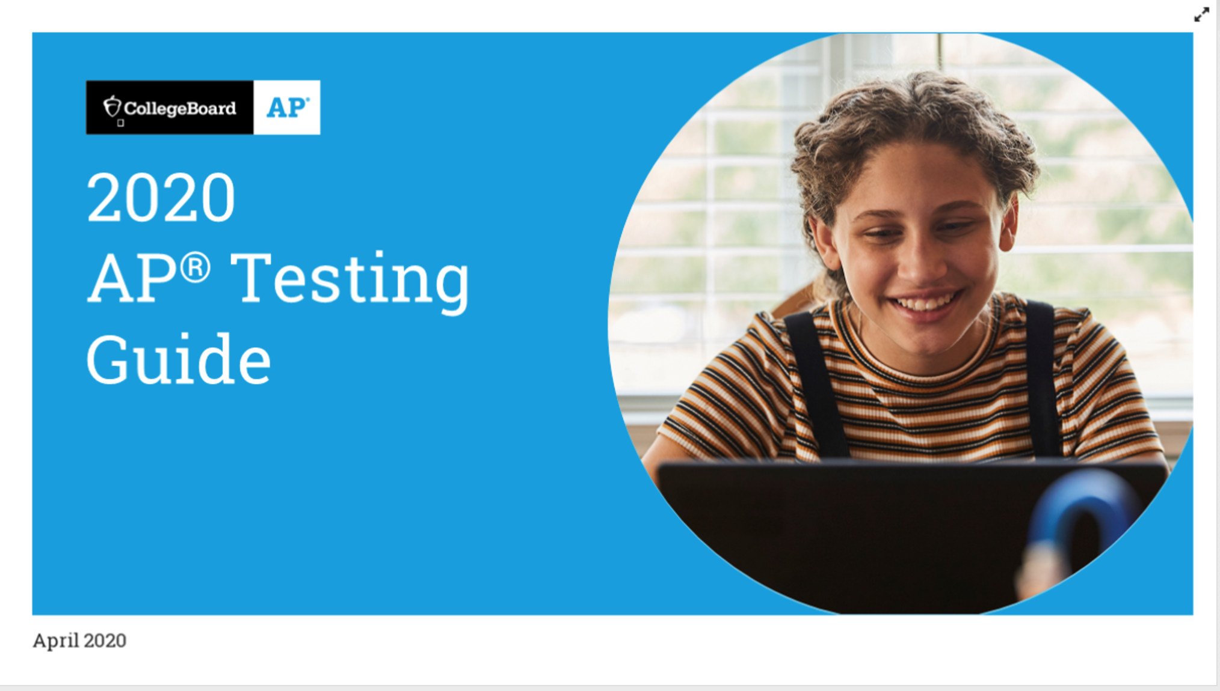
College Board Updates: Science
April 28th 2020

Slide 3
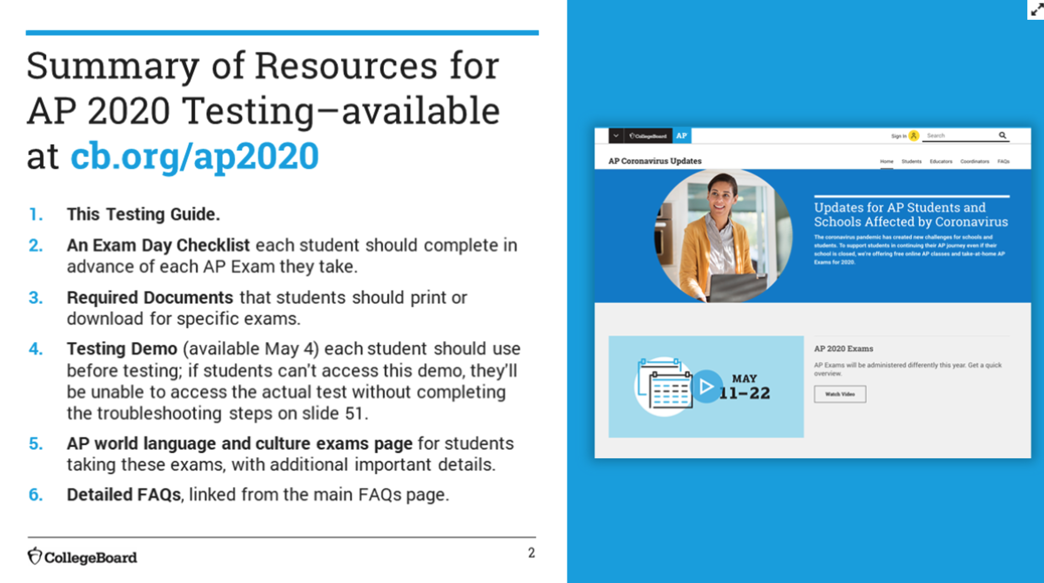

Slide 4
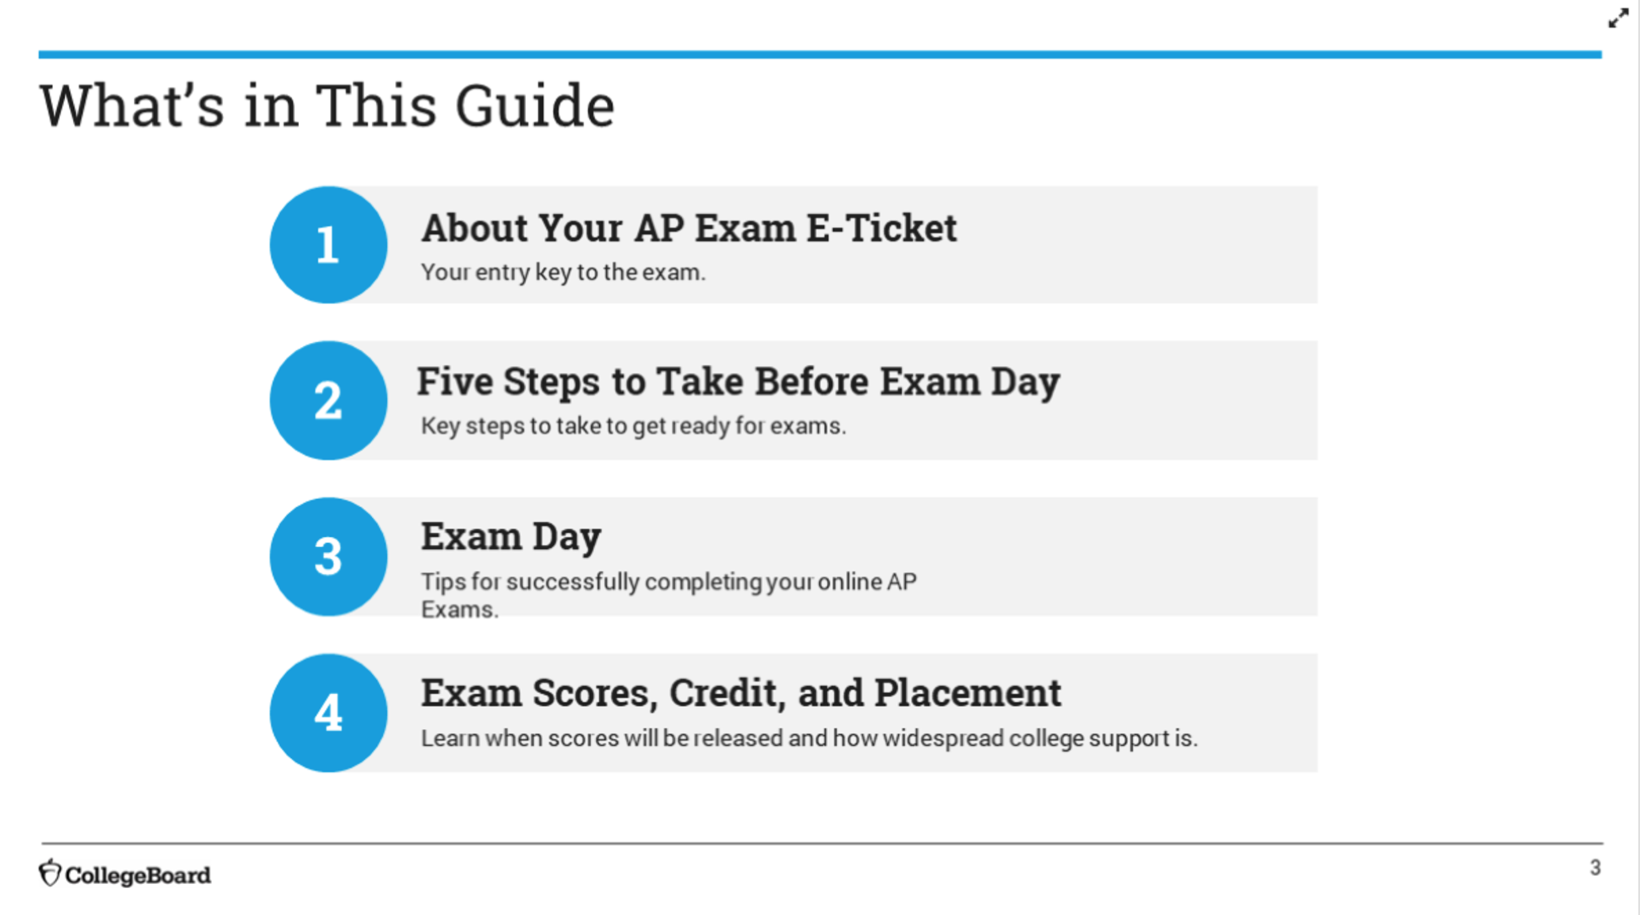

Slide 5
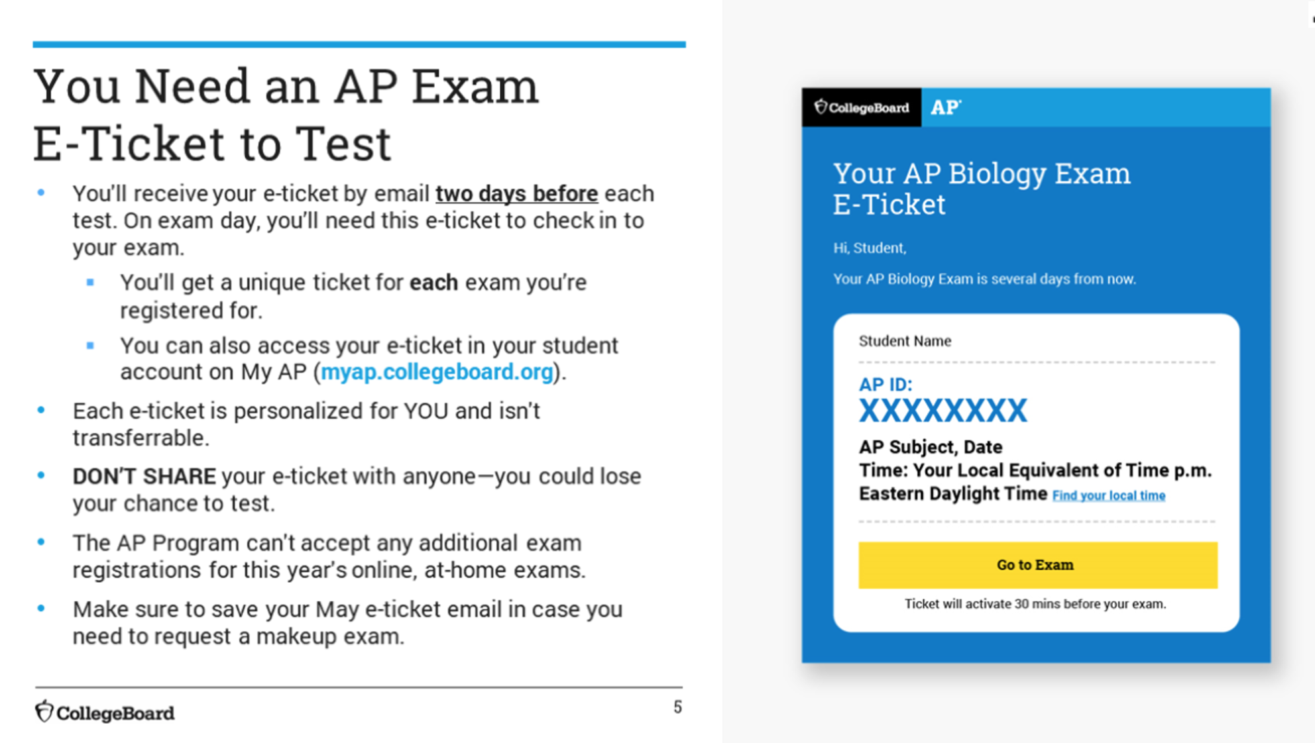

Slide 6
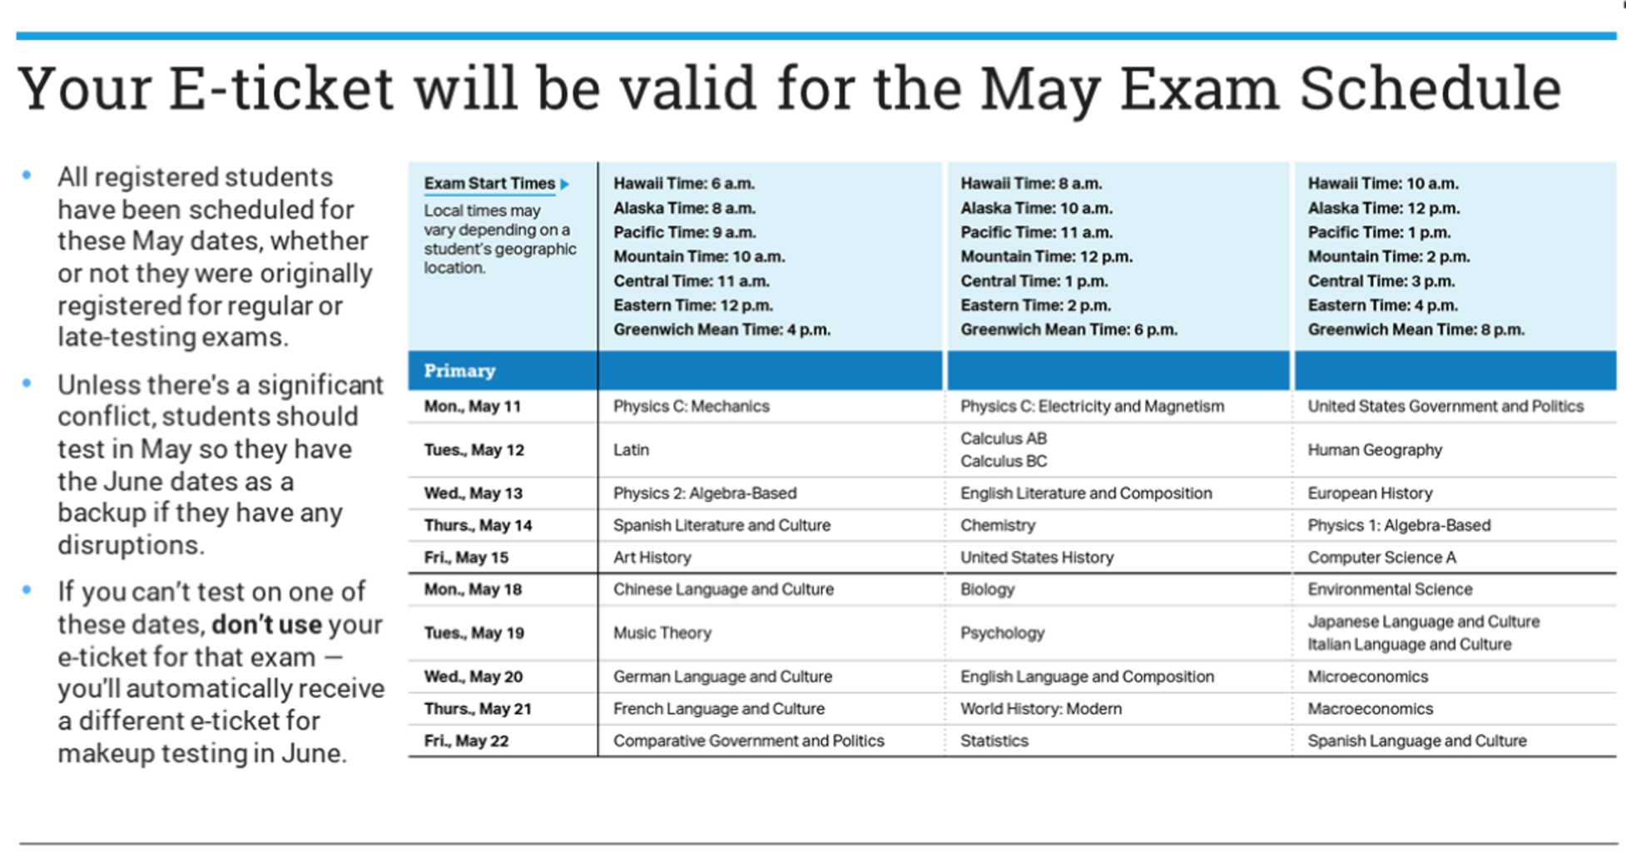
Notes:
You are automatically given the May ticket, if you can not use the May ticket - don’t open it. You will automatically be given a June date

Slide 7
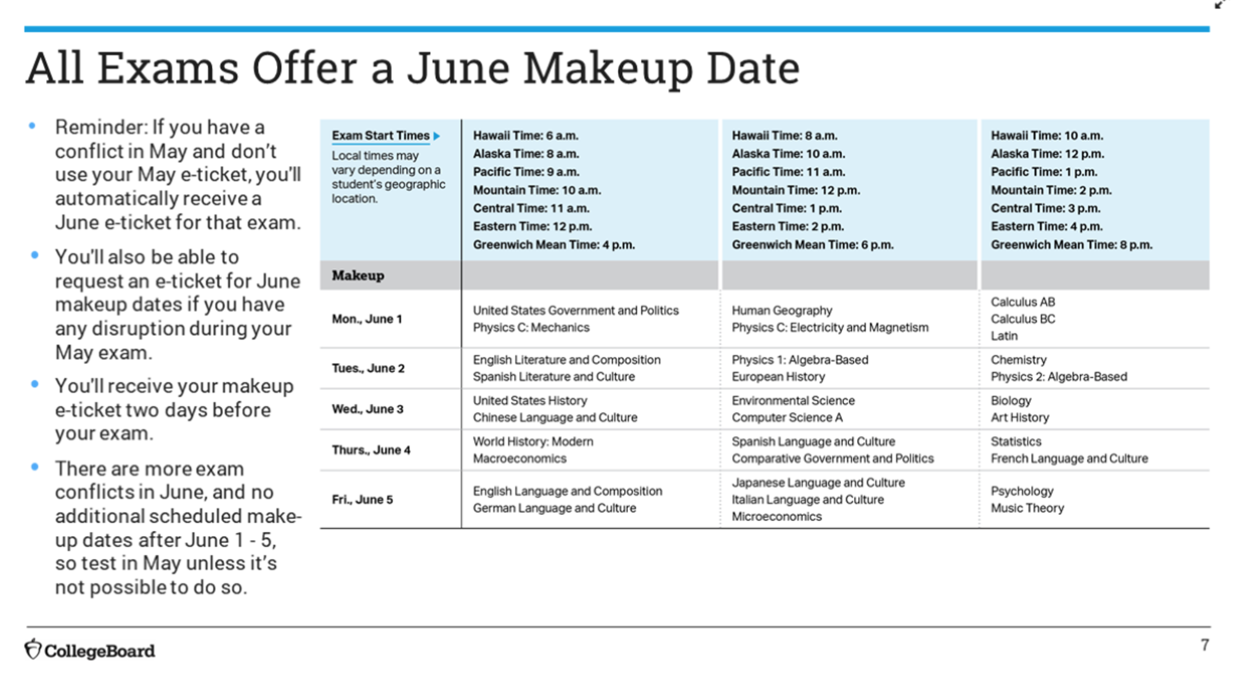
Notes:
If you have trouble during your May testing: YOU NEED TO REQUEST A JUNE TICKET

Slide 8
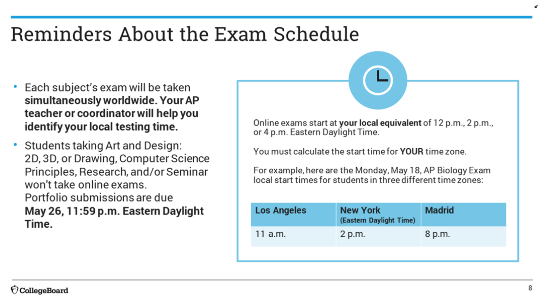
Notes:
Pay attention to the time you are taking the exam!

Slide 9
Notes:
Every year they set different cut scores - they will adjust for this year. There is NOT a CURVE! The exam may have more parts than they can complete. It is a cornucopia of opportunities to show what they know. YOU MUST TURN IN EXAM ON TIME!!!

Slide 11
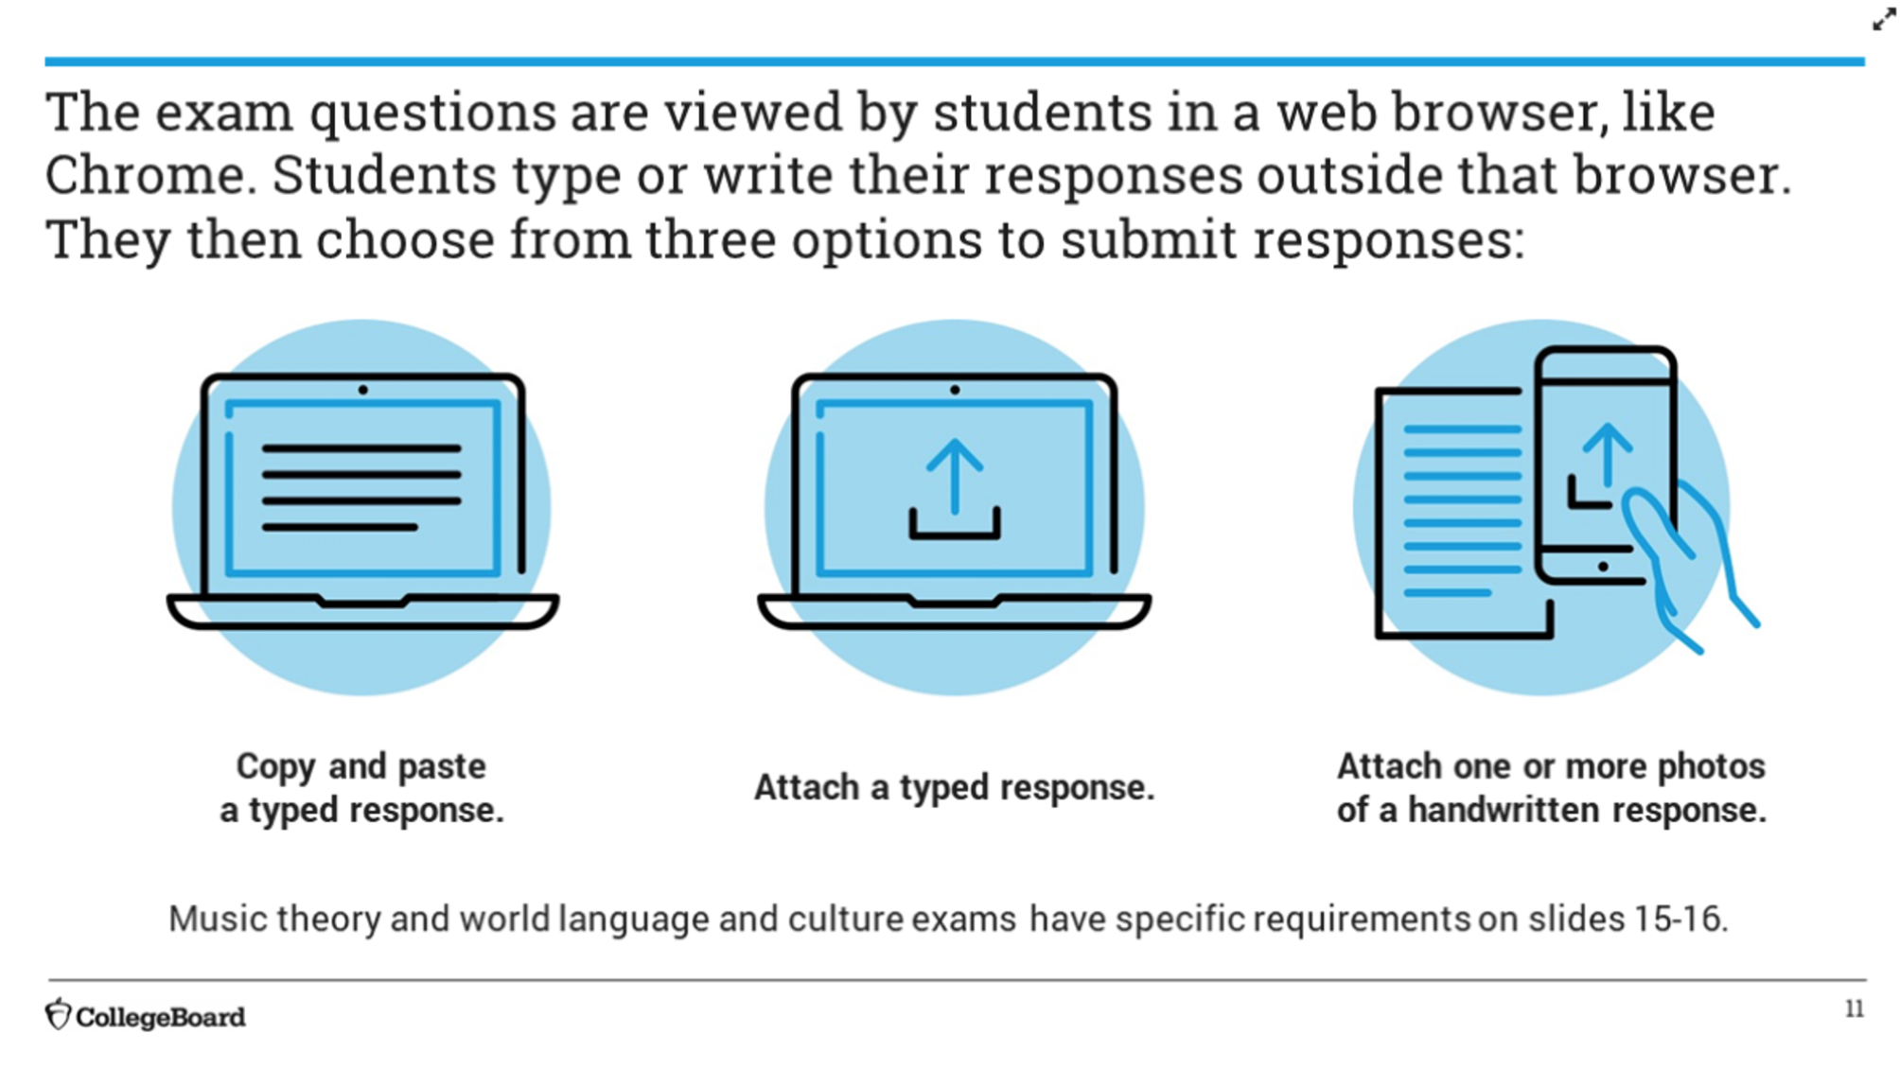

Slide 13
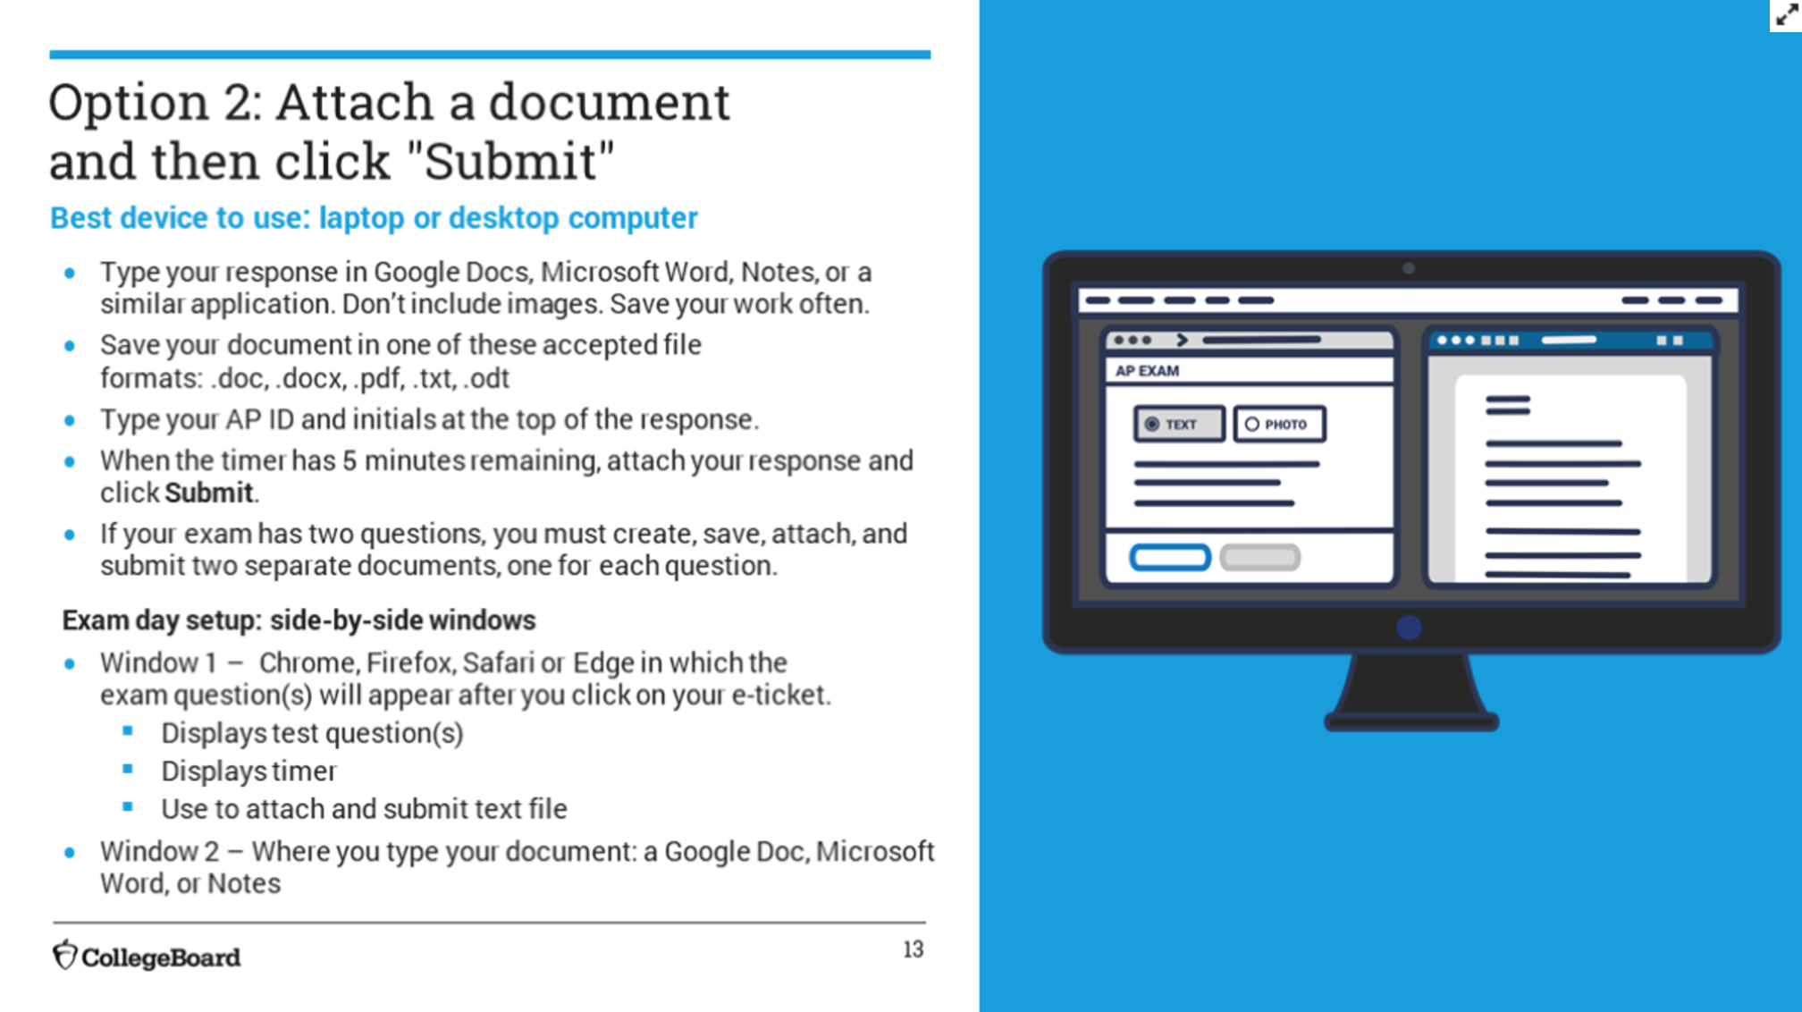

Slide 14
Notes:
This will probably be appealing for AP Chem and Calculus students

Slide 15
Notes:
These were due on Jan. 17th - you do not need to make further requests. It will be automatically on their exam timer. If you have an injury you need to get prior approval - so you can get assistance

Slide 16
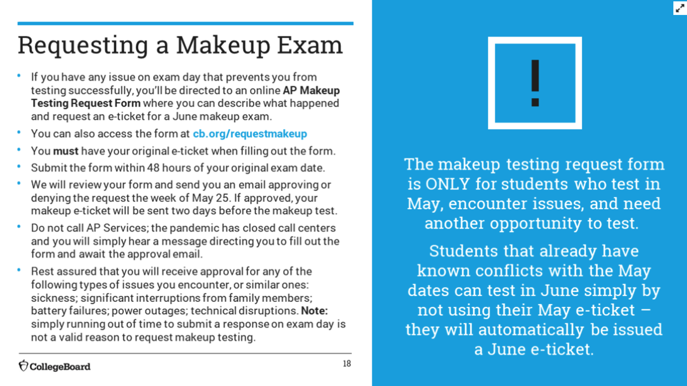
Notes:
You need to save your original e ticket and deadline for request for make-up: within 48 hours!! Your make-up will be approved by May 25th and then e ticket will should be received two days before make-up exam. IF YOU KNOW IN ADVANCE JUST DON’T USE YOUR ORIGINAL MAY E TICKET

Slide 17
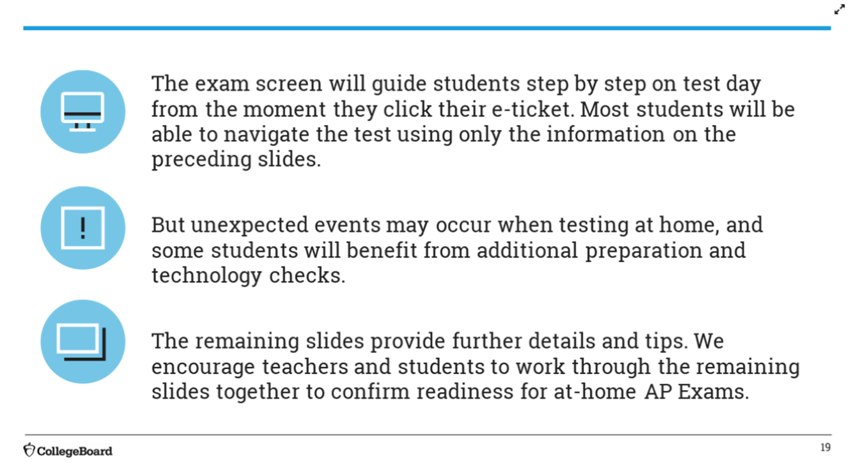

Slide 19
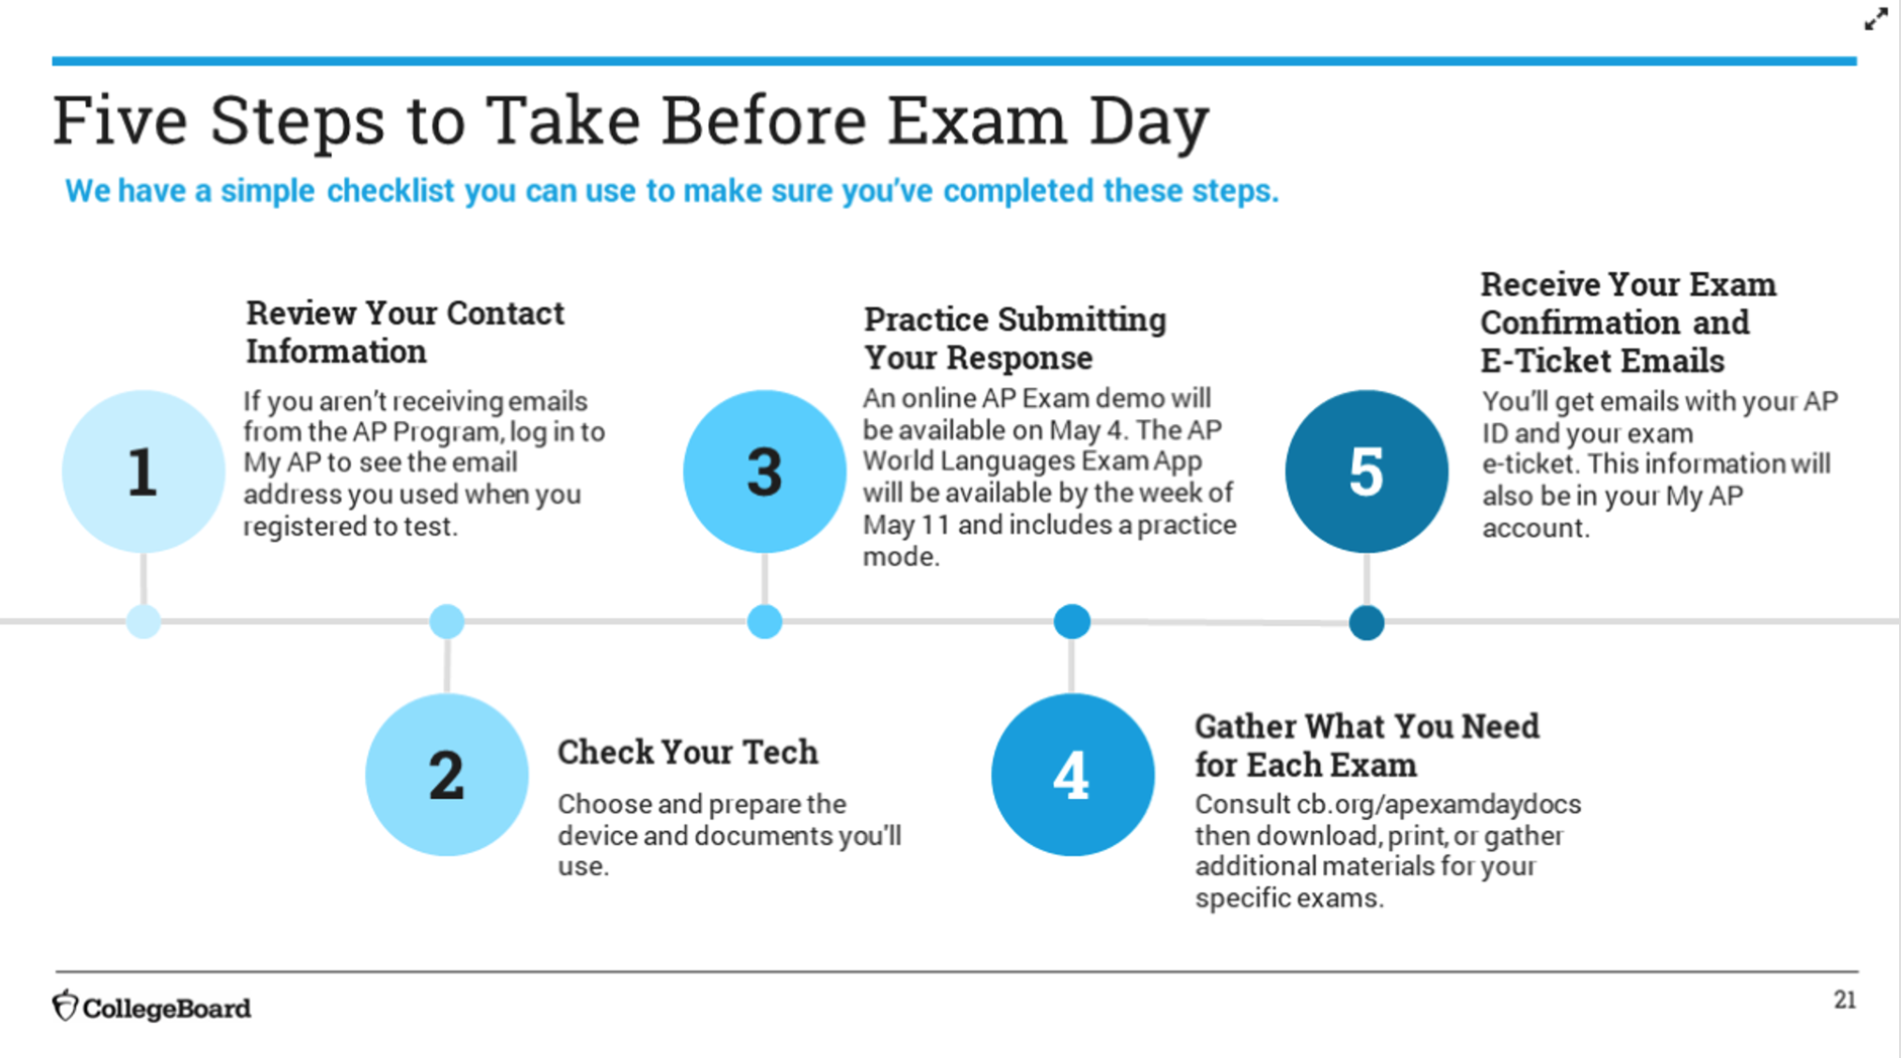
Notes:
MAY 4TH - practice test/demo

Slide 20
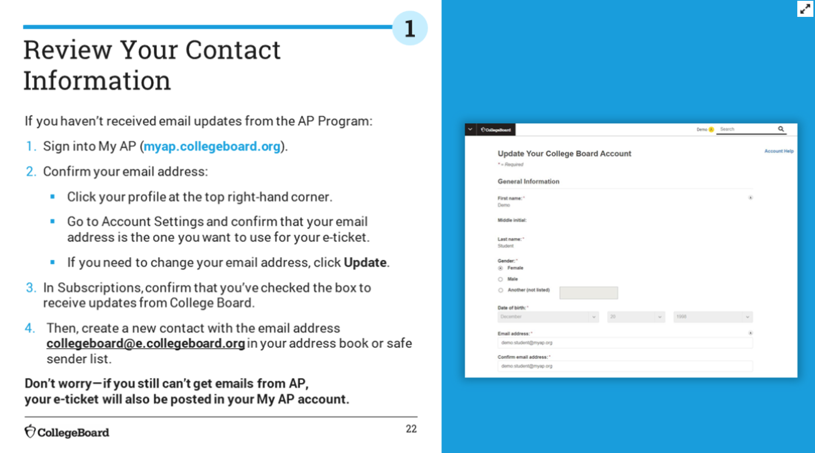

Slide 21
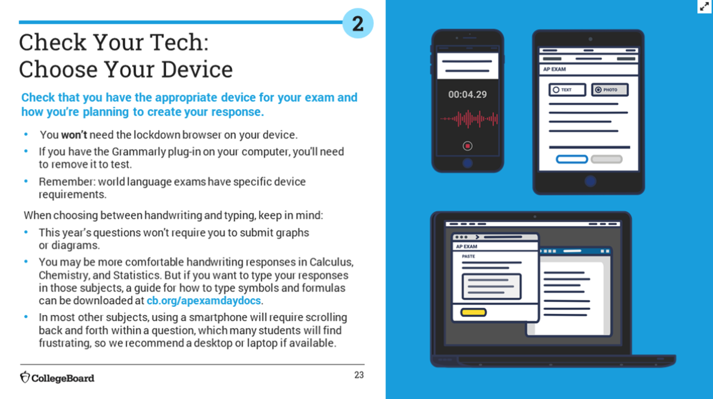
Notes:
Good News: you will not need the lockdown browser on the computer you use!!! Make sure grammarly is not on your device. No graphs or diagrams

Slide 22
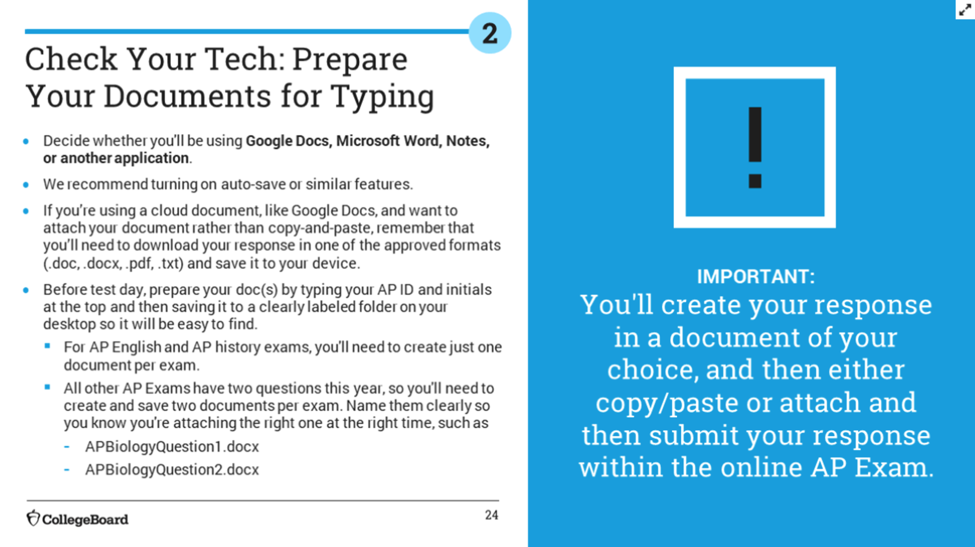
Notes:
Prepare your documents (so you don’t use test time), Word Processing or Paper, ahead of time (name and I.D.) and save digital documents on your desktop, different documents (digital or paper) for each of the two questions.

Slide 23
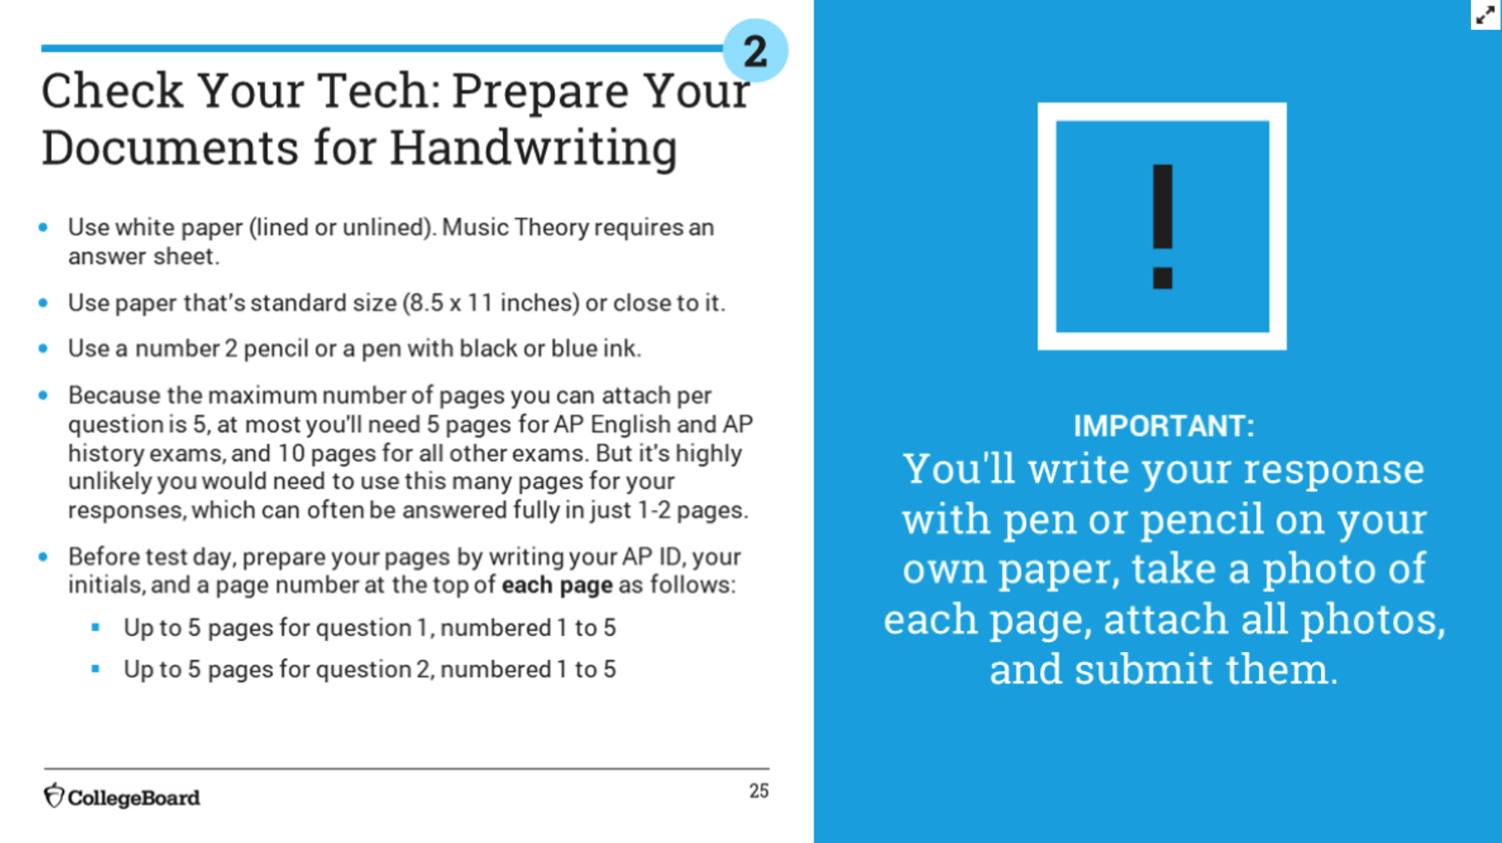
Notes:
Prepare your handwriting pages before testing if you use this format.

Slide 24
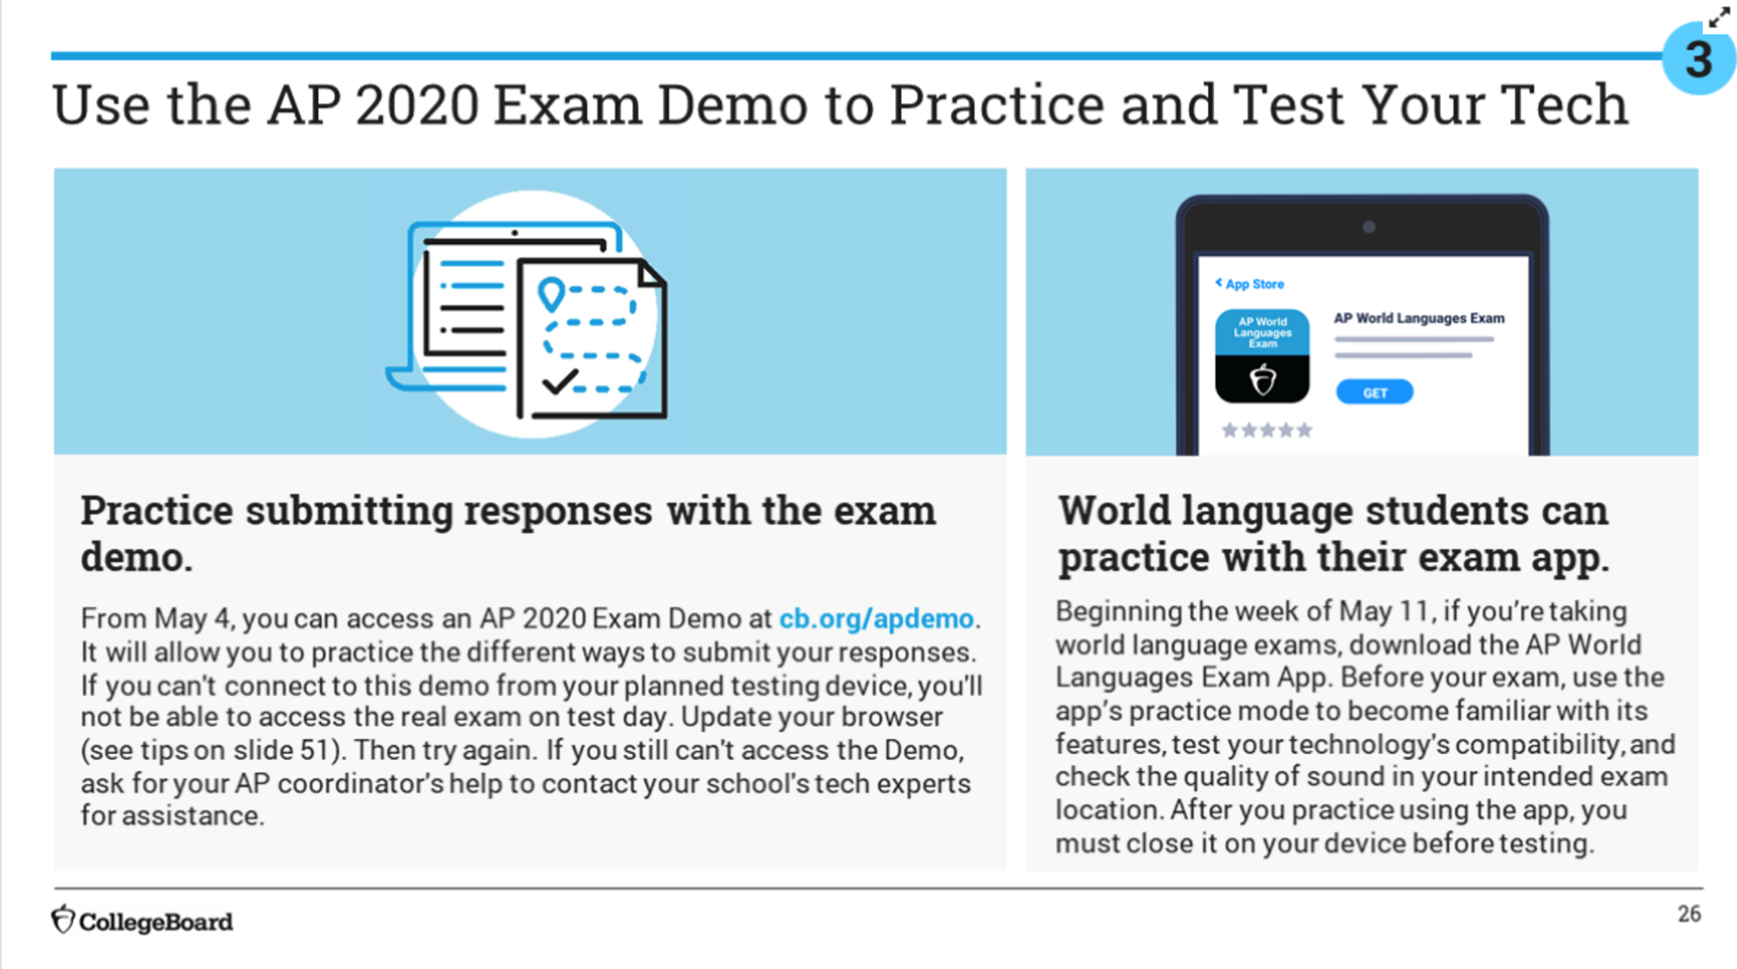
Notes:
Teachers should try the demo too! It focuses on the last five minutes.

Slide 27
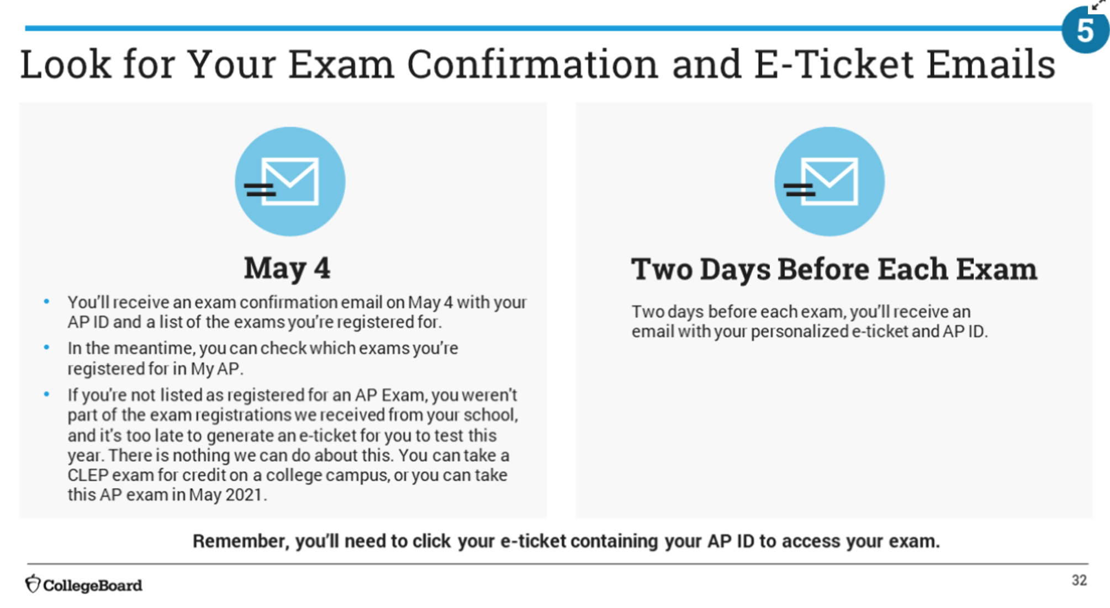

Slide 28
Notes:
MOST IMPORTANT IS YOUR 8-CHARACTER CODE

Slide 29
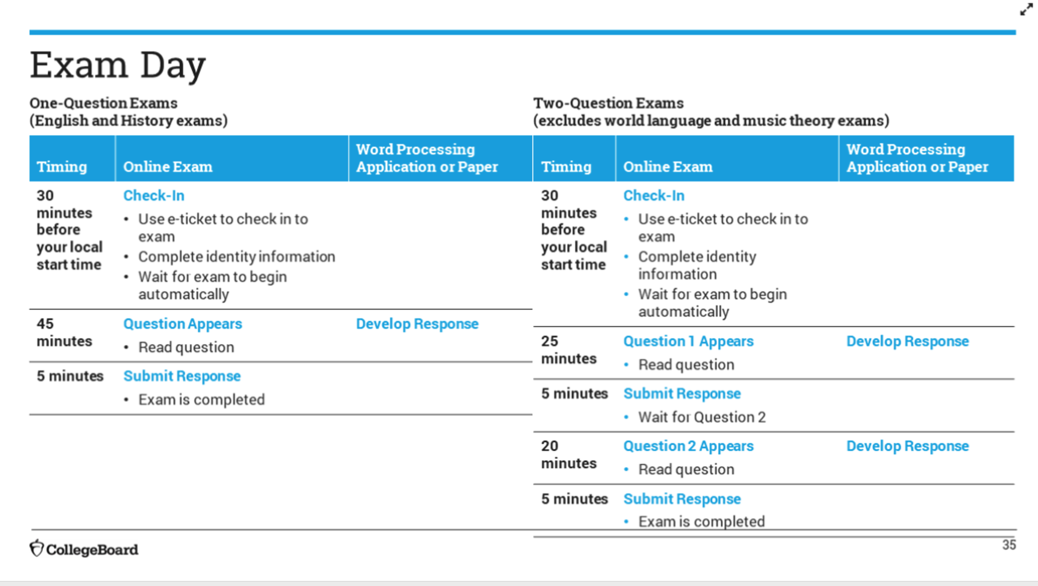
15
Notes:
WE ARE THE TWO-QUESTION EXAM FORMAT FOR SCIENCE. Second question only 15 mins, not twenty on the slide.

Slide 32
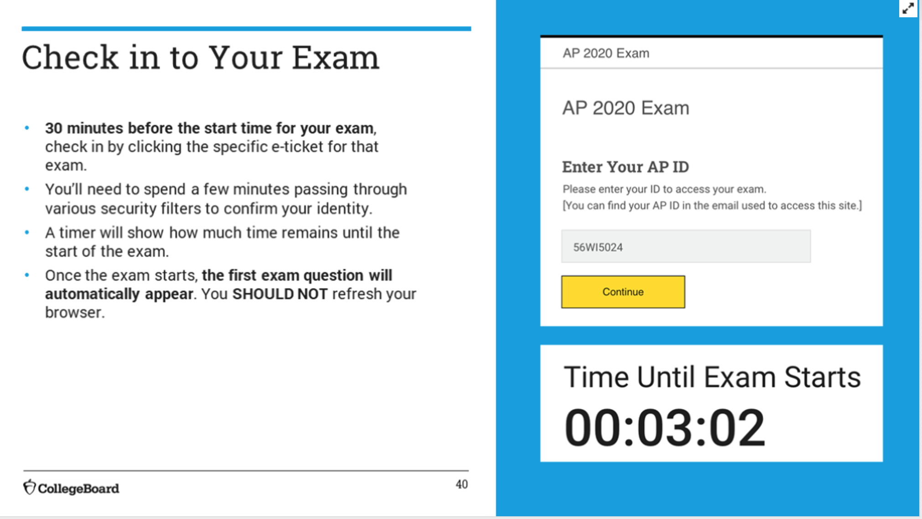
Notes:
DO NOT REFRESH BROWSER

Slide 33
Notes:
Can not annotate - do not have grammarly

Slide 34
Notes:
KEEP YOUR TIMER VISIBLE - You may still earn a “5” even if you don’t get to

Slide 35
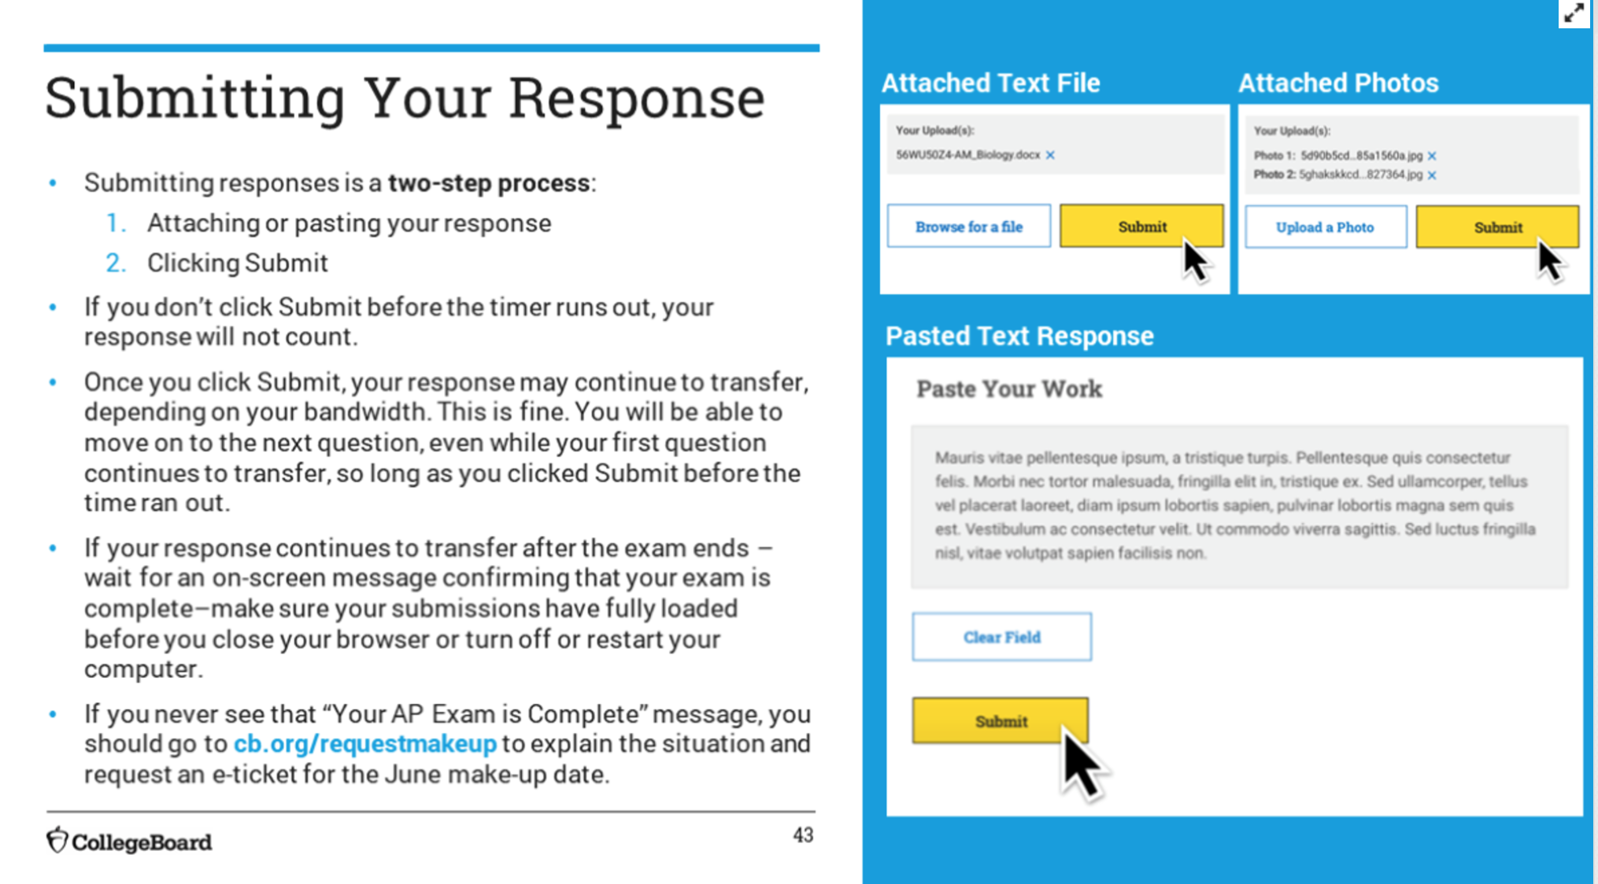
Notes:
MAKE SURE YOU START SUBMITTING AT THE RIGHT TIME! Must click submit!!! Don’t close your browser UNTIL YOU GET CONFIRMATION!!!!

Slide 36
Notes:
If you get booted for some reason, re-enter exam using e-ticket. DON’T TOUCH BACK ARROW OR REFRESH BROWSER!!!!

Slide 38
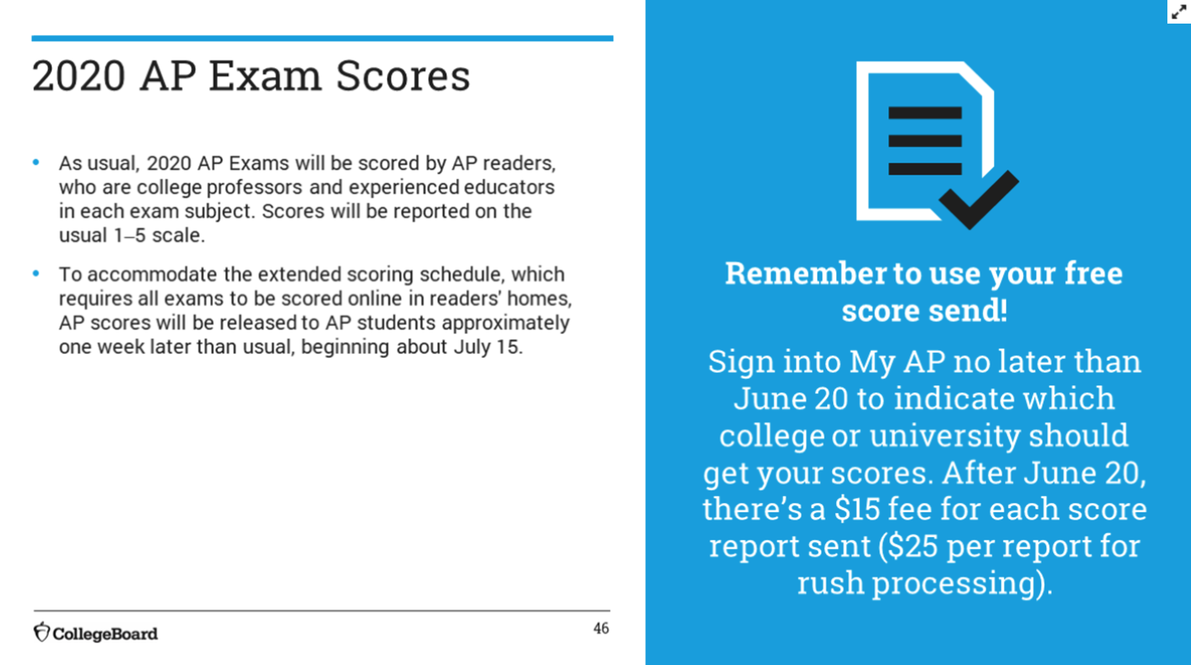
Notes:
They will analyze the difficulty level and then determine 5, 4, 3, etc...

Slide 40
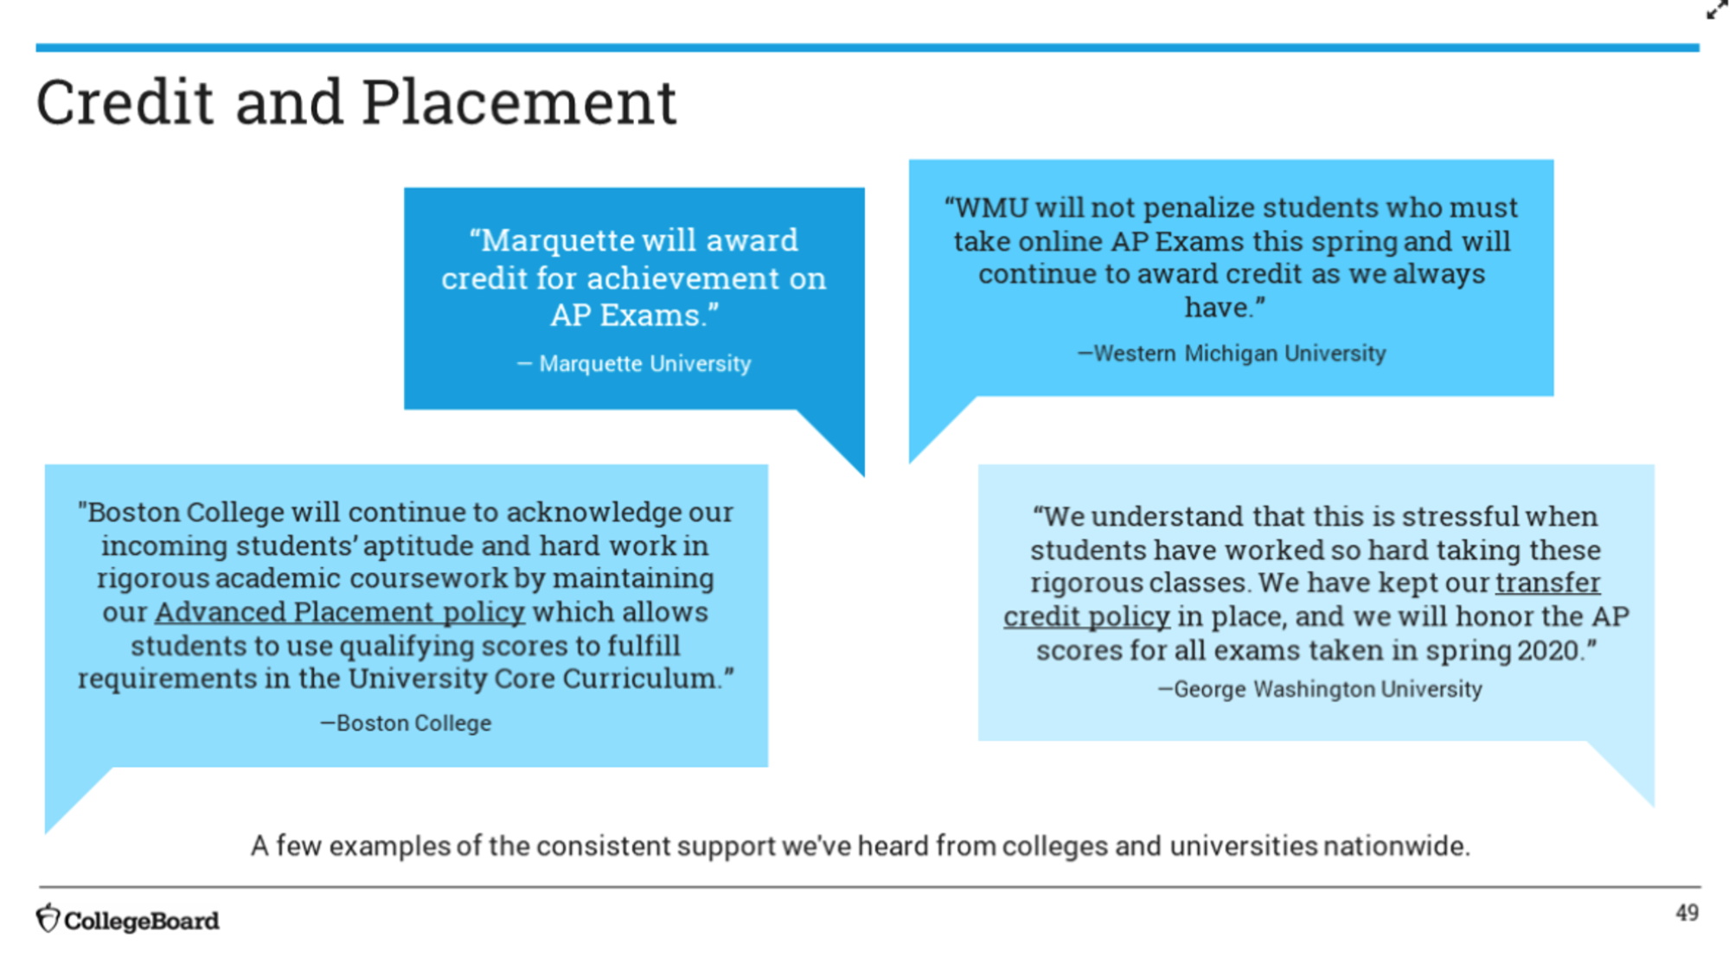

Slide 41
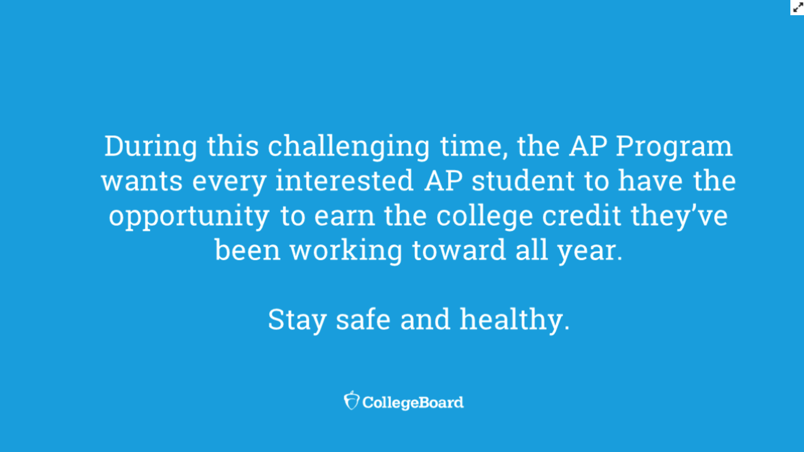

Slide 42
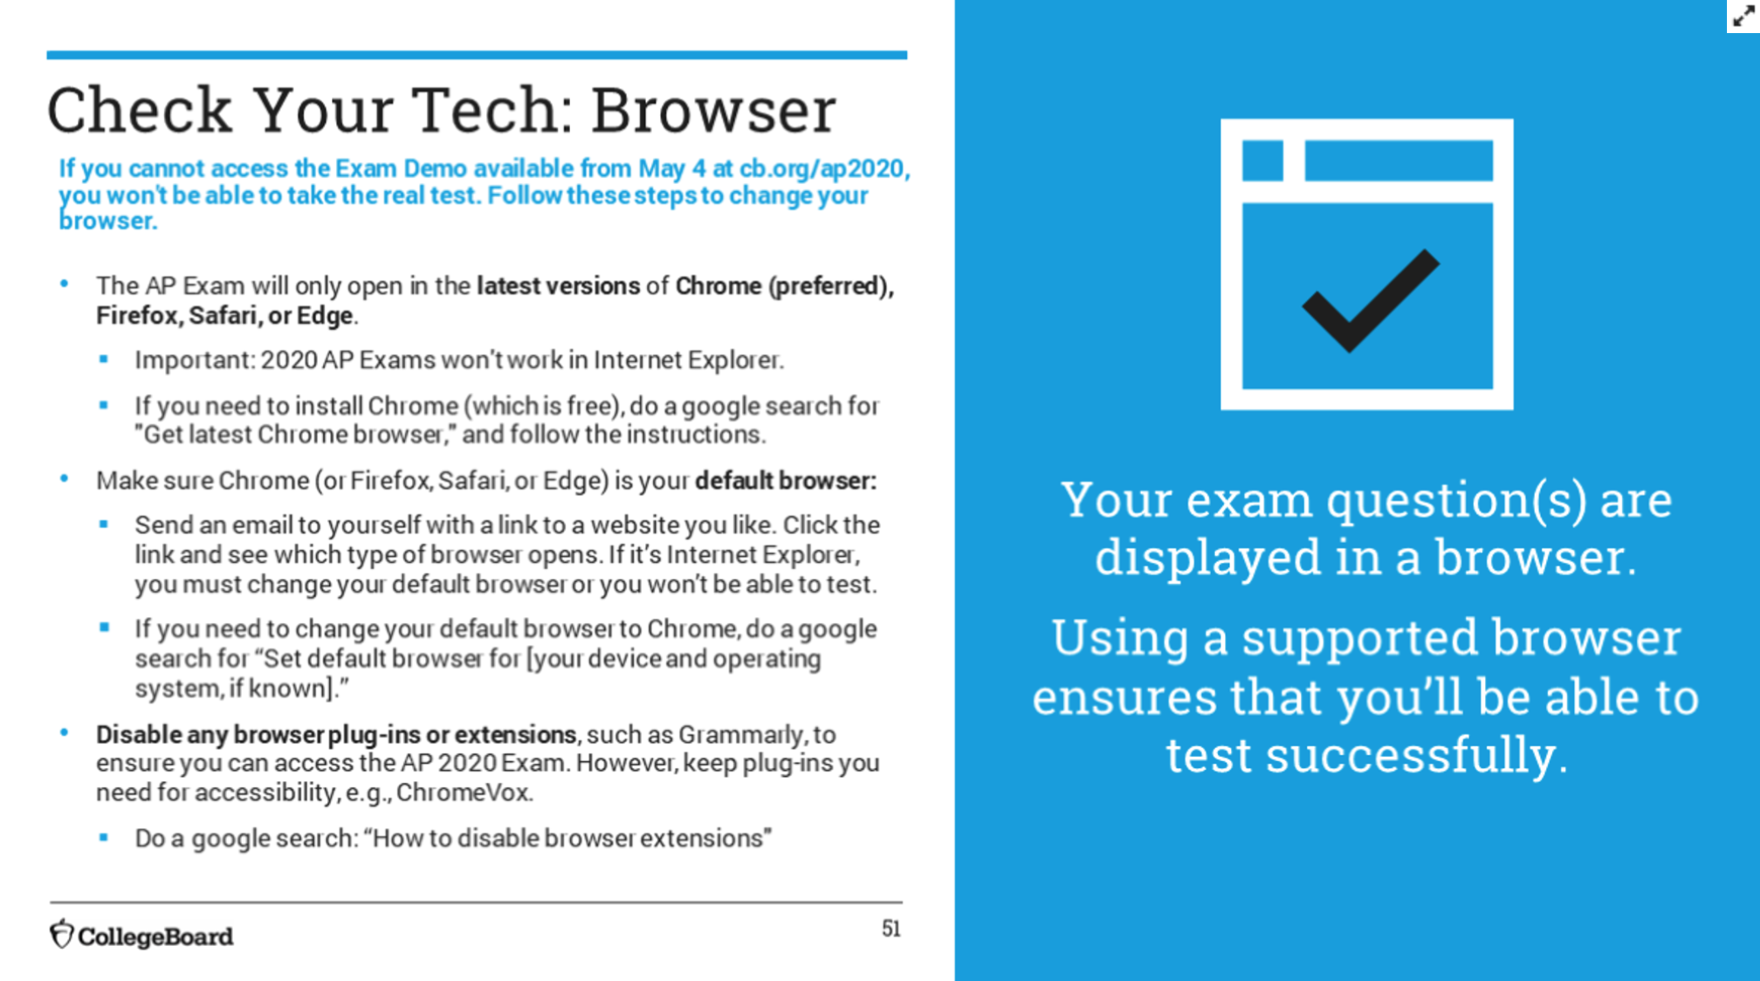
Notes:
THE EXAM DEMO MAKES SURE THAT YOU CAN ACCESS THE EXAM -if you can’t access the demo, you won’t be able to access the ACTUAL EXAM!!!!

Slide 43
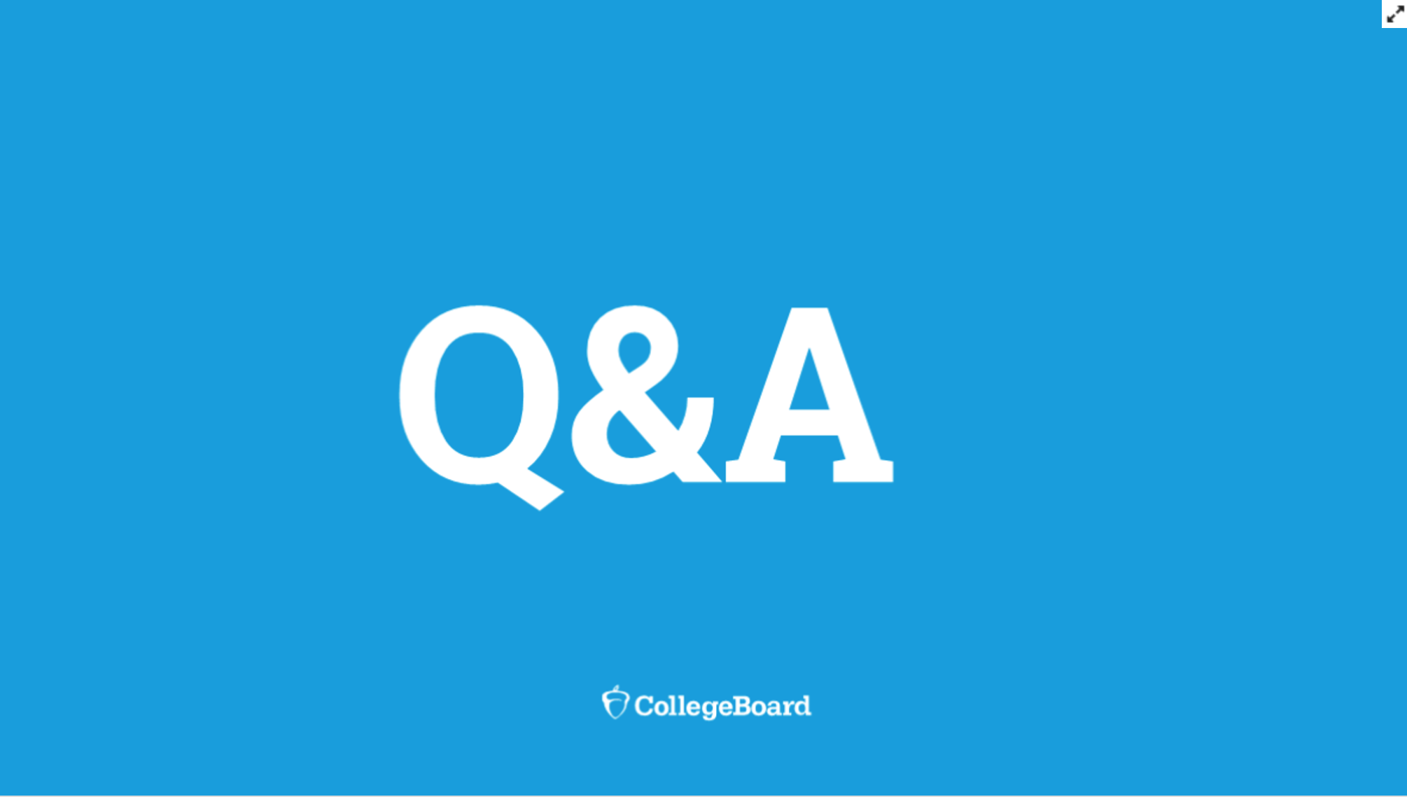

Slide 44
Do teachers need demo I.D. and can students do it multiple times?: You will receive a fake code: PRACTICE and you can do it as many times as you want. It does not include discipline dedicated questions - focuses on how to submit work - to practice the stressful last five minutes. They can practice uploading in several different ways.
The second question is 15 minutes not 20? YES!!! Only 15 mins.
Are there other plug-ins that could be a problem other than grammarly? You will know as soon as you try the demo, they don’t know of any others at this time.
What happens if they forget to put their I.D./number on their responses? Should be OK, but it is just another way to ensure the questions are attributed to the right person.
Can students type into the test/browser itself and not use a word processing (Google Docs, Microsoft Word, Notes, etc)? No, they will have a choice of either copy and pasting their answers or uploading a document with their answers (word processing) or hand-writing their answers and submitting photos of their hand-written pages.

