Slide 1
Nervous System
Sarah Mittan

Slide 2
Central & Peripheral Nervous system
CNS is responsible for integrating sensory information and responding accordingly
Brain and Spinal Cord
Contains all the nerves in the body that lie outside of the spinal cord and brain.
sensory cells, (smell and vision) motor cells, (eyeballs and hearing) both sensory and motor cells (taste and swallowing)
somatic nervous system—
autonomic nervous system

Slide 3
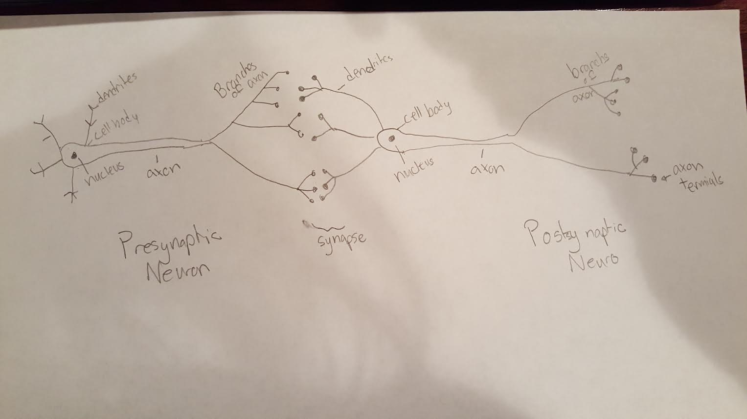
Nerve impulses traveling

Slide 4
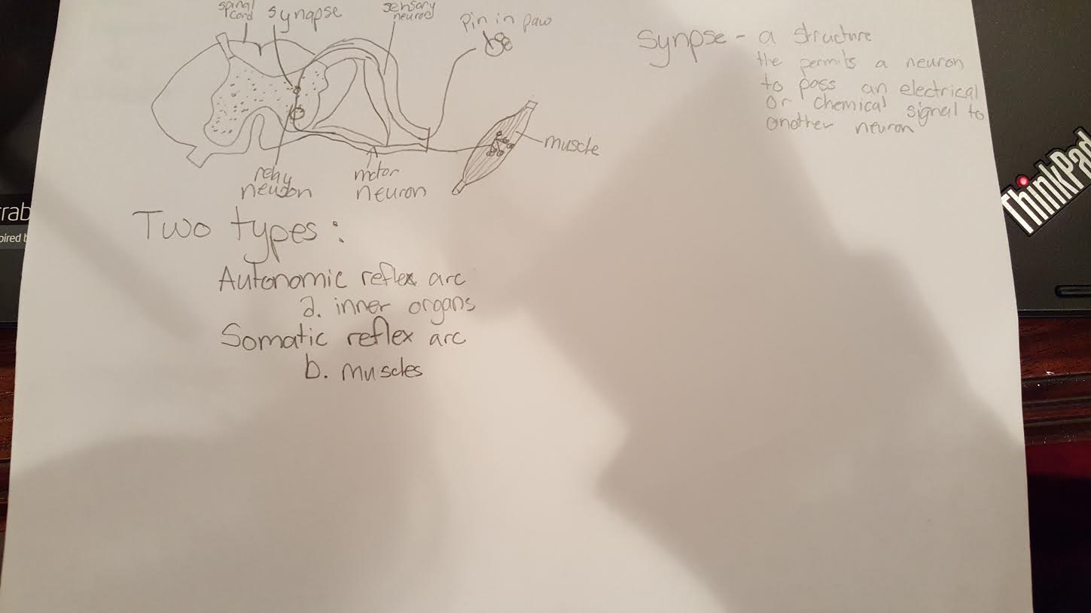
Simple Reflex Arc
Defines the pathway by which a reflex travels, from the stimulus to sensory neuron to motor neuron to reflex muscle movement

Slide 5
Simple Reflex Arc
Motor neuron: a nerve cell forming part of a pathway along which impulses pass from the brain or spinal cord to a muscle or gland.
Relay neuron: one of the three classifications of neurons found in the human body. Interneurons (relay neurons) create neural circuits, enabling communication between sensory or motor neurons and the central nervous system (CNS).
Sensory neuron: nerve cells within the nervous system responsible for converting external stimuli from the organism's environment into internal electrical impulses.

Slide 6
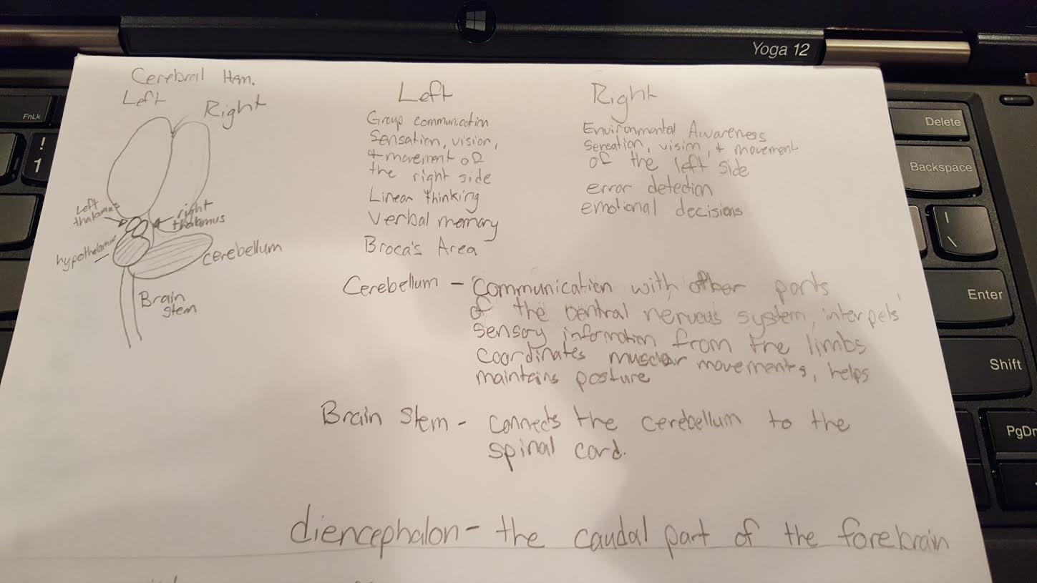
Brain

Slide 7
Nerve impulse travel
Polarization of the neuron's membrane: Sodium is on the outside, and potassium is on the inside.
Resting potential gives the neuron a break.
Action potential: Sodium ions move inside the membrane.
Each neuron has a threshold level — the point at which there's no holding back. After the stimulus goes above the threshold level, more gated ion channels open and allow more Na+ inside the cell. This causes complete depolarization of the neuron and an action potential is created
Repolarization: Potassium ions move outside, and sodium ions stay inside the membrane.
Hyperpolarization: More potassium ions are on the outside than there are sodium ions on the inside.
When the K+ gates finally close, the neuron has slightly more K+ on the outside than it has Na+ on the inside. This causes the membrane potential to drop slightly lower than the resting potential, and the membrane is said to be hyperpolarized because it has a greater potential.
Refractory period puts everything back to normal: Potassium returns inside, sodium returns outside.

Slide 8
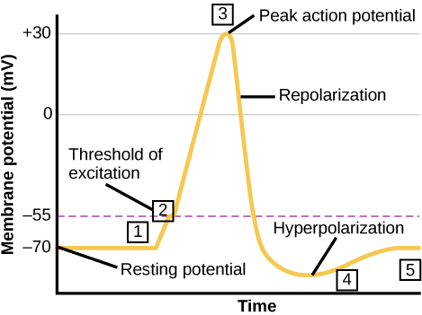
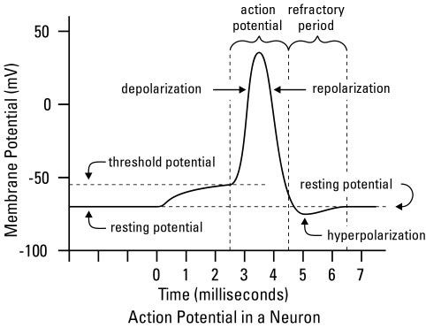
Diagrams

Slide 9
Neurotransmitters
the brain chemicals that communicate information throughout our brain and body
Excitatory neurotransmitters are not necessarily exciting – they are what stimulate the brain
Those that calm the brain and help create balance are called inhibitory. Inhibitory neurotransmitters balance mood and are easily depleted when the excitatory neurotransmitters are overactive.
https://faculty.washington.edu/chudler/chnt1.html

Slide 10
Neurotransmitters
Neurons have specialized projections called dendrites and axons. Dendrites bring information to the cell body and axons take information away from the cell body.
Information from one neuron flows to another neuron across a synapse. The synapse contains a small gap separating neurons. The synapse consists of
a presynaptic ending that contains neurotransmitters, mitochondria and other cell organelles
a postsynaptic ending that contains receptor sites for neurotransmitters
a synaptic cleft or space between the presynaptic and postsynaptic endings

Slide 11
Types of Synapse

Slide 12
Polio
Polio is a viral disease which may affect the spinal cord causing muscle weakness and paralysis. The polio virus enters the body through the mouth, usually from hands contaminated with the stool of an infected person.
Can have no symptoms
Muscle weakness, headache, sensitivity to light
Paralysis/ death
Can’t be cure but pain meds and bed rest help
One in 200 infections leads to irreversible paralysis. Among those paralyzed, 5% to 10% die when their breathing muscles become immobilized.

Slide 13
transient ischemic attack
Mini stroke like attack
Muscular: difficulty walking, muscle weakness, or problems with coordination
Speech: slurred speech or impaired voice
Visual: blurred vision or vision loss
Facial: muscle weakness or numbness
Whole body: lightheadedness or vertigo
Treatment: medication, surgery, or lifestyle change
TIA in men of 2.7% for 65 to 69 years of age and 3.6% for 75 to 79 years of age. For women, TIA prevalence was 1.6% for 65 to 69 years of age and 4.1% for 75 to 79 years of age.11 In the younger Atherosclerosis Risk in Communities cohort, the overall prevalence of TIAs was found to be 0.4% among adults 45 to 64 years of age.12

Slide 14
Bibliography
http://stroke.ahajournals.org/content/40/6/2276.full

