Slide 1
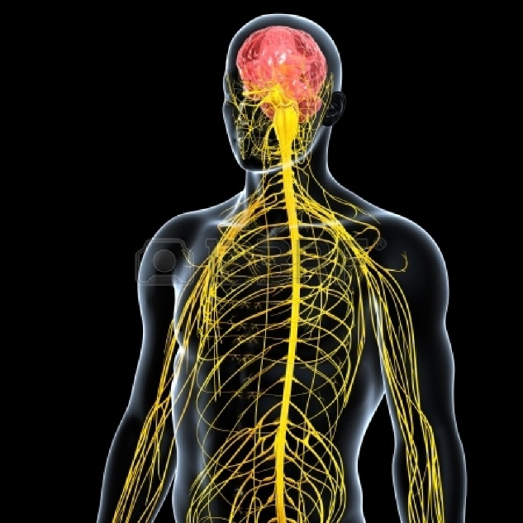
The Nervous System
By Hannah Gannon

Slide 2
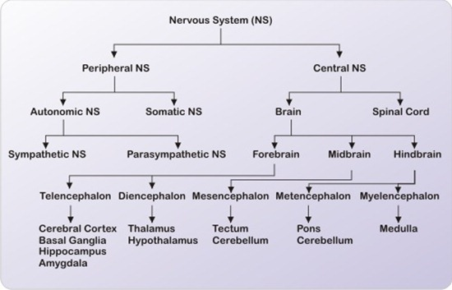
What is the function of the Nervous System?
The nervous system of the body is made up of many different organs, such as the brain, spinal cord and etc. This highly complex system is responsible for several different activities, such as communicating, coordinating, controlling and regulating.

Slide 3
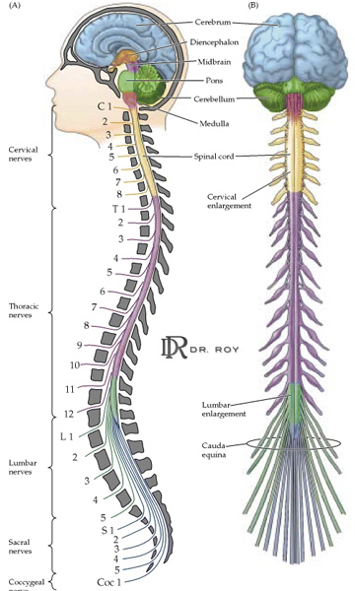
Central Nervous System
The central nervous system integrates
information arriving from the PNS, processes
this information to generate behavior, which it communicates back to the PNS.
The CNS is divided into two sections: the spinal cord, which connects directly with the PNS, and the brain, which contains the higher brain functions. Both are encased within bone. The brain communicates its behavior to the PNS by way of the spinal cord.

Slide 4
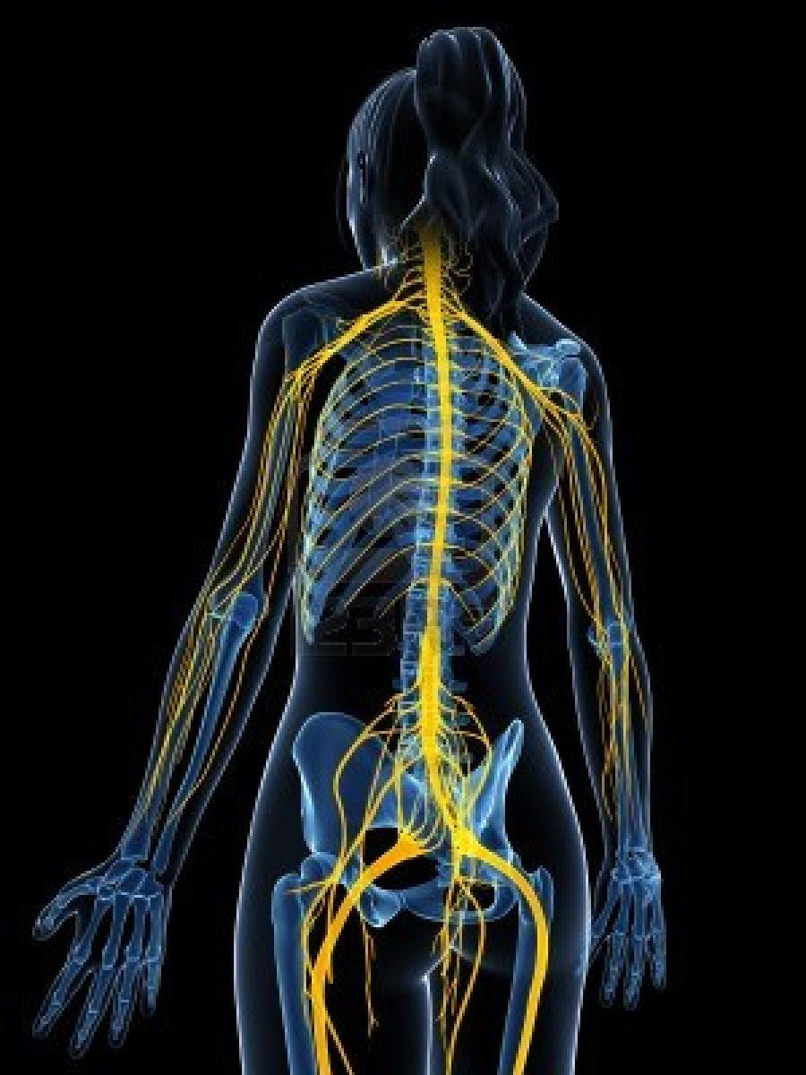
Peripheral Nervous System
The peripheral nervous system consists of nerve cells that lie outside the brain case or spinal vertebrae. Sensory receptors detect changes in the external environment (visual, auditory, olfactory, sensory, etc.) and communicates them to the CNS (via afferent sensory nerves). The CNS, in turn, communicates desired behavior such as muscle movement to the PNS (via efferent motor nerves) using motor effectors.
The PNS is divided into two sections: an Autonomic Division, which controls smooth muscles (involuntary), such as the stomach and heart, and a Somatic Division, which controls striated muscles (voluntary), which are the skeletal muscles.

Slide 5
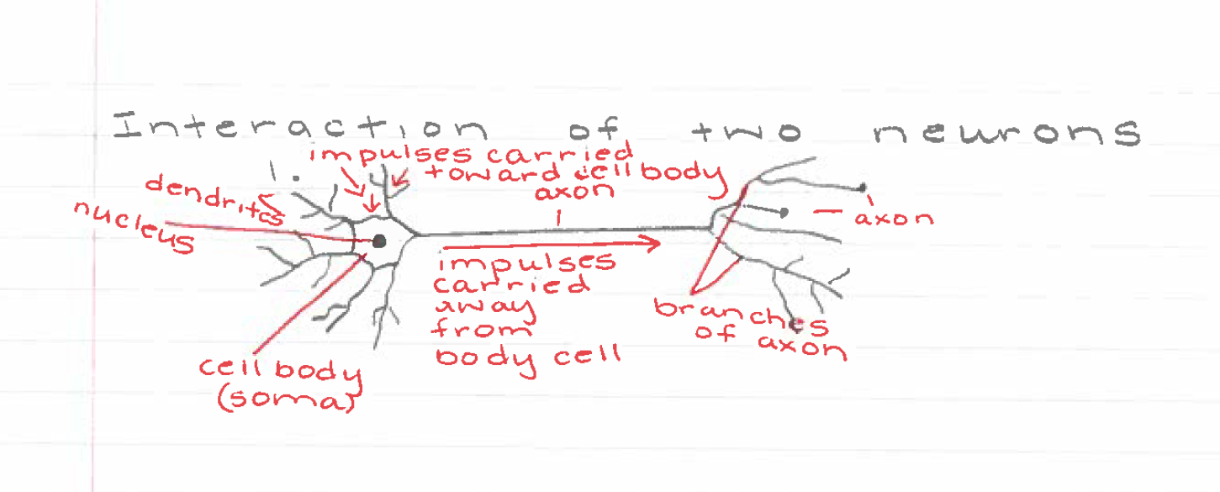
Interaction of Two Neurons
The neuron, or nerve cell, is the functional unit of the nervous system. The neuron has processes called dendrites that receive signals and an axon that transmits signals to another neuron.

Slide 6
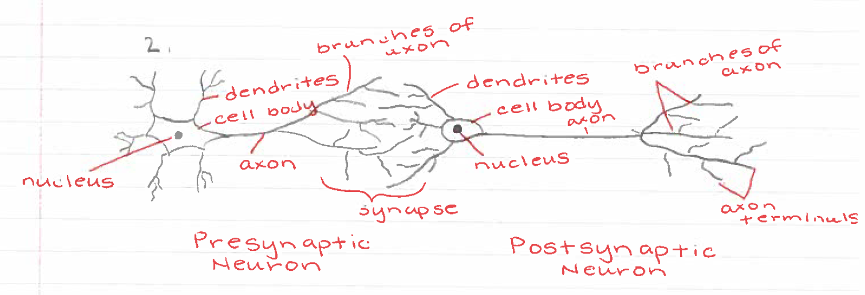
Interaction of Two Neurons
Neurons transmit information to other neurons. Information passes from the axon of the presynaptic neuron to the dendrites of the postsynaptic neuron.

Slide 7
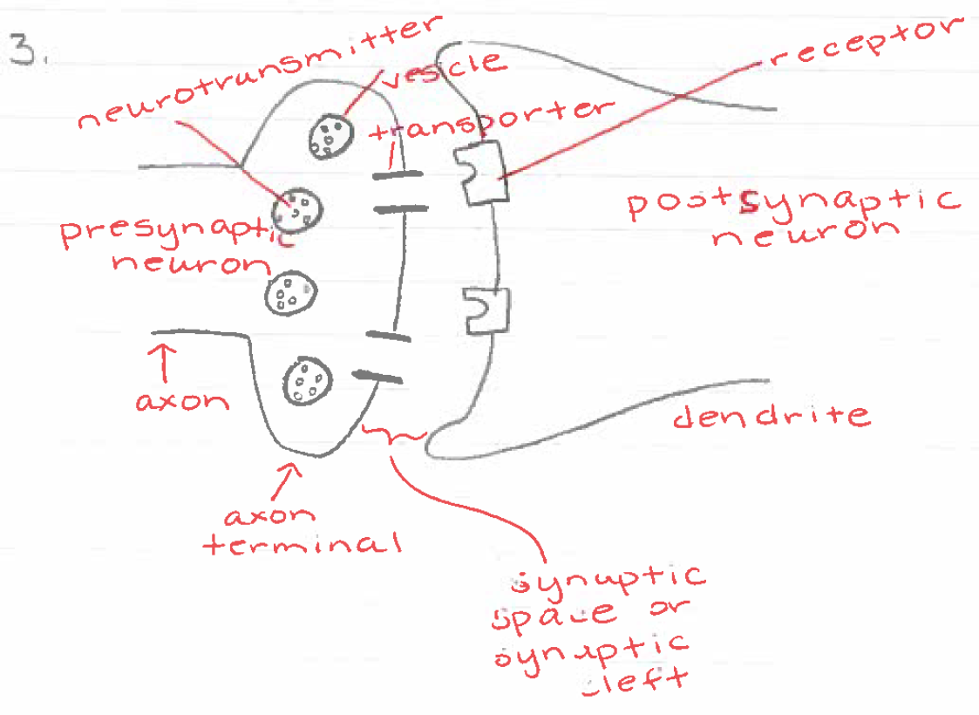
Interaction of Two Neurons
The synapse is the site where chemical signals pass between neurons. Neurotransmitters are released from the presynaptic neuron terminals into the extracellular space, the synaptic cleft or synaptic space. The released neurotransmitter molecules can then bind to specific receptors on the postsynaptic neuron to elicit a response. Excess neurotransmitter can then be reabsorbed into the presynaptic neuron through the action of specific reuptake molecules called transporters. This process ensures that the signal is terminated when appropriate.

Slide 8
Simple Reflex Arc
In this example, the stimulus occurs when the hammer hits the tendon. As a result, the muscle contracts and causes the foot to jerk upward.
In a knee-jerk reflex arc the sensory neuron directly connects to the motor neuron in the spinal cord. This is called a simple reflex arc.
In most reflex arcs the sensory neuron connects to motor neurons through association neurons (interneurons) in the central nervous system.

Slide 9
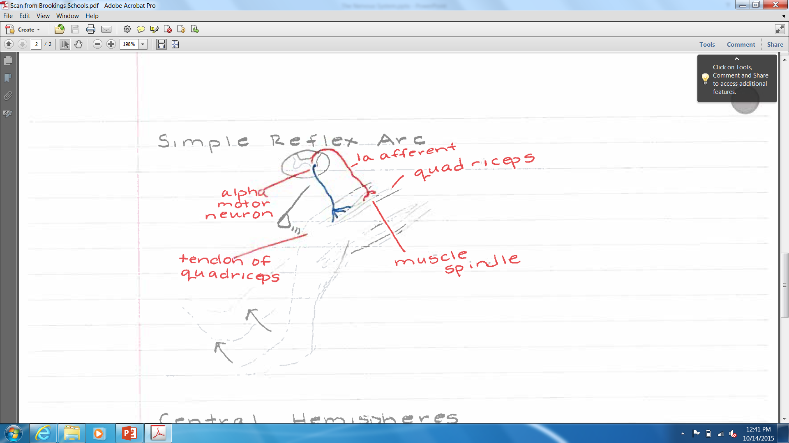
Simple Reflex Arc
When the stretch receptors are stimulated, they send a message to the muscles of your thigh.
The muscles in the front of your thigh contract.
The muscles in the back of your thigh relax.
Your foot jerks.

Slide 10
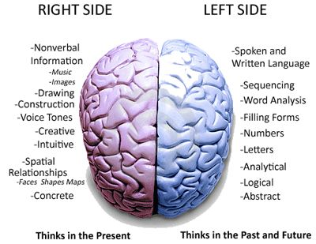
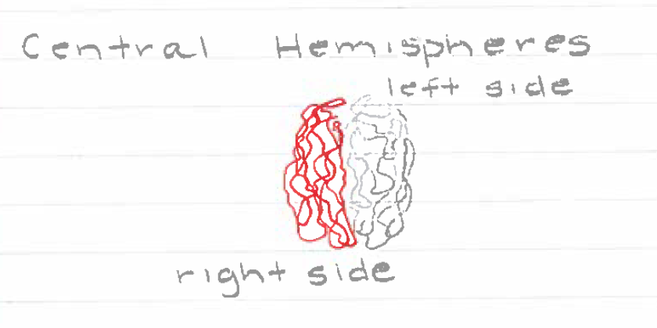
Cerebral Hemispheres
The brain is made up of two sides, or hemispheres. Each hemisphere is responsible for different body functions and skills. In most people, the left side of the brain contains the person's language centers. The right side controls cognitive functioning (thinking skills).
The two cerebral hemispheres are connected by a very large nerve bundle (the largest white matter structure in the brain) called the corpus callosum, which crosses the midline above the level of the thalamus.

Slide 11
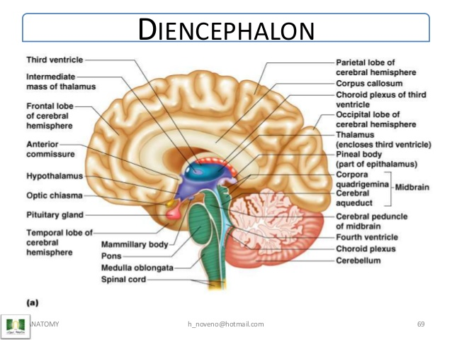
Diencephalon
Diencephalon is made up of four distinct components: the thalamus, the subthalamus, the hypothalamus, and the epithalamus. The hypothalamus is an integral part of the endocrine system, with one of the most important functions being to link the nervous system to the endocrine system via the pituitary gland.

Slide 12
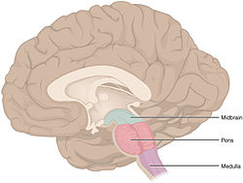
Brain Stem
The brain stem has many basic functions, including regulation of heart rate, breathing, sleeping, and eating. It includes the medulla oblongata (myelencephalon), pons (part of metencephalon), and midbrain (mesencephalon).

Slide 13
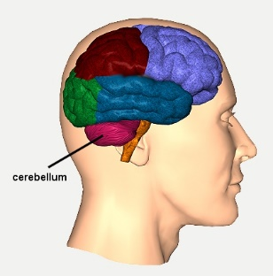
Cerebellum
The cerebellum receives information from the sensory systems, the spinal cord, and other parts of the brain and then regulates motor movements. The cerebellum coordinates voluntary movements such as posture, balance, coordination, and speech, resulting in smooth and balanced muscular activity.

Slide 14
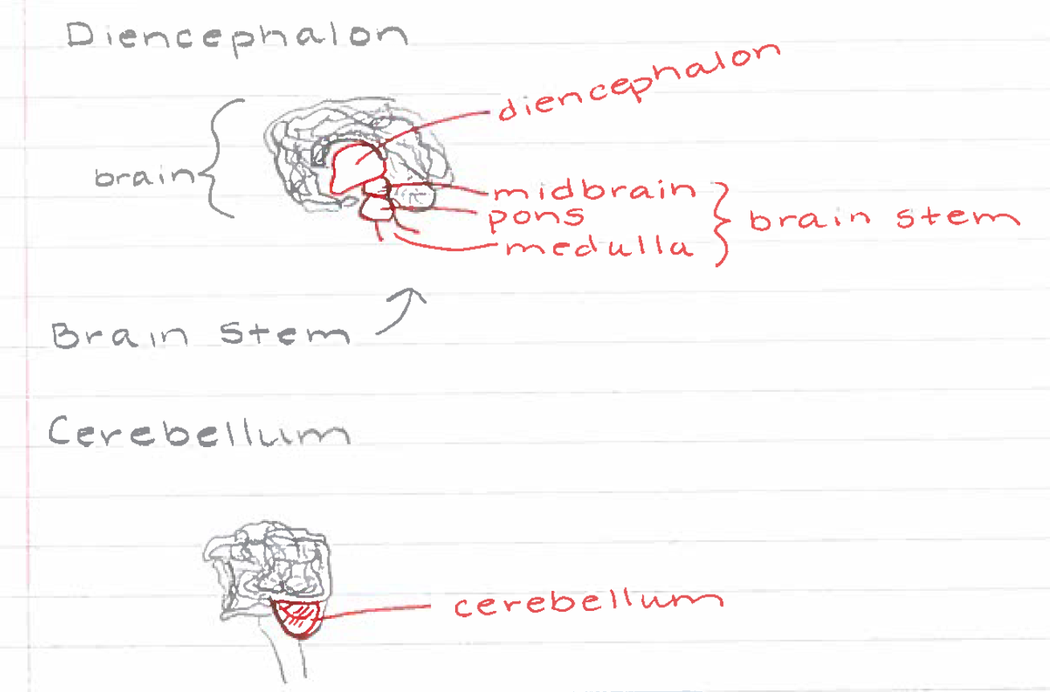

Slide 15
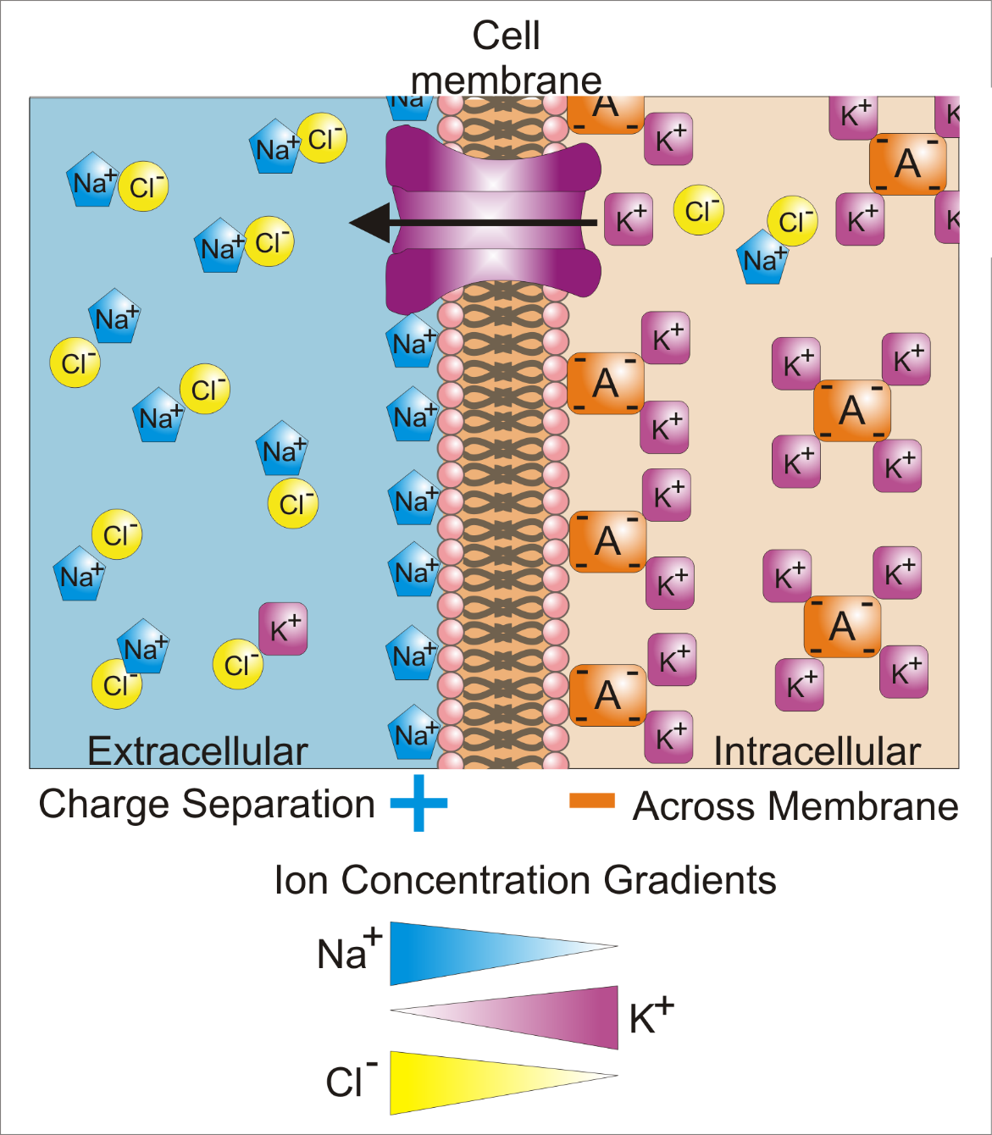
Moving Nerve Impulses
As an action potential travels down the axon, there is a change in polarity across the membrane, causing a change in the membrane potential. The Na⁺ and K⁺ gated ion channels open and close as the membrane reaches the threshold potential, in response to a signal from another neuron. At the beginning of the action potential, the Na⁺ channels open and Na⁺ moves into the axon, causing depolarization. Repolarization occurs when the K⁺ channels open and K⁺ moves out of the axon. This creates a change in polarity between the outside of the cell and the inside. The impulse travels down the axon in one direction only, to the axon terminal where it signals other neurons.

Slide 16
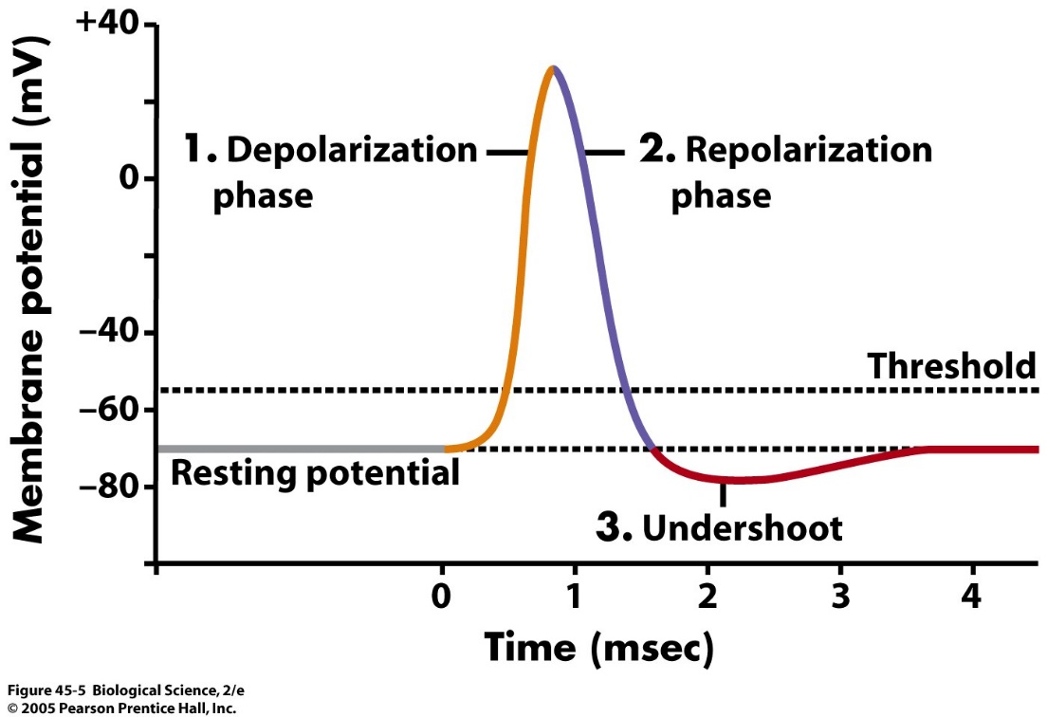
Moving Nerve Impulses (additional vocab.)
Threshold: the point at which a stimulus is of sufficient intensity to begin to produce an effect
Refractory Period: a period immediately following stimulation during which a nerve or muscle is unresponsive to further stimulation
Resting Potential: the electrical potential of a neuron or other excitable cell relative to its surroundings when not stimulated or involved in passage of an impulse

Slide 17
Neurotransmitters
Neurotransmitters are the brain chemicals that communicate information throughout our brain and body. They relay signals between nerve cells, called “neurons.” The nerve impulse travels from the first nerve cell through the axon—a single smooth body arising from the nerve cell— to the axon terminal and the synaptic knobs. Each synaptic knob communicates with a dendrite or cell body of another neuron, and the synaptic knobs contain neurovesicles that store and release neurotransmitters. The synapse lies between the synaptic knob and the next cell. For the impulse to continue traveling across the synapse to reach the next cell, the synaptic knobs release the neurotransmitter into that space, and the next nerve cell is stimulated to pick up the impulse and continue it.
The brain uses neurotransmitters to tell your heart to beat, your lungs to breathe, and your stomach to digest. They can also affect mood, sleep, concentration, weight, and can cause adverse symptoms when they are out of balance. Neurotransmitter levels can be depleted many ways. As a matter of fact, it is estimated that 86% of Americans have suboptimal neurotransmitter levels. Stress, poor diet, neurotoxins, genetic predisposition, drugs (prescription and recreational), alcohol and caffeine usage can cause these levels to be out of optimal range.

Slide 19
Inhibitory vs. Excitatory
There are two kinds of neurotransmitters – inhibitory and excitatory. Excitatory neurotransmitters are what stimulate the brain. Those that calm the brain and help create balance are called inhibitory. Inhibitory neurotransmitters balance mood and are easily depleted when the excitatory neurotransmitters are overactive.
EPSPs are graded potentials that can initiate an AP in the axon, whereas IPSPs produce a graded potential that lessens the chance of an AP in an axon.
EPSP - small depolarization is created; IPSP - small hyperpolarization is created.
EPSP - helps bring postsynaptic membrane closer to threshold; IPSP - helps bring postsynaptic membrane further from threshold.
EPSP - membrane becomes more excited; IPSP - membrane becomes less excited

Slide 20
Bell's Palsy
Bell's palsy is a paralysis or weakness of the muscles on one side of your face. Damage to the facial nerve that controls muscles on one side of the face causes that side of your face to droop. The nerve damage may also affect your sense of taste and how you make tears and saliva. This condition comes on suddenly, often overnight, and usually gets better on its own within a few weeks.
Symptoms include sudden weakness or paralysis on one side of your face that causes it to droop. This is the main symptom. It may make it hard for you to close your eye on that side of your face. Other signs are drooling, eye problems, loss of ability to taste, pain in or behind your ear, numbness in the affected side of your face, and increased sensitivity to sound.

Slide 21
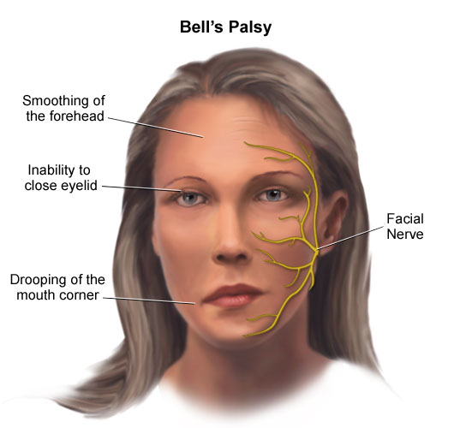
Bell's Palsy
Bell's palsy affects about 40,000 people in the United States every year. It affects approximately 1 person in 65 during a lifetime. Worldwide statistics indicate a frequency of about .02 percent of the population.
Bell's palsy usually resolves on its own within six months. Physical therapy can help prevent muscles from permanently contracting.

Slide 22
Parkinson's Disease
Parkinson's disease is a progressive disorder of the nervous system that affects movement. It develops gradually, sometimes starting with a barely noticeable tremor in just one hand. But while a tremor may be the most well-known sign of Parkinson's disease, the disorder also commonly causes stiffness or slowing of movement.
Parkinson's disease symptoms and signs may vary from person to person. Early signs may be mild and may go unnoticed. Symptoms often begin on one side of your body and usually remain worse on that side, even after symptoms begin to affect both sides. Symptoms may include a tremor, slowed movement, rigid muscles, impaired posture or balance, loss of automatic movements, speech changes, and writing changes.

Slide 23
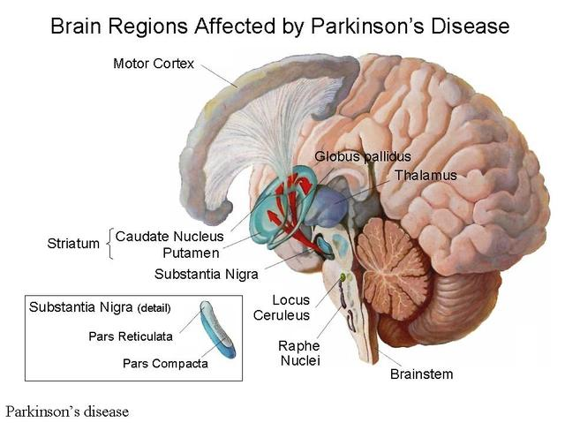
Parkinson’s Disease
According to the Parkinson's Disease Foundation, Parkinson's disease affects about 1 million people in the United States and more than 4 million people worldwide. About 60,000 people are diagnosed each year in the United States.
Parkinson's disease can't be cured, but medications can help control the symptoms, often dramatically. In some later cases, surgery may be advised.
The doctor may also recommend lifestyle changes, especially ongoing aerobic exercise. In some cases, physical therapy that focuses on balance and stretching also is important. A speech-language pathologist may help improve speech problems

Slide 24
Alzheimer's Disease
Alzheimer's disease is a progressive disease that destroys memory and other important mental functions. It's the most common cause of dementia — a group of brain disorders that results in the loss of intellectual and social skills. These changes are severe enough to interfere with day-to-day life. In Alzheimer's disease, the brain cells themselves degenerate and die, causing a steady decline in memory and mental function.
At first, increasing forgetfulness or mild confusion may be the only symptoms of Alzheimer's disease that a person will notice. But over time, the disease robs them of more of their memory, especially recent memories. The rate at which symptoms worsen varies from person to person. People with this disease may experience depression, anxiety, social withdrawal, mood swings, and distrust in others.
People with Alzheimer's may:
  Repeat statements and questions over and over, not realizing that they've asked the question before
  Forget conversations, appointments, or events
  Routinely misplace possessions, often putting them in illogical locations
  Eventually forget the names of family members and everyday objects

Slide 25
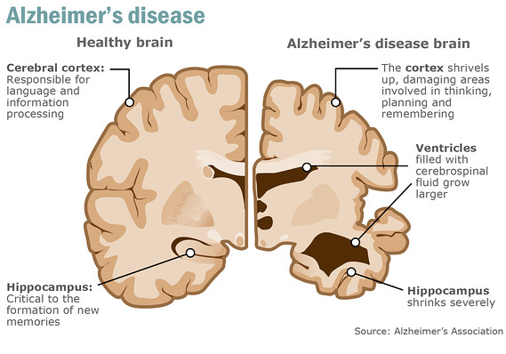
Alzheimer's Disease
An estimated 5.3 million Americans of all ages have Alzheimer's disease in 2015.
No cure exists.
There are medicines that can ease some of the symptoms in some people. They can slow down how quickly the disease gets worse, and help the brain work better for longer.

