Slide 1
Nervous System
Blair Flammond

Slide 2
Nervous System- Function
The nervous system is a complex collection of nerves and specialized cells known as neurons that transmit signals between different parts of the body.

Slide 3
Nervous System- Central nervous system
The complex of nerve tissues that controls the activities of the body.

Slide 4
Nervous System-Central Nervous System- Parts
Brain
Spinal Cord

Slide 5
Nervous System- Peripheral Nervous System
The peripheral nervous system is the division of the nervous system containing all the nerves that lie outside of the central nervous system. The primary role of the PNS is to connect the CNS to the organs, limbs and skin. These nerves extend from the central nervous system to the outermost areas of the body.

Slide 6
Nervous System- Peripheral Nervous System- parts
Neck
Arms
Torso
Legs
Skeletal muscles
Internal organs

Slide 7
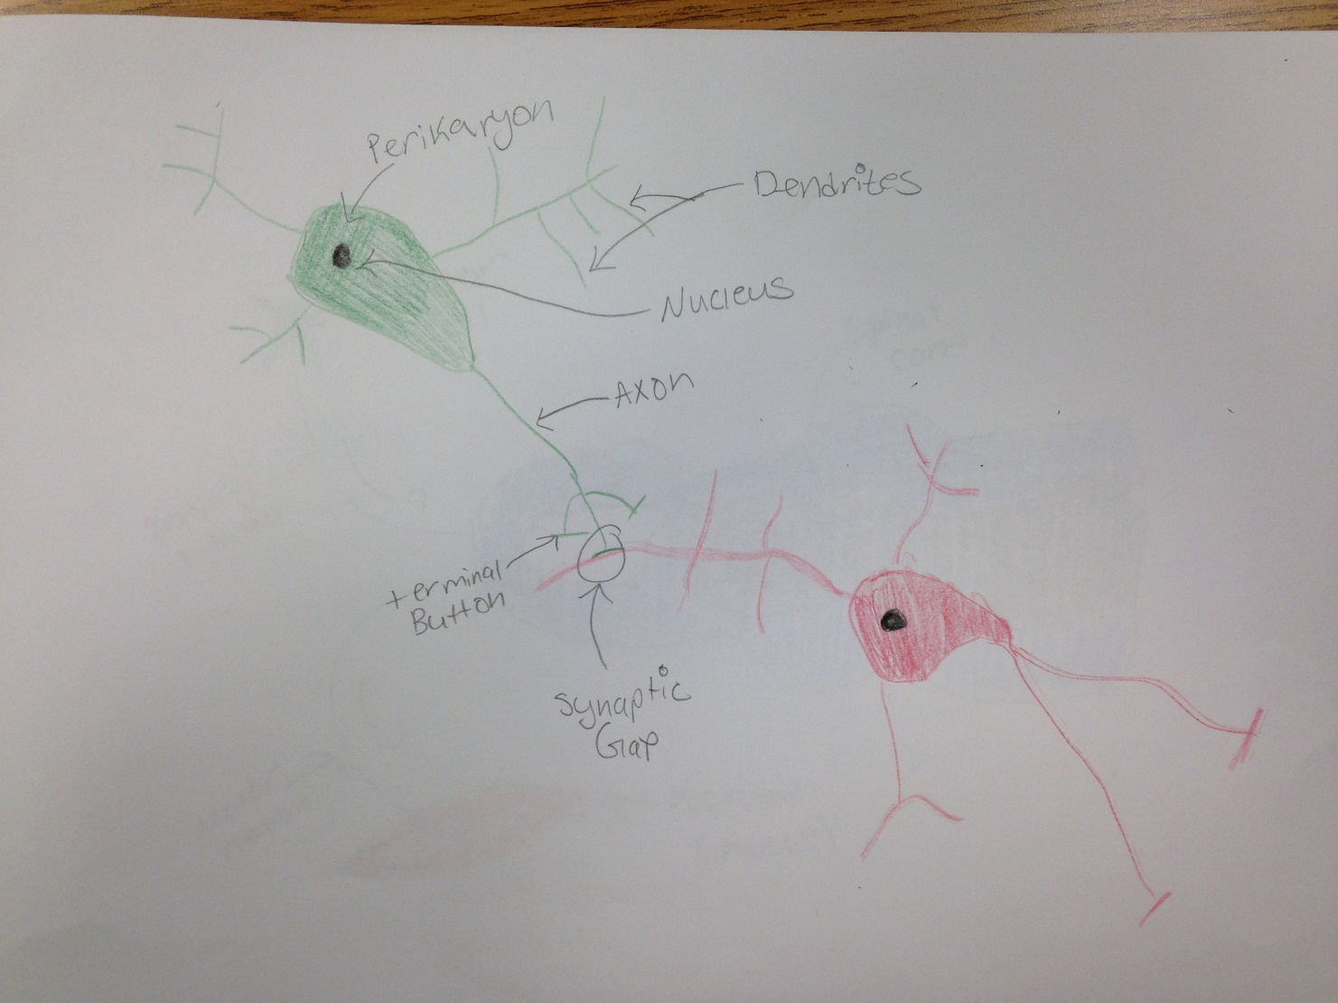
Interaction of two neurons Picture

Slide 8
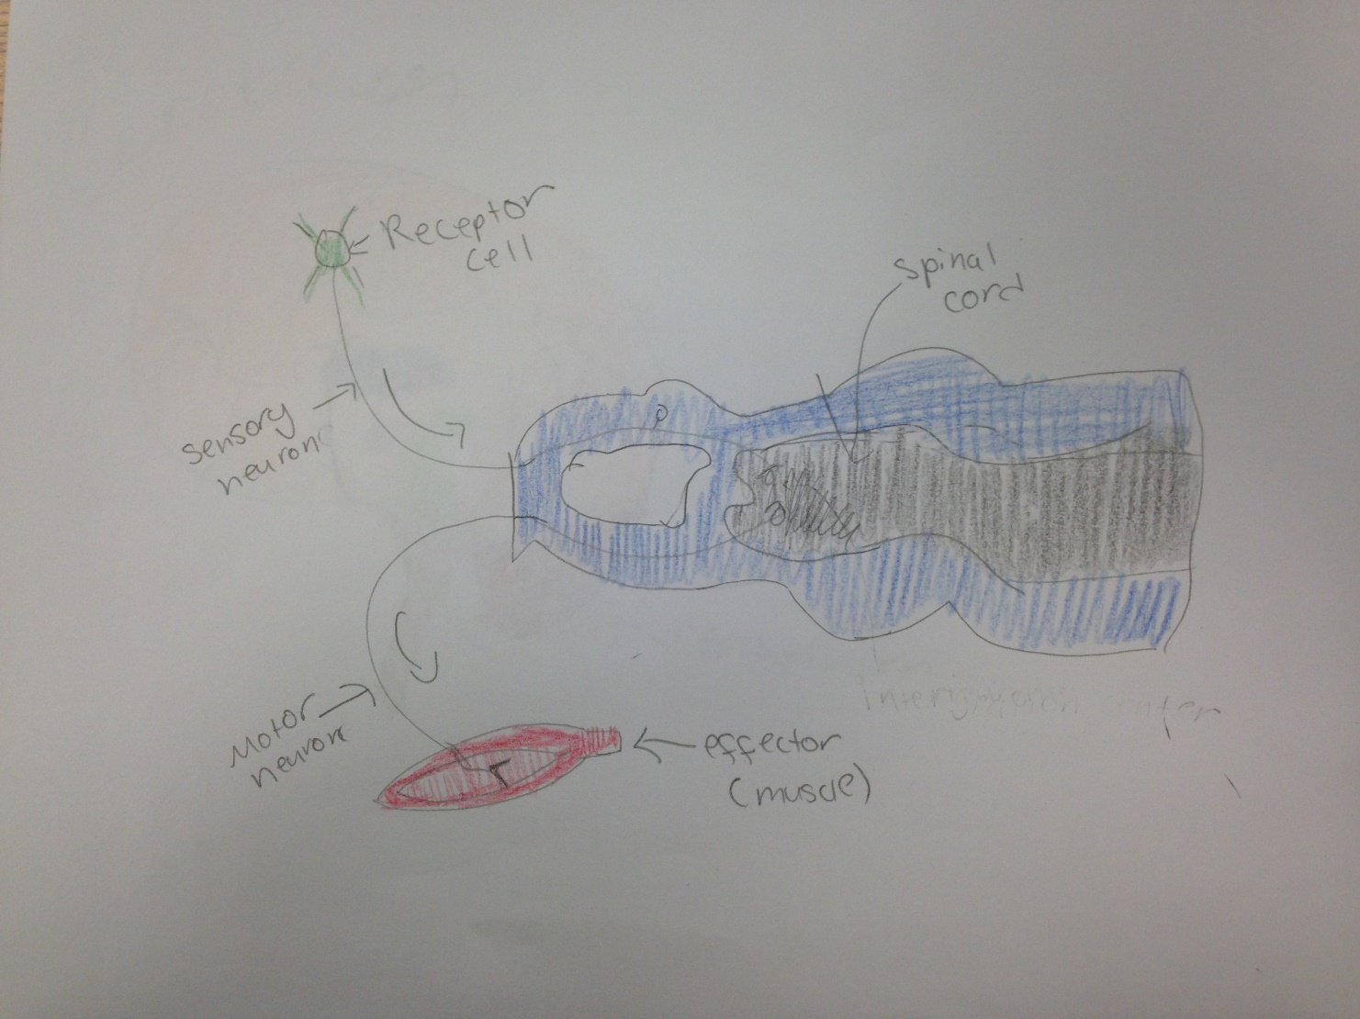
Simple reflex arc Picture

Slide 9
Simple reflex arc
  A sensory neuron carries the message from the receptor to the spinal cord and brain. A motor neuron carries the message from to the spinal cord and brain to the effector.
  Receptor- Some cells are specialized to react to a specific stimulus.
  Sensory Neuron- Carries the message from the receptor to the central nervous system
  Spinal cord- Part of the central nervous system
  Motor Neuron- Carries the message from the central nervous system to the effector
  Effector- When the receptor is stimulated, it sends a message to a part of your body that effects the correct response

Slide 10
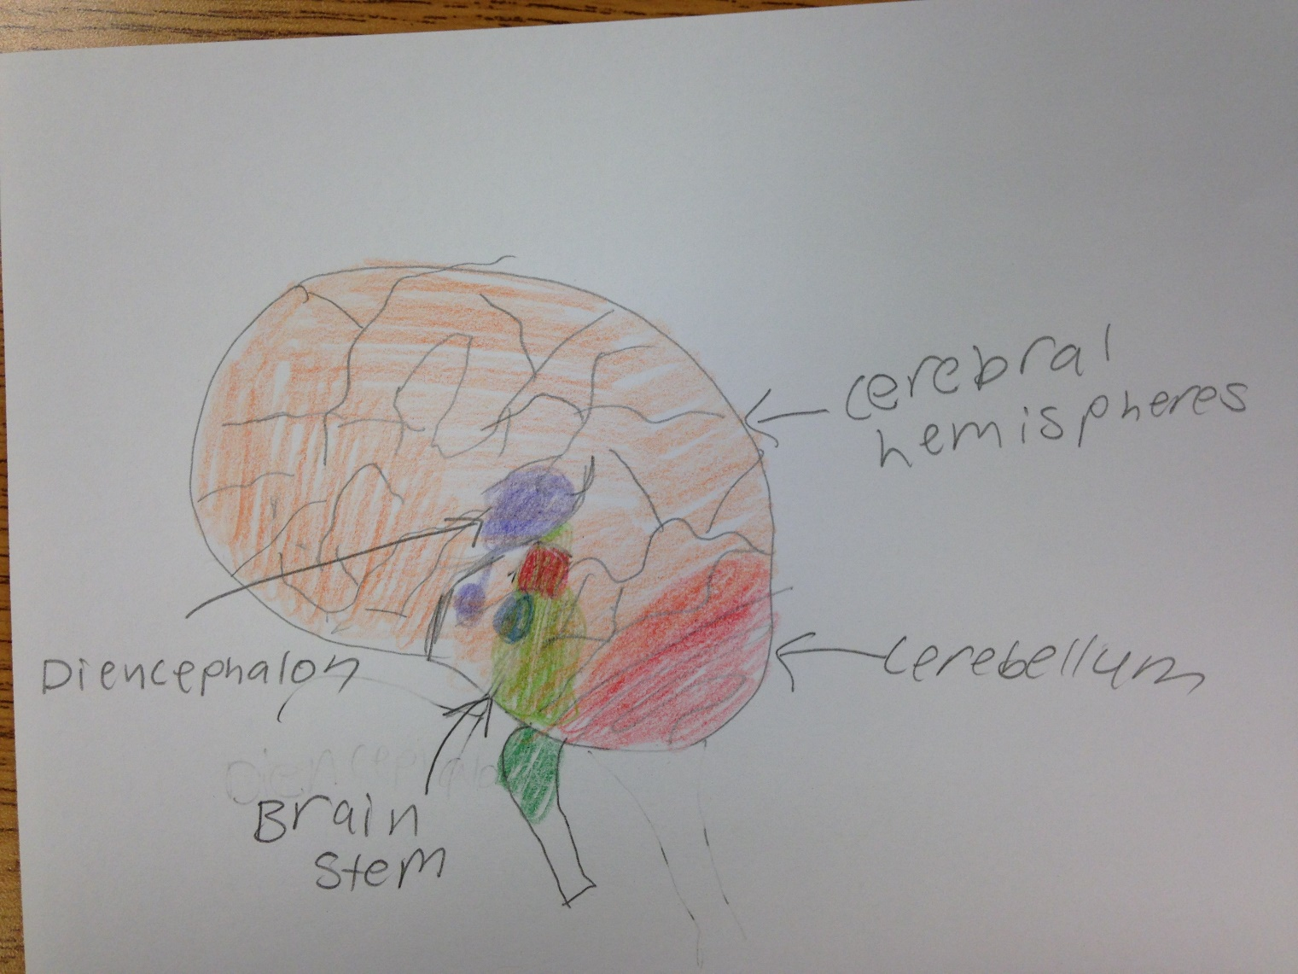
Brain Picture

Slide 11
Cerebral Hemispheres
Localization of a function, such as speech, to the right or left side of the brain
  Frontal Lobe- helps us reason, make judgments, make plans for the near and far future, make choices, take action, solve problems and generally control our living environment
  Parietal Lobe- Processes sensory information that had to do with taste, temperature, and touch
  Occipital Lobe- primary visual cortex and visual association areas
  Temporal Lobe- auditory perception, receptive components of language, visual memory, declarative memory, and emotion

Slide 12
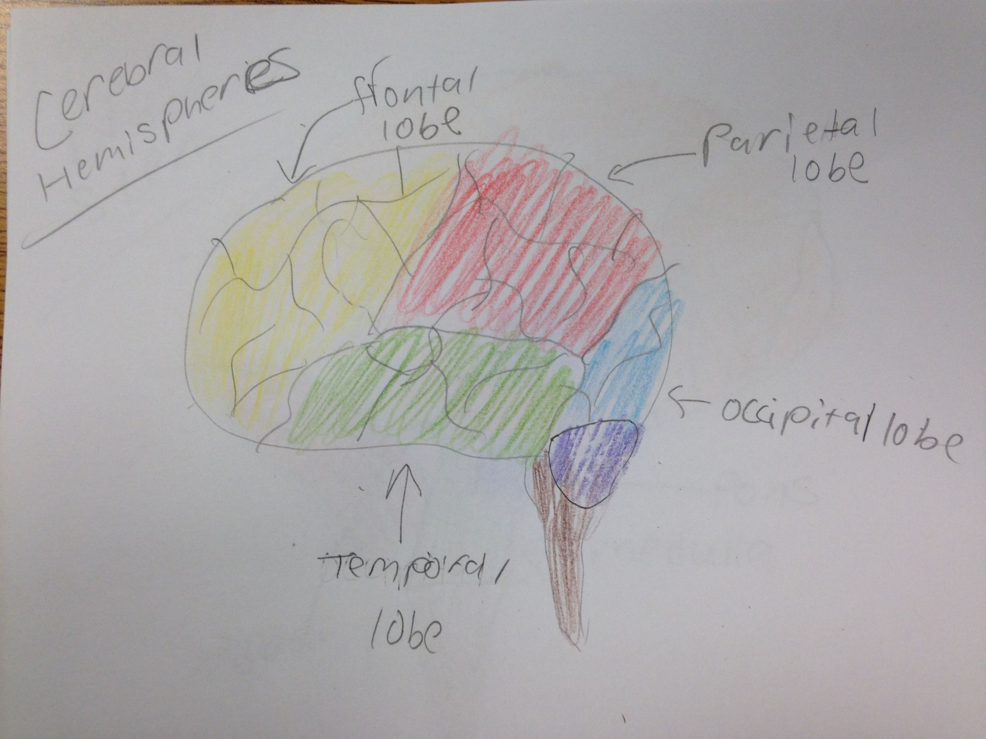
Cerebral Hemispheres Picture

Slide 13
Diencephalon
Regulate wakefulness and control the autonomic nervous system.
  Thalamus- Relaying sensory and motor signals to the cerebral cortex, and regulating consciousness, sleep, and alertness.
  Hypothalamus- Links the nervous system to the endocrine system
  Epithalamus- connection between the limbic system to other parts of the brain.

Slide 14
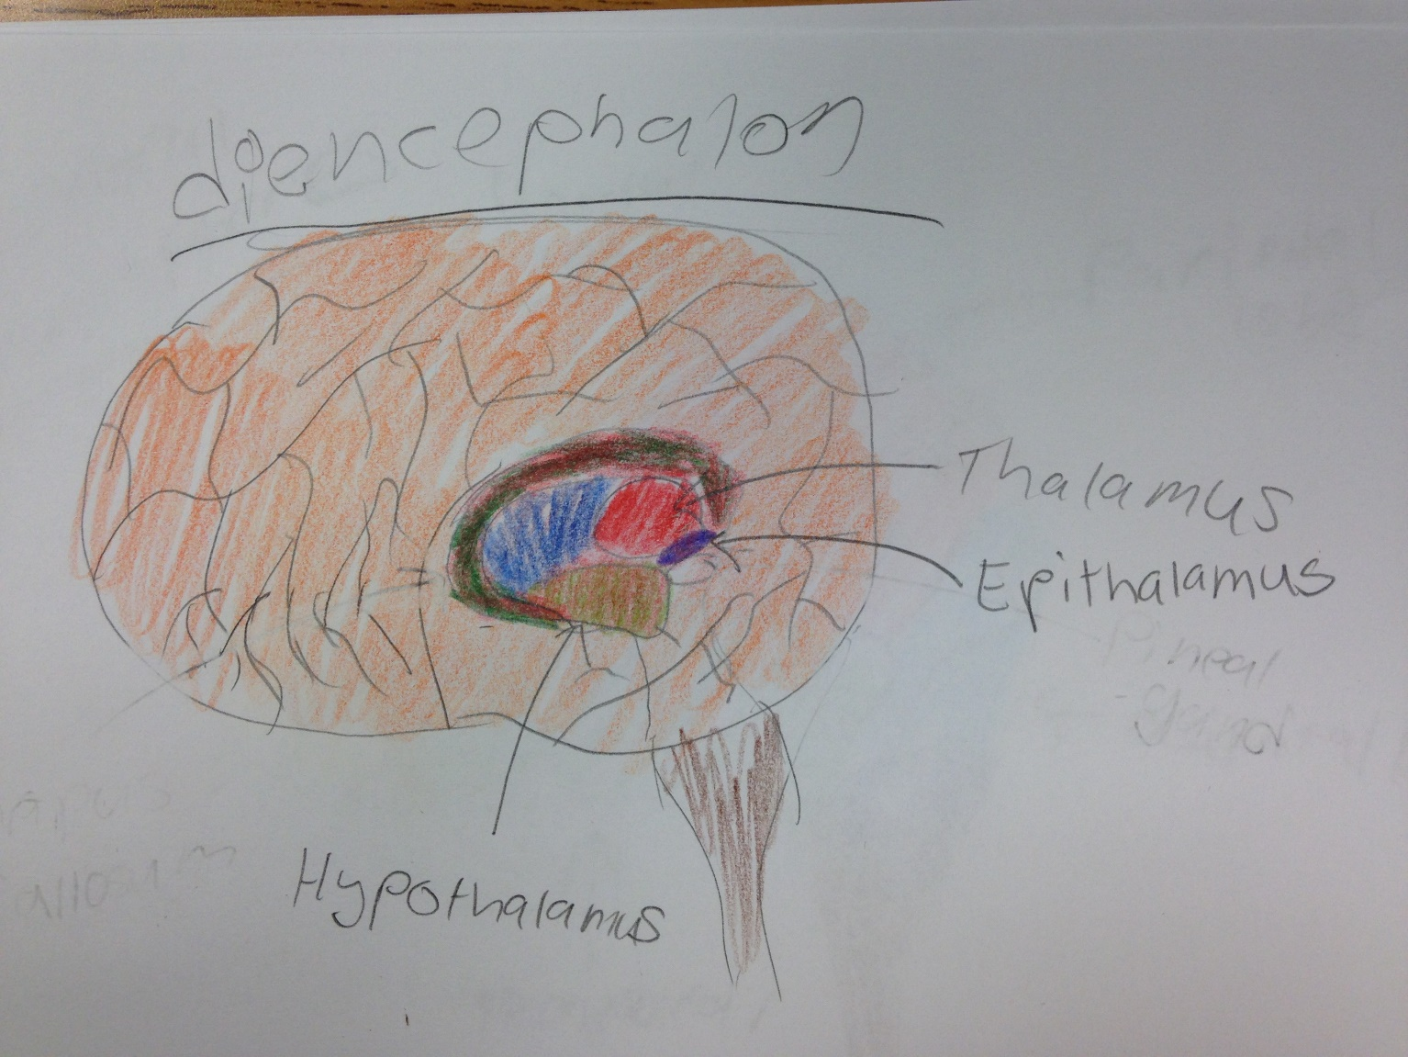
Diencephalon Picture

Slide 15
Brain Stem
  Regulation of heart rate, breathing, sleeping, and eating
    Medulla- helps regulate breathing, heart and blood vessel function, digestion, sneezing, and swallowing
    Pons- stimulates and controls the intensity of breathing, decreases the depth and frequency of breaths, and control of sleep cycles
    Midbrain- vision, hearing, eye movement, and body movement

Slide 16
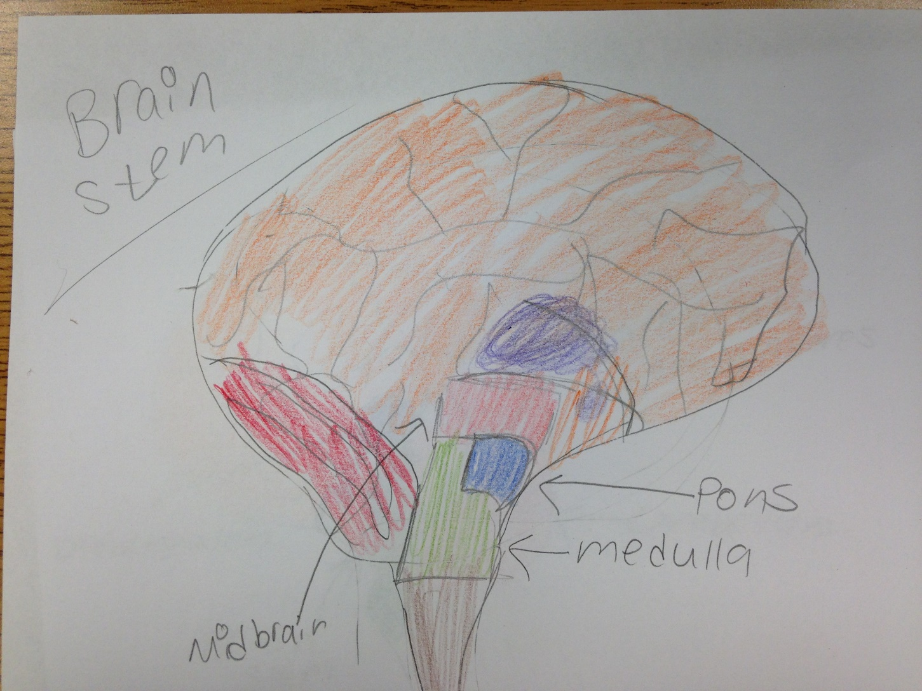
Brain Stem Picture

Slide 17
Cerebellum
Regulation and coordination of movement, posture, and balance.

Slide 18
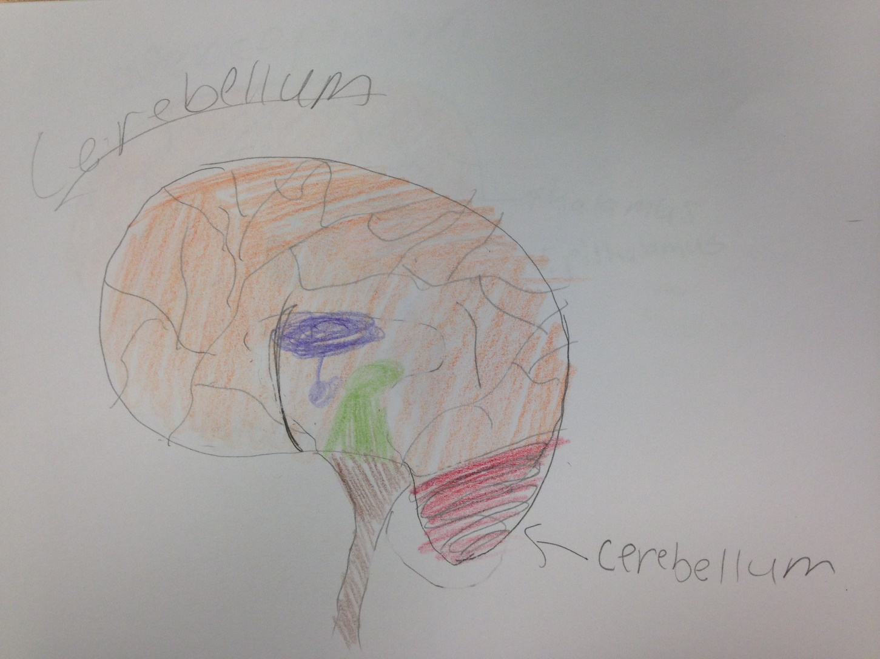
Cerebellum Picture

Slide 19
Nerve Impulse
Polarization of the neuron's membrane: Sodium is on the outside, and potassium is on the inside.
Resting potential gives the neuron a break.
Action potential: Sodium ions move inside the membrane
Repolarization: Potassium ions move outside, and sodium ions stay inside the membrane.
Hyperpolarization: More potassium ions are on the outside than there are sodium ions on the inside.
Refractory period puts everything back to normal: Potassium returns inside, sodium returns outside.

Slide 20
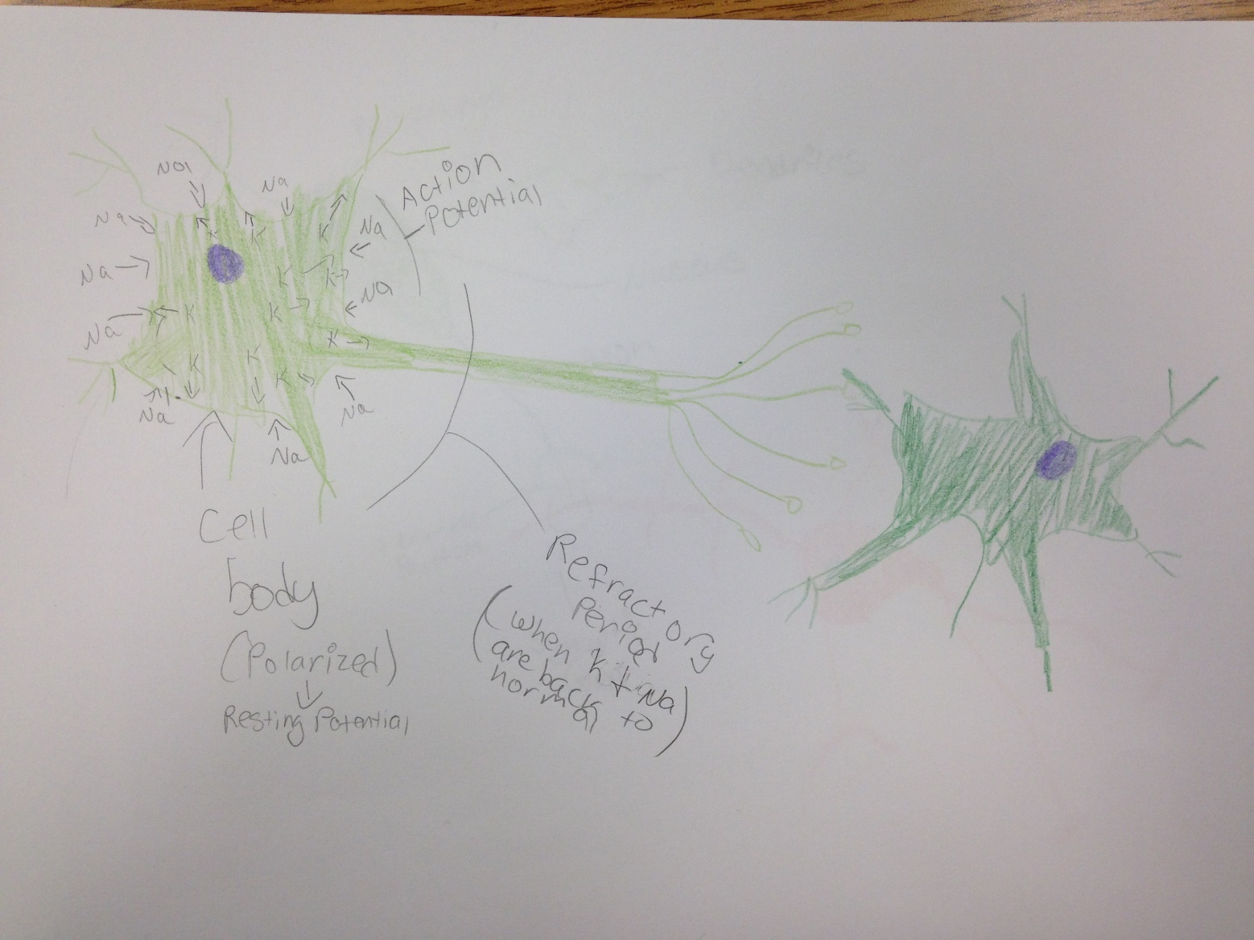
Nerve Impulse Picture

Slide 21
neurotransmitters
Neurotransmitters facilitate the signal transmission across chemical synapses.
In an electrical synapse, gap junctions, which are formed by the channel proteins connecting the presynaptic and postsynaptic membranes of two neurons, allow the current to pass directly from one neuron to the next.

Slide 22
Ipsp vs epsp
EPSPs increase the likelihood of a postsynaptic action potential occurring, and IPSPs decrease this likelihood.

Slide 23
Alzheimer's Disease
Description
  progressive, neurodegenerative disease that occurs when nerve cells in the brain die
Symptoms
  memory loss that affects job skills
  Difficulty performing familiar tasks
  problems with language
  disorientation to time and place
  poor or decreased judgment
  problems with abstract thinking
  misplacing things
  changes in mood or behavior
  changes in personality
  loss of initiative

Slide 24
Alzheimer's Disease
Statistics
  An estimated 5.3 million Americans have Alzheimer's disease.
Treatment
  At this time, there is no cure for Alzheimer's, no way of slowing down the progression of this disease, and no treatment available to reverse the deterioration of Alzheimer's disease.

Slide 25
Brain Tumor
Description
  abnormal growth of tissue in the brain
Symptoms
  headache
  vomiting (usually in the morning)
  nausea
  personality changes
  irritability
  drowsiness
  depression
  decreased cardiac and respiratory function and, eventually, coma if not treated

Slide 26
Brain Tumor
Statistics
  An estimated 22,070 people in the US will be diagnosed with malignant tumors of the brain or spinal cord during (2009).
Treatment
  surgery
  radiation therapy
  steroids
  anti-seizure medication
  placement of VP shunt
  supportive care
  rehabilitation
  antibiotics
  continuous follow-up care

Slide 27
Nervous System- Bibliography
http://www.livescience.com/22665-nervous-system.html
http://www.christopherreeve.org/site/c.ddJFKRNoFiG/b.4452157/k.3E9D/What_is_the_Central_Nervous_System.htm
http://psychology.about.com/od/pindex/f/peripheral-nervous-system.htm
http://study.com/academy/lesson/peripheral-nervous-system-definition-function-parts.html
http://www.mrothery.co.uk/nerves/NervesNotes.htm
http://www.microscopy-uk.org.uk/mag/indexmag.html?http://www.microscopy-uk.org.uk/mag/artoct02/gohisto2.html
http://www.asu.edu/courses/pgs461/Reflexes%20Arcs_PGS%20461.pdf
http://www.edoctoronline.com/medical-atlas.asp?c=4&id=21701&m=1&p=7&cid=1042&s=
https://www.boundless.com/physiology/textbooks/boundless-anatomy-and-physiology-textbook/the-central-nervous-system-cns-12/parts-of-the-brain-stem-117/functions-of-the-brain-stem-637-6728/
http://www.healthline.com/human-body-maps/pons
http://www.healthline.com/human-body-maps/medulla-oblongata
http://serendip.brynmawr.edu/bb/kinser/definitions/def-midbrain.html
http://www.nutters.com/nexus/snrsbrainpg2.html
https://www.boundless.com/psychology/textbooks/boundless-psychology-textbook/biological-foundations-of-psychology-3/structure-and-function-of-the-brain-35/cerebral-hemispheres-and-lobes-of-the-brain-153-12688/
http://brainmadesimple.com/parietal-lobe.html
http://www.livestrong.com/article/24256-functions-frontal-lobe-brain/
http://www.merckmanuals.com/professional/neurologic-disorders/function-and-dysfunction-of-the-cerebral-lobes/overview-of-cerebral-function

Slide 28
Nervous System- Bibliography
https://www.boundless.com/physiology/textbooks/boundless-anatomy-and-physiology-textbook/the-central-nervous-system-cns-12/the-diencephalon-119/functions-of-the-diencephalon-644-6500/
http://serendip.brynmawr.edu/bb/kinser/Structure1.html#cerebellum
http://www.dummies.com/how-to/content/understanding-the-transmission-of-nerve-impulses.html
https://www.boundless.com/biology/textbooks/boundless-biology-textbook/the-nervous-system-35/how-neurons-communicate-200/synaptic-transmission-763-11996/
http://www.ncbi.nlm.nih.gov/books/NBK11117/
http://uhealthsystem.com/health-library/neuro/disorder/alzheim
http://uhealthsystem.com/health-library/neuro/disorder/brain

