Slide 1
Nervous System
Mia Phillips

Slide 2
Nervous Systems
Central- the complex of nerve tissue that controls the activities of the body
Major Parts- Brain, Spinal Cord
Peripheral- outside the brain and the spinal cord
Major part- Nerve Fibers, Everything else

Slide 3
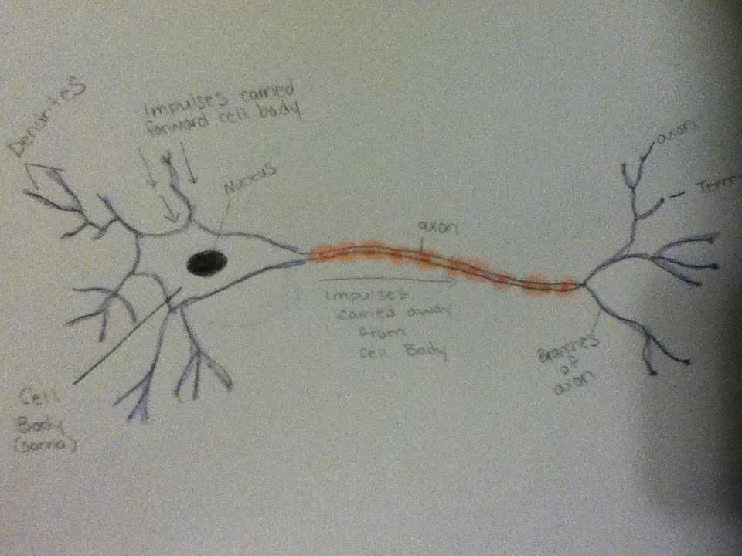
Interaction of Two Neurons

Slide 4
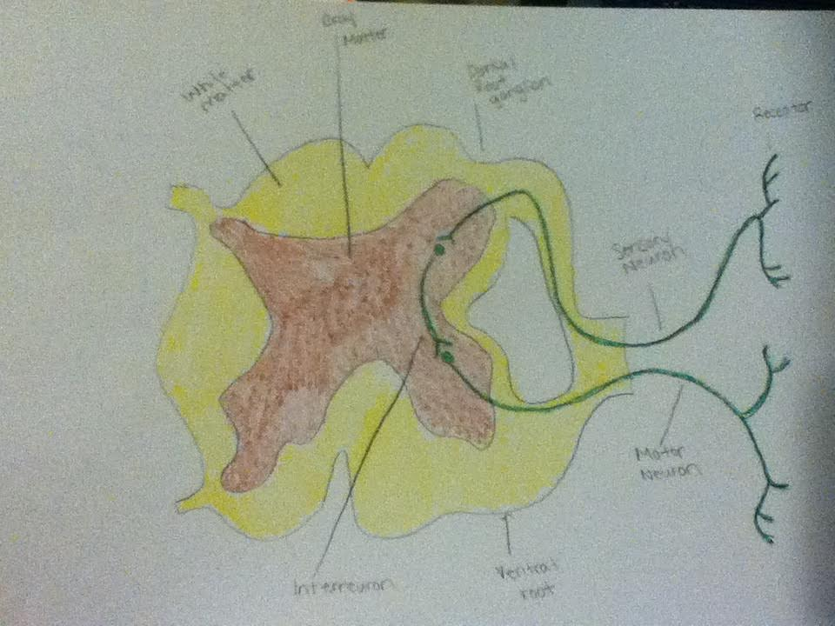
Simple Reflex Arc.

Slide 5
Reflex Arc.
A neutral pathway that controls a refelx.
Happens quickly
Autonomic reflex arc.- affects inner organs
Somatic reflex arc.- affects muscles

Slide 6
Elements of Simple Reflex Arc
Sensory Neuron- responsible for converting various external stimuli that comes from the environment in to another stimuli
Motor Neuron- located in central nervous system, controls the muscles

Slide 7
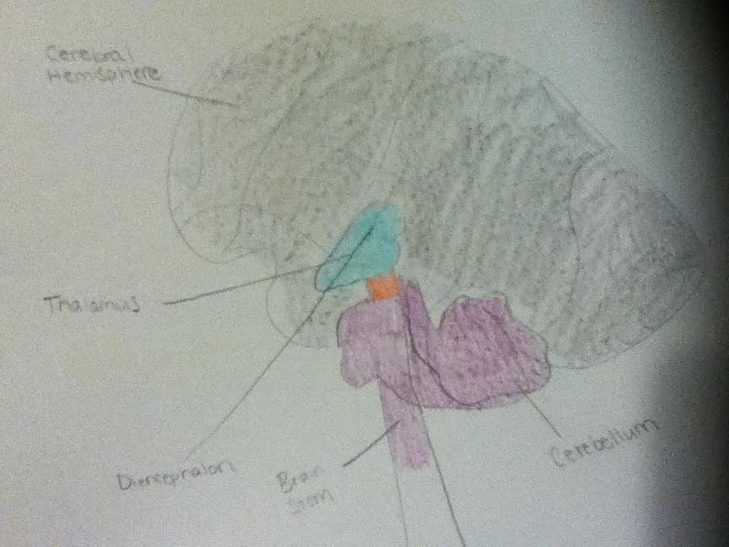
Major Parts of the Brain

Slide 8
Major Parts of the Brain
Cerebral Hemisphere- controls movement of the left side of the body, receives info from sensory system, regulates motor movements
Diencephalon- made up of the thalamus, subthalamus, hypothalamus, and epithalamiums
Brain Stem- regulates heart beat, breathing, sleeping, and eating

Slide 9
Nerve Impulses

Slide 10
Nerve Impulses

Slide 11
Nerve Impulses

Slide 12
Nerve Impulses

Slide 13
Nerve Impulses

Slide 14
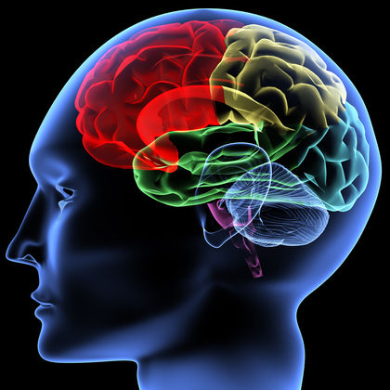
Neurotransmitters
Role: communicate information throughout the brain and the body
Influence any portion of the brain and just that portion

Slide 15
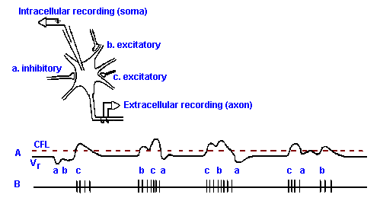
IPSP and EPSP
EPSP- excitatory postsynaptic potential, hyperpolarizing
IPSP- inhibitory postsynaptic potential

Slide 16
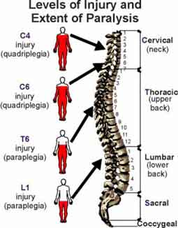
Spinal Cord Trauma
Damage to the spinal cord, bones, tissues, or blood vessels
Could lead to direct injury to the cord

Slide 17
Spinal Cord Trauma Symptoms
Increased muscle tone
Loss of bladder control
Numbness
Pain
Weakness
Paralysis

Slide 18
Spinal Cord Trauma Treatments
Realign the spinal bones
Remove fluid or tissue that puts pressure on the spinal cord
Remove bone fragments, disk fragments, foregin objects
Fuse broken spinal bones

Slide 19
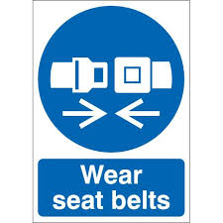
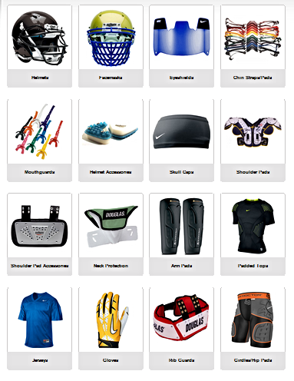
Spinal Cord Trauma Prevention
Wear Seat Belts Check water level before Diving Wear Proper Equipment

Slide 20
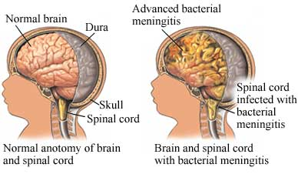
Meningitis
An inflammation of the meninges, the membranes that surround the brain

Slide 21
Meningitis Symptoms
Fever
Headache
Nausea, vomiting
Stiff neck
Confusion
Drowsiness
Seizures

Slide 22
Meningitis Treatments
Medications
Therapy
Surgery

Slide 23
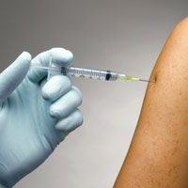
Meningitis Prevention
Vaccinations

Slide 24
References
http://uhealthsystem.com/health-library/neuro/disorder/meningit
https://www.nlm.nih.gov/medlineplus/ency/article/001066.htm
https://www.neurogistics.com/TheScience/WhatareNeurotransmi09CE.asp
https://www.boundless.com/physiology/textbooks/boundless-anatomy-and-physiology-textbook/the-peripheral-nervous-system-pns-13/reflexes-136/components-of-a-reflex-arc-727-2295/
https://www.boundless.com/physiology/textbooks/boundless-anatomy-and-physiology-textbook/the-peripheral-nervous-system-pns-13/reflexes-136/components-of-a-reflex-arc-727-2295/
https://science.education.nih.gov/supplements/nih2/addiction/guide/lesson2-1.html
http://www.medicinenet.com/script/main/art.asp?articlekey=2667

