Slide 1
The nervous system
By Jameson Meyer

Slide 2
Central Nervous system
Definition
The complex of nerve tissues that controls the activities of the body. In vertebrates it comprises the brain and spinal cord.
Major parts
Brain
Spinal Cord

Slide 3
Peripheral nervous system
Definition
The peripheral nervous system (PNS) is the part of the nervous system that consists of the nerves and ganglia outside of the brain and spinal cord.
Major Parts
12 pairs of cranial nerves and 31 pairs of spinal nerves.

Slide 4
Interaction of two neurons

Slide 5
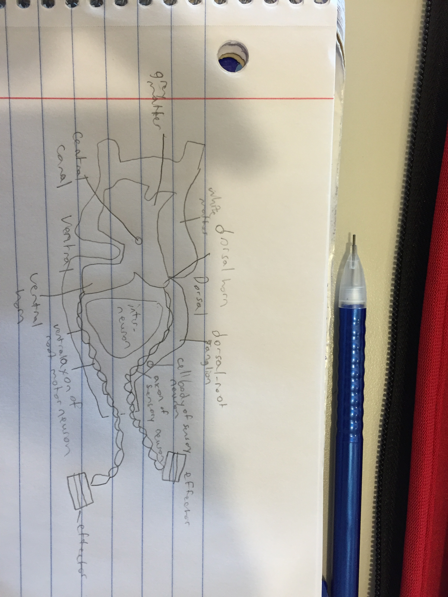
Reflex arc
Elements
Sensory neurons
Receive messages when the body is hit
Motor neurons
Motor neurons are told to move by the brain after the sensory neurons send a message to the brain to warn it
CNS
The brain and spinal cord
How it works
A sensory neuron carries the message from the receptor to the central nervous system (the spinal cord and brain). A motor neuron carries the message from the central nervous system to the effector. In a knee-jerk reflex arc the sensory neuron directly connects to the motor neuron in the spinal cord.

Slide 6
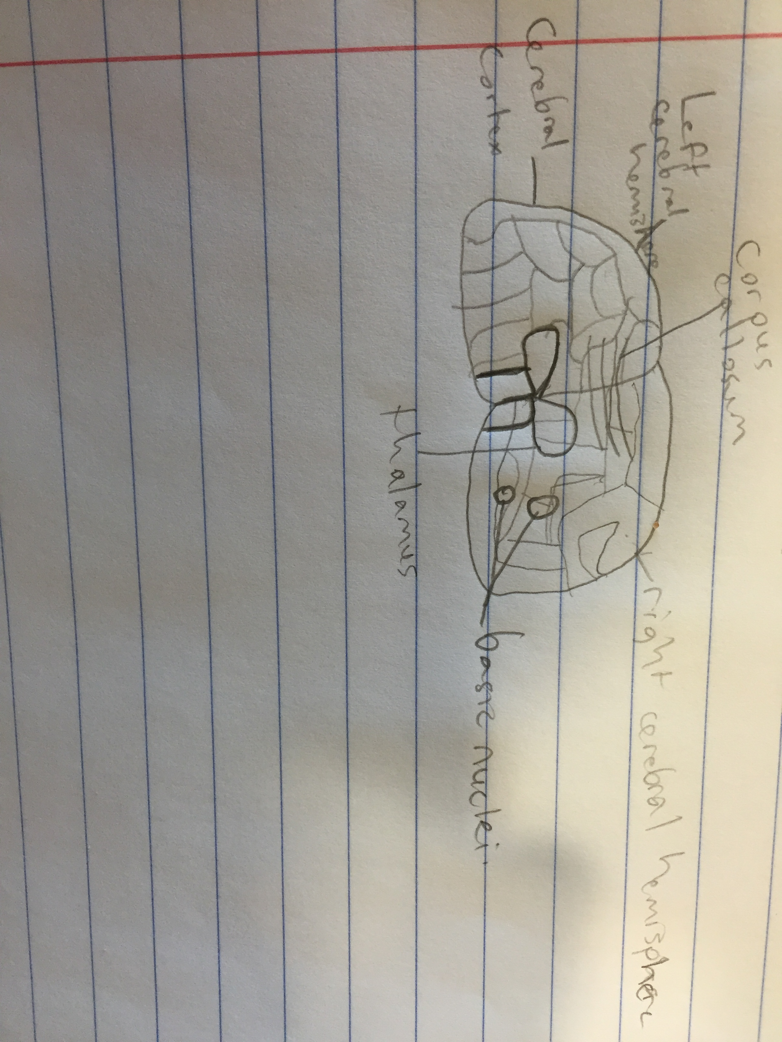
Cerebral hemispheres
Although the right and left hemispheres seem to be a mirror image of one another, there are important functional distinctions. In most people, for example, the areas that control speech are located in the left hemisphere, while areas that govern spatial perceptions reside in the right hemisphere.

Slide 7
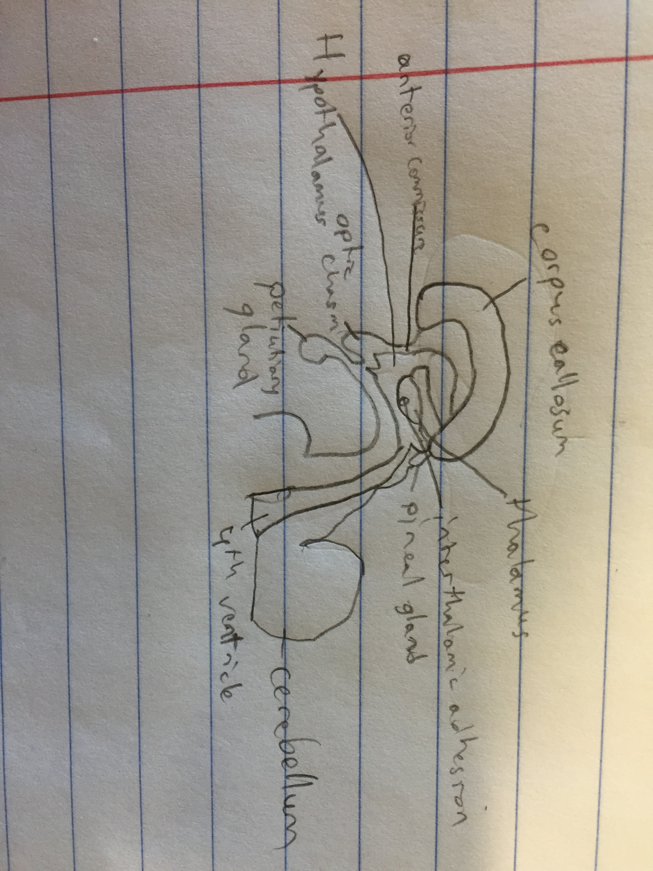
diencephalon
Diencephalon is made up of four distinct components: the thalamus, the subthalamus, the hypothalamus, and the epithalamus. The hypothalamus is an integral part of the endocrine system, with one of the most important functions being to link the nervous system to the endocrine system via the pituitary gland.

Slide 8
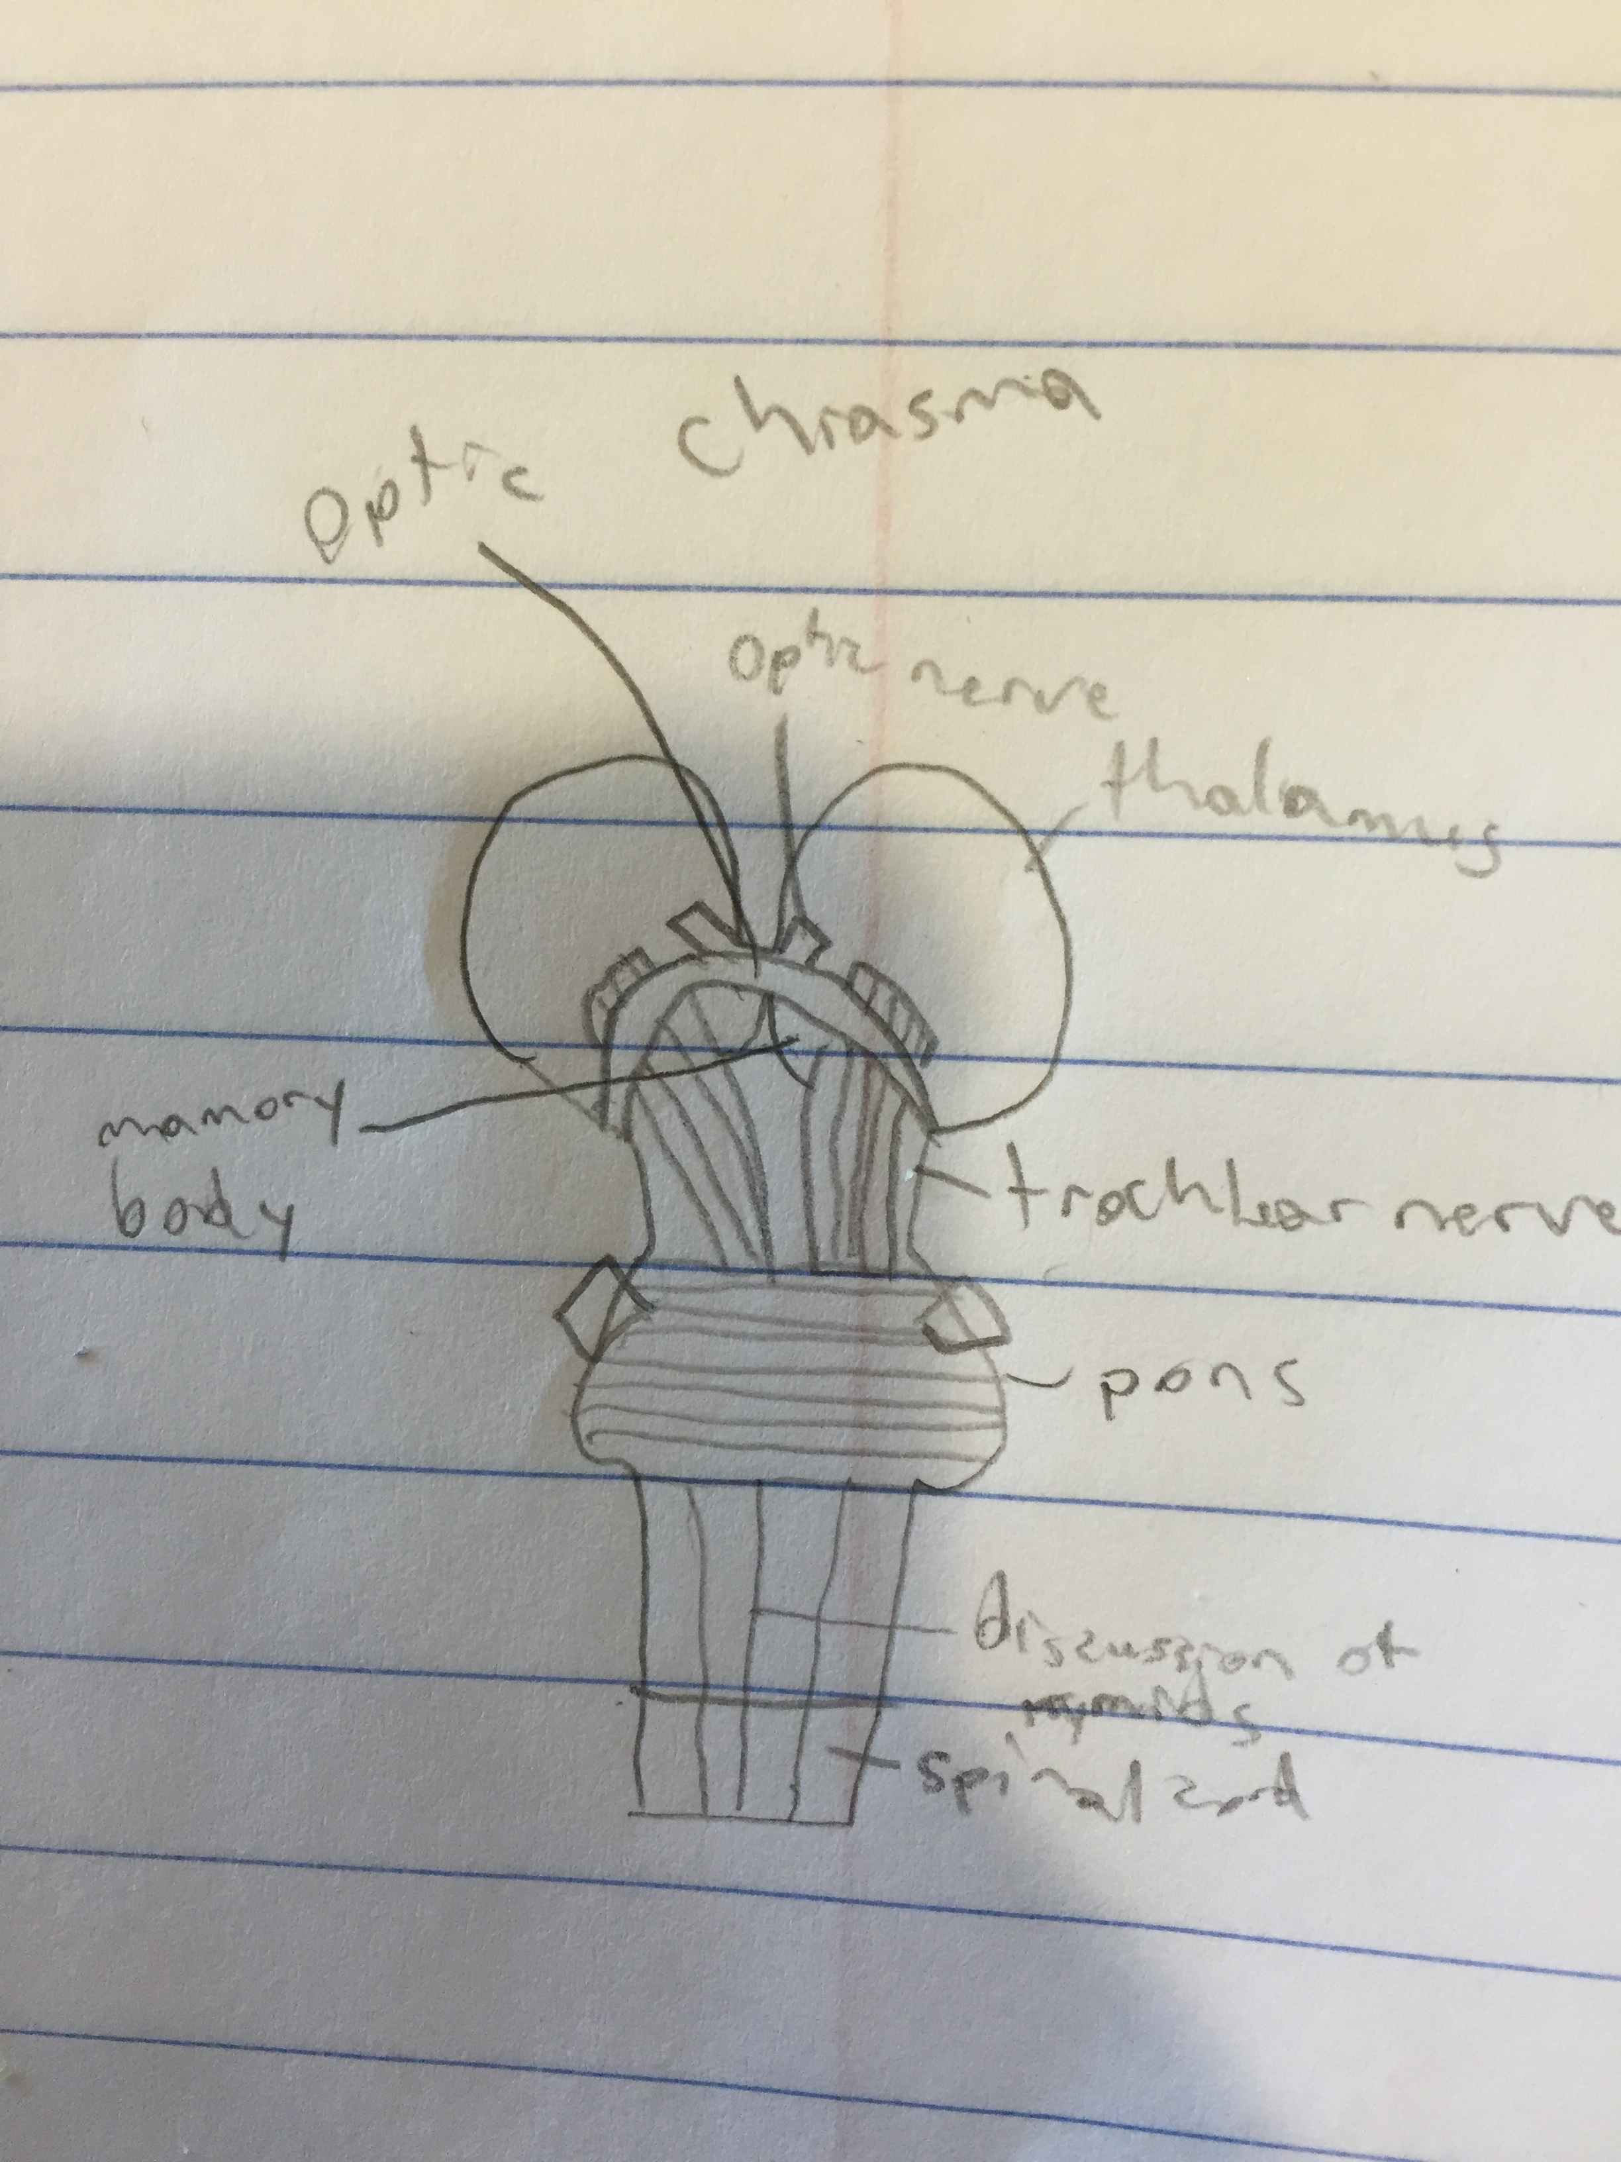
Brain stem
The brain stem has many basic functions, including regulation of heart rate, breathing, sleeping, and eating. It includes the medulla oblongata (myelencephalon), pons (part of metencephalon), and midbrain (mesencephalon).

Slide 9
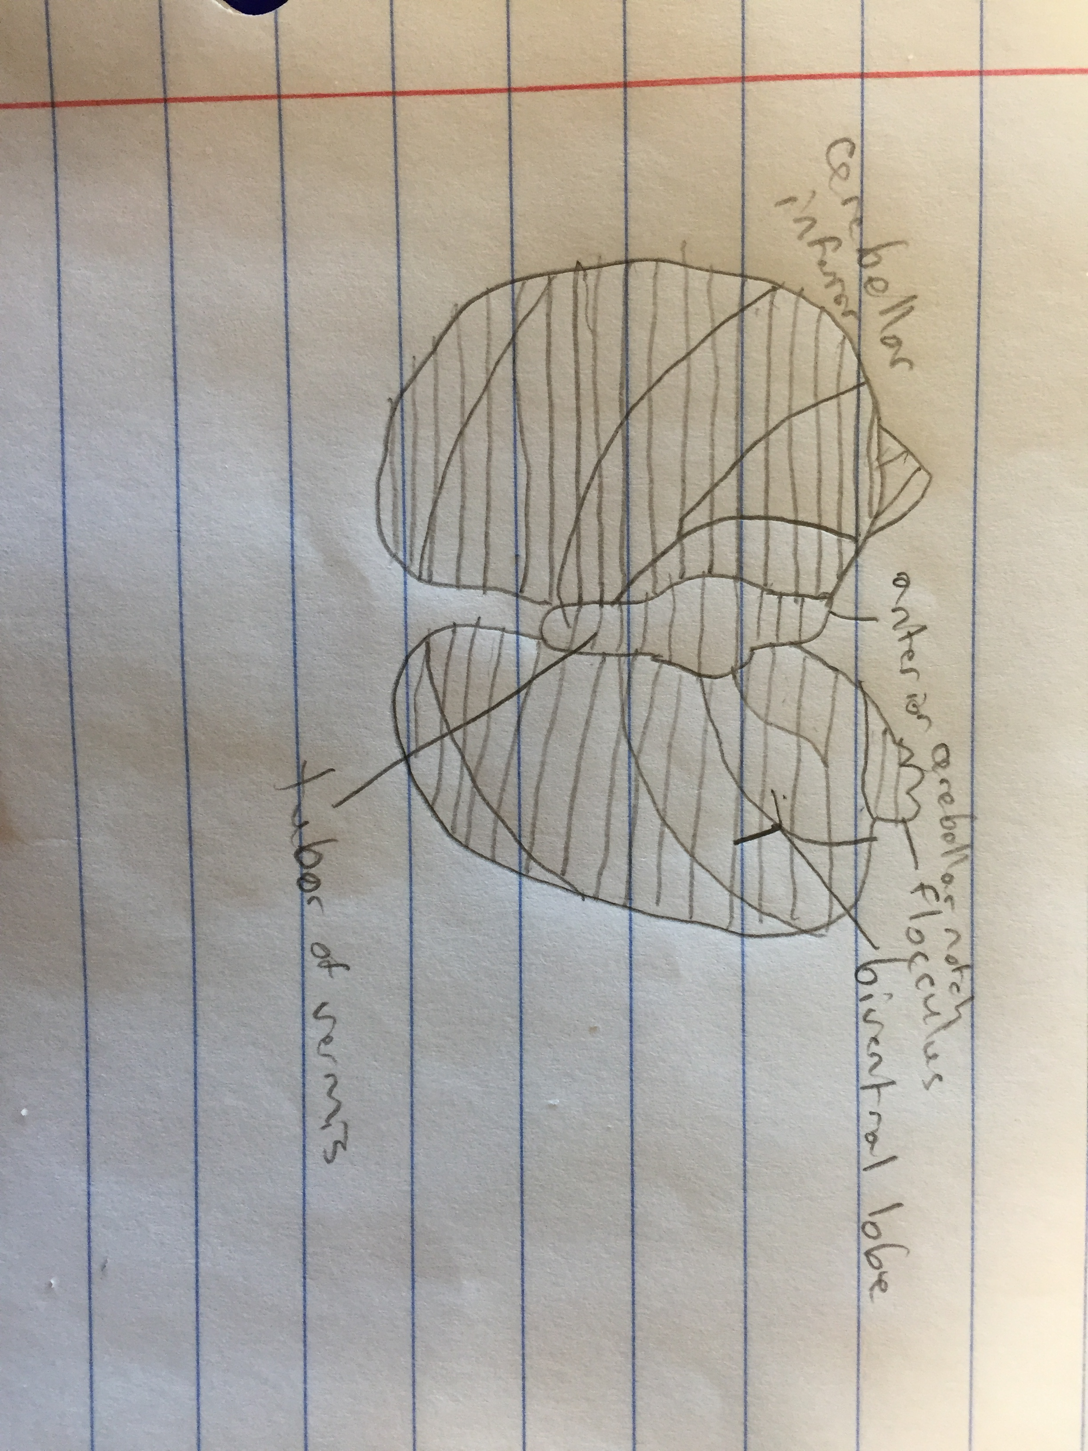
cerebellum
the part of the brain at the back of the skull in vertebrates. Its function is to coordinate and regulate muscular activity

Slide 10
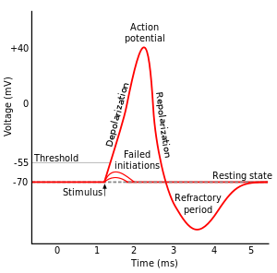
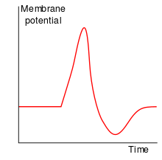
Nerve Impulse
All cells in animal body tissues are electrically polarized – in other words, they maintain a voltage difference across the cell's plasma membrane, known as the membrane potential. This electrical polarization results from a complex interplay between protein structures embedded in the membrane called ion pumps and ion channels (Sodium and potassium pumps). In neurons, the types of ion channels in the membrane usually vary across different parts of the cell, giving the dentrites, axon, and cell body different electrical properties. As a result, some parts of the membrane of a neuron may be excitable (capable of generating action potentials), whereas others are not. Recent studies have shown that the most excitable part of a neuron is the part after the axon hillock, which is called the initial segment, but the axon and cell body are also excitable in most cases.
Each excitable patch of membrane has two important levels of membrane potential: the resting potential, which is the value the membrane potential maintains as long as nothing perturbs the cell, and a higher value called the threshold potential. At the axon hillock of a typical neuron, the resting potential is around –70 millivolts (mV) and the threshold potential is around –55 mV. Synaptic inputs to a neuron cause the membrane to depolarize or hyperpolarize; that is, they cause the membrane potential to rise or fall. Action potentials are triggered when enough depolarization accumulates to bring the membrane potential up to threshold. When an action potential is triggered, the membrane potential abruptly shoots upward and then equally abruptly shoots back downward, often ending below the resting level, where it remains for some period of time. The shape of the action potential is stereotyped; that is, the rise and fall usually have approximately the same amplitude and time course for all action potentials in a given cell. (Exceptions are discussed later in the article.) In most neurons, the entire process takes place in about a thousandth of a second. Many types of neurons emit action potentials constantly at rates of up to 10–100 per second; some types, however, are much quieter, and may go for minutes or longer without emitting any action potentials.
All of this happens linked between two neurons and they are able to react to each other nearly instantaneously because of the way these reactions happen.

Slide 11
neurotransmitters
A neurotransmitter during a synapse has the job of relaying information from a presynaptic neuron to a postsynaptic neuron
There are two types of postsynaptic neurons
an excitatory postsynaptic potential, or EPSP, or hyperpolarizing, resulting in an inhibitory postsynaptic potential, or IPSP. below the threshold for generating postsynaptic action potentials.

Slide 12
Alzheimer’s disease
Alzheimer's disease is an irreversible, progressive brain disease that slowly destroys memory and thinking skills, and eventually even the ability to carry out the simplest tasks. In most people with Alzheimer's, symptoms first appear after age 65.
Alzheimer’s symptoms progress from just misplacing words when talking to complete memory loss depending on how progressive the disease is
About 1 in 9 people older than the age of 65 have Alzheimer’s
Currently there is no cure for it but there are many drug and non drug options to help with the cognitive problems

Slide 13
Parkinson’s disease
Parkinson's disease is a progressive disorder of the nervous system that affects movement. It develops gradually, sometimes starting with a barely noticeable tremor in just one hand. But while a tremor may be the most well-known sign of Parkinson's disease, the disorder also commonly causes stiffness or slowing of movement.
The main sign of Parkinson’s is the tremble of one hand but in many cases, it happens that the patient first stops moving their arms when they walk because of stiffness.
About 4 million people in the world have Parkinson’s
There is no cure for Parkinson’s disease but medications may help you manage problems with walking, movement and tremor. These medications increase or substitute for dopamine, a specific signaling chemical (neurotransmitter) in your brain.

Slide 14
References
http://www.merriam-webster.com/dictionary/central%20nervous%20system
https://www.boundless.com/psychology/textbooks/boundless-psychology-textbook/biological-foundations-of-psychology-3/the-nervous-system-34/the-central-nervous-system-cns-147-12682/
https://www.boundless.com/psychology/textbooks/boundless-psychology-textbook/biological-foundations-of-psychology-3/structure-and-function-of-the-brain-35/cerebral-hemispheres-and-lobes-of-the-brain-153-12688/
https://www.boundless.com/physiology/textbooks/boundless-anatomy-and-physiology-textbook/the-central-nervous-system-cns-12/the-diencephalon-119/functions-of-the-diencephalon-644-6500/
http://biology.about.com/od/anatomy/p/Brainstem.htm
http://neuroscience.uth.tmc.edu/s3/chapter05.html
http://www.flashcardmachine.com/chapter-8-synaptictransmissionandneuralintegration.html
http://www.mayoclinic.org/diseases-conditions/parkinsons-disease/basics/definition/con-20028488

