Slide 1
The Nervous System
Cole McDougall

Slide 2
Nervous System
The nervous system is a complex collection of nerves and specialized cells known as neurons that transmit signals between different parts of the body.

Slide 3
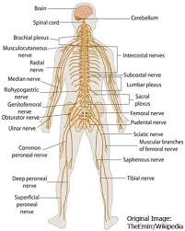
The Central Nervous System
The central nervous system is the integration and command center of the body. It consists of the brain, spinal cord and retina.

Slide 4
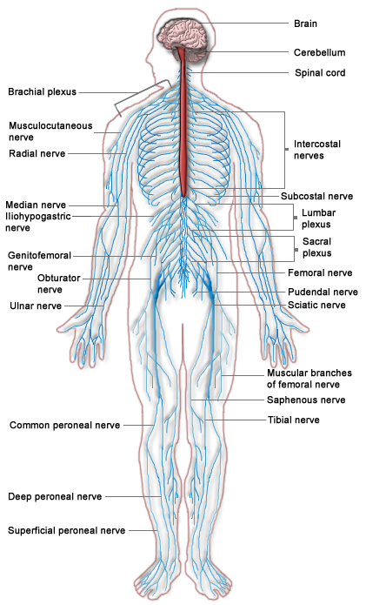
The Peripheral Nervous System
The peripheral nervous system consists of sensory neurons, ganglia and nerves that connect the central nervous system to hands, legs and feet.

Slide 5
Interaction of Two Neurons

Slide 6
Reflex Arc

Slide 7
The Brain

Slide 8
Function of Cerebral Hemispheres
The frontal lobes are involved with control of movement, from stimulation of individual muscles to abstract planning about what to do.
The parietal lobe processes visual, auditory and touch information.
The temporal lobe is the primary area for early auditory processing and a high level visual processing area.
The occipital lobe processes visual information and sends it to the parietal and temporal lobes.

Slide 9
Functions
The diencephalon is made up of the Thalamus and Hypothalamus. The thalamus interprets sensations of sound, smell, taste, pain, pressure, temperature, and touch; the thalamus also regulates some emotions and memory. The hypothalamus controls a number of body functions, such as heartbeat rate and digestion, and helps regulate the endocrine system and normal body temperature. The hypothalamus interprets hunger and thirst, and it helps regulate sleep, anger, and aggression.
The cerebellum controls many subconscious activities, such as balance and muscular coordination.

Slide 10
Functions (brain stem)
The brain stem connects the brain with the spinal cord. All the messages that are transmitted between the brain and spinal cord pass through the medulla.
The medulla controls the heartbeat, the rate of breathing, and the diameter of the blood vessels and helps to coordinate swallowing, vomiting, hiccupping, coughing, and sneezing.
The pons conducts messages between the spinal cord and the rest of the brain, and between the different parts of the brain.
Conveying impulses between the cerebral cortex, the pons, and the spinal cord is a section of the brain stem known as the midbrain, which also contains visual and audio reflex centers involving the movement of the eyeballs and head.

Slide 11
Transmission of Nerve Impulses
1. Polarization of the neuron's membrane: Sodium (Na+) is on the outside, and potassium (K+) is on the inside.
2. Resting potential gives the neuron a break.
3. Action potential: Sodium ions move inside the membrane.
When a stimulus reaches a resting neuron, the gated ion channels on the resting neuron's membrane, creating membrane potential, open suddenly and allow the Na+ that was on the outside of the membrane to go rushing into the cell. As this happens, the neuron goes from being polarized to being depolarized.
Each neuron has a threshold level — the point at which there's no holding back. After the stimulus goes above the threshold level, more gated ion channels open and allow more Na+ inside the cell. This causes complete depolarization of the neuron and an action potential is created.
When an impulse travels down an axon covered by a myelin sheath, the impulse must move between the uninsulated gaps called nodes of Ranvier that exist between each Schwann cell.

Slide 12
Transmission of Nerve Impulses
4. Repolarization: Potassium ions move outside, and sodium ions stay inside the membrane.
After the inside of the cell becomes flooded with Na+, the gated ion channels on the inside of the membrane open to allow the K+ to move to the outside of the membrane. With K+ moving to the outside, the membrane's repolarization restores electrical balance
5. Hyperpolarization: More potassium ions are on the outside than there are sodium ions on the inside.
When the K+ gates finally close, the neuron has slightly more K+ on the outside than it has Na+ on the inside. This causes the membrane potential to drop slightly lower than the resting potential, and the membrane is said to be hyperpolarized because it has a greater potential.
6. Refractory period puts everything back to normal: Potassium returns inside, sodium returns outside.
The refractory period is when the Na+ and K+ are returned to their original sides: Na+ on the outside and K+ on the inside. After the Na+/K+ pumps return the ions to their rightful side of the neuron's cell membrane, the neuron is back to its normal polarized state and stays in the resting potential until another impulse comes along.

Slide 13
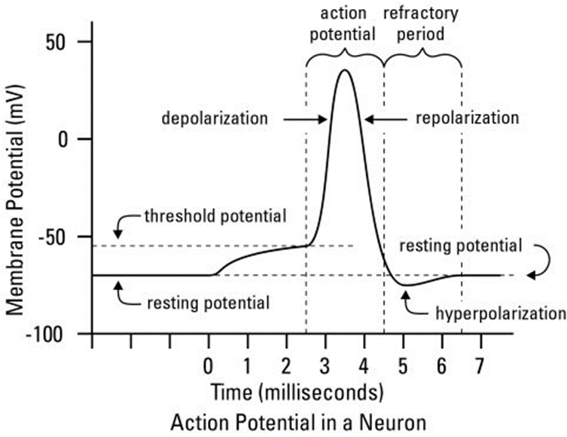
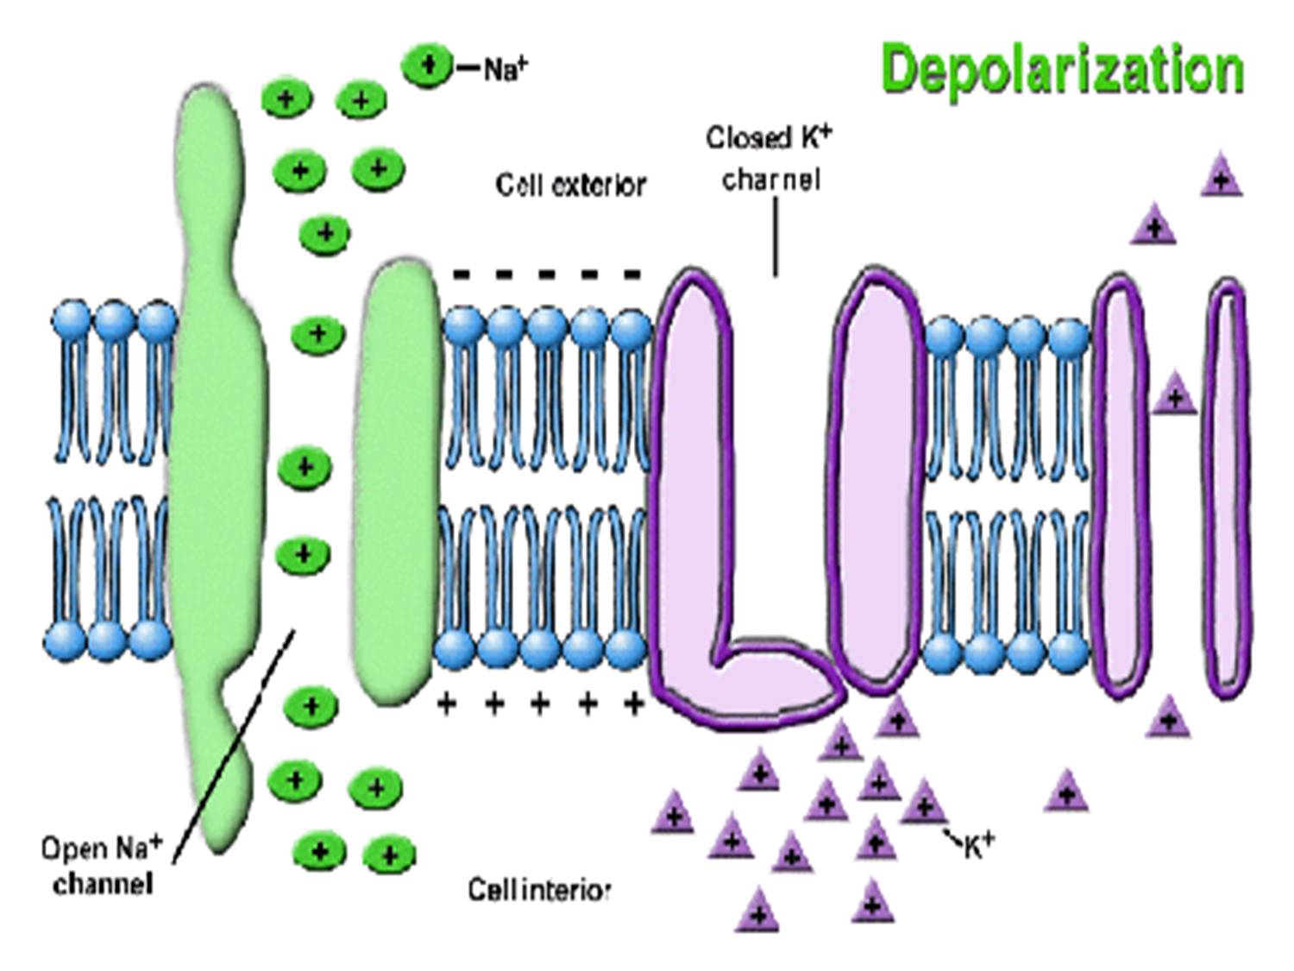
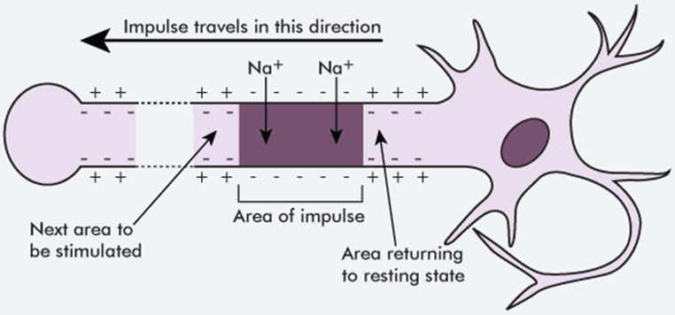

Slide 14
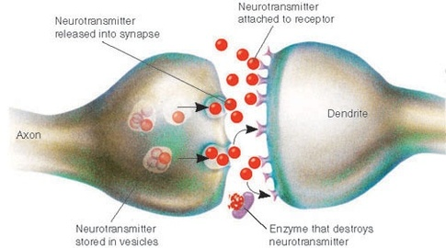
Neurotransmitters
Communication of information between neurons is accomplished by movement of chemicals across a small gap called the synapse. Chemicals, called neurotransmitters, are released from one neuron at the presynaptic nerve terminal. Neurotransmitters then cross the synapse where they may be accepted by the next neuron at a specialized site called a receptor.
The action that follows activation of a receptor site may be either depolarization or hyperpolarization. A depolarization makes it more likely that an action potential will fire; a hyperpolarization makes it less likely that an action potential will fire.

Slide 15
IPSP and EPSP
Excitatory (EPSP): increases the likelihood of a postsynaptic action potential occurring
Inhibitory (IPSP): decreases likelihood of postsynaptic action potential occuring

Slide 16
Huntington’s Disease
Huntington's disease is an inherited disease that causes the progressive breakdown of nerve cells in the brain. Huntington's disease has a broad impact on a person's functional abilities and usually results in movement, thinking and psychiatric disorders.
Symptoms
Involuntary jerking or writhing movements
Muscle problems, such as rigidity or muscle contracture
Lack of impulse control that can result in outbursts, acting without thinking and sexual promiscuity
Lack of awareness of one's own behaviors and abilities
Slowness in processing thoughts or ''finding'' words
It is estimated that for every 100,000 people worldwide, 5–10 will have Huntington’s disease. Huntington’s disease can affect men and women of all ethnic backgrounds. The disease occurs throughout the world, however, there are geographic clusters where it is unusually common.
Medications are available to help manage the symptoms of Huntington's disease, but treatments can't prevent the physical, mental and behavioral decline associated with the condition.

Slide 17
Alzheimer's
Alzheimer's disease is a progressive disease that destroys memory and other important mental functions. It's the most common cause of dementia — a group of brain disorders that results in the loss of intellectual and social skills. These changes are severe enough to interfere with day-to-day life.
Symptoms:
At first, increasing forgetfulness or mild confusion may be the only symptoms of Alzheimer's disease that you notice. But over time, the disease robs you of more of your memory, especially recent memories.
Worldwide, nearly 44 million people have Alzheimer’s or a related dementia.
Current Alzheimer's disease medications and management strategies may temporarily improve symptoms. This can sometimes help people with Alzheimer's disease maximize function and maintain independence, but there is no cure for Alzheimer's disease.

Slide 18
References:
http://www.livescience.com/22665-nervous-system.html
http://www.newhavenscience.org/52UNHSensesUnit.htm
http://www.dummies.com/how-to/content/examining-the-brains-four-lobes-frontal-parietal-t.html
http://psychology.jrank.org/pages/92/Brain.html
http://www.dummies.com/how-to/content/understanding-the-transmission-of-nerve-impulses.html
https://faculty.washington.edu/chudler/chnt1.html
http://www.ncbi.nlm.nih.gov/books/NBK11117/
http://www.mayoclinic.org/diseases-conditions/huntingtons-disease/basics/definition/con-20030685
http://www.mayoclinic.org/diseases-conditions/alzheimers-disease/basics/definition/con-20023871
http://www.alzheimers.net/resources/alzheimers-statistics/

