Slide 1
Nervous System
Ally Schleicher

Slide 2
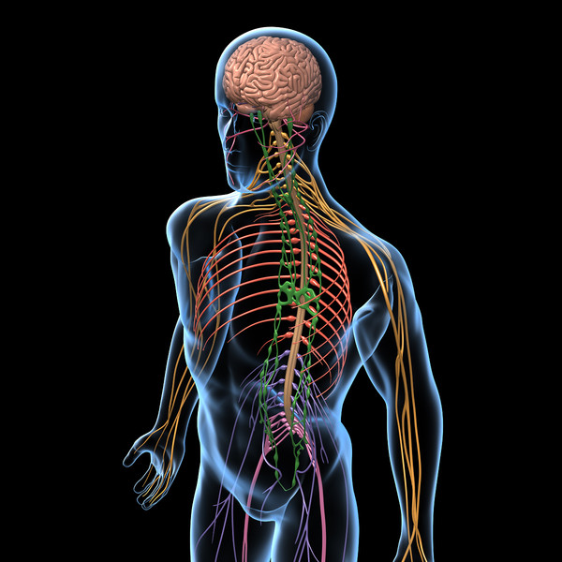
The Nervous system
The nervous system is made up of many different organs, such as the brain, spinal cord and sensory organs. This highly complex system is responsible for several different activities, such as communicating, coordinating, controlling and regulating.
http://www.harvard-wm.org/the-basic-concept-of-the-human-brain-nerve/

Slide 3
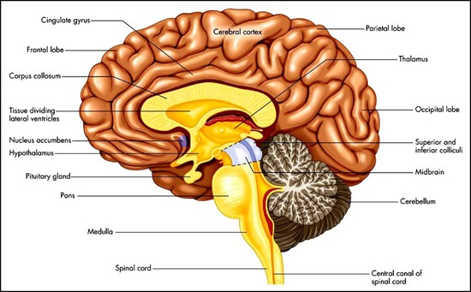
The central and Peripheral Nervous System
The central nervous system (CNS) controls most functions of the body and mind. It consists of the brain and spinal cord. The brain is the center of our thoughts, interpreter of the external environment, and the origin of control over our bodily movements.
The peripheral nervous system (PNS) is to connect the central nervous system to the limbs and organs, serving as a communication relay going back and forth between the brain and the extremities.

Slide 4
Reaction of two Neurons
A neuron is a specialized cell transmitting nerve impulses, AKA, a nerve cell.. Here is a drawing of one:

Slide 5
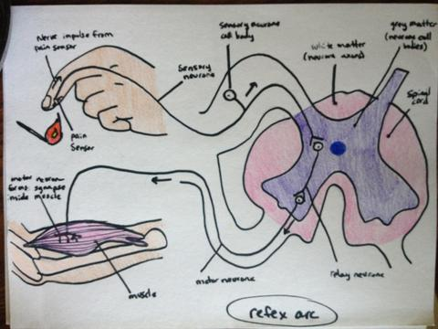
Simple Reflex arc
A simple reflex arc is a neural pathway that controls a reflex reaction. In some animals, most sensory neurons do not pass into the brain, but into the spinal cord. This allows reflex actions to occur swiftly by activating spinal motor neurons without the delay of routing signals. There are two types of reflex arc: autonomic reflex arc (affecting inner organs) and somatic reflex arc (affecting muscles). The simple reflex arc is the pathway followed by sensory nerve in carrying the sensation from receptor organ to spinal cord and then the pathway followed by motor nerve in carrying the order from spinal cord to effector organ during a reflex action. A sensory neuron receives a stimulus from a sensory receptor. The axon of this neuron leads into the gray matter of the spinal cord, where it synapses with the cell body of a motor neuron whose axon leads to an effector muscle.

Slide 6
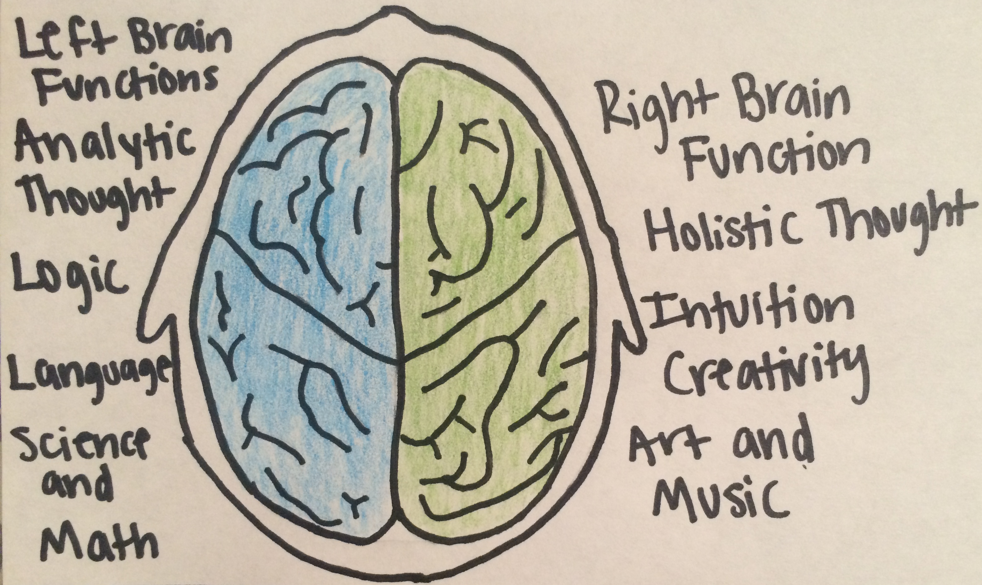
Cerebral Hemispheres
The cerebral hemispheres are the highest level of the Central Nervous System. They are like two mushroom caps bulging of the left and right front end of the brain stem. They are called the Left and Right Hemispheres

Slide 7
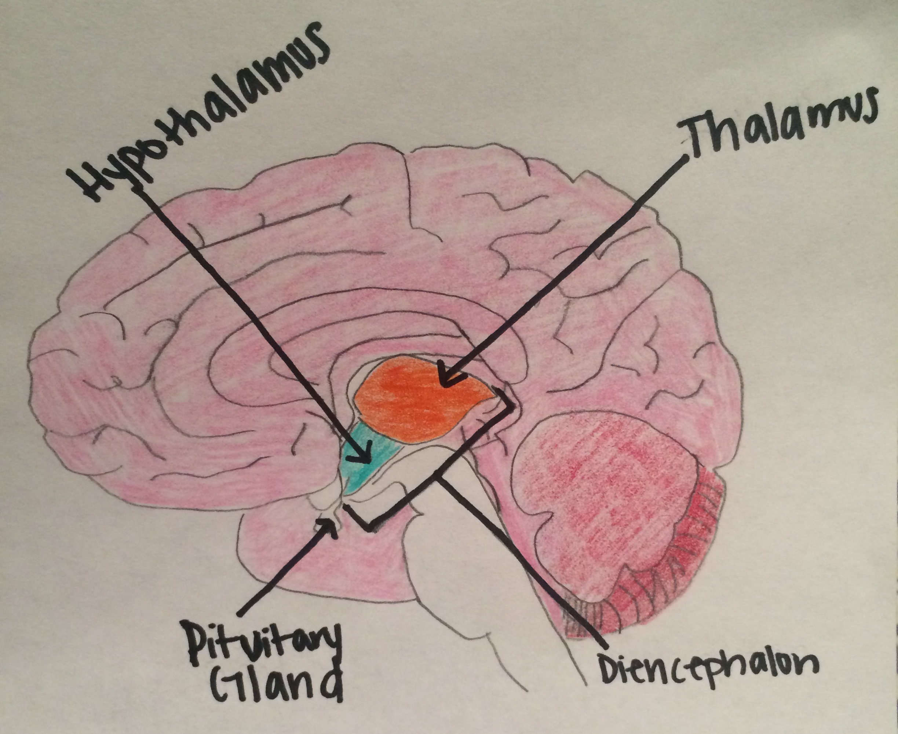
Diencephalon
The diencephalon is the posterior part of the forebrain, containing the epithalamus, thalamus, hypothalamus, and ventral thalamus and the third ventricle.

Slide 8
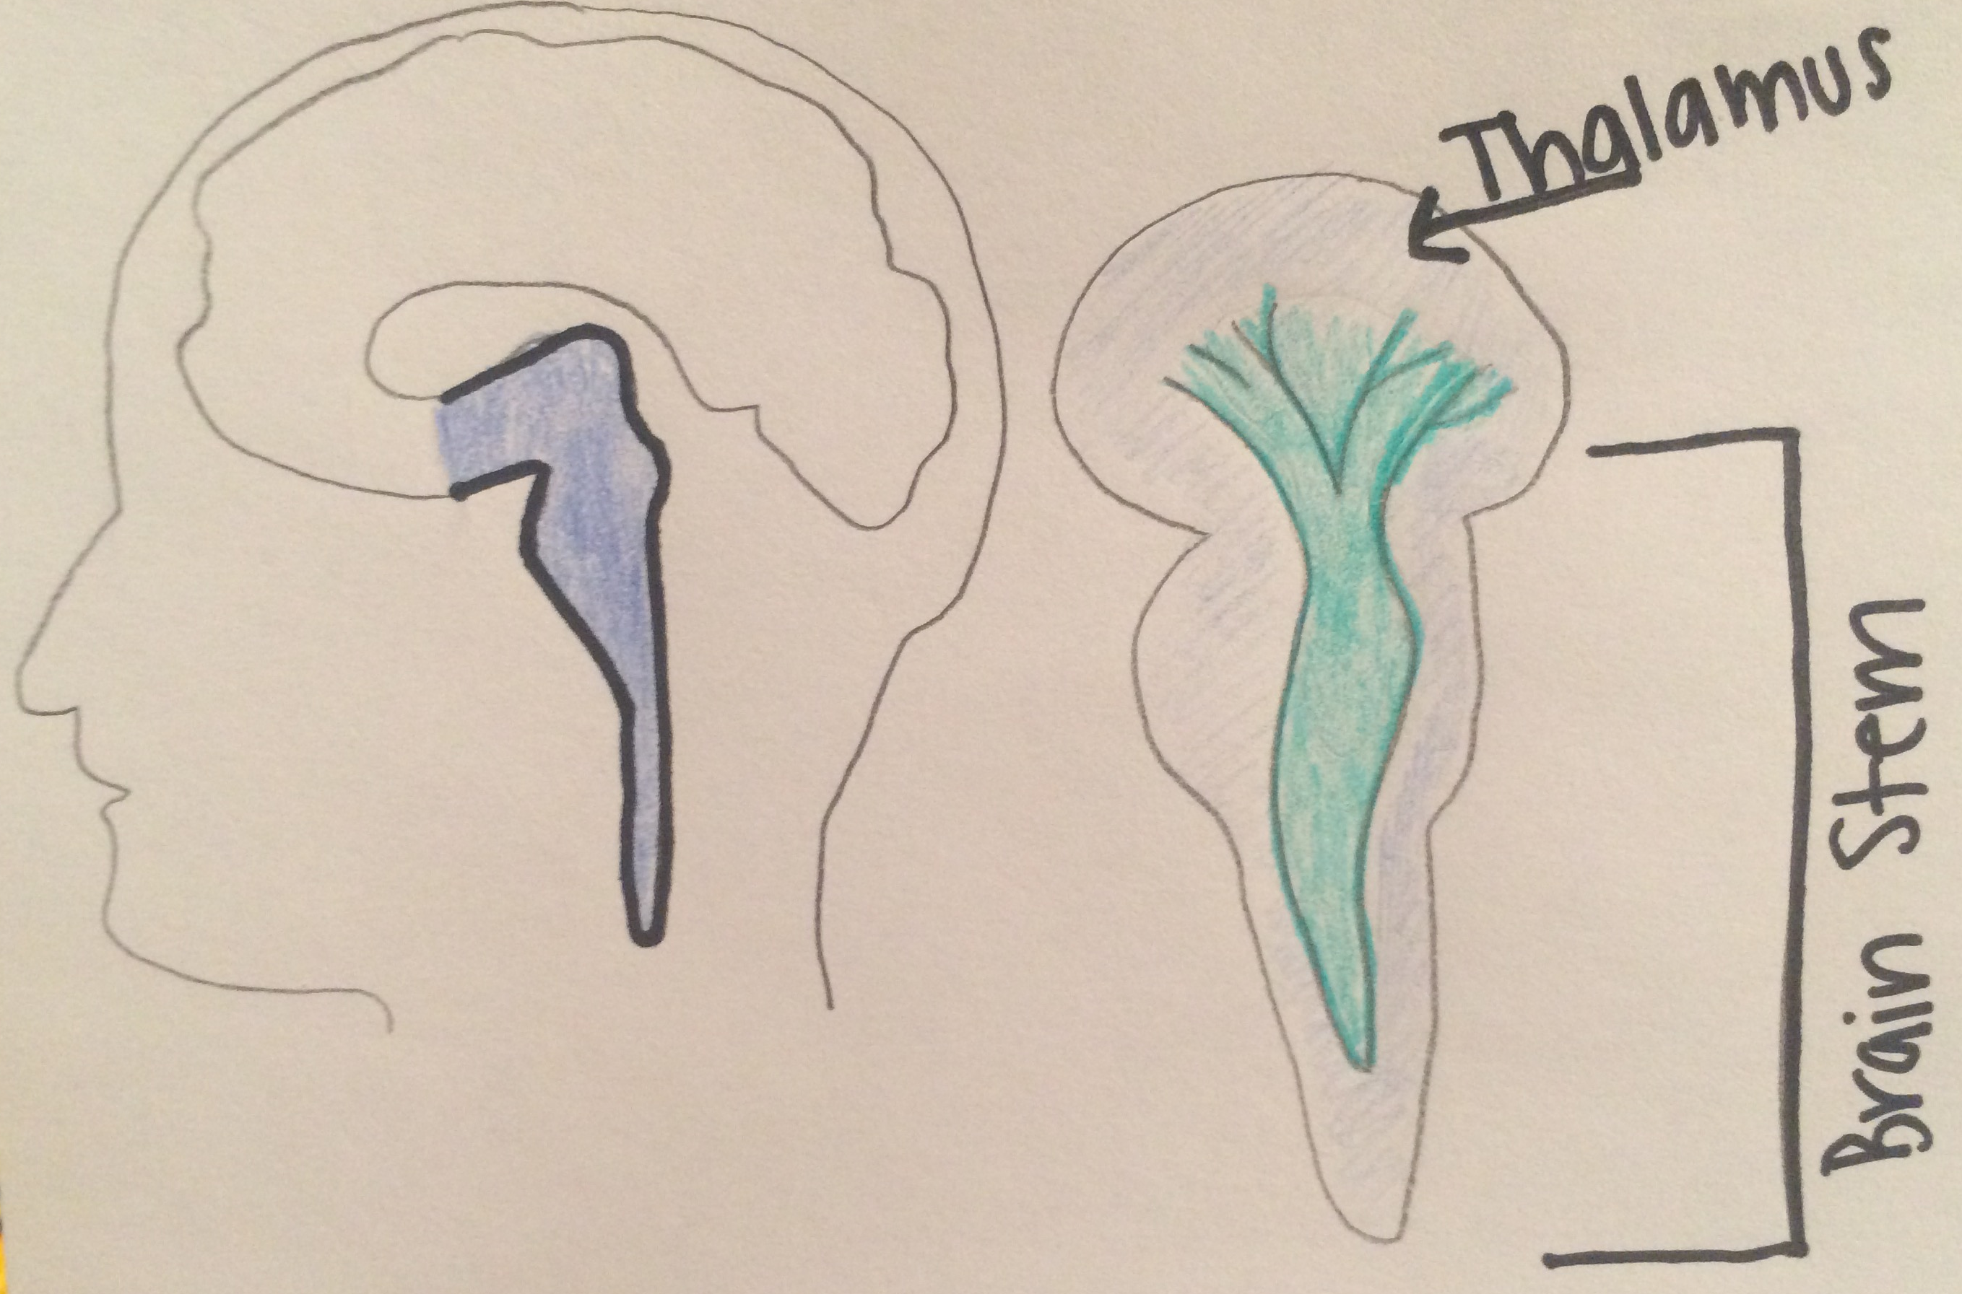
Brain Stem
The brain stem is the central trunk of the mammalian brain, consisting of the medulla oblongata, pons, and midbrain, and continuing downward to form the spinal cord.

Slide 9
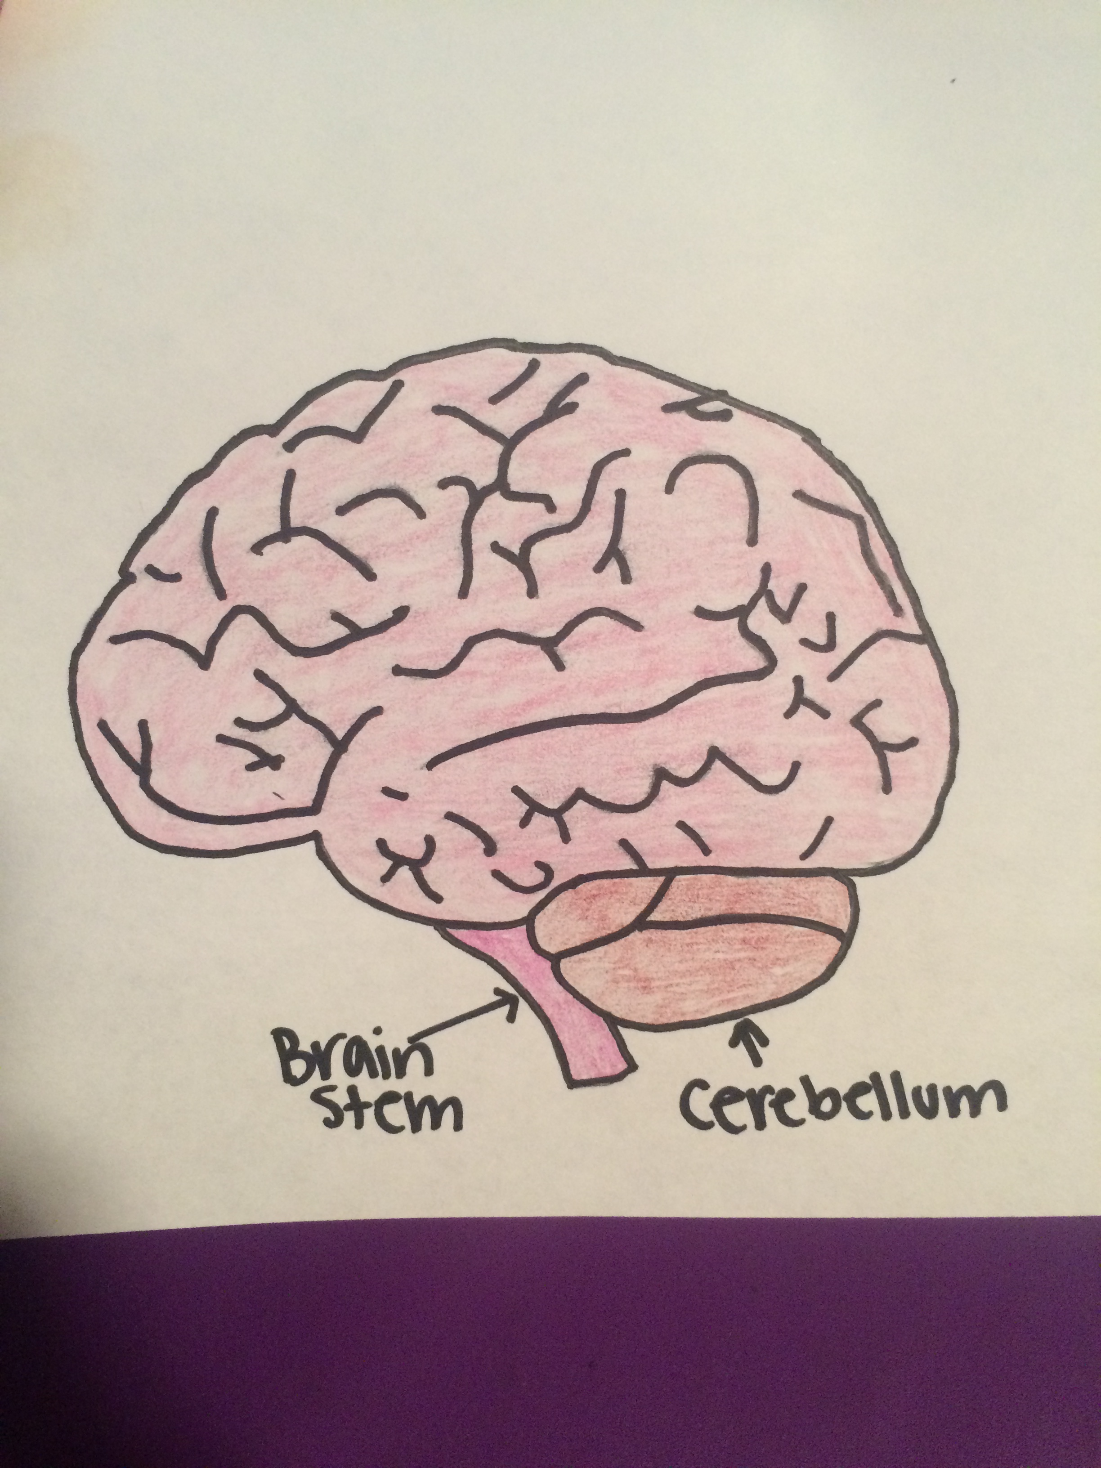
Cerebellum
The Cerebellum is the part of the brain at the back of the skull in vertebrates. Its function is to coordinate and regulate muscular activity. It makes up 1/10 of the volume of the brain.

Slide 10
How do Impulses travel from Neuron to Neuron? And how do they send messages?
When a nerve impulse reaches the end of an axon, the axon releases chemicals called neurotransmitters. Neurotransmitters travel across the synapse between the axon and the dendrite of the next neuron. Neurotransmitters bind to the membrane of the dendrite. When neurons receive or send messages, they transmit electrical impulses along the axons, which can range in many different sizes. Axons are covered in layered myelin sheaths, which can help speed up the transmission of electrical signals along the axon. The sheath is made by specialized cells called glia. The glia make the sheath in the brain that are called oligodendrocytes. In the peripheral nervous system, these are known as Schwann cells. The brain contains at least ten times more glia than neurons. Glia perform many jobs like: transport nutrients to neurons, clean up brain debris, digest parts of dead neurons, and help hold neurons in place. The sodium-potassium pump creates a concentration gradient of Na⁺ outside the neuron and K⁺ inside. The other force is charge interactions: for example, K⁺ is repelled by the Na⁺ outside and attracted to the negatively charged proteins inside the axon. Depolarization refers to the sudden change within a cell during which the cell undergoes a dramatic electrical change. When a neuron receives signals, an abrupt, temporary reversal in the polarity is generated, action potential is created. Resting potential results from differences between sodium and potassium positively charged ions and negatively charged ions in the cytoplasm. Membrane potential (also transmembrane potential or membrane voltage) is the difference in electric potential between the interior and the exterior of a biological cell. Refractory period is a period immediately following stimulation during which a nerve or muscle is unresponsive to further stimulation. The threshold, or minimal stimulus, is defined as the electrical stimulus whose strength, or voltage, is sufficient to excite the tissue.

Slide 11
Neurotransmitters
Neurotransmitters are released from terminals on axons in response to an action potential. These chemical messengers diffuse across space between neurons and bind to receptors on the receiving cell membrane. Neurotransmitter binding alters the permeability of the membrane in a way that stimulates or blocks depolarization of the receiving cell. Postsynaptic conductance changes and the potential changes that accompany them alter the probability that an action potential will be produced in the postsynaptic cell. At the neuromuscular junction, synaptic action increases the probability that an action potential will occur in the postsynaptic muscle cell; indeed, the large amplitude of the EPP ensures that an action potential always is triggered. At many other synapses, PSPs actually decrease the probability that the postsynaptic cell will generate an action potential. PSPs are called excitatory (or EPSPs) if they increase the likelihood of a postsynaptic action potential occurring, and inhibitory (or IPSPs) if they decrease this likelihood. Given that most neurons receive inputs from both excitatory and inhibitory synapses, it is important to understand more precisely the mechanisms that determine whether a particular synapse excites or inhibits its postsynaptic partner.

Slide 12
Diseases
Parkinson’s Disease
A.) Parkinson’s Disease is a progressive disease of the nervous system marked by tremor, muscular rigidity, and slow, imprecise movement, chiefly affecting middle-aged and elderly people. It is associated with degeneration of the basal ganglia of the brain and a deficiency of the neurotransmitter dopamine.
B.) Some signs and symptoms may include tremors or shaking, slowed movement, rigid muscles, impaired posture and balance, loss of automatic movements, speech changes, and writing difficulties.
C.) According to the Parkinson's Disease Foundation, Parkinson's disease affects about 1 million people in the United States and more than 4 million people worldwide. About 60,000 people are diagnosed each year in the United States.
D.) Parkinson’s Disease currently has no cure, but there are treatment plans that can help with the side effects and may help delay some of the more serious effects. Treatment options include taking medications, and in some cases surgery may be of help. Doctors may also recommend lifestyle changes, for example, physical exercise, physical therapy and speech language pathologist.

Slide 13
Diseases
Amyotrophic Lateral Sclerosis (ALS)
A.) ALS is a progressive neurodegenerative disease that affects nerve cells in the brain and spinal cord. It occurs when a muscle has no nourishment, and it “atrophies” or wastes away.
B.) Signs and symptoms can be very different in people. Some could have trouble grasping a pen, and others may experience a change in vocal pitch when speaking. Symptoms also include gradual onset, painless, progressive muscle weakness, tripping, dropping things, muscle cramps, slurred speech, uncontrollable periods of laughing or crying, and abnormal fatigue.
C.) There are two different types of ALS, sporadic and familial. Sporadic which is the most common form of the disease in the U.S., is 90 – 95 percent of all cases. It may affect anyone, anywhere. Familial ALS (FALS) accounts for 5 to 10 percent of all cases in the U.S. Familial ALS means the disease is inherited. In those families, there is a 50% chance each offspring will inherit the gene mutation and may develop the disease.
D.) Although there is no cure for ALS, also known as Lou Gehrig's Disease, different medications can be used to prevent the damage that the disease creates. Physical therapy and nutritional supplements can help slow muscle decline and weight loss. Another controversial method is to use synthetic forms of an insulin-like nerve growth factor that can protect motor neurons and stimulate the regeneration of damaged cells.

Slide 14
Sources
http://www.indiana.edu/~p1013447/dictionary/cer_hemi.htm
http://www.brainfacts.org/brain-basics/neuroanatomy/articles/2012/the-neuron/
http://www.webmd.com/brain/understanding-als-treatment
http://www.oxforddictionaries.com/us/definition/american_english/Parkinson's-disease
http://www.alsa.org/about-als/what-is-als.html?referrer=https://www.google.com/
http://www.merriam-webster.com/dictionary/nervous%20system
https://faculty.washington.edu/chudler/nsdivide.html
https://www.dartmouth.edu/~rswenson/NeuroSci/chapter_10.html
http://www.encyclopedia.com/topic/cerebellum.aspx

