Slide 1
Nervous System
Human Body Systems Project
Caroline Crinion

Slide 2
Nervous System
Function: System of neurons that transmit messages of what to do from the brain, the control center, to parts of the body.

Slide 3
Central Nervous System
CNS is the processing center of the nervous system sending and receiving messages from the peripheral nervous system.
Major parts: Brain, Spinal Cord

Slide 4
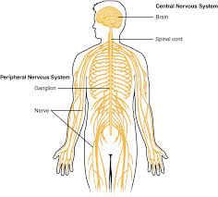
Peripheral Nervous System
PNS carries information to sensory nervous cells from motor nervous cells or the CNS. It also controls skeletal and voluntary muscle as well as external sensory organs.
Major Parts: All nerves and gangalia outside of the brain and spinal cord.

Slide 5
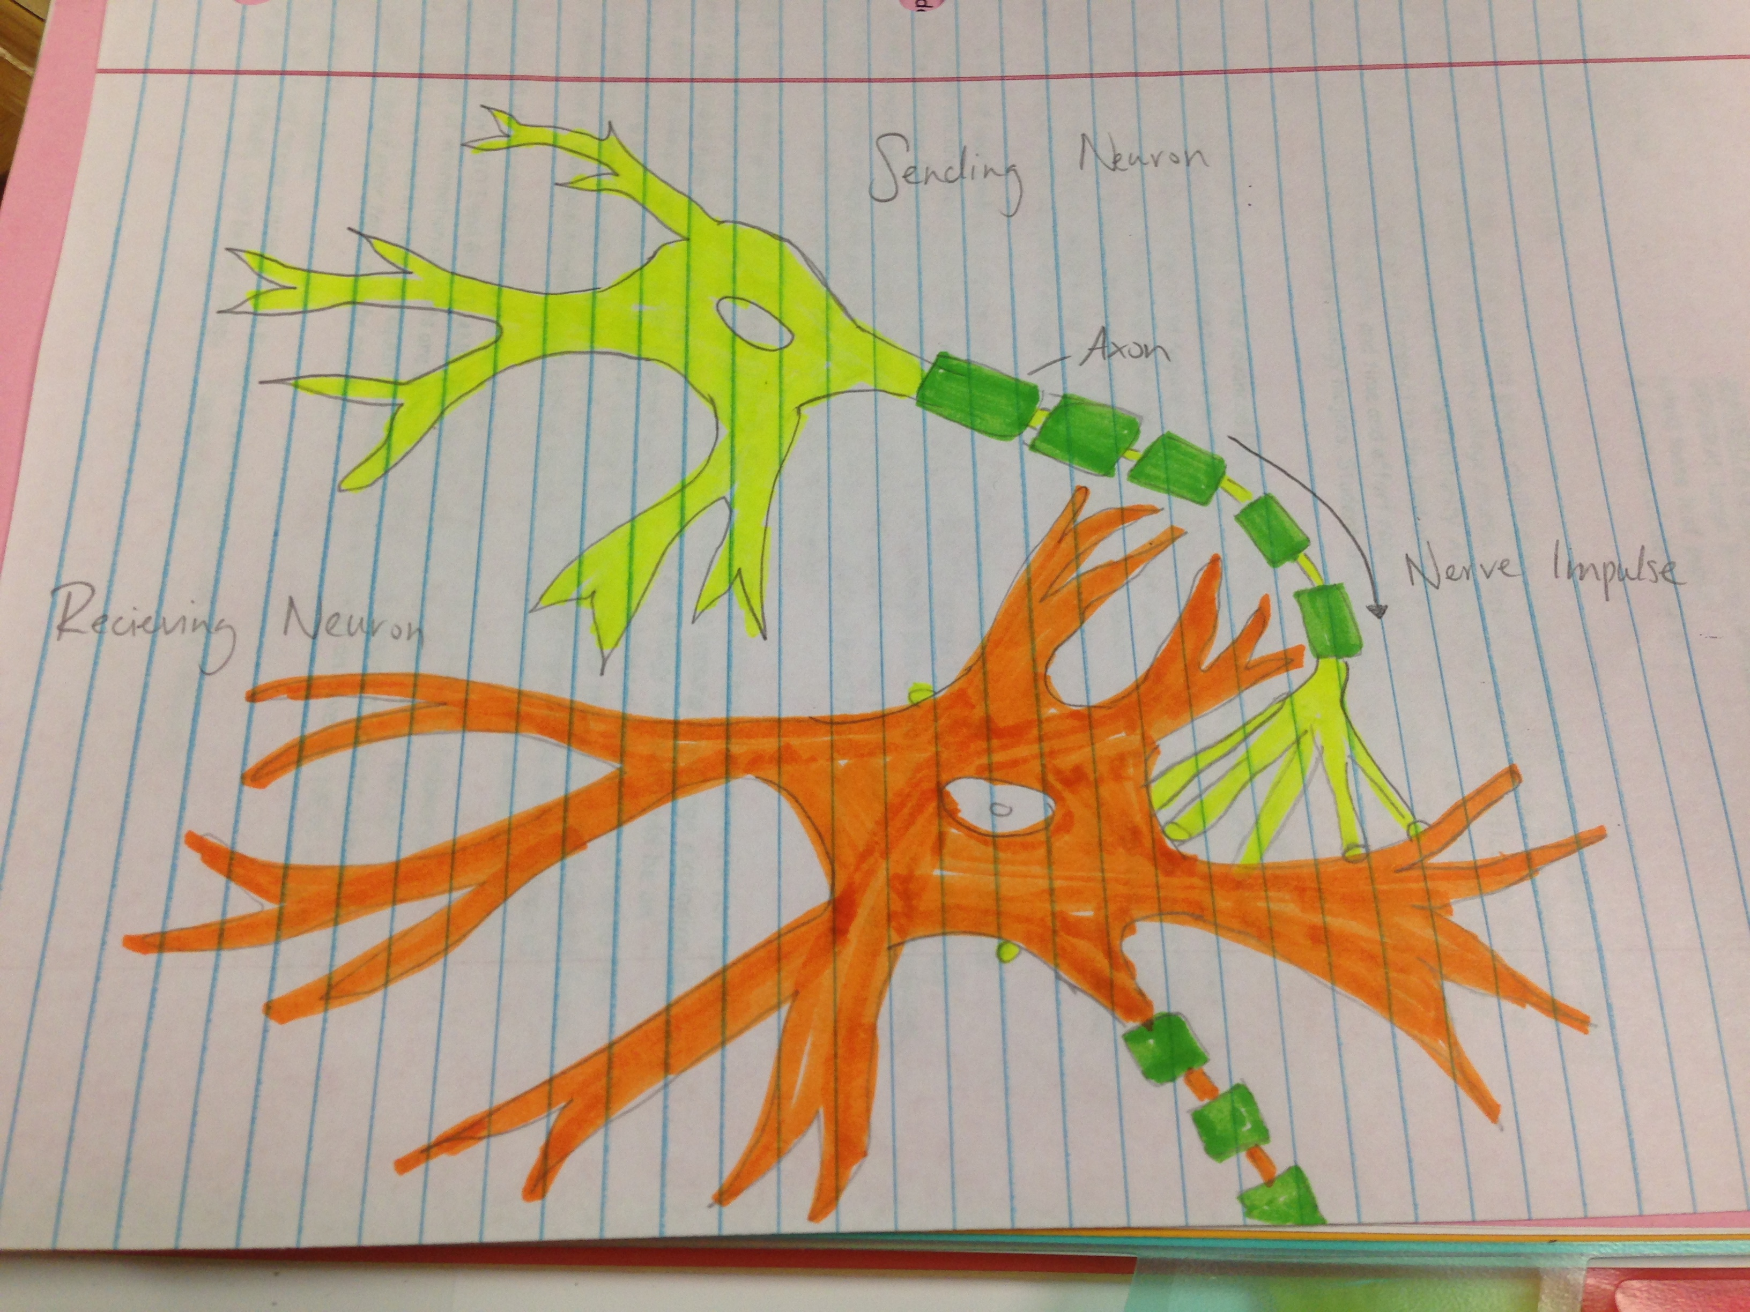
Interaction of Two Neurons

Slide 6
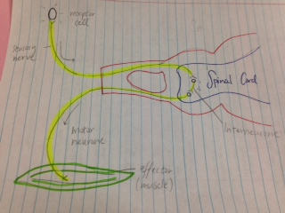
Simple Reflux Arc

Slide 7
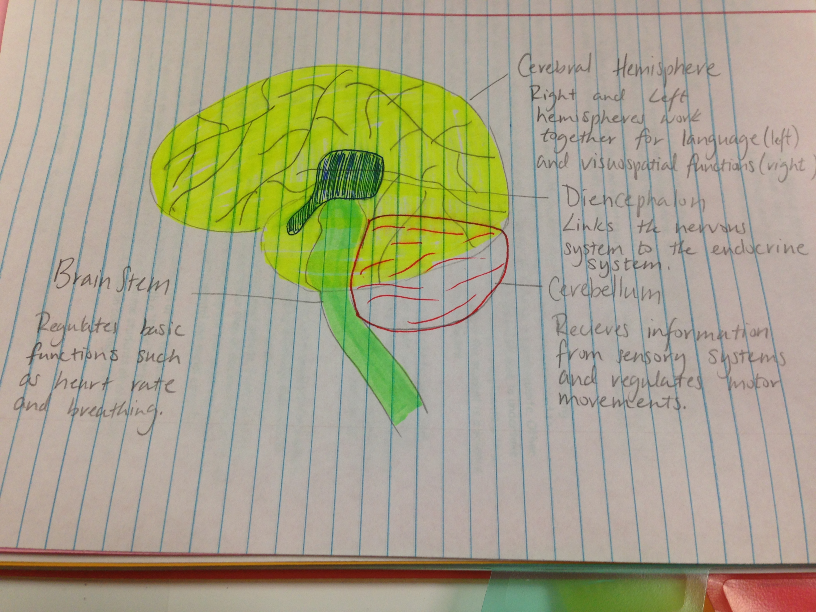
Parts of the Brain

Slide 8
Nerve Transport
A stimulus causes a cell membrane to depolarize and increases membrane potential.
Sodium-ion channels open and sodium diffuses in until the cell reaches its threshold.
Potassium-ion channels open and the cell becomes hyperpolarized as potassium leaves the cell.
The action potential travels down the axon while the axon membrane depolarizes and repolarizes and myelin prevents leakage.
Nodes of Ranvier are gaps in the myelin along the axons, they contain sodium and potassium ion channels, allowing the action potential to travel quickly down the axon from one node to the next.
The cell enters a refractory period resetting the membrane potential and ready for the next signal.

Slide 9
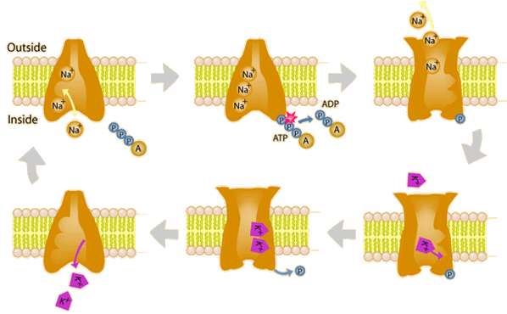
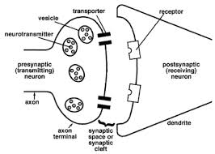
Nerve impulse travelling

Slide 10
Neurotransmitters
Chemicals in the brain that stimulate neurons to transmit signals.
A molecule is considered a neurotransmitter if it meets the following criteria:
Synthesis of the neurotransmitter occurs in the neuron itself
It can be found in the presynaptic membrane (because it was carried there from the soma, or because it was synthesized there directly)
Its release into the synaptic cleft causes a change in the postsynaptic membrane
Its effect on a neuron is the same whether released exogenously (i.e., from outside the organism as a drug) or endogenously (from the presynaptic terminal)
Once released, the molecule is specifically removed from the synaptic cleft either by reuse.

Slide 11
IPSP versus EPSP
An excitatory postsynaptic potentials (EPSP) is a temporary depolarization of postsynaptic membrane caused by the flow of positively charged ions into the postsynaptic cell as a result of opening of ligand-sensitive channels.
An inhibitory postsynaptic potentials (IPSP) is a temporary hyperpolarization of postsynaptic membrane caused by the flow of negatively charged ions into the postsynaptic cell.

Slide 12
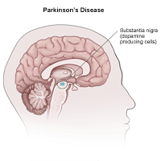
Parkinson’s Diseases
A motor system disorder that is a slowly progressive, degenerative disease.
Symptoms: tremor or trembling of the arms, jaw, legs, and face, stiffness or rigidity of the limbs and trunk, bradykinesia (slowness of movement), postural instability, or impaired balance and coordination
60,000 Americans diagnosed each year, with approximately total 1 million Americans affected.
Treatment: Surgery such as brain simulation or burning of tissue, medication or supportive therapies.

Slide 13
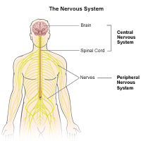
Multiple Sclerosis
Multiple sclerosis (MS) is a chronic disease of the central nervous system. It is thought to be an autoimmune disorder. It is an unpredictable condition that can be relatively benign, disabling, or devastating.
Symptoms: paresthesia, difficulty with coordination, tremor, spasticity, paralysis and fatigue.
Prevalence: Affects 400,000 people in U.S. and 2.5 million worldwide.
Treatment: medication, clinical trials, assistive technology and rehabilitation activities

Slide 14
Bibliography
Campbell Reece Biology (Seventh Edition)
http://hello-berlin.net/portal/nervous-system-of-human-image
http://www.columbia.edu/cu/psychology/courses/1010/mangels/neuro/transmission/transmission.html
http://uhealthsystem.com/health-library/neuro/disorder/parkins

