Slide 1
The nervous system
By matt krishnan

Slide 2
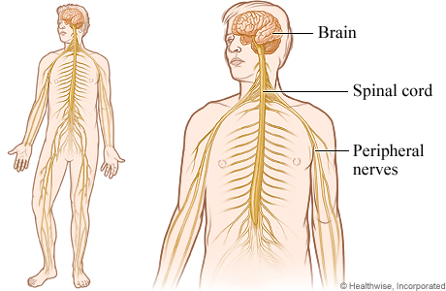
Function of the nervous system- allows us to perceive, comprehend, and respond to the world around us
Everyday functions:
Contract muscles
Breathing
Reflexes
Smelling, tasting, touching, et cetera
http://www.webmd.com/brain/nervous-system

Slide 3
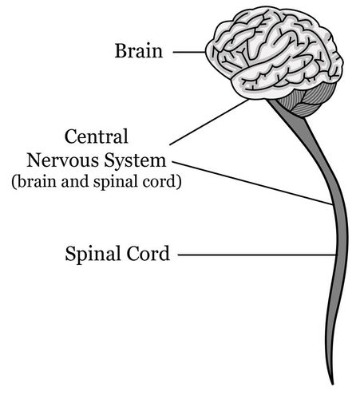
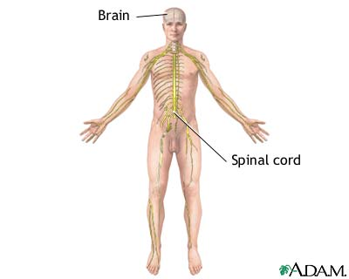
Central nervous system-system of the body that receives and processes all information from all parts of the body
Major Parts:
Brain
Spinal Cord
Neurons
http://www.ck12.org/biology/Central-Nervous-System/lesson/user:biologyepisd/Central-Nervous-System/
http://health.kernan.org/patiented/articles/000626.htm

Slide 4
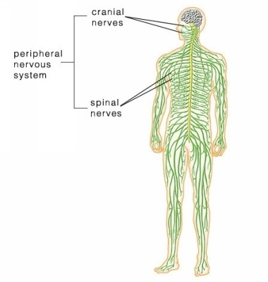
Peripheral nervous system- the part of the nervous system that is outside the central nervous system and comprises the cranial nerves excepting the optic nerve, the spinal nerves, and the autonomic nervous system
Major Parts:
24 cranial nerves
62 spinal nerves
*made of
a. sensory cells
i. smell and vision
b. motor cells
i. involve in eyeballs and hearing
http://medicalterms.info/anatomy/Peripheral-Nervous-System/

Slide 5
Interaction between two neurons

Slide 6
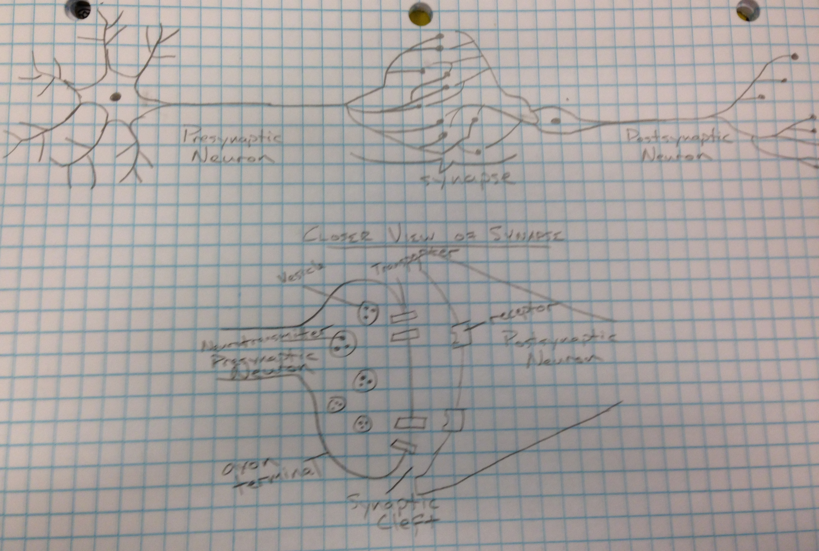
Interaction between two neurons (cont’d)

Slide 7
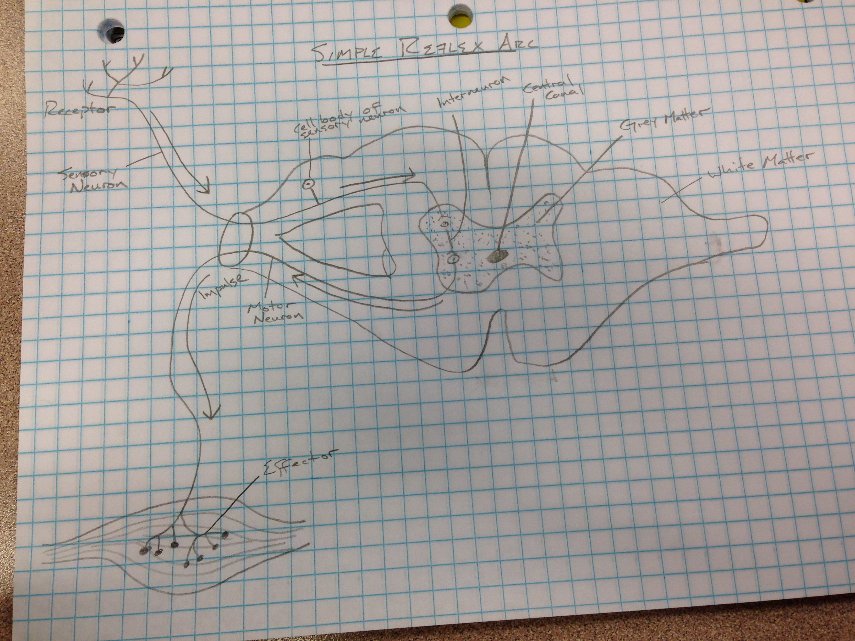
Simple reflex arc

Slide 8
Simple reflex arc (cont’d I)
Elements:
Receptor
-End of sensory neuron that reacts to a stimulus
Sensory Neuron
-conducts nerve impulses along an efferent pathway towards the central nervous system
Cell Body of Neuron
-includes cytoplasmic mass and nucleus, nerve fibers extend from here
Interneuron
-neuron located between sensory and motor neuron/ intercalated; internuncial, or association neuron, processing center
Motor Neuron
-conducts a nerve impulse along an efferent pathway from the integration center to an effector
Effector
-responds to the efferent impulses by contracting or secreting a product
Grey Matter
-region that lacks myelin and appears grey
White Matter
-carries information between the nerve cells in the brain and spinal cord
Central Canal
- A major part of the central nervous system which conducts sensory and motor nerve impulses to and from the brain

Slide 9
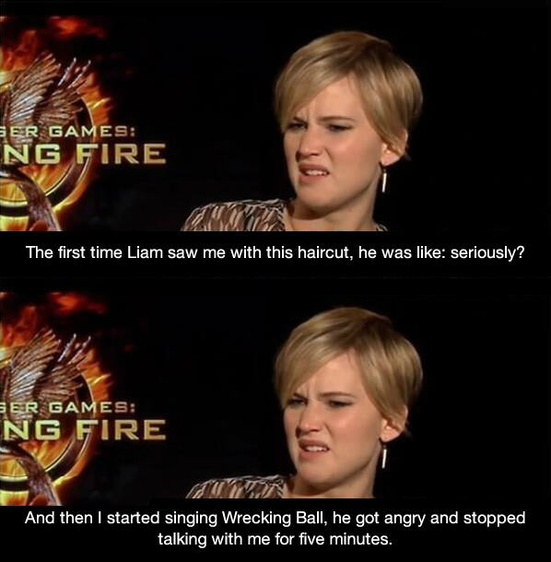
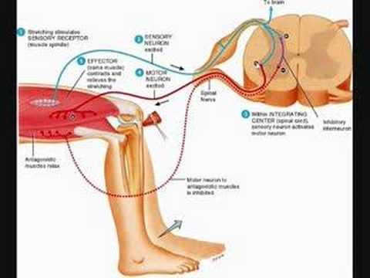
Simple reflex arc (cont’d II)
How it works:
Stimulus is received by the receptor
Nerve impulse transmitted via sensory neuron
Conducts nerve impulse from the sensory neuron to motor neuron
Nerve impulse reaches effector and responds with the reflex or behavioral action
Funny Reaction
http://weknowmemes.com/2013/12/liams-reaction-to-jennifer-lawrences-new-haircut/
http://www.youtube.com/watch?v=HfuhVWK8C0U

Slide 10
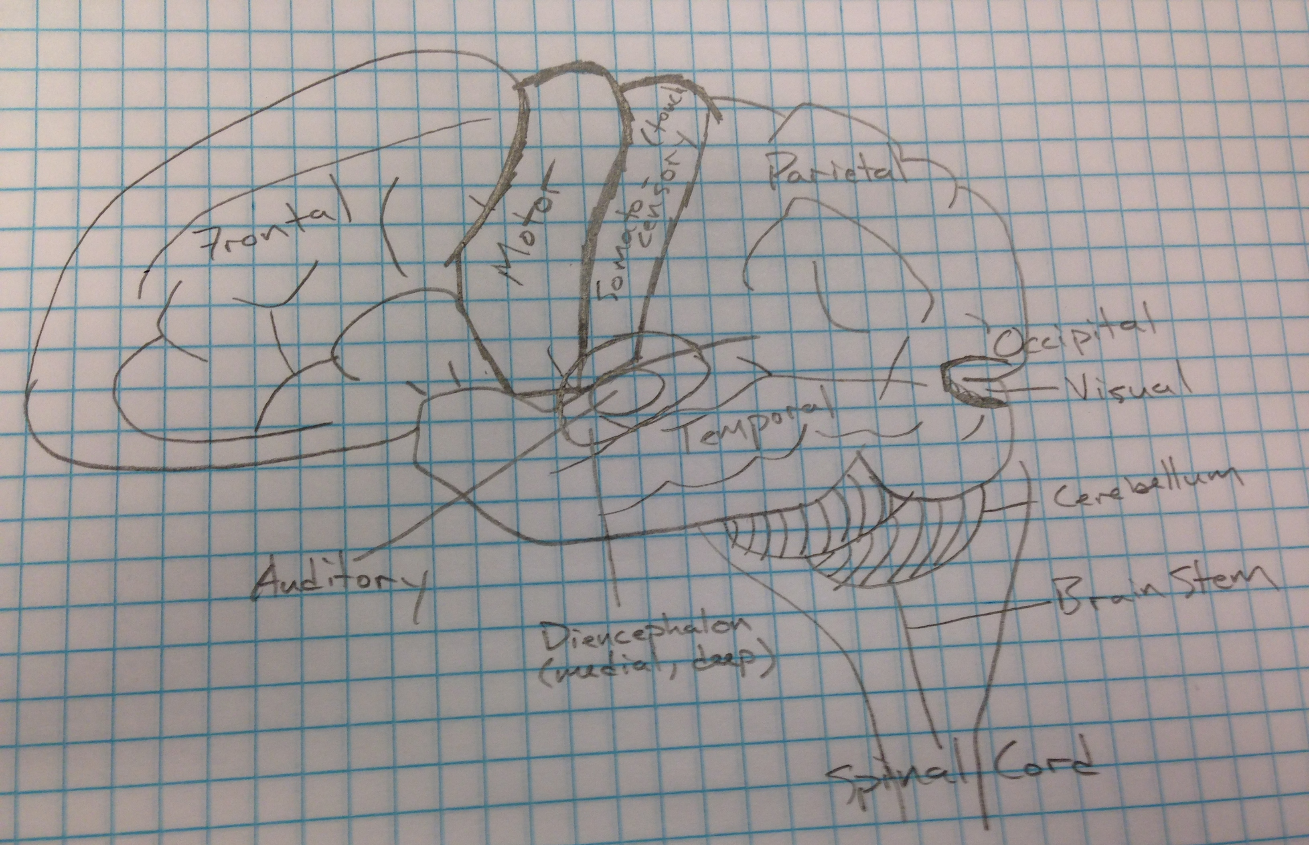
Cerebral hemispheres

Slide 11
Cerebral hemispheres (cont’d)
Major Part | Function
Frontal | “moral center”, advanced decision making
Parietal | Integrates sensory information
Occipital | Visual
Temporal | Long/Short-term memory
Diencephalon | relays sensory information between brain regions and controls many autonomic functions of the peripheral nervous system
Cerebellum | receives information from the sensory systems, the spinal cord, and other parts of the brain and then regulates motor movements. Controls voluntary movements (posture, coordination, etc)
Brain Stem | cardiac, respiratory, heart rate, breathing and blood pressure.
Spinal Cord | transmission of neural signals between the brain and rest of body, reflexes

Slide 12
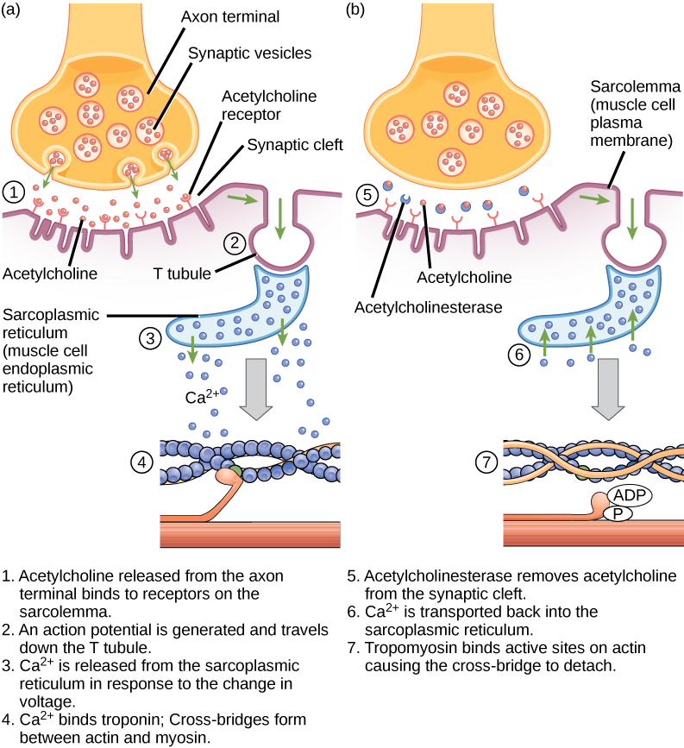
Outline of nerve impulse path
Sending Signal:
Membrane potential depolarized at threshold potential
Action potential depolarizes the plasma membrane of the synaptic terminal
Ca²⁺ voltage-gated channels open in membrane, increasing Ca²⁺
Increase in [Ca²⁺] in terminal causes synaptic vesicles to fuse with presynaptic membrane
Neurotransmitter (acetylcholine) binds to receptor portion of ligand-gated ion channels in postsynaptic membrane, open channels. Na⁺ moving in and K⁺ moving out through ion channels depolarizes membrane sending signal.
Neurotransmitter releases form receptors, then channels close.
Synaptic transmission ends when neurotransmitter diffuses out of the synaptic cleft and taken up by vesicles at synaptic terminal or another cell, or broken down by and enzyme.
Na⁺-K⁺ pump resets the membrane by pumping 3Na⁺ out and 2K⁺ into cell
https://www.boundless.com/biology/textbooks/boundless-biology-textbook/the-musculoskeletal-system-38/muscle-contraction-and-locomotion-218/excitation-contraction-coupling-828-12071/

Slide 13
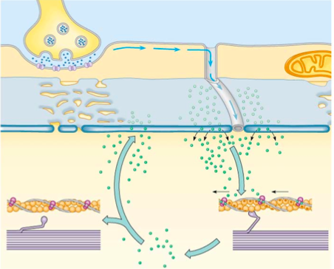
Outline of nerve impulse path (Cont’d)
Receiving the Signal
Acetylcholine binding triggers transition from resting potential to action potential
in membrane, then moves Na⁺ in and K⁺ out through ion channels
Action potential carried by T tubules into cell triggers release of Ca²⁺ from sarcoplasmic
reticulum via ion channels into cytoplasm
Ca²⁺ binds to troponin
Shape change removes tropomyosin block
ATP-powered myosin motor proteins “walk” along actin filaments pulling them toward the center
After contraction, Ca²⁺ is actively transported back in sarcoplasmic reticulum
Na⁺-K⁺ pump resets membrane potential during what is called refractory period (recovery period)
http://bioap.wikispaces.com/Ch+48+Collaboration

Slide 14
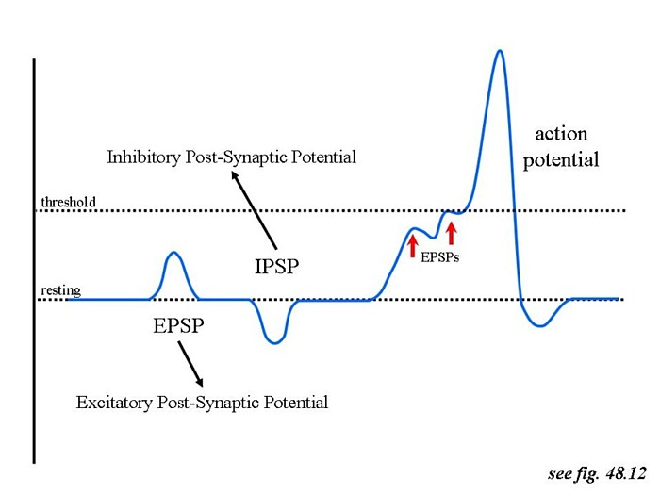
Neurotransmitters → Function: a chemical that stimulates a muscle fiber to contract or fire an impulse
IPSP vs. EPSP
IPSP-Inhibitory Postsynaptic Potential
Decrease likelihood of a postsynaptic action potential occurring
EPSP-Excitatory Postsynaptic Potential
Increase likelihood of a postsynaptic action potential occurring
http://bealbio.wikispaces.com/On+Line+and+Upload+Period3+Nervous+System

Slide 15
Diseases of the nervous system
Alzheimer’s Disease Description: Alzheimer’s disease is progressive and destroys memory and important mental functions. The brain cells of the patient degenerate and die, worsening memory and mental function
Signs and Symptoms:
-repeating of statements and questions over and over, not realizing they’ve already done it
-forget conversations, appointments, et cetera
-routinely misplace things
-forget names and family members
-Disorientation
-inability to concentrate, do simple everyday tasks
-depression
-anxiety
-wandering
Prevalence: -First-degree relative may pass on genes
-Women more at risk b/c of longer life span
-5.2 million in US, 60% women
Treatment Options: exercise, good nutrition, and medication can help the symptoms of Alzheimer’s Disease

Slide 16
Diseases of the nervous system (cont’d)
Duchenne Muscular Dystrophy
Description: Duchenne Muscular Dystrophy is a recessive X-linked disease. People with this disease have muscles that are abnormally prone to be damaged. These muscles will get weaker over time
Signs and Symptoms:
-trouble breathing or swallowing
-limbs draw inward and become fixed that way (contracture)
-Frequent falls
-difficulty getting up from lying position
-large calf muscles
-learning disabilities
Prevalence:
-mostly boys
-1 in every 3,600 boys
Treatment Options: As of now, there is no cure for any type of muscular dystrophy, but there is medication that can be taken to slow down the process of the disease. Physical therapy may also help.

Slide 17
bibliography
Hole’s Human Anatomy & Physiology 11th Edition-David Shier, Jackie Butler, Ricki Lewis
http://education-portal.com/
http://www.merriam-webster.com/
http://www.healthline.com/
http://csmbio.csm.jmu.edu/biology/danie2jc/reflex.htm
http://www.biology-online.org/dictionary/
https://science.education.nih.gov/supplements/nih2/addiction/guide/lesson2-1.htm
http://www.indiana.edu/~p1013447/dictionary/cer_hemi.htm
http://www.mayoclinic.org/
http://www.ncbi.nlm.nih.gov/books/NBK11117/

