Slide 1
The Nervous System
Yilun Li

Slide 2
The Nervous System
Divided into two parts:
Central nervous system
Peripheral nervous system
The central nervous system and peripheral nervous system act together to integrate sensory information and to control motor and cognitive functions.

Slide 3
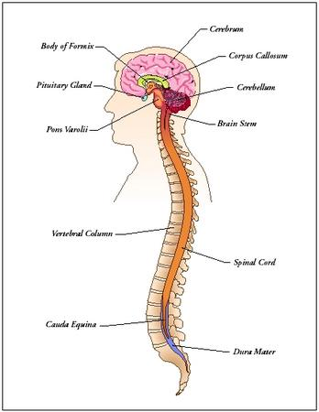
Central Nervous System
The Central Nervous System is responsible for integrating sensory information and responding accordingly
Consists of two main parts:
Brain
Spinal Chord
http://www.faqs.org/health/Body-by-Design-V2/The-Nervous-System-Design-parts-of-the-nervous-system.html

Slide 4
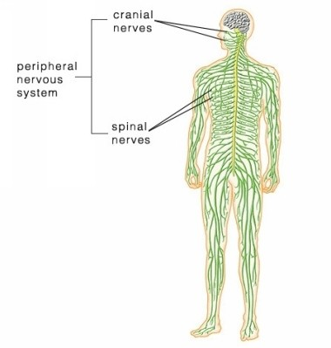
Peripheral Nervous System
The Peripheral Nervous System is responsible for connecting the Central Nervous System to the brain and the spinal chord.
Two major parts:
Somatic nervous system
Automatic nervous system
Controls breathing, heartbeat, etc.
http://medicalterms.info/anatomy/Peripheral-Nervous-System/

Slide 5
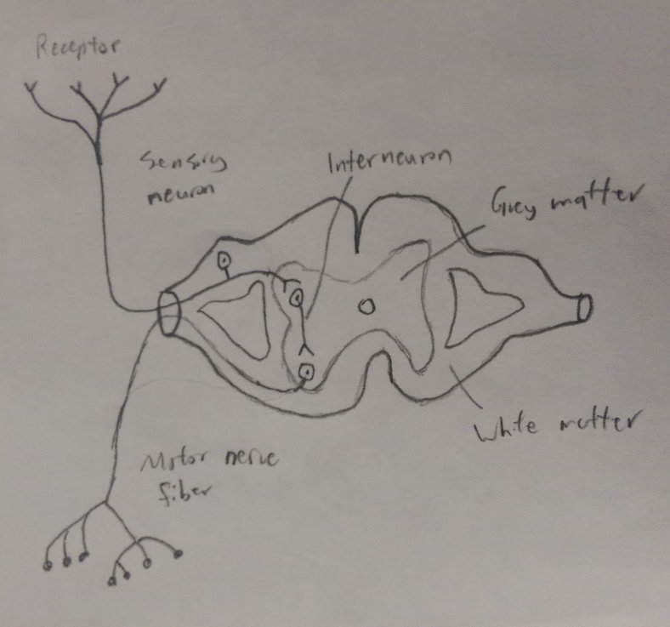
Simple Reflex Arc
The simple reflex arc connects the motor neuron directly to the spinal cord instead of the brain
Receptors from a sensory neuron get a signal
The sensory neuron relays the signal through the inter or relay neuron and to a motor neuron.
This allows for an instant, unconscious reaction.

Slide 6
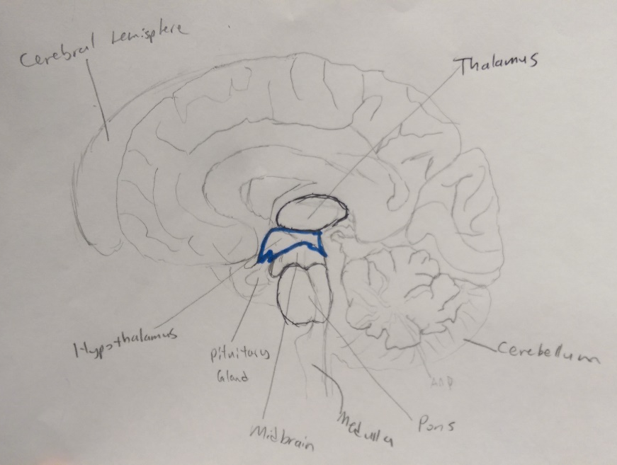
The Brain
Cerebral Hemispheres
The brain is formed by two cerebral hemispheres, left and right.
Diencephalon
Major parts include the Thalamus, and Hypothalamus
Located at the upper end of the brain stem
Performs many functions related to the regulation of visceral activities of other brain regions and the autonomic nervous system
Brain Stem
Joins the brain to the spinal cord
Major parts include Medulla, Pons, and Midbrain
Important functions include regulating the Central Nervous system, cardiac and respiratory function, maintaining consciousness, heart rate, breathing, sleeping, and eating.

Slide 7
The Brain cont.
Cerebellum
Located at the bottom of the brain
Important in motor control and cognitive functions
Contributes to coordination, precision, and accurate timing

Slide 8
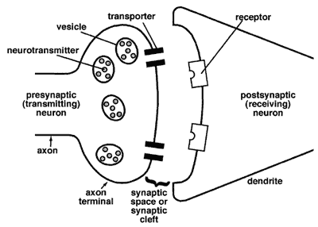
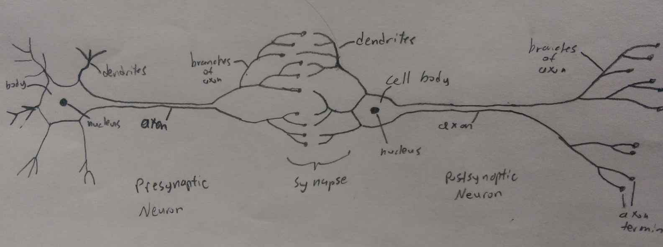
How a message travels
Neuron to neuron
When a neuron is not sending a signal, it is resting. While resting, the difference in voltage between the inside and outside of the neuron is its resting potential.
https://science.education.nih.gov/supplements/nih2/addiction/guide/lesson2-1.htm
Two Neurons Interacting

Slide 9
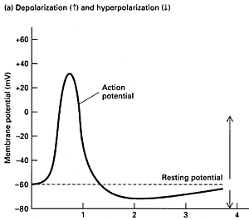
How a message travels
Action potential caused by a depolarizing current fires at the threshold and releases the membrane potential. The neuron temporarily enters a refractory period, not being able to repeat the action
https://science.education.nih.gov/supplements/nih2/addiction/guide/lesson2-1.htm

Slide 10
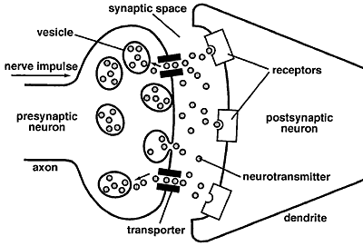
How a message travels
This opens up Ca²⁺ ion channels, triggering an influx of Ca²⁺ ions.
Ca²⁺ ions cause vesicles to fuse with the presynaptic membrane
Vesicles release neurotransmitters, causing synapsis in the synaptic cleft.
Neurotransmitters bind to receptors of ligand-gated ion channels in the postsynaptic membrane and open the Na+ - K+ pumps/channels.
Movement of Na+ and K+ depolarizes the membrane.
https://science.education.nih.gov/supplements/nih2/addiction/guide/lesson2-1.htm

Slide 11
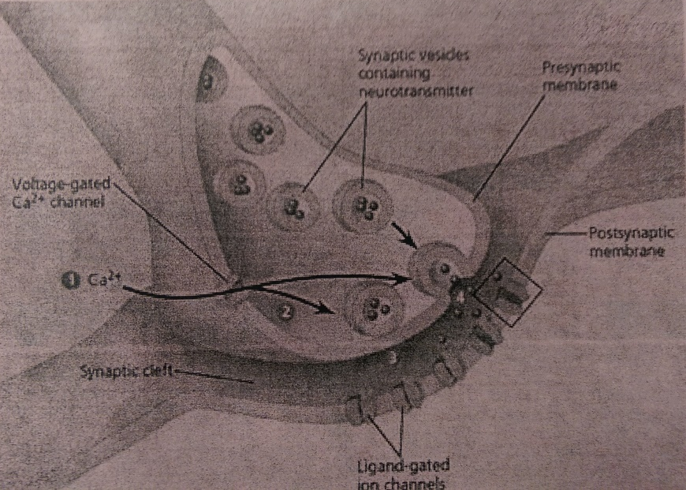
How a message travels
Neurotransmitters unbind and close the ion pumps/channels.
Synapsis ends when the neurotransmitters diffuse out of the synaptic cleft
Na+ - K+ pump resets the membrane

Slide 12
IPSP and EPSP
Inhibitory postsynaptic potential (IPSP)
Synaptic potential that makes a postsynaptic neuron less likely to generate an action potential.
Can take place at all chemical synapses
Releases neurotransmitters that bind to postsynaptic receptors
Can cause depolarization
Opposite of EPSP
Excitatory postsynaptic potential (EPSP)
Makes a postsynaptic neuron more likely to fire an action potential
Temporary depolarization of postsynaptic membrane potential
Caused by flow of + ions into the postsynaptic cell
Result of opened ligand-gated ion channels

Slide 13
Nervous System Disorders
Parkinson’s Disease
Movement disorder that occurs when nerve cells in the brain don’t produce enough dopamine
Symptoms include:
Trembling of hands, arms, legs, jaw and face
Stiffness of the arms and legs
Slowness of movement
Poor balance and coordination
Prevalence
Occurs more often in men
Usually occurs in people over 60
Not classified as a genetic disorder; however, some people with the disorder have relatives who have had it
Possibly caused by environment
Treatment options:
Cannot be cured
Medicine
Surgery or Deep Brain Stimulation

Slide 14
Nervous system disorders
ADHD
Disorder in which there are problems with attention or hyperactivity
Symptoms
Inattention
Loss of focus
Struggle to follow direction
Hyperactivity
Fidgeting
Nonstop talking
Prevalence
Often diagnosed in children
4.1% of adults 18 or older, 9.0% age 13 to 18
Boys 4x more likely
Treatment
Controversial
Counseling, Lifestyle changes
Medications

Slide 15
References
http://www.nlm.nih.gov/medlineplus/autonomicnervoussystemdisorders.html
https://science.education.nih.gov/supplements/nih2/addiction/guide/lesson2-1.htm
https://faculty.washington.edu/chudler/ap.html
http://www.bbc.co.uk/schools/gcsebitesize/science/add_ocr_pre_2011/brain_mind/reflexactionsrev1.shtml
http://www.nimh.nih.gov/health/topics/attention-deficit-hyperactivity-disorder-adhd/index.shtml
http://www.ruf.rice.edu/~lngbrain/cglidden/dien.html
http://www.britannica.com/EBchecked/topic/77391/brainstem
http://neuroscience.uth.tmc.edu/s3/chapter05.html
https://faculty.washington.edu/chudler/nsdivide.html

