Slide 1
Nervous System
Bridgette Ramlo

Slide 2
Function
Transmits signals between different parts of the body

Slide 3
Define
central nervous system: part of the nervous system that consists of the brain and spinal cord
peripheral nervous system: connects the central nervous system to sensory organs, other organs of the body, muscles, blood vessels, and glands

Slide 4
Interaction of two Neurons

Slide 5
Simple Reflex Arc

Slide 6
Information flows in single directions in our nervous system
Receptor sensory neuron neuron in the CNS motor neuron effector
Elements:
Neurons that carry sensory information
Neurons carrying motor information
Interneurons
Receptor
Stimulus
Sensory information comes into spinal cord via sensory neurons that are packed with other neurons in nerves
Sensory neurons from synapses with interneurons and motor neurons
Motor neurons transmit action potentials generating reflex response
At same time, interneurons transmit sensory information to the brain

Slide 7
Brain

Slide 8
Frontal lobe: motor function, problem solving, memory, language, impulse control
Temporal lobe: sensory input, auditory perception, language and speech production, memory
Parietal lobe: sensory information, sense of touch, language processing
Occipital lobe: visual processing center, motion perception, color differentiation
Diencephalon: gives rise to posterior forebrain structures including thalamus, hypothalamus, posterior portion of the pituitary gland, and pineal gland
Cerebellum: receives information from the sensory systems, the spinal cord, and other parts of the brain and then regulates motor movements; coordinates voluntary movements such as posture, balance, coordination, and speech
Brain stem: upper part is continuous with pons, medulla is lower half; medulla contains the cardiac, respiratory, vomiting, and vasomotor centers dealing with heart rate, blood pressure, and breathing

Slide 9
Nerve Impulse
Resting neurons maintain difference in electrical charge across cell membranes, inside being negatively charged and outside being positively charged (membrane potential)
Established by maintaining excess of sodium ions outside, less potassium ions inside
Difference in permeability of resting membrane to potassium ions versus sodium ions
Resting membrane much more permeable to potassium ions than to sodium ions
Results in slightly more net potassium ion diffusion than sodium ion diffusion
Neuron stays inactive and polarized at its resting potential until a stimulus reaches it
Nerve impulses are conducted along neuron by wave of membrane polarity reversals (action potentials)
Sodium ions move inside the membrane
As Na+ goes into cell, neuron goes from being polarized to depolarized
When inside becomes positive, polarization is removed and the threshold is reached
K+ ions move outside, Na+ ions stay inside membrane
Refractory period returns everything
Potassium ions go back inside, sodium ions go to outside

Slide 10
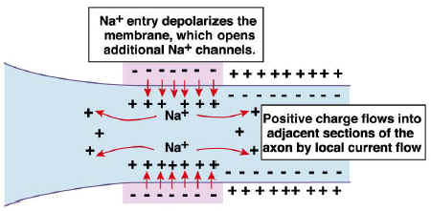
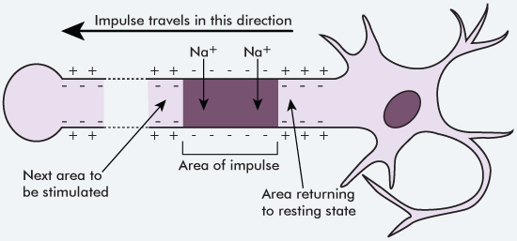

Slide 11
Neurotransmitters
Chemical that is released into the synaptic cleft from axon terminal of a sending neuron, crosses a synapse, and binds to appropriate receptor sites on dendrites or cell body
Neurotransmitter molecules diffuse across synaptic cleft where they can bind with receptor sites on postsynaptic end to influence electrical response in neuron
If number of excitatory postsynaptic events is large enough, will cause action potential in postsynaptic cell and continuation of message

Slide 12
IPSP versus EPSP
Excitatory (EPSP): increase the likelihood of a postsynaptic action potential occuring
Inhibitory (IPSP): decrease likelihood of postsynaptic action potential occuring

Slide 13
Multiple Sclerosis
“many hardenings”
Disease of unknown cause that manifests as multiple hard plaques of degeneration of insulating layer of nerve fibers in the central nervous system, allowing short circuiting of nerve impulses
Patients may suffer paralysis, blindness, or sensory disturbances
Affects about 400,000 people in United States, 2.5 million worldwide
Treatment options
Disease-modifying drugs
Deep brain stimulation (surgical procedure)
Plasma exchange
Cytoxan therapy (suppresses immune system)
Baclofen pump
Botox
Slow progression of MS

Slide 14
Aphasia
Loss of speech, caused by stroke or traumatic brain injury
Speech centers located on left side of brain in majority of people
Signs include:
Speaking in single words or fragments
Omitting smaller words such as “the,” “of,” and “was”
Putting words in the wrong order
Making up words
Estimated 80,000 new cases annually in the United States
43% are 85 years or older
Treatment options:
Speech therapy
Computer-aided rehabilitation

Slide 15
https://www.google.com/search?q=function+of+nervous+system&oq=function+of+nervous+system&aqs=chrome..69i57j0l3.8496j0j1&sourceid=chrome&ie=UTF-8
http://www.medicinenet.com/script/main/art.asp?articlekey=2667
http://science.education.nih.gov/supplements/nih2/addiction/guide/lesson2-1.htm
http://lecerveau.mcgill.ca/flash/capsules/articles_pdf/membrane_potential.pdf
http://www.cliffsnotes.com/sciences/anatomy-and-physiology/nervous-tissue/transmission-of-nerve-impulses
http://www.dummies.com/how-to/content/understanding-the-transmission-of-nerve-impulses.html
http://www.blinn.edu/socialscience/ldthomas/mynotes/03neuron.htm
https://faculty.washington.edu/chudler/synapse.html
http://www.ncbi.nlm.nih.gov/books/NBK11117/
https://www.dmu.edu/medterms/nervous-system/nervous-system-diseases/
https://www.google.com/search?q=multiple+sclerosis+prevalence&oq=multiple+sclerosis+preval&aqs=chrome.1.69i57j0l3.18304j0j4&sourceid=chrome&ie=UTF-8
http://www.webmd.com/multiple-sclerosis/guide/multiple-sclerosis-treatment-care
http://www.medicinenet.com/aphasia/page2.htm#what_is_the_treatment_for_aphasia
https://adapaproject.org/bbk/tiki-index.php?page=Leaf%3A+How+does+a+reflex+arc+work%3F+Do+they+really+leave+out+the+brain+entirely%3F

