Slide 1
Cell Signaling and Homeostasis Modeling
Cole McDougall, Mia Phillips

Slide 2
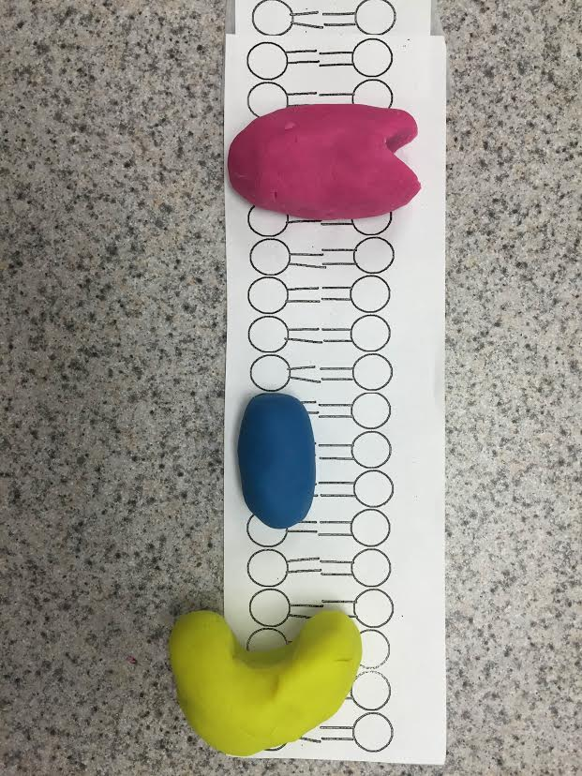

Slide 3
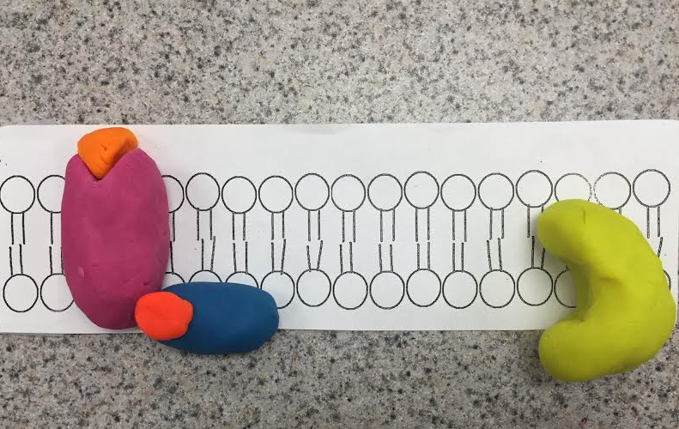
Reception
When the appropriate signal molecule binds to the extracellular side of the receptor, the G protein binds GTP (instead of GDP) and becomes active.

Slide 4
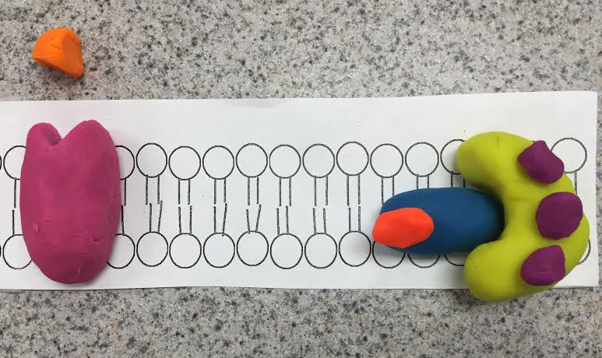
Transduction
The activated G protein dissociates from the receptor and diffuses along the membrane, where it binds to an enzyme, altering its activity, letting molecules pass through.

Slide 5
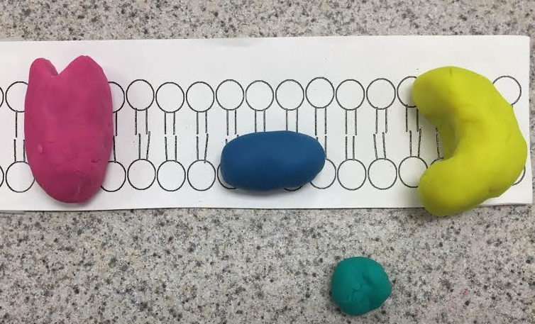
Cell Response
The activated enzyme triggers the cell response which pushes the G-Protein away, making one phosphate.

Slide 6
Analysis
A) What role does phosphorylation and phosphorylation play in cell signaling?
Phosphorylation and the reverse reaction, dephosphorylation, occur thanks to the actions of 2 key enzymes. Protein kinases phosphorylate proteins by transferring a phosphate group from adenosine triphosphate to their target protein. This process is balanced by the action of protein phosphatases, which can subsequently remove the phosphate group.
B) What role do secondary messengers, such as Ca+2 and cyclic AMP) play in cell signaling?
Second messengers are molecules that relay signals received at receptors on the cell surface to target molecules in the cytosol and/or nucleus. But in addition to their job as relay molecules, second messengers serve to greatly amplify the strength of the signal.

Slide 7
Analysis
C) Why are they called secondary messengers?
The cell releases secondary messengers in response to exposure to extracellular signaling molecules, the first messengers.
D) What does cell signaling have to do with homeostasis of cells?
Homeostasis has do with cell signaling because homeostasis makes the cell able to behave and correctly respond to the receptor.
E) How does what you learned about hormones relate to cell signaling?
Hormones are carried through the circulatory system, and then carried onto nearby target cells in the body. Hormones can be sent to the cells’ receptor to signal another change in the body. These hormones can regulate different body function.

Slide 8
Analysis
F) How else, besides cell signaling, do cells do to maintain homeostasis?
vacuoles and chloroplasts
D) Organisms respond to changes in their environment through behavior and physiological mechanisms. Give two examples of a behavior mechanism and physiological mechanisms of an organism(s).
Behavior Mechanisms: Avoidance, mentally or physically avoiding something that causes distress; Compensation, making up for a weakness in one area by gaining strength in another
Physiological Mechanisms: A physiological mechanisms would be a change in temperature. A bird gets a message from its brain when it gets cold and winter may be coming. Then, the birds will fly South so they stay warm and they won’t freeze. It is a response from a signal they are receiving.

