Slide 1
DRAW ME A PICTURE OF . . .
AP BIOLOGY REVIEW 1st semester- Molecules, Cell Structure, MembraneTransport & Signaling, Mitosis/Meiosis
Genetics & Disorders Photosynthesis Cellular Respiration

Slide 2
Draw a diagram of a typical biological membrane including the lipid bilayer and both integral and peripheral proteins.
Label your diagram and GIVE AN EXAMPLE of an integral and a peripheral protein you learned about.

Slide 3
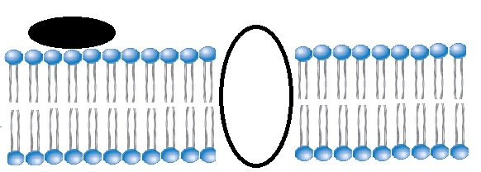
Peripheral proteins- G protein Last ETC protein
Integral proteins: transport proteins (ion channels, carriers, aquaporins, ATP synthase . . . .)
.

Slide 4
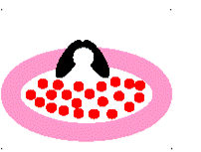
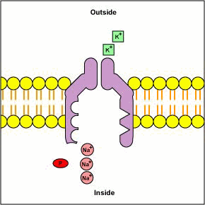
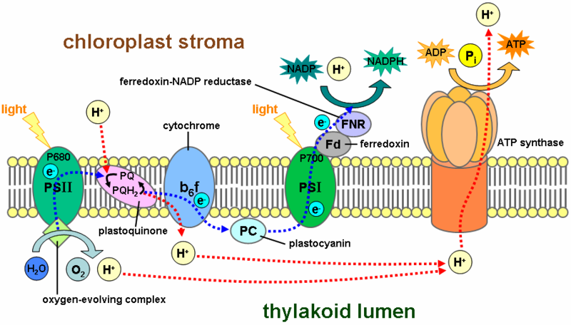

Slide 5
Draw a picture of an amino acid
Show how 2 amino acids could be joined together.
Identify this process and the type of bond formed

Slide 6
DEHYDRATION SYNTHESIS (CONDENSATION) REACTION Remove H₂O
MAKES A PEPTIDE BOND

Slide 7
Draw a picture of the subunit used to make nucleic acids.
Circle the parts of this subunit that make the backbone of a DNA molecule
Which nitrogen bases could be found in the nitrogen base spot if this were used to make RNA?

Slide 8
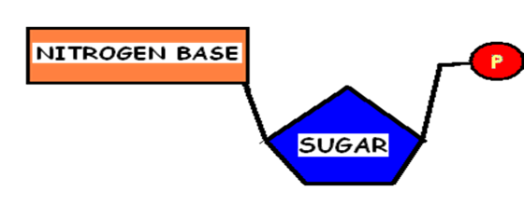
NUCLEOTIDE
Adenine Guanine
Cytosine Uracil NO THYMINE IN RNA

Slide 9
Draw a chloroplast Label all the places & spaces.
Mark the locations of ETC and Calvin Cycle.
Show where H⁺ ions build up during ETC.

Slide 10
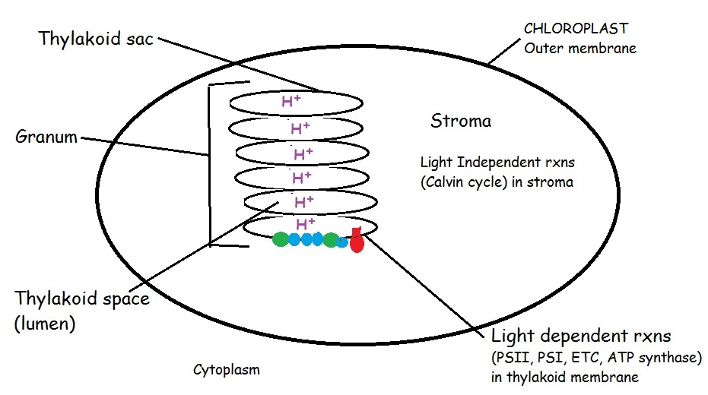
Draw a chloroplast

Slide 11
Draw a picture of a human red blood cell placed in distilled water.
Use arrows to show how the water will move.
What vocab word(s) describe what will happen to this cell?

Slide 12
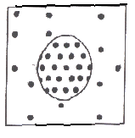
Draw a picture of a human red blood cell placed in distilled water.
Use arrows to show how the water will move.
What vocab word describes what will happen to this cell?
More water
will enter than leave.
Animal cell will swell and possibly burst = cytolysis

Slide 13
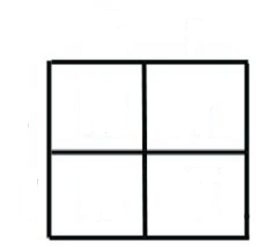
Draw a PUNNETT SQUARE that shows the
offspring of a cross between a father with
colorblindness and a non-colorblind mother whose father had normal vision.
Tell the possible outcomes of this cross.

Slide 14
X^{C} X^{C}
X^{c}
y
X^{C}X^{c} X^{C}X^{c}
X^{C}y X^{C}y
50% normal female (carriers)
50% normal males

Slide 15
Diagram the differences between cells that are haploid, diploid, triploid, trisomic, and monosomic
USE 2n=6

Slide 16
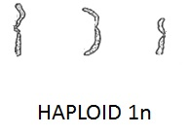
Diagram the differences between cells that are haploid, diploid, triploid, trisomic, and monosomic
USE 2n=6
DIPLOID 2n
TRIPLOID 3n
TRISOMY 2n+1
MONOSOMY 2n-1

Slide 17
Draw a diagram showing the glycoproteins on the surface of a blood cell from a person with A positive blood.
WHAT KIND OF ANTIBODIES WOULD THIS PERSON MAKE?

Slide 18
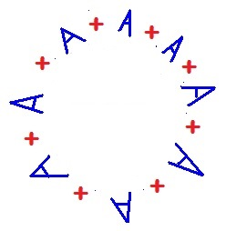
Draw a diagram showing the glycoproteins on the surface of a blood cell from a person with A positive blood.
WHAT KIND OF ANTIBODIES WOULD THIS PERSON MAKE?
ANTI-B antibodies

Slide 19
DRAW A DIAGRAM showing the molecules in the thylakoid membrane involved in the light reactions and label them.
Add H+ ions to show where H+ ions build up during the light reaction.
Tell 2 things that happen to create the H+ gradient.

Slide 20
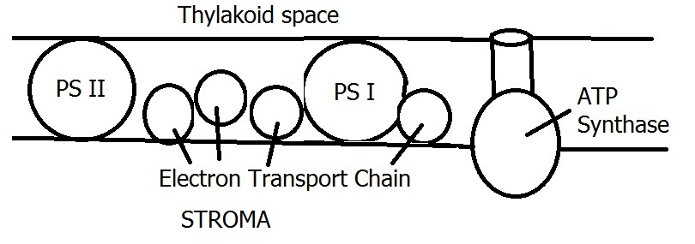
DRAW A DIAGRAM showing the molecules in the thylakoid membrane involved in the light reactions and label them.
H⁺ H⁺ H⁺ H⁺ H⁺ H⁺ H⁺ H⁺ H⁺ H⁺
H⁺ accumulate in the thylkoid space due to : 1. Splitting water to replace electrons in chlorophyll 2. ETC (proton pumps) move H⁺ from stroma into thylakoid space

Slide 21
Draw a diagram of a diploid cell with 4 chromosomes in Metaphase I of meiosis. Compare this to the same cell in Metaphase of mitosis

Slide 22
Metaphase I of meiosis
Metaphase of mitosis
Metaphase of mitosis

Slide 23
Draw the 2 kinds of shapes found in the secondary structure of proteins.
What kinds of groups are involved in holding this shape in position?

Slide 24
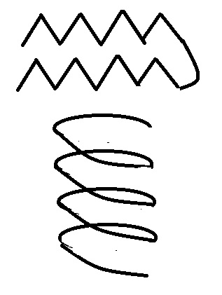
Beta pleated sheet
Alpha helix
Hydrogen bonds between C=O on one amino acid and the N-H on another amino acid

Slide 25
Show how alpha and beta glucose are different.
Give examples of polysaccharides made with each of these.
Which of these polysaccharide are humans and other animals unable to digest?

Slide 26
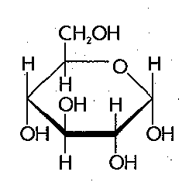
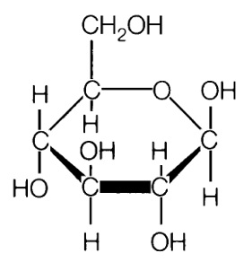
Alpha (α)glucose Beta (β) glucose glycogen & starch cellulose & chitin
Humans and other animals are unable to break polysaccharides with β linkages

Slide 27
Draw a picture showing the components used to make a FAT molecule. What kind of reaction joins the “pieces”?
How is a fat different than a phospholipid?
How does adding unsaturated fatty acid tails change the shape of the phospholipid? How does this affect its behavior in cell membranes?

Slide 28
FAT = 1 glycerol + 3 fatty acid tails
Joined by dehydration synthesis
Phospholipid = 1 glycerol + 2 fatty acid tails + 1 phosphate group

Slide 29
MAKE A FAT
GLYCEROL
3 FATTY ACIDS

Slide 30
PHOSPHOLIPID

Slide 31
STRUCTURE/FUNCTION!
UNSATURATED
FA’s affect
structure.
Can’t pack as tightly.
Makes membranes MORE fluid

Slide 32
Draw a diagram showing the glycoproteins on the surface of a blood cell from a person with I^{B} i genotype.
WHAT KIND OF ANTIBODIES WOULD THIS PERSON MAKE?

Slide 33
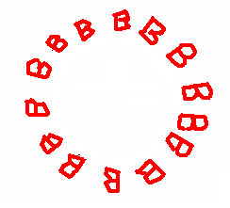
Draw a diagram showing the glycoproteins on the surface of a blood cell from a person with I^{B} i genotype.

Slide 34
Draw a mitochondrion. Label all the places & spaces.
Mark the locations of glycolysis, Krebs Cycle and ETC.
Show where H⁺ ions build up during ETC.
Add some mitochondrial DNA.

Slide 35
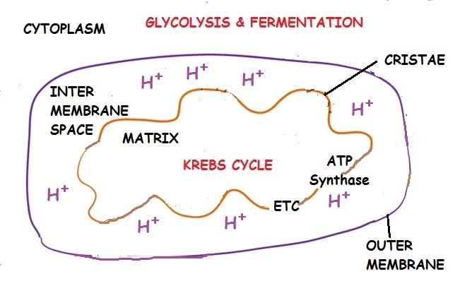

Slide 36
Draw the shape of a phospholipid and identify the parts that are polar and non-polar.
Identify the parts that are hydrophobic and hydrophilic.
How does adding unsaturated fatty acids
change the shape of the molecule and impact membrane fluidity?

Slide 37
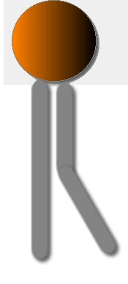
HEAD = polar/hydrophilic
TAILS = non-polar/hydrophobic
Unsaturated fatty acids put bends in the tails; They pack less tightly together in membrane; Increase fluidity

Slide 38
Draw a diagram showing the action of a non-polar hormone like cholesterol in a cell signaling pathway.

Slide 39
Draw a diagram showing the action of a non-polar hormone like cholesterol in a cell signaling pathway.

Slide 40
Draw a bacterial cell engulfed by phagocytosis and label 3 parts that are similar to mitochondria and chloroplasts
and provide evidence for Lynn Margulis’s
Endosymbiotic theory

Slide 41
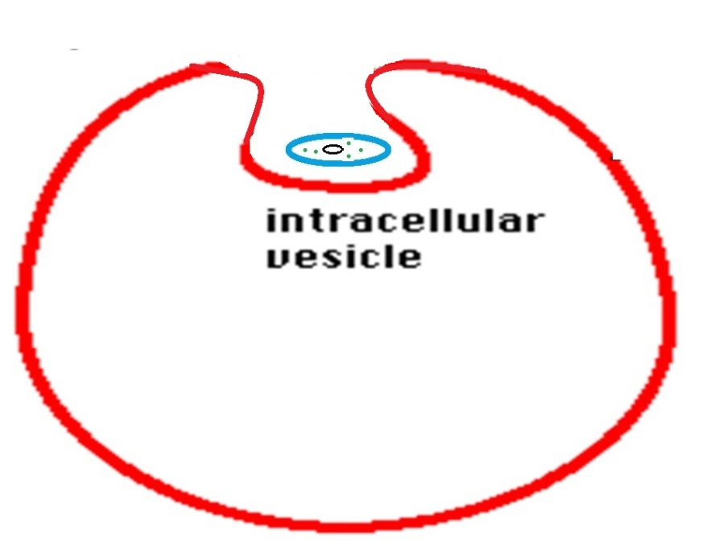
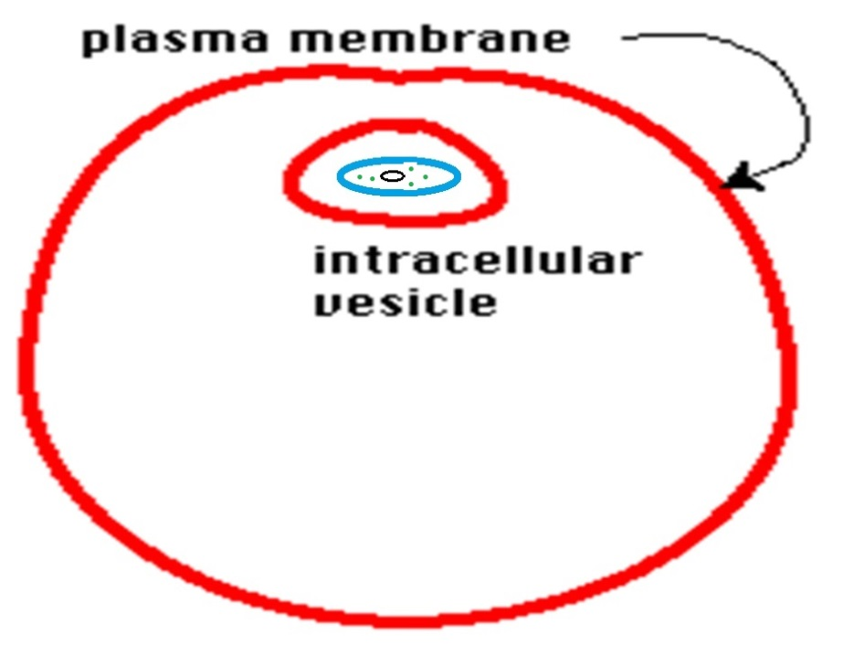
DNA is one circular loop Ribosomes are smaller than cellular ribosomes like prokaryotes Inner mitochondrial/chloroplast membranes have bacterial phospholipids Outer mitochondrial/chloroplast membrane like cell membranes
Inner membranes have enzymes for respiration/photosynthesis like bacterial outer membranes

Slide 42
Draw a pathway that shows the movement of a protein like insulin from where it is made in a cell to where it is secreted into the blood stream.

Slide 43
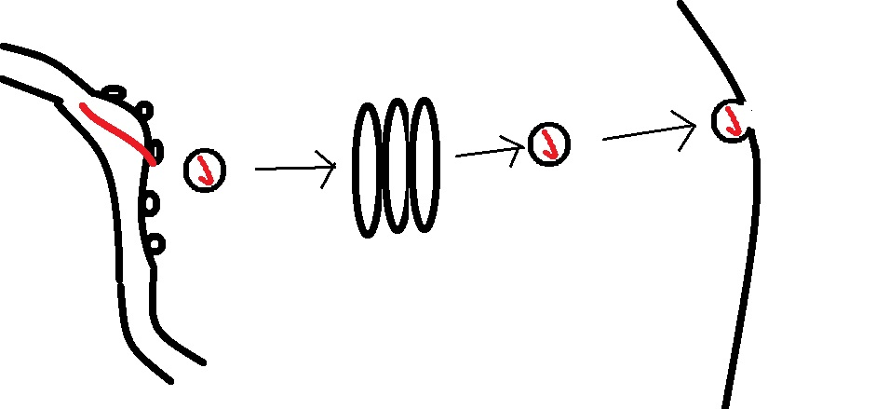
Made on ribosomes.
Travels through Rough ER Sent via vesicle to Golgi Sent via vesicle to plasma membrane Exocytosis to exit

Slide 44
Draw a gene map based on the following recombination frequencies: A-B 8% A-C 28% A-D 25% B-C 20%
B-D 33%

Slide 45
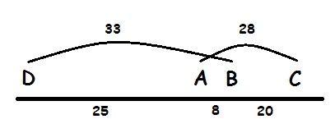
Draw a gene map based on the following recombination frequencies: A-B 8% A-C 28% A-D 25% B-C 20%
B-D 33%

Slide 46
Draw a picture of a nerve axon and show how the two kinds of Na+/K+ transporters work together to polarize and depolarize a nerve cell. Which of these transporters is active/passive?

Slide 47
POLARIZATION Na ⁺ - K⁺ pumps
Set potential on membrane More + outside than in
ACTIVE TRANSPORT requires energy
PASSIVE TRANSPORT No energy needed Move down gradient from [high] → [low]
DEPOLARIZATION Ion channels allow Na ⁺ and K⁺ to where they started

Slide 48
Draw a picture of a chromosome in G₁ of interphase. Show what it looks like in G₂

Slide 49
Draw a picture of a chromosome in G₁ of interphase. Show what it looks like in G₂

Slide 50
Draw a diagram to show 2 ways (ALLOSTERIC) NON-COMPETITIVE INHIBITORS work

Slide 51
NON-COMPETITVE (ALLOSTERIC) INHIBITION

Slide 52
Draw a picture of a chromosome in prophase of interphase. Label its parts.

Slide 53
Draw a picture of a chromosome in prophase of interphase. Label its parts.
telomeres
centromere
chromatid
chromatid

Slide 54
Draw a graph of FREE ENERGY of PRODUCTS and REACTANTS over time in a NEGATIVE ∆ G chemical reaction. Label ACTIVATION ENERGY and ∆G
How does adding an enzyme change the graph? How does it change the ∆G of this reaction?

Slide 55
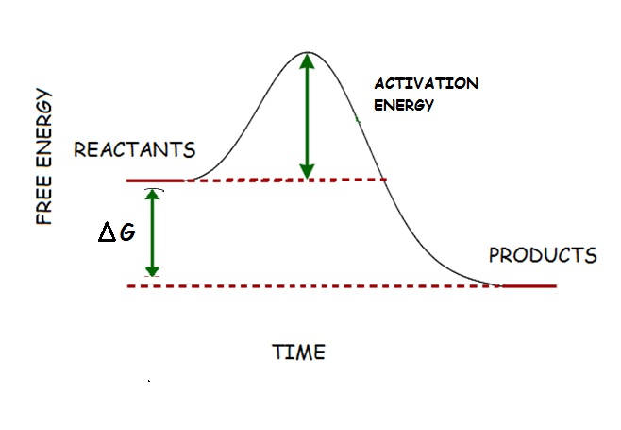
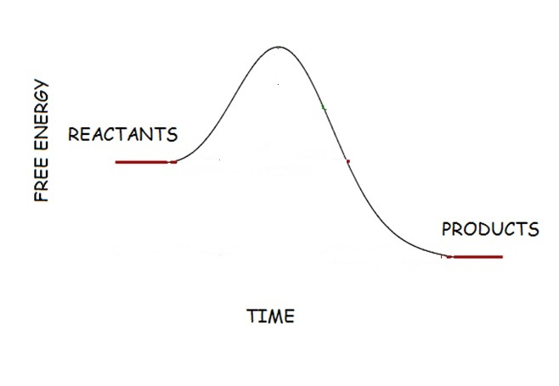
Draw a graph of FREE ENERGY of PRODUCTS and REACTANTS over time in a NEGATIVE ∆ G chemical reaction. Label ACTIVATION ENERGY and ∆G
How does adding an enzyme change the graph? How does it change the ∆G of this reaction?

Slide 56
Draw a picture to explain why NADH makes more ATP than FADH₂ when electrons are passed to the ETC during cellular respiration.
Image from: http://study.com/cimages/multimages/16/Electron_Transport_Mitochondrion.png

Slide 57
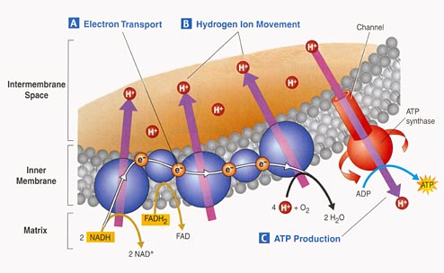
NADH drops its electrons at beginning of ETC so as electrons pass down ETC 3 proton pumps move H⁺ ions into the intermembrane space = 3 ATP when they return through ATP synthase.
FADH₂ drops its electrons farther down ETC skipping the 1st proton pump so less H⁺ moved = 2 ATP
Image from: http://study.com/cimages/multimages/16/Electron_Transport_Mitochondrion.png

Slide 58
Draw a graph of FREE ENERGY versus time showing the PRODUCTS and REACTANTS for a NEGATIVE ∆ G and a POSITIVE ∆G
REACTION.
How is the ∆ G in these reactions different? Which of these is spontaneous? Which is endergonic/exergonic?

Slide 59
Draw a graph of FREE ENERGY versus time showing the PRODUCTS and REACTANTS for a NEGATIVE ∆ G and a POSITIVE ∆G
REACTION.
How does the energy of reactants and products compare in these two kinds of reactions? Label these as: spontaneous or not? endergonic/exergonic?

Slide 60
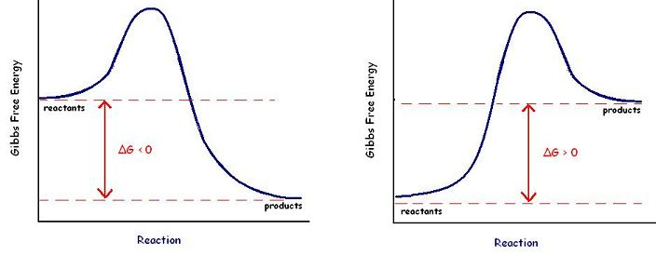
EXERGONIC REACTION ∆G < 0 Reaction is spontaneous
Energy of reactants is greater than energy of products
EXERGONIC REACTION ∆G > 0 Reaction is NOT spontaneous
Energy of products is greater than energy of reactants

Slide 61
asdfasdf

Slide 62
asdfasdf

Slide 63
asdfasdf

