Slide 1
AP BIOLOGY “STEAM” REVIEW
DRAW ME A PICTURE OF . . .
Kelly Riedell Brookings Biology

Slide 2
Draw a picture of an amino acid
Show how 2 amino acids could be joined together.
Identify this process and the type of bond formed
4.A.1.b. 2. Proteins have an amino (NH₂) end and a carboxyl (COOH) end, and consist of a linear sequence of amino acids connected by the formation of peptide bonds by dehydration synthesis between the amino and carboxyl groups of adjacent monomers.

Slide 3
DEHYDRATION SYNTHESIS (CONDENSATION) REACTION Remove H₂O
MAKES A PEPTIDE BOND

Slide 4
Draw the shape of a phospholipid and identify the parts that are polar and non-polar.
Identify the parts that are hydrophobic and hydrophilic.
How does adding unsaturated fatty acids
change the shape of the molecule and impact membrane fluidity?
4.A.1.a.3. In general, lipids are nonpolar; however phospholipids exhibit structural properties , with polar regions that interact with other polar molecules such as water, and with nonpolar regions where differences in saturation determine the structure and function of lipids

Slide 5
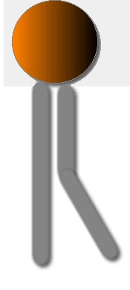
4.A.1.a.3. In general, lipids are nonpolar; however phospholipids exhibit structural properties , with polar regions that interact with other polar molecules such as water, and with nonpolar regions where differences in saturation determine the structure and function of lipids
HEAD = polar/hydrophilic
TAILS = non-polar/hydrophobic
Unsaturated fatty acids put “kinks” in the tails; They pack less tightly together in membrane; Increase fluidity
Organisms that live in cold places have more unsaturated FA’s in their phospholipids

Slide 6
Draw a diagram of a typical biological membrane including the lipid bilayer and both integral and peripheral proteins.
Label your diagram and GIVE AN EXAMPLE of an integral and a peripheral protein you learned about.
What other molecules can be found in cell membranes?
2.B.1.b.1. Cell membranes consist of a structural frame work of phospholipid molecules, embedded proteins, and cholesterol, glycoproteins, and glycolipdis. 2.B.1.b.2 Phospholipids give the membrane both hydrophilic and hydrophobic properties. The hydrophilic phosphate portions of the phospholipids are oriented toward the aqueous external or internal environments, while the hydrophobic fatty acids portions face each other within the interior of the membrane itself

Slide 7
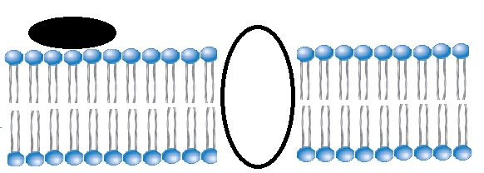
Peripheral proteins- G protein Last ETC protein
Integral proteins: transport proteins (ion channels, carriers, aquaporins, ATP synthase . . . .)
.

Slide 8
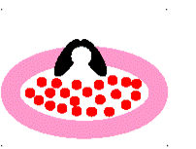
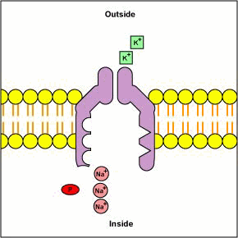
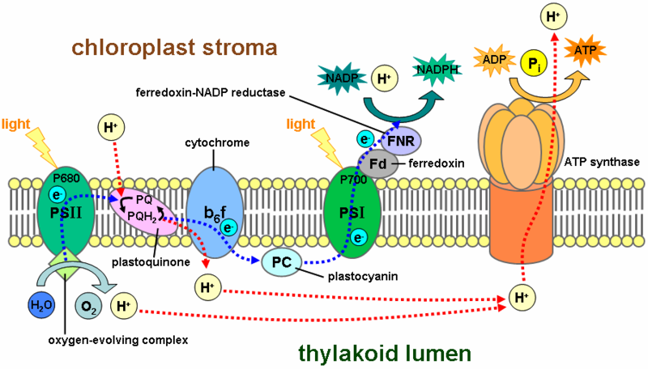

Slide 9
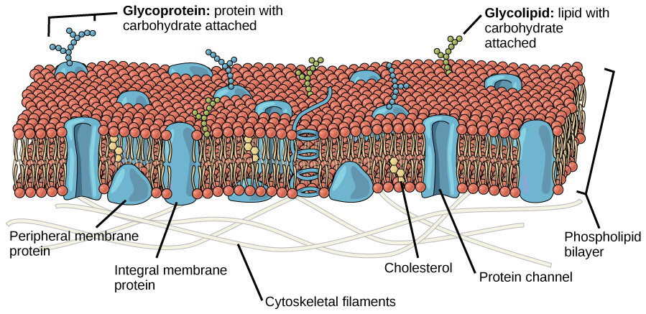
Other molecules in cell membranes
Glycoproteins Glycolipids Cholesterol (animals)

Slide 10
Draw a picture of the subunit used to make nucleic acids.
Circle the parts of this subunit that make the backbone of a DNA molecule
Which nitrogen bases could be found in the nitrogen base spot if this were used to make DNA?
Which sugar can be found in the sugar spot?
4.A.1.a. 1. In nucleic acids, biological information is encoded in sequences of nucleotide monomers. Each nucleotide has structural components: a five-carbon sugar (deoxyribose or ribose), a phosphate and a nitrogen base (adenine, thymine, guanine cytosine, or uracil). DNA and RNA differ in function and differ slightly in structure, and these structural difference account for the differing functions.
3.A.1.b DNA and RNA molecules have structural similarities and differences that define function. 2. The basic structural differences include: I DNA contains deoxyribose (RNA contains ribose) Ii RNA contains uracil in lieu of thymine in DNA

Slide 11
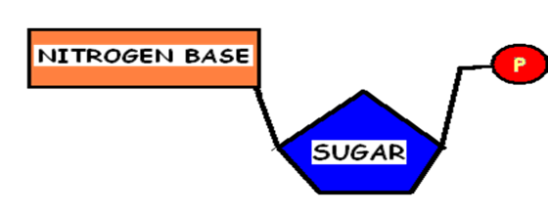
NUCLEOTIDE
Adenine Guanine
Cytosine Thymine NO URACIL IN DNA
Deoxyribose

Slide 12
Draw a diagram showing the glycoproteins on the surface of a blood cell from a person with A positive blood.
WHAT KIND OF ANTIBODIES WOULD THIS PERSON MAKE?

Slide 13
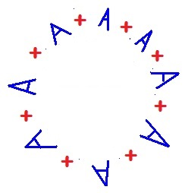
Draw a diagram showing the glycoproteins on the surface of a blood cell from a person with A positive blood.
WHAT KIND OF ANTIBODIES WOULD THIS PERSON MAKE?
ANTI-B antibodies

Slide 14
Draw a graph of FREE ENERGY versus time showing the PRODUCTS and REACTANTS for a NEGATIVE ∆ G and a POSITIVE ∆G
REACTION.
How does the energy of reactants and products compare in these two kinds of reactions? Label these as: spontaneous or not? endergonic/exergonic?

Slide 15
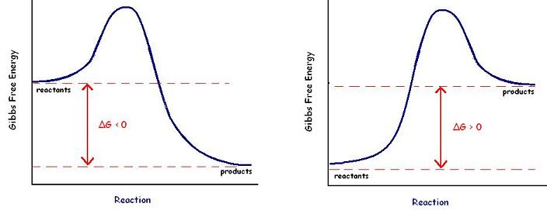
EXERGONIC REACTION ∆G < 0 Reaction is spontaneous
Energy of reactants is greater than energy of products
ENDERGONIC REACTION ∆G > 0 Reaction is NOT spontaneous
Energy of products is greater than energy of reactants

Slide 16
Show how alpha and beta glucose are different.
Give examples of polysaccharides made with each of these.
Which of these polysaccharide are humans and other animals unable to digest?
4.A.1.a. 4. Carbohydrates are composed of sugar monomers whose structures ad bonding with each other by dehydration synthesis determine the properties and functions of the molecules. Illustrative examples include: cellulose vs starch

Slide 17
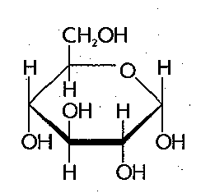
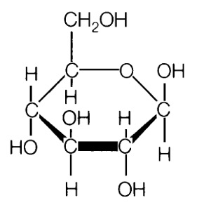
Alpha (α)glucose Beta (β) glucose glycogen & starch cellulose & chitin
Humans and other animals are unable to break polysaccharides with β linkages

Slide 18
Draw a mitochondrion. Label all the places & spaces.
Mark the locations of glycolysis, Krebs Cycle and ETC.
Show where H⁺ ions build up during ETC.
Add some mitochondrial DNA.
2.A.2. g.1. Electron transport chain reactions occur in chloroplasts (photosynthesis), mitochondria (cellular
respiration) and prokaryotic plasma membranes
4.A.2.d.1. Mitochondria have a double membrane that allows compartmentalization within the mitochondria and is important to its function. 4.A.2.d.2 The outer membrane is smooth, the inner membrane is highly convoluted, forming folds called cristae 4.A.2.d.3. Cristae contain enzymes important to ATP production; cristae also increase surface area for ATP production

Slide 19
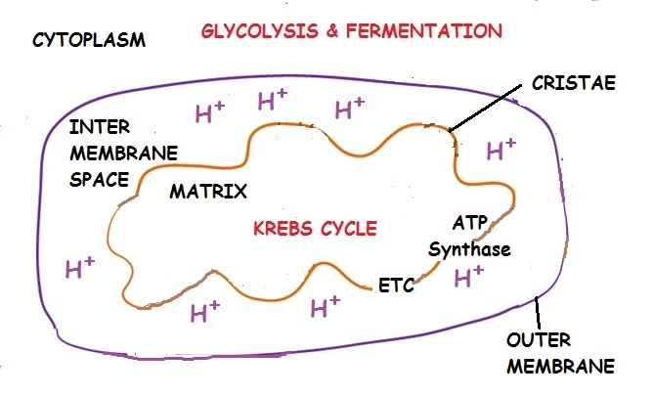

Slide 20
Draw a picture showing the components used to make a FAT molecule. What kind of reaction joins the “pieces”?
How is a fat different than a phospholipid?
How does adding unsaturated fatty acid tails change whether the fat is solid or liquid at room temperature?
4.A.1.a.3. In general, lipids are nonpolar; however phospholipids exhibit structural properties , with polar regions that interact with other polar molecules such as water, and with nonpolar regions where differences in saturation determine the structure and function of lipids

Slide 21
FAT = 1 glycerol + 3 fatty acid tails
Joined by dehydration synthesis
Phospholipid = 1 glycerol + 2 fatty acid tails + 1 phosphate group

Slide 22
MAKE A FAT
GLYCEROL
3 FATTY ACIDS

Slide 23
PHOSPHOLIPID

Slide 24
STRUCTURE/FUNCTION!
UNSATURATED
FA’s put “kinks” in tails
Can’t pack as tightly.
Learn more
UNSATURATED Fats = liquid at room temperature.
Saturated fats = solid at room temperature.

Slide 25
Draw a segment of DNA, use it to make a pre-mRNA. Use color to add some introns and exons. Show what happens during mRNA processing to make an edited mRNA.
Use the same segment of DNA to make another pre-mRNA. Use color to show how alternative splicing could make a different mRNA message.
3.A.1.c.2. In eukaryotic cells the mRNA transcript undergoes a series of enzyme-regulated modifications. Illustrative example: Excision of introns

Slide 26
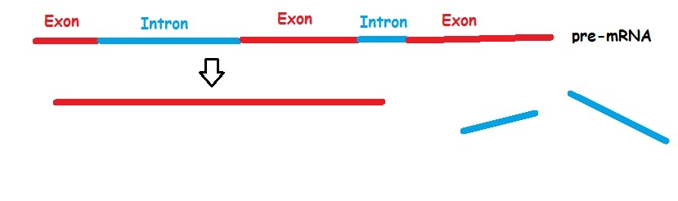

Slide 27
Draw a picture of the subunit used to make nucleic acids.
Which nitrogen bases could be found in the nitrogen base spot if this were used to make RNA?
Which sugar can be found in the sugar spot?
4.A.1.a. 1. In nucleic acids, biological information is encoded in sequences of nucleotide monomers. Each nucleotide has structural components: a five-carbon sugar (deoxyribose or ribose), a phosphate and a nitrogen base (adenine, thymine, guanine cytosine, or uracil). DNA and RNA differ in function and differ slightly in structure, and these structural difference account for the differing functions.
3.A.1.b DNA and RNA molecules have structural similarities and differences that define function. 2. The basic structural differences include: I DNA contains deoxyribose (RNA contains ribose) Ii RNA contains uracil in lieu of thymine in DNA

Slide 28
NUCLEOTIDE
Adenine Guanine
Cytosine Uracil NO THYMINE IN RNA
Ribose

Slide 29
Draw a chloroplast Label all the places & spaces.
Mark the locations of ETC and Calvin Cycle.
Show where H⁺ ions build up during ETC.
2.A.2. g.1. Electron transport chain reactions occur in chloroplasts (photosynthesis), mitochondria (cellular
respiration) and prokaryotic plasma membranes.
4.A.2.d.3. Chloroplasts have a double outer membrane that creates a compartmentalized structure, which supports if function. Within the chloroplasts are membrane-bound structures called thylakoids. Energy-capturing reactions housed in the thylakoids are organized into stacks, called “grana”, to produce ATP and NADPH, which fuel carbon-fixing reactions in the Calvin-Benson cycle. Carbon fixation occurs in the stroma, where molecules of CO₂ are converted into carbohydrates.

Slide 30
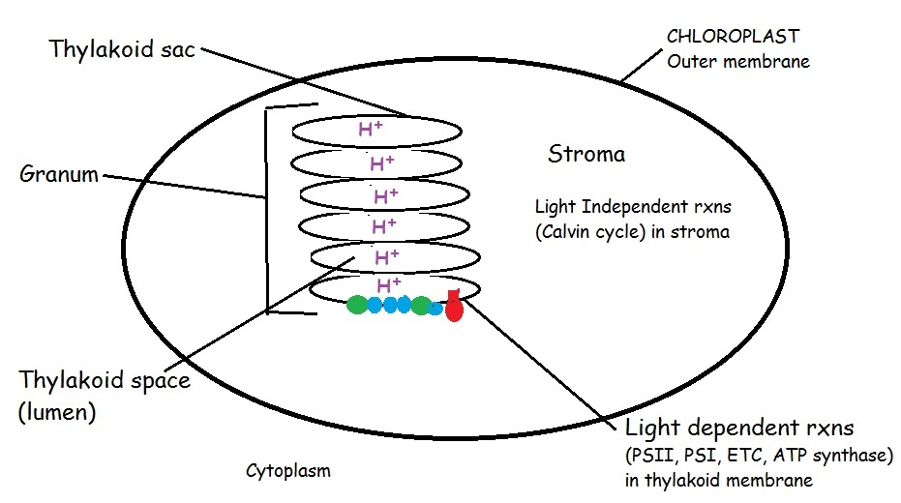
Draw a chloroplast

Slide 31
Draw a picture of a human red blood cell placed in distilled water.
Use arrows to show how the water will move.
What vocab word(s) describe what will happen to this cell?

Slide 32
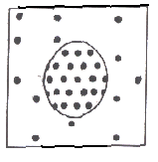
Draw a picture of a human red blood cell placed in distilled water.
Use arrows to show how the water will move.
What vocab word describes what will happen to this cell?
More water
will enter than leave.
Animal cell will swell and possibly burst = cytolysis

Slide 33
Draw a picture of a chromosome in prophase of interphase. Label its parts.

Slide 34
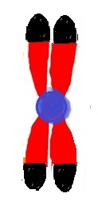
Draw a picture of a chromosome in prophase. Label its parts.
telomeres
centromere
chromatid
chromatid

Slide 35
Draw a pathway that shows the movement of a protein like insulin from where it is made in a cell to where it is secreted into the blood stream.
4.A.4 Organisms exhibit complex properties due to interactions between their constituent parts
LO 4.4 The student is able to make a prediction about the interactions of subcellular organelles

Slide 36
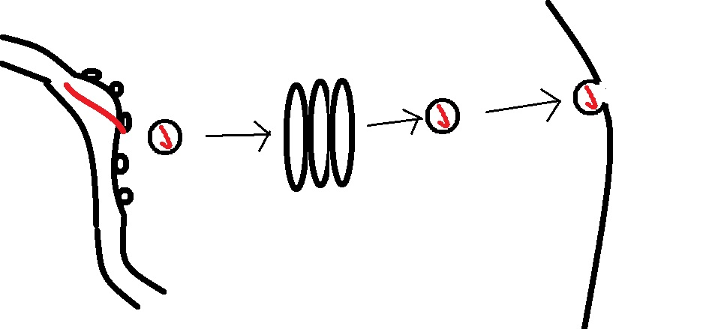
Made on ribosomes.
Travels through Rough ER Sent via vesicle to Golgi Sent via vesicle to plasma membrane Exocytosis to exit

Slide 37
Draw a picture of a nerve axon and show how the two kinds of Na⁺/K⁺ transporters work together to polarize and depolarize a nerve cell. Which of these transporters is active/passive?
3.E.2.b. 2. In response to a stimulus, Na+ and K+ gated channels sequentially open and cause the membrane to become locally depolarized. 3.E.2.b.3. Na+/K+ pumps, powered by ATP, work to maintain membrane potential.

Slide 38
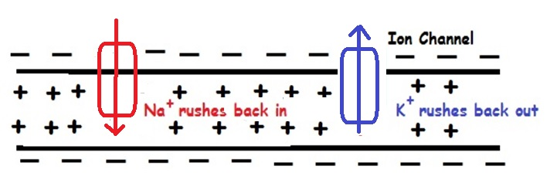
POLARIZATION Na ⁺ - K⁺ pumps
Set potential on membrane More + outside than in
ACTIVE TRANSPORT requires energy
DEPOLARIZATION Ion channels allow Na ⁺ and K⁺ to return to where they started
PASSIVE TRANSPORT No energy needed Move down gradient from [high] → [low]

Slide 39
Draw the 2 kinds of shapes found in the secondary structure of proteins.
What kinds of groups are involved in holding this shape in position?
4.A.1.a. 2 In proteins, the specific order of amino acids in a polypeptide (primary structure) interacts with the environment to determine the overall shape of the protein, which also involves secondary, tertiary, and quaternary structure, and thus, its function.

Slide 40
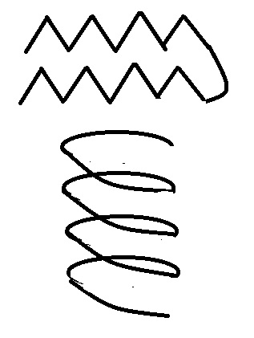
Beta pleated sheet
Alpha helix
Hydrogen bonds between C=O on one amino acid and the N-H on another amino acid
R-groups NOT involved!

Slide 41
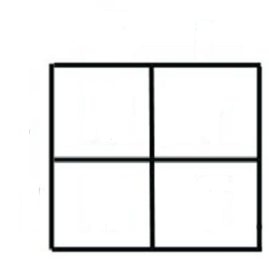
Draw a PUNNETT SQUARE that shows the
offspring of a cross between a father with
colorblindness and a non-colorblind mother whose father had normal vision.
Tell the possible outcomes of this cross.

Slide 42
X^{C} X^{C}
X^{c}
y
X^{C}X^{c} X^{C}X^{c}
X^{C}y X^{C}y
50% normal female (carriers)
50% normal males

Slide 43
Draw a diagram of a transmembrane protein like an ION CHANNEL in a cell membrane and show where you would expect to find hydrophobic and hydrophilic amino acids.
2.B.1.3 Embedded proteins can be hydrophilic, which charged and polar side groups, or hydrophobic with nonpolar side groups

Slide 44
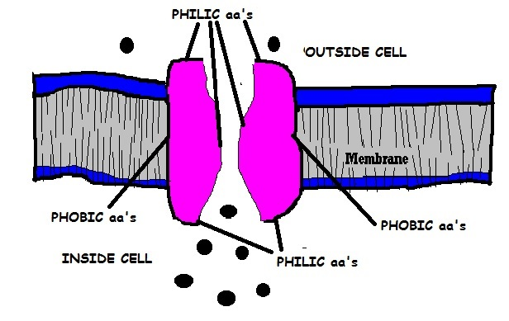
Draw a diagram of a transmembrane protein like an ION CHANNEL in a cell membrane and show where you would expect to find phobic and philic amino acids.
IMAGE MODIFEID FROM: http://www2.montana.edu/cftr/images/IonChannel2.gif

Slide 45
Draw a diagram of a diploid cell with 4 chromosomes in Metaphase I of meiosis. Compare this to the same cell in Metaphase of mitosis
3.A.2.b. 4. Mitosis is a continuous process with observable structural features along the mitotic process. Evidence of student learning is demonstrated by knowing the order of the processes (replication, alignment, separation) 3.A.2.c.2 During meiosis, homologous chromosomes are paired, with one homologue originating from the maternal parent and the other from the paternal parent. Orientation of the chromosome pairs is random with respect to the cell poles.

Slide 46
Metaphase I of meiosis
Metaphase of mitosis
Metaphase of mitosis

Slide 47
Draw a diagram to show crossing over between homologous chromosomes during Meiosis.
3.A.2.c.4. During meiosis, homologous chromatids exchange genetic material via a process called “crossing over,” which increases genetic variation in the resultant gametes.

Slide 48
Draw a diagram to show crossing over between homologous chromosomes during Meiosis.

Slide 49
Draw a bacterial cell engulfed by phagocytosis and label 3 parts that are similar to mitochondria and chloroplasts
and provide evidence for Lynn Margulis’s
Endosymbiotic theory

Slide 50
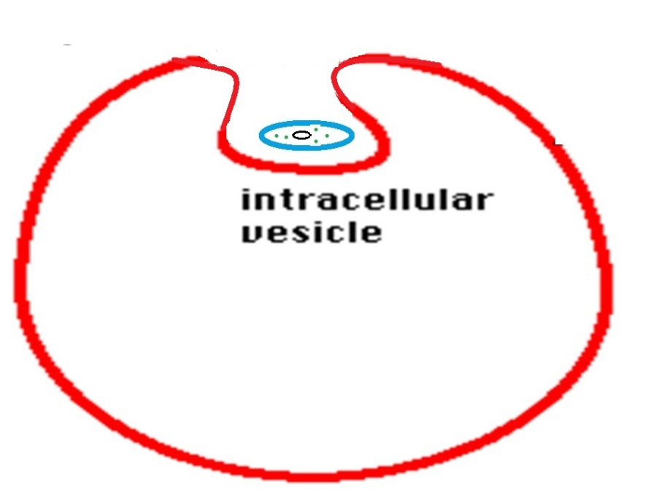
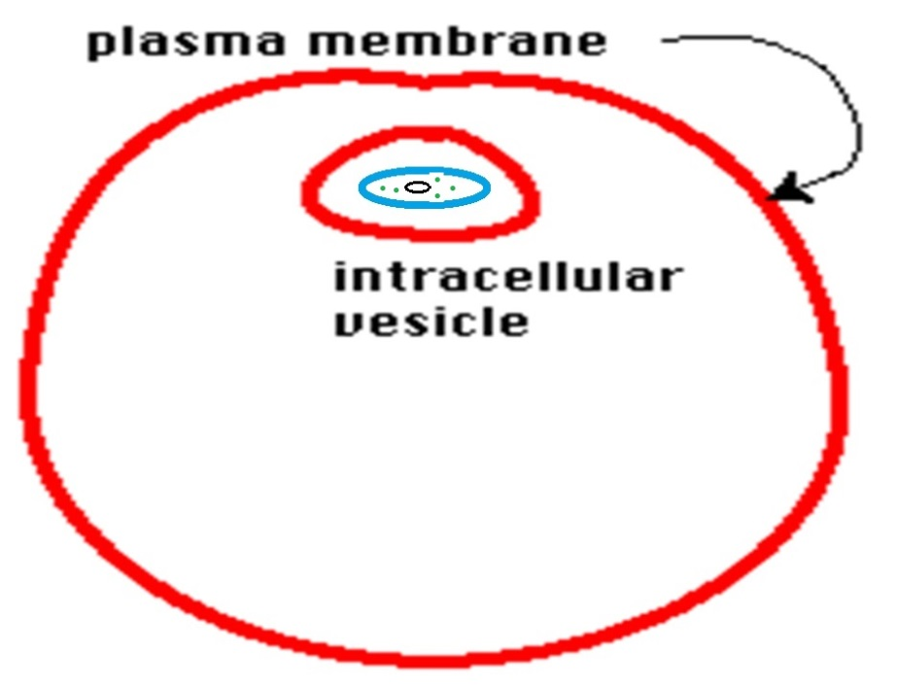
DNA is one circular loop Ribosomes are smaller than cellular ribosomes like prokaryotes Inner mitochondrial/chloroplast membranes have bacterial phospholipids Outer mitochondrial/chloroplast membrane like cell membranes
Inner membranes have enzymes for respiration/photosynthesis like bacterial outer membranes

Slide 51
Draw a picture that shows the structure of a chromosome in prophase of mitosis. Show what it looks like in anaphase or telophase
3.A.2.b. 4. Mitosis is a continuous process with observable structural features along the mitotic process. Evidence of student learning is demonstrated by knowing the order of the processes (replication, alignment, separation)

Slide 52
Draw a picture that shows the structure of a chromosome in prophase of mitosis. Show what it looks like in anaphase or telophase
anaphase
and
telophase
prophase

Slide 53
Draw a diagram showing the glycoproteins on the surface of a blood cell from a person with I^{B} i genotype.
WHAT KIND OF ANTIBODIES WOULD THIS PERSON MAKE?

Slide 54
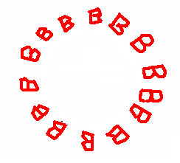
Draw a diagram showing the glycoproteins on the surface of a blood cell from a person with I^{B} i genotype.
Makes Anti-A antibodies

Slide 55
Draw a picture of the lac operon when it is turned on showing the operator, promoter, repressor, and any other molecules you need.
3.B.1. a.1. Regulatory sequences are stretches of DNA that interact with regulatory proteins to control transcription. Illustrative example: Promoters
3.B.1.b.2. The expression of specific genes can he inhibited by the presence of a repressor. 3.B.1.b.4. Regulatory proteins inhibit gene expression by binding to DNA and blocking transcription (negative control)

Slide 56
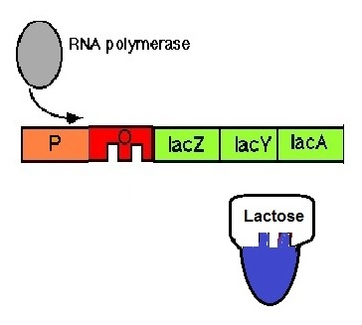
Draw a picture of the lac operon when it is turned on showing the operator, promoter, repressor, and any other molecules you need.
Inactive Repressor

Slide 57
DRAW A DIAGRAM showing the molecules in the thylakoid membrane involved in the light reactions and label them.
Add H+ ions to show where H+ ions build up during the light reaction.
Tell 2 things that happen to create the H+ gradient.
2.A.2.d. 2. Photosystems I and I are embedded in the internal membranes of chloroplasts (thylakoids) and are connected by the transfer of higher free energy electrons through an electron transport chain (ETC) 2.A.2.d.3. When electrons are transferred between molecules in a sequence of reactions as they pass through the ETC, an electrochemical gradient of hydrogen ions (protons) across the thylakoid membrane is established. 2.A.2.d.4. The formation of the proton gradient is a separate process, but it is linked to the synthesis of ATP from ADP and inorganic phosphate via ATP synthetase.

Slide 58
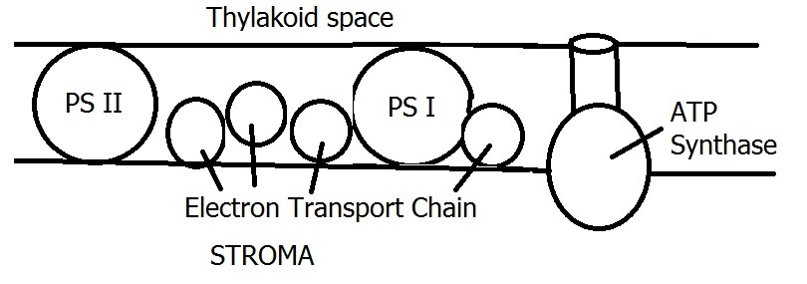
DRAW A DIAGRAM showing the molecules in the thylakoid membrane involved in the light reactions and label them.
H⁺ H⁺ H⁺ H⁺ H⁺ H⁺ H⁺ H⁺ H⁺ H⁺
H⁺ accumulate in the thylkoid space due to : 1. Splitting water to replace electrons in chlorophyll 2. ETC (proton pumps) move H⁺ from stroma into thylakoid space

Slide 59
Draw a picture of the trp operon when it is turned ON showing the operator, promoter, repressor, and any other molecules you need.
3.B.1. a.1. Regulatory sequences are stretches of DNA that interact with regulatory proteins to control transcription. Illustrative example: Promoters
3.B.1.b.2. The expression of specific genes can he inhibited by the presence of a repressor. 3.B.1.b.4. Regulatory proteins inhibit gene expression by binding to DNA and blocking transcription (negative control)

Slide 60
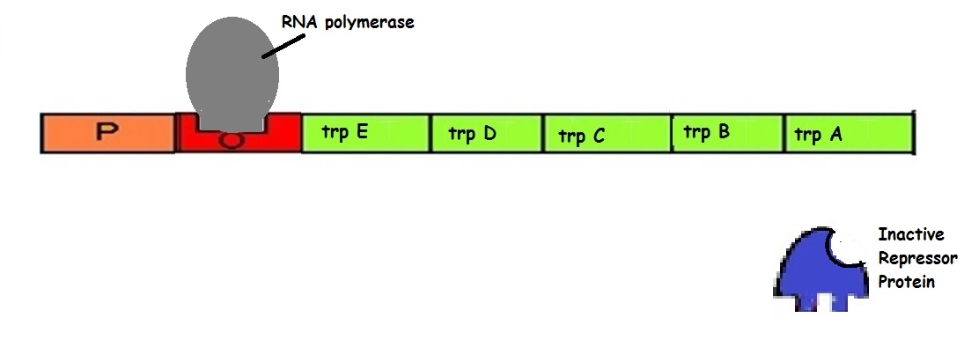
Draw a picture of the trp operon when it is turned ON showing the operator, promoter, repressor, and any other molecules you need.
If tryptophan is absent, repressor is inactive.
3.B.1. a.1. Regulatory sequences are stretches of DNA that interact with regulatory proteins to control transcription. Illustrative example: Promoters
3.B.1.b.2. The expression of specific genes can he inhibited by the presence of a repressor. 3.B.1.b.4. Regulatory proteins inhibit gene expression by binding to DNA and blocking transcription (negative control)

Slide 61
Draw a diagram to show 2 ways (ALLOSTERIC) NON-COMPETITIVE INHIBITORS work

Slide 62
NON-COMPETITVE (ALLOSTERIC) INHIBITION

Slide 63
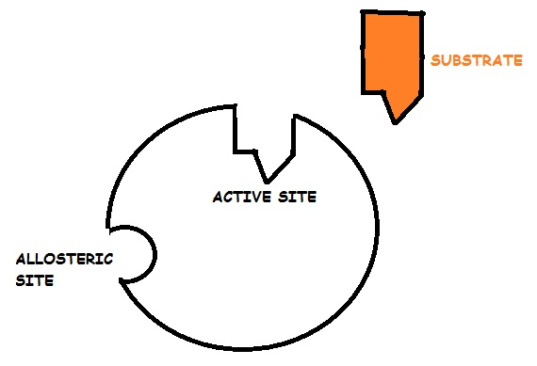
Draw and label a picture of an enzyme showing its active and allosteric sites. Include a substrate molecule in your drawing.
Essential knowledge 4.B.1: Interactions between molecules affect their structure and function.
b. The shape of enzymes, active sites and interaction with specific molecules are essential for basic functioning of the enzyme.
Evidence of student learning is a demonstrated understanding of each of the following:
1. For an enzyme-mediated chemical reaction to occur, the substrate must be complementary to the surface properties (shape and charge) of the active site. In other words, the substrate must fit into the enzyme's active site.

Slide 64
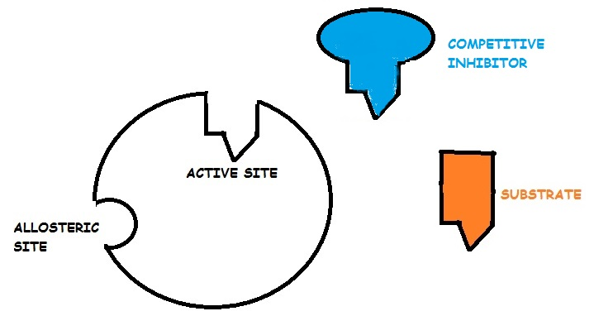
Add a competitive inhibitor to your diagram. How would this change the rate of this reaction?
Adding a competitive inhibitor would decrease the reaction rate
Essential knowledge 4.B.1: Interactions between molecules affect their structure and function.
b. The shape of enzymes, active sites and interaction with specific molecules are essential for basic functioning of the enzyme.
Learning Objective: LO 4.17 The student is able to analyze data to identify how molecular interactions affect structure and function. [See SP 5.1]

Slide 65
How would increasing substrate concentration change the rate of this reaction?
Adding more substrate increases the chance of a substrate molecule interacting with the active site. Reaction rate would increase
Essential knowledge 4.B.1: Interactions between molecules affect their structure and function.
b. The shape of enzymes, active sites and interaction with specific molecules are essential for basic functioning of the enzyme.
Learning Objective: LO 4.17 The student is able to analyze data to identify how molecular interactions affect structure and function. [See SP 5.1]

Slide 66
Draw a picture to show how electrophoresis works. Label the + and – ends. Explain the relationship between fragment size and distance moved on the gel and why DNA moves in an electric field.
3.A.1.e. Genetic engineering techniques can manipulate the heritable information of DNA and in special cases, RNA Illustrative example: Electrophoresis

Slide 67
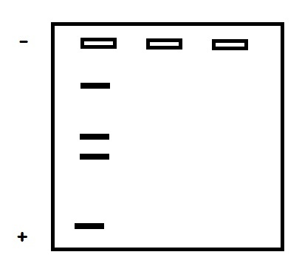
Draw a picture to show how electrophoresis works. Label the + and – ends. Explain the relationship between fragment size and distance moved on the gel and why DNA moves in an electric field.
Phosphates in DNA have negative charge attracted to + pole
Shorter fragments move farther and faster along the gel
3.A.1.e. Genetic engineering techniques can manipulate the heritable information of DNA and in special cases, RNA Illustrative example: Electrophoresis

Slide 68
Draw a diagram of a food chain that includes 5 trophic levels.
Label producers/consumers as primary, secondary, etc.
EXPLAIN the impact of a pollutant on the organisms in the different trophic levels. You had a vocab word for this.
4.B.6. Interactions among living systems and with their environment result in the movement of matter and enregy.
c. Organisms within food chains interact.

Slide 69
BIOLOGICAL MAGNIFICATION- Chemicals (BPA, DDT, etc) are concentrated in higher and higher amounts in bodies of organisms as you move up to higher trophic levels
IMAGE FROM: http://images.slideplayer.com/14/4486690/slides/slide_31.jpg

Slide 70
Draw a graph of FREE ENERGY of PRODUCTS and REACTANTS over time in a NEGATIVE ∆ G chemical reaction. Label ACTIVATION ENERGY and ∆G
How does adding an enzyme change the graph? How does it change the ∆G of this reaction?

Slide 71
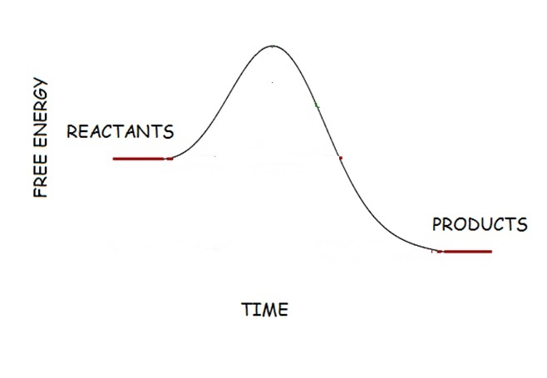
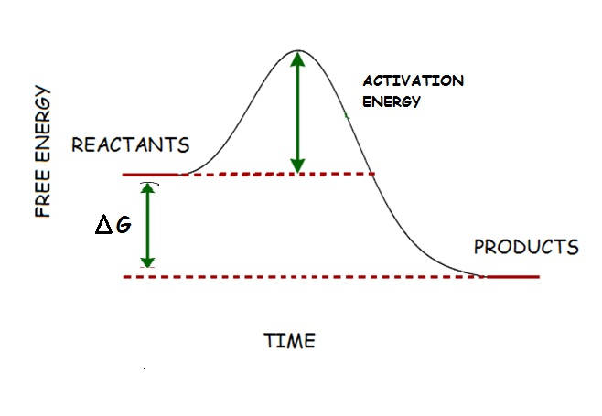
Draw a graph of FREE ENERGY of PRODUCTS and REACTANTS over time in a NEGATIVE ∆ G chemical reaction. Label ACTIVATION ENERGY and ∆G

Slide 72
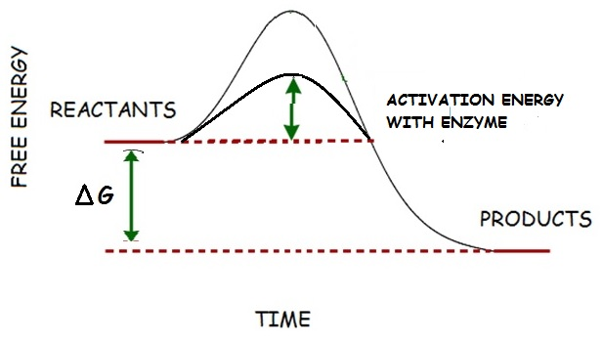
How does adding an enzyme change this graph? How does it change the ∆G of this reaction?
Enzymes decrease activation energy needed to get a reaction started. NO CHANGE in overall ∆G of reaction. Energy of products and reactants stay the same.
Essential knowledge 4.B.1: Interactions between molecules affect their structure and function.
a. Change in the structure of a molecular system may result in a change of the function of the system. [See also 3.D.3]

Slide 73
Draw a gene map based on the following recombination frequencies: A-B 8% A-C 28% A-D 25% B-C 20%
B-D 33%

Slide 74
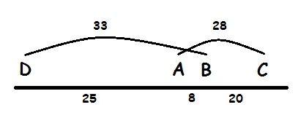
Draw a gene map based on the following recombination frequencies: A-B 8% A-C 28% A-D 25% B-C 20%
B-D 33%

Slide 75
Draw a picture to explain why NADH makes more ATP than FADH₂ when electrons are passed to the ETC during cellular respiration.
2.A.2.d. 2. Photosystems I and I are embedded in the internal membranes of chloroplasts (thylakoids) and are connected by the transfer of higher free energy electrons through an electron transport chain (ETC) 2.A.2.d.3. When electrons are transferred between molecules in a sequence of reactions as they pass through the ETC, an electrochemical gradient of hydrogen ions (protons) across the thylakoid membrane is established. 2.A.2.d.4. The formation of the proton gradient is a separate process, but it is linked to the synthesis of ATP from ADP and inorganic phosphate via ATP synthetase.

Slide 76
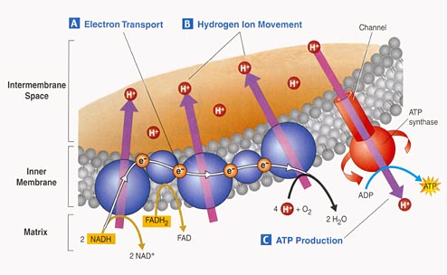
NADH drops its electrons at beginning of ETC so as electrons pass down ETC 3 proton pumps move H⁺ ions into the intermembrane space = 3 ATP when they return through ATP synthase.
FADH₂ drops its electrons farther down ETC skipping the 1st proton pump so less H⁺ moved = 2 ATP
Image from: http://study.com/cimages/multimages/16/Electron_Transport_Mitochondrion.png

Slide 77
Draw a diagram that shows TYPE I, TYPE II, and TYPE III survivorship curves.
Give an example of an organism for each type
of curve.
Which curves are associated with r-selected and K-selected species?

Slide 78
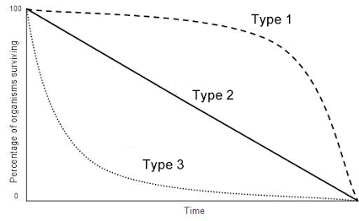
K-selected
r-selected
TYPE I – human, large mammals (elephants) TYPE II- birds, small mammals TYPE III- dandelions, insects, frogs, oysters, sea turtles, trees

Slide 79
Draw a picture of the lac operon when lactose is NOT present showing the operator, promoter, repressor, and any other molecules you need.
Identify the molecules in your diagram.
Explain what would cause this operon to “turn on”
3.B.1. a.1. Regulatory sequences are stretches of DNA that interact with regulatory proteins to control transcription. Illustrative example: Promoters
3.B.1.b.2. The expression of specific genes can he inhibited by the presence of a repressor. 3.B.1.b.4. Regulatory proteins inhibit gene expression by binding to DNA and blocking transcription (negative control)

Slide 80
Draw a diagram of a lac operon when lactose is NOT present.
Identify the molecules in your diagram.
Explain what would cause this operon to “turn on”
Addition of lactose- lactose binds to repressor and prevents its attachment to operator
Without Lactose
repressor is active
RNA polymerase can’t read gene
Gene “turned off”
Active repressor

Slide 81
Write the equation for cellular respiration
C₆H₁₂O₆ + 6 O₂→6 H₂O + 6 CO₂ + energy
2.A.2.f. Cellular respiration involves a series of coordinated enzyme catalyzed reactions that harvest free energy from simple carbohydrates

Slide 82
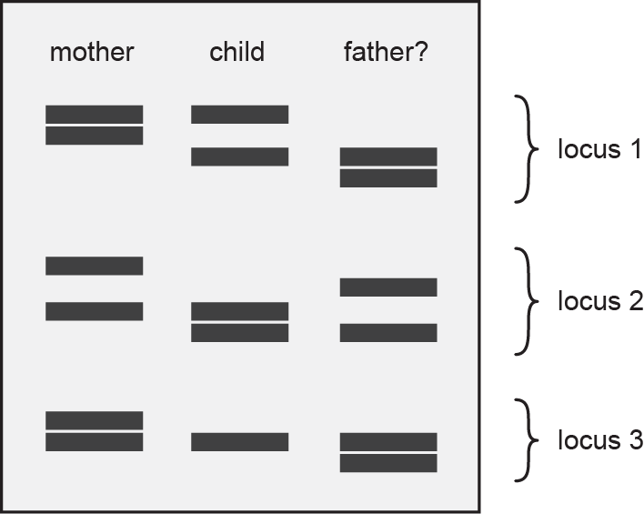
Look at the diagram. Is this the father of this child? EXPLAIN YOUR ANSWER
3.A.1.e. Genetic engineering techniques can manipulate the heritable information of DNA and in special cases, RNA Illustrative example: Electrophoresis

Slide 83
Child gets ½ DNA from mom and ½ from dad. If child has a band it must come from one parent or other
YES THIS IS THEDAD

Slide 84
Draw a diagram that shows a population undergoing logistic growth.
Label carrying capacity.
Identify 2 biotic and 2 abiotic factors that could impact carrying capacity in this population.
4.A.6..e. Models allow the prediction of the impact of change in biotic and abiotic factors Evidence of student learning is a demonstrated understanding of each of the following:. 1. Competition for resources and other factors limits growth and can be described by the logistic model.
4.B.3. a. Interactions between populations affect the distributions and abundance of populations.

Slide 85
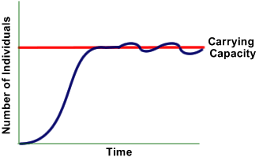
BIOTIC- number of predators, disease, availability of food, invasive species . . . ABIOTIC- drought, light, rainfall, space/shelter, . . .

Slide 86
Draw a picture of the trp operon when it is turned off showing the operator, promoter, repressor, and any other molecules you need.
3.B.1. a.1. Regulatory sequences are stretches of DNA that interact with regulatory proteins to control transcription. Illustrative example: Promoters
3.B.1.b.2. The expression of specific genes can he inhibited by the presence of a repressor. 3.B.1.b.4. Regulatory proteins inhibit gene expression by binding to DNA and blocking transcription (negative control)

Slide 87
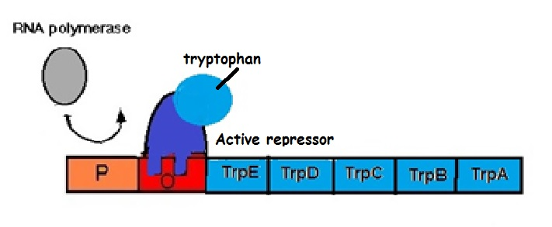
Draw a picture of the trp operon when it is turned off showing the operator, promoter, repressor, and any other molecules you need.
Tryptophan makes repressor ACTIVE, gene turns off when tryptophan is present

Slide 88
Draw a diagram showing the action potential of a nerve cell. Label polarization and depolarization. Identify what is happening to the Na⁺ and K⁺ channels on different parts of the curve.

Slide 89
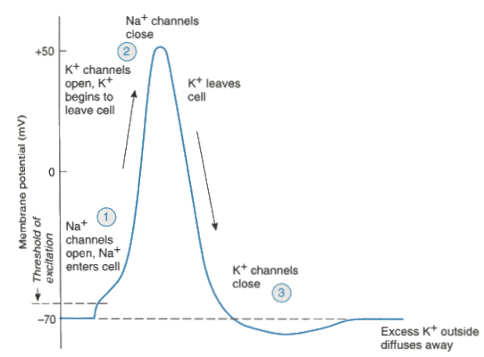
Draw a diagram showing the action potential of a nerve cell. Label polarization and depolarization. Identify what is happening to the Na⁺ and K⁺ channels during the process.

Slide 90
Draw the shape of a phospholipid and identify the parts that are polar and non-polar.
Identify the parts that are hydrophobic and hydrophilic.
How does the structure of phospholipids lead to the formation of cell membranes and their selectively permeable characteristics.
4.A.1.a.3. In general, lipids are nonpolar; however phospholipids exhibit structural properties , with polar regions that interact with other polar molecules such as water, and with nonpolar regions where differences in saturation determine the structure and function of lipids
2.B.1.b.2 Phospholipids give the membrane both hydrophilic and hydrophobic properties. The hydrophilic phosphate portions of the phospholipids are oriented toward the aqueous external or internal environments, while the hydrophobic fatty acids portions face each other within the interior of the membrane itself

Slide 91
HEAD = polar/hydrophilic
TAILS = non-polar/hydrophobic
Phospholipids associate with phobic tails toward inside and polar heads to outside touching water. Phobic tails keep polar molecules/ions from passing through without help (ion channels, carriers, etc). Small non-polar molecules can pass through without help.

Slide 92
Diagram the differences between cells that are haploid, diploid, triploid, trisomic, and monosomic
USE 2n=6

Slide 93
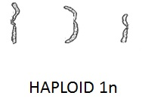
Diagram the differences between cells that are haploid, diploid, triploid, trisomic, and monosomic
USE 2n=6
DIPLOID 2n
TRIPLOID 3n
TRISOMY 2n+1
MONOSOMY 2n-1

Slide 94
Write the equation for photosynthesis
6 H₂O + 6 CO₂ + energy → C₆H₁₂O₆ + 6 O₂
_{(sunlight)}

Slide 95
Draw a diagram showing what happens in a lake undergoing eutrophication.
EXPLAIN how this is related to lakes in South Dakota turning green in the summer and “Dead zones” in the Gulf of Mexico.
4.B.3.c. Species-specific and environmental catastrophes, geological events, the sudden influx/depletion of abiotic resources or increased human activities affect species distribution and abundance.

Slide 96
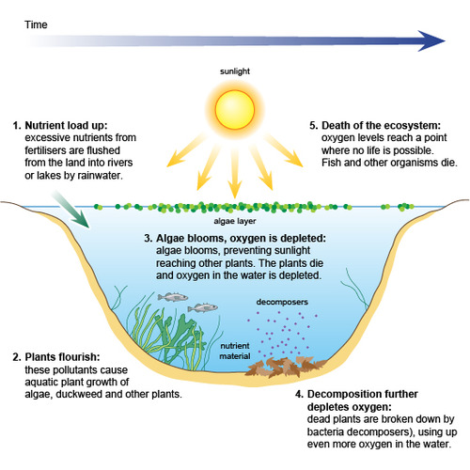
.
Image from: https://quizlet.com/32536401/pollution-eutrophication-flash-cards/

Slide 97
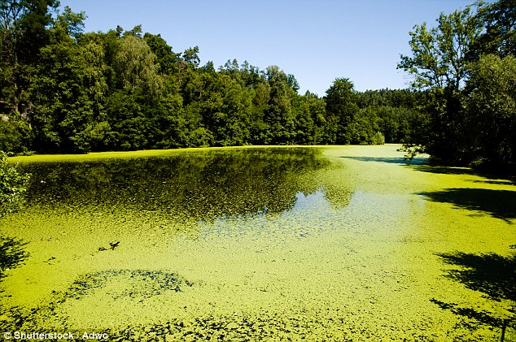
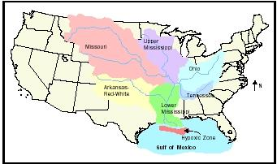
Same process that happens in SD lakes, happens on larger scale in places where rivers empty in to oceans due to manure/fertilizer runoff from farms
IMAGES FROM: http://i.dailymail.co.uk/i/pix/2016/01/25/23/308EB40200000578-3416409-image-a-13_1453766095280.jpg
http://www.waterencyclopedia.com/images/wsci_03_img0360.jpg

Slide 98
Draw a picture that shows how oogenesis and spermatogenesis in humans and other animals are different.
Add numbers to the cells to show what happens to the chromosome number changes during meiosis. (Use the human 2n number

Slide 99
http://images.slideplayer.com/25/7838082/slides/slide_27.jpg
Notice chromosome number is cut in half during 1ST division

Slide 100
Draw a diagram showing the action of a non-polar hormone like cholesterol in a cell signaling pathway.

Slide 101
Draw a diagram showing the action of a non-polar hormone like cholesterol in a cell signaling pathway.

