Slide 1
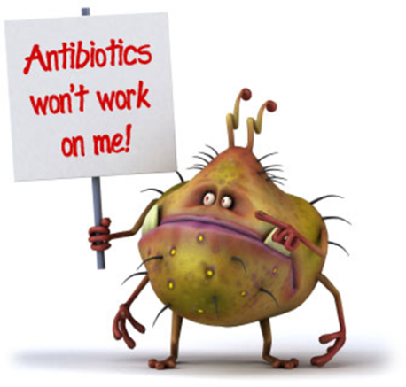
Many antibiotics that are used to kill bacteria which make us sick work because they interfere with the ability of bacterial ribosomes to make proteins.
Use what you know about classification to EXPLAIN WHY these antibiotics don’t kill fungi.
WHY can’t doctors use medicines that affect fungal ribosomes to treat athlete’s foot fungus in humans?

Slide 2
Approximately 70% of the atmosphere is made up of nitrogen (N₂) gas, but the majority of organisms on the planet can NOT take this gas in and break it down.
1. EXPLAIN how nitrogen gas enters the food chains in ecosystems.
2. How do humans get the nitrogen they need?
3. Give examples (3) of some molecules your body needs nitrogen to make.
Image from: http://www.habitatkokomo.com/wordpress1/recycle/

Slide 3
Explain how coupling – ∆ G reactions to reactions that have a + ∆ G allow life to exist.

Slide 4
Hormone signal molecules interact with cell receptors in/on cell targets in TWO different ways, depending on whether the hormone molecule is hydrophilic or hydrophobic.
EXPLAIN these mechanisms and give an example of each.

Slide 5
An important cause of the deterioration of flavor, texture, and vitamin content of frozen fruits and vegetables during storage is the action of hydrolytic enzymes released from vacuoles of the cells.
Blanching (a quick dip in boiling water) prior to freezing improves the keeping qualities of produce. EXPLAIN WHY blanching works.
Image from: http://ec.l.thumbs.canstockphoto.com/canstock5880066.jpg

Slide 6
STRUCTURE ~ FUNCTION
Which fatty acid tail is unsaturated?
How can you tell?
What is the relationship between unsaturated fatty acids in cell membranes and membrane fluidity in organisms that live in cold environments?
SP 7: The student is able to connect and relate knowledge across various scales, concepts, and representations in and across domains.
Image from: http://bioweb.wku.edu/courses/BIOL115/wyatt/Biochem/Lipid/P-lipid.gif

Slide 7
Explain why NADH makes more ATP than FADH₂ when electrons are passed to the ETC during cellular respiration.

Slide 8
Explain the difference between cyclic and non-cyclic photophosphorylation and explain why a plant cell might switch between these two pathways.

Slide 9
Compare electron transport in chloroplasts and mitochondra. Be sure to discuss the molecules involved, location, electron donors, final electron acceptors, reactants and products, etc.

Slide 10
Insulin is a protein hormone produced by beta cells in pancreas and released into the blood stream.
Explain the pathway a molecule of insulin would follow from where it is made in the cell to where it is released into the blood stream.

Slide 11
Explain the difference between 1◦, 2◦, 3◦, and 4◦ structure in proteins. Give examples.
◦
◦

Slide 12
Cells use a variety of regulatory steps to control protein production. Give 3 examples of post-transcriptional and post-translational gene regulation.
◦

Slide 13
asfa

