Slide 1
How to Approach FRQ Writing
With a Review of Graphing and Scientific Method

Slide 2
Give the Readers Exactly what they are Looking For
BE SHORT!
Do not waste time including material that isn’t necessary or wasn’t asked for
Support your statements with BRIEF, STRONG facts
Write in full sentences
No bullet points
Label your sections

Slide 3
Skim All Questions and Order Them
Take less than a minute to skim through ALL the questions and order them
From easiest to hardest
This will allow you to be able to answer the questions you have the best chances of getting points from

Slide 4
Read Each Questions all the Way Through
Read each question at least TWO TIMES
Focus on any key words
Especially those that are bold
Some questions will contain more than one bold term
The majority of points are lost because students misread the questions or fail to do what is specifically asked of them

Slide 5
Popular Key Words—CLAIM
Make a simple statement that something is true
Often will be compounded with providing evidence or reasoning
Example:
The pyruvate dehydrogenase complex (PDC) catalyzes the conversion of pyruvate to acetyl-CoA, a substrate for the Krebs (citric acid) cycle. The rate of pyruvate conversion is greatly reduced in individuals with PDC deficiency, a rare disorder.
(b) Make a claim about how PDC deficiency affects the amount of NADH produced by glycolysis AND the amount of NADH produced by the Krebs (citric acid) cycle in a cell. Provide reasoning to support claims.
There will be no change in glycolysis, because glycolysis does not require the conversion of pyruvate to acetyl-CoA in order to occur
The Kreb’s Cycle will be drastically lessened or stopped, because it requires acetyl-CoA in order to occur

Slide 6
How NOT to Write a Claim
It is my belief that there will be little to not change with glycolysis. OR I think that there would be no change in glycolysis.
These are not strong statements because they leave the reader feeling like you are guessing.
Glycolysis takes place in the cytoplasm of the cell, starting with a molecule of glucose and ending with two molecules of pyruvate. PDC is a catalyst on the conversion of pyruvate into acetyl-CoA, which is then used as a reactant in the Kreb’s Cycle. Glycolysis would therefore be unaffected by the absence of PDC, because glycolysis does not require the use of acetyl-CoA.
This statement is NOT WRONG. But it contains excessive information that tends to weaken your claim and make it difficult for the reader to find it.

Slide 7
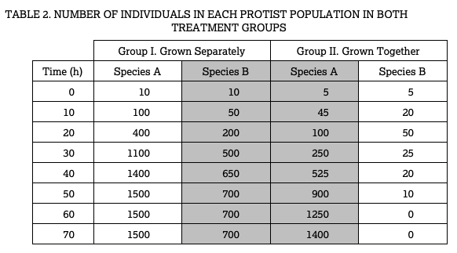
Popular Key Words—EVIDENCE
Evidence is almost always pulled from data in a chart or graph
Could also say “support” which may come from textual data
Example:
The student claims that species A and B compete for the same food source. Provide TWO pieces of evidence from the data to support this claim.
The growth rate of species A alone (group 1) is faster than the growth rate of species A grown with species B (group 2)
The population density of species B is higher when grown separately (group 1) than it is when grown with species A (group 2)

Slide 8
How NOT to Provide Evidence
The table shows that species A in group 1 starts off with 10 individuals and then it grows to 100 then 400 then 1100 all the way to 1500. The table also shows that species A in group 2 starts off with 5 individuals and then grows to 45 and then 100 all the way to 1400.
This is just giving numbers from a chart. Evidence is data from the chart, but it clearly supports your claim, and it should be given as simple, direct statements.

Slide 9
Popular Key Words—REASONING
Justification for HOW or WHY the evidence supports a claim
Example:
Same data from the last question.
As shown in the data table, the researcher established treatment group 2 with 5 individuals of each species. Provide reasoning for the reduced initial population sizes.
Reduced initial population sizes maintain a control for population density of 10 individuals for both experimental groups

Slide 10
How NOT to Give Reasoning
I think that it is important to make sure there are the same number of individuals in each container
The readers do not want to know what you think, they want to know what you know
The reason behind making sure there are reduced numbers of individuals in group 2 containers is because it is important to carrying out the experiment
Vague statements tell us nothing

Slide 11
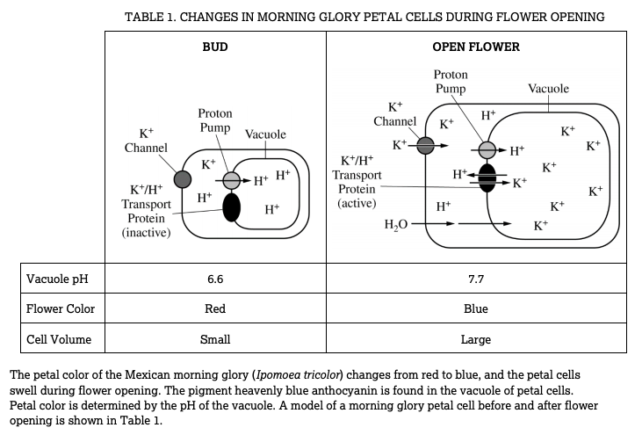
Popular Key Words—DESCRIBE
To give a picture of something
in words
Example:
Identify the cellular component in the model that is responsible for the increase of the pH of the vacuole during flower opening AND describe the components role in changing the pH of the vacuole
The cellular component in the model that is responsible for the increase of pH is the K+/H+ transport protein. This transport protein opens and closes to allow the passage of H+ ions in or out of the vacuole, which is directly responsible in changing the pH.

Slide 12
How NOT to Describe
pH is a logarithmic expression of the acidity or alkalinity of a solution. When more H+ is present, the solution creates more H3O+ or hydronium and lowers the pH. When the solution contains more OH- or hydroxide, the pH is increased. Because the K+/H+ transport protein moves H+ across the vacuole membrane, it is a key component in changing the pH.
Too much detail. Be SHORT. Only tell the readers what they need to answer the question. We don’t need to know about logarithmic expression or hydronium or hydroxide, they simply want to know you that you understand the big idea that the presence of H+ effects pH

Slide 13
Popular Key Words—PREDICT
Say or estimate what will happen in the future
Must be a FACTUAL statement
Often coupled with a second key word--JUSTIFY
Example:
Many protists contain an organelle called a contractile vacuole that pumps water out of the cell. If a group of protists were grown in a medium with a lower solute concentration, predict the activity of the contractile vacuole and justify your prediction.
The contractile vacuole activity will increase

Slide 14
How NOT to Predict
I believe that the contractile vacuole activity will stop OR I think that the contractile vacuole activity will stop
The readers do not care about what you think or believe
It is my prediction that the activity of the contractile vacuole will most likely increase.
Too flowery. Just give them a short and sweet statement

Slide 15
Popular Key Words—JUSTIFY
Give a good reason for something, or show it to be right
Example (same as before):
Many protists contain an organelle called a contractile vacuole that pumps water out of the cell. If a group of protists were grown in a medium with a lower solute concentration, predict the activity of the contractile vacuole and justify your prediction.
The contractile vacuole activity will increase because the environment has a higher water potential than inside the protist, causing an increase of water moving into the protist that must be pumped out.

Slide 16
How NOT to Justify
Water potential in the cell is about the amount of work that water is capable of doing. When there are less solutes in the water, the water potential is higher. Water will tend to move from areas of high water potential to areas of low water potential. Because the protist is in a solution that has less solutes, the water potential will be greater on the outside of the cell and will move into the cell, creating a higher activity of the contractile vacuole to pump the water back out.
Again, way too much information

Slide 17
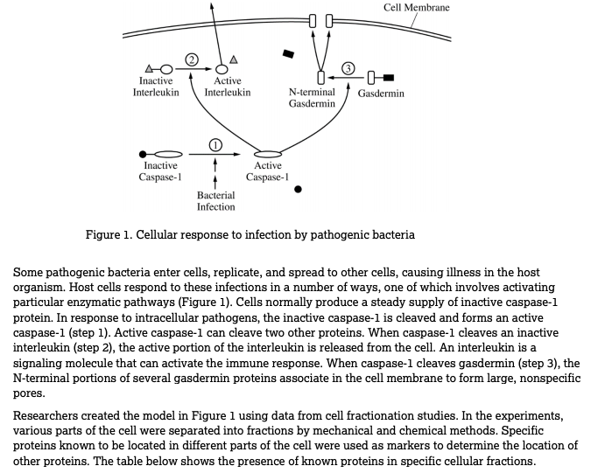
Popular Key Words—EXPLAIN
Tell how to do, give the meaning of, give reasons for
Example: Explain how gasdermin pore formation and interleukin release contribute to an organism’s defense against bacteria
Interleukin is released from the cell as a signaling molecule that will active the immune response. Pores in the cell membrane will cause the cell to fill with water and burst. The bursting of the cell will keep the infection from spreading

Slide 18
How NOT to Explain
The release of interleukins activates the adaptive immune response. The adaptive immune system is a developed immune response that targets specific pathogens that the body has come into contact with before. When the interleukin is released from the cell, it acts as a signaling molecule and docks in a receptor on B cells and T cells—specific white blood cells of the immune system. When the docking occurs, B cells and T cells become activated through a signal transduction pathway to respond to the infection.
Too much information. The reader just wants to see that you understand one cell signaling to another to come and help destroy the pathogen—the activation of an immune response.

Slide 19
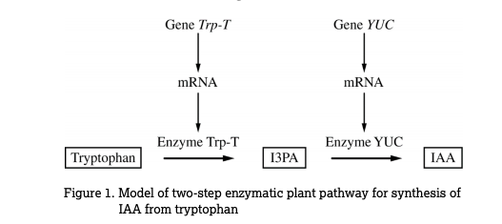
Popular Key Words—IDENTIFY
Name, list, or give an example
Example:
Identify the molecule that would be absent if enzyme YUC is non-functional
The molecule that would be absent would be IAA.

Slide 20
How NOT to Identify
IAA
The College Board prefers that you write in complete sentences/complete thoughts
The molecule that would be absent is IAA. When an enzyme is non-functioning, it is next to impossible for a product to be made randomly, without catalyzation. For this reason, if the enzyme YUC is ineffective, the product IAA will not be able to be made from the reactants.
Too much information to sift through. Make it easier for them to read.

Slide 21
Popular Key Words that are More Specific
Complete or Construct—occasionally they will ask you to complete a diagram or construct a graph. They will ALWAYS provide you with a template or framework to do so. Be sure to read carefully what is specifically asked of you to complete and do no more.
Calculate—math does make an appearance in FRQs. Be sure to do all the math on the paper to ensure you don’t make mistakes. Report the math requested in sentence form and be sure it is well labeled.
Circle or Draw—sometimes they will ask more specific things of you, such as circling a portion of a diagram or model that is responsible for a certain function or they may ask you to draw a model of something
Artistic skills are not graded here. They are simply seeing if you can demonstrate your knowledge through modeling or selecting specific areas of a model
Estimate—estimations are occasionally asked for and are usually in regard to extrapolating or interpolating data on a graph

Slide 22
Designing an Experiment Example
What would be the null hypothesis?
Caffeine has no effect on the number of floral visits by bees
What would be the appropriate control treatment?
A flower without caffeine added
What is your prediction?
Caffeine would stimulate bee visits because…

Slide 23
Popular Key Phrases—DESIGN AN EXPERIMENT
Understand the problem
Determine your independent variable—what are you manipulating?
Determine your dependent variable—what is the measured outcome?
Determine your controlled variables—what things have to stay the same from group to group?
Design a control group—the standard to compare your experimental groups to
Write out a null hypothesis and an experimental hypothesis

Slide 24
Proper Graphing Techniques
Use the correct graph
Bozeman science has the best review of graph types and uses
Be sure to title the graph
Include the dependent variable as well as the independent variable
Label the X axis and Y axis
Use appropriate increments on your grid lines

Slide 25
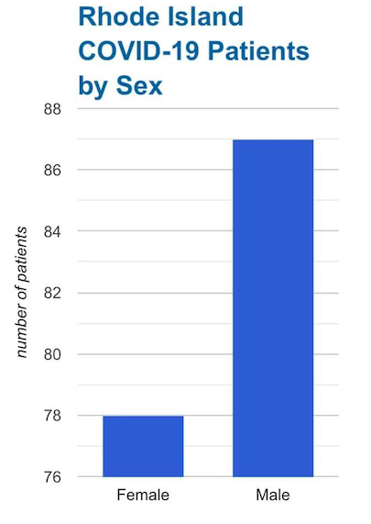
Recent Graphs in the New
What does this graph lead you to
believe at first glance?

Slide 26
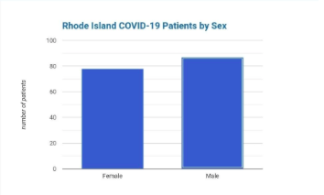
More Appropriate Graph

