Slide 1
AP Biology Exam Unit 3 Review Byron Strohm

Slide 2
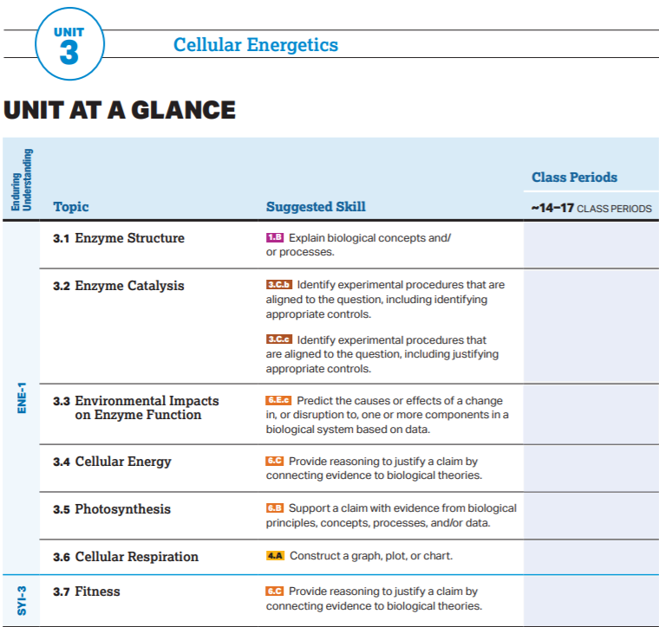

Slide 3
AP Biology Exam Review
3.1-3.3

Slide 4
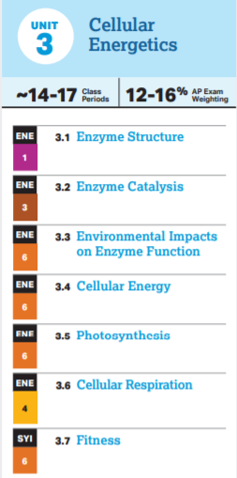
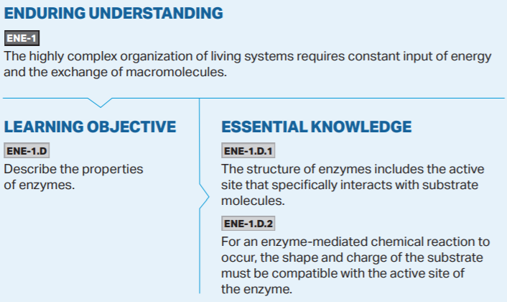

Slide 5
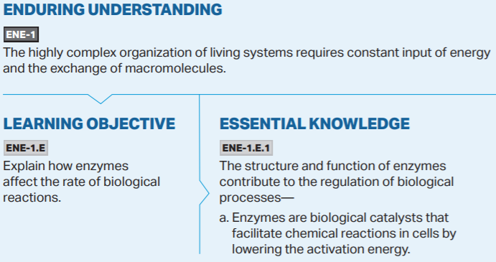

Slide 6
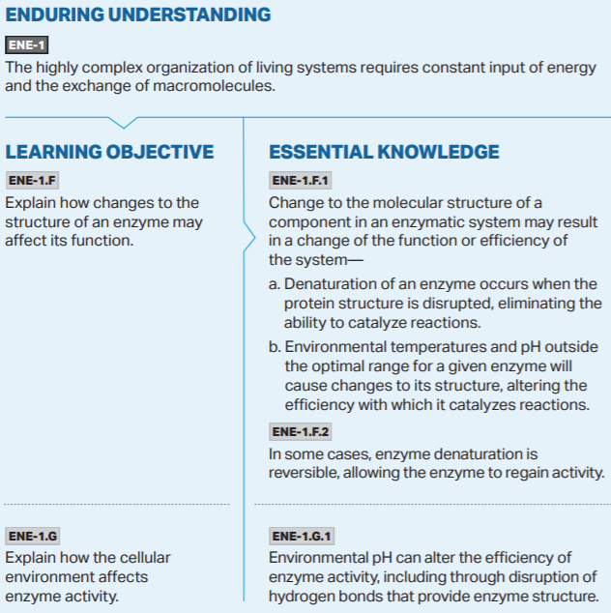
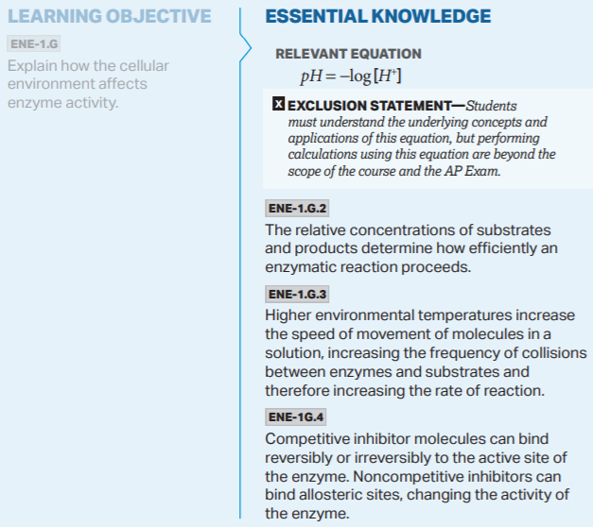

Slide 7
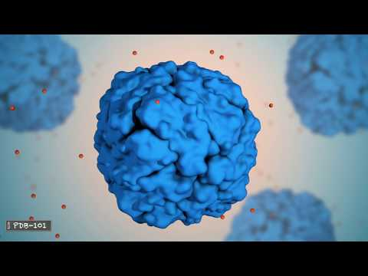

Slide 8
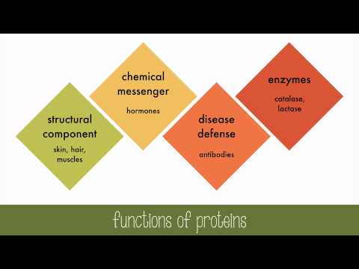

Slide 9
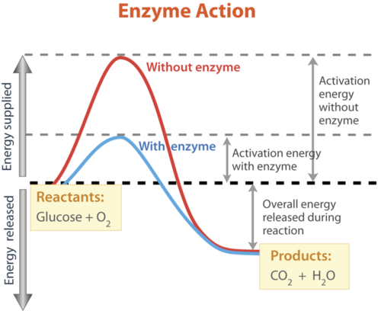

Slide 11
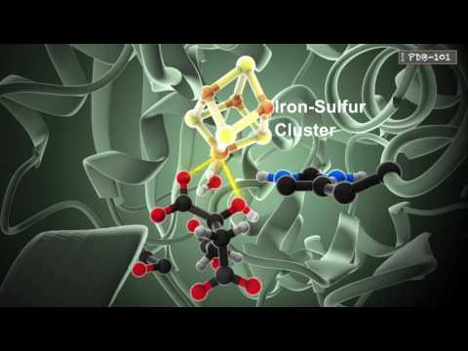

Slide 12
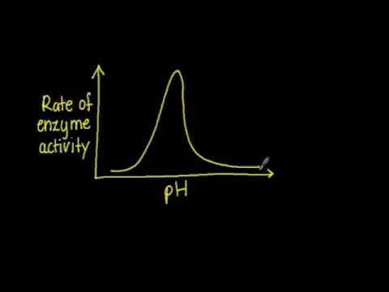

Slide 13
AP Biology Exam Review
3.4

Slide 16
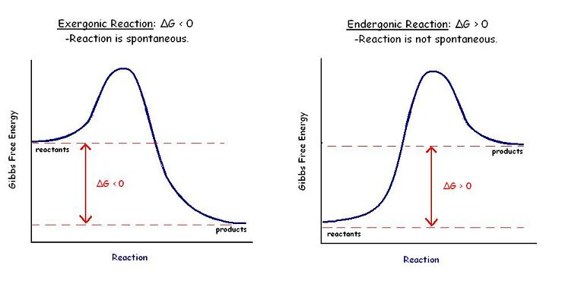

Slide 17
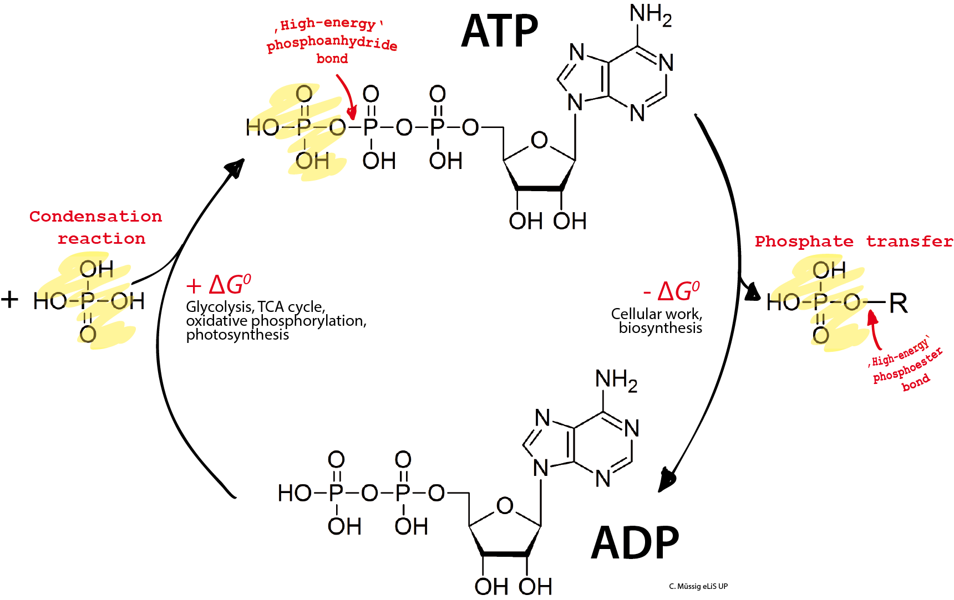

Slide 19
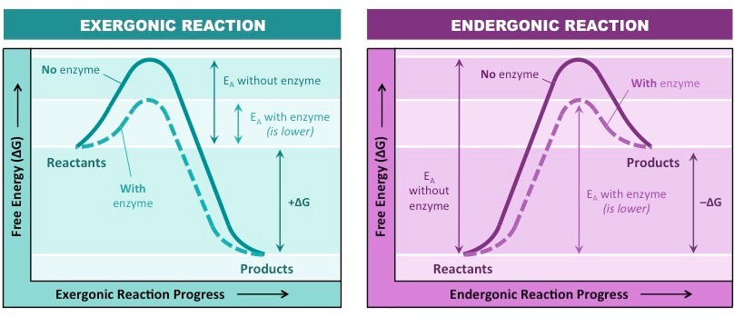

Slide 20
AP Biology Exam Review
3.5

Slide 21
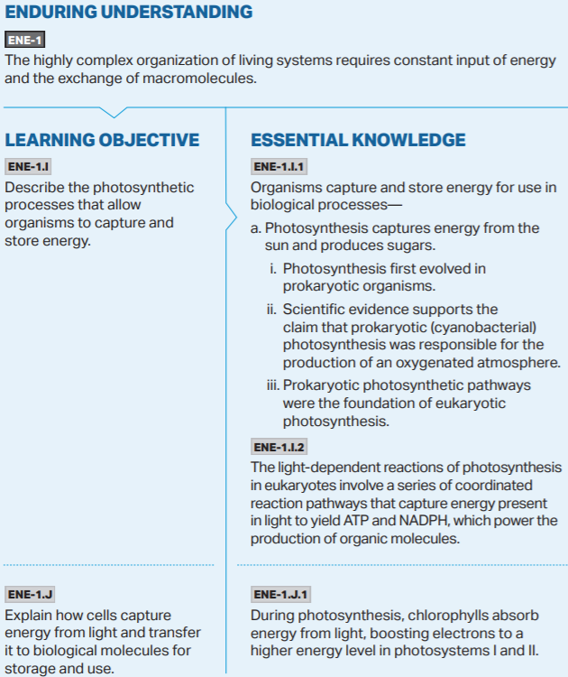
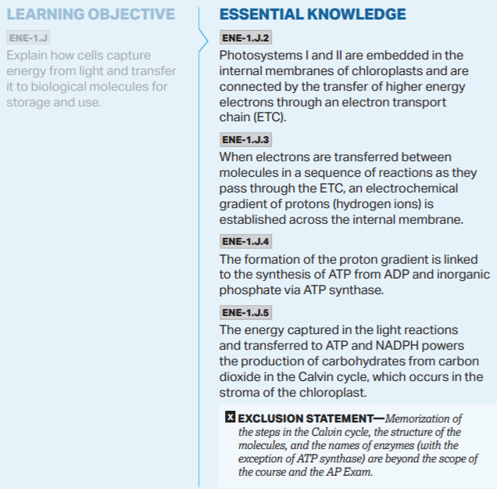

Slide 23
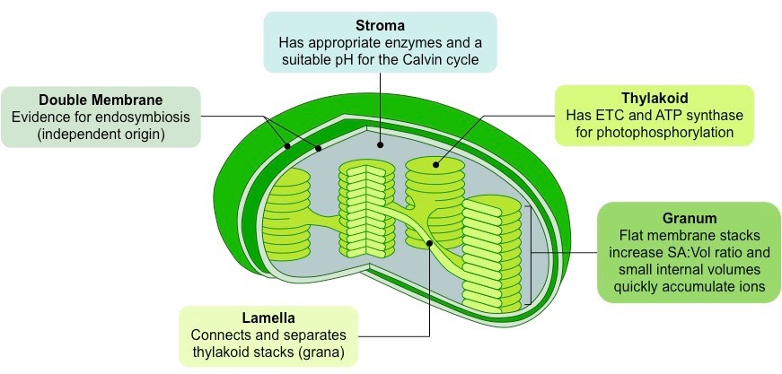

Slide 25
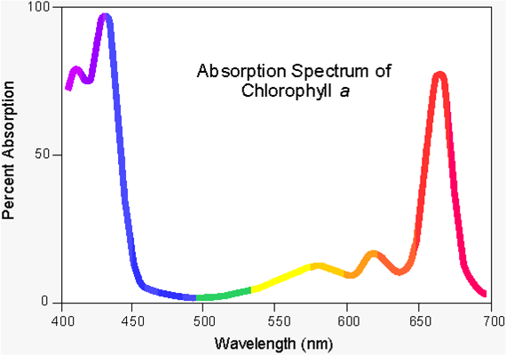

Slide 28
AP Biology Exam Review
3.6

Slide 29
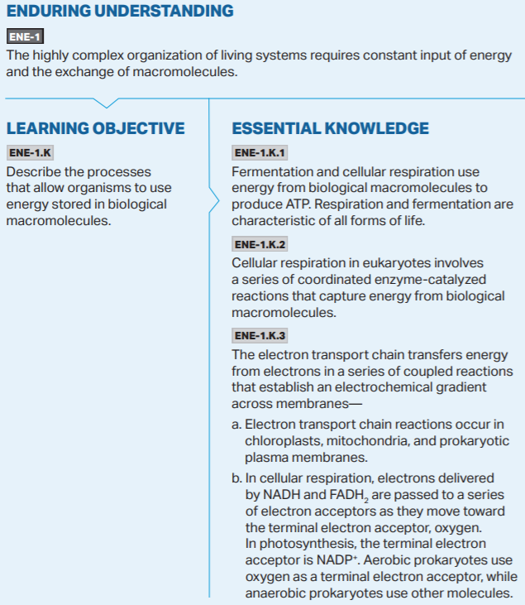
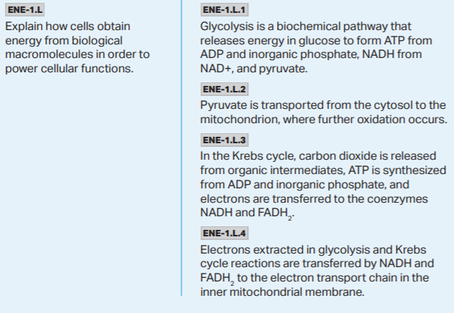
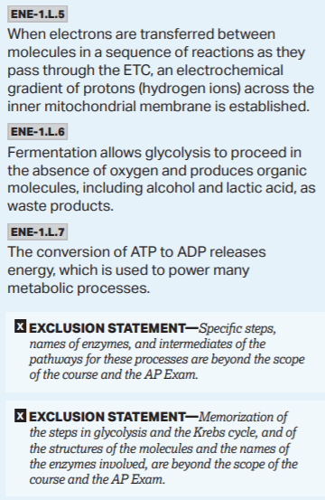
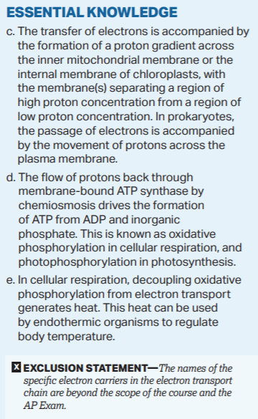

Slide 32
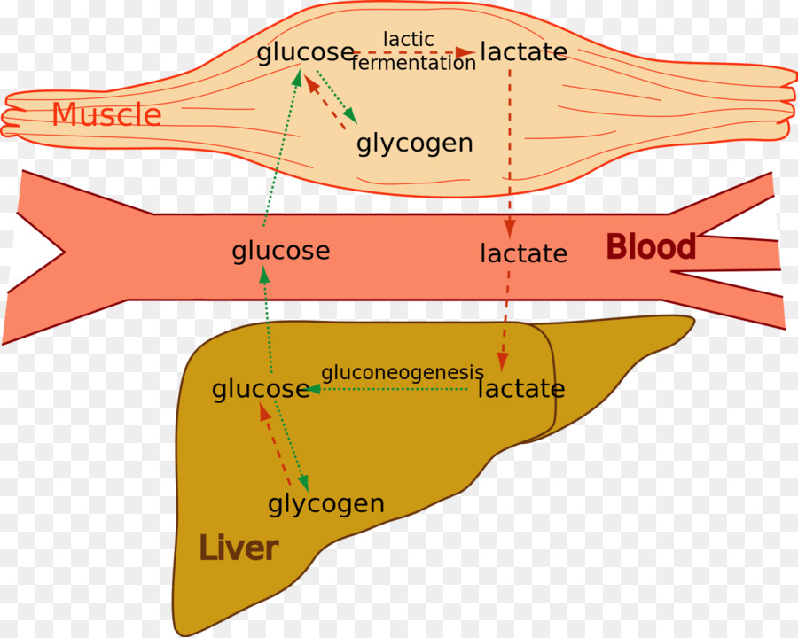

Slide 33
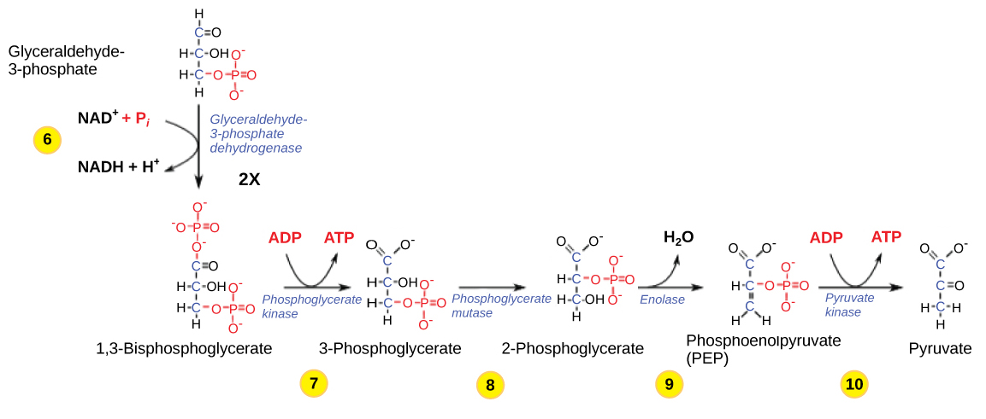
Aerobic Respiration - A Tour in Diagrams
Glycolysis

Slide 34
Aerobic Respiration - A Tour in Diagrams

Slide 35
Aerobic Respiration - A Tour in Diagrams

Slide 36
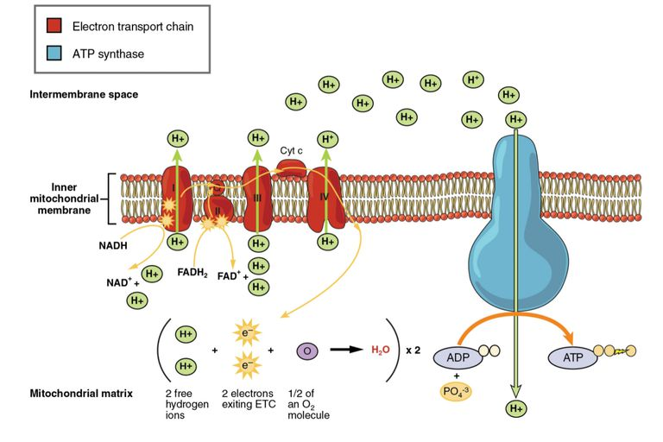
Aerobic Respiration - A Tour in Diagrams
Electron Transport Chain

Slide 37
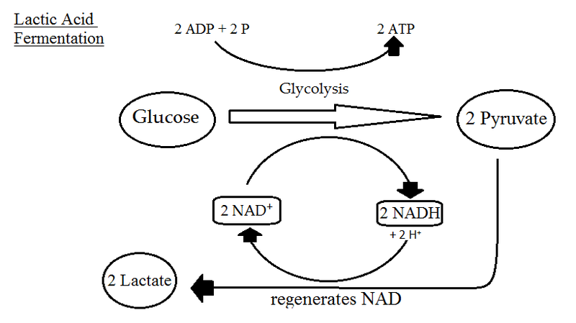

Slide 38
Tylenol Murders Case Study

Slide 39
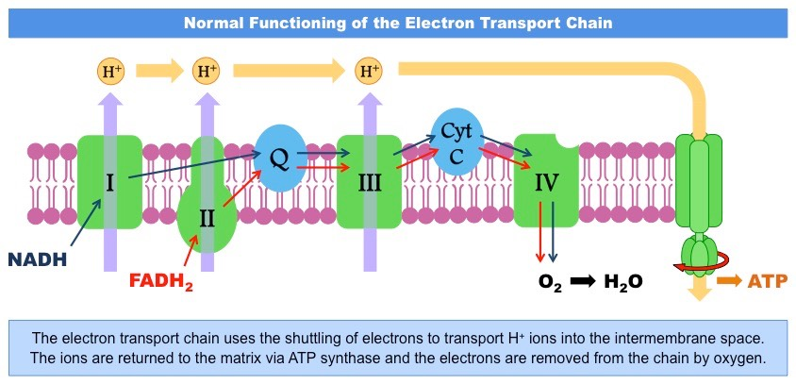

Slide 40
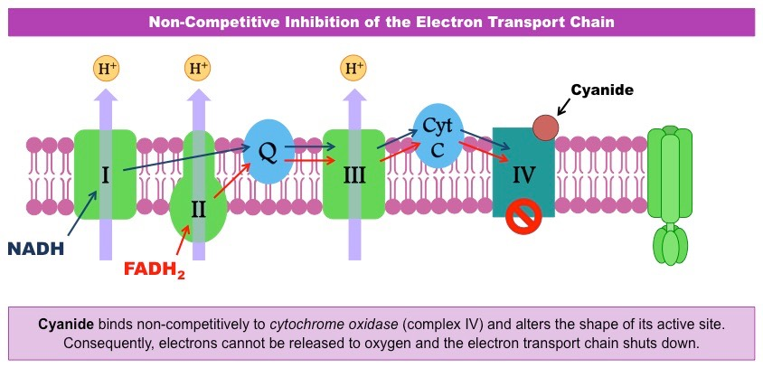

Slide 41
Cyanide Poisoning leads to abnormally high Blood Oxygen Levels. Why is this?
Oxygen enters cells through diffusion from the blood
Cyanide shuts down the ETC which means that cellular Oxygen is not being consumed (converted into water at the end of the ETC)
Due to the build up of cellular oxygen, the concentration gradient between the blood and body cells diminishes leading to no diffusion of O2 from the blood and into the cells. This causes high blood oxygen levels
Lower O2
Higher O2

Slide 42
AP Biology Exam Review
3.7

Slide 43
