Slide 1
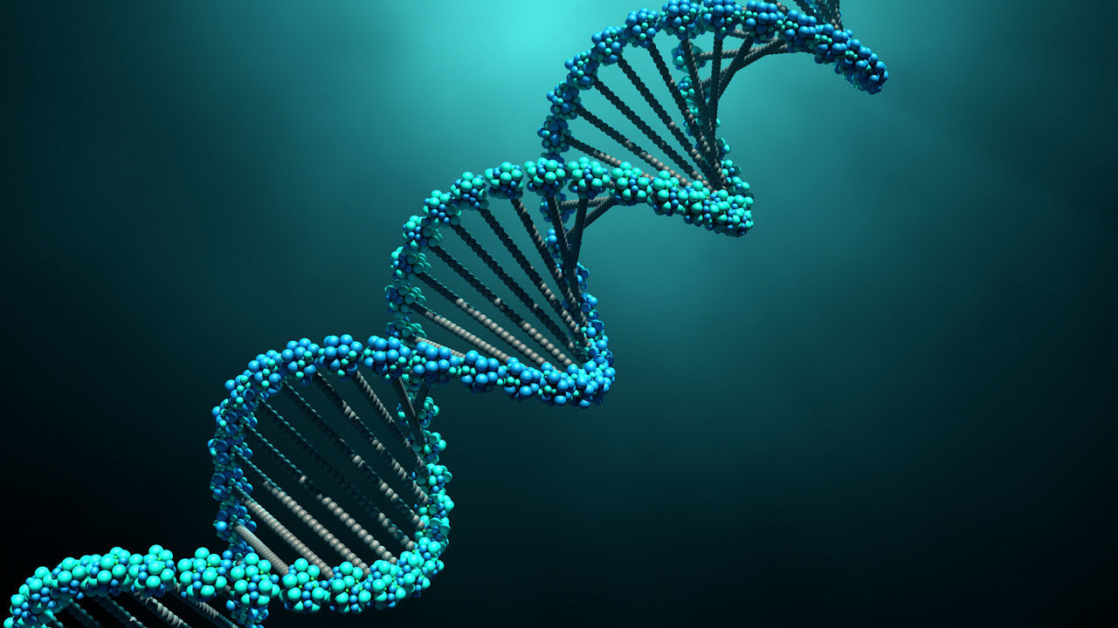
AP Biology Exam Unit 6 Review Byron Strohm

Slide 2
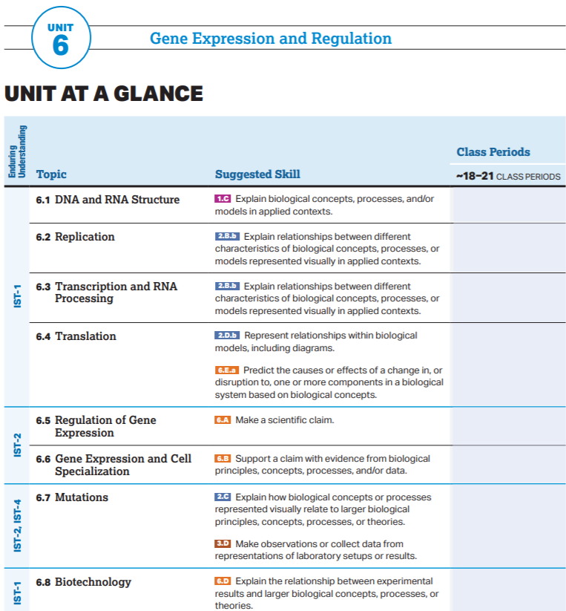

Slide 3
AP Biology Exam Review
6.1

Slide 4
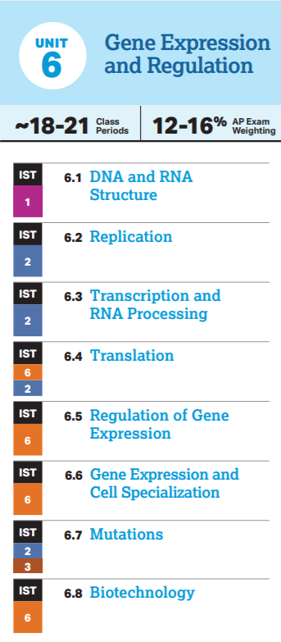
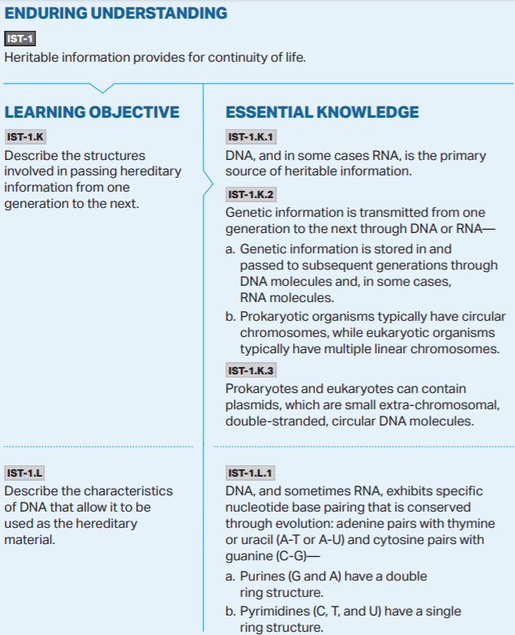

Slide 6
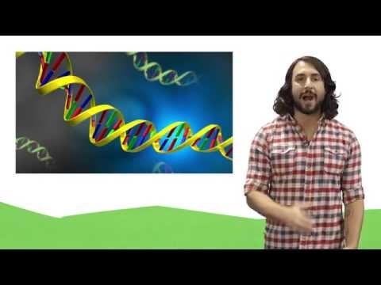

Slide 8
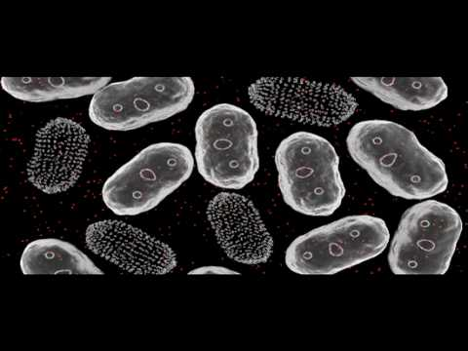

Slide 9
AP Biology Exam Review
6.2

Slide 11
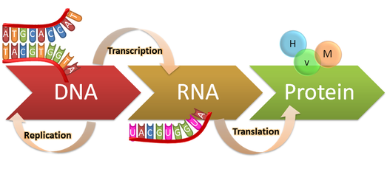
Occurs in Nucleus
Occurs in Cytoplasm

Slide 12
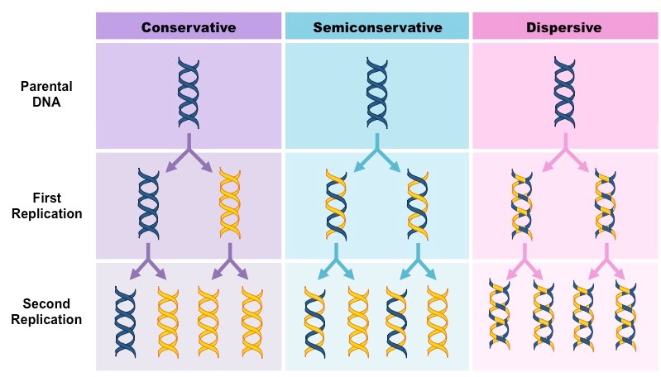
DNA Replication occurs through a Semiconservative Model

Slide 13
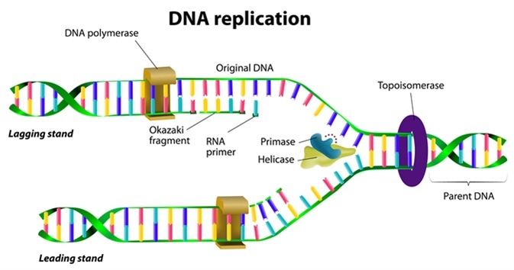

Slide 14
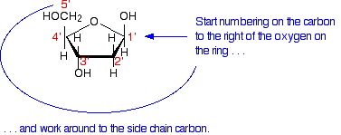
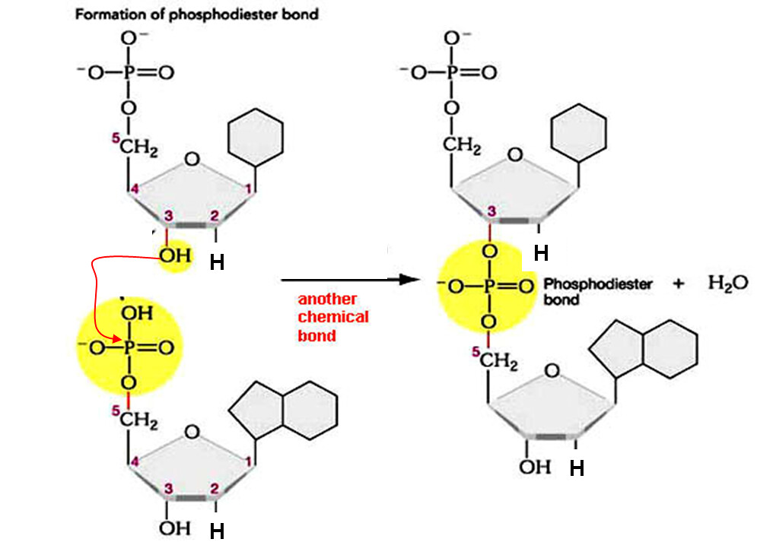
DNA Polymerase can only add free DNA nucleotides to an exposed 3’ carbon on the adjacent Deoxyribose Sugar
Dehydration (Condensation) Synthesis

Slide 15
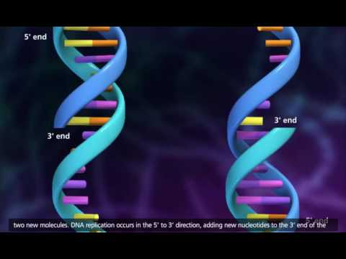

Slide 16
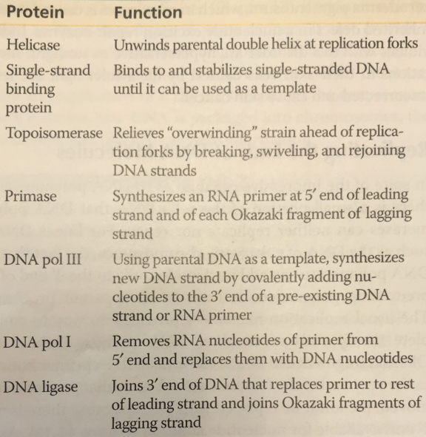
Enzymes of DNA
Remember that enzymes derive their unique function directly from their structure. This means that they have significant limits in what they can and cannot do.
For instance, DNA Pol III can ONLY add DNA nucleotides to a free 3’ carbon on another nucleotide.

Slide 17
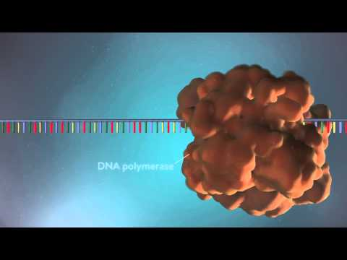

Slide 19
AP Biology Exam Review
6.3

Slide 20
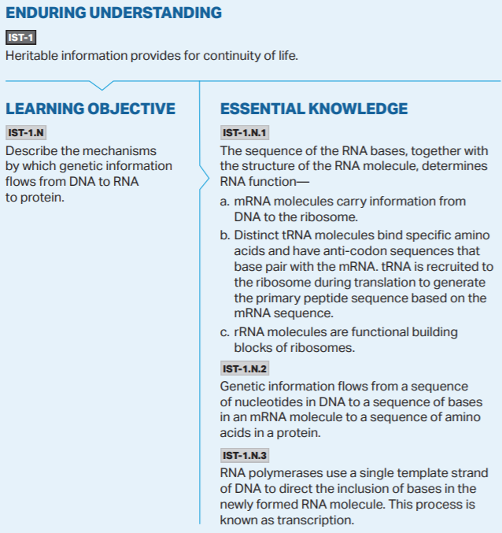
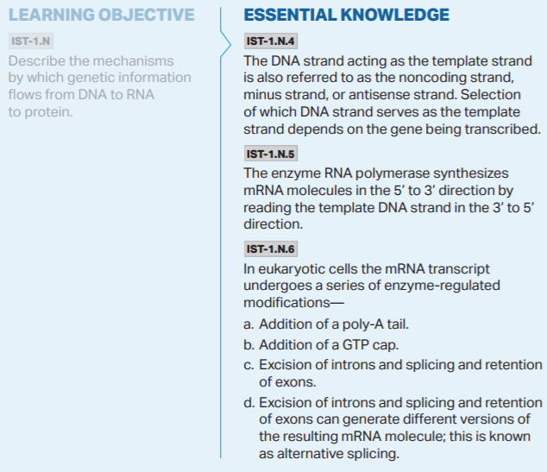

Slide 21
Occurs in Nucleus
Occurs in Cytoplasm

Slide 22
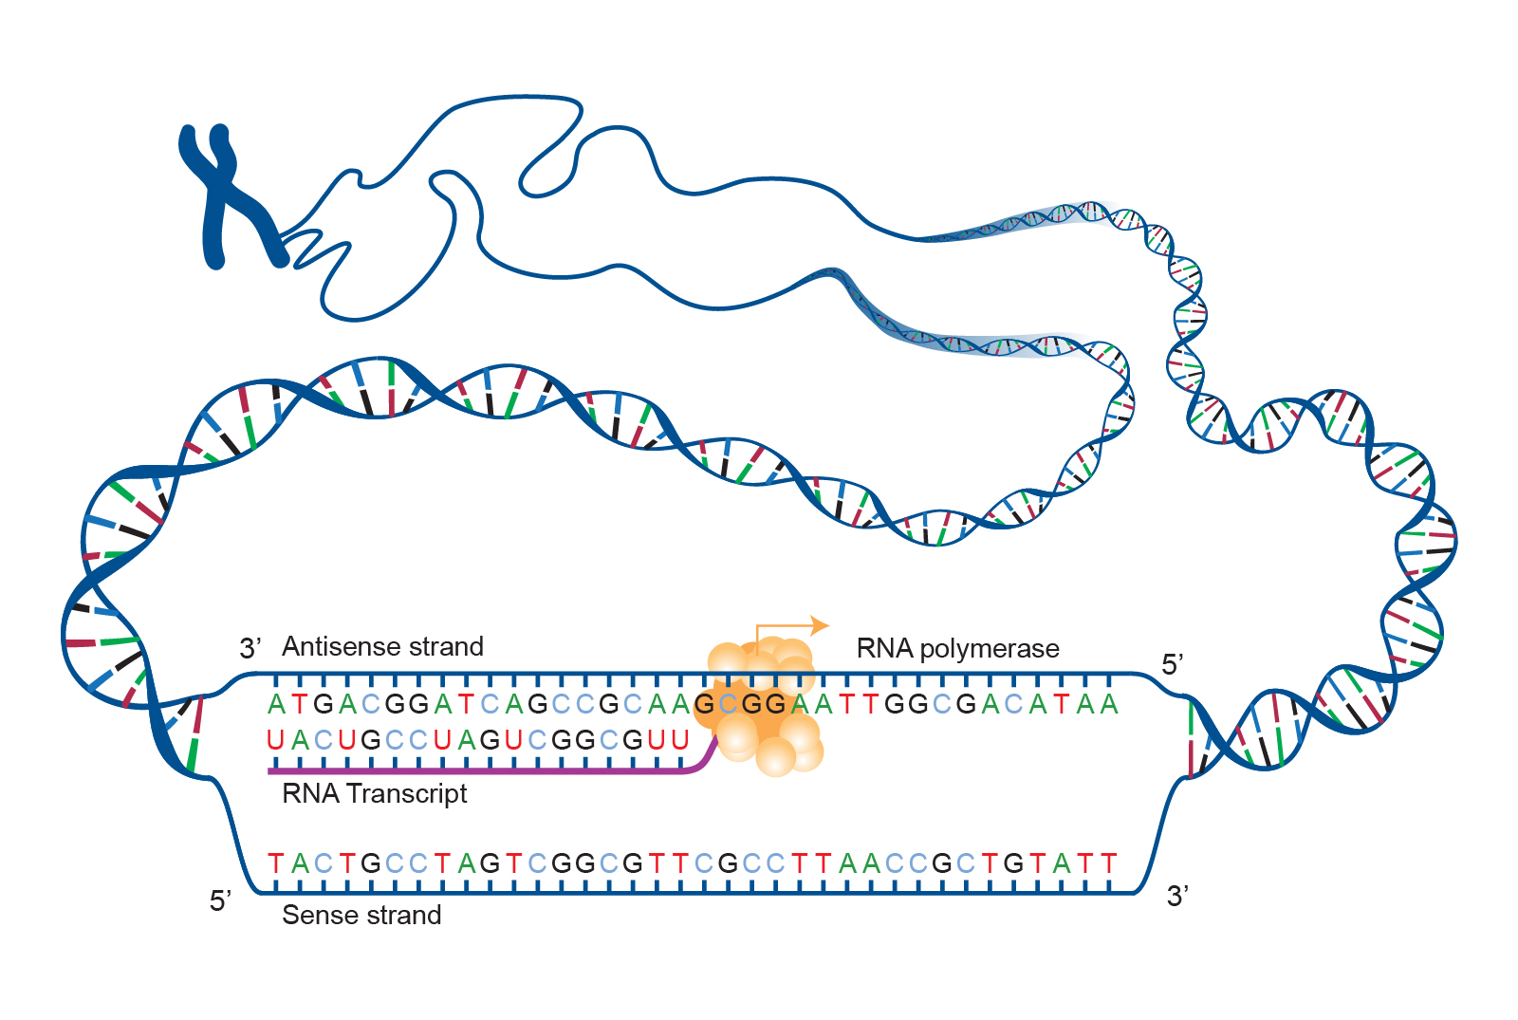

Slide 23
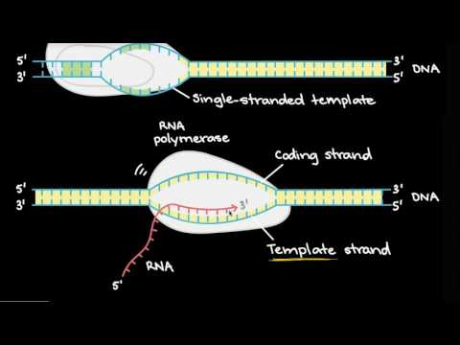

Slide 24
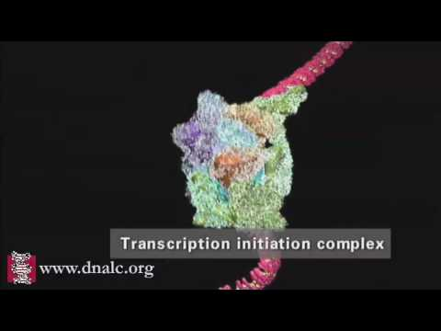

Slide 25
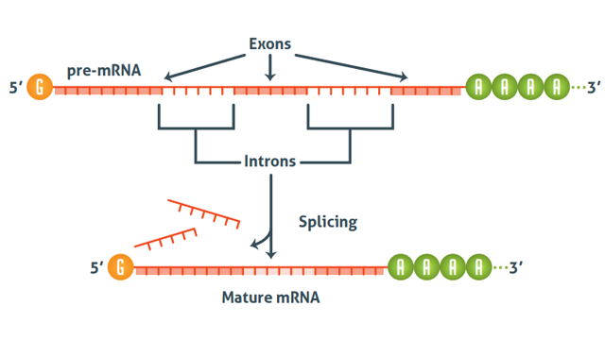
Following Transcription, the pre-mRNA molecule must be processed into mature mRNA before being exported from the nucleus into the cytoplasm.

Slide 26
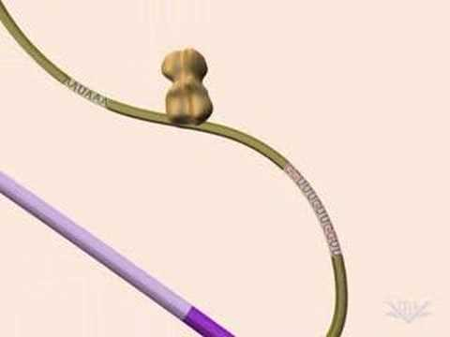

Slide 27
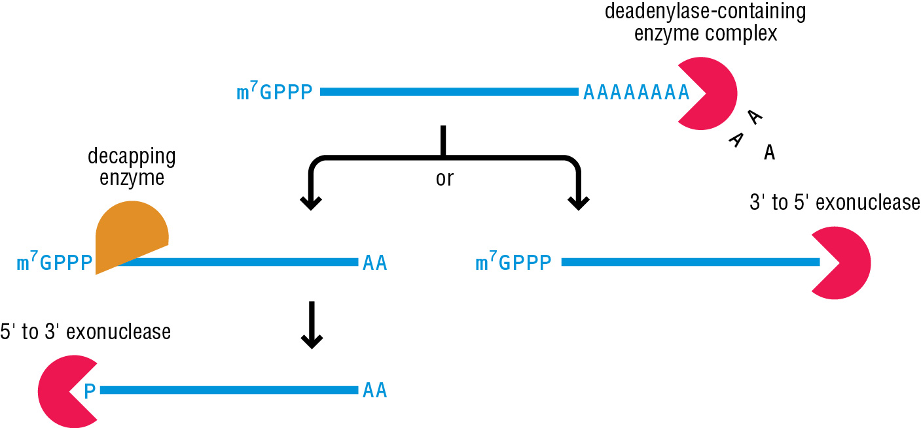
Poly-A Tail & Exonuclease
The 3’ Poly-A tail prevents the mRNA from being prematurely broken down and recycled by the enzyme Exonuclease in the cytoplasm. The length of the poly-a tail determines the “lifespan” of the mature mRNA transcript in the cytoplasm and in turn how much protein will be made from it.

Slide 28
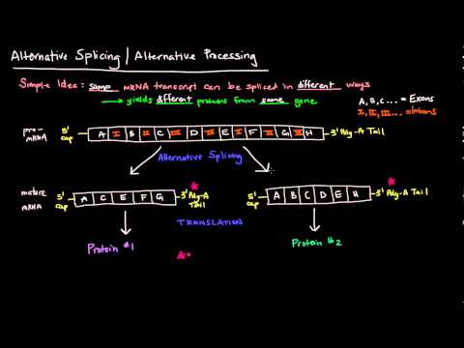

Slide 29
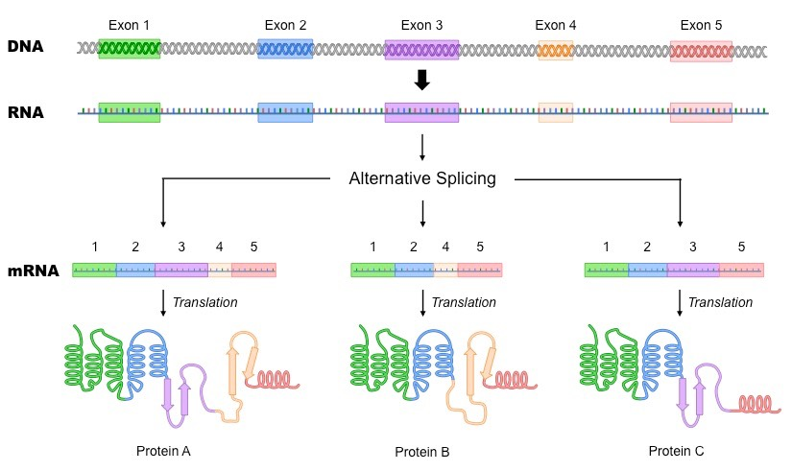

Slide 30
AP Biology Exam Review
6.4

Slide 31
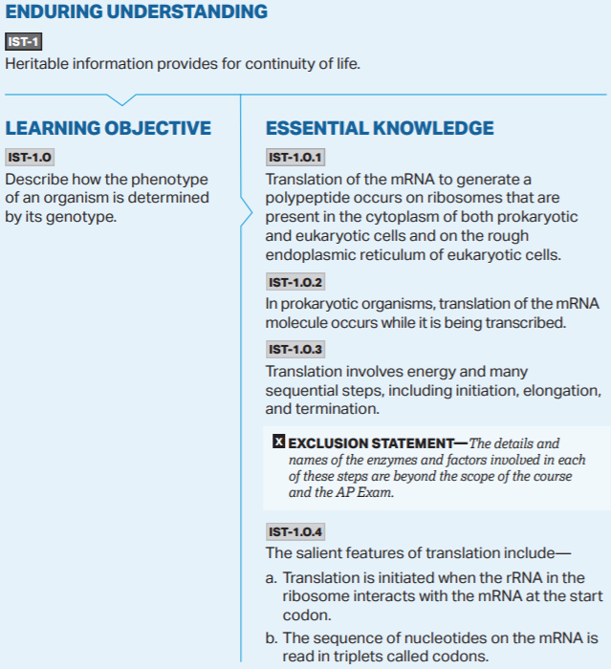
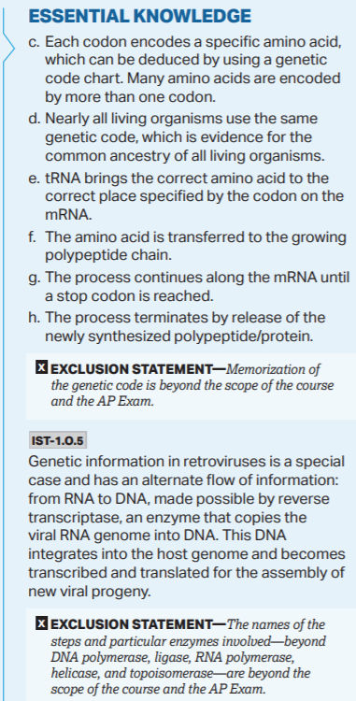

Slide 32
Occurs in Nucleus
Occurs in Cytoplasm

Slide 33
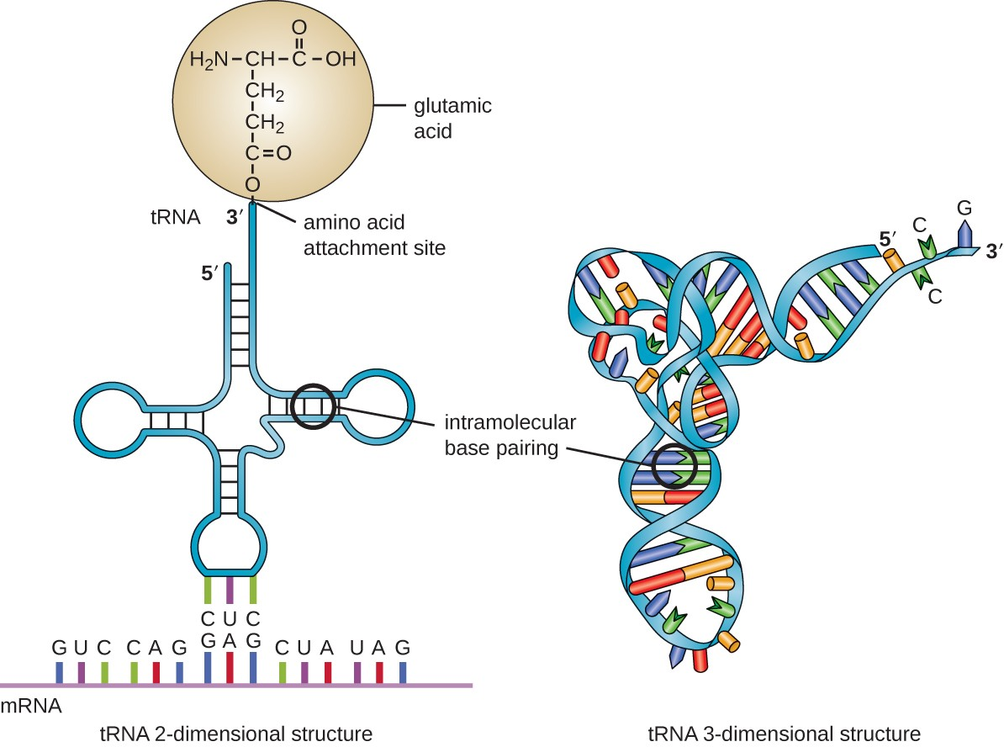
Transfer RNA (tRNA)
Anticodon

Slide 34
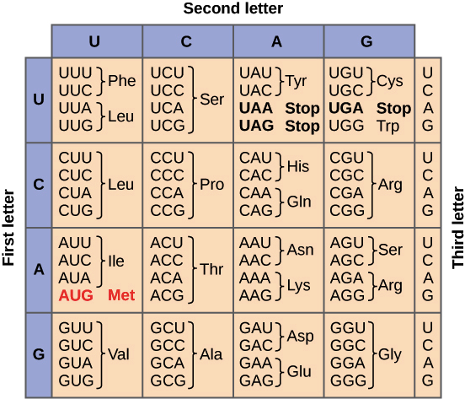
The Genetic Code
This chart shows the mRNA Codons which correspond to a specific tRNA carrying a specific Amino Acid.
Notice that there is some redundancy in the genetic code leading to multiple ways to code for the some Amino Acids.
Start Codon

Slide 35
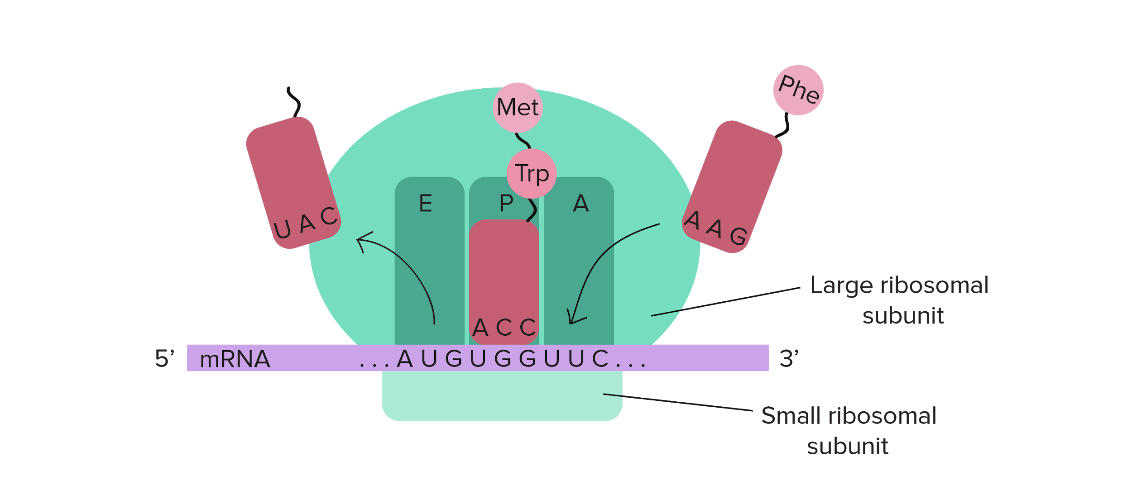
Uncharged tRNAs are ejected at the E site and then recycled by the cell
Peptide Bonds Form at the P Site (Construction of the Primary Structure of the Protein)
tRNAs enter the Ribosome at the A Site

Slide 36
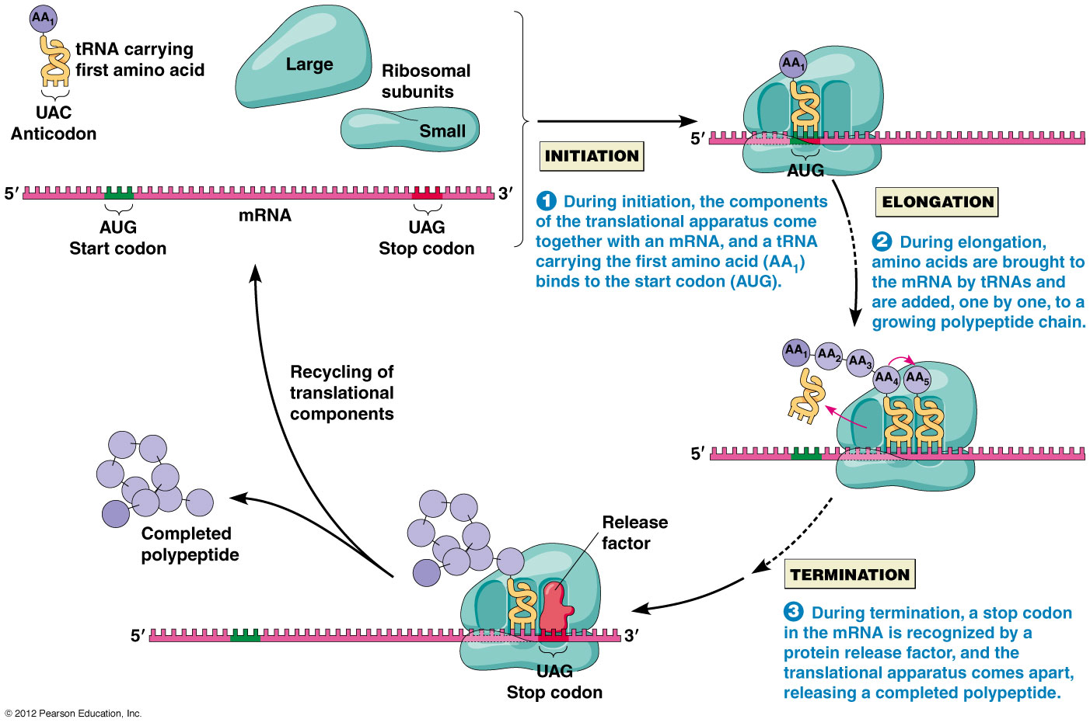

Slide 37
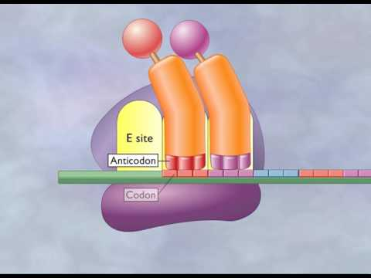

Slide 38
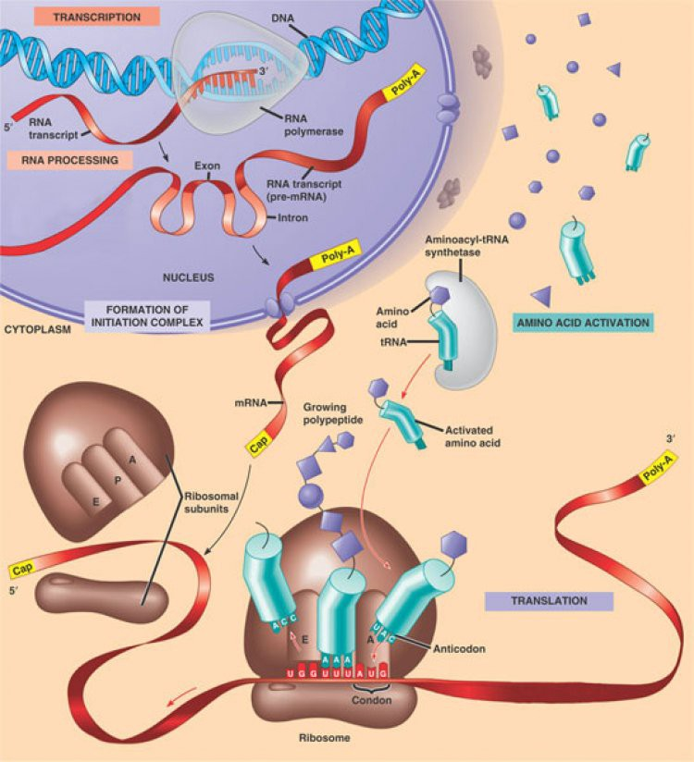

Slide 40
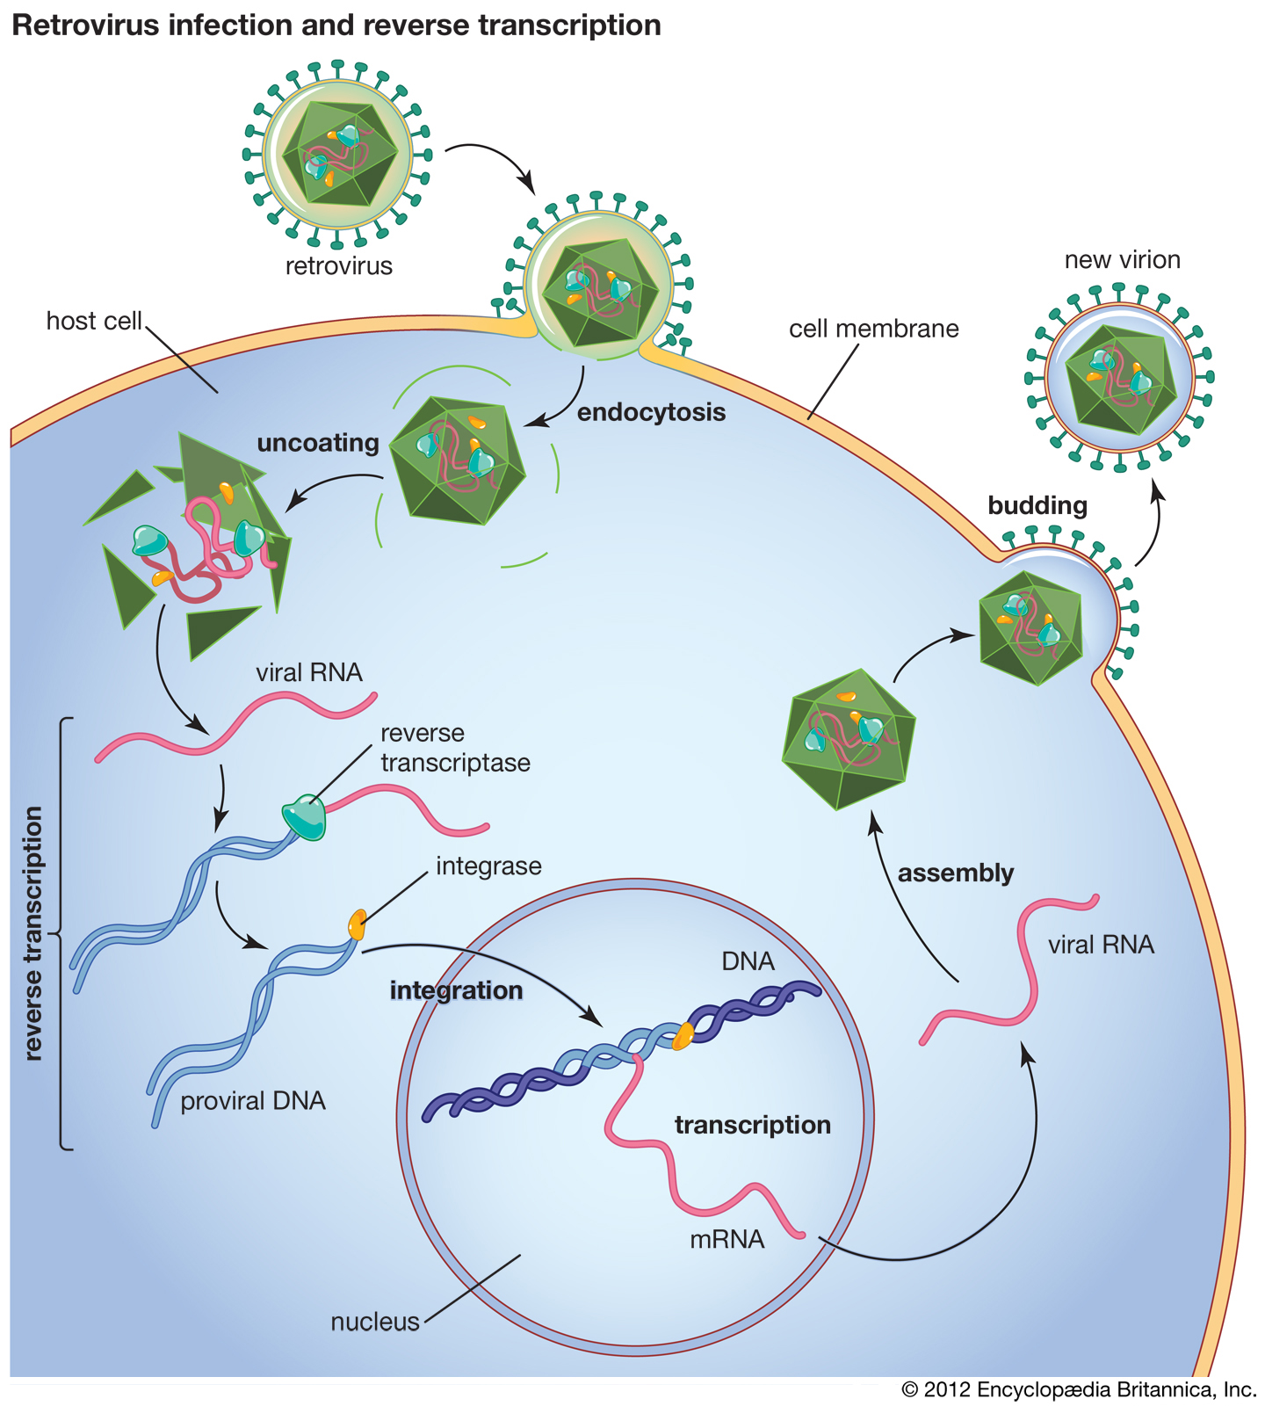
Retroviruses and Reverse Transcription
Retroviruses such as HIV work backwards from RNA → DNA using the enzyme Reverse Transcriptase.
The viral genome then enters the host cell’s nucleus where it is spliced into the host cell’s genome.
Each time the host cell replicates its genome, it now also replicates the viral genome leading to lifelong infection.

Slide 41
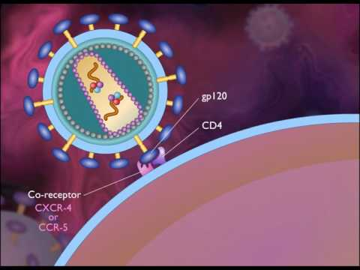

Slide 42
AP Biology Exam Review
6.5-6.6

Slide 43
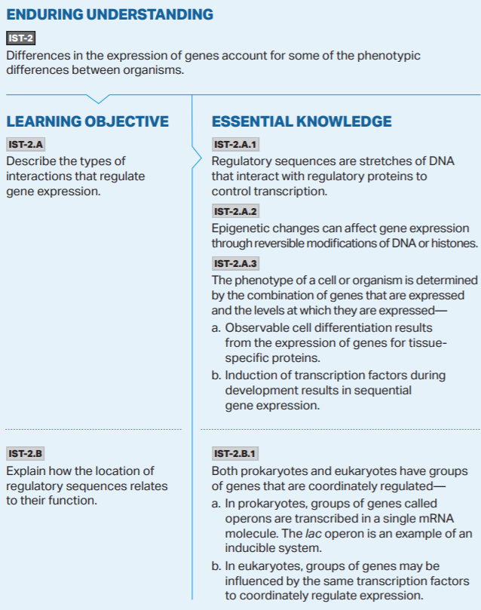

Slide 44
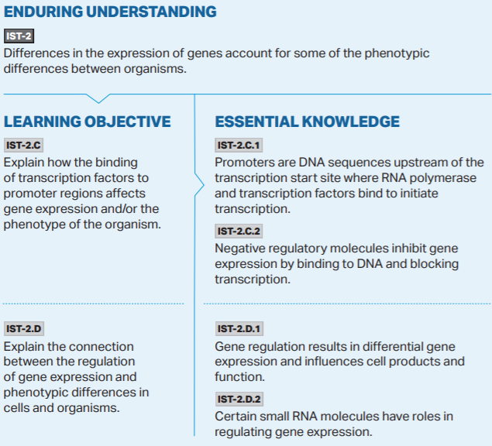

Slide 45
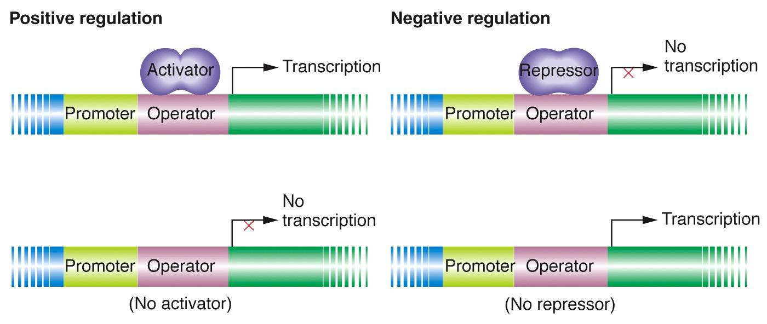
Prokaryotic Gene Regulation
How do prokaryotic organisms control when a gene is expressed and a protein is made?
*It would be energetically wasteful (and therefore evolutionarily unfavorable) to produce proteins when they are not needed
*Most gene regulation is controlled at the level of Transcription
Positive Gene Regulation: A regulatory protein binds to the gene and triggers Transcription to begin
Negative Gene Regulation: A regulatory protein removed from the gene and triggers Transcription to begin

Slide 46
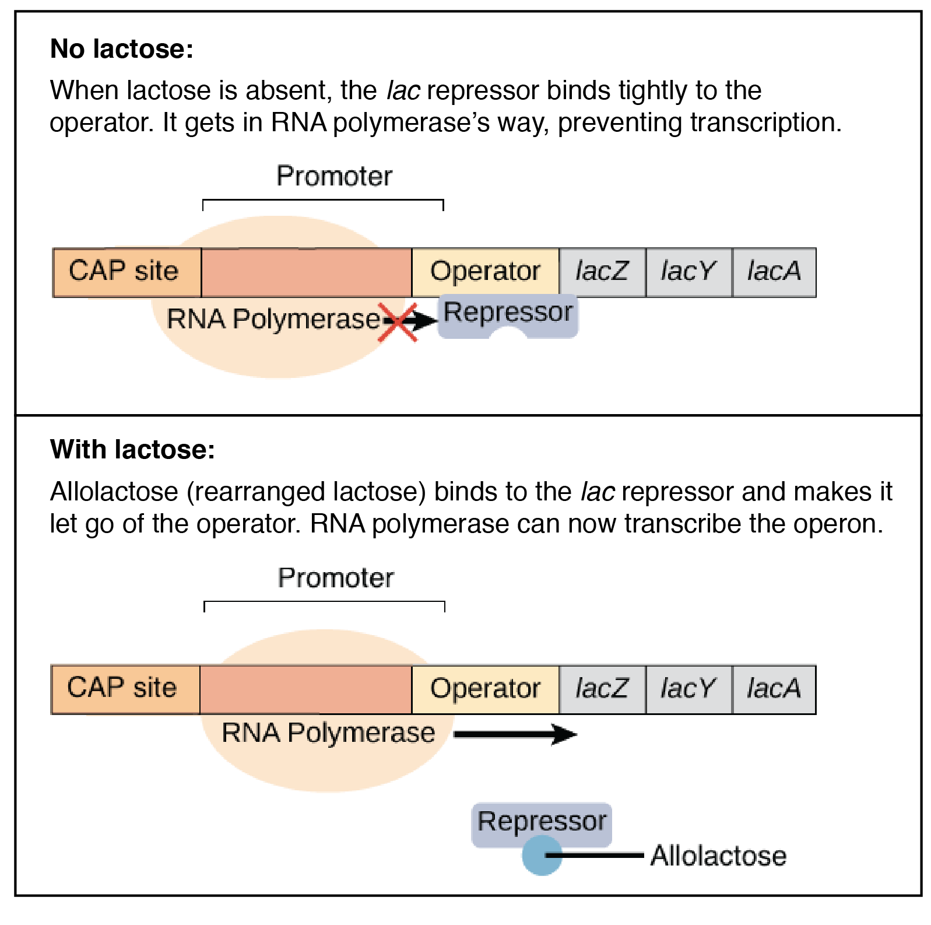
The Lac Operon found in Ecoli is an excellent example of both positive and negative gene regulation.
This is a method in which the Ecoli only produces the enzyme Lactase (for the breakdown and utilization of Lactose sugar for energy) when Lactose levels are high and Glucose levels (their prefered nutrient) is low.

Slide 48
Eukaryotic Gene Regulation
Eukaryotic genomes are not set up into operons, instead Eukaryotic cells perform gene regulation using a series regulatory regions on the DNA along with performing histone modifications within the chromatin.
Vital Vocab:
Transcription Factors
Enhancer Regions
Promoter Regions
Regulatory Sequences
Histone Modification
Acetylation
Methylation
Epigenetics
Non-Coding RNA (ncRNA)

Slide 49
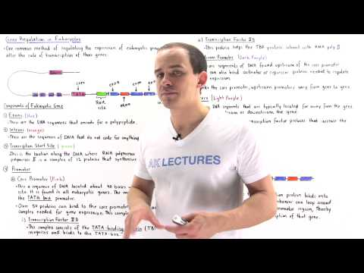

Slide 50
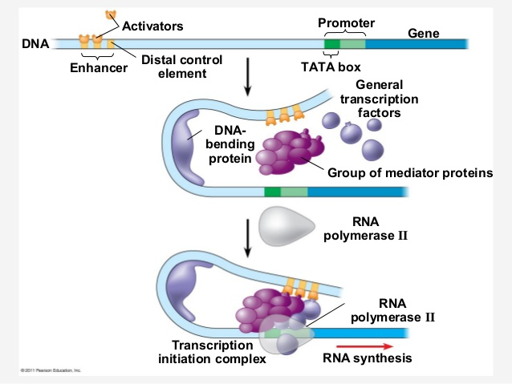
Eukaryotic Gene Regulation

Slide 51
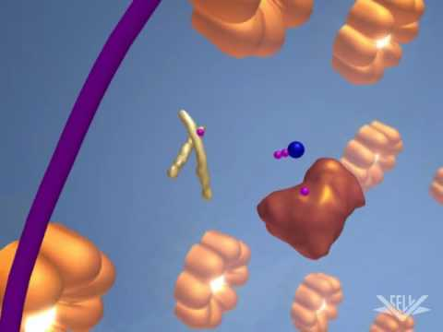

Slide 52
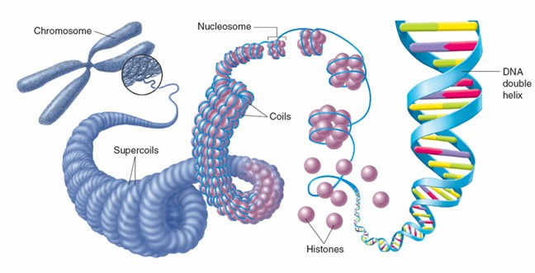

Slide 53
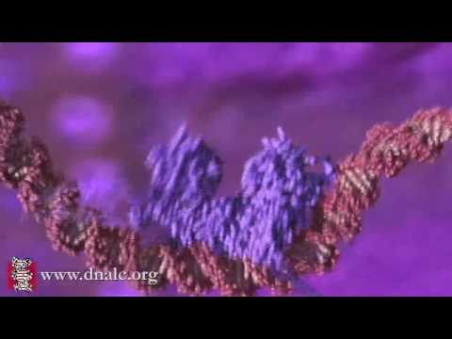

Slide 54
Gene Regulation: Histone Modification
*The extent to which stretches of DNA are wound around the histones determines how accessible that region of DNA is for Transcription
The Epigenome (above the genome) is made up of a series of specific chemical tags applied to histones which impact which genes are active and to what extent.
Methylation: Methyl groups (CH3) attach to genes (directly to the DNA itself) which deactivates some genes and enhances the expression of others. They do this by altering the ability of transcription factors to bind to the DNA. They always attach to Cytosines bordered by Guanines in the 5’ → 3’ direction
Histone Modification: Histones are proteins which DNA is wound around when forming Chromatin. Certain chemical tags will cause the histones to wind the DNA tighter (inhibiting the gene expression at that loci) or looser (amplifying the gene expression.)

Slide 55
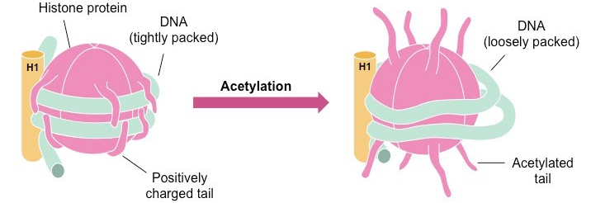
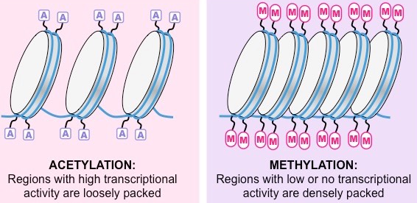

Slide 56
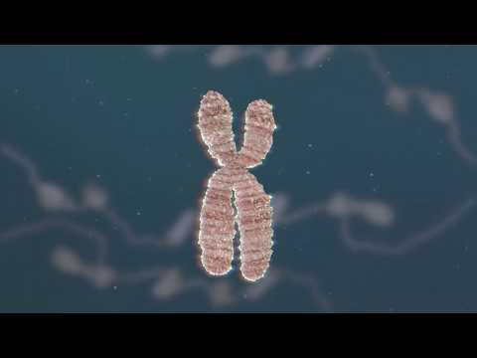

Slide 57
Gene Regulation: Non-coding RNA
ncRNA: Non-coding RNA strands which either inhibit specific genes from being translated, or inhibit proteins from being finished following translation.
These three factors have been identified in forming a vast array of gene regulation outside of your inherited DNA.
The interesting thing about the epigenome, however, is the idea that your experiences may determine the location, and to what extent, these chemical markers are placed throughout your genome.
Further, it has been shown through animal studies, that roughly 1% of these genetic markers can be passed down to offspring...meaning that some of your epigenome may actually be hardwired into your offspring’s genome.

Slide 58
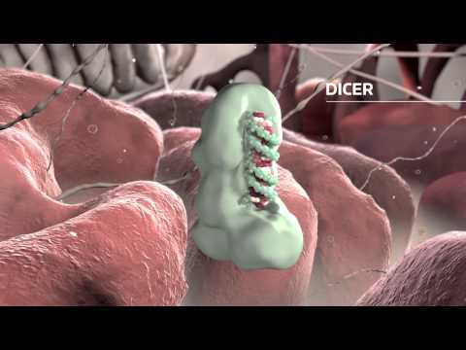

Slide 59
The Epigenome
The sum total of these three factors and their impacts make up your Epigenome

Slide 60
Epigenetics NOVA Video
https://optv.pbslearningmedia.org/asset/biot09_vid_epigenetics/

Slide 61
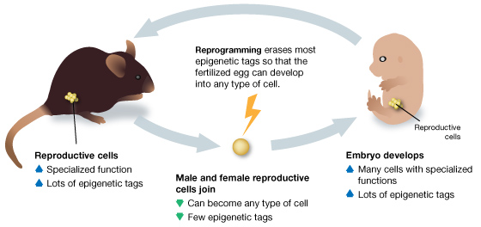
Nature vs Nurture and the Epigenome
During embryonic development, any existing epigenetic tags are supposed to be removed through a process called reprogramming. This must occur to ensure the proper differentiation of the cells within the developing tissues.
This process, however, is not perfect, and about 1% of the inherited epigenome from the parents are retained.

Slide 62
The Norm of Reaction
This does not mean that the environment can entirely change the proteins being expressed throughout the entire body. Research has shown that certain genes seem to be more susceptible to being altered.
Further, there are limits to the expression of each gene and the various phenotypes which can result from the gene. These upper and lower boundaries of gene expression are called the Norm of Reaction.
If the gene has only a set few phenotypes which it is able to produce, then it will have a low reaction norm. In this case, environmental changes will not impact the gene expression very much at all. Ex: ABO blood type.

Slide 63
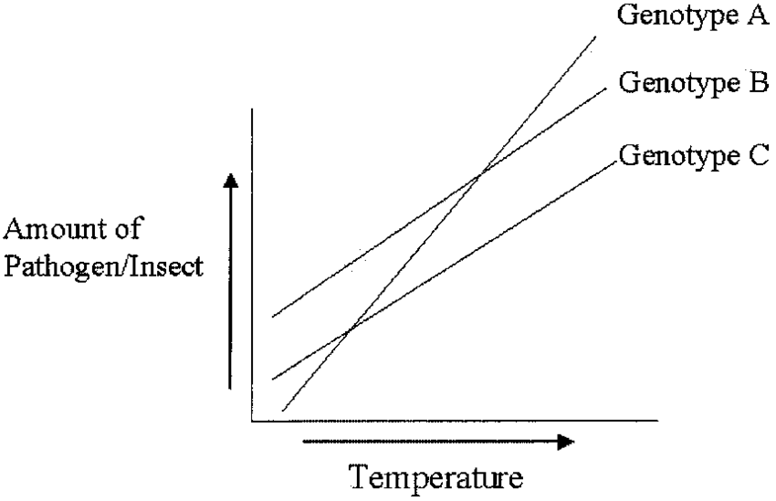
The Norm of Reaction
However, if the norm of reaction in a gene is high, then environmental changes can play a large role in the expression of the genes and in turn lead to a larger spectrum of possible phenotypes.
Ex: Red Blood Cell count and elevation. Melanin production and UV exposure.

Slide 65
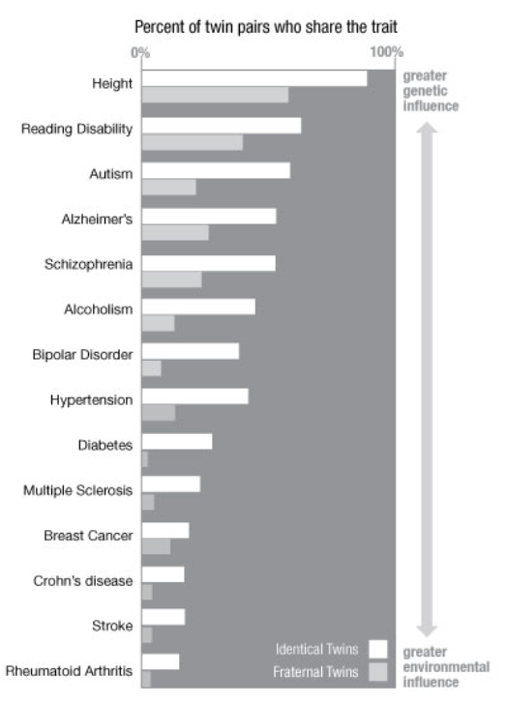
Identical twin studies are particularly useful in providing evidence for the impacts of the epigenome due to them having identical genomes.
This means that any variance in phenotype must be the product of the environment...the result of the epigenome.

Slide 67
AP Biology Exam Review
6.7

Slide 72
AP Biology Exam Review
6.8

Slide 74
Biotechnology
Gel Electrophoresis
Restriction Enzymes
Polymerase Chain Reaction
Bacterial Transformation
*You need to understand the basic science behind these procedures and their applications.

Slide 75
Image making these three guys run through a bungee maze with extremely small openings to fit through. If you gave all three the same amount of time to try and get through the maze, who will make it the furthest?

Slide 77
A DNA sample would be cut into predictable fragments using a specific Restriction Enzyme.
Larger fragments move slower through the gel due to the increased resistance from their size.
This means that large DNA fragments will not run as far down the gel as smaller fragments.
The fragments collect at particular distances as bands

