Slide 1
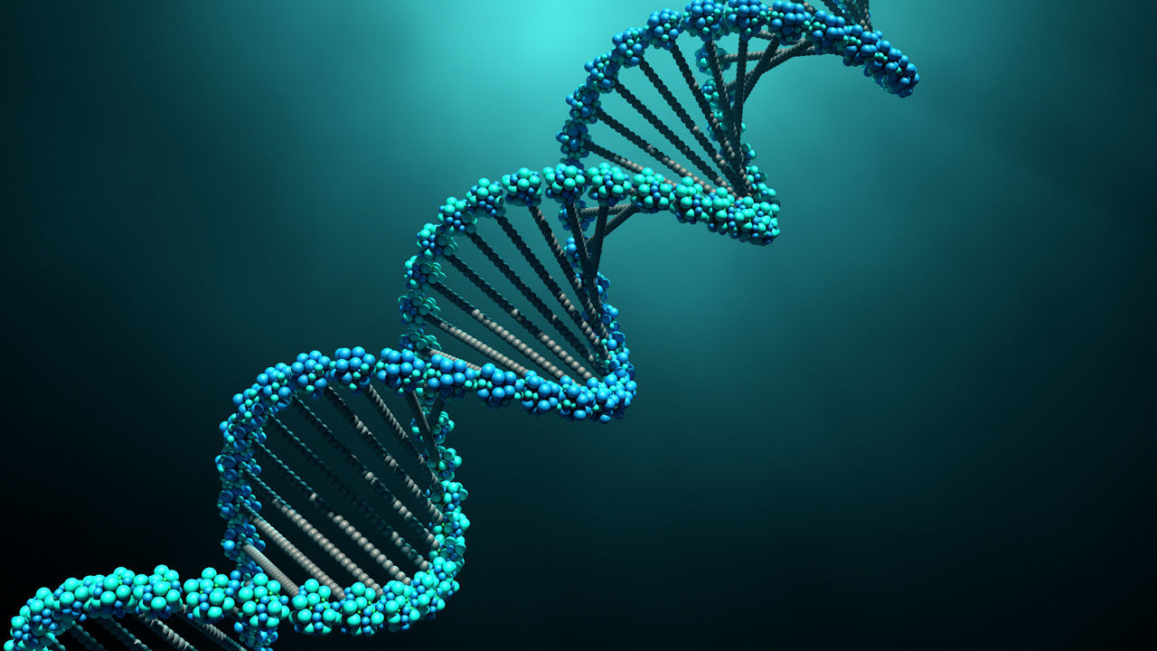
AP Biology Exam Unit 5 Review Byron Strohm

Slide 2
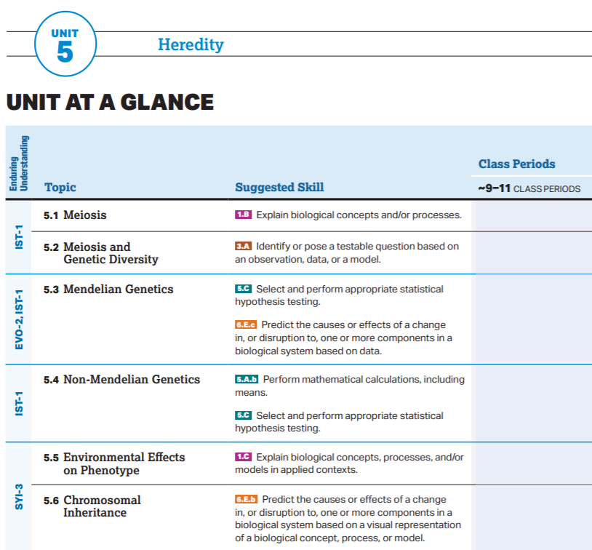

Slide 3
AP Biology Exam Review
5.1

Slide 4
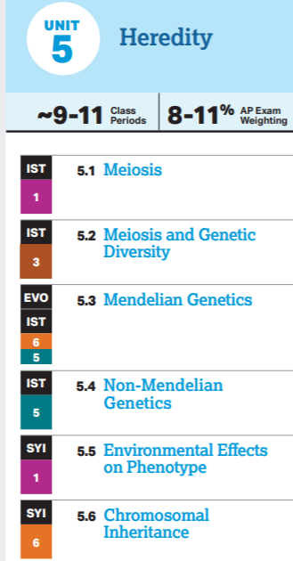
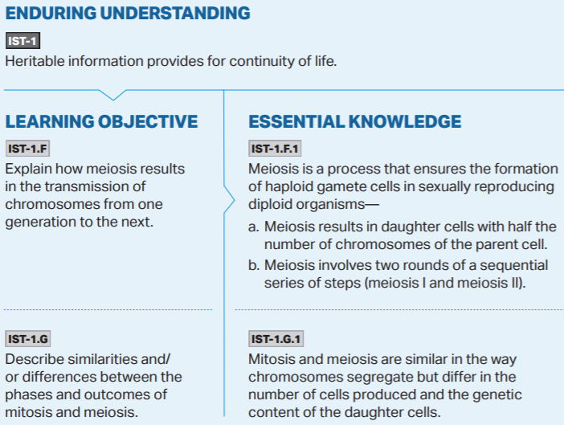

Slide 7
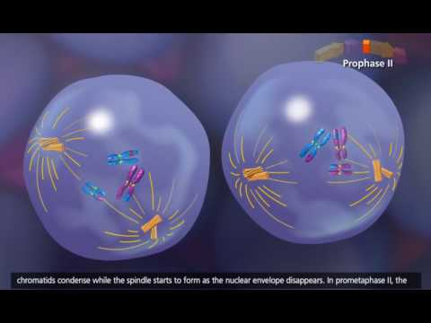

Slide 8
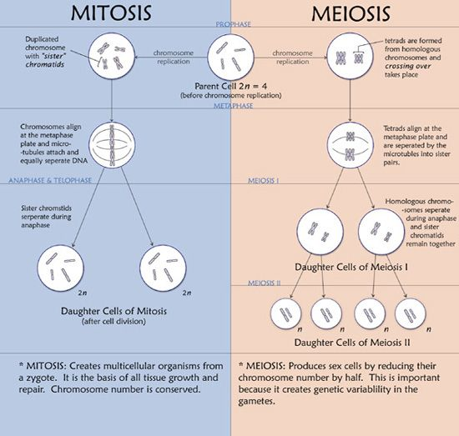

Slide 9
AP Biology Exam Review
5.2

Slide 11
Meiosis provides genetic diversity through 3 primary means:
Crossing Over and Homologous Recombination:
During Prophase I homologous chromosomes come together in tetrads and the two middle chromosomes overlap at corresponding loci. The chromosomes then exchange the overlapping regions of DNA, creating 4 genetically different chromosomes within the tetrad (2 parental and 2 hybrids)
Independent Assortment:
During Metaphase I & II the chromosomes randomly align down the metaphase plate providing a different ratio of maternal, paternal, and hybrid chromosomes in the resulting gametes.
Random Fertilization:
During sexual reproduction no one single gamete is any more likely to be used during fertilization than another gamete. This leads to the random combination of the genetic possibilities created by the two mating organisms

Slide 12
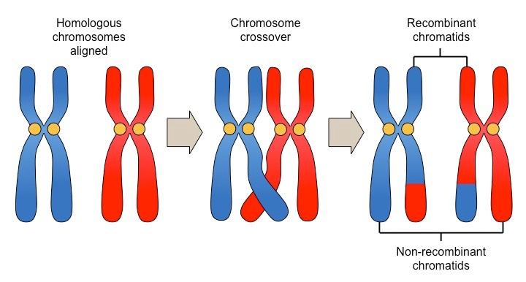
Crossing Over

Slide 13
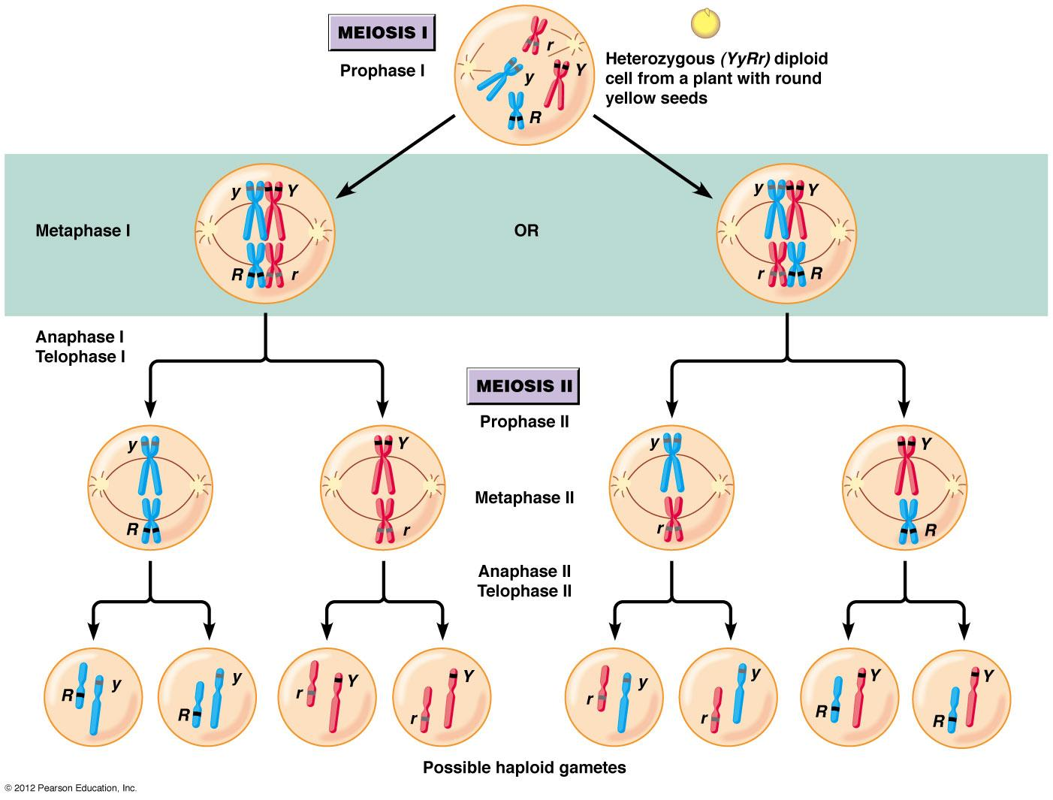
Independent Assortment

Slide 14
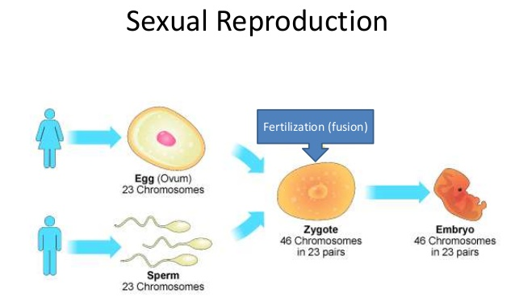
Random Fertilization
Any sperm or egg each individual generates could be the one used during fertilization. Meiosis and Sexual Reproduction truly is a genetic blender.

Slide 15
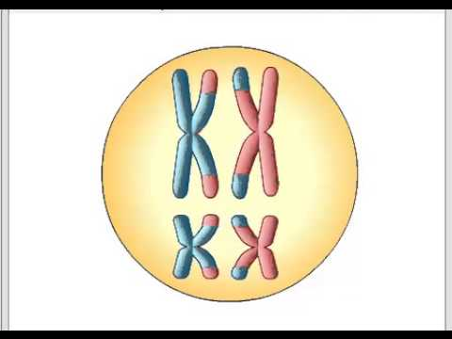

Slide 16
AP Biology Exam Review
5.3

Slide 17
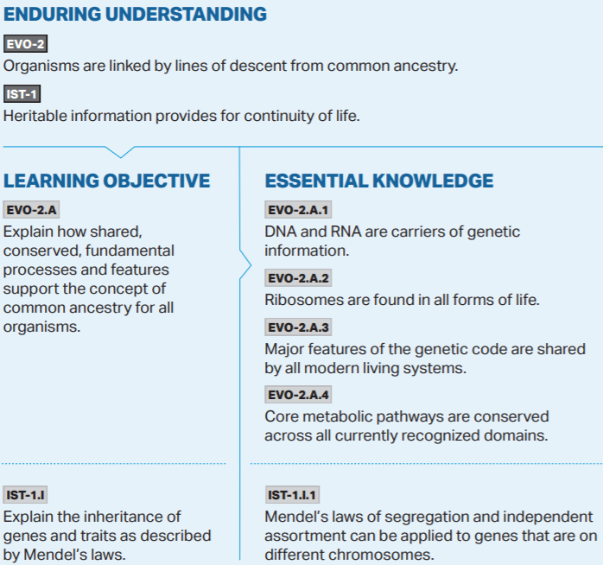
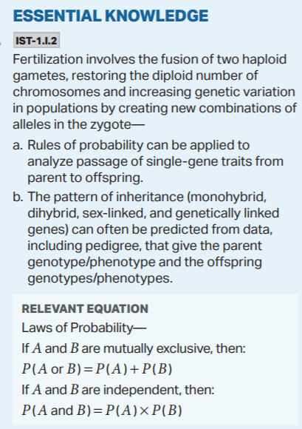

Slide 18
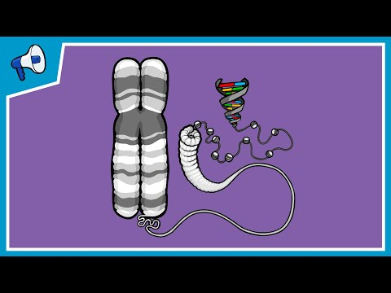

Slide 21
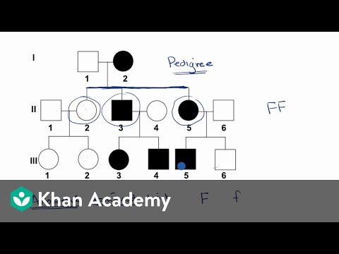

Slide 22
Mendelian Inheritance Patterns only hold true under the following circumstances:
The traits being examined are located on separate chromosomes
The traits being examined exhibit complete dominance
The traits being examined are monogenic (controlled by a single gene)
*A chi-square analysis can be performed to test whether the traits are inherited through a Mendelian Inheritance Pattern. The pattern predicted through Mendelian Inheritance is used for the expected values during this analysis.

Slide 23
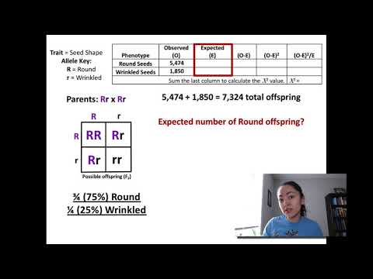

Slide 24
AP Biology Exam Review
5.4

Slide 25
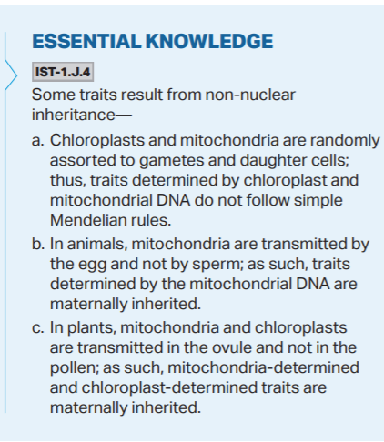

Slide 28
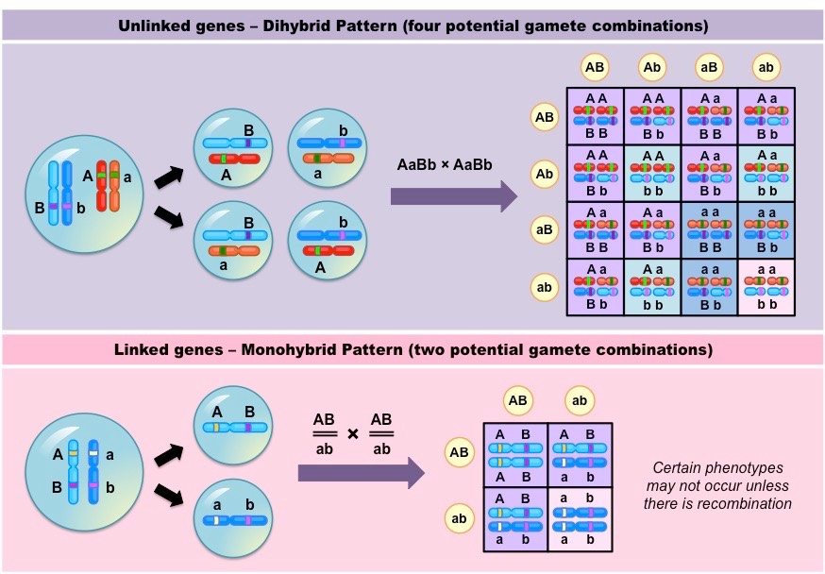
Linked Genes
When Genes are located on the same chromosome, they are called Linked Genes. The distance they are from each other on the chromosome determines the probability of them being separated during crossing over.
In crosses, linked genes will exhibit a high number of parental genotype combinations.

Slide 29
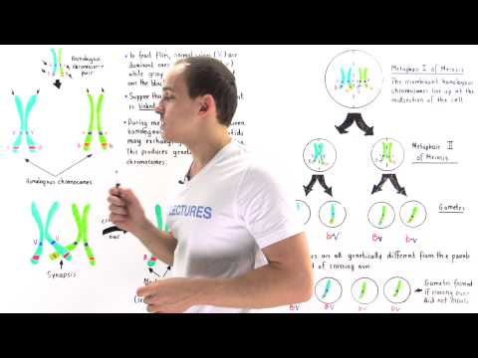

Slide 31
AP Biology Exam Review
5.5

Slide 32
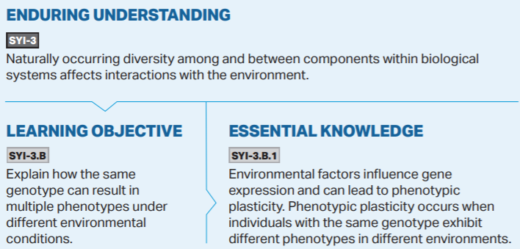

Slide 34
