Slide 1
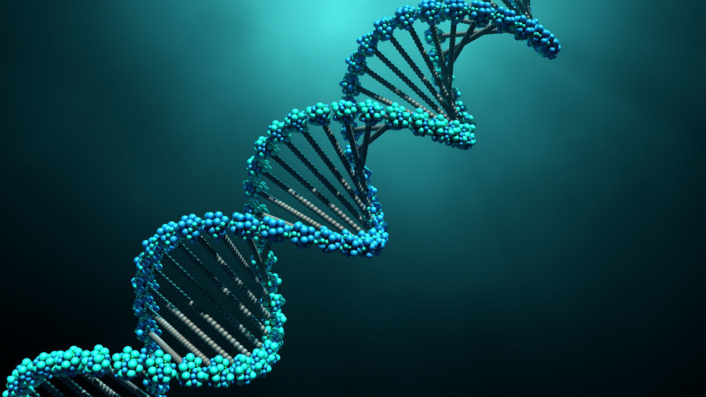
AP Biology Exam Unit 1 Review From: Byron Strohm

Slide 2
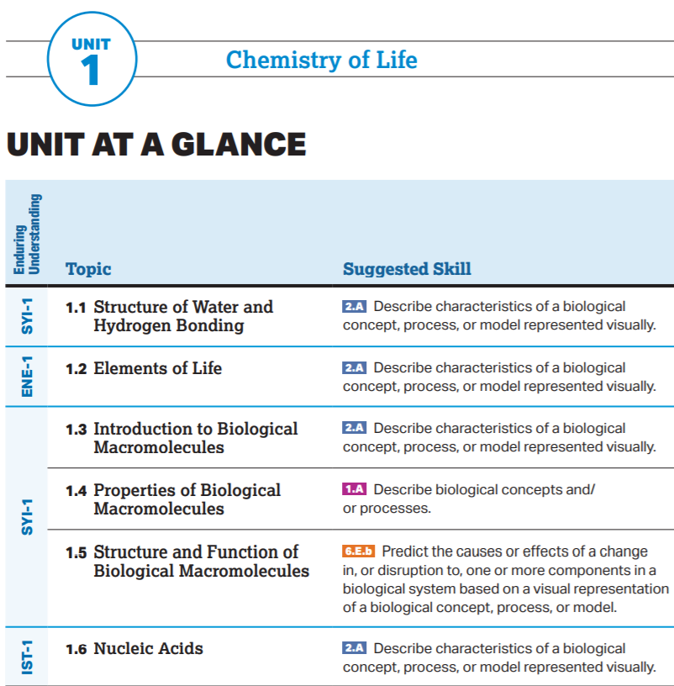

Slide 3
AP Biology Exam Review
1.1 Hydrogen Bonding and Water Structure

Slide 4
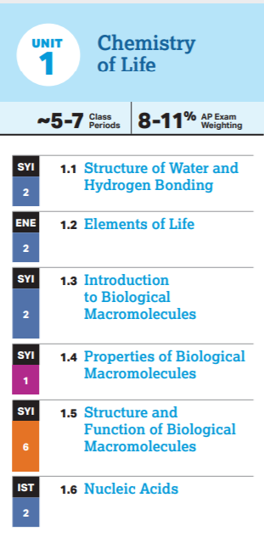
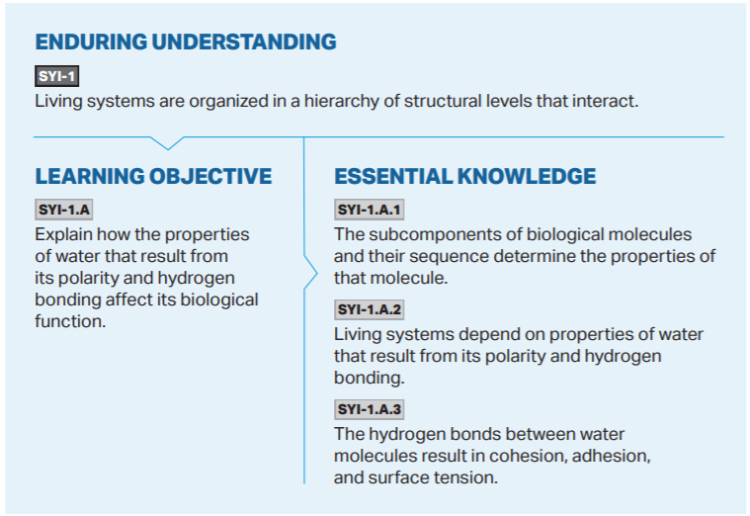

Slide 6
Strohm’s Video
https://www.loom.com/share/e6e164da31da480d98d94e58d3be1350

Slide 7
AP Biology Exam Review
1.2 - 1.5 Elements of Life - Structure & Function of Biological Molecules

Slide 8
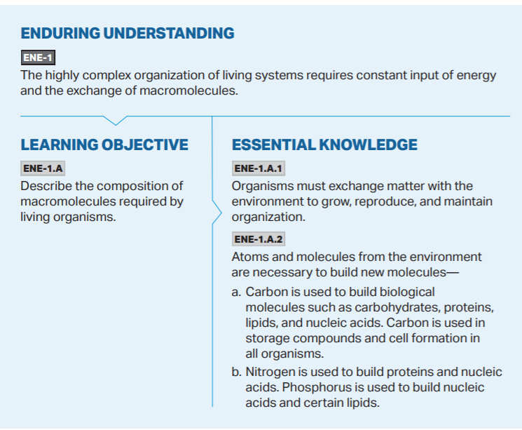

Slide 9
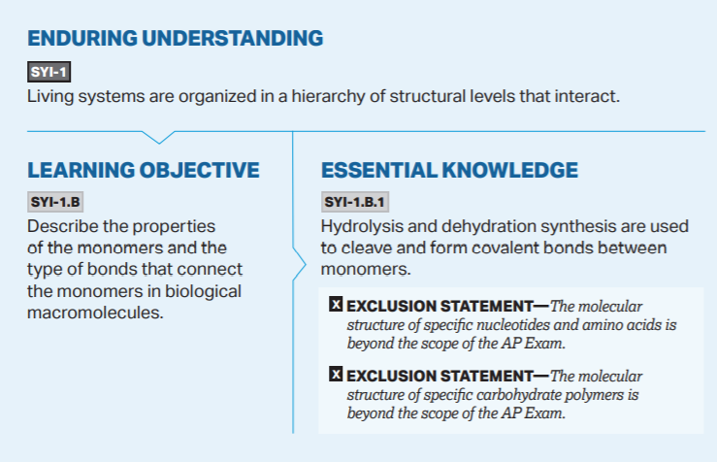

Slide 10
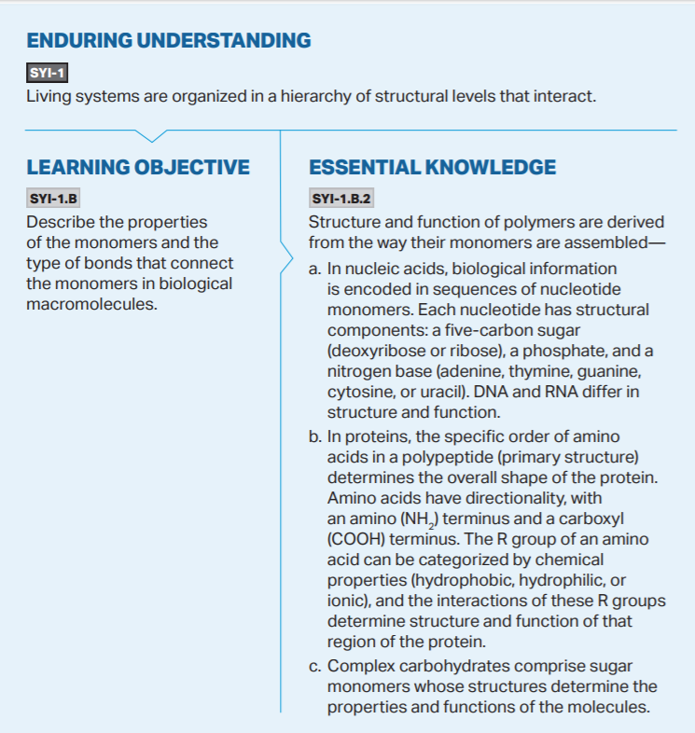

Slide 11
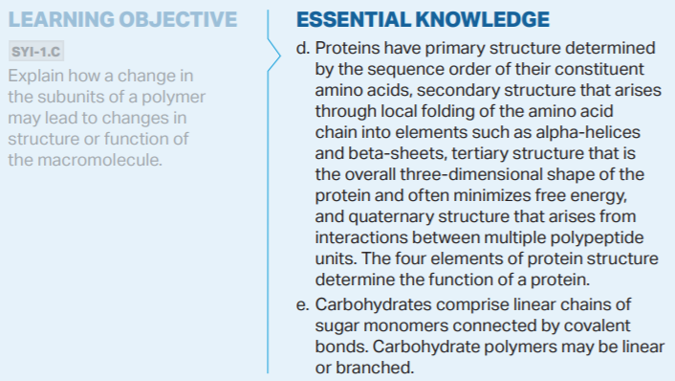

Slide 15
AP Biology Exam Review
1.6 Nucleic Acids

Slide 16
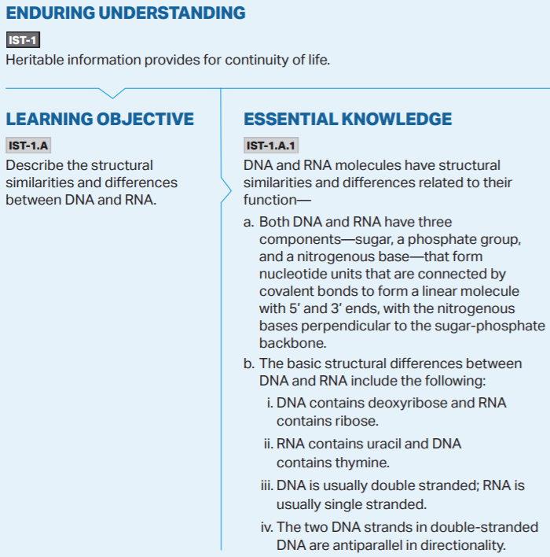

Slide 18
Now go back and re-attempt the Personal Progress Checks from Unit 1
https://apclassroom.collegeboard.org/

