Slide 1
REVIEW Math, Graphs, Diagrams, & Scientific Method Kelly Riedell/Brookings Biology BASED ON 2019 CED
Animation from: https://tenor.com/view/drawing-pusheen-gif-5828061
Grab some scratch paper. You will have to do some calculations with this one!

Slide 2
Remember: Biology is more than "just the facts". It's all about connections. (That said... you have to know the vocab and concepts to be able to see the "big picture" and make those connections)
See the BIG PICTURE
and make Connections!
Memorizing “facts”
Image modified from: https://www.pinterest.com/pin/50313720815813086/

Slide 3
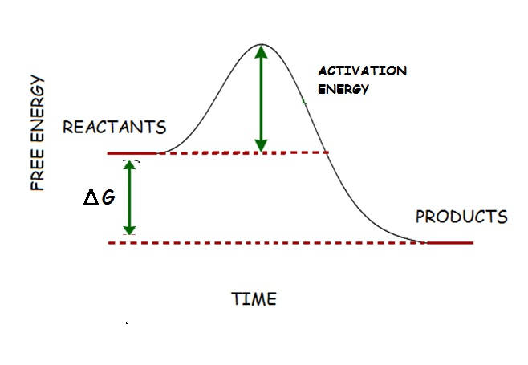
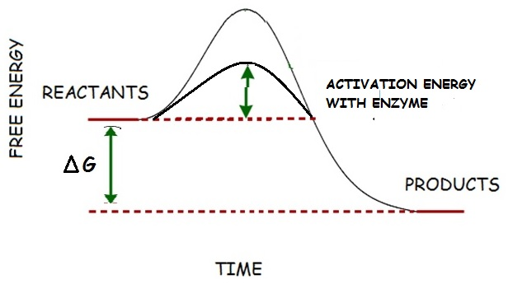
How does adding an enzyme change this graph? How does it change the energy of reactants or products?
Enzymes decrease activation energy needed to get a reaction started BUT DON’T CHANGE the overall energy of products or reactants
ENE 1.E Explain how enzymes affect the rate of biological reactions.
ENE 1.E.1 The structure and function of enzymes contribute to the regulation of biological processes— a. Enzymes are biological catalysts that facilitate chemical reactions in cells by lowering the activation energy
SP 4. B Describe data from a table or graph, including b. Describing trends and/or patterns in the data.
c. Describing relationships between variables.

Slide 4
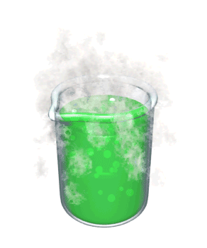
Images from: http://ppt.wz51z.com/PMP2/Science.To.WebText/animations/science/chemistry_physics/vp_beaker_bubbles_steam.htm
http://nobel.scas.bcit.ca/debeck_pt/science/images/blue_bubbling_liquid.gif
http://ps205.org/wp-content/uploads/2010/09/beaker_red_liquid_bubbling_sm_wht.gif
Label the solutions as acidic, basic, or neutral
pH 4 pH 7 pH 10
_________ ________ __________
acidic
neutral
basic
SP 1.A Describe biological concepts or processes

Slide 5
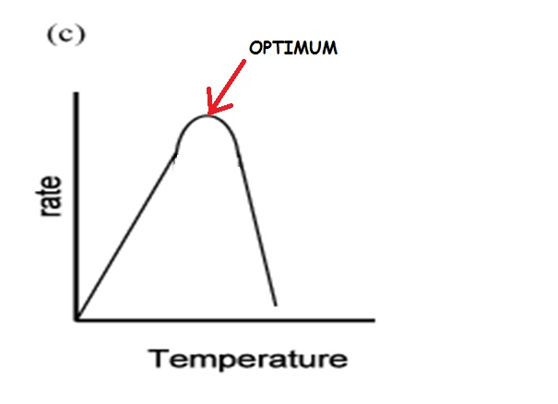
Image from: http://www.epikness.com/wp-content/uploads/2011/11/chem191ss5q5.gif
EXPLAIN why the following graph has the shape it does
All enzymes have an optimum temperature and pH at which they function the best so rate of reaction is highest here. Increasing or decreasing the temperature on either side of the optimum decreases enzyme activity.
At lower temperatures, enzyme activity slows due to decrease in molecule collisions. Fewer enzymes and substrates find each other.
ESSENTIAL KNOWLEDGE ENE F. 1 b. Environmental temperatures and pH outside the optimal range for a given enzyme will cause changes to its structure, altering the efficiency with which it catalyzes reactions
SP 2 B Explain relationships between different characteristics of biological concepts, processes, or models represented visually
a. in theoretical contexts
SP 2.C Explain how biological concepts or processes represented visually relate to larger biological principles, concepts, processes or theories.

Slide 6
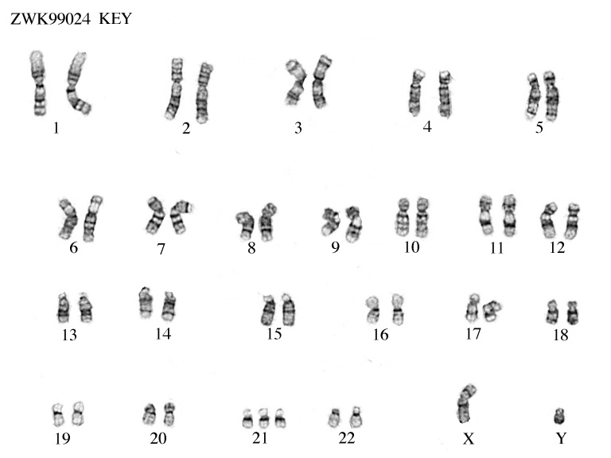
http://worms.zoology.wisc.edu/zooweb/Phelps/ZWK99024k.jpeg
This karyotype shows the chromosomes from a person with which genetic disorder?
Down syndrome- trisomy 21
What happens during meiosis that results in this extra chromosome?
NONDISJUNCTION
IST 4.A Explain how changes in genotype may result in changes in phenotype
IST 4.A.2 Errors in mitosis or meiosis can result in changes in phenotype— a. Changes in chromosome number often result in new phenotypes, including sterility caused by triploidy, and increased vigor of other polyploids. b. Changes in chromosome number often result in human disorders with developmental limitations, including Down syndrome/ Trisomy 21 and Turner syndrome.

Slide 7
FROM: http://serranohighschoolapbiology.weebly.com/uploads/6/7/9/9/6799747/ap_biology_evolution_unit_practice_test_1.pdf
Blue light is that portion of the visible spectrum that penetrates the deepest into bodies of water. Ultraviolet (UV) light, though, can penetrate even deeper. A gene within a population of marine fish that inhabits depths from 500 m to 1,000 m has an allele for a photopigment that is sensitive to UV light, and another allele for a photopigment that is sensitive to blue light. Which of the following graphs best depicts the predicted distribution of these alleles within a population if the fish that carry these alleles prefer to locate themselves where they can see best?
EVO-1.E.2 Environments change and apply selective pressures to populations.
EVO-1.E.3 Some phenotypic variations significantly increase or decrease fitness of the organism in particular environments.
SP 4. B Describe data from a table or graph, including b. Describing trends and/or patterns in the data.
.

Slide 8
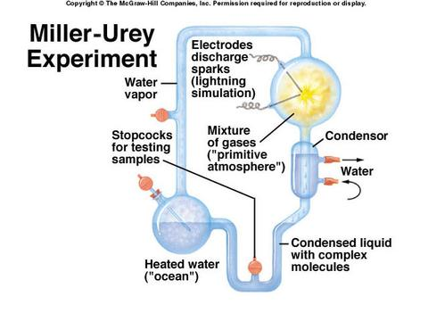
In 1953 a classic experiment by Stanley Miller and Harold Urey discharged electric sparks into a laboratory chamber containing gases including water vapor, hydrogen gas, methane, and ammonia.
Data showed that a number of organic molecules, including 25 amino, several fatty acids, and other organic compounds were produced. What was the significance of this classic experiment?
This experiment tested the hypothesis that molecules essential to life today could have formed from simpler organic molecules present in the Earth’s early atmosphere.
See a short video
SYI 3. E.1 b. There are several models about the origin of life on Earth— i. Primitive Earth provided inorganic precursors from which organic molecules could have been synthesized because of the presence of available free energy and the absence of a significant quantity of atmospheric oxygen (O₂).
SYI-3 Naturally occurring diversity among and between components within biological systems affects interactions with the environment.
c. Chemical experiments have shown that it is possible to form complex organic molecules from inorganic molecules in the absence of life—
i. Organic molecules/monomers served as building blocks for the formation of more complex molecules, including amino acids and nucleotides.
ii. The joining of these monomers produced polymers with the ability to replicate, store, and transfer information.

Slide 9
https://media.cheggcdn.com/media/265/26543fca-c09f-4203-959d-13272944f8e9/phpNSt9TU.png
Which enzyme is likely found in humans? EXPLAIN YOUR ANSWER.c
Enzyme A would be active in humans because it shows optimum activity at human body temperature (37 ⁰C/ 98.6 ⁰F). Enzyme B has optimum activity at much higher temperatures. Enzyme B would be inactive at human body temperature.
ESSENTIAL KNOWLEDGE
ENE-1.F.1Change to the molecular structure of a component in an enzymatic system may result in a change of the function or efficiency of the system—
a. Denaturation of an enzyme occurs when the protein structure is disrupted, eliminating the ability to catalyze reactions.
b. Environmental temperatures and pH outside the optimal range for a given enzyme will cause changes to its structure, altering the efficiency with which it catalyzes reactions.
SP 4.B Describe data from a table or graph, including b. Describing trends and/or patterns in the data. c. Describing relationships between variables.

Slide 10
Hemophilia is caused by mutations in gene that codes for blood clotting factors, which is located on the X chromosome. A male with hemophilia and a homozygous female with no family history of hemophilia have a son.
X^{h} Y
What is the probability that their son will have hemophilia?
X^{H}
X^{H}
X^{H}X^{h} X^{H}Y
X^{H}X^{h} X^{H}Y
0% chance of son having hemophilia.
All male offspring inherit Y from dad and X^{H} from mom.
The probability of daughters will be carriers for the hemophilia allele?
100% of daughters will be carriers for hemophilia allele. All female offspring inherit X^{H} from mom and X^{h} from dad.
IST 1.I.2 Fertilization involves the fusion of two haploid gametes, restoring the diploid number of chromosomes and increasing genetic variation in populations by creating new combinations of alleles in the zygote— a. Rules of probability can be applied to analyze passage of single-gene traits from parent to offspring. b. The pattern of inheritance (monohybrid, dihybrid, sex-linked, and genetically linked genes) can often be predicted from data, including pedigree, that give the parent genotype/phenotype and the offspring genotypes/phenotypes.
2019 FRQ

Slide 11
From Released 2013 AP BIOLOGY Practice Exam
Undersea landslides can disrupt marine habitats by burying organisms that live on the ocean floor. The graph above shows the size of a population of a certain organism that lives on the ocean floor. The population was affected by a recent landslide at the time indicated on the graph. Which of the following best predicts how the population will be affected by the landslide?
A) The surviving organisms will evolve into a new species.
B) The reduced populations will likely have allelic frequencies that are different from the initial population
C) The population will adapt to deeper waters to avoid future landslides.
D) The reduced population will have a greater number of different genes that the initial population.
EVO-1.H.1 Evolution is also driven by random occurrences—. b. Genetic drift is a nonselective process occurring in small populations— i. Bottlenecks.
SYI-3.D.1 The level of variation in a population affects population dynamics— a. Population ability to respond to changes in the environment is influenced by genetic diversity. Species and populations with little genetic diversity are at risk of decline or extinction.
SP 4. B Describe data from a table or graph, including b. Describing trends and/or patterns in the data.
.

Slide 12
FROM: http://www.phschool.com/science/biology_place/labbench/lab1/quiz.html
Ψ = Ψ_{s} + Ψ_{p}
Ψ _{p} = pressure potential
Ψ _{s} = solute potential
Ψ _{s} = - iCRT
i = ionization constant (1.0 for sucrose because sucrose does not ionize in water)
C = molar concentration
R = pressure constant (R= 0.0831 liter bars/mole K)
T = temperature in Kelvin (◦C + 273)
ESSENTIAL KNOWLEDGE
ENE 2.H.1 External environments can be hypotonic, hypertonic or isotonic to internal environments of cells— a. Water moves by osmosis from areas of high water potential/low osmolarity/ low solute concentration to areas of low water potential/high osmolarity/high solute concentration.
SP 5 A. Perform mathematical calculations including:
a. Mathematical equations in the curriculum

Slide 13
http://www.nimbios.org/education/SIDcalc_exer.pdf
https://www.scribd.com/document/139724238/Biological-Diversity-Practice-Problems
http://dryuc24b85zbr.cloudfront.net/tes/resources/11173045/image?width=500&height=500&version=1498037198806
biodiversity
Simpson’s diversity index (SDI) measures________________ in a community.
The range is from 0 to 1, where:
High scores (close to 1) indicate high or low diversity.
Low scores (close to 0) indicate high or low diversity.
Biological diversity can be quantified in many different ways.
The number of species present in a sample area is called species _________
The measure of the relative abundance of each species in the sample area is called species ___________
RICHNESS
EVENESS
ENE-4.A.1 The structure of a community is measured and described in terms of species composition and species diversity.
SP 5 A. Perform mathematical calculations including: a. Mathematical equations in the curriculum

Slide 14
https://quizlet.com/21269382/exam-2-flash-cards/
This graph illustrates Robert Paine's results for his experiment on mussels and Pisaster sea stars.
Based on this data, Pisaster is most likely a(n)
dominant species
invasive species
keystone species overharvested species
SYI-3.F.2 Keystone species, producers, and essential abiotic and biotic factors contribute to maintaining the diversity of an ecosystem.
SYI-3.G.2 The effects of keystone species on the ecosystem are disproportionate relative to their abundance in the ecosystem, and when they are removed from the ecosystem, the ecosystem often collapses.
SP 4. B Describe data from a table or graph, including b. Describing trends and/or patterns in the data.
c. Describing relationships between variables.

Slide 15
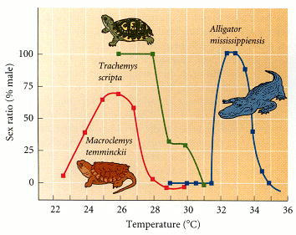
http://1.bp.blogspot.com/-SXDXx4Ez810/UbEKTKUqkDI/AAAAAAAAAHI/Uq4qE4VxAh8/s640/ch17f20.jpg
Not all organisms determine sex with X and Y chromosomes like humans do. In reptiles, sex of offspring is determined by temperature of eggs during incubation.
What is the % males that hatch from eggs from Alligator mississippiensis nests at temperatures below 31 ^{O}C (88 ^{O}F) ?
How does this change by increasing the temperature only 2 degrees?
Macrodenya temminckii populations show the greatest % males hatched at what temperature ?
0% males
100% males
Around 26 ^{O}C (79 ^{O}F)
Watch a 5 minute video about how other organisms determine sex
IST 1.J Explain deviations from Mendel’s model of the inheritance of traits
SYI 3.B.1 Environmental factors influence gene expression and can lead to phenotypic plasticity. Phenotypic plasticity occurs when individuals with the same genotype exhibit different phenotypes in different environments.
ILLUSTRATIVE EXAMPLES page 104 CED Sex determination in reptiles.

Slide 16
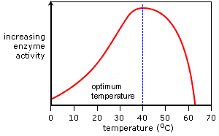
Image from: https://alevelnotes.com/static/content_images/i71_gcsechem_18part2.gif
EXPLAIN what is happening in this part of the graph?
EXPLAIN what is happening in this part of the graph?
As temperature continues to increase, above 40⁰ C, bonds holding 2⁰ , 3⁰ , and 4⁰ (if present) are disrupted and the protein structure loses its 3D shape causing the enzyme to denature and substrate no longer fits the enzyme’s active site. This results in a dramatic decrease in the enzyme’s ability to catalyzes the reaction.
As temperature increases, higher environmental temperatures increase the speed of movement of molecules in a solution, increasing the frequency of collisions between enzymes and substrates and therefore increasing the rate of reaction.
ENE 1.G.3 Higher environmental temperatures increase the speed of movement of molecules in a solution, increasing the frequency of collisions between enzymes and substrates and therefore increasing the rate of reaction.
SP 2 B Explain relationships between different characteristics of biological concepts, processes, or models represented visually
a. in theoretical contexts
SP 2.C Explain how biological concepts or processes represented visually relate to larger biological principles, concepts, processes or theories.

Slide 17
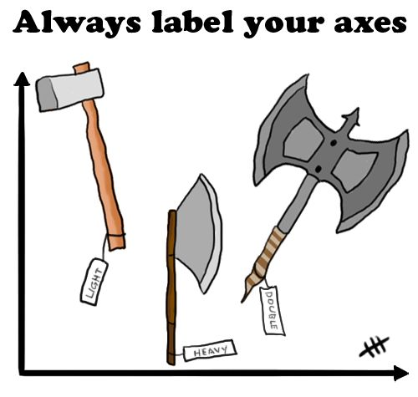
http://flowingdata.com/2012/06/07/always-label-your-axes/
TAKE A BREAK

Slide 18
MOM with I^{A} i genotype X DAD with I^{B} i genotype
I^{B}
i
I^{A}
I^{A} I^{B} I^{A} i
I^{B} i i i
i
POSSIBLE OFFSPRING
PROBABILITY GENOTYPE PHENOTYPE (BLOOD TYPE)
_________ ________ _______
_________ _________ _______ __________ _________ _______ __________ _________ ________
25%
I^{A} I^{B}
AB
25%
I^{A} i
A
25%
I^{B} i
B
25%
i i
O
IST 1.I Explain the inheritance of genes and traits as described by Mendel’s laws
SP 5 A. Perform mathematical calculations including: d. Ratios e. Percentages

Slide 19
In certain trees, smooth bark is dominant over wrinkled. Cross two trees that are heterozygous for smooth bark. If there are 160 offspring produced, how many will likely have wrinkled bark?
If both parents are heterozygous there is a 25% chance offspring will be homozygous recessive.
160 X .25 = 40 will have wrinkled bark
IST 1.I.2 Fertilization involves the fusion of two haploid gametes, restoring the diploid number of chromosomes and increasing genetic variation in populations by creating new combinations of alleles in the zygote— a. Rules of probability can be applied to analyze passage of single-gene traits from parent to offspring. b. The pattern of inheritance (monohybrid, dihybrid, sex-linked, and genetically linked genes) can often be predicted from data, including pedigree, that give the parent genotype/phenotype and the offspring genotypes/phenotypes.
SP 5 A. Perform mathematical calculations including: e. Percentages

Slide 20
https://apcentral.collegeboard.org/pdf/ap18-frq-biology.pdf
Seagrasses are aquatic plants that reproduce sexually. Male seagrass flowers produce sticky pollen that is carried by circulating water to female flowers, resulting in fertilization. A researcher claims that mobile aquatic invertebrates can also transfer polled from male to female flowers in the absence of circulating water. O investigate this claim, the researcher set up aquariums to model the possible interactions between the invertebrates and the seagrasses.
Use the symbols below and the template aquariums to demonstrate the experimental design for testing the researcher’s claim that mobile aquatic invertebrates can pollinate seagrass in the absence of circulating water. DRAW the appropriate symbols in the negative control aquarium AND the experimental aquarium. Do not use any symbol more than once in the same aquarium.
IDENTIFY the dependent variable in the experiment. PREDICT the experimental results that would support the researcher’s claim that mobile aquatic invertebrates can also transfer pollen from male to female flowers in the absence of circulating water.
SP 2. D Represent relationships within biological models including b. Diagrams
SP 3 3.A Identify or pose a testable question based on an observation, data, or a model.
SP 3.B State the null or alternative hypotheses, or predict the results of an experiment.
SP 3.C Identify experimental procedures that are aligned to the question, including
a. Identifying dependent and independent variables.

Slide 21
From Released 2013 AP BIOLOGY Practice Exam
If this experiment was continued for an additional 500 days, the population density of T. castaneum with the parasite would most likely stabilize at a value closest to which of the following?
A) 5 beetles/culture dish
B) 10 beetles/culture dish
C) 20 beetles/culture dish
D) 25 beetles/culture dish
ENE-4.B.4 Competition, predation, and symbioses, including parasitism, mutualism, and commensalism, can drive population dynamics.
SP 4. B Describe data from a table or graph, including a. Identifying specific data points
b. Describing trends and/or patterns in the data.
SP 6 E Predict the causes or effects of a change in, or disruption to, one or more components in a biological system based on
c. Data.
.

Slide 22
HETEROZYGOUS INCOMPLETELY DOMINANT SNAPDRAGON PLANTS
In snapdragons, red flowers (R) is INCOMPLETELY DOMINANT to white flowers (W). Make a cross between TWO HETEROZYGOUS snapdragon plants. What are the probabilities for offspring phenotype and genotype?
POSSIBLE OFFSPRING
PROBABILITY GENOTYPE PHENOTYPE
_________ ______ _______________ _________ ________ __________________ __________ __________ ___________________
R
W
R
RR RW
RW WW
W
25%
RR
Red flowers
50%
RW
Pink flowers
25%
WW
White flowers
IST 1.J Explain deviations from Mendel’s model of the inheritance of traits.
IST 1.J.1 Patterns of inheritance of many traits do not follow ratios predicted by Mendel’s laws and can be identified by quantitative analysis, where observed phenotypic ratios statistically differ from the predicted ratios
SP 5 A. Perform mathematical calculations including: d. Ratios e. Percentages

Slide 23
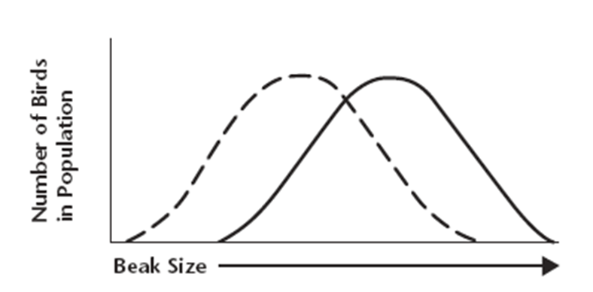
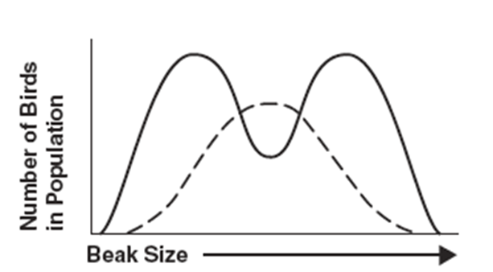
Images from BIOLOGY by Miller and Levine; Prentice Hall Publishing©2006
Male birds use their plumage to attract mates. Male birds in the population with less brilliant and showy plumage are less likely to attract a mate, but are also less likely to be seen and eaten by predators. Male birds with showy plumage are more likely to attract a mate but also more likely to attract predators, and are less likely to live long enough to find a mate.
MAKE A PREDICTION about what will happen to this population over time. EXPLAIN your answer
Color brightness
Color brightness
Color brightness
The most fit, are the male birds in the middle--showy, but not too showy. The frequency of very bright birds in population will decrease (get eaten so don’t reproduce and pass on their “bright color” genes). The frequency of dull colored bird will also decrease (don’t get mates so can’t pass on their
“dull color” genes) so over time more birds in the population are in the middle for “colorfulness”
EVO-1.E.1 Natural selection acts on phenotypic variations in populations.
.EVO-1.E.2 Environments change and apply selective pressures to populations.
EVO-1.E.3 Some phenotypic variations significantly increase or decrease fitness of the organism in particular environment
ILLUSTRATIVE EXAMPLE Graphical analysis of allele frequencies in a population SP 6.E Predict the causes or effects of a change in, or disruption to, one or more components in a biological system based on b. A visual representation of a biological concept, process, or model.

Slide 24
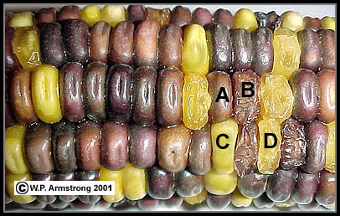
https://www2.palomar.edu/users/warmstrong/lmexer4.htm
P = Purple S = Smooth (starchy)
p = Yellow s = Shrunken (sweet)
Genes are located on 2 separate pairs of homologous chromosomes
(A) Purple & smooth
(B) Purple & shrunken
(C) Yellow & smooth
(D) Yellow & shrunken.
Watch a Bozeman Science video about Chi Square testing
Chi Square Problem: An ear of corn has a total of 381 grains, including 216 Purple & Smooth, 79 Purple & Shrunken, 65 Yellow & Smooth, and 21 Yellow & Shrunken.
Were the parents in this cross both heterozygous for both traits?
Write a CHI SQUARE NULL Hypothesis (H₀ ) :
There is no difference between this observed data and what is expected (9:3:3:1) for a heterozygous 2 gene cross
IST 1.I.2 Fertilization involves the fusion of two haploid gametes, restoring the diploid number of chromosomes and increasing genetic variation in populations by creating new combinations of alleles in the zygote— a. Rules of probability can be applied to analyze passage of single-gene traits from parent to offspring. b. The pattern of inheritance (monohybrid, dihybrid, sex-linked, and genetically linked genes) can often be predicted from data, including pedigree, that give the parent genotype/phenotype and the offspring genotypes/phenotypes.
SP 5 A. Perform mathematical calculations including a. Mathematical equations in the curriculum

Slide 25
https://drive.google.com/file/d/19LB59B61OmalW5o-N4wPv3O4pKlhJVW0/view
The chart above compares the annual energy expenditures for various functions of several animals. According to the data, a 4-kg male Adelie penguin has higher energy expenditure than a similarly-sized female eastern indigo snake. The observed trend is primarily due to differences in
A. relative size
B. mode of nutrition
C. mode of internal temperature regulation
D. mode of ATP production
ENE-1.M.1 Organisms use energy to maintain organization, grow, and reproduce— a. Organisms use different strategies to regulate body temperature and metabolism. i. Endotherms use thermal energy generated by metabolism to maintain homeostatic body temperatures. ii. Ectotherms lack efficient internal mechanisms for maintaining body temperature, though they may regulate their temperature behaviorally by moving into the sun or shade or by aggregating with other individuals. c. There is a relationship between metabolic rate per unit body mass and the size of multicellular organisms—generally, the smaller the organism, the higher the metabolic rate.
SP 2 B Explain relationships between different characteristics of biological concepts, processes, or models represented visually b in applied contexts
SP 2.C Explain how biological concepts or processes represented visually relate to larger biological principles, concepts, processes or theories.

Slide 26
Hemophilia is caused by mutations in gene that codes for blood clotting factors, which is located on the X chromosome. A male with hemophilia and a homozygous female with no family history of hemophilia have a son.
X^{h} Y
What is the probability that their son will have hemophilia?
X^{H}
X^{H}
X^{H}X^{h} X^{H}Y
X^{H}X^{h} X^{H}Y
0% chance of son having hemophilia.
All male offspring inherit Y from dad and X^{H} from mom.
The probability of daughters will be carriers for the hemophilia allele?
100% of daughters will be carriers for hemophilia allele. All female offspring inherit X^{H} from mom and X^{h} from dad.
IST 1.I.2 a. Rules of probability can be applied to analyze passage of single-gene traits from parent to offspring. b. The pattern of inheritance (monohybrid, dihybrid, sex-linked, and genetically linked genes) can often be predicted from data, including pedigree, that give the parent genotype/phenotype and the offspring genotypes/phenotypes.
SP 5 A. Perform mathematical calculations including a. Mathematical equations in the curriculum
2019 FRQ

Slide 27
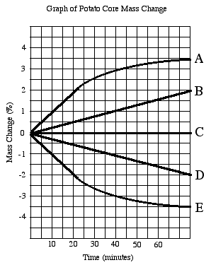
Graph from: http://www2.sluh.org/bioweb/apbio/labs/apl01potatocoregraph.png
This graph shows data from potato cores placed in different concentrations of sucrose (0.2M, 0.4M, 0.6M, 0.8M, 1.0 M ) for 80 min.
Which of the sucrose solutions is/are hypotonic to potatoes? EXPLAIN YOUR ANSWER
Solutions that are hypotonic to potatoes would cause the potatoes to gain mass as water moves from an area of higher Ψ (sucrose solution) to an area of lower Ψ (inside the potato) .Therefore, solutions A and B are hypotonic.
ESSENTIAL KNOWLEDGE
ENE 2.H.1 External environments can be hypotonic, hypertonic or isotonic to internal environments of cells— a. Water moves by osmosis from areas of high water potential/low osmolarity/ low solute concentration to areas of low water potential/high osmolarity/high solute concentration.
SP 4. B Describe data from a table or graph, including
b. Describing trends and/or patterns in the data
SP 5 A. Perform mathematical calculations including: a. Mathematical equations in the curriculum

Slide 28
From Released 2013 AP BIOLOGY Practice Exam
The data over the duration of the experiment provide the strongest support for which of the following conclusions regarding the effect of the parasite on Tribolium populations?
A) T. confusum is adversely affected by the parasite, while T. castaneum is not.
B) T. castaneum is adversely affected by the parasite, while T. confusum. is not.
C) Both T. confusum and T. castaneum are adversely affected by the parasite.
D) Both T. confusum and T. castaneum show increased fitness in the presence of the parasite.
ENE-4.B.4 Competition, predation, and symbioses, including parasitism, mutualism, and commensalism, can drive population dynamics.
SP 4. B Describe data from a table or graph, including b. Describing trends and/or patterns in the data.
c. Describing relationships between variables.
.

Slide 29
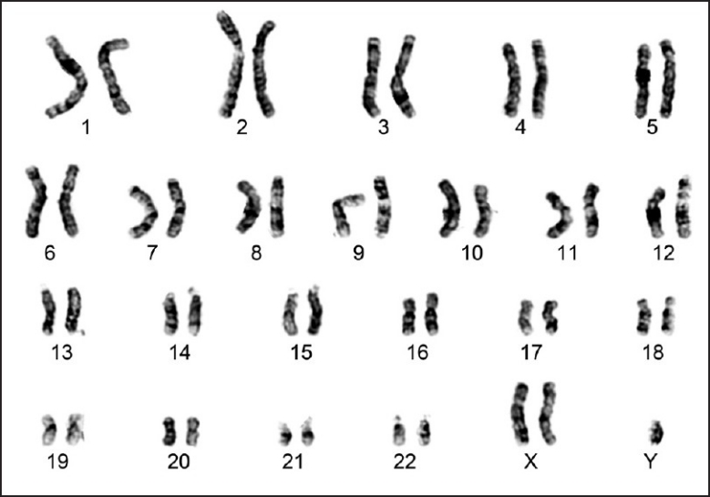
This karyotype shows the chromosomes from a person with which genetic disorder?
Klinefelter syndrome- Males with XXy
What happens during meiosis that results in this extra X chromosome?
NONDISJUNCTION
IST 4.A Explain how changes in genotype may result in changes in phenotype
IST 4.A.2 Errors in mitosis or meiosis can result in changes in phenotype— a. Changes in chromosome number often result in new phenotypes, including sterility caused by triploidy, and increased vigor of other polyploids. b. Changes in chromosome number often result in human disorders with developmental limitations, including Down syndrome/ Trisomy 21 and Turner syndrome.

Slide 30
From Released 2013 AP BIOLOGY Practice Exam
Based on the data shown, calculate the average rate of increase in oxygen consumption for animals acclimated to 5◦C as the temperature increases from 10◦C to 30◦C. Give your answer in mL O₂/g/h/◦C to the nearest tenth.
185 - 80 = 105 = 5.25 mL O₂/g/h/◦C
30 -10 20
Answer can include any value from 5.0 to 5.5 inclusive or 5/1 to 55/10
.
SP 4. B Describe data from a table or graph, including a. Identifying specific data points

Slide 31
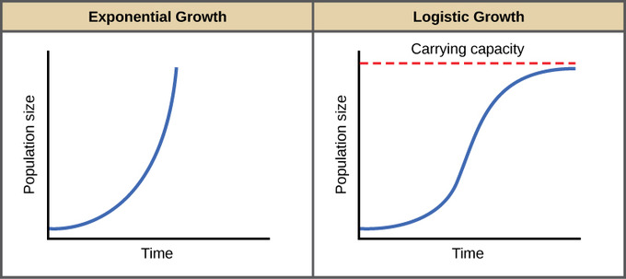
Image from: https://figures.boundless-cdn.com/21346/large/figure-45-03-01.jpe
Identify these growth curves shown below
Exponential
Logistic
__________________________ ____________________________
SYI-1.G.2 Many adaptations in organisms are related to obtaining and using energy and matter in a particular environment— a. Population growth dynamics depend on a number of factors. i. Reproduction without constraints results in the exponential growth of a population.
SYI-1.H.1 A population can produce a density of individuals that exceeds the system’s resource availability.
SYI-1.H.2 As limits to growth due to density-dependent and density-independent factors are imposed, a logistic growth model generally ensues
SP 2. D Represent relationships within biological models including b. Diagrams.

Slide 32
Image from: http://www.epikness.com/wp-content/uploads/2011/11/chem191ss5q5.gif
EXPLAIN why the following graph has the shape it does
As long as substrate is unlimited, increasing the amount of enzyme available will increase the reaction rate because the more enzyme that is available, the more likely an enzyme will find a substrate and react.
ENE 1.G.2 The relative concentrations of substrates and products determine how efficiently an enzymatic reaction proceeds.
SP 2 A Describe characteristics of a biological process, or model, represented visually.
SP 2 B Explain relationships between different characteristics of biological concepts, processes, or models represented visually
a. in theoretical contexts
SP 2.C Explain how biological concepts or processes represented visually relate to larger biological principles, concepts, processes or theories.

Slide 33
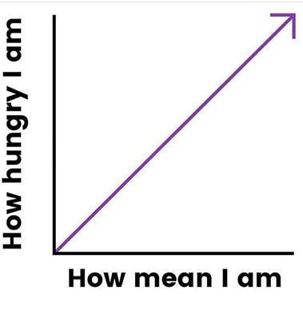
TAKE A BREAK

Slide 34
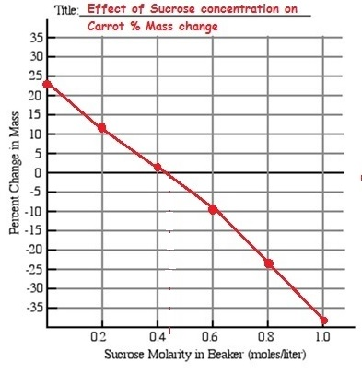
Ψ = Ψ_{s} + Ψ_{p}
Ψ _{p} = pressure potential
Ψ _{s} = solute potential
Ψ _{s} = - iCRT
i = ionization constant (1.0 for sucrose because sucrose does not ionize in water)
C = molar concentration
R = pressure constant (R= 0.0831 liter bars/mole K)
T = temperature in Kelvin (◦C + 273)
Molarity where % mass change = 0 is isotonic to carrots
Calculate the solute potential (Ψs) of the carrot cores in sucrose at 22 °C .
Ψ s = -(1) (0.45) ( 0.0831) (273+22)
Ψ s = -11.03 bars
ESSENTIAL KNOWLEDGE
ENE 2.H.1 External environments can be hypotonic, hypertonic or isotonic to internal environments of cells— a. Water moves by osmosis from areas of high water potential/low osmolarity/ low solute concentration to areas of low water potential/high osmolarity/high solute concentration.
SP 4. B Describe data from a table or graph, including a. Identifying specific data points
b. Describing trends and/or patterns in the data
SP 5 A. Perform mathematical calculations including: a. Mathematical equations in the curriculum RELEVANT EQUATIONS- Water Potential

Slide 35
https://drive.google.com/file/d/19LB59B61OmalW5o-N4wPv3O4pKlhJVW0/view
Adelie penguins need ice as a platform to feed on krill while Chinstrap and Gento penguins prefer to live in areas with less ice.
Which of the following explanations is the least likely reason for the trends shown in the graph.
Numbers of Adelie penguins are decreasing due to global climate change.
Populations of Chinstrap and Gentoo penguins are increasing because they are introduced species free of predators and competitors
Populations of Adelie penguins are decreasing due to habitat fragmentation
D. As the climate of the arctic changes, the distribution of penguin species changes as well.
SYI-2.B.2 Human impact accelerates change at local and global levels— b. Habitat change can occur because of human activity ILLUSTRATIVE EXAMPLES: Global climate change
SP 4. B Describe data from a table or graph, including a. Identifying specific data points
b. Describing trends and/or patterns in the data.
c. Describing relationships between variables.

Slide 36
http://content.njctl.org/courses/science/ap-biology/ecology/ecology-multiple-choice-review/ecology-multiple-choice-review-2014-04-14.pdf
A well-known ecological field study involved rodents in the Chihuahuan Desert, Arizona. The study consisted of 9 different species, divided into three categories: large granivores (animals that eat seeds), small granivores, and small insectivorous rodents. Ecologists wanted to determine the effect of large granivores on the abundance of smaller rodents.
Experimental Design: Researchers built eight 50m by 50m plots that were surrounded with small wire mesh fencing. On four of the plots, holes were cut in each side of the fence that were large enough to allow free passage of all rodents. On the other four plots, smaller holes were used that would only allow passage of small rodents. These plots were referred to as semi-permeable.
Four out of the eight study plots were made semi-permeable. What was the purpose of maintaining the four plots that were not semi-permeable?
A. These plots contained control populations to which the populations in the semipermeable
plots could be compared. B. These plots were held in reserve, to be used if something negative happened in the semi- permeable plots.
C. These plots allowed the ecologists to study the feeding habits of the large granivores.
D.. These plots were maintained in order to be used in an identical study that would increase the initial study’s reliability
SP 3.C Identify experimental procedures that are aligned to the question, including b. Identifying appropriate controls.

Slide 37
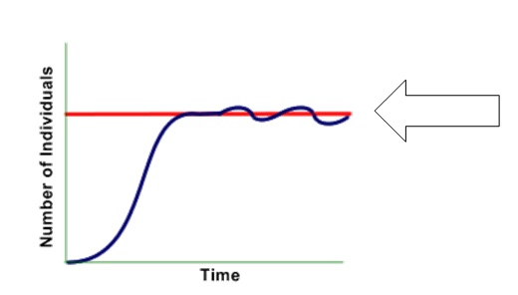
Image from: https://figures.boundless-cdn.com/21346/large/figure-45-03-01.jpe
The maximum population size that an ecosystem can support is called the __________________
It is represented by the letter ____
CARRYING CAPACITY
K
SYI-1.H.1 A population can produce a density of individuals that exceeds the system’s resource availability.
SYI-1.H.2 As limits to growth due to density-dependent and density-independent factors are imposed, a logistic growth model generally ensues.

Slide 38
https://quizizz.com/admin/quiz/5bb2f2a1100319001b10d86e/ap-bio-population-ecology
Refer to this graph to answer the following question.
An increase in the lynx population
A. is followed by an increase in the hare population
B. is followed by a decrease in the hare population
C. has no effect on the hare population
EXPLAIN YOUR ANSWER
Lynx eat hares so an increase in the number of lynx means more hares will be eaten. The hare population will decrease.
ENE-4.B.1 Communities change over time depending on interactions between populations. ENE-4.B.2 Interactions among populations determine how they access energy and matter within a community ENE-4.B.3 Relationships among interacting populations can be characterized by positive and negative effects and can be modeled. Examples include predator/prey interactions, ENE-4.B.4 Competition, predation, and symbioses, including parasitism, mutualism, and commensalism, can drive population dynamics
SP 4. B Describe data from a table or graph, including
b. Describing trends and/or patterns in the data.
c. Describing relationships between variables.
SP 1 C. Explain biological concepts, processes, and/or models in applied contexts.
SP 2 B Explain relationships between different characteristics of biological concepts, processes, or models represented visually b in applied contexts

Slide 39
Image from: https://figures.boundless-cdn.com/21346/large/figure-45-03-01.jpe
Which of these growth curves would be seen in a population where nutrient availability becomes limited?
Logistic growth-
Population increases while nutrients are available;
graph levels off when nutrients are limited
SYI-1.G.2 Many adaptations in organisms are related to obtaining and using energy and matter in a particular environment— a. Population growth dynamics depend on a number of factors. i. Reproduction without constraints results in the exponential growth of a population.
SYI-1.H.1 A population can produce a density of individuals that exceeds the system’s resource availability.
SYI-1.H.2 As limits to growth due to density-dependent and density-independent factors are imposed, a logistic growth model generally
SP 2 A Describe characteristics of a biological process, or model, represented visually.

Slide 40
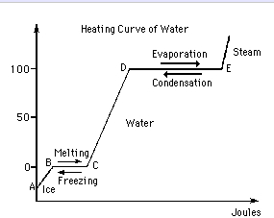
Image from: http://i.stack.imgur.com/sucSu.jpg
One type of question you may encounter on the AP Exam asks you to interpret a graph. What is happening to water molecules between points A-B and C-D on this graph.
What is happening between points B-C and D-E?
Adding energy increases the kinetic energy of the molecules and the temperature of the H₂O molecules increases.
At these points on the graph, water is changing phase (solid → liquid/liquid →gas) and adding energy increases the kinetic energy of the molecules but the temperature of the H₂O molecules stays the same until enough molecules have the energy to change phase.
ESSENTIAL KNOWLEDGE
SYI A. Explain how the properties of water that result from its polarity and hydrogen bonding affect its biological function 1.A. 2 Living systems depend on properties of water that result from its polarity and hydrogen bonding
1. A. 3 The hydrogen bonds between water molecules result in cohesion, adhesion and surface tension.

Slide 41
Image from: http://i.stack.imgur.com/sucSu.jpg
In the graph shown, the line between points D-E doesn’t increase even though energy is added because water has a _____ heat of vaporization low high
HIGH
ESSENTIAL KNOWLEDGE
SYI A. Explain how the properties of water that result from its polarity and hydrogen bonding affect its biological function 1.A. 2 Living systems depend on properties of water that result from its polarity and hydrogen bonding

Slide 42
From Released 2013 AP BIOLOGY Practice Exam
Under which of the following conditions is
the observed number of beetles per
culture dish the greatest?
A) T. confusum with parasite at 500 days
B) T. confusum without parasite at 300 days
C) T. castaneum with parasite at 100 days
D) T. castaneum with parasite at 600 days
ENE-4.B.4 Competition, predation, and symbioses, including parasitism, mutualism, and commensalism, can drive population dynamics.
SP 4. B Describe data from a table or graph, including b. Describing trends and/or patterns in the data.
c. Describing relationships between variables.
.

Slide 43
https://www.highschooltestprep.com/ap/biology/unit-8-practice-test/
WHAT DOES LINE C REPRESENT?
A. Exponential growth
B. Logistic population growth
C. Geometric population growth
D. Zero population growth
Which line represents a population with the highest maximum growth rate increase?
A B C D
SYI-1.H.1 A population can produce a density of individuals that exceeds the system’s resource availability. SYI-1.H.2 As limits to growth due to density-dependent and density-independent factors are imposed, a logistic growth model generally ensues
SP 2. D Represent relationships within biological models including b. Diagrams
.

Slide 44
http://content.njctl.org/courses/science/ap-biology/ecology/ecology-multiple-choice-review/ecology-multiple-choice-review-2014-04-14.pdf
A well-known ecological field study involved rodents in the Chihuahuan Desert, Arizona. The study consisted of 9 different species, divided into three categories: large granivores (animals that eat seeds), small granivores, and small insectivorous rodents. Ecologists wanted to determine the effect of large granivores on the abundance of smaller rodents.
Experimental Design: Researchers built eight 50m by 50m plots that were surrounded with small wire mesh fencing. On four of the plots, holes were cut in each side of the fence that were large enough to allow free passage of all rodents. On the other four plots, smaller holes were used that would only allow passage of small rodents. These plots were referred to as semi-permeable.
Researchers hypothesized that large rodents compete with small rodents.
If this hypothesis were correct, what would be a likely result of the exclusion experiment?
A Small rodent populations would decrease in the semi-permeable plots.
B. No population change would be observed in the semi-permeable plots.
C. Small rodent populations would increase in the semi-permeable plots.
D. Large rodent populations would increase in the semi-permeable plots.
SP 6A. Make a scientific claim.

Slide 45
https://courses.lumenlearning.com/wmopen-biology2/chapter/community-ecology/Graphs from: https://courses.lumenlearning.com/wm-biology2/chapter/competition/
Image from: https://image.slidesharecdn.com/c-151205143259-lva1-app6892/95/c1-species-and-community-37-638.jpg?cb=1449326189
The growth of two protozoan species, Paramecium aurelia and Paramecium caudatum grown in test tubes in the laboratory is shown in the graphs below. Both P. caudatum and P. aurelia eat bacteria provided in the test tubes. The bacteria live off uncooked rice contained in the test tubes. The bacteria do not eat each other.
Describe the change in the two populations between days 0 and 10 when grown separately.
When grown individually both populations thrive. The P. aurelia population increased from near 0 to approximately 225 cells. The P. caudatum population grew from near 0 to 70 cells.
How do the populations differ when grown together?
When the two species are placed together, P. aurelia thrives, growing in numbers from near 0 on day 1 to almost
250 cells by day 16. P. caudatum numbers also start near 0 on day one but never rise above 25 cells and then slowly decrease to 0 by day 16, suggesting that when grown together in the same test tube (habitat),
P. aurelia outcompetes P. caudatum for food, leading to the latter’s eventual extinction.
ENE-4.B.2 Interactions among populations determine how they access energy and matter within a community
ENE-1.N.1 Changes in energy availability can result in changes in population size. SP 4. B Describe data from a table or graph, including a. Identifying specific data points
b. Describing trends and/or patterns in the data.
SP 6 D. Explain the relationship between experimental results and larger biological concepts, processes, or theories

Slide 46
Images from: http://ppt.wz51z.com/PMP2/Science.To.WebText/animations/science/chemistry_physics/vp_beaker_bubbles_steam.htm
http://nobel.scas.bcit.ca/debeck_pt/science/images/blue_bubbling_liquid.gif
http://ps205.org/wp-content/uploads/2010/09/beaker_red_liquid_bubbling_sm_wht.gif
pH 4 pH 6 pH 9 A B C
100
acidic
Solution A is _______ times more __________ than solution B acidic basic
Solution C is _______ times more __________ than solution B acidic basic
1000
basic
Each unit difference = 10 times more/less
SP 1.A Describe biological concepts or processes

Slide 47
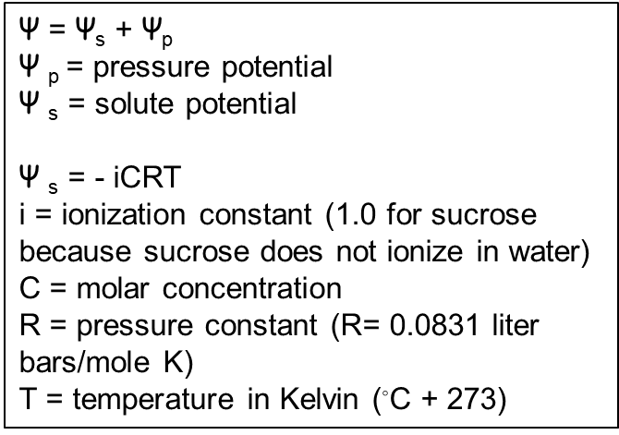
Which beaker with potato cores is at equilibrium? What is the water potential (Ψ) of the potato core in beaker #1?
What will happen to the potato core in beaker 1? EXPLAIN
Beaker 2 is at equilibrium Ψ of distilled water in Beaker 2 =0 bars Ψ of Potato core (Ψs + Ψp) = 0.5 + (-0.5) = 0 bars
Ψ of Potato core (Ψs + Ψp) = (-0.5) + 0.3 = -0.2 bars
Potatoes in Beaker 1 will gain mass. Distilled water has Ψ = 0 Potatoes have a Ψ = -0.2 0 > -0.2 Water moves from higher Ψ to lower Ψ Water will enter potato until Ψ inside and outside are equal
ESSENTIAL KNOWLEDGE
ENE 2.H.1 External environments can be hypotonic, hypertonic or isotonic to internal environments of cells— a. Water moves by osmosis from areas of high water potential/low osmolarity/ low solute concentration to areas of low water potential/high osmolarity/high solute concentration.
RELEVANT EQUATIONS- Water Potential
SP 5 A. Perform mathematical calculations including: a. Mathematical equations in the curriculum
SP 6A. Make a scientific claim.
SP 6B Support a claim with evidence from biological principles, concepts, processes, and/or data
SP 6C. Provide reasoning to justify a claim by connecting evidence to biological theories

Slide 48
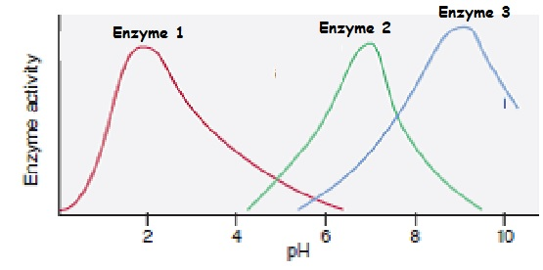
Image modified from: http://mgh-images.s3.amazonaws.com/9780073402659/1748-18-164PEI1.png
What is the optimum pH for Enzyme 3? EXPLAIN
pH 9-
The graph for Enzyme 3 shows its highest activity
at this place in the graph
ESSENTIAL KNOWLEDGE ENE 1.F Explain how changes to the structure of an enzyme may affect its function.
ENE F. 1 Change to the molecular structure of a component in an enzymatic system may result in a change of the function or efficiency of the system— a. Denaturation of an enzyme occurs when the protein structure is disrupted, eliminating the ability to catalyze reactions. b. Environmental temperatures and pH outside the optimal range for a given enzyme will cause changes to its structure, altering the efficiency with which it catalyzes reactions
ENE F.2 In some cases, enzyme denaturation is reversible, allowing the enzyme to regain activity.
SP 4. B Describe data from a table or graph, including a. Identifying specific data points

Slide 49
From Released 2013 AP BIOLOGY Practice Exam
In Figure 1. the difference between the two curves can best be attributed to which of the following?
A) The difference between controlled laboratory conditions and the natural environment.
B) The effect of the host on its parasite.
C) The influence of competition for limited resources.
D) The natural variation among populations.
ENE-4.B.4 Competition, predation, and symbioses, including parasitism, mutualism, and commensalism, can drive population dynamics.
SP 4. B Describe data from a table or graph, including a. Identifying specific data points
b. Describing trends and/or patterns in the data.
c. Describing relationships between variables.
.

Slide 50
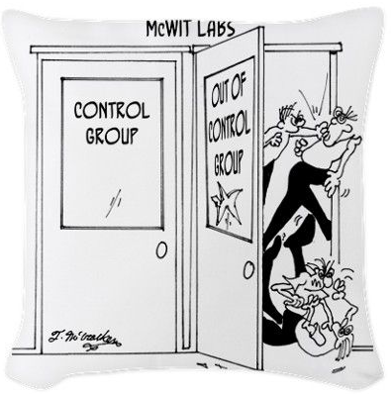
https://www.pinterest.com/pin/50313720817171899/
TAKE A BREAK

Slide 51
Image from: http://www.epikness.com/wp-content/uploads/2011/11/chem191ss5q5.gif
This graph shows the effect substrate concentration on the rate of reaction
EXPLAIN what is happening in this part of the graph?
All active sites are full. All enzymes are working at maximum velocity = V_{max}
Reaction can’t go any faster
Take a break and see a 3 minute
funny video about how this works.
ENE 1.G.2 The relative concentrations of substrates and products determine how efficiently an enzymatic reaction proceeds
SP 2 B Explain relationships between different characteristics of biological concepts, processes, or models represented visually
a. in theoretical contexts
SP 2.C Explain how biological concepts or processes represented visually relate to larger biological principles, concepts, processes or theories..

Slide 52
Wanda thinks either Ralph or Fred could be the father of her baby.
Wanda’s genotype is I^{A} i. Wanda’s baby has type O blood.
Ralph’s genotype is I^{A}I^{B}. Fred’s genotype is I^{B} i.
Ralph X Wanda Fred X Wanda
I^{A}
I^{B}
I^{B}
i
I^{A}
I^{A} I^{B} I^{A} I^{B}
I^{B} i I^{B} i
I^{A}
I^{A} I^{B} I^{A} i
I^{B} i i i
i
i
IS IT POSSIBLE RALPH IS THE FATHER? YES NO
IS IT POSSIBLE FRED IS THE FATHER? YES NO
DOES IT PROVE IT’S FRED? YES NO
ANYONE WITH AN i ALLELE COULD BE THE DAD
IST 1.I Explain the inheritance of genes and traits as described by Mendel’s laws
SP 5 A. Perform mathematical calculations including: d. Ratios e. Percentages

Slide 53
From: Released 2013 AP BIOLOGY Practice Exam
Thrips are insects that feed on rose pollen. Scientists noted that the thrips population increased in the spring and decreased dramatically during the summer. The researchers hypothesized that food abundance was the limiting factor for the population. Which of the following types of data would be most useful for the scientists to collect at regular intervals on a designated test plot of rose plants?
Amount of sunlight (Hours/day)
Mean temperature (◦C)
Density of rose pollen produced (g/m²)
D. Amount of pollen produced by each flower (g/flower)
SYI 1.H.2 As limits to growth due to density-dependent and density-independent factors are imposed, a logistic growth model generally ensues
SP 3.C Identify experimental procedures that are aligned to the question, including
a. Identifying dependent and independent variables. . SP 3.E Propose a new/next investigation based on
b. An evaluation of the design/methods.

Slide 54
From Released 2013 AP BIOLOGY Practice Exam
The enzyme phosphofructokinase (PFK) is an allosterically regulated enzyme that catalyzes the following reaction.
Fructose-6-phosphate + ATP Fructose 1,6-bisphosphate + ADP
The graph below shows that at certain concentrations ATP inhibits the enzyme, whereas AMP activates it. According to the information presented in the graph, when the concentration of Fructose-6-phosphate is 0.5 mM, how many times more active is PFK in cells with 1 mM ATP + 0.1 mM AMP than in cells with 5mM ATP? Express your answer to the nearest whole number
@ 0.5mM fructose-6-phosphate
5 mM 1ATP ~ 0.5
1 mM ATP +0.1 mM AMP ~ 5
5/0.5 = 10 times more active
Answer can include any value from 10 to 15 or 10/1 to 15/1
0.5
.
ENE-1.F.1 Change to the molecular structure of a component in an enzymatic system may result in a change of the function or efficiency of the system—
SP 4. B Describe data from a table or graph, including a. Identifying specific data points

Slide 55
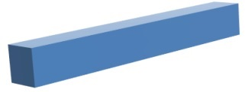
Calculate Surface area/Volume ratio for these cells
2cm X 2cm X 2cm
1cm X 1cm X 8cm
SA = 6 X 2cm X 2cm
= 24 cm²
SA = 2 X (1cm X 1cm) + 4 (1cm X 8cm) = 2 cm² + 32 cm²
= 34 cm²
Vol = 2cm X 2cm X 2cm
= 8 cm³
Vol = 1cm X 1cm X 8cm
= 8 cm³
SA/V =24 cm² /8 cm³
= 3
SA/V = 34 cm² /8 cm³
= 4.25
Which would have the largest SA/V ratio?
Which of these will be the most efficient at transporting materials across its membrane?
EXPLAIN YOUR ANSWER
Blue rectangular solid has larger SA/V ratio.
Blue rectangular solid- Cells with greater SA/V ratios are more efficient at transporting materials into/out of the cell.
ESSENTIAL KNOWLEDGE
ENE 2.H.1 External environments can be hypotonic, hypertonic or isotonic to internal environments of cells— a. Water moves by osmosis from areas of high water potential/low osmolarity/ low solute concentration to areas of low water potential/high osmolarity/high solute concentration.
ENE 1.B.2 The surface area of the plasma membrane must be large enough to adequately exchange materials— a. These limitations can restrict cell size and shape. Smaller cells typically have a higher surface area-to-volume ratio and more efficient exchange of materials with the environment. b. As cells increase in volume, the relative surface area decreases and the demand for internal resources increases. c. More complex cellular structures (e.g., membrane folds) are necessary to adequately exchange materials with the environment. d. As organisms increase in size, their surface area-to-volume ratio decreases, affecting properties like rate of heat exchange with the environment
ENE 2.H.1 External environments can be hypotonic, hypertonic or isotonic to internal environments of cells— a. Water moves by osmosis from areas of high water potential/low osmolarity/ low solute concentration to areas of low water potential/high osmolarity/high solute concentration.
SP 5 A. Perform mathematical calculations including: a. Mathematical equations in the curriculum

Slide 56
What conclusions can you draw from Chi Square analysis of data if the X² value is less than the probability value in the 0.05 row on the Chi Square Table?
If the Chi square value is less than the probability value, then the differences observed in the data are not statistically significant. Therefore, the data support the hypothesis that there is no difference between the observed data and what was expected. “Fail to reject” the null hypothesis.
Watch a Bozeman Science video about Chi Square testing
SP 5 A. Perform mathematical calculations including a. Mathematical equations in the curriculum
Notes:
:

Slide 57
Modified from: http://apbioreview.weebly.com/practice-questions.html
A scientist testing the affects of a chemical on apple yield sprays an orchard with the chemical.
A second orchard does not receive the chemical. In the fall, the number of apples harvested from each forest is counted.
Which of the following is the independent (manipulated) variable in the experiment? a. the chemical b. the number of apples c. the first orchard d. the second orchard
Which of the following is the dependent variable in the experiment? a. the chemical b. the number of apples produced c. rainfall on each orchard d. the second orchard that doesn’t receive the chemical
SP 3.C Identify experimental procedures that are aligned to the question, including a. Identifying dependent and independent variables.

Slide 58
Modified from: http://apbioreview.weebly.com/practice-questions.html
A scientist testing the affects of a chemical on apple yield sprays an orchard with the chemical.
A second orchard does not receive the chemical. In the fall, the number of apples harvested from each forest is counted.
Write a H₀ for this experiment
Give some examples of variables that need to be controlled in this experimental design.
Does this experiment have an experimental control group?
There will be no difference in number of apples produced by the orchard treated with the chemical compared to the orchard without the chemical.
Both orchards should: have the same number/sizes of trees have same species of apple trees have similar types of soil receive similar amounts of rain be in areas with similar temperatures
Receive same amount of water if irrigated harvest apples after same amount of growth time
Receive same amounts of fertilizer/pest control
Yes, orchard that doesn’t receive the chemical acts as the control group to compare against
SP 3.B State the null or alternative hypotheses, or predict the results of an experiment. 3.C Identify experimental procedures that are aligned to the question, including b. Identifying appropriate controls. c. Justifying appropriate controls.

Slide 59
A common laboratory investigation involves putting a solution of starch and glucose into a dialysis bag and suspending the bag in a beaker of water, as shown in the figure below.
The investigation is aimed at understanding how molecular size affects movement through a membrane. Which of the following best represents the amount of starch, water, and glucose in the dialysis bag over the course of the investigation?
NOT A SECURE EXAM QUESTION MC question from 2013 Released Exam posted to public on College board website
ESSENTIAL KNOWLEDGE
ENE 2.H.1 External environments can be hypotonic, hypertonic or isotonic to internal environments of cells— a. Water moves by osmosis from areas of high water potential/low osmolarity/ low solute concentration to areas of low water potential/high osmolarity/high solute concentration. ENE 2.E.1 Passive transport is the net movement of molecules from high concentration to low concentration without the direct input of metabolic energy.

Slide 60
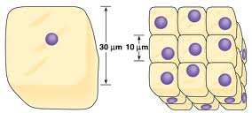
Image from: https://marilynemathew.files.wordpress.com/2013/02/surface.jpg
How does the cell surface area/volume ratio differ in these two diagrams? EXPLAIN the relationship of SA/Vol ratio to obtain resources and remove waste.
Volume appears to be approximately the same, but the cells in diagram on the right have greater surface area than the cell on the left.
Demand for resources depends on Volume; Ability to transport depends on the surface area of the membrane. As cells increase in size both surface area and volume increase, but volume increases at a greater rate than surface area. SA/Vol ratio decreases as cell grows bigger OR larger cell has smaller SA/Vol ratio than small cell
It’s more difficult for larger cells to move substances across cell membrane fast enough to supply cell’s needs; Small cells can transport substances more efficiently than larger cells
ESSENTIAL KNOWLEDGE
ENE 2.H.1 External environments can be hypotonic, hypertonic or isotonic to internal environments of cells— a. Water moves by osmosis from areas of high water potential/low osmolarity/ low solute concentration to areas of low water potential/high osmolarity/high solute concentration.
ENE 1.B.2 The surface area of the plasma membrane must be large enough to adequately exchange materials— a. These limitations can restrict cell size and shape. Smaller cells typically have a higher surface area-to-volume ratio and more efficient exchange of materials with the environment. b. As cells increase in volume, the relative surface area decreases and the demand for internal resources increases. c. More complex cellular structures (e.g., membrane folds) are necessary to adequately exchange materials with the environment. d. As organisms increase in size, their surface area-to-volume ratio decreases, affecting properties like rate of heat exchange with the environment.

Slide 61
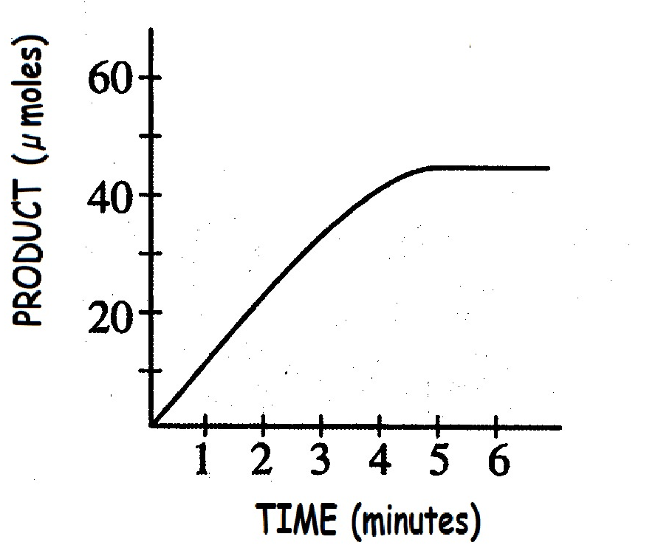
Why does this graph level off after 4 minutes?
Product does not increase any more because enzyme has run out of substrate. All the substrate has been turned into product.
ENE 1.G Explain how the cellular environment affects enzyme activity.
ENE 1.G.2 The relative concentrations of substrates and products determine how efficiently an enzymatic reaction proceeds
SP 2 B Explain relationships between different characteristics of biological concepts, processes, or models represented visually
a. in theoretical contexts
SP 2.C Explain how biological concepts or processes represented visually relate to larger biological principles, concepts, processes or theories.

Slide 62
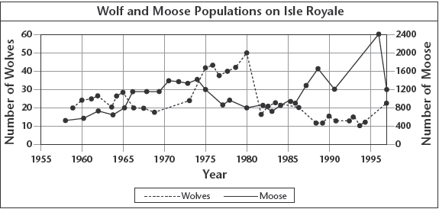
Image from: http://mayhewbiology.com/Reading%20Guides/Chapter%205_files/image005.gif
The graph shows moose and wolf populations on Isle Royale.
Explain how these two species interact? How does the change in numbers of one population impact the other?
Wolves and moose have a predator/prey relationship. When wolf numbers increase the moose population decreases because there are more wolves eating moose. When moose populations decrease, a decrease in wolf population follows because there is less food for the wolves. When the wolf population decreases, the moose population increases because there are fewer predators to eat them.
SYI 1.H.2 As limits to growth due to density-dependent and density-independent factors are imposed, a logistic growth model generally ensues
ENE-4.B.3 Relationships among interacting populations can be characterized by positive and negative effects and can be modeled. Examples include predator/prey interactions
SP 4. B Describe data from a table or graph, including b. Describing trends and/or patterns in the data.
c. Describing relationships between variables.
SP 1 C. Explain biological concepts, processes, and/or models in applied contexts.

Slide 63
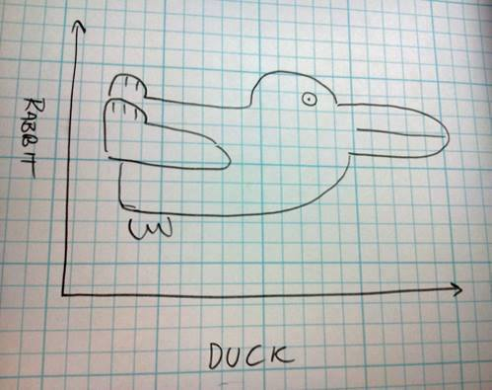
http://flowingdata.com/2014/06/25/duck-vs-rabbit-plot/
TAKE A BREAK

Slide 64
MAKE A PREDICTION about the mode of inheritance for the following trait. JUSTIFY your answer.
White eyed female flies are crossed with wild type males.
Offspring are shown below
NOT a 3:1 ratio
Notice: IF white eyed male X WT female this ratio will be different
White eyes is an X-LINKED RECESSIVE trait Both WT and white eye flies appear in F₁ generation Differences in #’s males/females for trait 1:1:1:1 ratio NOT 3:1 in F₂ generation (Expected for an X linked trait)
IST 1.I.2 b. The pattern of inheritance (monohybrid, dihybrid, sex-linked, and genetically linked genes) can often be predicted from data, including pedigree, that give the parent genotype/phenotype and the offspring genotypes/phenotypes.
SP 5 A. Perform mathematical calculations including a. Mathematical equations in the curriculum
2010 FRQ 2003 FRQ

Slide 65
http://www.phschool.com/science/biology_place/labbench/lab1/factors.html
Ψ = Ψ_{s} + Ψ_{p}
Ψ _{p} = pressure potential
Ψ _{s} = solute potential
Ψ _{s} = - iCRT
i = ionization constant (1.0 for sucrose because sucrose does not ionize in water)
C = molar concentration
R = pressure constant (R= 0.0831 liter bars/mole K)
T = temperature in Kelvin (◦C + 273)
Plant cell immediately after being put into distilled water
Plant cell after being in distilled water for some time
+2
Ψp = 0
Ψs = 0
Ψ = 0
Ψp = 0
Ψs = -2
Ψ = ?
Ψp = ___
Ψs = ___
Ψ = ___
-2
-2
0
Fill in the missing Ψp , Ψs and Ψ
True or False At equilibrium the solute concentrations inside and outside the cell are always equal
ENE 2.H.1 External environments can be hypotonic, hypertonic or isotonic to internal environments of cells— a. Water moves by osmosis from areas of high water potential/low osmolarity/ low solute concentration to areas of low water potential/high osmolarity/high solute concentration.
RELEVANT EQUATIONS- Water Potential
SP 5 A. Perform mathematical calculations including: a. Mathematical equations in the curriculum

Slide 66
https://www.scribd.com/document/139724238/Biological-Diversity-Practice-Problems
The table above shows data from two different fields of wildflowers.
How does the RICHNESS of the two samples compare?
How does the EVENNESS of the two samples compare?
Which Sample shows the greatest diversity? EXPLAIN your choice
Which would have a Simpson’s Diversity index closer to 1?
BOTH samples show the same richness (3 species) and the same total number of individuals (1000)
Sample 1 has more evenness that Sample 2 because the total number of individuals in the Sample 1 is evenly distributed between the three species. In Sample 2 most individuals are buttercups with only a few daisies and dandelions present.
Sample 1 is more diverse than Sample 2. A community dominated by one or two species is considered to be less diverse than one in which several different species have a similar abundance
Sample 1 is more diverse than Sample 2 . More diverse ecosystems have a DI closer to 1.
SYI-3.G.1 The diversity of species within an ecosystem may influence the organization of the ecosystem
SP 4. B Describe data from a table or graph, including a. Identifying specific data points
b. Describing trends and/or patterns in the data.
c. Describing relationships between variables

Slide 67
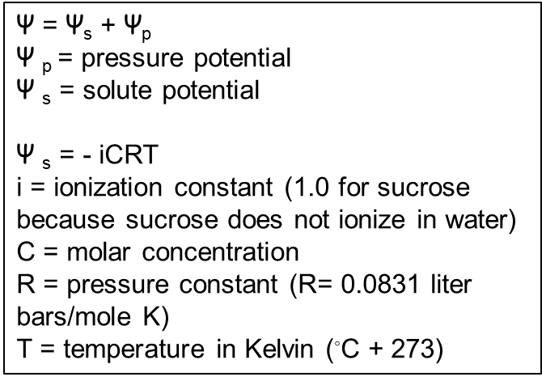
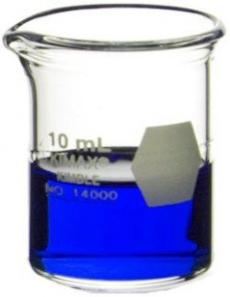
https://www.labsource.com/media/catalog/product/cache/1/small_image/250x/17f82f742ffe127f42dca9de82fb58b1/Kimble-Chase/kimble-chase-14000-10.jpg
Calculate the (Ψ_{s}) for a solution of 0.2 M glucose at 20 °C
Ψs =
=
- (1) (0.2) ( 0.0831) (273+20)
- 4.87 bars
ESSENTIAL KNOWLEDGE
ENE 2.H.1 External environments can be hypotonic, hypertonic or isotonic to internal environments of cells— a. Water moves by osmosis from areas of high water potential/low osmolarity/ low solute concentration to areas of low water potential/high osmolarity/high solute concentration.
RELEVANT EQUATIONS- Water Potential
SP 5 A. Perform mathematical calculations including: a. Mathematical equations in the curriculum

Slide 68
http://ehardmanapbio.weebly.com/uploads/5/2/0/5/5205206/jenniferkloocksquantitativeguidekey2.pdf
ψ = ψ_{s} + ψ_{p}
Ψ_{p} = pressure potential
ψ_{s} = solute potential
ψ_{s} = - iCRT
i = ionization constant (1.0 for sucrose because sucrose does not ionize in water)
C = molar concentration
R = pressure constant (R= 0.0831 liter bars/mole K)
T = temperature in Kelvin (◦C + 273)
Looking at the water potential equation:
Pressure potential is always positive negative
Solute potential is always
less than or equal to 0 greater than or equal to 0
When Solute potential goes down (gets more negative), water potential
increases decreases
When Pressure potential goes down (gets smaller), water potential
increases decreases
The water potential will be equal to the solute potential of a solution in an open container is zero,
.
SP 4. B Describe data from a table or graph, including a. Identifying specific data points

Slide 69
There are 190 grey tree frogs in a swamp. If r = -0.093 frogs/ year, predict the population size next year.
dN/dt= r _{max} N
dN/dt = -0.093 (190)
dN/dt = 17.67
190 -18 = 172
172 frogs
If the growth rate stays the same. What will the population be the second year.
dN/dt= r _{max} N
Is this a suitable habitat?
dN/dt = -0.093 (172)
= 16
Not suitable habitat, growth rate is negative (-0,093). Population is decreasing each year.
172 -16 = 156 frogs
SYI-1.G.2 Many adaptations in organisms are related to obtaining and using energy and matter in a particular environment— a. Population growth dynamics depend on a number of factors. i. Reproduction without constraints results in the exponential growth of a population. SP 5 A. Perform mathematical calculations including: a. Mathematical equations in the curriculum
SP 1.C Explain biological concepts, processes, and/or models in applied contexts.

Slide 70
Image from: http://www.epikness.com/wp-content/uploads/2011/11/chem191ss5q5.gif
This graph shows the effect substrate concentration on the rate of reaction
Why does the graph start to level off here?
Eventually reach a point where all active sites are full. Adding more substrate doesn’t increase reaction rate.
ENE 1.G.2 The relative concentrations of substrates and products determine how efficiently an enzymatic reaction proceeds
SP 2 B Explain relationships between different characteristics of biological concepts, processes, or models represented visually
a. in theoretical contexts
SP 2.C Explain how biological concepts or processes represented visually relate to larger biological principles, concepts, processes or theories.

Slide 71
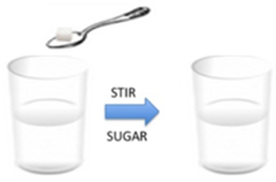
http://ehardmanapbio.weebly.com/uploads/5/2/0/5/5205206/jenniferkloocksquantitativeguidekey2.pdf
Ψ = Ψ_{s} + Ψ_{p}
Ψ _{p} = pressure potential
Ψ _{s} = solute potential
Ψ _{s} = - iCRT
i = ionization constant (1.0 for sucrose because sucrose does not ionize in water)
C = molar concentration
R = pressure constant (R= 0.0831 liter bars/mole K)
T = temperature in Kelvin (◦C + 273)
Looking at the water potential equation:
What would happen to the solute potential when Temperature is increased?
Justify your answer using the equation(s) shown
Ψ _{s} will decrease if T is increased.
Since ψ_{s} = - iCRT, increasing T makes Ψ _{s} a bigger NEGATIVE number.
The water potential will be equal to the solute potential of a solution in an open container is zero,
What would happen to the solute potential when the dissolved substance is glucose vs. NaCl (table salt) Justify your answer i = 1 vs i=2
NaCl ionizes so i = 2 instead of 1 with glucose. Since Ψ _{s} = - iCRT, Ψ _{s} will be even more negative than for a glucose solution with the same concentration.
Ψ_{s} when dissolving NaCl will be a bigger NEGATIVE number than when dissolving glucose.
.
SP 4. B Describe data from a table or graph, including a. Identifying specific data points

Slide 72
Modified from: http://www.phschool.com/science/biology_place/labbench/lab1/quiz.html
Difference
in Molarity
- .04 -.08 0 + .08 - ,02
Circle all the beakers contain a solution that is hypertonic to the dialysis bag Which dialysis bag would you PREDICT to show the least % change in mass at the end of the experiment? JUSTIFY your answer.
Bag in beaker 3. If the bag has the same molarity as its beaker solution, the bag is in an isotonic solution. The net flow of water into and out of the bag would be equal, and there will be no change in mass.
Arrange the beakers in order of the mass of the bags inside them after the experiment has run of 30 minutes. List the bag that loses the most mass first.
2, 1 , 5, 3, 4
ESSENTIAL KNOWLEDGE
ENE 2.E.1 Passive transport is the net movement of molecules from high concentration to low concentration without the direct input of metabolic energy.
SP 6A. Make a scientific claim.
SP 6C. Provide reasoning to justify a claim by connecting evidence to biological theories
RELAVENT EQUATIONS- Water Potential

Slide 73
Released 2015 Course and Exam Description (CED)
Testosterone oxido-reductase is a liver enzyme that regulates testosterone levels in alligators. One study compared testosterone oxido-reductase activity between male and female alligators from Lake Woodruff, a relatively pristine environment, and from Lake Apopka,
an area that has suffered severe contamination. The graph shown depicts the findings of that study. The data in the graph best support which of the following claims?
Environmental contamination elevates total testosterone oxido-reductase activity in females.
Environmental contamination reduces total testosterone oxido-reductase activity in females.
Environmental contamination elevates total testosterone oxido-reductase activity in males.
Environmental contamination reduces total testosterone oxido-reductase activity in males.
SYI-2.B.2 Human impact accelerates change at local and global levels—
b. Habitat change can occur because of human activity
SP 4.B Describe data from a table or graph, including
b. Describing trends and/or patterns in the data.
c. Describing relationships between variables.
SP 5.B Use confidence intervals and/ or error bars (both determined using standard errors) to determine whether sample means are statistically different.
.

Slide 74
Graph from: http://www2.sluh.org/bioweb/apbio/labs/apl01potatocoregraph.png
This graph shows data from potato cores placed in different concentrations of sucrose (0.2M, 0.4M, 0.6M, 0.8M, 1.0 M) for 80 min.
Which solution contained the greatest concentration of sucrose? EXPLAIN
E is the solution with the greatest solute concentration. Solutions with a high amount of solute have a lower water potential. Water always moves from an area of higher Ψ to an area of lower Ψ. Water will leave the potatoes cells causing the greatest negative % mass change.
ESSENTIAL KNOWLEDGE
ENE 2.H.1 External environments can be hypotonic, hypertonic or isotonic to internal environments of cells— a. Water moves by osmosis from areas of high water potential/low osmolarity/ low solute concentration to areas of low water potential/high osmolarity/high solute concentration.
SP 4. B Describe data from a table or graph, including
b. Describing trends and/or patterns in the data
SP 5 A. Perform mathematical calculations including: a. Mathematical equations in the curriculum

Slide 75
http://content.njctl.org/courses/science/ap-biology/ecology/ecology-multiple-choice-review/ecology-multiple-choice-review-2014-04-14.pdf
A well-known ecological field study involved rodents in the Chihuahuan Desert, Arizona. The study consisted of 9 different species, divided into three categories: large granivores (animals that eat seeds), small granivores, and small insectivorous rodents. Ecologists wanted to determine the effect of large granivores on the abundance of smaller rodents. Experimental Design: Researchers built eight 50m by 50m plots that were surrounded with small wire mesh fencing. On four of the plots, holes were cut in each side of the fence that were large enough to allow free passage of all rodents. On the other four plots, smaller holes were used that would only allow passage of small rodents. These plots were referred to as semi-permeable.
In the first three years of the experiment, small granivore populations increased 3.5 times in the semi-permeable plots. In these same plots, however, small insectivorous populations did not change. How can these results be explained?
A. Large granivores only compete with small insectivorous populations.
B. Competition is not a factor in the community ecology of desert rodents.
C. Small granivores are a keystone species of the desert ecosystem.
D. Competition that occurs between large and small rodents is a result of nutrient availability.
SP 6 D. Explain the relationship between experimental results and larger biological concepts, processes, or theories
ENE-4.B.1 Communities change over time depending on interactions between populations.
ENE-4.B.2 Interactions among populations determine how they access energy and matter within a community
ENE-4.B.3 Relationships among interacting populations can be characterized by positive and negative effects and can be modeled.

Slide 76
https://towardsdatascience.com/10-funny-graphs-that-perfectly-explain-everyday-life-bdaa6565baa0
TAKE A BREAK

Slide 77
What do r, N, and K stand for in this equation?
r =
N =
k =
This equation is used for problems involving populations showing _____________ growth. exponential logistic
growth rate
number of individuals in population
carrying capacity
logistic
SYI-1.H.1 A population can produce a density of individuals that exceeds the system’s resource availability. SYI-1.H.2 As limits to growth due to density-dependent and density-independent factors are imposed, a logistic growth model generally ensues. SP 5 A. Perform mathematical calculations including: a. Mathematical equations in the curriculum

Slide 78
https://media.cheggcdn.com/media/265/26543fca-c09f-4203-959d-13272944f8e9/phpNSt9TU.png
Which enzyme is likely found in thermophilic bacteria? EXPLAIN YOUR ANSWER.c
Thermophilic bacteria live in extreme heat environments. Enzyme B has an optimum rate of reaction at a very high temperature (75 ⁰C/167 ⁰F )
so that it would be able to function in this kind of environment. Enzyme A would be inactive in an extreme heat environment.
ENE-1.F.1 Change to the molecular structure of a component in an enzymatic system may result in a change of the function or efficiency of the system—
a. Denaturation of an enzyme occurs when the protein structure is disrupted, eliminating the ability to catalyze reactions.
b. Environmental temperatures and pH outside the optimal range for a given enzyme will cause changes to its structure, altering the efficiency with which it catalyzes reactions.
SP 4.B Describe data from a table or graph, including b. Describing trends and/or patterns in the data. c. Describing relationships between variables.

Slide 79
In a Hardy Weinberg problem,
which variable is used to
represent the frequency of the
recessive allele ____
dominant allele ____
homozygous recessive individuals ____
homozygous dominant individuals ____
heterozygous individuals _____
p + q = 1
P² + 2pq + q² = 1
p = frequency of allele 1 in a population
q = frequency of allele 2 in a population
q
p
q²
p²
2pq
EVO-1.K.2 Allele frequencies in a population can be calculated from genotype frequencies
SP 5 A. Perform mathematical calculations including: a. Mathematical equations in the curriculum

Slide 80
Pepsin is an enzyme that works in the stomach to break down proteins.
Which graph do you think represents pepsin?
Enzyme 1 is pepsin because it has an optimum pH around 2 which would allow it to work in the acidic conditions found in the stomach.
ENE 1.F Explain how changes to the structure of an enzyme may affect its function.
ENE F. 1 Change to the molecular structure of a component in an enzymatic system may result in a change of the function or efficiency of the system— a. Denaturation of an enzyme occurs when the protein structure is disrupted, eliminating the ability to catalyze reactions. b. Environmental temperatures and pH outside the optimal range for a given enzyme will cause changes to its structure, altering the efficiency with which it catalyzes reactions
ENE F.2 In some cases, enzyme denaturation is reversible, allowing the enzyme to regain activity.
SP 2 A Describe characteristics of a biological process, or model, represented visually.
SP 2 B Explain relationships between different characteristics of biological concepts, processes, or models represented visually
b in applied contexts
SP 2.C Explain how biological concepts or processes represented visually relate to larger biological principles, concepts, processes or theories.

Slide 81
Question from: https://mrsnyders.wikispaces.com/file/view/Pop.+growth.wks.w.answers.doc mage from: http://mayhewbiology.com/Reading%20Guides/Chapter%205_files/image005.gif
The graph shows moose and wolf populations on Isle Royale.
Is the number of moose on the island a density-dependent or density-independent limiting factor for the wolf?
The number of moose is a density-dependent limiting factor because when the wolf population is small there may be plenty of food (moose) for each wolf. The larger the wolf population, the less food that will be available for the wolves that are there and this can limit the numbers of wolves that can survive on the island
SYI 1.H.2 As limits to growth due to density-dependent and density-independent factors are imposed, a logistic growth model generally ensues
ENE-4.B.3 Relationships among interacting populations can be characterized by positive and negative effects and can be modeled. Examples include predator/prey interactions
SP 4. B Describe data from a table or graph, including
b. Describing trends and/or patterns in the data.
c. Describing relationships between variables.

Slide 82
https://secure-media.collegeboard.org/digitalServices/pdf/ap/ap15_frq_biology.pdf
RUBRIC
NOT A SECURE EXAM QUESTION 2015 Released FRQ posted to public on College board website
Phototropism in plants is a response in which a plant grows toward a light source. The results of five different experimental treatments from classic investigations of phototropism are shown above.
GIVE SUPPORT for the claim that the cells located in the tip of the plant shoot detect the light by comparing the results from treatment group 1 with the results from treatment group II and treatment group III.
Group I tip is present and uncovered and bends toward the light
SUPPORT:
In treatment II the tip is removed and the plant no longer bends toward light
In treatment III the cap blocks the light to the tip and the plant no longer bends toward light
SP 6A. Make a scientific claim.
SP 6B Support a claim with evidence from biological principles, concepts, processes, and/or data
SP 6C. Provide reasoning to justify a claim by connecting evidence to biological theories
SP 6 D. Explain the relationship between experimental results and larger biological concepts, processes, or theories
SP 6 E. Predict the causes or effects of a change in or disruption to, one or more components in a biological system based on b. A visual representation of a biological concept, process, or model.

Slide 83
https://secure-media.collegeboard.org/digitalServices/pdf/ap/ap15_frq_biology.pdf
RUBRIC
NOT A SECURE EXAM QUESTION 2015 Released FRQ posted to public on College board website
(b) In treatment groups IV and V, the tips of the plants are removed and placed back onto the shoot on either a permeable or impermeable barrier. Using the results from treatment groups IV and V, DESCRIBE TWO additional characteristics of the phototropism response.
DESCRIPTION
Tip produces a substance/signal/hormone (auxin) in response to light causing the plants to bend
Substance must diffuse from the tip causing the plants to bend.
ESSENTIAL KNOWLEDGE SP 6A. Make a scientific claim.
SP 6B Support a claim with evidence from biological principles, concepts, processes, and/or data
SP 6C. Provide reasoning to justify a claim by connecting evidence to biological theories
SP 6 D. Explain the relationship between experimental results and larger biological concepts, processes, or theories
SP 6 E. Predict the causes or effects of a change in or disruption to, one or more components in a biological system based on b. A visual representation of a biological concept, process, or model.

Slide 84
Image from: http://www.epikness.com/wp-content/uploads/2011/11/chem191ss5q5.gif
This graph shows the effect substrate concentration on the rate of reaction
EXPLAIN what is happening in this part of the graph?
As substrate increases, the rate increases because more substrate is available for enzymes to interact with.
ENE 1.G.2 The relative concentrations of substrates and products determine how efficiently an enzymatic reaction proceeds
SP 2 B Explain relationships between different characteristics of biological concepts, processes, or models represented visually
a. in theoretical contexts
SP 2.C Explain how biological concepts or processes represented visually relate to larger biological principles, concepts, processes or theories..

Slide 85
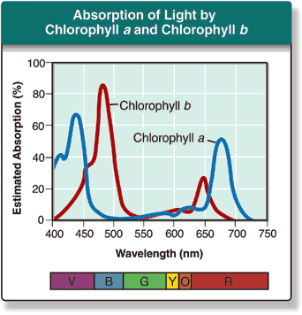
Image by Kelly Riedell http://cosbiology.pbworks.com/f/5.013image.pngB
Corn seeds were planted, watered, and placed in boxes covered with gels that allow only certain wavelengths of light through. Boxes were placed under grow lights for 2 weeks. Boxes were opened and plant growth evaluated. Make a PREDICTION comparing the results of this experiment. EXPLAIN your answer.
Chlorophyll, the main photosynthetic pigment in plants, absorbs red, blue, violet wavelengths of light the best. Chlorophyll doesn’t absorb green, yellow, or orange wavelengths very well.
The absorbed wavelengths are the ones the plant uses for photosynthesis, so the boxes with the red, blue, and violet gels will grow the best compared to the green, orange, and yellow boxes.
Chlorophyll reflects green wavelengths so the plants in the box with the green gel will grow the poorest.
SP 2.B Explain relationships between different characteristics of biological concepts, processes, or models represented visually. b. In applied contexts. SP 6.A Make a scientific claim. SP 6.B Support a claim with evidence from biological principles, concepts, processes, and/or data. SP 6.C Provide reasoning to justify a claim by connecting evidence to biological theories. SP 6.D Explain the relationship between experimental results and larger biological concepts, processes, or theories. ENE I Describe the photosynthetic processes that allow organisms to capture and store energy. ENE I.1. Organisms capture and store energy for use in biological processes— a. Photosynthesis captures energy from the sun and produces sugars ENE 1,J,1 During photosynthesis, chlorophylls absorb energy from light, boosting electrons to a higher energy level in photosystems I and II.

Slide 86
An artificial cell consisting of an aqueous solution enclosed in a selectively
permeable membrane has just been immersed in a beaker containing a different
solution. The membrane is permeable to water and to the simple sugars glucose
and fructose, but completely impermeable to the disaccharide sucrose.
Which solution-the cell or the environment- is hypertonic to the other?
In which direction will there be a net osmotic movement of water?
Ψ = Ψ_{s} + Ψ_{p}
Ψ _{p} = pressure potential
Ψ _{s} = solute potential
Ψ _{s} = - iCRT
i = ionization constant (1.0 for sucrose because sucrose does not ionize in water)
C = molar concentration
R = pressure constant (R= 0.0831 liter bars/mole K)
T = temperature in Kelvin (◦C + 273)
ENVIRONMENT 0.01 M sucrose
0.01 M glucose
0.01 M fructose
CELL 0.03 M sucrose
0.02 M glucose
Cell (0.05 M) is hypertonic to the environment (0.03 M)
Glucose and fructose will move until concentrations of these are equal on both sides. Sucrose can’t cross the membrane, so net movement of water will be out of the cell toward the environment with greater solute concentration
ESSENTIAL KNOWLEDGE
E NE 2.E. 1 Passive transport is the net movement of molecules from high concentration to low concentration without the direct input of metabolic energy.
ENE 2.H.1 External environments can be hypotonic, hypertonic or isotonic to internal environments of cells— a. Water moves by osmosis from areas of high water potential/low osmolarity/ low solute concentration to areas of low water c/high osmolarity/high solute concentration.
SP 5 A. Perform mathematical calculations including: a. Mathematical equations in the curriculum
Campbell Concept check

Slide 87
https://apcentral.collegeboard.org/pdf/ap-biology-practice-exam-2013.pdf?course=ap-biology
This figure shows a model of a ligand precursor being cleaved to produce an active ligand that binds to a specific receptor. Which of the following is most likely to reduce the binding of the active ligand to its receptor? A) A change in the cytoskeletal attachment of transmembrane proteins. B) The presence of a large amount of the precursor form of the ligand.
C) An increase in the ratio of the number of unsaturated to the number of saturated fatty acid tails of the membrane lipids.
D) A mutation in the receptor gene that causes a substitution of a charged amino acid for a nonpolar amino acid in the ligand binding site of the receptor.
IST-3.D.1 Signaling begins with the recognition of a chemical messenger—a ligand—by a receptor protein in a target cell—
a. The ligand-binding domain of a receptor recognizes a specific chemical messenger, which can be a peptide, a small chemical, or protein, in a specific one-to-one relationship
SP 2 B Explain relationships between different characteristics of biological concepts, processes, or models represented visually b in applied contexts
SP 2.C Explain how biological concepts or processes represented visually relate to larger biological principles, concepts, processes or theories.

Slide 88
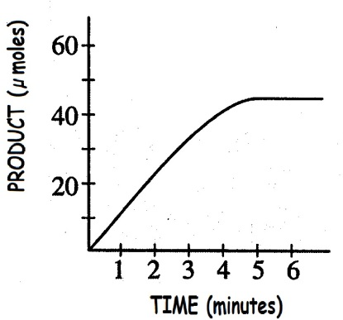
Image from: http://www.biology.arizona.edu/biochemistry/problem_sets/energy_enzymes_catalysis/15t.html reaction rate
This graph show the change in amount of product over time
Why does this graph level out after 5 minutes?
All enzyme is used up.
All substrate has been turned into product
Enzyme is working at it’s maximum rate
Enzyme has been denatured
30sec
ENE 1.G Explain how the cellular environment affects enzyme activity.
ENE 1.G.2 The relative concentrations of substrates and products determine how efficiently an enzymatic reaction proceeds
SP 2 B Explain relationships between different characteristics of biological concepts, processes, or models represented visually
a. in theoretical contexts
SP 2.C Explain how biological concepts or processes represented visually relate to larger biological principles, concepts, processes or theories.

Slide 89
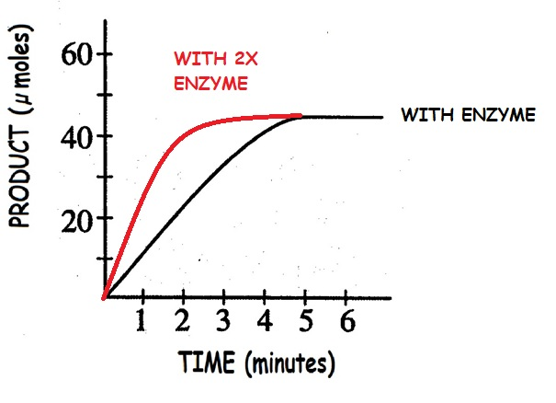
PREDICT what the graph would look like if TWICE as much enzyme was added
Initial rate is faster because more enzyme is available to catalyze reaction, but graph still levels out at same amount of product produced when enzyme has run out of substrate
ENE 1.G Explain how the cellular environment affects enzyme activity.
ENE 1.G.2 The relative concentrations of substrates and products determine how efficiently an enzymatic reaction proceeds
SP 2 B Explain relationships between different characteristics of biological concepts, processes, or models represented visually
a. in theoretical contexts
SP 2.C Explain how biological concepts or processes represented visually relate to larger biological principles, concepts, processes or theories.

Slide 90
Images from: http://ppt.wz51z.com/PMP2/Science.To.WebText/animations/science/chemistry_physics/vp_beaker_bubbles_steam.htm
http://nobel.scas.bcit.ca/debeck_pt/science/images/blue_bubbling_liquid.gif
http://ps205.org/wp-content/uploads/2010/09/beaker_red_liquid_bubbling_sm_wht.gif
Which solution has the least number of H⁺ ions? EXPLAIN YOUR ANSWER
Solution C has the least number of
H⁺ ions
pH 3 pH 6 pH 9 A B C
pH = -log[H+] pH 2 has 1 X 10⁻³ or 0.001 H⁺ per liter (0.01 M)
pH 6 has 1 X 10⁻⁶ or 0.000001 H⁺ per liter pH 9 has 1 X 10⁻⁹ or 0.000000001 H⁺ per liter
SP 1.A Describe biological concepts or processes

Slide 91
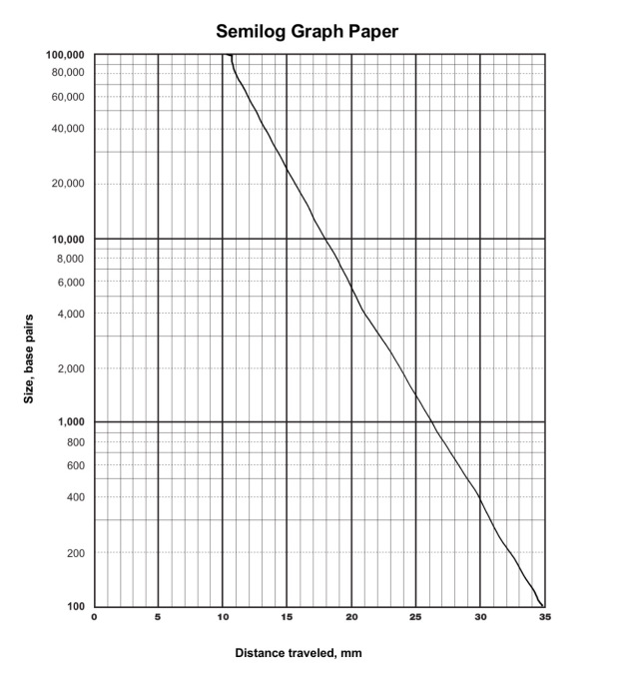
DNA MIGRATION STANDARD CURVE
If a fragment traveled
26 cm on this gel
what size is it?
1000 bp
SP 4.A Construct a graph, plot, or chart (X,Y; Log Y; Bar; Histogram; Line, Dual Y; Box and Whisker; Pie).
a. Orientation
b. Labeling
c. Units
d. Scaling
e. Plotting

Slide 92
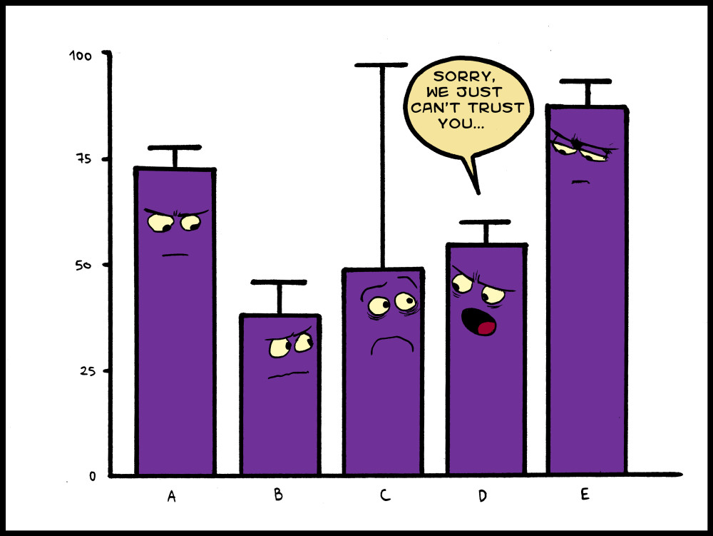
https://webassignwired.files.wordpress.com/2013/11/graph-ff.jpg
TAKE A BREAK

Slide 93
Images from BIOLOGY by Miller and Levine; Prentice Hall Publishing©2006
Identify the patterns of evolution shown in the following graphs.
______________ _________________ _________________
Which of these patterns of evolution are most likely to lead to speciation?
Stabilizing
Directional
Disruptive
Disruptive
EVO-1.E.1 Natural selection acts on phenotypic variations in populations.
.EVO-1.E.2 Environments change and apply selective pressures to populations.
EVO-1.E.3 Some phenotypic variations significantly increase or decrease fitness of the organism in particular environme
ILLUSTRATIVE EXAMPLE Graphical analysis of allele frequencies in a population SP 6.E Predict the causes or effects of a change in, or disruption to, one or more components in a biological system based on b. A visual representation of a biological concept, process, or model.

Slide 94
http://www.phschool.com/science/biology_place/labbench/lab1/quiz.html
Ψ = Ψ_{s} + Ψ_{p}
Ψ _{p} = pressure potential
Ψ _{s} = solute potential
Ψ _{s} = - iCRT
i = ionization constant (1.0 for sucrose because sucrose does not ionize in water)
C = molar concentration
R = pressure constant (R= 0.0831 liter bars/mole K)
T = temperature in Kelvin (◦C + 273)
What is the water potential of the distilled water?
What is the water potential of the beet core?
Which way will water move?
Ψ = 0 + 0 = 0 bars
Ψ = 0.2 + -0.4 = -0.2 bars
From higher Ψ to lower Ψ - move from distilled (0) in beaker into beet core (-0.2)
ESSENTIAL KNOWLEDGE
ENE 2.H.1 External environments can be hypotonic, hypertonic or isotonic to internal environments of cells— a. Water moves by osmosis from areas of high water potential/low osmolarity/ low solute concentration to areas of low water potential/high osmolarity/high solute concentration. RELEVANT EQUATIONS- Water Potential
SP 5 A. Perform mathematical calculations including:
a. Mathematical equations in the curriculum

Slide 95
Sample MC questions from 2015 Course and Exam Description Book posted on College Board website
https://secure-media.collegeboard.org/digitalServices/pdf/ap/ap-biology-course-and-exam-description.pdf
In a hypothetical population of beetles, there is a wide variety of color, matching the range of coloration of the tree trunks on which the beetles hide from predators. The graphs below illustrate four possible changes to the beetle population as a result of a change in the environment due to pollution that darkened the tree trunks.
(A) The coloration range shifted toward more light-colored beetles (diagram I). The pollution helped the predators find the darkened tree trunks.
(B) The coloration in the population split into two extremes (diagram II) Both the lighter-colored & darker-colored beetles were able to hide on the darker tree trunks.
(C) The coloration range became narrower (diagram III) The predators selected beetles at the color extremes.
(D) The coloration in the population shifted toward more darker- colored beetles (diagram IV) The lighter-colored beetles were found more easily by the predators than were the darker-colored beetles.
Which of the following includes the most likely change in the coloration of the beetle population after pollution and a correct rationale for the change?
EVO-1.E.1 Natural selection acts on phenotypic variations in populations.
.EVO-1.E.2 Environments change and apply selective pressures to populations.
EVO-1.E.3 Some phenotypic variations significantly increase or decrease fitness of the organism in particular environme
ILLUSTRATIVE EXAMPLE Graphical analysis of allele frequencies in a population SP 6.E Predict the causes or effects of a change in, or disruption to, one or more components in a biological system based on b. A visual representation of a biological concept, process, or model.

Slide 96
If the vestigial wings and black body genes are linked, a way to determine the cross over frequency/map distance is to cross an F₁ heterozygous tan body normal winged female with a ________________ male.
black body vestigial winged
tan body normal winged
tan body vestigial winged
black body normal winged
RESULTS OF THIS CROSS
ARE SHOWN BELOW
OFFSPRING: 778- tan body-normal wings 785- black body-vestigial wings 146- black body- normal wings 139- tan body-vestigial wings
Always cross with
homozygous recessive
What is the cross over frequency for black body and vestigial winged genes?
146 + 139
778 + 785
285_
1563
Recombinants = Total
=
= 18.2%
What is the map distance between the black body and vestigial winged genes?
Approximately 18 centimorgans (cM)
IST 1.I.2 Fertilization involves the fusion of two haploid gametes, restoring the diploid number of chromosomes and increasing genetic variation in populations by creating new combinations of alleles in the zygote— a. Rules of probability can be applied to analyze passage of single-gene traits from parent to offspring. b. The pattern of inheritance (monohybrid, dihybrid, sex-linked, and genetically linked genes) can often be predicted from data, including pedigree, that give the parent genotype/phenotype and the offspring genotypes/phenotypes.
SP 5 A. Perform mathematical calculations including: d. Ratios e. Percentages
2010 FRQ
Notes:
1

Slide 97
Kentwood, Michigan had a population of 49,000 in the year 2013. The infrastructure of the city allows for a carrying capacity of 60,000 people. r_{max} = 0.9 for Kentwood a. Is the current population above or below the carrying capacity?
b. Will the population increase or decrease next year?
49,000 < 60,000; current population is below carrying capacity
r = positive; population will increase
SYI-1.H.1 A population can produce a density of individuals that exceeds the system’s resource availability. SYI-1.H.2 As limits to growth due to density-dependent and density-independent factors are imposed, a logistic growth model generally ensues. SP 5 A. Perform mathematical calculations including: a. Mathematical equations in the curriculum

Slide 98
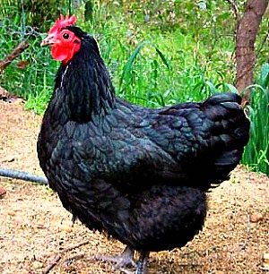
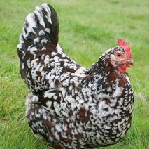
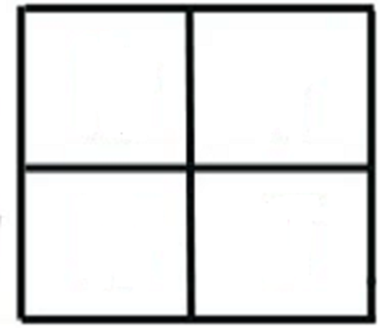
IDENTIFY the PHENOTYPIC frequencies for the offspring from a cross between TWO ERMINETTE chickens.
WW
BB
BW
B W
BB BW
BW WW
B
W
25% BB Black
50% BW Erminette
25% WW White
IST 1.J Explain deviations from Mendel’s model of the inheritance of traits.
IST 1.J.1 Patterns of inheritance of many traits do not follow ratios predicted by Mendel’s laws and can be identified by quantitative analysis, where observed phenotypic ratios statistically differ from the predicted ratios—
SP 5 A. Perform mathematical calculations including: d. Ratios e. Percentages

Slide 99
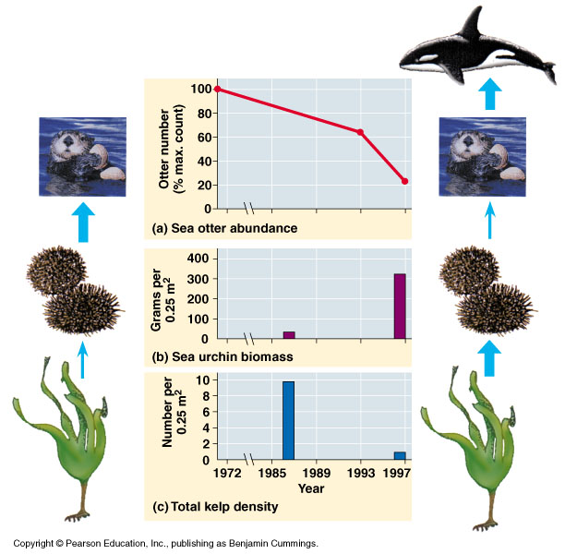
Image from: http://www.zo.utexas.edu/faculty/sjasper/images/53.15.jpg
According to the graphs shown, whales have an impact on the other populations in the ecosystem.
EXPLAIN WHY Graph 1 shows a
decrease in sea otter numbers.
In ecosystems without whales as the
apex predator, the number of sea otters
is high (Graph 1- 100% of max count).
This is because there are no whales to
eat the sea otters.
When whales are present in the ecosystem, the number of sea otters decreases from 100% to 20% of max count between 1985 and 1997, since there are whales in the food chain now, more sea otters are eaten by whales.
SYI-3.G.1 The diversity of species within an ecosystem may influence the organization of the ecosystem.
SP 4. B Describe data from a table or graph, including a. Identifying specific data points
b. Describing trends and/or patterns in the data.
c. Describing relationships between variables.

Slide 100
Image from: http://www.zo.utexas.edu/faculty/sjasper/images/53.15.jpg
EXPLAIN WHY sea urchin and kelp populations respond differently to the presence of whales.
The sea urchin population show a dramatic increase in biomass from near zero grams per 0.25 m² in 1986 to over
300 grams per 0.25 m² 1996, This
represents an increase sea urchin
numbers. Since sea otter numbers show
a decrease during this time, there are
fewer sea otters to eat sea urchins.
Kelp populations show a dramatic decrease in numbers (from 10 per 0.25 m² to 1 per 025 m²) during this same time. As sea urchin numbers increase, kelp numbers decrease because there are more sea urchins to eat the kelp.
SYI-3.G.1 The diversity of species within an ecosystem may influence the organization of the ecosystem
SP 4. B Describe data from a table or graph, including a. Identifying specific data points
b. Describing trends and/or patterns in the data.
c. Describing relationships between variables..

Slide 101
https://www.highschooltestprep.com/ap/biology/unit-8-practice-test/
A sea turtle lays approximately 100 eggs at a time, yet on average only one of the eggs will survive to adulthood.
Which type of survivorship curve represents a sea turtle population?
A. Type I
B. Type II
C. Type III
D. Types II and III
SYI-1.G.1 Populations comprise individual organisms that interact with one another and with the environment in complex ways. SYI-1.G.2 Many adaptations in organisms are related to obtaining and using energy and matter in a particular environment— a. Population growth dynamics depend on a number of factors.

Slide 102
What is the highest water potential a solution in an open beaker can have? JUSTIFY your answer.
Ψ = Ψ_{s} + Ψ_{p}
Ψ _{p} = pressure potential
Ψ _{s} = solute potential
Ψ _{s} = - iCRT
i = ionization constant (1.0 for sucrose because sucrose does not ionize in water)
C = molar concentration
R = pressure constant (R= 0.0831 liter bars/mole K)
T = temperature in Kelvin (◦C + 273)
0- ZERO
Ψ = (Ψ_{p}) + (Ψ_{s})
The (Ψ_{p}) in an open beaker is 0
So basically Ψ = Ψ_{s} in an open beaker.
Adding solute decreases the Ψ_{s} (ie. makes it more negative)
That means an open container with just distilled water would have the highest possible Ψ at ZERO.
ESSENTIAL KNOWLEDGE
ENE 2.H.1 External environments can be hypotonic, hypertonic or isotonic to internal environments of cells— a. Water moves by osmosis from areas of high water potential/low osmolarity/ low solute concentration to areas of low water potential/high osmolarity/high solute concentration.
RELEVANT EQUATIONS- Water Potential
SP 5 A. Perform mathematical calculations including: a. Mathematical equations in the curriculum

Slide 103
https://www.biomanbio.com/HTML5Quizzes/SciMethodsQuizzes/scimethodsquiz1_html5page.html
To see if baldness is caused by a high protein diet, a scientist gives on group of men a low protein diet and another group of men a high protein diet.
What is the dependent variable in this experiment?
a. the amount of protein in the diets of the men b the number of men in each group
c. the age and weight of the men in each group
d. whether or not the men develop baldness
Which of the following is the independent variable in the experiment? a. the amount of protein in the diets of the men b the number of men in each group
c. the age and weight of the men in each group
d. whether or not the men develop baldness
SP 3.C Identify experimental procedures that are aligned to the question, including a. Identifying dependent and independent variables.

Slide 104
http://www.phschool.com/science/biology_place/labbench/lab1/factors.html
Ψ = Ψ_{s} + Ψ_{p}
Ψ _{p} = pressure potential
Ψ _{s} = solute potential
Ψ _{s} = - iCRT
i = ionization constant (1.0 for sucrose because sucrose does not ionize in water)
C = molar concentration
R = pressure constant (R= 0.0831 liter bars/mole K)
T = temperature in Kelvin (◦C + 273)
Initial flaccid cell
Turgid cell at osmotic equilibrium with its surroundings
Ψp = 0
Ψs = -0.7
Ψ = ?
0.7
Ψp = ___
Ψs = ___
Ψ = ___ MPa
-0.7
-0.7
0
Fill in the missing Ψp , Ψs and Ψ
hypotonic
This solution is ___________ to the cell.
hypertonic hypotonic isotonic
ESSENTIAL KNOWLEDGE
ENE 2.H.1 External environments can be hypotonic, hypertonic or isotonic to internal environments of cells— a. Water moves by osmosis from areas of high water potential/low osmolarity/ low solute concentration to areas of low water potential/high osmolarity/high solute concentration.
RELEVANT EQUATIONS- Water Potential
SP 5 A. Perform mathematical calculations including: a. Mathematical equations in the curriculum

Slide 105
You are on a ship at sea that sinks and a few survivors (including you)
escape by climbing into a life raft. You begin to get thirsty while
waiting for rescue and someone suggests drinking sea water.
Use what you learned in AP Bio class to determine if this is a good idea. a. NaCl is the main dissolved ions in seawater at roughly a 0.5 M concentration. Calculate the SOLUTE potential for seawater if you know the water temperature is 27° C.
b. Human body cells have a 0.15M NaCl concentration. Calculate the SOLUTE potential for body cells knowing body temperature is 37° C.
c. Is drinking seawater a good idea? EXPLAIN our answer.
Ψ = Ψ_{s} + Ψ_{p}
Ψ _{p} = pressure potential
Ψ _{s} = solute potential
Ψ _{s} = - iCRT
i = ionization constant (1.0 for sucrose because sucrose does not ionize in water)
C = molar concentration
R = pressure constant (R= 0.0831 liter bars/mole K)
T = temperature in Kelvin (◦C + 273)
Ψs =
- (2) (0.5) ( 0.0831) (273+ 27)
=- 24.93 bars
Ψs =
- (2) (0.15) ( 0.0831) (273+ 37)
= - 7.73 bars
NOT A GOOD IDEA The Ψs of sea water is -24.93 bars compared to -7.73 for human body cells. Drinking salty sea water would be very hypertonic to body cells, causing blood to become more hypertonic to body cells. Body cells would actually lose water and shrivel up
ESSENTIAL KNOWLEDGE
ENE 2.H.1 External environments can be hypotonic, hypertonic or isotonic to internal environments of cells— a. Water moves by osmosis from areas of high water potential/low osmolarity/ low solute concentration to areas of low water potential/high osmolarity/high solute concentration.
SP 5 A. Perform mathematical calculations including: a. Mathematical equations in the curriculum
RELEVANT EQUATIONS-Water Potential

Slide 106
Image from: https://figures.boundless-cdn.com/21346/large/figure-45-03-01.jpe
Which of these growth curves might be seen in a population of algae in a
pond immediately following a huge influx of fertilizer runoff after a heavy rain from nearby farms?
Exponential growth-
population continues to increase due to availability of nutrients for all
SYI-1.G.2 Many adaptations in organisms are related to obtaining and using energy and matter in a particular environment— a. Population growth dynamics depend on a number of factors. i. Reproduction without constraints results in the exponential growth of a population.
SYI-1.H.1 A population can produce a density of individuals that exceeds the system’s resource availability.
SYI-1.H.2 As limits to growth due to density-dependent and density-independent factors are imposed, a logistic growth model generally ensues
SP 2 A Describe characteristics of a biological process, or model, represented visually.
SP 2 B Explain relationships between different characteristics of biological concepts, processes, or models represented visually b in applied contexts
.

Slide 107
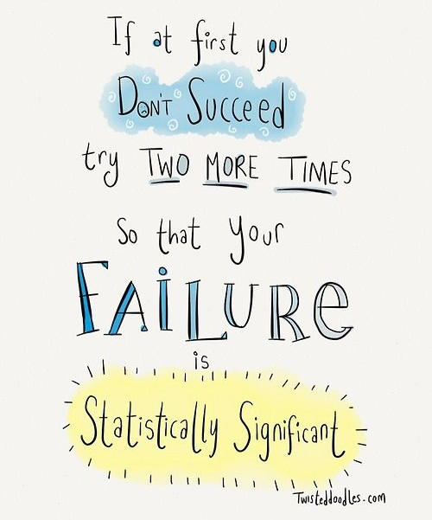
https://www.pinterest.com/pin/50313720816915380/
TAKE A BREAK

Slide 108
http://www.germanna.edu/wp-content/uploads/tutoring/handouts/Hardy-Weinberg-Equilibrium.pdf
Rabbit’s ears can be either short or floppy, where short ears are dominant over floppy ears. There are 653 individuals in a population. 104 rabbits have floppy ears and 549 have short ears. Find: the frequency of the dominant and recessive alleles and the frequency of individuals with homozygous dominant, heterozygous, and homozygous recessive genotypes.
The next generation of rabbits has 560 individuals with short ears and 840 individuals with floppy ears. Solve for p and q. Is the population in Hardy-Weinberg Equilibrium?
Homozygous recessive genotype = 𝑞² = 104/653 = 0.16
Recessive allele = q = √ 0.16 = 0.4
Dominant allele = p = 1- 0.4 = 0.6
Homozygous dominant genotype = p² = (0.6)2 = 0.36
Heterozygous genotype = 2pq = 2 (0.6) (0.4) = 0.48
𝑞2 = 840/1400 = 0.6
q = √0.6 = 0.77
p + q = 1
P² + 2pq + q² = 1
p = frequency of allele 1 in a population
q = frequency of allele 2 in a population
p = 1- 0.77 = 0.23
No, the population is not in a state of Hardy-Weinberg Equilibrium because the allele frequencies are not the same as the preceding generation. .
EVO-1.K.2 Allele frequencies in a population can be calculated from genotype frequencies
EVO-1.L.1 Changes in allele frequencies provide evidence for the occurrence of evolution in a population.
SP 5 A. Perform mathematical calculations including: a. Mathematical equations in the curriculum

Slide 109
https://www.acsboe.org/cms/lib/AL01828617/Centricity/Domain/2862/Exploring%20the%20Scientific%20Method.pdf
EXPERIMENT | INDEPENDENT VARIABLE | DEPENDENT VARIABLE | EXPERIMENTAL GROUP | CONTROL GROUP
A company wants to test a new dog food that is supposed to help overweight dogs lose weight. 50 dogs are chosen to get the new food and 50 more continue on their normal diets. After one month the dogs are checked to see if they have lost weight
A new sun screen has been developed that is supposed to be more effective at preventing sunburn. 30 participants spray one arm with the new formula and spray the other arm with the leading formula. After 4 hours in the sun their skin is evaluated for any redness
A student wants to study the effect of sunlight on plant growth. In his experiment 12 plants receive normal amounts of sunlight , but half of them are kept under bright sunlamps all night long. After 6 weeks, the plants’ heights are measured
Dogs receiving new food
Dogs on
normal diet
New dog food
Weight loss
Original
sunscreen
Arm with leading formula
New sunscreen
Arm with new formula
Sunlamps giving extra light a night
Normal sunlight
Plants under sunlamps at night
Plants getting only normal sunlight
SP 3.C Identify experimental procedures that are aligned to the question, including a. Identifying dependent and independent variables.

Slide 110
http://highered.mcgraw-hill.com/sites/0072485949/student_view0/chapter3/interactive_activity.html
Could this trait be inherited as AUTOSOMAL RECESSIVE?
Fill in the genotypes for A, B, C, and D
AUTOSOMAL RECESSIVE is possible
Dd
dd
dd
Dd
dd
dd
dd
Dd
D?
dd
dd
D?
D?
IST 1.I.2 Fertilization involves the fusion of two haploid gametes, restoring the diploid number of chromosomes and increasing genetic variation in populations by creating new combinations of alleles in the zygote— b. The pattern of inheritance (monohybrid, dihybrid, sex-linked, and genetically linked genes) can often be predicted from data, including pedigree, that give the parent genotype/phenotype and the offspring genotypes/phenotypes.

Slide 111
https://drive.google.com/file/d/1dYc0UwWU0Ap8WXSvCQsUaSMMZ_S7Xpzb/view
Use the data provided to answer the following questions
Which of these ecosystems show the greatest biodiversity? EXPLAIN your answer
The diversity index is a measure of biodiversity in an ecosystem and is determined by RICHNESS (the number of species present in a sample area) and EVENESS ( the relative abundance of each species in the sample area). The tropical Rain Forest has the greatest number of species AND more than one of each.
A high Diversity Index score (near 1) means high diversity. The Tropical Rain forest has the greatest diversity index (0.75) compared to the 3 ecosystems. (0.5, 0.33, and 0.0.19)
ENE-4.A.1 The structure of a community is measured and described in terms of species composition and species diversity.
SP 4. B Describe data from a table or graph, including a. Identifying specific data points
b. Describing trends and/or patterns in the data.
c. Describing relationships between variables.

Slide 112
http://education-portal.com/cimages/multimages/16/rh-blood-group-system.jpg
In humans, Rh-positive individuals have the Rh antigen on their red blood cells, while Rh-negative individuals do not. If the Rh-positive phenotype is produced by a dominant gene (A), and the Rh-negative phenotype is due to its recessive allele (a), what is the frequency of the Rh-positive allele if 84% of a population is Rh-positive?
q² = 1-.84 = 0.16
q = √ 0.16 = 0.4
p + q = 1
p + 0.4 = 1
p = 0.6
p + q = 1
P² + 2pq + q² = 1
p = frequency of allele 1 in a population
q = frequency of allele 2 in a population
Rh-positive allele = 60%
EVO-1.K.2 Allele frequencies in a population can be calculated from genotype frequencies
SP 5 A. Perform mathematical calculations including: a. Mathematical equations in the curriculum

Slide 113
From: Released 2013 AP BIOLOGY Practice Exam
Thrips are insects that feed on rose pollen. Scientists noted that the thrips population increased in the spring and decreased dramatically during the summer. The researchers hypothesized that food abundance was the limiting factor for the population. Which of the following types of data would be most useful for the scientists to collect at regular intervals on a designated test plot of rose plants?
Amount of sunlight (Hours/day)
Mean temperature (◦C)
Density of rose pollen produced (g/m²)
D. Amount of pollen produced by each flower (g/flower)
SYI 1.H.2 As limits to growth due to density-dependent and density-independent factors are imposed, a logistic growth model generally ensues
SP 3.C Identify experimental procedures that are aligned to the question, including
a. Identifying dependent and independent variables. . SP 3.E Propose a new/next investigation based on
b. An evaluation of the design/methods.

Slide 114
http://1.bp.blogspot.com/-SXDXx4Ez810/UbEKTKUqkDI/AAAAAAAAAHI/Uq4qE4VxAh8/s640/ch17f20.jpg
Not all organisms determine sex with X and Y chromosomes like humans do. In reptiles, sex of offspring is determined by temperature of eggs during incubation.
What is the % of males that hatch from eggs from Trachemys scripta tortoise nests at temperatures around 28.5 ^{O}C (83 ^{O}F) ?
How does this change by increasing the temperature 3 degrees?
How might the warming of the Earth due to climate change impact breeding in reptile populations?
Approximately 50% males; 50% females
0% males . . . All hatchlings will be female!
In species whose sex is temperature dependent, warming of the planet will change male/female ratios and may result in populations with only females or only males. This would lead to decreases in population numbers; even to extinction.
Watch a 5 minute video about how other organisms determine sex
IST 1.J Explain deviations from Mendel’s model of the inheritance of traits
SYI 3.B.1 Environmental factors influence gene expression and can lead to phenotypic plasticity. Phenotypic plasticity occurs when individuals with the same genotype exhibit different phenotypes in different environments.
ILLUSTRATIVE EXAMPLES page 104 CED Sex determination in reptiles.

Slide 115
What conclusions can you draw from Chi Square analysis of data if the X² value is greater than the probability value in the 0.05 row on the Chi Square Table?
If the Chi square value is greater than the probability value, then the differences observed in the data ARE statistically significant. Therefore, the data DO NOT support the hypothesis that there is no difference between the observed data and what was expected. “Reject” the null hypothesis. There is a difference!
Watch a Bozeman Science video about Chi Square testing
SP 5 A. Perform mathematical calculations including a. Mathematical equations in the curriculum
Notes:
:

Slide 116
MICHIGAN | q2 | q | p | p² | 2pq
 | 0.0009 | .03 | 0.97 | 0.94 | 0.058
Following are the data that were actually collected in Wisconsin. Perform a
chi-square test on these data. Can you accept the hypothesis that the allele frequency is the same in Wisconsin as in Michigan? Use the chi-square table below to interpret your results. Give degrees of freedom and p values.
WISCONSIN | AA | Aa | aa | TOTAL
OBSERVED | 2346 | 150 | 4 | 2500
EXPECTED |  |  |  | 2500
0.94 x 2500 =
2350
0.058x2500 =
145
0.0009x2500 =
2
Χ² =Σ
(o – e)² = (2346-2350)² + (150-145)² + (4-2)² = 0.007 + .172 + 2.0 = 2.18
e 2350 145 2
In Hardy-Weinberg chi-square analysis, the number of degrees of freedom is equal to the number of genotypes minus the number of alleles. (Once a value for q is determined, there is no freedom for choosing the value for p.)
Degrees of freedom = 3-2=1
The Chi square value of 2.18 is less than the p value of 3.84 Fail to reject the null hypothesis. There is no statistically significant difference between the allele frequencies in the two populations.
EVO-1.K.2 Allele frequencies in a population can be calculated from genotype frequencies
EVO-1.L.1 Changes in allele frequencies provide evidence for the occurrence of evolution in a population.
SP 5 A. Perform mathematical calculations including: a. Mathematical equations in the curriculum

Slide 117
https://www.pinterest.com/pin/50313720819838829/
TAKE A BREAK

Slide 118
In fruit flies black body and vestigial wings is recessive to the wild type gray body and normal wings. A cross between a homozygous wild type fly with a black body vestigial winged fly produces 100% wild type offspring. An F₁ Wild type fruit fly (heterozygous for gray body and normal wings) is mated with a black fly with vestigial wings and the offspring shown below: 778- wild type 785- black-vestigial 158- black- normal wings 162- gray body-vestigial wings
What is the recombination frequency between these genes?
What is the map distance between black body and vestigial wing genes?
320 = 1883
17%
Recombinants = Total
17 centimorgans
IST 1.J Explain deviations from Mendel’s model of the inheritance of traits.
IST 1.J.1 Patterns of inheritance of many traits do not follow ratios predicted by Mendel’s laws and can be identified by quantitative analysis, where observed phenotypic ratios statistically differ from the predicted ratios— a. Genes that are adjacent and close to one another on the same chromosome may appear to be genetically linked; the probability that genetically linked genes will segregate as a unit can be used to calculate the map distance between them.
SP 5 A. Perform mathematical calculations including: d. Ratios e. Percentages

Slide 119
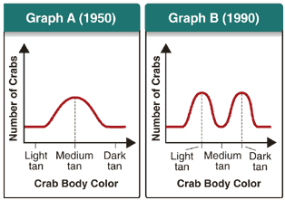
Image from: Miller and Levine Biology
Which of the following is most likely to have caused
the change in the population shown in the graphs?
A. a new predator prefers dark-tan crabs
B. a new predator prefers light-tan crabs
C. a new beach color makes medium-tan crabs the least visible
D. a new beach color makes medium-tan crabs the most visible
EXPLAIN YOUR ANSWER:
The graph shows a decrease in the number of medium tan crabs in the population.
If the beach color changed to make the medium tan crabs more visible, then more crabs of this color would be seen and eaten by predators and their numbers would decrease.
EVO-1.E.2 Environments change and apply selective pressures to populations.
EVO-1.E.3 Some phenotypic variations significantly increase or decrease fitness of the organism in particular environments
SP 4. B Describe data from a table or graph, including
b. Describing trends and/or patterns in the data..

Slide 120
https://www.biologycorner.com/quiz/qz_populations.html
A negative growth rate means
the population is decreasing
the population is increasing
the growth rate is exponential
carrying capacity has been reached
SYI-1.G.2 Many adaptations in organisms are related to obtaining and using energy and matter in a particular environment— a. Population growth dynamics depend on a number of factors. ENE-1.N.1 Changes in energy availability can result in changes in population size.

Slide 121
780 turkeys live in Merriam township, which is 92 acres in size. The birth rate is 0.472 turkeys/ year. The death rate is 0.331 turkeys/ year.
What is the population density?
What is dN/dt?
Predict N after one year, assuming dN/dt stays constant.
780/92 = 8.5 turkeys/acre
dN/dt= r _{max} N
(0.472-0.331) (780) = 0.141 (780)
110 turkeys/ year
780 + 110 = 890 turkeys
SYI-1.G.2 Many adaptations in organisms are related to obtaining and using energy and matter in a particular environment— a. Population growth dynamics depend on a number of factors. i. Reproduction without constraints results in the exponential growth of a population. SP 5 A. Perform mathematical calculations including: a. Mathematical equations in the curriculum

Slide 122
Image and questions from: http://www.mtchs.org/BIO/text/chapter5/review5.html
Why does the rate of the reaction catalyzed by enzyme A slow down at temperatures above 40ºC?
Above 40º C Enzyme A loses activity because proteins (like enzymes) denature at higher temperatures. They lose function because 2º, 3º, and 4º structure (if present) changes shape and active site can no longer bind to the substrate reducing it’s activity.
ENE 1.F Explain how changes to the structure of an enzyme may affect its function.
ENE F. 1 Change to the molecular structure of a component in an enzymatic system may result in a change of the function or efficiency of the system— a. Denaturation of an enzyme occurs when the protein structure is disrupted, eliminating the ability to catalyze reactions. b. Environmental temperatures and pH outside the optimal range for a given enzyme will cause changes to its structure, altering the efficiency with which it catalyzes reactions
ENE F.2 In some cases, enzyme denaturation is reversible, allowing the enzyme to regain activity.
SP 2 A Describe characteristics of a biological process, or model, represented visually.
SP 2 B Explain relationships between different characteristics of biological concepts, processes, or models represented visually
b in applied contexts
SP 2.C Explain how biological concepts or processes represented visually relate to larger biological principles, concepts, processes or theories.

Slide 123
One dandelion plant can produce many seeds, leading to a high growth rate for dandelion populations. If a population of dandelions is currently 40 individuals, and r_{max}= 80 dandelions/month, predict dN/dt if these dandelions would grow exponentially.
Exponential growth:
dN/dt= r_{max} N
dN/dt= 80 x 40= 3200 dandelions
SYI-1.G.2 Many adaptations in organisms are related to obtaining and using energy and matter in a particular environment— a. Population growth dynamics depend on a number of factors. i. Reproduction without constraints results in the exponential growth of a population. SP 5 A. Perform mathematical calculations including: a. Mathematical equations in the curriculum

Slide 124
When tackling a Hardy-Weinberg problem, always
start with the ____________ _________ individuals.
When solving Hardy-Weinberg problems, which of
these represent organisms with a dominant phenotype?
homozygous
recessive
homozygous OR heterozygous
dominant OR recessive
p q p² 2pq q²
p + q = 1
P² + 2pq + q² = 1
p = frequency of allele 1 in a population
q = frequency of allele 2 in a population
EVO-1.K.2 Allele frequencies in a population can be calculated from genotype frequencies
SP 5 A. Perform mathematical calculations including: a. Mathematical equations in the curriculum

Slide 125
https://quizizz.com/admin/quiz/5c792ab60ea58c001c41a55c/box-and-whisker-plot-quiz
Which city has the smallest minimum temperature?
Nashville Dallas
.
SP 4. B Describe data from a table or graph, including a. Identifying specific data points

Slide 126
https://image.slidesharecdn.com/ankitseminar-180315173151/95/cytoplasmic-inheritance-9-638.jpg?cb=1521135293
Four o'clock plant possess either white,
green, or variegated leaves. Results of an
experiment to determine the inheritance
pattern for leaf color are shown at the right.
Which parent appears to be responsible for
transmitting the genes for leaf color?
mother father both
JUSTIFY your answer.
Leaf color in offspring appears to follow color of mother. If the maternal plant is white, offspring will be white, even if paternal plant is green or variegated. If the maternal plant is green offspring will be green, even if paternal plant is white or variegated. If maternal plant is variegated offspring
will be variegated, even if paternal plant is green or white. If paternal DNA played a role in inheritance of leaf color, results should show differences in offspring color depending on the combination of paternal and maternal colors.
SP 6A. Make a scientific claim.
SP 6B Support a claim with evidence from biological principles, concepts, processes, and/or data
SP 6C. Provide reasoning to justify a claim by connecting evidence to biological theories
SP 6 D. Explain the relationship between experimental results and larger biological concepts, processes, or theories
Notes:
s

Slide 127
https://image.slidesharecdn.com/ankitseminar-180315173151/95/cytoplasmic-inheritance-9-638.jpg?cb=1521135293
Leaf color in four o'clock plants is an example
of non-nuclear inheritance.
Some variegated plants have mutations that prevent them from synthesizing chlorophyll throughout their leaves. EXPLAIN how these
data support the hypothesis that at least
some of the genes for chlorophyll synthesis
might be found in chloroplast DNA.
If all chlorophyll producing genes were located in the nucleus, it would be expected that the data would have shown a paternal contribution to leaf color since nuclear DNA is divided evenly in gametes. During oogenesis, cytoplasm divides unequally resulting in organelles including chloroplasts being inherited from the mother in the ovule. Since leaf color appears to follow maternal color this would suggest that at least some of the chlorophyll genes are not located in the nucleus. Since chlorophyll is found in chloroplasts, it is not unreasonable that the DNA for chloroplast production would be found there as well.
IST 1.J.4 Some traits result from non-nuclear inheritance— a. Chloroplasts and mitochondria are randomly assorted to gametes and daughter cells; thus, traits determined by chloroplast and mitochondrial DNA do not follow simple Mendelian rules.
SP 6A. Make a scientific claim.
SP 6B Support a claim with evidence from biological principles, concepts, processes, and/or data
SP 6C. Provide reasoning to justify a claim by connecting evidence to biological theories

Slide 128
From Released 2013 AP BIOLOGY Practice Exam
In the Arctic Ocean, the predominant primary producers are
phytoplankton. Phytoplankton are consumed by zooplankton, which in turn are eaten by codfish. In years when there is more open water (less ice coverage), there are more zooplankton and fish than in years with less open water (more ice coverage). Based on the graph shown, the difference is most likely because
A) when there is less open water, light is blocked from the zooplankton, so they cannot produce as much food for the fish.
B) when there is more open water, the temperature is warmer, so the zooplankton and fish populations increase in size.
C) the ice blocks the light, so in years with more ice coverage, there is less photosynthesis by the phytoplankton.
D) the ice increases the light available for photosynthesis, so primary production increases and zooplankton populations increase in size
True-but not shown on graph
ENE-4.B.3 Relationships among interacting populations can be characterized by positive and negative effects and can be modeled. Examples include predator/prey interactions, trophic cascades, and niche partitioning
SP 6 E Predict the causes or effects of a change in, or disruption to, one or more components in a biological system based on
a. Biological concepts or processes.
.

Slide 129
http://ehardmanapbio.weebly.com/uploads/5/2/0/5/5205206/jenniferkloocksquantitativeguidekey2.pdf
Hydrogen peroxide is broken down to water and oxygen by the enzyme catalase.
The data were taken over 5 minutes.
What is the rate of enzymatic reaction in mL/min from 2 to 4 minutes?
Round to the nearest hundreds
5.5 – 3.6
4-2
= 1.9 = 0.95 mL/min
2
.
SP 4. B Describe data from a table or graph, including a. Identifying specific data points

Slide 130
Image from: http://www.epikness.com/wp-content/uploads/2011/11/chem191ss5q5.gif
This graph shows the effect substrate concentration on the rate of reaction
EXPLAIN why reaction rate is low on this part of the graph?
At low substrate concentrations the rate of reaction is slow because chances for enzyme and substrate to interact is low.
As substrate concentration increases, rate of reaction increases because there is more substrate available to interact with enzyme up to a point.
ENE 1.G.2 The relative concentrations of substrates and products determine how efficiently an enzymatic reaction proceeds
SP 2 B Explain relationships between different characteristics of biological concepts, processes, or models represented visually
a. in theoretical contexts
SP 2.C Explain how biological concepts or processes represented visually relate to larger biological principles, concepts, processes or theories.

Slide 131
http://rlv.zcache.com/dont_be_mean_be_above_average_statistics_humor_postcard-r33f5612b6cbe488db7e5571298622668_vgbaq_8byvr_630.jpg?view_padding=%5B285%2C0%2C285%2C0%5D
TAKE A BREAK

Slide 132
Which of the graphs shown here represents a Type III survivor curve?
C is Type III
Give 3 characteristics of this kind of population.
___ selected organisms show this kind of curve.
Give an example of an organism like this.
small size, short life span, early maturity, large number of offspring, little parental care, high mortality,
r
dandelions, insects, small mammals, frogs, cockroaches There are others
SYI-1.G.1 Populations comprise individual organisms that interact with one another and with the environment in complex ways. SYI-1.G.2 Many adaptations in organisms are related to obtaining and using energy and matter in a particular environment— a. Population growth dynamics depend on a number of factors.
SP 4. B Describe data from a table or graph, including b. Describing trends and/or patterns in the data

Slide 133
A lake that has been depleted of walleye is stocked with a population of 1000 walleye fish in 2013. The birth rate = 0.73 walleye/year. The death rate = 0.32 walleye/year
What is the growth rate ?
Predict the population in 2014, if the growth rate stays the same?
r = (b-d) = (0.73 -0.32) = 0.41
dN = 0.41 (1000) = 41 walleye dt
1000 + 41 = 1041 There will 1041 walleye in 2014
Is this a suitable habitat?
Yes, growth rate is positive; population is increasing
SYI-1.G.2 Many adaptations in organisms are related to obtaining and using energy and matter in a particular environment— a. Population growth dynamics depend on a number of factors. i. Reproduction without constraints results in the exponential growth of a population. SP 5 A. Perform mathematical calculations including: a. Mathematical equations in the curriculum

Slide 134
https://teachers.stjohns.k12.fl.us/lyons-s/files/2018/09/AP-Bio-Cells-Practice-Test.pdf
The solutions in the arms of a U-tube are separated at
the bottom of the tube by a selectively permeable
membrane. The membrane is permeable to sodium
chloride (NaCl), but not to glucose. Side A is filled with
a solution of 0.4 M glucose and 0.5 M sodium chloride
and side B is filled with a solution containing 0.8 M glucose
and 0.4 M sodium chloride. Initially, the volume in both arms is the
same. If you examine side A after 3 days, you should find
A. decrease in the concentration of NaCl and glucose and an increase in the water level.
B. a decrease in the concentration of NaCl, an increase in water level, and no change in the concentration of glucose.
C. no net change in the system.
D. a decrease in the concentration of NaCl and a decrease in the water level.
E. no change in the concentration of NaCl and glucose and an increase in the water level.
ESSENTIAL KNOWLEDGE
ENE 2.E.1 Passive transport is the net movement of molecules from high concentration to low concentration without the direct input of metabolic energy.
ENE 2.H.1 External environments can be hypotonic, hypertonic or isotonic to internal environments of cells— a. Water moves by osmosis from areas of high water potential/low osmolarity/ low solute concentration to areas of low water potential/high osmolarity/high solute concentration.

Slide 135
FROM: Released 2013 AP Biology Exam
A researcher is investigating the relationship between the species diversity in a community and the ability of an introduced nonnative species to destabilize the community. Which of the following graphs is most consistent with the claim that communities with high diversity are more resistant to change than are communities with low diversity?
Survival of invaders is high when diversity is low and low when diversity is high
SP 4. B Describe data from a table or graph, including
b. Describing trends and/or patterns in the data.
c. Describing relationships between variables.
SYI-3.F.1 Natural and artificial ecosystems with fewer component parts and with little diversity among the parts are often less resilient to changes in the environment.

Slide 136
http://www.germanna.edu/wp-content/uploads/tutoring/handouts/Hardy-Weinberg-Equilibrium.pdf
Petal coloration of pea plants has a complete dominance relationship where purple petals are dominant over white petals. There are 276 plants, 273 have purple petals. Find: the frequency of the dominant and recessive alleles and the frequency of individuals with the homozygous dominant, heterozygous, and homozygous recessive genotype.
The next generation of pea plants has 552 plants, 546 have purple petals.
Is the population in Hardy-Weinberg Equilibrium? Solve for p and q.
Homozygous recessive genotype = 𝑞² = 3/276 = 0.01
p + q = 1
P² + 2pq + q² = 1
p = frequency of allele 1 in a population
q = frequency of allele 2 in a population
Recessive allele = q = √ 0.01 = 0.1
Dominant allele = p = 1- 0.1 = 0.9
Homozygous dominant genotype = p² = (0.9)2 = 0.81
Heterozygous genotype = 2pq = 2 (0.1) (0.9) = 0.18
𝑞² = 6/552 = 0.01
q = √0.01 = 0.1
p = 1- 0.1 = 0.9
YES, the population is in a state of Hardy-Weinberg Equilibrium because the allele frequencies are the same as the preceding generation. .
EVO-1.K.2 Allele frequencies in a population can be calculated from genotype frequencies
EVO-1.L.1 Changes in allele frequencies provide evidence for the occurrence of evolution in a population.
SP 5 A. Perform mathematical calculations including: a. Mathematical equations in the curriculum

Slide 137
https://quizizz.com/admin/quiz/5c792ab60ea58c001c41a55c/box-and-whisker-plot-quiz
Which city has the smaller median?
Nashville Dallas
.
SP 4. B Describe data from a table or graph, including a. Identifying specific data points

Slide 138
https://www2.palomar.edu/users/warmstrong/lmexer4.htm
Watch a Bozeman Science video about Chi Square testing
Data for offspring from a genetic cross are shown below
498 Wild type (red eyes)
383 Wild type (red eyes)
117 Purple eyes
Use Chi Square analysis on data for F₂ offspring. Is purple eyes an autosomal recessive trait? Write an H₀.
H₀ is always: There is NO DIFFERENCE between the observed data and what was expected ( you have to include what was expected) !
There is NO DIFFERENCE between the observed data and a 3:1 ratio expected for an autosomal recessive cross.
IST 1.I. b. The pattern of inheritance (monohybrid, dihybrid, sex-linked, and genetically linked genes) can often be predicted from data, including pedigree, that give the parent genotype/phenotype and the offspring genotypes/phenotypes.
SP 5 A. Perform mathematical calculations including a. Mathematical equations in the curriculum
Notes:
:

Slide 139
Use Chi Square Analysis
383 Wild type (red eyes)-
383-375
(8 ) ² = 64
64//375 =0.17
117 Purple eyes
117- 125
(-8)² = 64
64/7125 = 0.51
0.68
1
Degrees of Freedom = _______
What conclusions can you draw?
Chi square value of 0.68 is less than the probability value of 3.84. Therefore “Fail to reject” the null hypothesis. The differences observed in the data are not statistically significant at the 0.5 level. Therefore the data support the hypothesis that there is no difference between the observed data and what was expected for a 3:1 pattern expected for an autosomal recessive trait
IST 1.I.2 Fertilization involves the fusion of two haploid gametes, restoring the diploid number of chromosomes and increasing genetic variation in populations by creating new combinations of alleles in the zygote— a. Rules of probability can be applied to analyze passage of single-gene traits from parent to offspring. b. The pattern of inheritance (monohybrid, dihybrid, sex-linked, and genetically linked genes) can often be predicted from data, including pedigree, that give the parent genotype/phenotype and the offspring genotypes/phenotypes
SP 5 A. Perform mathematical calculations including a. Mathematical equations in the curriculum
Notes:
:

Slide 140
Use Chi Square Analysis to determine if the H₀ hypothesis is correct?
An ear of corn has a total of 381 grains, including 216 Purple & Smooth, 79 Purple & Shrunken, 65 Yellow & Smooth, and 21 Yellow & Shrunken.
2019 FRQ
Purple & smooth - 216
216- 214.31
(1.69) ² = 2.86
2.86/214.31=0.013
Purple & shrunken - 79
79- 71.43
(7.57)² = 57.3
57.3/71.43.31= 0.8
Yellow & smooth - 65
65- 71.43
(- 6.43)² = 41.34
41.34/71.43=0.58
Yellow & shrunken - 21
21- 23.81
(-2.81)² = 7.9
7.9/23.81=0.33
1.71
4-1 = 3
Degrees of Freedom = _______
Chi square value of 1.71 < probability value of 7.81. “Fail to reject” the null hypothesis. The differences observed in the data are not statistically significant at the 0.5 level. Therefore, the data support the hypothesis that there is no difference between the observed data and what was expected for a 9:3:3:1 pattern.
IST 1.I.2. b. The pattern of inheritance (monohybrid, dihybrid, sex-linked, and genetically linked genes) can often be predicted from data, including pedigree, that give the parent genotype/phenotype and the offspring genotypes/phenotypes.
SP 5 A. Perform mathematical calculations including a. Mathematical equations in the curriculum
Notes:
:

Slide 141
MAKE A PREDICTION about the mode of inheritance for the following trait and JUSTIFY your answer. WT (red eyed normal wings) female flies are crossed with sepia eyed dumpy winged males. Offspring are shown below
Sepia eyes and dumpy wings are AUTOSOMAL RECESSIVE traits
No differences in #’s of males/females for each trait Only wild type flies appear in F₁ generation
Sepia eyed trait and dumpy wing trait each return in 3:1 ratio in F₂ generation
This is a dihybrid cross 9:3:3:1 = classic Mendelian ratio Indicates 2 genes are on different chromosomes (not linked)
9: Dominant Trait 1; Dominant Trait 2 3: Dominant Trait 1; Recessive Trait 2 3: Recessive Trait 2; Recessive Trait 1 1: Recessive Trait 1; Recessive Trait 2
9: Normal wings; Red eyes
3: Normal wings ; sepia eyes 3: Dumpy wings; red eyes 1: Dumpy wings; sepia eyes
IST 1.I.2 Fertilization involves the fusion of two haploid gametes, restoring the diploid number of chromosomes and increasing genetic variation in populations by creating new combinations of alleles in the zygote— a. Rules of probability can be applied to analyze passage of single-gene traits from parent to offspring. b. The pattern of inheritance (monohybrid, dihybrid, sex-linked, and genetically linked genes) can often be predicted from data, including pedigree, that give the parent genotype/phenotype and the offspring genotypes/phenotypes
SP 5 A. Perform mathematical calculations including a. Mathematical equations in the curriculum.

Slide 142
Image from: https://i.ytimg.com/vi/ownsru2JO0w/hqdefault.jpg
A Wild type fruit fly (heterozygous for gray body and red eyes) is mated with a black fly with purple eyes.
OFFSPRING: 721- gray body/red eyes 751- black body/purple eyes 49- gray body/purple eyes 45- black body/red-eyes
What is the recombination frequency between these genes?
What is the map distance between these 2 genes?
Recombinants = Total
94
1566
= 6 %
6 cM (centimorgans)
IST 1.J.1 Patterns of inheritance of many traits do not follow ratios predicted by Mendel’s laws and can be identified by quantitative analysis, where observed phenotypic ratios statistically differ from the predicted ratios— a. Genes that are adjacent and close to one another on the same chromosome may appear to be genetically linked; the probability that genetically linked genes will segregate as a unit can be used to calculate the map distance between them.
SP 5 A. Perform mathematical calculations including: a. Mathematical equations in the curriculum d. Ratios e. Percentages

Slide 143
Modified from: https://teachers.stjohns.k12.fl.us/lyons-s/files/2014/11/Population-Ecology-Practice-Problems-ABrokaw2012-13.pdf
One dandelion plant can produce many seeds leading to a high growth rate for dandelion populations. If a population of dandelions is currently 100 individuals and r_{max} = 0.4 dandelions/month per capita, predict how many dandelions would be in this population in the next 4 months. Complete the table. Round to the nearest whole number.
dN/dt= r _{max} N
100
0.4 (100) = 40
140
140
0.4 (140) = 56
196
0.4 (196) = 112
196
308
308
0.4 (308) = 123
431
Imagine the original dandelion population mentioned above cannot grow exponentially due to lack of space. The carrying capacity for their field is 150 dandelions. What is their dN/dt in this logistic growth situation?
dN/dt = r _{max} N (K-N)
K
dN/dt = (0.4) (100) (150-100)
150
dN/dt= (0.4) (100) (50) = 13 dandelions/month
150
SYI-1.G.2 Many adaptations in organisms are related to obtaining and using energy and matter in a particular environment— a. Population growth dynamics depend on a number of factors. i. Reproduction without constraints results in the exponential growth of a population. SP 5 A. Perform mathematical calculations including: a. Mathematical equations in the curriculum

Slide 144
http://www.mathfunny.com/images/racoon-meme-plotting-graph-graphing-paper-math-funny.jpg
TAKE A BREAK

Slide 145
Female wild type flies are crossed with purple eyed males. Results are shown below
MAKE A PREDICTION about the mode of inheritance for the purple eyed trait.
PROVIDE EVIDENCE for your answer.
Purple eyes is an autosomal recessive trait
No differences in #’s of males/females with trait in
each generation Only wild type flies appear in F₁ generation/no purple eyed flies WT: purple eyed trait returns in 3:1 ratio in F₂ generation ( 760 WT; 240 purple eyed ) Classic Mendelian ratio
Show Punnett squares for both crosses (Use Wild type (P) and Purple (p)
P P
P p
F₁
F₂
p p
P p P p P p P p
P p
P P P p
P p p p
IST 1.I.2 a. Rules of probability can be applied to analyze passage of single-gene traits from parent to offspring. b. The pattern of inheritance (monohybrid, dihybrid, sex-linked, and genetically linked genes) can often be predicted from data, including pedigree, that give the parent genotype/phenotype and the offspring genotypes/phenotypes.
SP 5 A. Perform mathematical calculations including a. Mathematical equations in the curriculum
2010 FRQ

Slide 146
http://www.nimbios.org/education/SIDcalc_exer.pdf
One of the more useful aspects of the Simpson’s Diversity index is to compare two sets of data to see which is more diverse. Data for 2 populations of salamanders is shown below. Calculate the Simpson’s Diversity Index for each Plot. Which has greater biodiversity?
A higher score (closest to 1) means high diversity.
The Plot 1 has greater diversity than Plot 2.
PLOT 2
PLOT 1
= 1- 30 ² + 34 ² + 36 ²
100 100 100
= 1 - 20 ² + 7 ² + 73 ²
100 100 100
= 1 - (0.09 + 0.116 + 0.13 )
= 1 - (0.04) + 0.005 + 0.53 )
= 1 - 0.336 = 0.664
= 1 - 0.575 = 0.425
ENE-4.A.1 The structure of a community is measured and described in terms of species composition and species diversity.
SP 5 A. Perform mathematical calculations including: a. Mathematical equations in the curriculum

Slide 147
Circle the individuals in this pedigree that tell you this is NOT X-LINKED
CAN’T BE X-linked Moms gives X to sons MOM with TRAIT
CAN’T have a SON WITHOUT THE TRAIT
IST 1.I.2 b. The pattern of inheritance (monohybrid, dihybrid, sex-linked, and genetically linked genes) can often be predicted from data, including pedigree, that give the parent genotype/phenotype and the offspring genotypes/phenotypes.
a. Genes that are adjacent and close to one another on the same chromosome may appear to be genetically linked; the probability that genetically linked genes will segregate as a unit can be used to calculate the map distance between them.

Slide 148
In dogs hereditary deafness is caused by a recessive gene (d). A kennel owner has a hearing male dog that she wants to use for breeding purposes if possible. She would like to avoid having deaf puppies. What are the possible genotypes of this male dog? ______ ______
A testcross would use a female dog with this genotype _____ to try and determine if this male dog should be used for breeding.
A testcross is done and a litter of puppies is born that includes the following: 5 hearing puppies
What can you conclude about the male dog’s unknown genotype?
DD Dd
dd
Still unknown; Both DD and Dd dogs can produce hearing puppies. Do another test cross
IST 1.I.2 Fertilization involves the fusion of two haploid gametes, restoring the diploid number of chromosomes and increasing genetic variation in populations by creating new combinations of alleles in the zygote— b. The pattern of inheritance (monohybrid, dihybrid, sex-linked, and genetically linked genes) can often be predicted from data, including pedigree, that give the parent genotype/phenotype and the offspring genotypes/phenotypes.
SP 6A. Make a scientific claim.
SP 6B Support a claim with evidence from biological principles, concepts, processes, and/or data

Slide 149
https://www.biologyexams4u.com/2012/12/how-to-solve-hardy-weinberg-equilibrium.html#.Xt7IHDpKjIU
In a plant species, the ability to grow in soil contaminated with nickel is determined by a dominant allele. If 60% of the seeds in a randomly mating population are able to germinate in contaminated soil, what is the frequency of the nickel resistance allele?
q2 = 0.4
q = √0.4 = 0.63
p = 1- 0.63 = 0.37 = frequency of dominant allele
What is the frequency of plants that are homozygous dominant?
What is the frequency of plants that are heterozygous?
p² = (0.37)² = 0.14 = frequency of homozygous dominant plants
p + q = 1
P² + 2pq + q² = 1
p = frequency of allele 1 in a population
q = frequency of allele 2 in a population
2pq = 2 (0.37) (0.63) = 0.47 = frequency of heterozygous plants
EVO-1.K.2 Allele frequencies in a population can be calculated from genotype frequencies
SP 5 A. Perform mathematical calculations including: a. Mathematical equations in the curriculum

Slide 150
Image from: https://media.recordsetter.com/2dc10685-a4dc-476b-b430-88ffaf5ac7d8_mooggm.mp4_xl.jpg
M & M’s are sorted by color and counted.
How many degrees of freedom would be used for X² analysis of color distribution?
Number of groups
Number of groups minus 1
Number of M & M/s counted minus 1
Average number of M & M’s per group
SP 5.A Perform mathematical calculations, including a. Mathematical equations in the curriculum.
SP5.C Perform chi-square hypothesis testing. SP 5.D Use data to evaluate a hypothesis (or prediction), including a. Rejecting or failing to reject the null hypothesis.

Slide 151
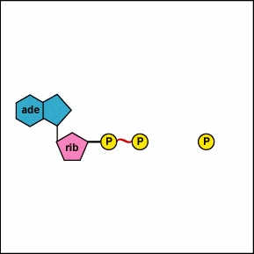
Image from: https://media.recordsetter.com/2dc10685-a4dc-476b-b430-88ffaf5ac7d8_mooggm.mp4_xl.jpg
Animation from: http://student.ccbcmd.edu/biotutorials/energy/adpan.html
Which graph represents the reaction that adds the phosphate group to ADP to make ATP?
SP 4.B Describe data from a table or graph, including a. Identifying specific data points. b. Describing trends and/or patterns in the data. c. Describing relationships between variables.

Slide 152
Modified from: 2013 Released AP Biology Practice Exam
A group of mice were sampled and released into a large field to
which no other mice had access. After twenty years, another
representative sample of the mice was captured, and the fur color
of individual mice in the sample was again recorded. Which of the
following best explains the change in the frequency distribution of
the fur color phenotypes in the mouse population, as shown in the
graphs?
The allele for gray fur color is unstable, and over twenty years most of those alleles mutated to become alleles for black fur.
The field was composed primarily of light-colored soil and little vegetation affording gray mice protection from predators.
Sexual selection led to increased mating frequency of black and brown versus gray and brown
The gray mice were hardest to capture and so were underrepresented in the twenty-year sample
EVO-1.E.3 Some phenotypic variations significantly increase or decrease fitness of the organism in particular environments. SP 4. B Describe data from a table or graph, including b. Describing trends and/or patterns in the data.
c. Describing relationships between variables.

Slide 153
http://www.theseashore.org.uk/theseashore/stats%20for%20twits/Additional%20Material/SE%20errorbars3.jpg
The following graph shows data collected on the average tail length of 3 different types of aliens.
Error bars show 95% confidence levels (2 SEM).
What conclusion(s) can be drawn from this about the differences in tail lengths between the 3 types of aliens? EXPLAIN YOUR ANSWER
Since error bars for Reddies and Yellowies data overlap, their differences are not statistically different. (p > 0.05)
Error bars for Greenies and Reddies, as well as Greenies and Yellowies, do not overlap suggesting that differences could be statistically significant.
SP 4.B Describe data from a table or graph, including a. Identifying specific data points. b. Describing trends and/or patterns in the data. c. Describing relationships between variables

Slide 154
Dots = solute. Diagrams show cells placed in various concentrations of solute in open beakers.
Which of these diagrams shows a cell placed in a hypotonic solution?
B
A
B
C
Which of these diagrams shows a plant cell in a solution that will cause plasmolysis?
C
Which of these diagrams shows an animal cell in a solution that will cause it to swell and possibly burst?
B
The amount of water entering is equal to the amount of water leaving this cell
A
The ψ of the solution outside the cell is greater than ψ inside the cell in this diagram.
B
This cell is has reached equilibrium with it’s environment.
A
ENE-2.H.1 External environments can be hypotonic, hypertonic or isotonic to internal environments of cells— a. Water moves by osmosis from areas of high water potential/low osmolarity/ low solute concentration to areas of low water potential/high osmolarity/high solute concentration.
SP 2.A Describe characteristics of a biological concept, process, or model represented visually.
SP 2.C Explain how biological concepts or processes represented visually relate to larger biological principles, concepts, processes, or theories.

Slide 155
http://www.mathbitsnotebook.com/Algebra1/StatisticsData/STboxPractice.html
EXAMINE THE BOX PLOT What is the value of the third quartile
2 4 7 11
What is the median score?
2 4 7 11
What percent of the values are less than 4?
25 50 75 100
What is the range of the data presented in this box plot?
2 7 10 12
.
SP 4. B Describe data from a table or graph, including a. Identifying specific data points

Slide 156
https://www.pinterest.com/pin/50313720819738042/
TAKE A BREAK

Slide 157
https://teachers.stjohns.k12.fl.us/lyons-s/files/2018/09/AP-Bio-Cells-Practice-Test.pdf
The solutions in the two arms of this U-tube are separated by a membrane that is permeable to water and glucose but not to sucrose.
Side A is half filled with a solution of 2 M sucrose and 1 M glucose. Side B is half filled with 1 M sucrose and 2 M glucose. Initially, the liquid levels on both sides are equal.
After the system reaches equilibrium, what changes are observed?
a. The molarity of sucrose and glucose are equal on both sides.
b. The molarity of glucose is higher on side A than on side B.
c. The water level is higher in side A than on side B.
d. The water level is unchanged.
e. The water level is higher inside B than on side
ESSENTIAL KNOWLEDGE ENE 2.E.1 Passive transport is the net movement of molecules from high concentration to low concentration without the direct input of metabolic energy
ENE 2.H.1 External environments can be hypotonic, hypertonic or isotonic to internal environments of cells— a. Water moves by osmosis from areas of high water potential/low osmolarity/ low solute concentration to areas of low water potential/high osmolarity/high solute concentration.

Slide 158
What is the probability of having 6 children and they are ALL boys?
½ X ½ X ½ X ½ X ½ X ½ = 1/64
IST 1.I.2 Fertilization involves the fusion of two haploid gametes, restoring the diploid number of chromosomes and increasing genetic variation in populations by creating new combinations of alleles in the zygote— a. Rules of probability can be applied to analyze passage of single-gene traits from parent to offspring.
SP 5 A. Perform mathematical calculations including: d. Ratios e. Percentages

Slide 159
IF PARENT GENOME : AaBbCcDD What is the probability of producing a gamete with this gene combination?
abcD ________________________ Abcd ________________________
½ X ½ X ½ X 1 = 1/8
½ X ½ X ½ X 0 = 0
IF PARENT GENOME : AaBbCcDd What is the probability of producing a gamete with this gene combination?
ABcd ________________________ aBCD ________________________
½ X ½ X ½ X ½ = 1/16
½ X 1 X ½ X ½ = 1/8
IST 1.I.2 Fertilization involves the fusion of two haploid gametes, restoring the diploid number of chromosomes and increasing genetic variation in populations by creating new combinations of alleles in the zygote— a. Rules of probability can be applied to analyze passage of single-gene traits from parent to offspring.
SP 5 A. Perform mathematical calculations including: d. Ratios e. Percentages

Slide 160
What is the probability?
AaBbCcDd X AaBbCcDd parents
What is the probability of producing a offspring with this gene combination?
AABbCcDd _____________________________
AaBBccdd______________________________
AaBbCcDd_______________________________
¼ X ½ X ½ X ½
= 1/32
½ X ¼ X ¼ X ¼
= 1/128
½ X ½ X ½ X ½
= 1/16
IST 1.I.2 Fertilization involves the fusion of two haploid gametes, restoring the diploid number of chromosomes and increasing genetic variation in populations by creating new combinations of alleles in the zygote— a. Rules of probability can be applied to analyze passage of single-gene traits from parent to offspring.
SP 5 A. Perform mathematical calculations including: d. Ratios e. Percentages

Slide 161
https://braddlibby.files.wordpress.com/2010/08/lions-gazelle-1.jpg
Explain the relationship between
predator and prey populations as
shown in this graph.
Increase in prey results in an increase in
predators because more food is available;
an increase in predators leads to decrease in prey as more gazelle are eaten; decrease in prey leads to a decrease in predators because there is less food available for lions.
Why are lion numbers always lower than gazelle numbers?
Each higher trophic levels always contains fewer
organisms than the previous layer below because
only 10% of energy is passed up to next level.
One lion eats many gazelles.
ENE-1.N.1 Changes in energy availability can result in changes in population size. ILLUSTRATIVE EXAMPLES: § Food chains/webs
SP 2.D Represent relationships within biological models, including b. Diagrams
SP 4. B Describe data from a table or graph, including b. Describing trends and/or patterns in the data.
c. Describing relationships between variables.
.

Slide 162
Modified from: http://www.phschool.com/science/biology_place/labbench/lab1/quiz.html
Difference
in Molarity
- .04 -.08 0 + .08 - ,02
Circle all the beakers contain a solution that is hypertonic to the bag Which bag would you PREDICT to show the least % change in mass at the end of the experiment? JUSTIFY your answer.
Bag in beaker 3. If the bag has the same molarity as its beaker solution, the bag is in an isotonic solution. The net flow of water into and out of the bag would be equal, and there will be no change in mass.
Arrange the beakers in order of the mass of the bags inside them after the experiment has run of 30 minutes. List the bag that loses the most mass first.
2, 1 , 5, 3, 4
ESSENTIAL KNOWLEDGE
ENE 2.E.1 Passive transport is the net movement of molecules from high concentration to low concentration without the direct input of metabolic energy.
SP 6A. Make a scientific claim.
SP 6C. Provide reasoning to justify a claim by connecting evidence to biological theories
RELAVENT EQUATIONS- Water Potential

Slide 163
https://apcentral.collegeboard.org/pdf/ap-biology-practice-exam-2013.pdf?course=ap-biology
Data regarding the presence (+) or absence (-) of five derived traits in several different species are show in the table below.
Which of the cladograms shown provides the simplest and most accurate representation of the data in the table?
Which two organisms are the least closely related?
Y and X are least closely related Y shares none of the traits shown by X
EVO-3.B.1 Phylogenetic trees and cladograms show evolutionary relationships among lineages— b. Traits that are either gained or lost during evolution can be used to construct phylogenetic trees and cladograms— i. Shared characters are present in more than one lineage. ii. Shared, derived characters indicate common ancestry and are informative for the construction of phylogenetic trees and cladograms. iii. The out-group represents the lineage that is least closely related to the remainder of the organisms in the phylogenetic tree or cladogram.
SP 2. D Represent relationships within biological models including b. Diagrams
.

Slide 164
MICHIGAN | q2 | q | p | p² | 2pq
 | 0.0009 | .03 | 0.97 | 0.94 | 0.058
Following are the data that were actually collected in Wisconsin.
Perform a chi-square test on these data. Can you accept the hypothesis that the allele frequency is the same in Wisconsin as in Michigan? Use the chi-square table below to interpret your results. Give degrees of freedom and p values.
WISCONSIN | AA | Aa | aa | TOTAL
OBSERVED | 2346 | 150 | 4 | 2500
EXPECTED |  |  |  | 2500
0.94 x 2500 =
2350
0.058x2500 =
145
0.0009x2500 =
2
Χ² =Σ
(o – e)² = (2346-2350)² + (150-145)² + (4-2)² = 0.007 + .172 + 2.0 = 2.18
e 2350 145 2
In Hardy-Weinberg chi-square analysis, the number of degrees of freedom is equal to the number of genotypes minus the number of alleles. (Once a value for q is determined, there is no freedom for choosing the value for p.)
Degrees of freedom = 3-2=1
The Chi square value of 2.18 is less than the p value of 3.84 Fail to reject the null hypothesis. There is no significant difference
between the allele frequencies in the two populations.
EVO-1.K.2 Allele frequencies in a population can be calculated from genotype frequencies
EVO-1.L.1 Changes in allele frequencies provide evidence for the occurrence of evolution in a population.
SP 5 A. Perform mathematical calculations including: a. Mathematical equations in the curriculum

Slide 165
Which of the graphs shown here represents a Type II survivor curve?
B is Type II; relatively constant mortality rate throughout life
Give an example of an organism like this.
Which of the above graphs is exhibited by humans?
songbirds, lizards; there are others
Type I survivorship (A in graph above)
SYI-1.G.1 Populations comprise individual organisms that interact with one another and with the environment in complex ways. SYI-1.G.2 Many adaptations in organisms are related to obtaining and using energy and matter in a particular environment— a. Population growth dynamics depend on a number of factors.
SP 4. B Describe data from a table or graph, including b. Describing trends and/or patterns in the data
8. All of the following characteristics are typical of an r-selected population except

Slide 166
MAKE A PREDICTION about the mode of inheritance for the following trait and JUSTIFY your answer.
WT (red eyed tam body) female flies are crossed with black bodied vestigial winged males. Offspring are shown below
Since it’s not X-linked,
ignoring sex makes it
easier to see pattern
Only wild type flies appear in F₁ generation Black body and vestigial winged traits return in F₂ generation
No differences in #’s of males/females for each trait (Not sex linked)
Black body and vestigial wings are AUTOSOMAL RECESSIVE traits.
BUT this is NOT a 9:3:3:1 ratio. Something else is going on !
IST 1.I.2 Fertilization involves the fusion of two haploid gametes, restoring the diploid number of chromosomes and increasing genetic variation in populations by creating new combinations of alleles in the zygote— a. Rules of probability can be applied to analyze passage of single-gene traits from parent to offspring. b. The pattern of inheritance (monohybrid, dihybrid, sex-linked, and genetically linked genes) can often be predicted from data, including pedigree, that give the parent genotype/phenotype and the offspring genotypes/phenotypes.

Slide 167
MAKE A PREDICTION about the mode of inheritance for the following trait and JUSTIFY your answer.
WT (tan bodied normal winged) female flies are crossed with black bodied vestigial winged males. Offspring are shown below
Since it’s not X-linked,
ignoring sex makes it
easier to see pattern
BUT this is NOT a 9:3:3:1 ratio. Something else is going on !
MORE LIKELY to get parental traits together normal wings/tan body OR vestigial wings/black body
LESS LIKELY to get recombinants together
normal wings/black body OR vestigial wings/tan body
Suggests that these traits are linked on the same chromosome. They don’t sort independently.
IST 1.I.2 Fertilization involves the fusion of two haploid gametes, restoring the diploid number of chromosomes and increasing genetic variation in populations by creating new combinations of alleles in the zygote— a. Rules of probability can be applied to analyze passage of single-gene traits from parent to offspring. b. The pattern of inheritance (monohybrid, dihybrid, sex-linked, and genetically linked genes) can often be predicted from data, including pedigree, that give the parent genotype/phenotype and the offspring genotypes/phenotypes.
SP 5 A. Perform mathematical calculations including a. Mathematical equations in the curriculum
2010 FRQ

Slide 168
http://www.mathbitsnotebook.com/Algebra1/StatisticsData/STboxPractice.html
The box plot shows the lengths of cell phone calls made by three students in a one week period. Mark whether Which of the following statements is TRUE or FALSE.
T F All of Nikki’s calls were longer than all of Paula’s calls.
T F Paula made the fewest number of calls.
T F Mario made 50% more calls than Paula.
T F The median length of Mario’s calls is equal to the median length of Nikki/s calls.
.
SP 4. B Describe data from a table or graph, including a. Identifying specific data points

Slide 169
https://image.slidesharecdn.com/ankitseminar-180315173151/95/cytoplasmic-inheritance-9-638.jpg?cb=1521135293
Conserved genes have remained essentially unchanged throughout evolution, indicating that they are unique and essential. Conserved genes are those that can be found in all organisms Examples include sequences in promoters, ribosomal RNA, and proteins involved in DNA replication. There is not an extra copy of that gene with which evolution can tinker, and changes in the gene are likely to be lethal.
This diagram shows that a majority of the mitochondrial genome is highly conserved DNA
when compared to nuclear genes.
Some genes for ETC subunits and ATP synthase are found in mitochondrial DNA. EXPLAIN why these might be highly conserved .
ETC proteins and ATP synthase are found in mitochondria of eukaryotes and are needed for cellular respiration. They are also found in the plasma membranes of prokaryotes. ATP synthase and ETC proteins are necessary for obtaining energy for cellular activities from the breakdown of sugars. so the genes that code for these proteins would likely be highly conserved over time. Mutations in genes that interfere with the process obtaining energy would definitely be harmful to an organism.
IST 1.J.4 Some traits result from non-nuclear inheritance— a. Chloroplasts and mitochondria are randomly assorted to gametes and daughter cells; thus, traits determined by chloroplast and mitochondrial DNA do not follow simple Mendelian rules. b. In animals, mitochondria are transmitted by the egg and not by sperm; as such, traits determined by the mitochondrial DNA are maternally inherited. c. In plants, mitochondria and chloroplasts are transmitted in the ovule and not in the pollen; as such, mitochondria-determined and chloroplast-determined traits are maternally inherited.
SP 6A. Make a scientific claim.
SP 6B Support a claim with evidence from biological principles, concepts, processes, and/or data
SP 6C. Provide reasoning to justify a claim by connecting evidence to biological theories

Slide 170
https://www.pinterest.com/pin/Ad_xq1HIpai1-2AoDgjfvyUJGLb_8bocNPB4jU2hURTbM9bkyXpMPrI/
TAKE A BREAK

Slide 171
Graph modified from: https://biodivcanada.chm-cbd.net/ecosystem-status-trends-2010/invasive-non-native-species
NUMBER OF FRESHWATER MUSSEL SPECIES BEFORE AND AFTER ZEBRA MUSSEL INVASION
Make a claim about the impact of zebra mussels on the biodiversity in Lake Erie?
Provide evidence and justify your answer.
The invasion of zebra mussels has a negative effect on biodiversity; The table shows a dramatic decrease in number of fresh water mussel species at 6 locations (A,B, C, E, F, G) sampled before and after zebra mussel invasion in Lake Erie. At 3 of sample locations (A, B, and F) the number of native fresh water mussel species dropped to zero. Zebra mussels, like other invasive species, spread rapidly, have no natural predators, out compete native mussels for their food sources, so as zebra mussels increase in an area other species decrease
SYI-2.A.1 The intentional or unintentional introduction of an invasive species can allow the species to exploit a new niche free of predators or competitors or to outcompete other organisms for resources.
SYI-2.A.2 The availability of resources can result in uncontrolled population growth and ecological changes. ILLUSTRATIVE EXAMPLES: Zebra mussels
SP 6A. Make a scientific claim.
SP 6B Support a claim with evidence from biological principles, concepts, processes, and/or data
SP 6C. Provide reasoning to justify a claim by connecting evidence to biological theories
SP 4. B Describe data from a table or graph, including a. Identifying specific data points
b. Describing trends and/or patterns in the data.
c. Describing relationships between variables.

Slide 172
The gene for albinism is known to be a recessive allele. In Michigan, 9 people in a sample of 10,000 were found to have albino phenotypes. The other 9,991 had skin pigmentation normal for their ethnic group.
a. Assuming Hardy-Weinberg equilibrium, what is the allele frequency for the dominant pigmentation allele in this population?
b. How many out of the 10,000 people in the sample above were expected to be heterozygous for pigmentation
9/10,000 = q²
0.0009 = q²
q = √ 0.0009 = 0.03
p + q = 1
p + 0.03 = 1
p = 0.97
Normal pigment allele = 97%
2pq = 2 (0.97) ( 0.03) = 0.058
10000 X 0.058 = 580 people are expected to be heterozygous
EVO-1.K.2 Allele frequencies in a population can be calculated from genotype frequencies
SP 5 A. Perform mathematical calculations including: a. Mathematical equations in the curriculum

Slide 173
2013 Released AP Biology Practice Exam
What most likely causes the trends in oxygen concentration
shown in the graph?
The water becomes colder at night and thus holds more oxygen
Respiration in most organisms increases at night.
More organisms are respiring at night than during the day.
Photosynthesis produces more oxygen than is consumed by respiration during the day.
ENE-1.K.3 b. In cellular respiration, electrons delivered by NADH and FADH2 are passed to a series of electron acceptors as they move toward the terminal electron acceptor, oxygen. ENE-1.I.1. a. ii. Scientific evidence supports the claim that prokaryotic (cyanobacterial) photosynthesis was responsible for the production of an oxygenated atmosphere.
SP 4. B Describe data from a table or graph, including b. Describing trends and/or patterns in the data.
c. Describing relationships between variables.

Slide 174
Ψ = Ψ_{s} + Ψ_{p}
Ψ _{p} = pressure potential
Ψ _{s} = solute potential
Ψ _{s} = - iCRT
i = ionization constant (1.0 for sucrose because sucrose does not ionize in water)
C = molar concentration
R = pressure constant (R= 0.0831 liter bars/mole K)
T = temperature in Kelvin (◦C + 273)
An artificial cell consisting of an aqueous solution enclosed in a selectively permeable membrane has just been immersed in a beaker containing a different solution. The membrane is permeable to water
and to the simple sugars glucose and fructose, but completely impermeable to the disaccharide sucrose.
Which solute(s) will exhibit a net diffusion into the cell?
Which solute(s) will exhibit a net diffusion out of the cell?
ENVIRONMENT 0.01 M sucrose
0.01 M glucose
0.01 M fructose
CELL 0.03 M sucrose
0.02 M glucose
Fructose will enter cell until equilibrium (0.005M in/out)
Glucose will leave cell until equilibrium (0.015M in/out)
ESSENTIAL KNOWLEDGE
E NE 2.E. 1 Passive transport is the net movement of molecules from high concentration to low concentration without the direct input of metabolic energy.
ENE 2.H.1 External environments can be hypotonic, hypertonic or isotonic to internal environments of cells— a. Water moves by osmosis from areas of high water potential/low osmolarity/ low solute concentration to areas of low water potential/high osmolarity/high solute concentration.
SP 5 A. Perform mathematical calculations including: a. Mathematical equations in the curriculum
Campbell Concept check

Slide 175
Which of the graphs shown here represents a Type I survivor curve?
A is Type I
Give 3 characteristics of this kind of population.
___ selected organisms show this kind of curve.
Give an example of an organism like this.
tend to live long lives but dramatic increase in death rate toward end of life, large size, long life span, mature later, few offspring, much parental care, low mortality,
k
Humans, Giant Red wood trees, Giraffes, Elephants, Tortoises, Rhinoceros, Whales, Grizzlies, Lions: there are more
SYI-1.G.1 Populations comprise individual organisms that interact with one another and with the environment in complex ways. SYI-1.G.2 Many adaptations in organisms are related to obtaining and using energy and matter in a particular environment— a. Population growth dynamics depend on a number of factors.
SP 4. B Describe data from a table or graph, including b. Describing trends and/or patterns in the data

Slide 176
https://cdn.pixabay.com/photo/2013/07/12/14/11/sapling-147940_960_720.png
Ψ = Ψ_{s} + Ψ_{p}
Ψ _{p} = pressure potential
Ψ _{s} = solute potential
Ψ _{s} = - iCRT
i = ionization constant (1.0 for sucrose because sucrose does not ionize in water)
C = molar concentration
R = pressure constant (R= 0.0831 liter bars/mole K)
T = temperature in Kelvin (◦C + 273)
A scientist is asked to estimate if a certain species of plant could live in a salt marsh. The following data was collected:
a. The overall Ψ of the soil (Ψsoil): -25.0 bar
b. Solute concentration of plant cell contents: 0.1M (assume i=1, and 25 °C)
c. Pressure potential of the plant cells is: -19.0 bar
CALCULATE THE Ψ_{s} and Ψ for the plant
Plant
Soil
Ψs = - iCRT
Ψ = -25 bar
Ψs =
- (1) (0.0831) (0.1) (273 + 25)
Do you think the plant could grow in this environment? JUSTIFY your answer.
Ψs =
- 2.48 bar
Ψ = (Ψ_{p}) + (Ψ_{s})
This plant could not grow in this environment. The water potential of the plant is - 21.48 bar. The water potential of the soil is -25 bar. The soil is hypertonic to the plant cells. Water always moves from an area of higher water potential (plant cells) to an area of lower water potential (the soil). This would cause the plant to undergo plasmolysis and wilt.
Ψ = (- 19 bar) + (-2.48)
Ψ = - 21.48 bar
ESSENTIAL KNOWLEDGE
E NE 2.E. 1 Passive transport is the net movement of molecules from high concentration to low concentration without the direct input of metabolic energy.
ENE 2.H.1 External environments can be hypotonic, hypertonic or isotonic to internal environments of cells— a. Water moves by osmosis from areas of high water potential/low osmolarity/ low solute concentration to areas of low water c/high osmolarity/high solute concentration.
SP 5 A. Perform mathematical calculations including: a. Mathematical equations in the curriculum

Slide 177
6.12
Not tested
7.10
5.81
The largest average seed mass (7.13) was not an answer choice. Of answer choices, the largest average seed mass was for plants grown at 23 °C with 14 hours of light and adequate water. All other average mass choices above were less than 7.10 mg
not an answer choice
SP 6.A Make a scientific claim.
SP 6.B Support a claim with evidence from biological principles, concepts, processes, and/or data.
SP 6.C Provide reasoning to justify a claim by connecting evidence to biological theories.

Slide 178
F
T
T
T
5.98 > 5.27
Seeds that are farthest from stem are released last .
As seed position moves farther away from the stem the average seed mass generally decreases.
Seeds that are farthest from the stem are smaller than those closest to stem
first
↓ ↓
last
Size decreases
↓ ↓
SP 6.A Make a scientific claim.
SP 6.B Support a claim with evidence from biological principles, concepts, processes, and/or data.
SP 6.C Provide reasoning to justify a claim by connecting evidence to biological theories.

Slide 179
All above 6.12
Plants with 14 hours of light and no variables changed showed a decrease in average seed mass from 7.10 to 5.63 when the temperature was increased from 23 °C to 29 ° C. Since avg seed mass for similar conditions with 8 hrs of light at 23 °C was 6.12 mg, I would predict that there would be a decrease in average seed mass (less than 6.12) when the temp was increased to 29 C.
?
SP 6.A Make a scientific claim.
SP 6.B Support a claim with evidence from biological principles, concepts, processes, and/or data.
SP 6.C Provide reasoning to justify a claim by connecting evidence to biological theories.

Slide 180
Is this a controlled experiment?
CLAIM:
EVIDENCE:
REASONING:
This is a controlled experiment
The experimental design includes a control group in which the light is kept the same as the other groups (14 hours) and the other variables (leaf removal and amount of water) are not changed.
A controlled experiment includes a control group that provide a basis for comparison to show whether the treatments (leaves removed, reduced water, or temperature change) being tested have an effect on seed mass. Because this experiment includes a control group, it is a controlled experiment.
SP 6.A Make a scientific claim.
SP 6.B Support a claim with evidence from biological principles, concepts, processes, and/or data.
SP 6.C Provide reasoning to justify a claim by connecting evidence to biological theories.

Slide 181
THE END
http://www.gifs.net

