Slide 1
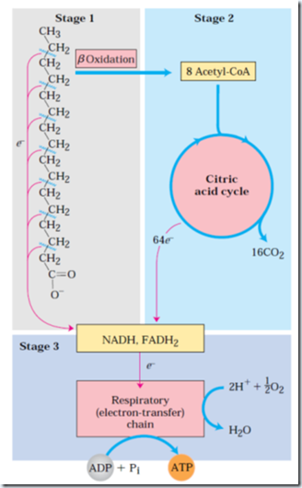
http://lh4.ggpht.com/-f3sAtH0CJtI/U1NxUlJi8mI/AAAAAAAAA6o/M-ZKSUTKo-I/image_thumb%25255B25%25255D.png?imgmax=800

Slide 2
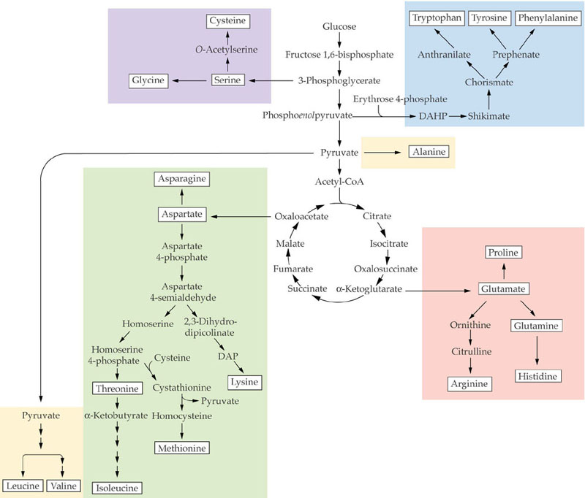
http://www.uky.edu/~dhild/biochem/24/ASPP%208.2.jpg

