Slide 1
Mean Variance Standard Deviation
From: Mathisfun.com
http://www.mathsisfun.com/data/standard-deviation.html

Slide 2
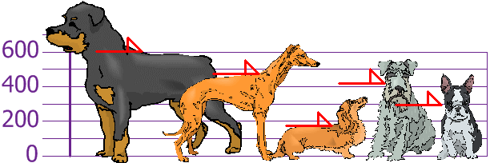
Standard Deviation is a measure of how spread out numbers are.
The heights (at the shoulders) are:
600mm, 470mm, 170mm, 430mm and 300mm.
Find out the Mean, the Variance, and the Standard Deviation.
http://www.mathsisfun.com/data/standard-deviation.html

Slide 3
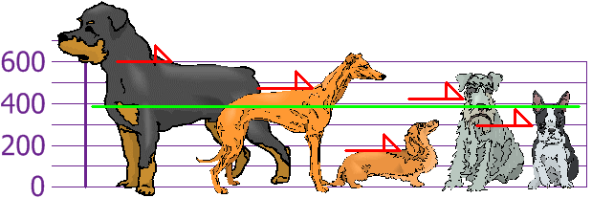
Find MEAN
So Mean (average) height is 394 mm
http://www.mathsisfun.com/data/standard-deviation.html

Slide 4
VARIANCE (σ ²) = each dog’s difference from the Mean = average of the squared differences from the Mean
To calculate VARIANCE, take each difference, square it, and then average the result
http://www.mathsisfun.com/data/standard-deviation.html

Slide 5
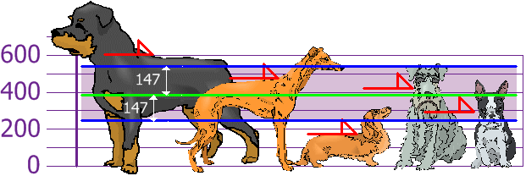
STANDARD DEVIATION (σ )
Standard Deviation= square root of Variance
σ = √21,704 = 147.32... = 147mm
Standard Deviation is useful. Now we can show which heights are within one Standard Deviation (147mm) of the Mean:
Rottweilers are tall dogs and Dachshunds are a bit short
http://www.mathsisfun.com/data/standard-deviation.html

Slide 6
SAMPLE
Our example was for a Population (the 5 dogs were the only dogs we were interested in)
But if the data is a Sample (a selection taken from a bigger Population), then the calculation changes
When you have "N" data values that are:
The Population: divide by N when calculating Variance (like we did)
A Sample: divide by N-1 when calculating Variance
All other calculations stay the same, including the mean.
http://www.mathsisfun.com/data/standard-deviation.html

Slide 7
SAMPLE of Bigger Population
http://www.mathsisfun.com/data/standard-deviation.html

Slide 8
POPULATION STANDARD DEVIATION
SAMPLE STANDARD DEVIATION
http://www.mathsisfun.com/data/standard-deviation.html

