Slide 1
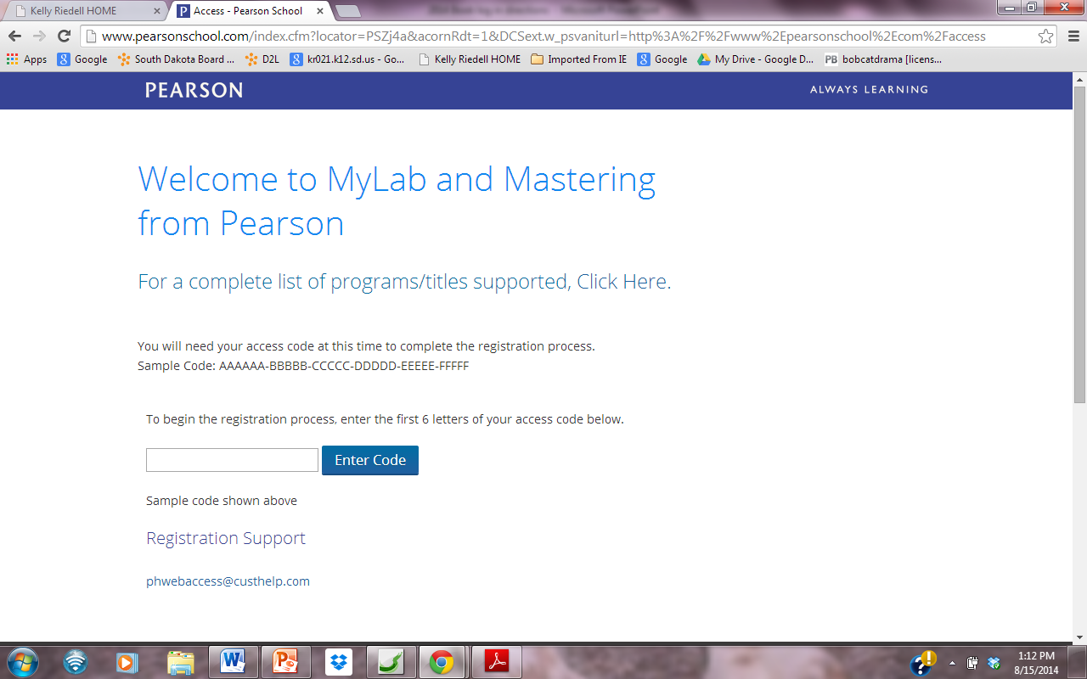
Register at www.pearsonschool.com/access
SSNAST

Slide 2
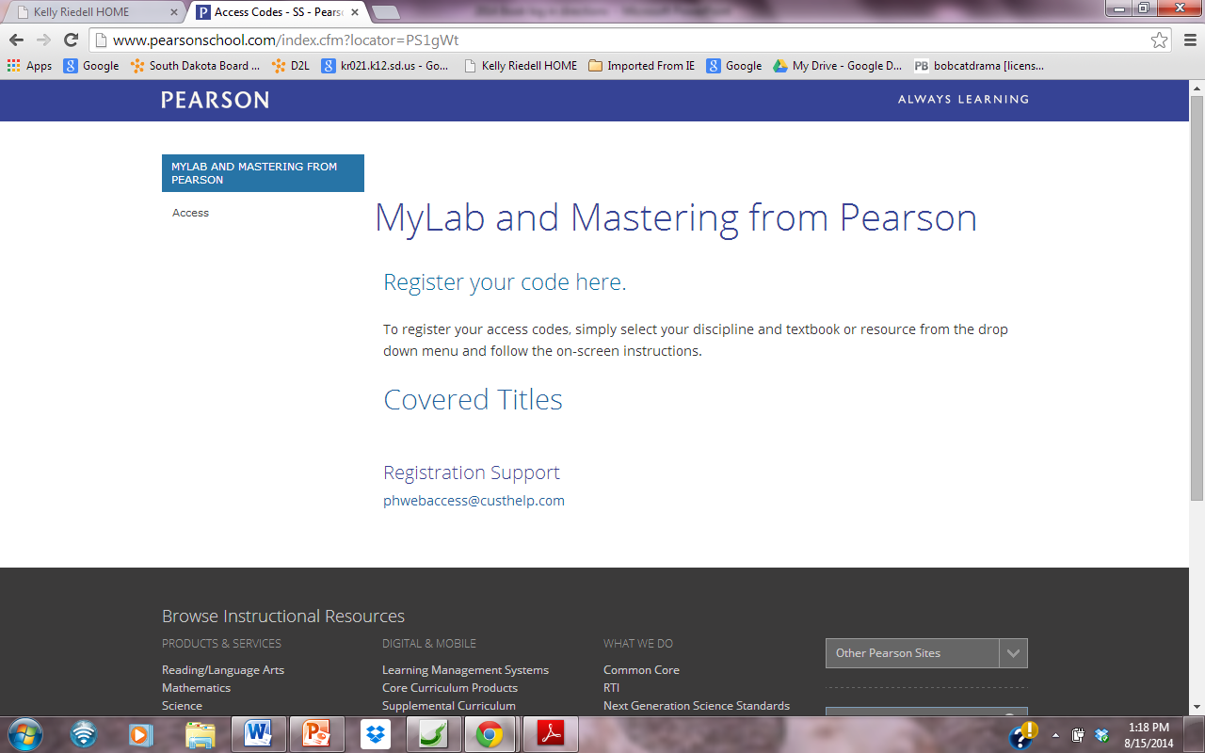

Slide 3
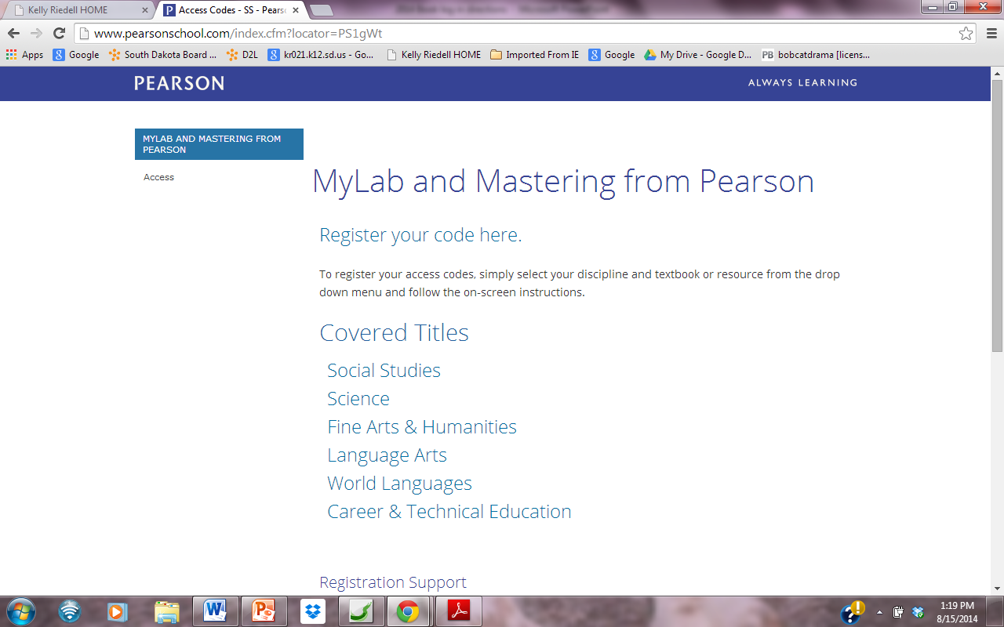

Slide 4
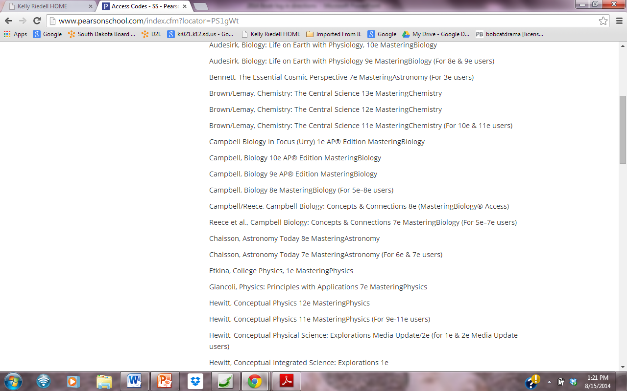
Choose 9e

Slide 5
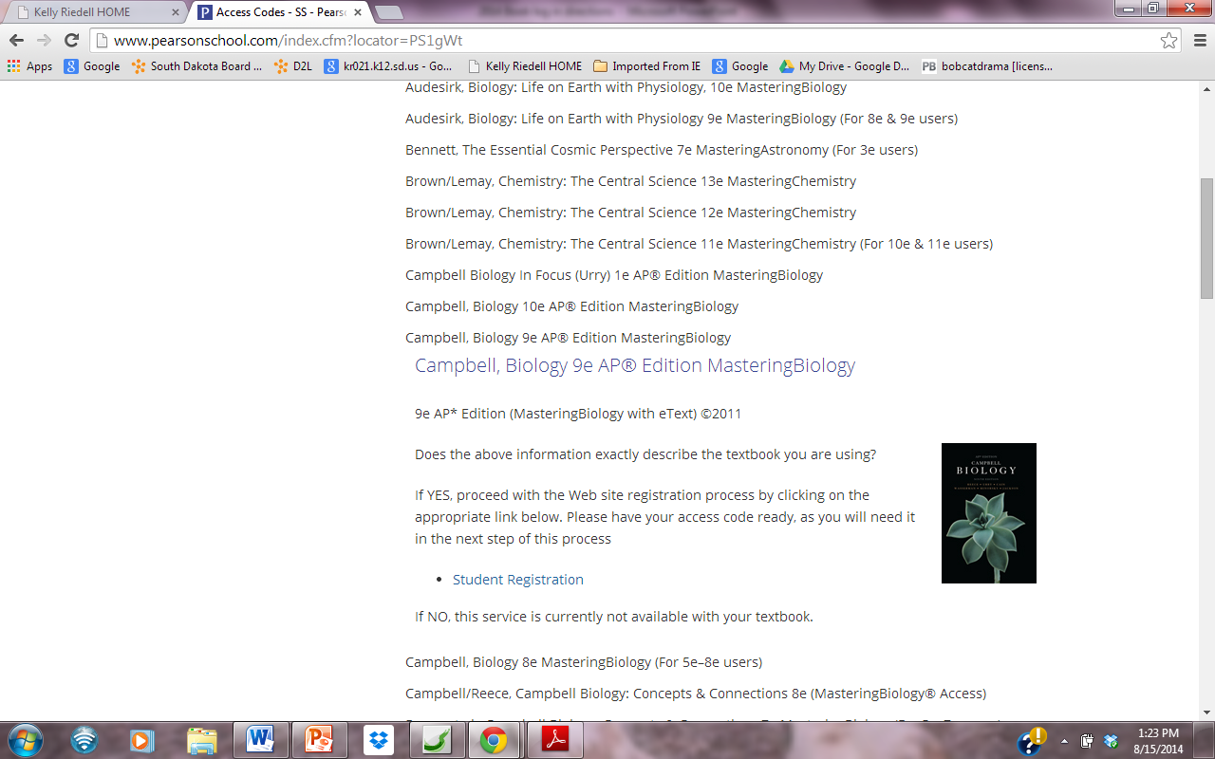
NOTICE: This picture is
DIFFERENT from your hard copy book

Slide 6
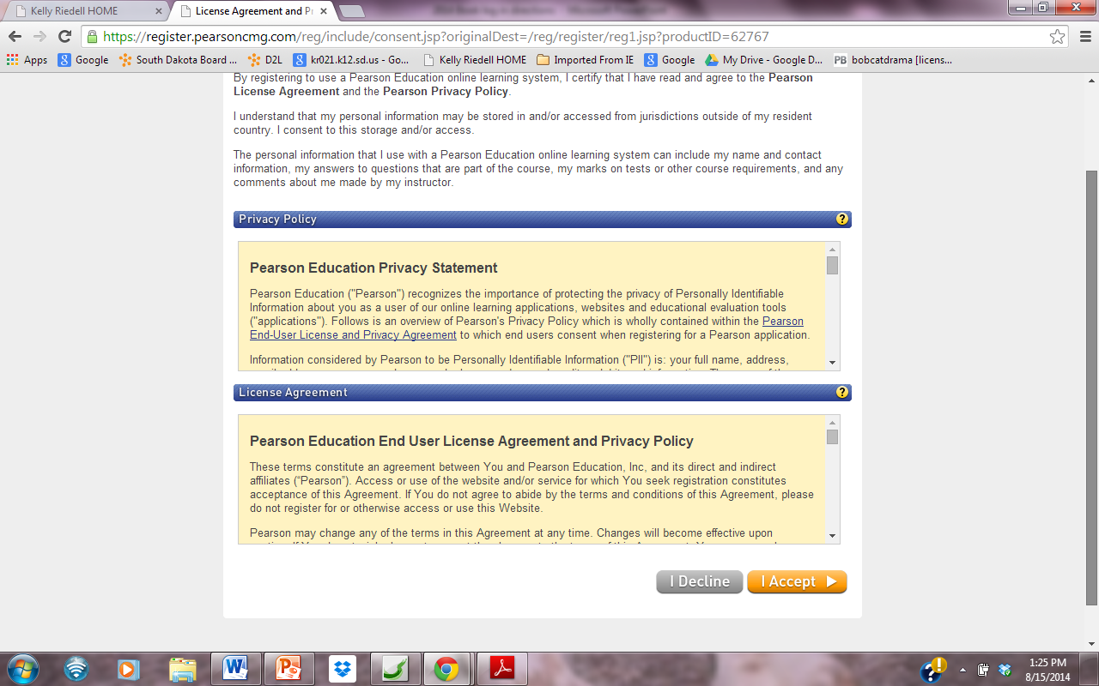

Slide 7
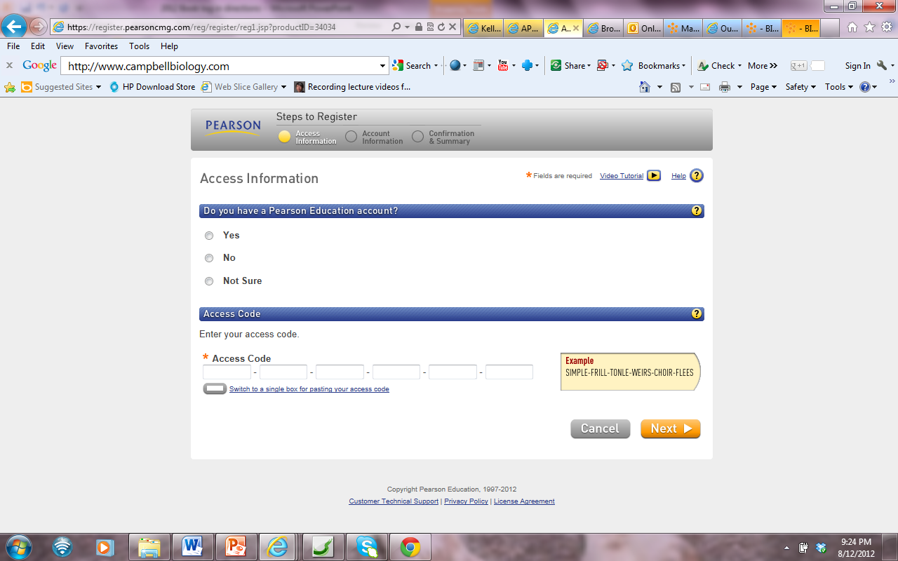

Slide 8
Use school email
At least 8 characters
One number/one letter
WRITE THIS IN YOUR BILL ! ! ! ! !
Then copy and paste from Brookings AP BIO webpage

Slide 10
FILL IN
BROOKINGS HIGH SCHOOL
BROOKINGS
PICK SD

Slide 11
Pick a question Fill in answer

Slide 13
CLASS ID CODE:

