Slide 1
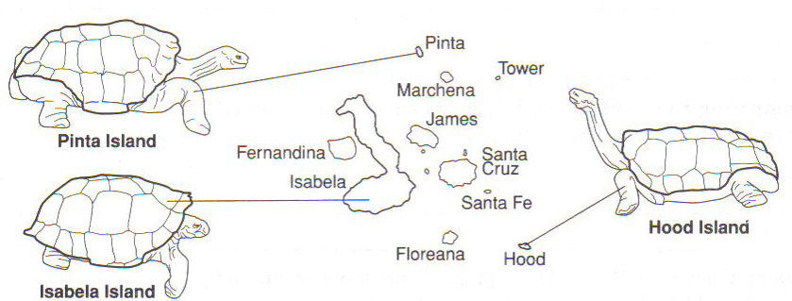
AP BIOLOGY NATURAL SELECTION REVIEW Kelly Riedell Brookings Biology Based on 2019 CED
Image from BIOLOGY by Miller and Levine; Prentice Hall Publishing © 2006

Slide 2
Remember: Biology is more than "just the facts". It's all about connections. (That said... you have to know the vocab and concepts to be able to see the "big picture" and make those connections)
See the BIG PICTURE
and make Connections!
Memorizing “facts”
Image modified from: https://www.pinterest.com/pin/50313720815813086/

Slide 3
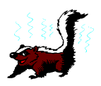
http://www.dwm.ks.edu.tw/bio/activelearner/19/ch19summary.html
http://www.zwani.com/graphics/antivalentines_day/images/4heart.gif
http://www.horton-szar.net/clipart/animals4.php
One species of spotted skunk mates in late summer, and another mates in late winter.
This is an example of a _____ zygotic reproductive barrier called
_________ isolation
pre
temporal
EVO-3.D.1 Speciation may occur when two populations become reproductively isolated from each other.
EVO-3.F.2 Speciation may be sympatric or allopatric.
EVO-3.F.3 Various prezygotic and postzygotic mechanisms can maintain reproductive isolation and prevent gene flow between populations
.

Slide 4
Similarities that result from CONVERGENT evolution are considered to be __________ structures.
analogous
homologous analogous
Watch a
2 min video
Analogous structures DO DO NOT provide evidence that organisms are evolutionarily related.
EVO-1.G.1 Convergent evolution occurs when similar selective pressures result in similar phenotypic adaptations in different populations or species.

Slide 5
https://evolution.berkeley.edu/evolibrary/article/bottlenecks_01
All of the following are random events except
A) Bottle neck effect
B) Mutations
C) Natural selection
D) Founder effect
E) Gene flow
EVO-1.C.2 According to Darwin’s theory of natural selection, competition for limited resources results in differential survival. Individuals with more favorable phenotypes are more likely to survive and produce more offspring, thus passing traits to subsequent generations
EVO-1.H.1 Evolution is also driven by random occurrences—
a. Mutation is a random process that contributes to evolution.
b. Genetic drift is a nonselective process occurring in small populations—
i. Bottlenecks.
ii. Founder effect.
c. Migration/gene flow can drive evolution.

Slide 6
Evolutionary change above the species level including the appearance of major evolutionary developments like flight (EX: fish → amphibians) is called _________evolution
Evolutionary change on the smallest scale
like new strains of HIV evolving from
current HIV virus is called _____ evolution
macro
micro macro
micro
micro macro
VOCAB
EVO-1.C.1 Natural selection is a major mechanism of evolution.

Slide 7
FROM: http://serranohighschoolapbiology.weebly.com/uploads/6/7/9/9/6799747/ap_biology_evolution_unit_practice_test_1.pdf
The synthesis of new DNA requires the prior existence of oligonucleotides to serve as primers. On Earth, these primers are small RNA molecules. This latter observation is evidence in support of the hypothesized existence of
A) earlier genetic systems than those based on DNA.
B) the abiotic synthesis of organic monomers.
C) the delivery of organic matter to Earth by meteors and comets.
D) the endosymbiotic origin of mitochondria and chloroplasts.
SYI-3 Naturally occurring diversity among and between components within biological systems affects interactions with the environment.
c. Chemical experiments have shown that it is possible to form complex organic molecules from inorganic molecules in the absence of life—
i. Organic molecules/monomers served as building blocks for the formation of more complex molecules, including amino acids and nucleotides.
ii. The joining of these monomers produced polymers with the ability to replicate, store, and transfer information.
SYI-3.E.2 The RNA World Hypothesis proposes that RNA could have been the earliest genetic material.
.

Slide 8
http://evolution.berkeley.edu/evolibrary/images/evo/appleflies.gif
Formation of two or more species from a single ancestral species all occupying the same geographical area.
Sympatric “same country” speciation
EVO-3.D.1 Speciation may occur when two populations become reproductively isolated from each other.
EVO-3.F.3 Various prezygotic and postzygotic mechanisms can maintain reproductive isolation and prevent gene flow between populations
EVO-3.F.1 Speciation results in diversity of life forms.
EVO-3.F.2 Speciation may be sympatric or allopatric.

Slide 9
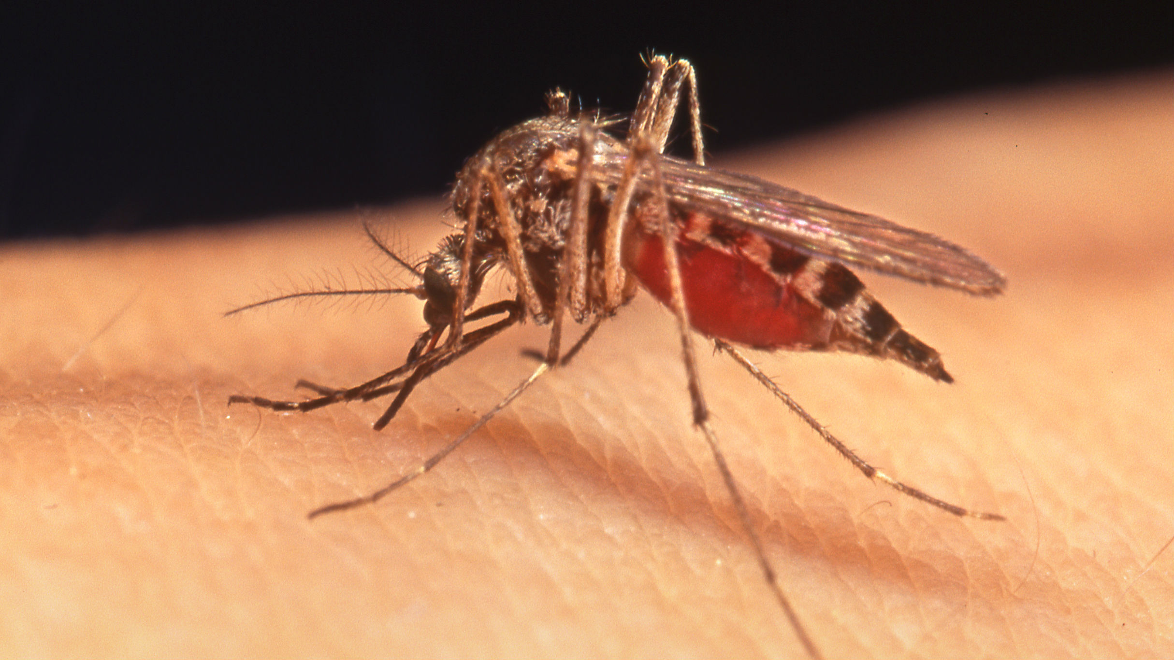
Image from: http://2gn058m8vqz358inn1lanr2o.wpengine.netdna-cdn.com/wp-content/uploads/2014/09/16-9-Mosquito.jpg
In the 19th century when London’s underground subway tube was being dug, a population of mosquitos colonized the tunnels. They originally fed on pigeons above ground, but since birds weren’t available, they started feeding on rats, mice, and people in the tunnels. Now a century later when tube dwelling mosquitoes try to mate with their above ground cousins, viable offspring are rarely produced. The subway mosquitoes are becoming a new species with different genes and different behaviors.
This is an example of
__________ speciation.
See a video
ALLOPATRIC
EVO-3.D.1 Speciation may occur when two populations become reproductively isolated from each other.
EVO-3.F.1 Speciation results in diversity of life forms.
EVO-3.F.2 Speciation may be sympatric or allopatric
EVO-3.F.3 Various prezygotic and postzygotic mechanisms can maintain reproductive isolation and prevent gene flow between populations

Slide 10
http://sisu.typepad.com/sisu/spongebob.jpg
Sperm of one sponge species cannot penetrate the egg of a closely related species.
This is an example of a
_____ zygotic reproductive barrier
called _________ isolation
pre
gametic
EVO-3.D.1 Speciation may occur when two populations become reproductively isolated from each other.
EVO-3.F.2 Speciation may be sympatric or allopatric.
EVO-3.F.3 Various prezygotic and postzygotic mechanisms can maintain reproductive isolation and prevent gene flow between populations

Slide 11
https://quizlet.com/242976830/test
In addition to the basic ideas of Darwin, the modern theory of evolution includes the concept that a. variations are the result of mutations and gene recombination b. competition occurs only between members of the same species c. variations exist only in large populations d. overproduction of organisms leads to extinction
Darwin didn’t know about DNA, genes, or chromosomes!
But now we do and DNA analysis adds powerful evidence to Darwin’s theory.
EVO-1.H.1 Evolution is also driven by random occurrences—
a. Mutation is a random process that contributes to evolution.
EVO-1.J.1 Mutation results in genetic variation, which provides phenotypes on which natural selection acts

Slide 12
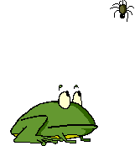
http://www.dwm.ks.edu.tw/bio/activelearner/19/ch19summary.htm
l http://www.animationlibrary.com
Nearly all the embryos die when eggs of a bullfrog are fertilized artificially with sperm from a leopard frog. This is an example of a ____ zygotic reproductive barrier pre post
called hybrid __________
post
inviability
EVO-3.D.1 Speciation may occur when two populations become reproductively isolated from each other.
EVO-3.F.2 Speciation may be sympatric or allopatric.
EVO-3.F.3 Various prezygotic and postzygotic mechanisms can maintain reproductive isolation and prevent gene flow between populations

Slide 13
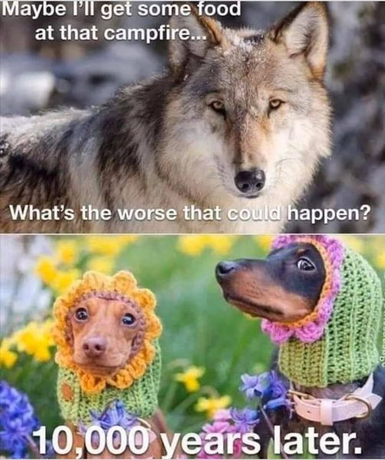
https://scontent.ffcm1-2.fna.fbcdn.net/v/t1.0-0/s600x600/120288695_2863098323791457_2563781361585213938_n.jpg?_nc_cat=101&_nc_sid=8bfeb9&_nc_ohc=2wxx-0s3LS4AX_EQDoz&_nc_ht=scontent.ffcm1-2.fna&tp=7&oh=2d412e4f5f2aedba6661dc0fd58751dd&oe=5F9D83FA
TAKE A STUDY BREAK

Slide 14
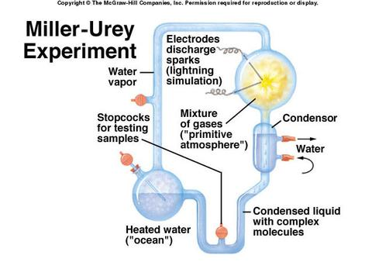
In 1953 a classic experiment by Stanley Miller and Harold Urey discharged electric sparks into a laboratory chamber containing gases including water vapor, hydrogen gas, methane, and ammonia.
Data showed that a number of organic molecules, including 25 amino, several fatty acids, and other organic compounds were produced. What was the significance of this classic experiment?
This experiment tested the hypothesis that molecules essential to life today could have formed from simpler organic molecules present in the Earth’s early atmosphere.
See a video
SYI 3. E.1 b. There are several models about the origin of life on Earth— i. Primitive Earth provided inorganic precursors from which organic molecules could have been synthesized because of the presence of available free energy and the absence of a significant quantity of atmospheric oxygen (O₂).
SYI-3 Naturally occurring diversity among and between components within biological systems affects interactions with the environment.
c. Chemical experiments have shown that it is possible to form complex organic molecules from inorganic molecules in the absence of life—
i. Organic molecules/monomers served as building blocks for the formation of more complex molecules, including amino acids and nucleotides.
ii. The joining of these monomers produced polymers with the ability to replicate, store, and transfer information.

Slide 15
http://www.dwm.ks.edu.tw/bio/activelearner/19/ch19summary.html
Mules produced when a horse and donkey interbreed are sterile. This is an example of a _____ zygotic reproductive barrier called hybrid ____________
post
sterility
EVO-3.D.1 Speciation may occur when two populations become reproductively isolated from each other.
EVO-3.F.2 Speciation may be sympatric or allopatric.
EVO-3.F.3 Various prezygotic and postzygotic mechanisms can maintain reproductive isolation and prevent gene flow between populations
EVO-3.D.2 The biological species concept provides a commonly used definition of species for sexually reproducing organisms. It states that species can be defined as a group capable of interbreeding and exchanging genetic information to produce viable, fertile offspring.

Slide 16
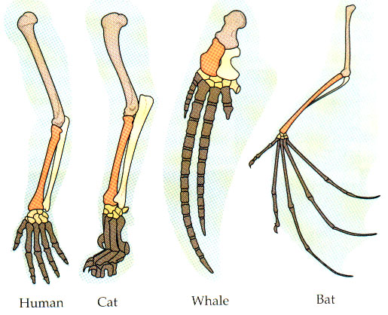
http://www.angelfire.com/ab7/evolution12/evolutionclues.html
The bones in the diagrams below are examples of ____________ structures.
They are evidence of __________ evolution
homologous
divergent
Watch a
2 min video
EVO-2.B.2 Structural and functional evidence supports the relatedness of organisms in all domains
EVO-1.N.1 Molecular, morphological, and genetic evidence from extant and extinct organisms adds to our understanding of evolution—
b. Morphological homologies, including vestigial structures, represent features shared by common ancestry.

Slide 17
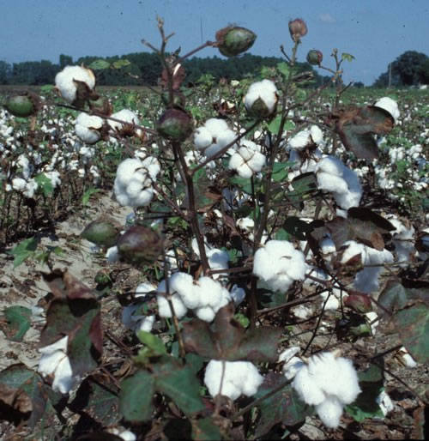
http://ipm.ncsu.edu/cotton/InsectCorner/photos/images/Open_cotton_plant.jpg
Two cotton species produce fertile hybrids but the next generation is infertile.
This is an example of a type of _____ zygotic reproductive barrier called hybrid __________
post
breakdown
EVO-3.D.1 Speciation may occur when two populations become reproductively isolated from each other.
EVO-3.F.2 Speciation may be sympatric or allopatric.
EVO-3.F.3 Various prezygotic and postzygotic mechanisms can maintain reproductive isolation and prevent gene flow between populations

Slide 18
FROM: http://serranohighschoolapbiology.weebly.com/uploads/6/7/9/9/6799747/ap_biology_evolution_unit_practice_test_1.pdf
Males of different species of the fruit fly Drosophila that live in the same parts of the Hawaiian Islands have different elaborate courtship rituals. These rituals involve fighting other males and making stylized movements that attract females. What type of reproductive isolation does this represent? A) habitat isolation B) temporal isolation C) behavioral isolation D) gametic isolation E) postzygotic barriers
.
EVO-3.D.1 Speciation may occur when two populations become reproductively isolated from each other.
EVO-3.F.2 Speciation may be sympatric or allopatric.
EVO-3.F.3 Various prezygotic and postzygotic mechanisms can maintain reproductive isolation and prevent gene flow between populations

Slide 19
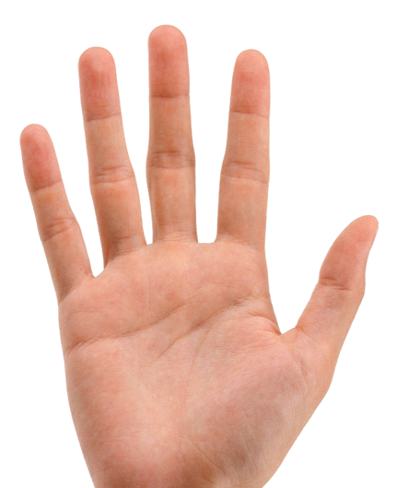
TELL THE CONDITIONS UNDER WHICH THE HARDY-WEINBERG PRINCIPLE HOLDS TRUE:
LARGE population (no genetic drift)
Random mating
NO mutations
NO movement IN OR OUT (no gene flow)
NO natural selection
SEE A VIDEO TED talks- Five fingers of Evolution
EVO-1.K.1 Hardy-Weinberg is a model for describing and predicting allele frequencies in a nonevolving population.
Conditions for a population or an allele to be in Hardy-Weinberg equilibrium are—
(1) a large population size,
(2) absence of migration,
(3) no net mutations,
(4) random mating, and
(5) absence of selection.
These conditions are seldom met, but they provide a valuable null hypothesis..

Slide 20
Describe the main points of Darwin’s theory of evolution
Natural variation in population provides basis
for natural selection to act
Overproduction of offspring forces competition for resources (struggle for survival)
Organisms best suited to their environment will survive
and reproduce; Other organisms die or leave fewer
offspring (survival of the fittest/natural selection)
Species alive today have descended with modification from ancestral species that lived in the distant past
All organisms are united into a single “tree of life” (common descent)
EVO-1.C.1 Natural selection is a major mechanism of evolution.
EVO-1.C.2 According to Darwin’s theory of natural selection, competition for limited resources results in differential survival. Individuals with more favorable phenotypes are more likely to survive and produce more offspring, thus passing traits to subsequent generations
EVO-1.E.1 Natural selection acts on phenotypic variations in populations.
EVO-1.E.3 Some phenotypic variations significantly increase or decrease fitness of the organism in particular environments.

Slide 21
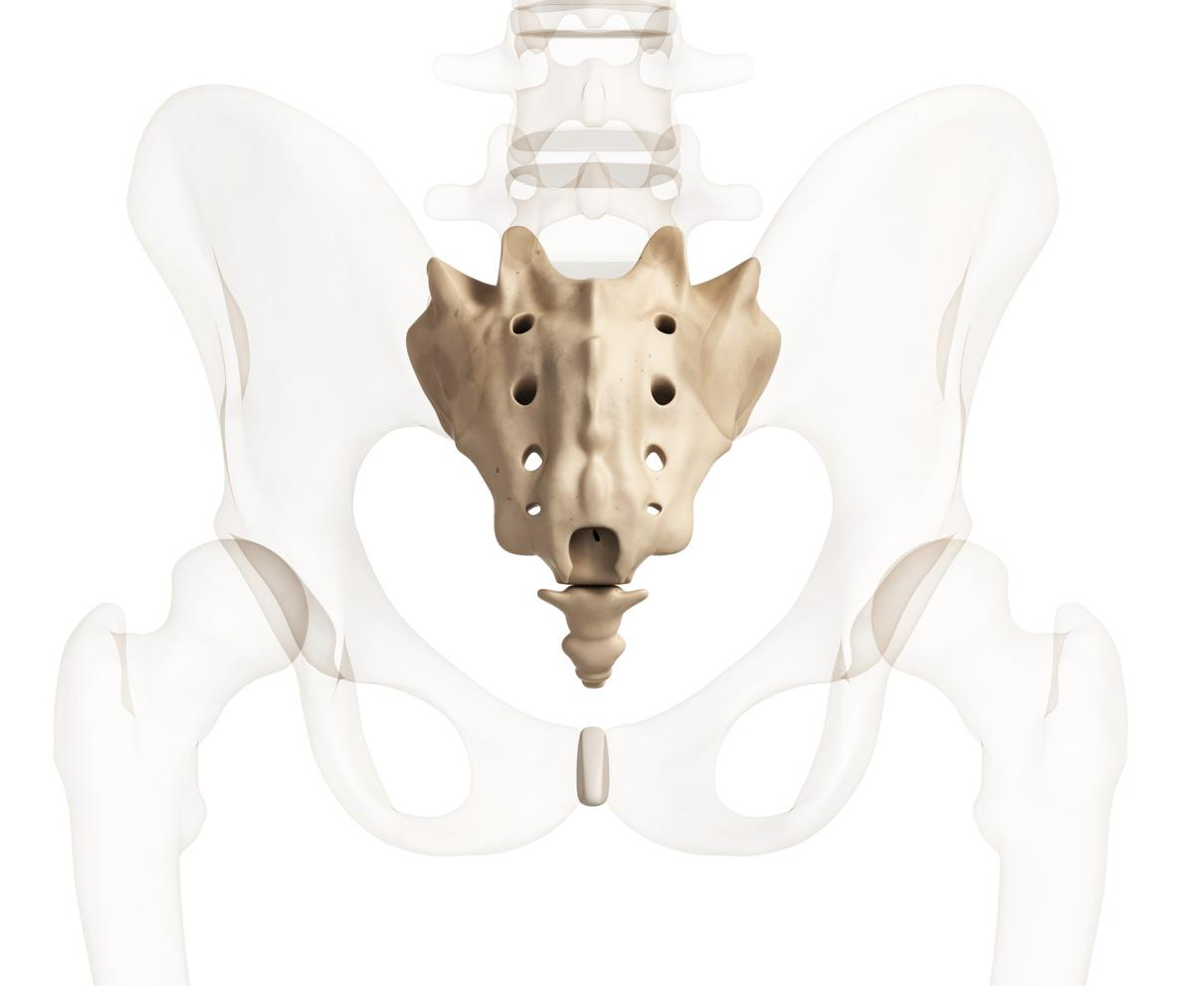
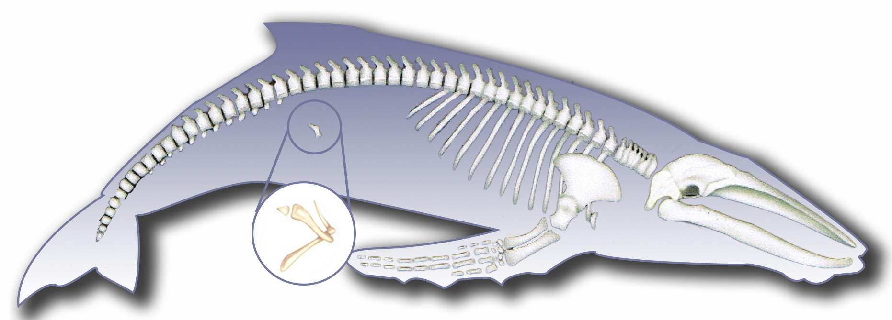
Images from: https://www.philpoteducation.com/pluginfile.php/1160/mod_book/chapter/1062/5.1.1d_full.jpg
http://media.buzzle.com/media/images-en/photos/human-biology/1200-35282264-human-tail-bone.jpg
https://tse3.mm.bing.net/th?id=OIP.XpEGOo1L897BB_eCtSq-CAHaFB&pid=Api&P=0&w=221&h=151
https://explorationsquared.com/wp-content/uploads/2019/10/Penguin-with-Fins-Wings.jpg
http://www.medicalgeo.com/images/appendix.gif
http://www.apologeticspress.org/user_images/image/rr/r&r94091.gif
Vestigial
_________ structures are genetically determined structures or attributes that have lost some or all of the ancestral function in a given species
Give some example of vestigial structures
Penguin wings
Human coccyx
Hipbones in whales/snakes
Skink legs
Penguin wings
Human appendix
There are
lots more!
EVO-1.N.1 Molecular, morphological, and genetic evidence from extant and extinct organisms adds to our understanding of evolution—
b. Morphological homologies, including vestigial structures, represent features shared by common ancestry.
EVO-2.B.1 Many fundamental molecular and cellular features and processes are conserved across organisms.
EVO-2.B.2 Structural and functional evidence supports the relatedness of organisms in all domains

Slide 22
https://www.highschooltestprep.com/ap/biology/unit-8-practice-test/
If you are ill with a bacterial infection and take antibiotics, the antibiotic will kill the harmful bacteria in your body. You will start feeling better and you may be tempted to stop taking the antibiotics before you finish the prescription. If you do stop taking the antibiotics, a small population of bacteria could survive. This small population of bacteria may have allele frequencies different from the bacteria that perished early in the antibiotic regimen. The remaining population can continue to live in your body and cause problems, but the population of bacteria will not be as genetically diverse. This phenomenon is referred to as
A. Bacterial resistance
B. Relative fitness
C. Disruptive selection
D. Bottleneck effect
EVO-1.E.1 Natural selection acts on phenotypic variations in populations. EVO-1.H.1 Evolution is also driven by random occurrences—
a. Mutation is a random process that contributes to evolution.
b. Genetic drift is a nonselective process occurring in small populations—
i. Bottlenecks.
EVO-1.J.1 Mutation results in genetic variation, which provides phenotypes on which natural selection acts
EVO 3.A.1 Populations of organisms continue to evolve.
EVO-3.A.2 All species have evolved and continue to evolve—
a Genomic changes over time.
c. Evolution of resistance to antibiotics, pesticides, herbicides, or chemotherapy drugs.
SYI-3.D.1 The level of variation in a population affects population dynamics— a. Population ability to respond to changes in the environment is influenced by genetic diversity. Species and populations with little genetic diversity are at risk of decline or extinction. ILLUSTRATIVE EXAMPLES § Antibiotic resistance in bacteria.

Slide 23
Which of the following provide evidence in support of the theory of evolution by natural selection? a. Improvement of domesticated animals and plants by breeding individuals with desirable traits
b. The fossil record that shows a clear relationship between living and extinct animals
c. Homologous structures in different organisms are dissimilar in form and function but have underlying structural similarities
d. Appearance of new viruses
e. All eukaryotes have membrane-bound organelles, linear chromosomes, and genes that contain introns
f. Presence of vestigial structures in modern organisms
g. Similarities in the development of all vertebrate embryos
h. Presence of a universal genetic code shared by all living things.
All of these (and more!)
EVO-1.M.1 Evolution is supported by scientific evidence from many disciplines (geographical, geological, physical, biochemical, and mathematical data).
EVO-1.N.1; EVO-1.N.; EVO-2.B.1; EVO-2.B.2; EVO-2.C.1 ; EVO-3.A.2 b,c,d

Slide 24
How would Lamarck’s view of “inheritance of acquired traits” explain these giraffes with longer necks?
Giraffes stretched their necks to reach food in tall trees and then had offspring with long necks.
Explain what was incorrect about Lamarck’s Inheritance of Acquired Traits hypothesis
Genes determine which traits are passed on;
unless genes are changed the acquired trait will only show in the original organism
Explain what was correct about Lamarck’s Inheritance of Acquired Traits hypothesis
First theory about evolution; Living things do change and adapt to their environments
Image from BIOLOGY by Miller and Levine; Prentice Hall Publishing © 2006

Slide 25
Image from BIOLOGY by Miller and Levine; Prentice Hall Publishing © 2006
How would Darwin explain these giraffes with longer necks?
Populations naturally have individuals
with different sizes of necks
(natural variation).The ones with longer necks are better able to get food, survive, reproduce, and pass on their longer neck trait to their offspring. Shorter necked giraffes have a harder time getting food and die out. Over time more giraffes
in the population have longer necks.
EVO-1.C.2 According to Darwin’s theory of natural selection, competition for limited resources results in differential survival. Individuals with more favorable phenotypes are more likely to survive and produce more offspring, thus passing traits to subsequent generations
EVO-1.J.1 Mutation results in genetic variation, which provides phenotypes on which natural selection acts
EVO-1.E.1 Natural selection acts on phenotypic variations in populations.
EVO-1.E.2 Environments change and apply selective pressures to populations.
EVO-1.E.3 Some phenotypic variations significantly increase or decrease fitness of the organism in particular environments.

Slide 26
TAKE A STUDY BREAK
https://docs.google.com/presentation/d/1I9EQhErYGPdkXV2P6_UcytA78bHoebd826aPuwIqAwQ/edit#slide=id.p15

Slide 27
http://www.dwm.ks.edu.tw/bio/activelearner/19/ch19summary.html http://www.zwani.com/graphics/antivalentines_day/images/4heart.gif
http://www.animalpicturesarchive.com/animal/
One species of garter snake is primarily aquatic, while another closely related species is primarily terrestrial.
This is an example of a ____ zygotic reproductive barrier called
___________ isolation
pre
Habitat
EVO-3.D.1 Speciation may occur when two populations become reproductively isolated from each other.
EVO-3.F.2 Speciation may be sympatric or allopatric.
EVO-3.F.3 Various prezygotic and postzygotic mechanisms can maintain reproductive isolation and prevent gene flow between populations

Slide 28
Evolution is an extremely slow process always involving small changes over long periods of time.
(a) True
(b) False
Darwin’s idea of gradualism is when evolution occurs slowly over hundreds of thousands or millions of years.
But more recent evidence suggests that evolution can also happen more rapidly after a long period of stasis (Punctuated equilibrium)
EVO-3.E.1 Punctuated equilibrium is when evolution occurs rapidly after a long period of stasis. Gradualism is when evolution occurs slowly over hundreds of thousands or millions of years.

Slide 29
Ability of an organism to survive and reproduce in a specific environment
fitness
How is evolutionary fitness different than fitness when exercising at the gym?
Evolutionary fitness is measured by reproductive success: number of offspring left behind that reproduce;
Fitness at the gym describes physical prowess and/or cardiovascular health
EVO-1.D.1 Evolutionary fitness is measured by reproductive success.

Slide 30
https://bioelevenncuevas.files.wordpress.com/2012/10/evolution-gradualism-3.gif
The idea that evolution can
happen rapidly after a
long period of stasis
is called
___________________
punctuated equilibrium
EVO-3.E.1 Punctuated equilibrium is when evolution occurs rapidly after a long period of stasis. Gradualism is when evolution occurs slowly over hundreds of thousands or millions of years.

Slide 31
TRUE or FALSE
TRUE
The amount of diversity in an ecosystem can be determined by the rate speciation and the rate of extinction.
Species and populations with the greatest genetic diversity are at risk of decline or extinction.
Extinctions have occurred throughout Earth’s history.
FALSE
TRUE
EVO-3.I.1 The amount of diversity in an ecosystem can be determined by the rate of speciation and the rate of extinction.
SYI-3.D.1 The level of variation in a population affects population dynamics— a. Population ability to respond to changes in the environment is influenced by genetic diversity. Species and populations with little genetic diversity are at risk of decline or extinction. ILLUSTRATIVE EXAMPLE- Genetic diversity and selective pressures EVO-3.G.1 Extinctions have occurred throughout Earth’s history.

Slide 32
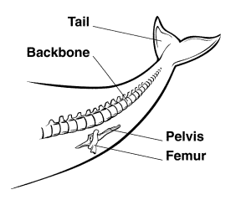
Image from BIOLOGY by Miller and Levine; Prentice Hall Publishing © 2006
According to this diagram, modern whales have a vestigial pelvis and femur. What does this suggest about ancestors of modern whales?
Ancestors of modern whales had legs and
walked on land
EVO-1.N.1 Molecular, morphological, and genetic evidence from extant and extinct organisms adds to our understanding of evolution—
b. Morphological homologies, including vestigial structures, represent features shared by common ancestry.

Slide 33
https://fiveable.me/ap-bio/mcq/biology-multiple-choice-questions/study-guide/Ej2O472Pjzzyu9SgxHuJ
Peter and Rosemary Grant spent 30 years observing the finches in the Galapagos Islands. On one of the most desolate islands, ground cacti and shrubs are the old vegetation that grows. In 1977, there was a severe drought and seeds of all kinds became scarce. The small, soft seeds were quickly eaten by the birds, leaving mainly large, tough seeds that the finches don’t normally eat. A year after the drought, the ecologists discovered that the average width of the finches’ beaks has increased compared to the measurements before the drought.
Which of the following statements best explains the increase in beak size?
A. The finches with the smaller beaks made their beaks bigger to get the tougher seeds.
B. The finches with the bigger beaks were stronger so they attacked and killed the finches with the smaller beaks.
C. The finches with the bigger beaks were able to eat the tough seeds and were healthier. Thus, they were able to produce more offspring that inherited the large beak gene.
D. All the finches’ beaks increased in size to be able to eat the tougher seeds.
Which of the following statements explains how the beak size increased?
A. A new allele appeared in a finch from a mutation
B. A new trait appeared in the population due to the bottle effect.
C. A new trait appeared in the population due to the recombination of alleles.
D. A change in the frequency of a gene was due to selective pressure from the environment.
EVO-1.C.1 Natural selection is a major mechanism of evolution.
EVO-1.C.2 According to Darwin’s theory of natural selection, competition for limited resources results in differential survival. Individuals with more favorable phenotypes are more likely to survive and produce more offspring, thus passing traits to subsequent generations
EVO-1.E.1 Natural selection acts on phenotypic variations in populations.
EVO-1.E.2 Environments change and apply selective pressures to populations.

Slide 34
Structures that develop from the same embryonic tissues, but have different mature forms
Homologous structures
Organs that are historical remnants of structures that had important functions in ancestors
Vestigial organs
EVO-2.B.2 Structural and functional evidence supports the relatedness of organisms in all domains
EVO-1.N.1 Molecular, morphological, and genetic evidence from extant and extinct organisms adds to our understanding of evolution—
b. Morphological homologies, including vestigial structures, represent features shared by common ancestry

Slide 35
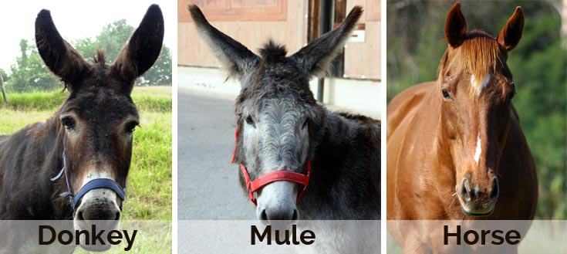
https://www.ponderweasel.com/wp-content/uploads/2015/07/difference-donkey-horse-mule.jpg
http://www.clipartbest.com/cliparts/Kij/exa/KijexaokT.png
When horses and donkeys mate, their mule offspring are unable to make sperm/eggs to reproduce.
MAKE A CONNECTION
Use what you learned about meiosis
to explain why mules can’t gametes.
62 chromosomes
63 chromosomes
64 chromosomes
During prophase I, homologous partners pair up (synapsis), line up
together during metaphase I, separate during anaphase I, and end up
in separate gametes.
Because mules have an odd number of chromosomes, not all their
chromosomes have a homologous partner to pair up with. They are
unable to make gametes with the correct number and complement
of chromosomes.
IST 1.H.1 Separation of the homologous chromosomes in meiosis I ensures that each gamete receives a haploid (1n) set of chromosomes that comprises both maternal and paternal chromosomes
EVO-3.D.2 The biological species concept provides a commonly used definition of species for sexually reproducing organisms. It states that species can be defined as a group capable of interbreeding and exchanging genetic information to produce viable, fertile offspring.

Slide 36
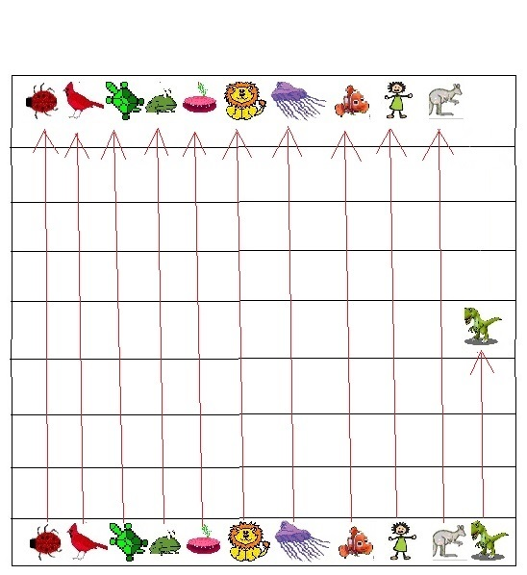
Diagrams by KRiedell
Fossils have left a record showing the change through time of living things.
Make a PREDICTION about what the fossil record would look like if all living
things had appeared on Earth at the same time and never changed. Represent
some different kinds of organisms (invertebrates like jellyfish, clams, insects
and vertebrates like fish, birds, reptiles, mammals, dinosaurs, humans, etc) in
your diagram.
Current time
Once life appears evidence would
be found of ALL kinds of organisms
in ALL layers until present day
(except for those that became
extinct like dinosaurs)
1st life appears
EVO-1.M.1 Evolution is supported by scientific evidence from many disciplines (geographical, geological, physical, biochemical, and mathematical data).
EVO-1.N.1 Molecular, morphological, and genetic evidence from extant and extinct organisms adds to our understanding of evolution—
a. Fossils can be dated by a variety of methods. These include:
i. The age of the rocks where a fossil is found
EVO 3.A.1 Populations of organisms continue to evolve.
EVO-3.A.2 All species have evolved and continue to evolve—
b. Continuous change in the fossil record.

Slide 37
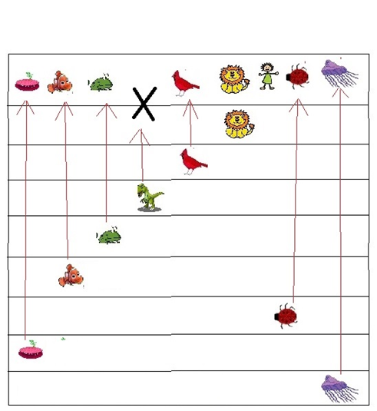
Now make a PREDICTION about what the fossil record should look
like if different kinds of organisms appeared at different times
throughout Earth’s history.
The fossil record shows organisms have appeared at different times throughout Earth’s history
Prokaryotes before eukaryotes. Invertebrates before vertebrates, in the following sequence: Cnidarians, worms, mollusks, echinoderms, arthropods, fish, amphibians, reptiles (including dinosaurs), birds, mammals, humans. Once an organism appears it is found in subsequent layers unless it becomes extinct. but never preceding ones.
EX: amphibians are never found in layers below the appearance of fish; birds are never found in layers below the appearance of reptiles; Humans never lived with dinosaurs!
Current time
1st life appears
EVO-1.M.1 Evolution is supported by scientific evidence from many disciplines (geographical, geological, physical, biochemical, and mathematical data).
EVO-1.N.1 Molecular, morphological, and genetic evidence from extant and extinct organisms adds to our understanding of evolution—
a. Fossils can be dated by a variety of methods. These include:
i. The age of the rocks where a fossil is found
EVO 3.A.1 and continue to evolve—
b. Continuous change in the fossil record.

Slide 38
FROM: http://serranohighschoolapbiology.weebly.com/uploads/6/7/9/9/6799747/ap_biology_evolution_unit_practice_test_1.pdf
Most Swiss starlings produce four to five eggs in each clutch. Starlings producing fewer, or more, than this have reduced fitness. Which of the following terms best describes this situation?
A) artificial selection
B) directional selection
C) stabilizing selection
D) disruptive selection
E) sexual selection
EVO-1.E.1 Natural selection acts on phenotypic variations in populations.
EVO-1.E.2 Environments change and apply selective pressures to populations.
EVO-1.E.3 Some phenotypic variations significantly increase or decrease fitness of the organism in particular environments.
EVO-1.D.2 Biotic and abiotic environments can be more or less stable/fluctuating, and this affects the rate and direction of evolution; different genetic variations can be selected in each generation
.

Slide 39
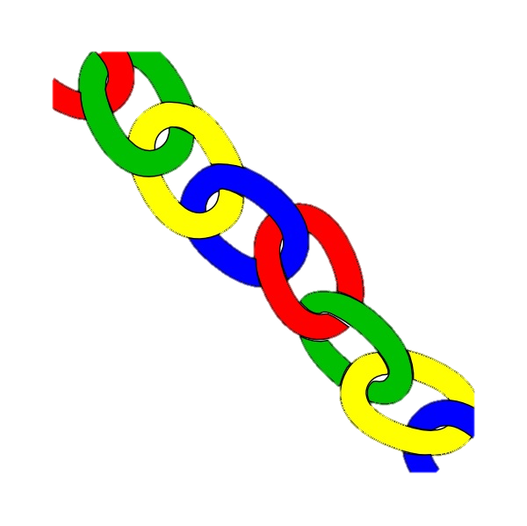
The ability of RNA molecules to catalyze chemical reactions supports the ___________ hypothesis that there was a time in the Earth’s evolutionary history that self-replicating RNA molecules proliferated before the evolution of DNA and proteins and that ______ could have been the earliest genetic material.
MAKE A CONNECTION
MOST enzymes are _______________
There are a few exceptions to this rule.
Spliceosomes that remove introns from pre-mRNA’s and ribosomes that synthesize proteins contain RNA molecules called __________that have the ability to catalyze specific biochemical reactions.
RNA WORLD
RNA
PROTEINS
carbohydrates proteins fats nucleic acids
ribozymes
SYI-3.E.1 Several hypotheses about the origin of life on Earth are supported with scientific evidence—
SYI-3.E.2 The RNA World Hypothesis proposes that RNA could have been the earliest genetic material.
SYI-3 Naturally occurring diversity among and between components within biological systems affects interactions with the environment.
c. Chemical experiments have shown that it is possible to form complex organic molecules from inorganic molecules in the absence of life—
i. Organic molecules/monomers served as building blocks for the formation of more complex molecules, including amino acids and nucleotides.
ii. The joining of these monomers produced polymers with the ability to replicate, store, and transfer information.

Slide 40
TAKE A STUDY BREAK
https://whyevolutionistrue.files.wordpress.com/2015/08/nq150822.gif?w=641&h=209

Slide 41
https://www.fusd1.org/site/handlers/filedownload.ashx?moduleinstanceid=7815&dataid=30441&FileName=AP%20Biology%20Evolution%20Review%20Slides.pdf
Use the data provided to construct a cladogram of the major plant groups.
1 indicates the character is present 0 indicates the character is NOT present
Pine trees
Flowering plants
Mosses
Ferns
Flowers
Vascular tissue
Circle the most recent common ancestor shared by Ferns and Flowering plants
EVO-3.B.1 Phylogenetic trees and cladograms show evolutionary relationships among lineages—
b. Traits that are either gained or lost during evolution can be used to construct phylogenetic trees and cladograms—
i. Shared characters are present in more than one lineage.
ii. Shared, derived characters indicate common ancestry and are informative for the construction of phylogenetic trees and cladogram
EVO-3.C.1 Phylogenetic trees and cladograms can be used to illustrate speciation that has occurred. The nodes on a tree represent the most recent common ancestor of any two groups or lineages.
EVO-3.C.2 Phylogenetic trees and cladograms can be constructed from morphological similarities of living or fossil species and from DNA and protein sequence similarities

Slide 42
During times of ecological stress, extinction rates ______________________
are always slower can be rapid always equal speciation rates
Which of the following provides the more accurate and reliable evidence for the construction of phylogenetic trees or cladograms?
morphological traits molecular data
Phylogenetic trees and cladograms both show relationships between lineages, but which of these shows the amount of change over time calibrated by fossils or a molecular clock.
phylogenetic trees cladograms
EVO-3.B.1 Phylogenetic trees and cladograms show evolutionary relationships among lineages—
a. Phylogenetic trees and cladograms both show relationships between lineages, but phylogenetic trees show the amount of change over time calibrated by fossils or a molecular clock.
b. Traits that are either gained or lost during evolution can be used to construct phylogenetic trees and cladograms—
ii. Shared, derived characters indicate common ancestry and are informative for the construction of phylogenetic trees and cladograms. c. Molecular data typically provide more accurate and reliable evidence than morphological traits in the construction of phylogenetic trees or cladograms.
EVO-3.C.2 Phylogenetic trees and cladograms can be constructed from morphological similarities of living or fossil species and from DNA and protein sequence similarities.
EVO-3. G.2 Extinction rates can be rapid during times of ecological stress

Slide 43
http://goldiesroom.org/AP%20Biology/AP%20Review%20pdf/AP%20Review%20-%20EVOLUTION%20v2015.pdf
Which of the following is not a valid conclusion based on studies of the structure of proteins, such as cytochrome c and lysozyme, in different species?
A) The rate of evolution of particular proteins is often relatively constant over time.
B) Many nucleotide substitutions result either in no change in the amino acid sequence of the protein or in a change to a functionally equivalent amino acid.
C) Fewer differences were observed in the amino acid sequences of a protein if the organismal sources of the proteins were closely related.
D) Functionally important regions of a protein can be discovered by identifying the regions with the most amino acid substitutions.
EVO-1.N.2 A comparison of DNA nucleotide sequences and/or protein amino acid sequences provides evidence for evolution and common ancestry
EVO 2.A.4 Core metabolic pathways are conserved across all currently recognized domains
IST 2.E.2 Alterations in a DNA sequence can lead to changes in the type or amount of the protein produced and the consequent phenotype. DNA mutations can be positive, negative, or neutral based on the effect or the lack of effect they have on the resulting nucleic acid or protein and the phenotypes that are conferred by the protein.

Slide 44
Modfied from: https://teachers.stjohns.k12.fl.us/lyons-s/files/2014/11/AP-Evolution-Practice-Test-2.pd
As a young biologist, Charles Darwin had expected the living plants of temperate South America would resemble those of temperate Europe, but he was surprised to find that they more closely resembled the plants of tropical South America. The biological explanation for this observation is most properly associated with the field of
A. meteorology.
B. embryology.
C. vertebrate anatomy.
D. biogeography.
EVO-1.N.1 Molecular, morphological, and genetic evidence from extant and extinct organisms adds to our understanding of evolution—
a. Fossils can be dated by a variety of methods. These include:
iii. Geographical data
b. Morphological homologies, including vestigial structures, represent features shared by common ancestry

Slide 45
https://evolution.berkeley.edu/evolibrary/article/speciationmodes_05
200 years ago, the ancestors of apple maggot flies laid their eggs only on hawthorns — but today, these flies lay eggs on hawthorns (which are native to America) and domestic apples (which were introduced to America by immigrants and bred). Many varieties of apples ripen three to four weeks before the hawthorn fruits do. Females generally choose to lay their eggs on the type of fruit they grew up in, and males tend to look for mates on the type of fruit they grew up in. So hawthorn flies generally end up mating with other hawthorn flies and apple flies generally end up mating with other apple flies. This means that gene flow between parts of the population that mate on different types of fruit is reduced. In fewer than 200 years, some genetic differences between these two groups of flies have evolved.
This is an example of
__________ speciation.
SYMPATRIC
Gene flow has been reduced between flies that feed on different food varieties, even though they both live in the same geographic area.
EVO-3.D.1 Speciation may occur when two populations become reproductively isolated from each other.
EVO-3.F.3 Various prezygotic and postzygotic mechanisms can maintain reproductive isolation and prevent gene flow between populations
EVO-3.F.1 Speciation results in diversity of life forms.
EVO-3.F.2 Speciation may be sympatric or allopatric.

Slide 46
Modfied from: https://teachers.stjohns.k12.fl.us/lyons-s/files/2014/11/AP-Evolution-Practice-Test-2.pd
A proficient engineer can easily design skeletal structures that are more functional than those currently found in the forelimbs of such diverse mammals as horses, whales, and bats. That the actual forelimbs of these mammals do not seem to be optimally arranged is because
A. natural selection has not had sufficient time to create the optimal design in each case, but will do so given enough time. B. natural selection is generally limited to modifying structures that were present in previous generations and in previous species.
C. in many cases, phenotype is not merely determined by genotype, but by the environment as well.
D. though we may not consider the fit between the current skeletal arrangements and their functions excellent, we should not doubt that natural selection ultimately produces the best design.
EVO-1.C.1 Natural selection is a major mechanism of evolution.
EVO-1.C.2 According to Darwin’s theory of natural selection, competition for limited resources results in differential survival. Individuals with more favorable phenotypes are more likely to survive and produce more offspring, thus passing traits to subsequent generations
EVO-1.E.1 Natural selection acts on phenotypic variations in populations.
EVO-1.E.2 Environments change and apply selective pressures to populations.
EVO-1.J.1 Mutation results in genetic variation, which provides phenotypes on which natural selection acts

Slide 47
Modfied from: https://teachers.stjohns.k12.fl.us/lyons-s/files/2014/11/AP-Evolution-Practice-Test-2.pd
Which statement about natural selection is most correct?
A. Adaptations beneficial in one habitat should generally be beneficial in all other habitats as well.
B. Different species that occupy the same habitat will adapt to that habitat by undergoing the same genetic changes.
C. Adaptations beneficial at one time should generally be beneficial during all other times as well.
D. Well-adapted individuals leave more offspring, and thus contribute more to the next generation's gene pool, than do poorly adapted individuals.
E. Natural selection is the sole means by which populations can evolve
EVO-1.D.2 Biotic and abiotic environments can be more or less stable/fluctuating, and this affects the rate and direction of evolution; different genetic variations can be selected in each generation EVO-1.E.1 Natural selection acts on phenotypic variations in populations.
EVO-1.E.2 Environments change and apply selective pressures to populations.
EVO-1.E.3 Some phenotypic variations significantly increase or decrease fitness of the organism in particular environments.
EVO-1.H.1 Evolution is also driven by random occurrences—
b. Genetic drift is a nonselective process occurring in small populations—
c. Migration/gene flow can drive evolution.
SYI-3.D.1 The level of variation in a population affects population dynamics— c. Alleles that are adaptive in one environmental condition may be deleterious in another because of different selective pressures.

Slide 48
Modified from: https://teachers.stjohns.k12.fl.us/lyons-s/files/2014/11/AP-Evolution-Practice-Test-2.pd
No two people are genetically identical, except for identical twins. The chief cause of genetic variation among human individuals is
A. new mutations that occurred in the preceding generation.
B. the reshuffling of alleles in sexual reproduction.
C. genetic drift due to the small size of the population.
D. geographic variation within the population.
IST 4.A.1 b. Mutations are the primary source of genetic variation
EVO-1.J.1 Mutation results in genetic variation, which provides phenotypes on which natural selection acts

Slide 49
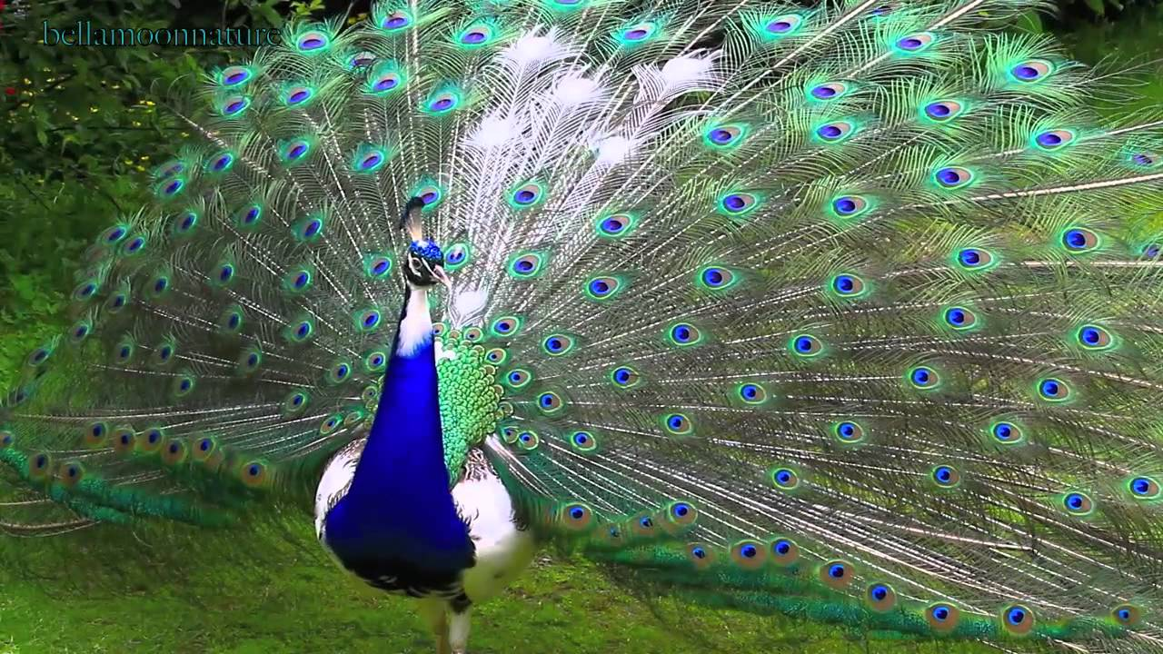
Modified from: https://teachers.stjohns.k12.fl.us/lyons-s/files/2014/11/AP-Evolution-Practice-Test-2.pd
Image from: https://i.ytimg.com/vi/6SlgpOzWuFU/maxresdefault.jpg
Which describes brightly colored peacocks mating more frequently than drab peacocks?
A. artificial selection
B. directional selection
C. stabilizing selection D. disruptive selection E. sexual selection
IST 4.A.1 b. Mutations are the primary source of genetic variation
EVO-1.J.1 Mutation results in genetic variation, which provides phenotypes on which natural selection acts

Slide 50
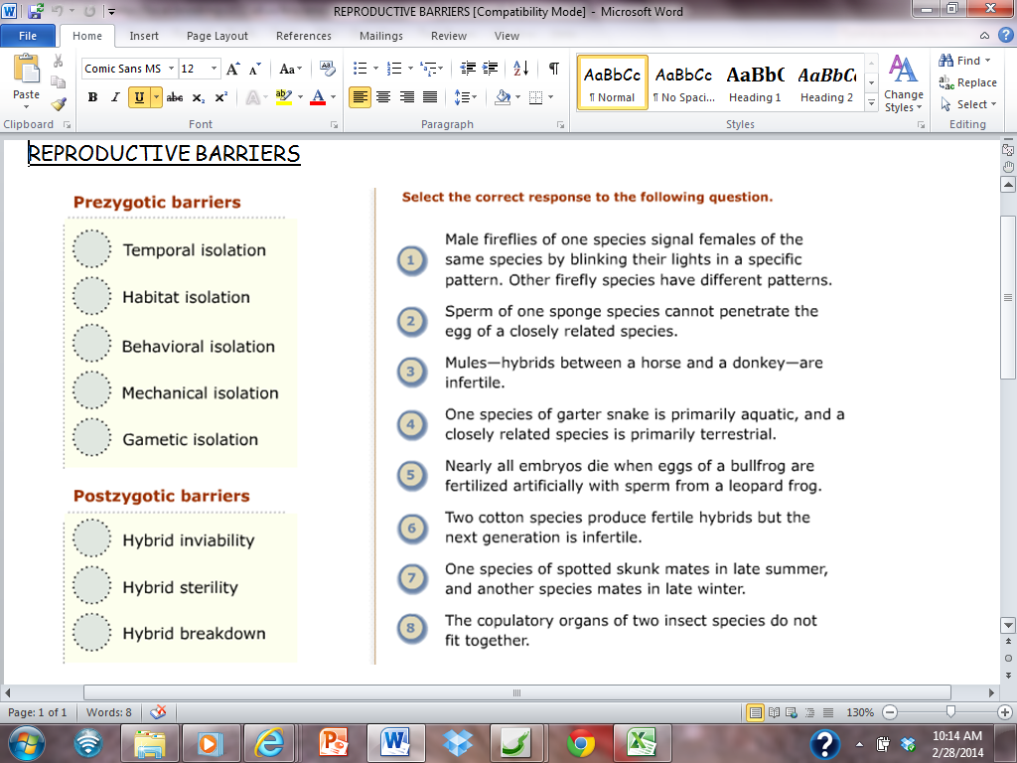
7
4
1
8
2
5
3
6
EVO-3.D.1 Speciation may occur when two populations become reproductively isolated from each other.
EVO-3.F.2 Speciation may be sympatric or allopatric.
EVO-3.F.3 Various prezygotic and postzygotic mechanisms can maintain reproductive isolation and prevent gene flow between populations

Slide 51
Give some examples of how human activity can drive changes in ecosystems that cause extinctions.
Deforestation and urbanization replace natural spaces with human environments which displace species and bring wildlife in contact with humans.
Agricultural run off from fertilizers produce algal blooms and dead zones
Toxins from pesticides like DDT can contaminate ecosystems and are passed up the food chain, concentrating his the top consumers.
Introduction of invasive species that outcompete native species can devastate ecosystems.
Burning fossil fuels has increased green house gases in the atmosphere resulting in climate change and acidification of oceans.
All of these have impacted organisms and resulted in the extinction of many species
EVO-3.H.1 Human activity can drive changes in ecosystems that cause extinctions.

Slide 52
https://www.fusd1.org/site/handlers/filedownload.ashx?moduleinstanceid=7815&dataid=30441&FileName=AP%20Biology%20Evolution%20Review%20Slides.pdf
1 indicates the character is present 0 indicates the character is NOT present
Based on the data above, which two organisms are the most closely related?
Dolphins and Tuna OR Dolphins and Leopards EXPLAIN your answer
Dolphins are more closely related to Leopards than to Tuna because Dolphins and Leopards share 5 of the 6 derived characters shown above. Dolphins and Tuna have only 3 derived characters in common.
EVO-3.B.1 Phylogenetic trees and cladograms show evolutionary relationships among lineages—
b. Traits that are either gained or lost during evolution can be used to construct phylogenetic trees and cladograms—
i. Shared characters are present in more than one lineage.
ii. Shared, derived characters indicate common ancestry and are informative for the construction of phylogenetic trees and cladograms
EVO-3.C.2 Phylogenetic trees and cladograms can be constructed from morphological similarities of living or fossil species and from DNA and protein sequence similarities.
SP 6A. Make a scientific claim.
SP 6C. Provide reasoning to justify a claim by connecting evidence to biological theories

Slide 53
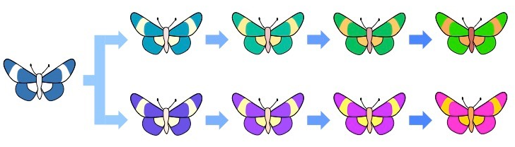
http://ib.bioninja.com.au/_Media/phyletic-gradualism_med.jpeg
Darwin’s idea that evolution happened
slowly over a long period of time is
called __________
gradualism
EVO-3.E.1 Punctuated equilibrium is when evolution occurs rapidly after a long period of stasis. Gradualism is when evolution occurs slowly over hundreds of thousands or millions of years.

Slide 54
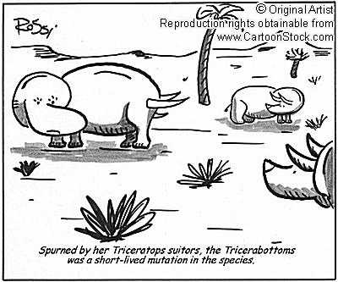
TAKE A STUDY BREAK
http://www.cartoonstock.com/newscartoons/cartoonists/rrs/lowres/rrsn69l.jpg

Slide 55
http://goldiesroom.org/AP%20Biology/AP%20Review%20pdf/AP%20Review%20-%20EVOLUTION%20v2015.pdf
Which of the following statements about evolution is NOT TRUE?
Some species living in stable environments appear to have changed very little over many millions of years.
B) Species have become extinct throughout the history of life.
C) The fossil record of trilobites provides a good example of gradual evolutionary change within a lineage of organisms.
D) There is no evidence in the fossil record for periods of rapid evolutionary change.
EVO-3. G.2 Extinction rates can be rapid during times of ecological stress.
EVO-1.M.1 Evolution is supported by scientific evidence from many disciplines (geographical, geological, physical, biochemical, and mathematical data).

Slide 56
All the genes, including all the different alleles, in a population
Gene pool
If the allele frequencies in a population do NOT change and the population does NOT EVOLVE, the populations is said to be in _______________
Genetic equilibrium
VOCAB
EVO-1.L.1 Changes in allele frequencies provide evidence for the occurrence of evolution in a population.

Slide 57
Image from BIOLOGY by Miller and Levine; Prentice Hall Publishing©2006
Name the type of selection shown in the diagram below.
Disruptive selection
EVO-1.E.1 Natural selection acts on phenotypic variations in populations.
EVO-1.E.2 Environments change and apply selective pressures to populations.
EVO-1.E.3 Some phenotypic variations significantly increase or decrease fitness of the organism in particular environments
EVO-1.K.2 Allele frequencies in a population can be calculated from genotype frequencies
ILLUSTRATIVE EXAMPLE Graphical analysis of allele frequencies in a population

Slide 58
https://teachers.stjohns.k12.fl.us/lyons-s/files/2014/11/AP-Evolution-Practice-Test-2.pd
There are those who claim that the theory of evolution cannot be true because the apes, which are supposed to be closely related to humans, do not likewise share the same large brains, capacity for complicated speech, and tool-making capability. They reason that if these features are generally beneficial, then the apes should have evolved them as well. Which of these provides the best argument against this misconception?
A. Advantageous alleles do not arise on demand.
B. A population's evolution is limited by historical constraints.
C. Adaptations are often compromises.
D. Evolution can be influenced by environmental change
EVO-1.C.2 According to Darwin’s theory of natural selection, competition for limited resources results in differential survival. Individuals with more favorable phenotypes are more likely to survive and produce more offspring, thus passing traits to subsequent generations

Slide 59
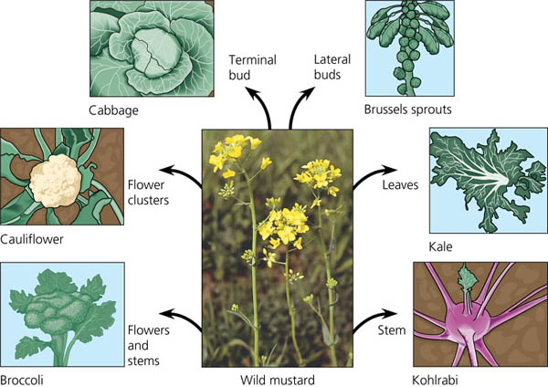
https://www.sciencenewsforstudents.org/wp-content/uploads/2019/11/860-header-dog-breeds.jpg
BIOLOGY by Campbell and Reece Prentice Hall Publishing©2005
When humans select and breed animals with certain useful traits from the natural variation in the population this is called
Artificial selection
EVO-1.F.1 Through artificial selection, humans affect variation in other species

Slide 60
Any inherited characteristic that increases and organism’s chances to survive and reproduce.
Give some examples of the above
adaptation
Webbed feet, camouflage, beaks, claws,
speed, venom, living in groups, wings, blubber, flippers, scales, jaws, hair/fur, . . .
EVO-1.C.2 According to Darwin’s theory of natural selection, competition for limited resources results in differential survival. Individuals with more favorable phenotypes are more likely to survive and produce more offspring, thus passing traits to subsequent generations

Slide 61
In a Hardy Weinberg problem,
which variable is used to
represent the frequency of the
recessive allele ____
dominant allele ____
homozygous recessive individuals ____
homozygous dominant individuals ____
heterozygous individuals _____
p + q = 1
P² + 2pq + q² = 1
q
p
q²
p²
2pq
EVO-1.K.2 Allele frequencies in a population can be calculated from genotype frequencies
SP 5 A. Perform mathematical calculations including: a. Mathematical equations in the curriculum

Slide 62
https://sites.google.com/site/mrstewartjfr/homework
Rabbits were introduced to Australia in the 1800s. They rapidly overpopulated because they had few natural predators in the area. To control their population, scientists introduced a rabbit-specific virus into the population, and their numbers greatly decreased. However, after several generations, the rabbit populations began to increase again. Which statement explains the new increase in the number of rabbits?
A) The rabbits interbred with native rabbit species
B) Some of the rabbits had a natural immunity to the virus
C) Some of the rabbits learned to survive even though they were sick.
D) The rabbits were able to have more offspring by changing their reproductive cycles.
EVO-1.J.1 Mutation results in genetic variation, which provides phenotypes on which natural selection acts SYI-3.D.1 The level of variation in a population affects population dynamics— a. Population ability to respond to changes in the environment is influenced by genetic diversity. Species and populations with little genetic diversity are at risk of decline or extinction. ILLUSTRATIVE EXAMPLES § Genetic diversity and selective pressures § Antibiotic resistance in bacteria. (Not all individuals in a diverse population are susceptible to a disease outbreak.)

Slide 63
Examination of chimp and human karyotypes shows that chimps have 2 smaller chromosome pairs not found in humans; and humans have one larger chromosome pair (#2) not found in chimps.
It has been suggested that human chromosome # 2 was formed by the end-to-end fusion of the two chimp chromosomes at some point in the past. If this is true, there should be some evidence that can be observed to support this idea. Use what you know about the STRUCTURE OF EUKARYOTIC CHROMOSOMES to MAKE SOME PREDICTIONS about the structure of human chromosome #2 that would suggest “relatedness” between chimps and humans COLOR OR ADD LABELS TO THIS DIAGRAM.
“If this fusion explanation is true, then I would expect that . . . “
EVO-1.N.2 A comparison of DNA nucleotide sequences and/or protein amino acid sequences provides evidence for evolution and common ancestry
SP 2.B Explain relationships between different characteristics of biological concepts, processes, or models represented visually
b. In applied contexts.

Slide 64
“If this fusion explanation is true, then I would expect that . . . “
BANDING PATTERNS
2. DNA SEQUENCING-
3. TELOMERE LOCATION ON THESE 2 chromosomes-
4. TELOMERE LOCATION ON OTHER HUMAN CHROMOSOMES
of human chromosome #2 and chimp chromosomes should match up. (They do!)
DNA/Genes for particular proteins/traits are in corresponding positions on the chimp/human chromosomes. (They are!)
Eukaryotic chromosomes have telomeres on the tips to protect code from being lost during replication.
If two chimp chromosomes fused, then there should be telomere sequences in the middle of human chromosome #2 where the fusion occurred. (There is)
Human chromosome #2 is the only human chromosome with telomeres in the middle
EVO-1.N.2 A comparison of DNA nucleotide sequences and/or protein amino acid sequences provides evidence for evolution and common ancestry
SP 2.B Explain relationships between different characteristics of biological concepts, processes, or models represented visually
b. In applied contexts.

Slide 65
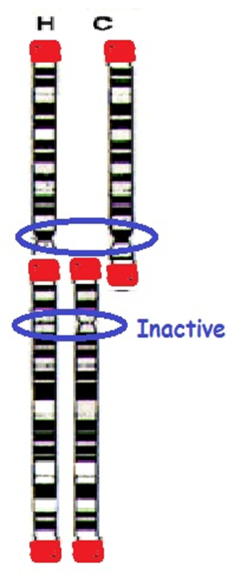
“If this fusion explanation is true, then I would expect that . . . “
5. CENTROMERE LOCATIONS-
6. CENTROMERE ACTIVITY
Eukaryotic chromosomes have centromere regions to which spindle fibers attach during cell division.
If two chimp chromosomes fused, then there should be 2 centromere regions on human chromosome #2. (There are)
There are 2 centromere regions on human chromosome #2 but one is inactive!
EVO-1.N.2 A comparison of DNA nucleotide sequences and/or protein amino acid sequences provides evidence for evolution and common ancestry
SP 2.B Explain relationships between different characteristics of biological concepts, processes, or models represented visually
b. In applied contexts.

Slide 66
Tell the 2 equations needed to solve Hardy Weinberg problems
p + q = 1
P² + 2pq + q² = 1
The number of times a certain allele occurs in a gene pool
compared to the number of times
other alleles for the same gene occur
Relative frequency
EVO-1.K.2 Allele frequencies in a population can be calculated from genotype frequencies

Slide 67
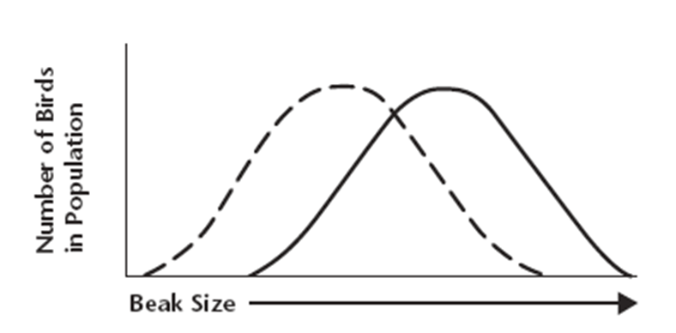
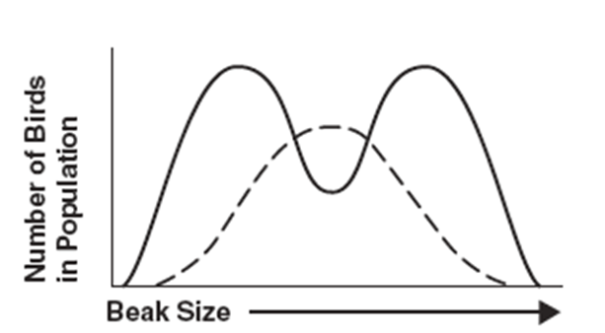
Images from BIOLOGY by Miller and Levine; Prentice Hall Publishing©2006
Male birds use their plumage to attract mates. Male birds in the population with less brilliant and showy plumage are less likely to attract a mate, while male birds with showy plumage are more likely to attract a mate. Male birds with showier, brightly-colored plumage also attract predators, and are less likely to live long enough to find a mate. MAKE A PREDICTION about what will happen to this population over time. EXPLAIN your answer
The most fit, are the male birds in the middle--showy, but not too showy. The frequency of very bright birds in population will decrease (get eaten so don’t reproduce and pass on their “bright color” genes). The frequency of dull colored bird will also decrease (don’t get mates so can’t pass on their
“dull color” genes).
EVO-1.E.1 Natural selection acts on phenotypic variations in populations.
.EVO-1.E.2 Environments change and apply selective pressures to populations.
EVO-1.E.3 Some phenotypic variations significantly increase or decrease fitness of the organism in particular environments.

Slide 68
http://education-portal.com/cimages/multimages/16/rh-blood-group-system.jpg
In humans, Rh-positive individuals have the Rh antigen on their red blood cells, while Rh-negative individuals do not. If the Rh-positive phenotype is produced by a dominant gene (A), and the Rh-negative phenotype is due to its recessive allele (a), what is the frequency of the Rh-positive allele if 84% of a population is Rh-positive?
q² = 1-.84 = 0.16
q = √ 0.16 = 0.4
p + q = 1
p + 0.4 = 1
p = 0.6
Rh-positive allele = 60%
EVO-1.K.2 Allele frequencies in a population can be calculated from genotype frequencies
SP 5 A. Perform mathematical calculations including: a. Mathematical equations in the curriculum

Slide 69
TAKE A STUDY BREAK
http://amoebasisters.tumblr.com/image/136048750242

Slide 70
file:///C:/Users/riedellke/Google%20Drive/FileBlimp/AP%20BIO/AP%20BIO%20Evolution/EXAMS/ap_biology_evolution_unit_practice_test_1.pdf
Based on this phylogenetic tree, which two organisms are the most closely related?
Circle their most recent common ancestor
Goats and humans are more closely related
because they share a more recent common ancestor
EVO-3.C.1 Phylogenetic trees and cladograms can be used to illustrate speciation that has occurred. The nodes on a tree represent the most recent common ancestor of any two groups or lineages.

Slide 71
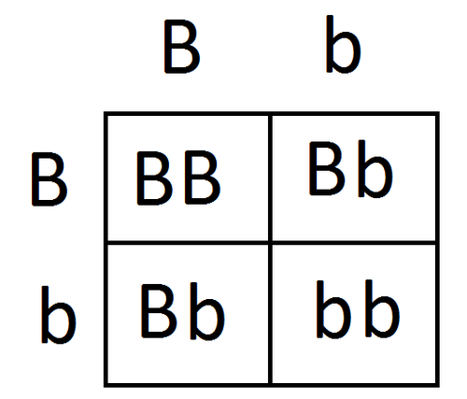
https://testprephq.com/wp-content/uploads/2017/04/68-Punnett-Squares.png
In the formula for determining a population's genotype frequencies, the 2 in the term 2pq is necessary because
A) the population is diploid.
B) heterozygotes can come about in two ways.
C) the population is doubling in number.
D) heterozygotes have two alleles
EVO-1.K.2 Allele frequencies in a population can be calculated from genotype frequencies

Slide 72
Describe the two main hypotheses that explain the origin of life on earth
Panspermia-
Abiogenesis-
What famous experiment provided evidence
for the abiogenesis hypothesis?
Organic molecules could have been transported to Earth by a meteorite or other celestial event.
Conditions on primitive Earth (low oxygen in atmosphere; available free energy from lightning, volcanic activity, or heat) produced simple organic molecules from inorganic precursors.
Miller-Urey experiment
SYI-3 Naturally occurring diversity among and between components within biological systems affects interactions with the environment.
c. Chemical experiments have shown that it is possible to form complex organic molecules from inorganic molecules in the absence of life—
i. Organic molecules/monomers served as building blocks for the formation of more complex molecules, including amino acids and nucleotides.
ii. The joining of these monomers produced polymers with the ability to replicate, store, and transfer information.
SYI-3.E.1 b. There are several models about the origin of life on Earth—
i. Primitive Earth provided inorganic precursors from which organic molecules could have been synthesized because of the presence of available free energy and the absence of a significant quantity of atmospheric oxygen (O₂).
ii. Organic molecules could have been transported to Earth by a meteorite or other celestial event.

Slide 73
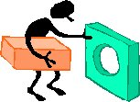
http://www.dwm.ks.edu.tw/bio/activelearner/19/ch19summary.htm
lhttp://newhaven828.typepad.com/.a/6a00d8347ae50569e200e5538e3c2e8834-320pi
The copulatory organs of two insect species do not fit together.
This is an example of a _____ zygotic reproductive barrier called ______________ isolation
pre
mechanical
EVO-3.D.1 Speciation may occur when two populations become reproductively isolated from each other.
EVO-3.F.2 Speciation may be sympatric or allopatric.
EVO-3.F.3 Various prezygotic and postzygotic mechanisms can maintain reproductive isolation and prevent gene flow between populations

Slide 74
TRUE or FALSE
Populations spend the majority of time in Hardy-Weinberg equilibrium.
Hardy-Weinberg equilibrium is an “IDEAL” concept. It is a valuable NULL hypothesis to compare against.
ALL 5 conditions are seldom met. . . there is always non-random mating, mutations, & natural selection. So there is ALMOST ALWAYS EVOLUTION HAPPENING !
EVO 3.A.1 Populations of organisms continue to evolve.
EVO-3.A.2 All species have evolved and continue to evolve—
EVO-1.K.1 Hardy-Weinberg is a model for describing and predicting allele frequencies in a nonevolving population.
These conditions are seldom met, but they provide a valuable null hypothesis..
EVO-1.L.1 Changes in allele frequencies provide evidence for the occurrence of evolution in a population.

Slide 75
If all the conditions of Hardy-Weinberg are met, what happens to the population?
There is NO EVOLUTION
Changes in the allele frequency in a small population that are due to random chance and don’t follow the laws of probability
Genetic drift
EVO-1.K.1 Hardy-Weinberg is a model for describing and predicting allele frequencies in a nonevolving population
EVO-1.L.1 Changes in allele frequencies provide evidence for the occurrence of evolution in a population.
EVO-1.H.1 Evolution is also driven by random occurrences—
b. Genetic drift is a nonselective process occurring in small populations—

Slide 76
Modified from: https://teachers.stjohns.k12.fl.us/lyons-s/files/2014/11/AP-Evolution-Practice-Test-2.pd
Natural selection is based on all of the following EXCEPT
genetic variation exists within populations.
the best-adapted individuals tend to leave the most offspring.
individuals adapt to their environments and, thereby, evolve.
D. individuals who survive longer tend to leave more offspring than those who die young.
E. populations tend to produce more individuals than the environment can support.
EVO-1.C.1 Natural selection is a major mechanism of evolution.
EVO-1.C.2 According to Darwin’s theory of natural selection, competition for limited resources results in differential survival. Individuals with more favorable phenotypes are more likely to survive and produce more offspring, thus passing traits to subsequent generations
EVO-1.D.1 Evolutionary fitness is measured by reproductive success.
EVO-3.A.1 Populations of organisms continue to evolve.

Slide 77
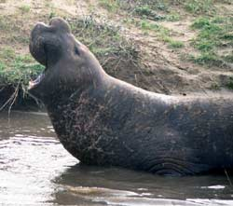
https://evolution.berkeley.edu/evolibrary/article/bottlenecks_01
Over hunting reduced the size of the population of Northern elephant seals population to as few as 20 individuals at the end of the 19th century.
Their population has since rebounded to over 30,000.
This is an example of the _______________ Effect.
The random decrease in individuals cause the genetic variation in a population to __________
Species and populations with ______ genetic diversity are at risk of
decline or extinction.
BOTTLENECK
DECREASE
LOW
LOW HIGH
EVO-1.H.1 Evolution is also driven by random occurrences—
b. Genetic drift is a nonselective process occurring in small populations—
i. Bottlenecks.
SYI-3.D.1 The level of variation in a population affects population dynamics— a. Population ability to respond to changes in the environment is influenced by genetic diversity. Species and populations with little genetic diversity are at risk of decline or extinction. b. Genetically diverse populations are more resilient to environmental perturbation because they are more likely to contain individuals who can withstand the environmental pressure

Slide 78
FROM: http://serranohighschoolapbiology.weebly.com/uploads/6/7/9/9/6799747/ap_biology_evolution_unit_practice_test_1.pdf
Fruit fly eyes are of the compound type, which is structurally very different from the camera–type eyes of mammals. Even the camera–type eyes of mollusks, such as octopi, are structurally quite different from those of mammals. Yet, fruit flies, octopi, and mammals possess very similar versions of Pax–6. The fact that the same gene helps produce very different types of eyes is most likely due to A) the few differences in nucleotide sequence among the Pax–6 genes of these organisms. B) variations in the number of Pax–6 genes among these organisms. C) the independent evolution of this gene at many different times during animal evolution. D) differences in the control of Pax–6 expression among these organisms
EVO-2.B.1 Many fundamental molecular and cellular features and processes are conserved across organisms.
EVO-2.B.2 Structural and functional evidence supports the relatedness of organisms in all domains

Slide 79
Image from BIOLOGY by Miller and Levine; Prentice Hall Publishing©2006
Type of distribution curve shown by
polygenic traits
Bell-shaped curve (OR normal distribution)

Slide 80
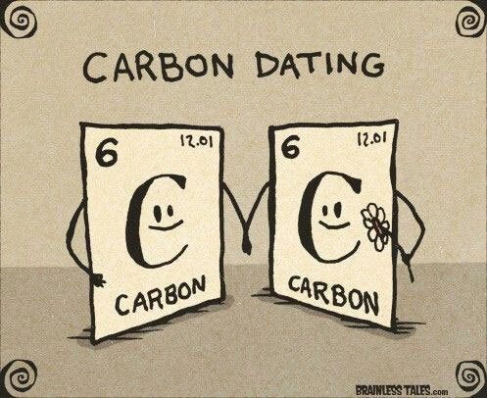
TAKE A STUDY BREAK
http://www.chemistryjokes.com/images/carbon-dating.jpg

Slide 81
Modified from: https://teachers.stjohns.k12.fl.us/lyons-s/files/2014/11/AP-Evolution-Practice-Test-2.pd
Mules, hybrid offspring from horse and donkey parents, are relatively long-lived and hardy organisms that cannot, generally speaking, perform successful meiosis. Consequently, which statement about mules is true?
A. They have a relative evolutionary fitness of zero.
B. Their offspring have less genetic variation than the parents.
C. Mutations cannot occur in their genomes.
D. If crossing-over happens in mules, then it must be limited to prophase of mitosis.
E. When two mules interbreed, genetic recombination cannot occur by meiotic crossing over, but only by the act of fertilization.
IST 4.A.1 b. Mutations are the primary source of genetic variation
EVO-1.J.1 Mutation results in genetic variation, which provides phenotypes on which natural selection acts
EVO-1.D.1 Evolutionary fitness is measured by reproductive success.
EVO-3.F.3 Various prezygotic and postzygotic mechanisms can maintain reproductive isolation and prevent gene flow between populations

Slide 82
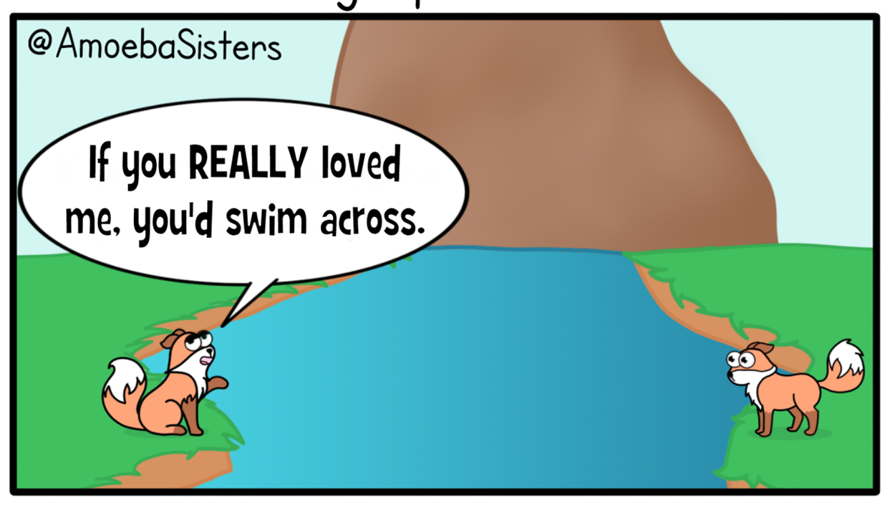
Image from: http://amoebasisters.tumblr.com/post/126009643342/oh-hey-its-a-golgi-gif-protein-delivery
Mode of speciation induced when an ancestral population becomes split by a geographic barrier
Allopatric “other country” speciation
EVO-3.D.1 Speciation may occur when two populations become reproductively isolated from each other.
EVO-3.F.3 Various prezygotic and postzygotic mechanisms can maintain reproductive isolation and prevent gene flow between populations
EVO-3.F.1 Speciation results in diversity of life forms.
EVO-3.F.2 Speciation may be sympatric or allopatric.

Slide 83
FROM: http://serranohighschoolapbiology.weebly.com/uploads/6/7/9/9/6799747/ap_biology_evolution_unit_practice_test_1.pdf
Pax–6 usually causes the production of a type of light–receptor pigment. In vertebrate eyes, though, a different gene (the rh gene family) is responsible for the light–receptor pigments of the retina. The rh gene, like Pax–6, is ancient. In the marine ragworm, for example, the rh gene causes production of c–opsin, which helps regulate the worm's biological clock. Which of these most likely accounts for vertebrate vision? A) The Pax–6 gene mutated to become the rh gene among early mammals. B) During vertebrate evolution, the rh gene for biological clock opsin was co–opted as a gene for visual receptor pigments.
C) In animals more ancient than ragworms, the rh gene(s) coded for visual receptor pigments; in lineages more recent than ragworms, rh has flip– flopped several times between producing biological clock opsins and visual receptor pigments. D) Pax–6 was lost from the mammalian genome, and replaced by the rh gene much later.
EVO-2.B.1 Many fundamental molecular and cellular features and processes are conserved across organisms.
EVO-2.B.2 Structural and functional evidence supports the relatedness of organisms in all domains

Slide 84
Image from BIOLOGY by Miller and Levine; Prentice Hall Publishing©2006
Name the type of selection shown in the diagram below.
Stabilizing selection
EVO-1.E.1 Natural selection acts on phenotypic variations in populations.
EVO-1.E.2 Environments change and apply selective pressures to populations.
EVO-1.E.3 Some phenotypic variations significantly increase or decrease fitness of the organism in particular environments
EVO-1.K.2 Allele frequencies in a population can be calculated from genotype frequencies
ILLUSTRATIVE EXAMPLE Graphical analysis of allele frequencies in a population

Slide 85
https://evolution.berkeley.edu/evolibrary/article/phylogenetics_08
When constructing phylogenetic trees the best hypothesis is the simplest scientific explanation that fits the evidence. That means all other things being equal, the best hypothesis is the one that requires the fewest evolutionary changes. This idea is called _________________
PARSIMONY
Which of these hypotheses for constructing phylogenetic trees is the most parsimonious?
Hypothesis 1 requires 6 mutations. Hypothesis 2 requires 7 mutations and bony skeleton must evolve 2 separate times.
EVO-3.C.1 Phylogenetic trees and cladograms can be used to illustrate speciation that has occurred. The nodes on a tree represent the most recent common ancestor of any two groups or lineages.
EVO-3.C.2 Phylogenetic trees and cladograms can be constructed from morphological similarities of living or fossil species and from DNA and protein sequence similarities.
EVO-3.C.3 Phylogenetic trees and cladograms represent hypotheses and are constantly being revised, based on evidence

Slide 86
The gene for albinism is known to be a recessive allele. In Michigan, 9 people in a sample of 10,000 were found to have albino phenotypes. The other 9,991 had skin pigmentation normal for their ethnic group.
a. Assuming Hardy-Weinberg equilibrium, what is the allele frequency for the dominant pigmentation allele in this population?
b. How many out of the 10,000 people in the sample above were expected to be heterozygous for pigmentation
9/10,000 = q²
0.0009 = q²
q = √ 0.0009 = 0.03
p + q = 1
p + 0.03 = 1
p = 0.97
Normal pigment allele = 97%
2pq = 2 (0.97) ( 0.03) = 0.058
10000 X 0.058 = 580 people are expected to be heterozygous
EVO-1.K.2 Allele frequencies in a population can be calculated from genotype frequencies
SP 5 A. Perform mathematical calculations including: a. Mathematical equations in the curriculum

Slide 87
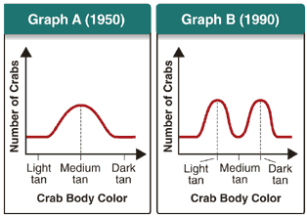
Image from: Miller and Levine Biology
Which of the following is most likely to have caused the change in the population shown in the graphs above?
A. a new predator prefers dark-tan crabs
B. a new predator prefers light-tan crabs
C. a new beach color makes medium-tan crabs the least visible
D. a new beach color makes medium-tan crabs the most visible
EXPLAIN YOUR ANSWER:
The graph shows a decrease in the number of medium tan crabs in the population.
If the beach color changed to make the medium tan crabs more visible, then more crabs of this color would be eaten by predators and their numbers would decrease.
EVO-1.E.2 Environments change and apply selective pressures to populations.
EVO-1.E.3 Some phenotypic variations significantly increase or decrease fitness of the organism in particular environments
SP 4. B Describe data from a table or graph, including
b. Describing trends and/or patterns in the data..

Slide 88
https://www.proprofs.com/quiz-school/topic/evolution
When comparing 2 populations of animals, which statement most likely indicates that they are the same species?
They can produce fertile offspring.
They inhabit the same general area.
Their outward appearance is similar.
They consume the same type of diet.
EVO-3.D.2 The biological species concept provides a commonly used definition of species for sexually reproducing organisms. It states that species can be defined as a group capable of interbreeding and exchanging genetic information to produce viable, fertile offspring.

Slide 89
In a population of squirrels, the allele that causes bushy tail (B) is dominant, while the allele that causes bald tail (b) is recessive. If 75% of the squirrels have a bushy tail, what is the frequency of the dominant allele?
p + q = 1 q2 + 2pq +p2 = 1
q² = 1.0 - 0.75 = 0.25
q = √0.25 = 0.5
p = 1.0 – 0.5 = 0.5
Frequency of the dominant allele (A) = 50%
EVO-1.K.2 Allele frequencies in a population can be calculated from genotype frequencies
SP 5 A. Perform mathematical calculations including: a. Mathematical equations in the curriculum

Slide 90
FROM: http://serranohighschoolapbiology.weebly.com/uploads/6/7/9/9/6799747/ap_biology_evolution_unit_practice_test_1.pdf
The diagram above shows an outcrop of sedimentary rock whose strata are labeled A–D.
If x indicates the fossils of two closely related species, neither of which is extinct, then their remains may be found in how many of these strata?
A) one stratum B) two strata C) three strata D) four strata
EVO-1.M.1 Evolution is supported by scientific evidence from many disciplines (geographical, geological, physical, biochemical, and mathematical data).
EVO-1.N.1 Molecular, morphological, and genetic evidence from extant and extinct organisms adds to our understanding of evolution—
a. Fossils can be dated by a variety of methods. These include:
i. The age of the rocks where a fossil is found
EVO-3.A.2 All species have evolved and continue to evolve—
b. Continuous change in the fossil record.

Slide 91
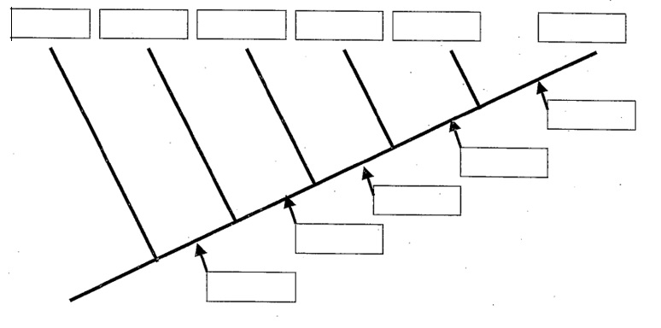
CREATE A CLADOGRAM FROM THIS DATA TABLE
LANCET
LAMPREY
TUNA
SALAMANDER
TURTLE
LEOPARD
HAIR
AMNIOTIC
TETRAPOD
JAWS
BACKBONE
EVO-3.C.1 Phylogenetic trees and cladograms can be used to illustrate speciation that has occurred. The nodes on a tree represent the most recent common ancestor of any two groups or lineages.
EVO-3.C.2 Phylogenetic trees and cladograms can be constructed from morphological similarities of living or fossil species and from DNA and protein sequence similarities.
EVO-3.B.1 b. Traits that are either gained or lost during evolution can be used to construct phylogenetic trees and cladograms—
i. Shared characters are present in more than one lineage.
ii. Shared, derived characters indicate common ancestry and are informative for the construction of phylogenetic trees and cladograms. iii. The out-group represents the lineage that is least closely related to the remainder of the organisms in the phylogenetic tree or cladogram.

Slide 92
When tackling a Hardy-Weinberg problem, always
start with the __________ _________ individuals.
When solving Hardy-Weinberg problems, which of
these represent organisms with a dominant phenotype?
p + q = 1
P² + 2pq + q² = 1
homozygous
recessive
homozygous heterozygous
dominant recessive
p q p² 2pq q²
EVO-1.K.2 Allele frequencies in a population can be calculated from genotype frequencies
SP 5 A. Perform mathematical calculations including: a. Mathematical equations in the curriculum

Slide 93
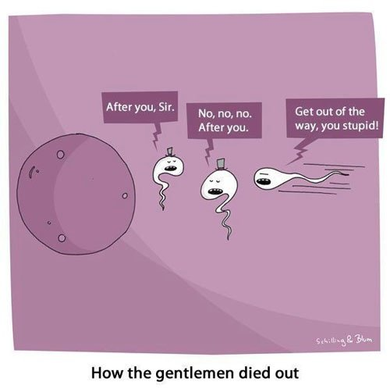
TAKE A STUDY BREAK
http://thechive.com/2013/06/12/i-wish-they-werent-but-these-things-are-all-just-too-true-35-photos/

Slide 94
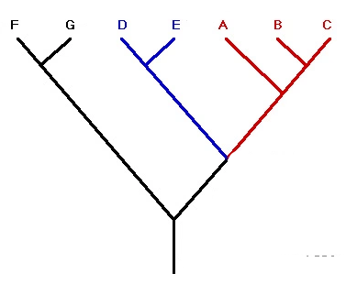
Image modified from: https://09au1905.files.wordpress.com/2009/11/cladogram.jpg?w=470
On the cladogram, draw a circle around all of the species that are descended from the species indicated by the node within the square.
EVO-3.C.1 Phylogenetic trees and cladograms can be used to illustrate speciation that has occurred. The nodes on a tree represent the most recent common ancestor of any two groups or lineages.
EVO-3.C.2 Phylogenetic trees and cladograms can be constructed from morphological similarities of living or fossil species and from DNA and protein sequence similarities.
EVO-3.B.1 b. Traits that are either gained or lost during evolution can be used to construct phylogenetic trees and cladograms—
i. Shared characters are present in more than one lineage.
ii. Shared, derived characters indicate common ancestry and are informative for the construction of phylogenetic trees and cladograms. iii. The out-group represents the lineage that is least closely related to the remainder of the organisms in the phylogenetic tree or cladogram.

Slide 95
FROM: http://serranohighschoolapbiology.weebly.com/uploads/6/7/9/9/6799747/ap_biology_evolution_unit_practice_test_1.pdf
All animals with eyes or eyespots that have been studied so far share a gene in common. When mutated, the gene Pax-6 causes lack of eyes in fruit flies, tiny eyes in mice, and missing irises (and other eye parts) in humans. The sequence of Pax-6 in humans and mice is identical. There are so few sequence differences with fruit fly Pax-6 that the human/mouse version can cause eye formation in eyeless fruit flies, even though vertebrates and invertebrates last shared a common ancestor more than 500 million years ago. The appearance of Pax–6 in all animals with eyes can be explained in multiple ways. Based on the information above, which explanation is most likely?
Pax–6 in all of these animals is not homologous; it arose independently in many different animal phyla due to intense selective pressure favoring vision.
B) The Pax–6 gene is really not "one" gene. It is many different genes that, over evolutionary time and due to convergence, have come to have a similar nucleotide sequence and function.
C) The Pax–6 gene was an innovation of an ancestral animal of the early Cambrian period. Animals with eyes or eyespots are descendants of this ancestor.
D) The perfectly designed Pax–6 gene appeared instantaneously in all animals created to have eyes or eyespots.
EVO-2.B.1 Many fundamental molecular and cellular features and processes are conserved across organisms.
EVO-2.B.2 Structural and functional evidence supports the relatedness of organisms in all domains

Slide 96
MODIFIED FROM: https://www.varsitytutors.com/ap_biology-help/understanding-biological-fitness?page=2
In an ecosystem, factors such as food supply, climate, and predator population are known as which of the following?
A. Survival of the fittest
B. Inheritance of Acquired Traits
C. Mendel’s Law of Segregation
D. Selective pressures E. Evolutionary catalysts
.
EVO-1.E.2 Environments change and apply selective pressures to populations.

Slide 97
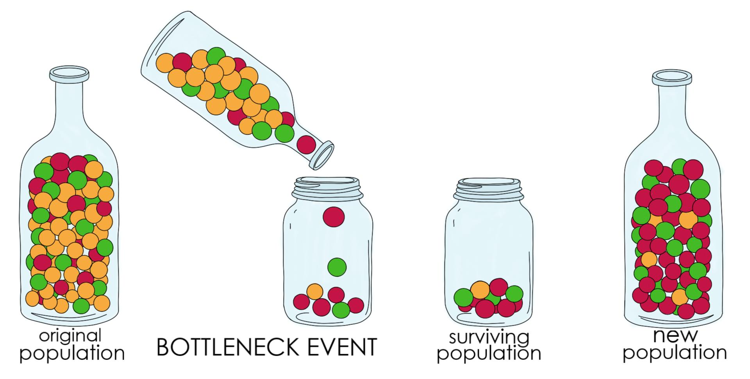
http://biology.gsu.edu/houghton/2107%20'08/Figures/Chapter22/bottleneck.jpg
BOTTLENECK EFFECT
Give an example of how humans might cause a Bottleneck effect.
Give an example of a natural cause of a Bottleneck effect
OVERHUNTING HABITAT DESTRUCTION
EARTHQUAKE, FLOOD, VOLCANIC ACTIVITY, TIDAL WAVE
EVO-1.H.1 Evolution is also driven by random occurrences—
b. Genetic drift is a nonselective process occurring in small populations—
i. Bottlenecks.
EVO-3. G.2 Extinction rates can be rapid during times of ecological stress.
EVO-3.H.1 Human activity can drive changes in ecosystems that cause extinctions.

Slide 98
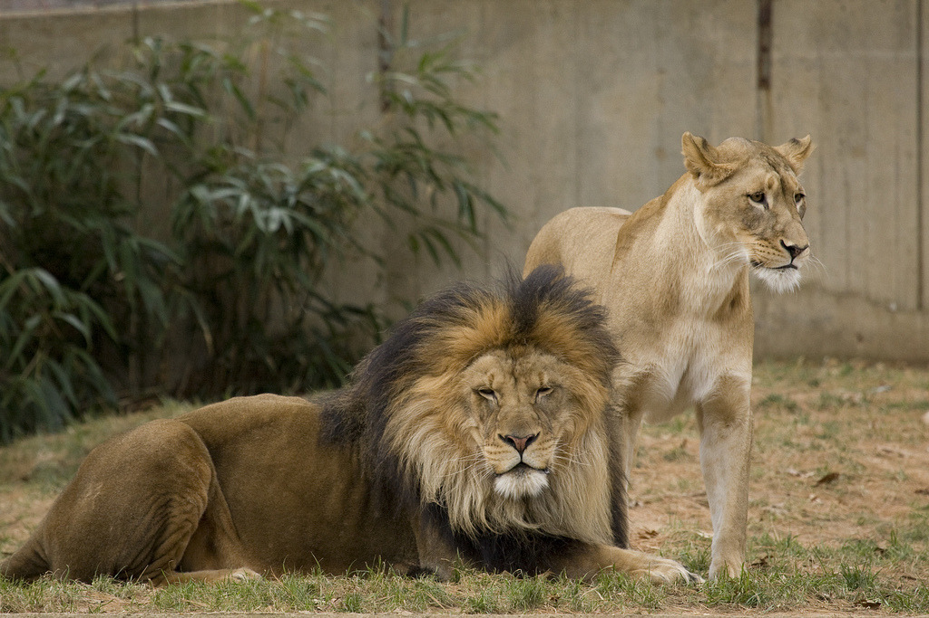
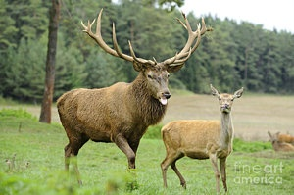
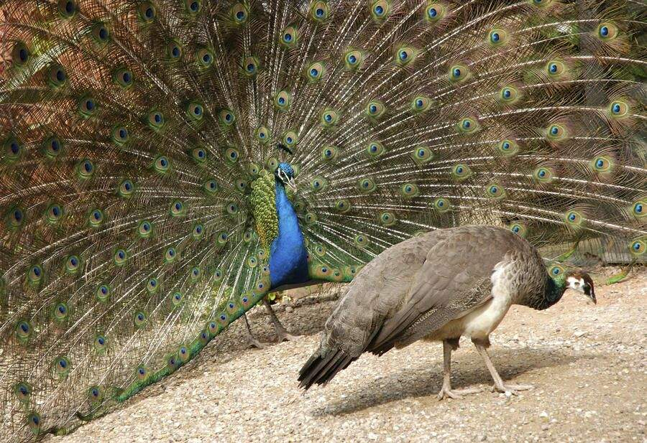
http://24.media.tumblr.com/tumblr_lh047lpMjQ1qatyxoo1_r1_1280.jpg
https://qph.fs.quoracdn.net/main-qimg-c70695b4de63e1d7c83627669359c4c3
https://pm1.narvii.com/6140/209441a83dd1f3a43867ab5f4ae9af8840ef2260_hq.jpg
In many species, particularly birds and mammals, males and females exhibit striking physical differences. This is called sexual ___________.
These features such as a male peacock’s large tail or a moose’s antlers, are the result of a special type of natural selection called _________ selection, in which the sexes acquire distinct forms either because the members of one sex choose mates with particular features or because in the competition for mates among the members of one sex only those with certain traits succeed.
dimorphism
SEXUAL
EVO-1.C.2 According to Darwin’s theory of natural selection, competition for limited resources results in differential survival. Individuals with more favorable phenotypes are more likely to survive and produce more offspring, thus passing traits to subsequent generations
EVO-1.E.1 Natural selection acts on phenotypic variations in populations

Slide 99
MODIFIED FROM: http://serranohighschoolapbiology.weebly.com/uploads/6/7/9/9/6799747/ap_biology_evolution_unit_practice_test_1.pdf
Currently, two extant elephant species (X and Y) are placed in the genus Loxodonta and a third extinct species (Z) is placed in the genus Elephas.
Assuming this classification reflects evolutionary relatedness, which of the following is the most accurate phylogenetic tree?
Tell the 2 main kinds of evidence used to create
phylogenetic trees.
Which of these provide the most accurate/reliable evidence in constructing phylogenetic trees or cladograms?
~ Morphological similarities
~ DNA/protein comparisons
Molecular data typically provide more accurate and reliable evidence than morphological traits in the construction of phylogenetic trees or cladograms.
EVO-3.B.1 Phylogenetic trees and cladograms show evolutionary relationships among lineages—
b. Traits that are either gained or lost during evolution can be used to construct phylogenetic trees and cladograms—
iii. The out-group represents the lineage that is least closely related to the remainder of the organisms in the phylogenetic tree or cladogram.
c. Molecular data typically provide more accurate and reliable evidence than morphological traits in the construction of phylogenetic trees or cladograms.
EVO-3.C.1 Phylogenetic trees and cladograms can be used to illustrate speciation that has occurred. The nodes on a tree represent the most recent common ancestor of any two groups or lineages.
EVO-3.C.2 Phylogenetic trees and cladograms can be constructed from morphological similarities of living or fossil species and from DNA and protein sequence similarities.
EVO-3.C.3 Phylogenetic trees and cladograms represent hypotheses and are constantly being revised, based on evidence
.

Slide 100
https://www.highschooltestprep.com/ap/biology/unit-7-practice-test/
A study published by a team led by the U.S. Geological Survey (USGS) revealed the movement of polar bears toward areas with more persistent sea ice. The researchers defined four general polar bear population clusters: Eastern Polar Basin, Western Polar Basin, Canadian Archipelago, and Southern Canada. By looking at the genes of the polar bears, they found that the polar bears have recently begun to move in a northward direction, from Southern Canada and Eastern Polar Basin into the Canadian Archipelago. The team of researchers hypothesized that the Canadian Archipelago will be a future refuge for polar bears if climate change continues to trend toward a warmer climate. This movement of polar bear populations provides a prime example of
A. natural variation B. gene flow
C. directional selection
D. founder effect
EVO-1.H.1 Evolution is also driven by random occurrences—
c. Migration/gene flow can drive evolution.

Slide 101
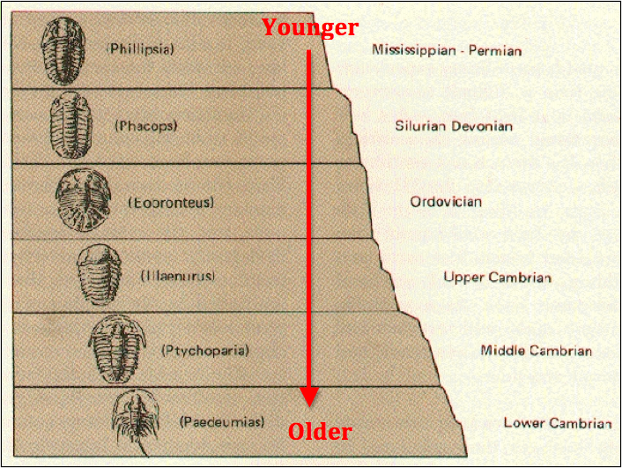
IMAGES FROM: https://calaski.files.wordpress.com/2014/01/screen-shot-2014-01-15-at-10-56-13-am.png https://www.scienceabc.com/wp-content/uploads/2018/07/carbon-reaction-1.jpg
Evolution is supported by scientific evidence from many disciplines including fossil records. What are some ways fossils can be dated?
Determining the age of the
rocks where a fossil is found
The rate of decay of isotopes including carbon-14
EVO-1.M.1 Evolution is supported by scientific evidence from many disciplines (geographical, geological, physical, biochemical, and mathematical data).
EVO-1.N.1 Molecular, morphological, and genetic evidence from extant and extinct organisms adds to our understanding of evolution—
a. Fossils can be dated by a variety of methods. These include:
i. The age of the rocks where a fossil is found
ii. The rate of decay of isotopes including carbon-14

Slide 102
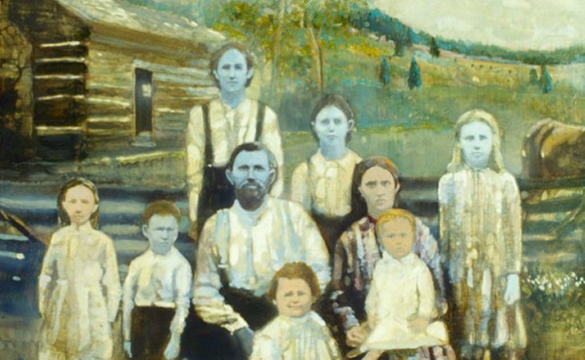
http://www.messagetoeagle.com/wp-content/uploads/2019/03/bluepeopleofkentucky.jpg
The clan of “blue people” in Kentucky you learned about are descended from an immigrant who carried the allele for a mutant form of hemoglobin and settled in the area which has little contact with the outside. This is an example a kind of genetic drift called _________ effect.
founder
EVO-1.H.1 Evolution is also driven by random occurrences—
b. Genetic drift is a nonselective process occurring in small populations—
ii. Founder effect.

Slide 103
https://www.fusd1.org/site/handlers/filedownload.ashx?moduleinstanceid=7815&dataid=30441&FileName=AP%20Biology%20Evolution%20Review%20Slides.pdf
1 indicates the character is present 0 indicates the character is NOT present
out-group
The ____________ represents the lineage that is least closely related to the remainder of the organisms in the phylogenetic tree or cladogram.
These data suggest that the ____________ is the outgroup of these organisms.
Lancet Lamprey Tuna Salamander Turtle Leopard Dolphin
JUSTIFY your answer
The out-group is the lineage that shares the fewest characteristics with the other groups. The Lancet data shows zeros for all of the characteristics considered. Zeros mean the characteristic is not present. All the other groups share at least one characteristic with another group (shown as 1 in the table)
EVO-3.B.1 Phylogenetic trees and cladograms show evolutionary relationships among lineages—
b. Traits that are either gained or lost during evolution can be used to construct phylogenetic trees and cladograms— iii. The out-group represents the lineage that is least closely related to the remainder of the organisms in the phylogenetic tree or cladogram
SP 6A. Make a scientific claim.
SP 6B Support a claim with evidence from biological principles, concepts, processes, and/or data
SP 6C. Provide reasoning to justify a claim by connecting evidence to biological theories

Slide 104
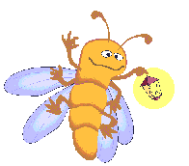
http://www.dwm.ks.edu.tw/bio/activelearner/19/ch19summary.htm http://www.webweaver.nu/clipart/insects2.shtml
Male fireflies of one species signal females of the same species by blinking their lights in a specific pattern. Other firefly species have different patterns.
This is an example of a _____ zygotic reproductive barrier called ______________ isolation
pre
Behavioral
EVO-3.D.1 Speciation may occur when two populations become reproductively isolated from each other.
EVO-3.F.2 Speciation may be sympatric or allopatric.
EVO-3.F.3 Various prezygotic and postzygotic mechanisms can maintain reproductive isolation and prevent gene flow between populations

Slide 105
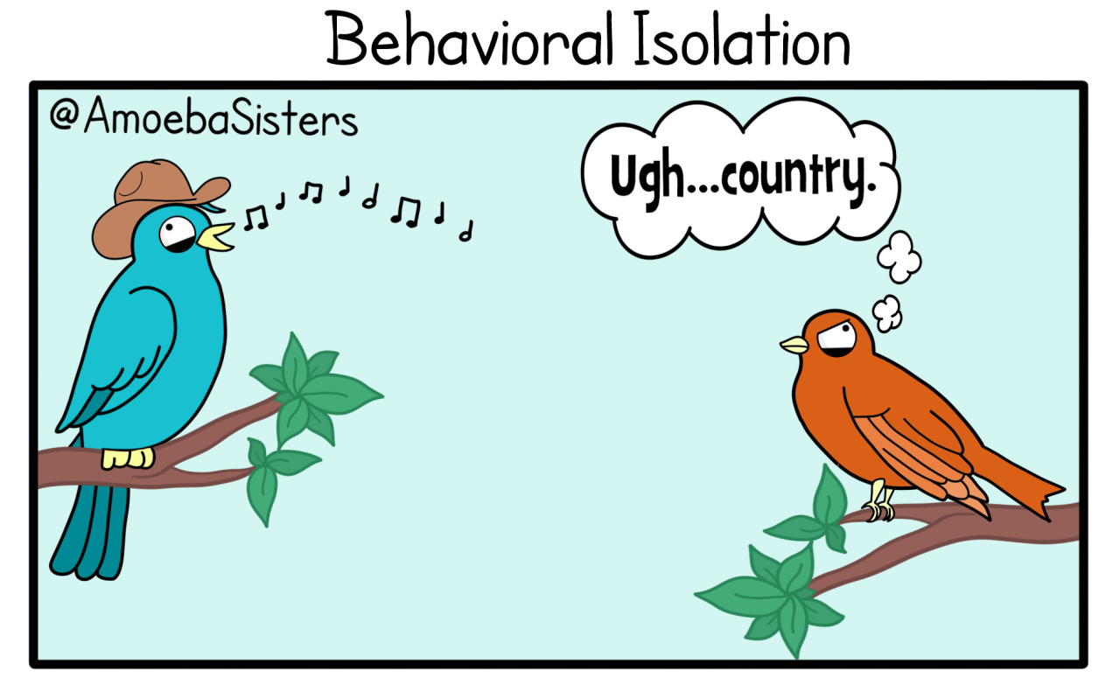
TAKE A STUDY BREAK
http://amoebasisters.tumblr.com/post/126009643342/oh-hey-its-a-golgi-gif-protein-delivery

Slide 106
Kind of genetic drift in which a population is drastically reduced in size often due to
environmental disaster, the hunting of a species to the point of extinction, or habitat destruction which results in a new population with little genetic diversity
Bottleneck effect
Kind of genetic drift in which a few individuals become isolated from a larger population and establish a new population whose gene pool is different from the parent population
Founder effect
EVO-1.H.1 Evolution is also driven by random occurrences—
a. Mutation is a random process that contributes to evolution.
b. Genetic drift is a nonselective process occurring in small populations—
i. Bottlenecks.
ii. Founder effect.

Slide 107
http://www.germanna.edu/wp-content/uploads/tutoring/handouts/Hardy-Weinberg-Equilibrium.pdf
Petal coloration of pea plants has a complete dominance relationship where purple petals are dominant over white petals. There are 276 plants, 273 have purple petals. Find: the frequency of the dominant and recessive alleles and the frequency of individuals with the homozygous dominant, heterozygous, and homozygous recessive genotype.
The next generation of pea plants has 552 plants, 546 have purple petals. Is the population in Hardy-Weinberg Equilibrium? Solve for p and q.
Homozygous recessive genotype = 𝑞² = 3/276 = 0.01
Recessive allele = q = √ 0.01 = 0.1
Dominant allele = p = 1- 0.1 = 0.9
Homozygous dominant genotype = p² = (0.9)2 = 0.81
Heterozygous genotype = 2pq = 2 (0.1) (0.9) = 0.18
𝑞2 = 6/552 = 0.01
q = √0.01 = 0.1
p = 1- 0.1 = 0.9
YES, the population is in a state of Hardy-Weinberg Equilibrium because the allele frequencies are the same as the preceding generation. .
EVO-1.K.2 Allele frequencies in a population can be calculated from genotype frequencies
EVO-1.L.1 Changes in allele frequencies provide evidence for the occurrence of evolution in a population.
SP 5 A. Perform mathematical calculations including: a. Mathematical equations in the curriculum

Slide 108
Concept that each living species has descended with changes from other species over time
Descent with Modifications
Idea that organisms that are best suited to their environment will survive and reproduce
Adaptive radiation is another term for ________ evolution
Survival of the Fittest
divergent
VOCAB
EVO-1.C.2 According to Darwin’s theory of natural selection, competition for limited resources results in differential survival. Individuals with more favorable phenotypes are more likely to survive and produce more offspring, thus passing traits to subsequent generations
EVO-3.E.2 Divergent evolution occurs when adaptation to new habitats results in phenotypic diversification. Speciation rates can be especially rapid during times of adaptive radiation as new habitats become available

Slide 109
WHAT’s the DIFFERENCE BETWEEN: Gene Flow and Genetic Drift?

Slide 110
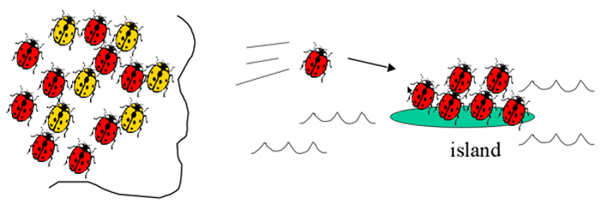
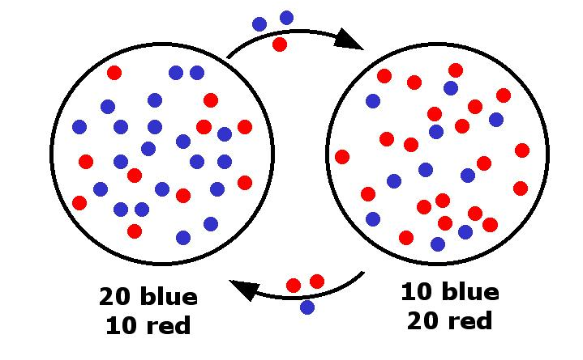
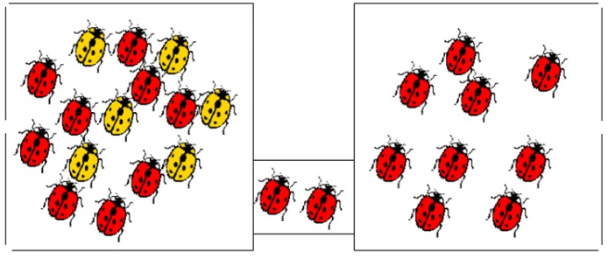
http://larryfrolich.com/Evolution/NaturalSelection/founder.jpg
http://biology.gsu.edu/houghton/2107%20'08/Figures/Chapter22/bottleneck.jpg
http://www.umbc.edu/bioclass/biol100/powerpoints/lecture10/img034.jpg
GENETIC DRIFT vs GENE FLOW
DUE TO RANDOM CHANCE
MOVEMENT for a reason Ex: Migration to find food
Start a new population
Founder effect- individuals move to new place
Bottlenecks – population size is reduced due to catastrophic event; Surviving population has different allele frequency
Migration of alleles or genes from one existing population to another.
EVO-1.H.1 Evolution is also driven by random occurrences—
b. Genetic drift is a nonselective process occurring in small populations—
i. Bottlenecks. ii. Founder effect.
c. Migration/gene flow can drive evolution.

Slide 111
MICHIGAN | q2 | q | p | p² | 2pq
 | 0.0009 | .03 | 0.97 | 0.94 | 0.058
Following are the data that were actually collected in Wisconsin. Perform a
chi-square test on these data. Can you accept the hypothesis that the allele frequency is the same in Wisconsin as in Michigan? Use the chi-square table below to interpret your results. Give degrees of freedom and p values.
WISCONSIN | AA | Aa | aa | TOTAL
OBSERVED | 2346 | 150 | 4 | 2500
EXPECTED |  |  |  | 2500
0.94 x 2500 =
2350
0.058x2500 =
145
0.0009x2500 =
2
Χ² =Σ
(o – e)² = (2346-2350)² + (150-145)² + (4-2)² = 0.007 + .172 + 2.0 = 2.18
e 2350 145 2
In Hardy-Weinberg chi-square analysis, the number of degrees of freedom is equal to the number of genotypes minus the number of alleles. (Once a value for q is determined, there is no freedom for choosing the value for p.)
Degrees of freedom = 3-2=1
The Chi square value of 2.18 is less than the p value of 3.84 Fail to reject the null hypothesis. There is no significant difference
between the allele frequencies in the two populations.
EVO-1.K.2 Allele frequencies in a population can be calculated from genotype frequencies
EVO-1.L.1 Changes in allele frequencies provide evidence for the occurrence of evolution in a population.
SP 5 A. Perform mathematical calculations including: a. Mathematical equations in the curriculum

Slide 112
GIVE AN EXAMPLE OF A PHYSICAL ADAPTATION
Webbed feet, horns, antlers,
claws, feathers, wings, camouflage,
. . . . there are a million
GIVE AN EXAMPLE OF A BEHAVIORAL ADAPTATION
Nocturnal (coming out at night);
Flying south for the winter, living in herds,
“wagon train” defense; burrowing; hibernation
EVO-1.C.2 According to Darwin’s theory of natural selection, competition for limited resources results in differential survival. Individuals with more favorable phenotypes are more likely to survive and produce more offspring, thus passing traits to subsequent generations

Slide 113
FROM: http://serranohighschoolapbiology.weebly.com/uploads/6/7/9/9/6799747/ap_biology_evolution_unit_practice_test_1.pdf
Over evolutionary time, many cave–dwelling organisms have lost their eyes. Tapeworms have lost their digestive systems. Whales have lost their hind limbs. How can natural selection account for these losses?
A) Natural selection cannot account for losses, only for innovations.
B) Natural selection accounts for these losses by the principle of use and disuse.
C) Under particular circumstances that persisted for long periods, each of these structures presented greater costs than benefits.
D) The ancestors of these organisms experienced harmful mutations that forced them to find new habitats that these species had not previously used.
SYI-3.D.1 The level of variation in a population affects population dynamics
c. Alleles that are adaptive in one environmental condition may be deleterious in another because of different selective pressures
EVO-1.E.3 Some phenotypic variations significantly increase or decrease fitness of the organism in particular environments.

Slide 114
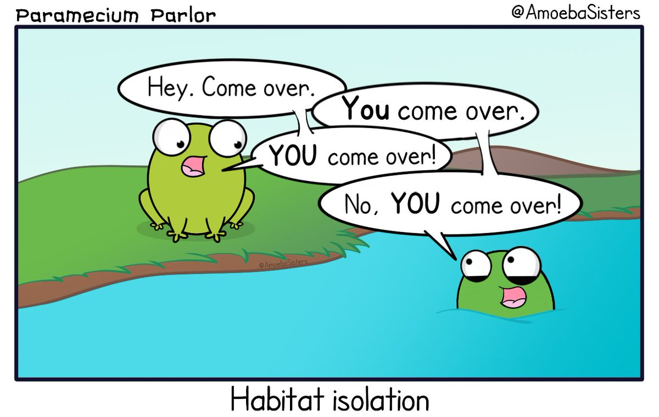
TAKE A STUDY BREAK
Amoeba Sisters Twitter feed

Slide 115
FROM: http://serranohighschoolapbiology.weebly.com/uploads/6/7/9/9/6799747/ap_biology_evolution_unit_practice_test_1.pdf
Blue light is that portion of the visible spectrum that penetrates the deepest into bodies of water. Ultraviolet (UV) light, though, can penetrate even deeper. A gene within a population of marine fish that inhabits depths from 500 m to 1,000 m has an allele for a photopigment that is sensitive to UV light, and another allele for a photopigment that is sensitive to blue light. Which of the following graphs best depicts the predicted distribution of these alleles within a population if the fish that carry these alleles prefer to locate themselves where they can see best?
EVO-1.C.2 According to Darwin’s theory of natural selection, competition for limited resources results in differential survival. Individuals with more favorable phenotypes are more likely to survive and produce more offspring, thus passing traits to subsequent generations
EVO-1.E.2 Environments change and apply selective pressures to populations.
EVO-1.E.3 Some phenotypic variations significantly increase or decrease fitness of the organism in particular environments.
.

Slide 116
Sample MC questions from 2015 Course and Exam Description Book posted on College Board website
https://secure-media.collegeboard.org/digitalServices/pdf/ap/ap-biology-course-and-exam-description.pdf
Experimental evidence shows that the process of glycolysis is present and virtually identical in organisms from all three domains, Archaea, Bacteria, and Eukarya. Which of the following hypothesis could be best supported by this evidence?
A) All organisms carry out glycolysis in mitochondria.
B) Glycolysis is a universal energy-releasing process and therefore suggests a common ancestor for all forms of life.
C) Across the three domains, all organisms depend solely on the process of
anaerobic respiration for ATP –production.
D) The presence of glycolysis as an energy-releasing process in all organisms suggests that convergent evolution occurred.
EVO-2.B.1 Many fundamental molecular and cellular features and processes are conserved across organisms.
EVO-2.B.2 Structural and functional evidence supports the relatedness of organisms in all domains

Slide 117
Sample MC questions from 2015 Course and Exam Description Book posted on College Board website
https://secure-media.collegeboard.org/digitalServices/pdf/ap/ap-biology-course-and-exam-description.pdf
Five new species of bacteria were discovered in Antarctic ice core samples. The nucleotide (base) sequences of rRNA subunits were determined for the new species. The table below shows the number of nucleotide differences between the species.
Which of the following phylogenetic trees is
most consistent with the data?
EVO-3.C.1 Phylogenetic trees and cladograms can be used to illustrate speciation that has occurred. The nodes on a tree represent the most recent common ancestor of any two groups or lineages.
EVO-3.C.2 Phylogenetic trees and cladograms can be constructed from morphological similarities of living or fossil species and from DNA and protein sequence similarities.
EVO-3.B.1 b. Traits that are either gained or lost during evolution can be used to construct phylogenetic trees and cladograms—
i. Shared characters are present in more than one lineage.
ii. Shared, derived characters indicate common ancestry and are informative for the construction of phylogenetic trees and cladograms. iii. The out-group represents the lineage that is least closely related to the remainder of the organisms in the phylogenetic tree or cladogram.

Slide 118
Images from BIOLOGY by Miller and Levine; Prentice Hall Publishing©2006
Which of these patterns is most likely to lead to SPECIATION?
EVO-3.D.1 Speciation may occur when two populations become reproductively isolated from each other
EVO-1.I.1 Reduction of genetic variation within a given population can increase the differences between populations of the same species
EVO-1.K.2 Allele frequencies in a population can be calculated from genotype frequencies
ILLUSTRATIVE EXAMPLE Graphical analysis of allele frequencies in a population
.

Slide 119
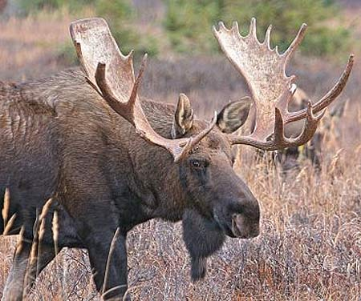
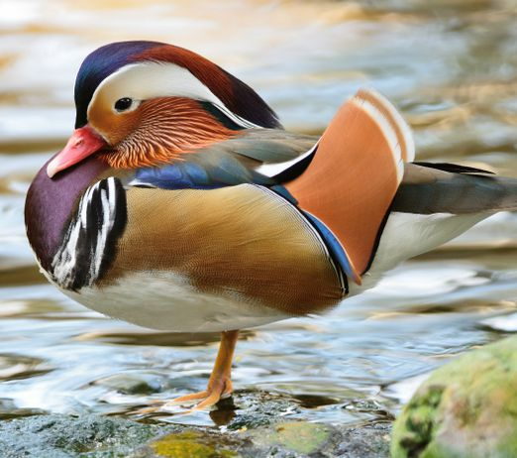
https://qph.fs.quor http://www.factzoo.com/sites/all/img/mammals/moose/big-antlers-moose.jpg
https://pm1.narvii.com/6140/209441a83dd1f3a43867ab5f4ae9af8840ef2260_hq.jpg
https://media.mnn.com/assets/images/2016/02/dimorphism-mandarinducks.jpg.990x0_q80_crop-smart.jpg
In many organisms males are often more brightly colored or endowed with conspicuous ornamentation compared to females, but the long plumage of male peacocks and birds of paradise and the enormous antlers of male deer are cumbersome and make these animals more visible to predators and so more likely to be eaten. Since natural selection does not favor the evolution of disadvantageous traits. How did Darwin explain the persistence of these kinds of traits in populations?
The fittest organisms are not those that live the longest but those that leave the greatest number of offspring. The individual males with traits that attract females are more likely to reproduce and leave more offspring even if they have shorter lives.
EVO-1.D.1 Evolutionary fitness is measured by reproductive success.
EVO-1.E.1 Natural selection acts on phenotypic variations in populations.
EVO-1.E.3 Some phenotypic variations significantly increase or decrease fitness of the organism in particular environments
SP 1. C Explain biological concepts, processes, and/or models in applied contexts.

Slide 120
Whales and wolves share a common ancestor, but have evolved to look very different.
This is an example of
a) convergent evolution b) divergent evolution c) punctuated equilibrium d) inheritance of acquired traits
EVO-3.E.2 Divergent evolution occurs when adaptation to new habitats results in phenotypic diversification. Speciation rates can be especially rapid during times of adaptive radiation as new habitats become available
EVO 3.A.1 Populations of organisms continue to evolve.
EVO-3.A.2 All species have evolved and continue to evolve—

Slide 121
FROM: http://serranohighschoolapbiology.weebly.com/uploads/6/7/9/9/6799747/ap_biology_evolution_unit_practice_test_1.pdf
A proficient engineer can easily design skeletal structures that are more functional than those currently found in the forelimbs of such diverse mammals as horses, whales, and bats. The actual forelimbs of these mammals do not seem to be optimally arranged because
natural selection has not had sufficient time to create the optimal design in each case,
but will do so given enough time.
B) in many cases, phenotype is not merely determined by genotype, but by the environment as well.
C) though we may not consider the fit between the current skeletal arrangements and their functions excellent, we should not doubt that natural selection ultimately produces the best design.
D) natural selection is generally limited to modifying structures that were present in previous generations and in previous species.
.
EVO-1.C.1 Natural selection is a major mechanism of evolution.
EVO-1.E.1 Natural selection acts on phenotypic variations in populations.

Slide 122
FROM: http://serranohighschoolapbiology.weebly.com/uploads/6/7/9/9/6799747/ap_biology_evolution_unit_practice_test_1.pdf
Over evolutionary time, many cave–dwelling organisms have lost their eyes. Tapeworms have lost their digestive systems. Whales have lost their hind limbs. How can natural selection account for these losses?
Natural selection cannot account for losses, only for innovations.
Natural selection accounts for these losses by the principle of use and disuse.
C) Under particular circumstances that persisted for long periods, each of these structures presented greater costs than benefits.
D) The ancestors of these organisms experienced harmful mutations that forced them to find new habitats which these species had not previously used
EVO-1.E.2 Environments change and apply selective pressures to populations.
EVO-1.E.3 Some phenotypic variations significantly increase or decrease fitness of the organism in particular environments.
EVO-1.D.2 Biotic and abiotic environments can be more or less stable/fluctuating, and this affects the rate and direction of evolution; different genetic variations can be selected in each generation
SYI-3.D.1 The level of variation in a population affects population dynamics— c. Alleles that are adaptive in one environmental condition may be deleterious in another because of different selective pressures

Slide 123
http://www.germanna.edu/wp-content/uploads/tutoring/handouts/Hardy-Weinberg-Equilibrium.pdf
Rabbit’s ears can be either short or floppy, where short ears are dominant over floppy ears. There are 653 individuals in a population. 104 rabbits have floppy ears and 549 have short ears. Find: the frequency of the dominant and recessive alleles and the frequency of individuals with homozygous dominant, heterozygous, and homozygous recessive genotypes.
The next generation of rabbits has 560 individuals with short ears and 840 individuals with floppy ears. Is the population in Hardy-Weinberg Equilibrium? Solve for p and q.
Homozygous recessive genotype = 𝑞² = 104/653 = 0.16
Recessive allele = q = √ 0.16 = 0.4
Dominant allele = p = 1- 0.4 = 0.6
Homozygous dominant genotype = p² = (0.6)2 = 0.36
Heterozygous genotype = 2pq = 2 (0.6) (0.4) = 0.48
𝑞2 = 840/1400 = 0.6
q = √0.6 = 0.77
p = 1- 0.77 = 0.23
No, the population is not in a state of Hardy-Weinberg Equilibrium because the allele frequencies are not the same as the preceding generation. .
EVO-1.K.2 Allele frequencies in a population can be calculated from genotype frequencies
EVO-1.L.1 Changes in allele frequencies provide evidence for the occurrence of evolution in a population.
SP 5 A. Perform mathematical calculations including: a. Mathematical equations in the curriculum

Slide 124
2015 Released Course and Exam Description (CED)
A group of students summarized
information on five great extinction
events. The students are sampling a
site in search of fossils from the
Devonian period. Based on the chart,
which of the following would be the
most reasonable plan for the students
to follow?
A. Searching horizontal rock layers in any class of rock and trying to find those that contain the greatest number of fossils.
B. Collecting fossils from rock layers deposited prior to the Permian period that contain some early vertebrate bones.
C. Looking in sedimentary layers next to bodies of water in order to find marine fossils of bivalves and trilobites.
D. Using relative dating techniques to determine the geological ages of the fossils found so they can calculate the rate of speciation of early organisms.
EVO 3.A.1 Populations of organisms continue to evolve.
EVO-3.A.2 All species have evolved and continue to evolve—
b. Continuous change in the fossil record.
EVO-3.G.1 Extinctions have occurred throughout Earth’s history.

Slide 125
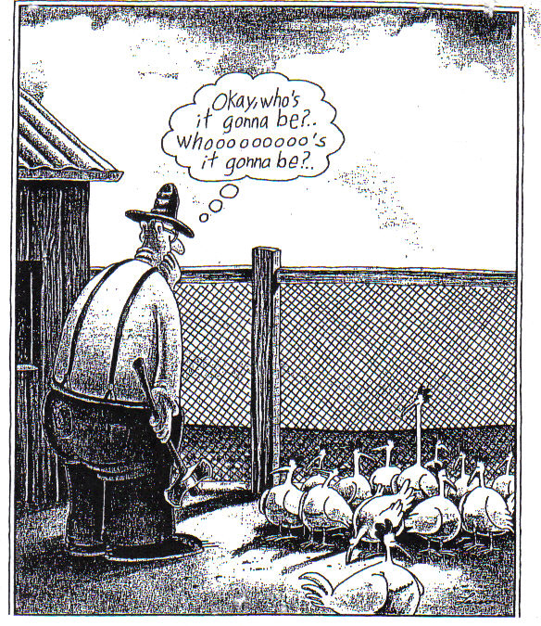
TAKE A STUDY BREAK

Slide 126
https://www.ponderweasel.com/wp-content/uploads/2015/07/difference-donkey-horse-mule.jpg
When horses and donkeys mate, their mule offspring are generally strong but unable to reproduce.
This is an example of
a. gametic isolation
b. hybrid inviability
c. hybrid sterility
d. allopatric speciation
EVO-3.D.1 Speciation may occur when two populations become reproductively isolated from each other.
EVO-3.F.3 Various prezygotic and postzygotic mechanisms can maintain reproductive isolation and prevent gene flow between populations

Slide 127
Tell two sources of genetic variation in populations
Mutations
caused by mistakes in copying DNA caused by radiation
or environmental chemicals
Gene shuffling during meiosis
crossing over
independent assortment
IST 1.H.1 Explain how the process of meiosis generates genetic diversity
IST 4.A.1 b. Mutations are the primary source of genetic variation.
EVO-1.J.1 Mutation results in genetic variation, which provides phenotypes on which natural selection acts

Slide 128
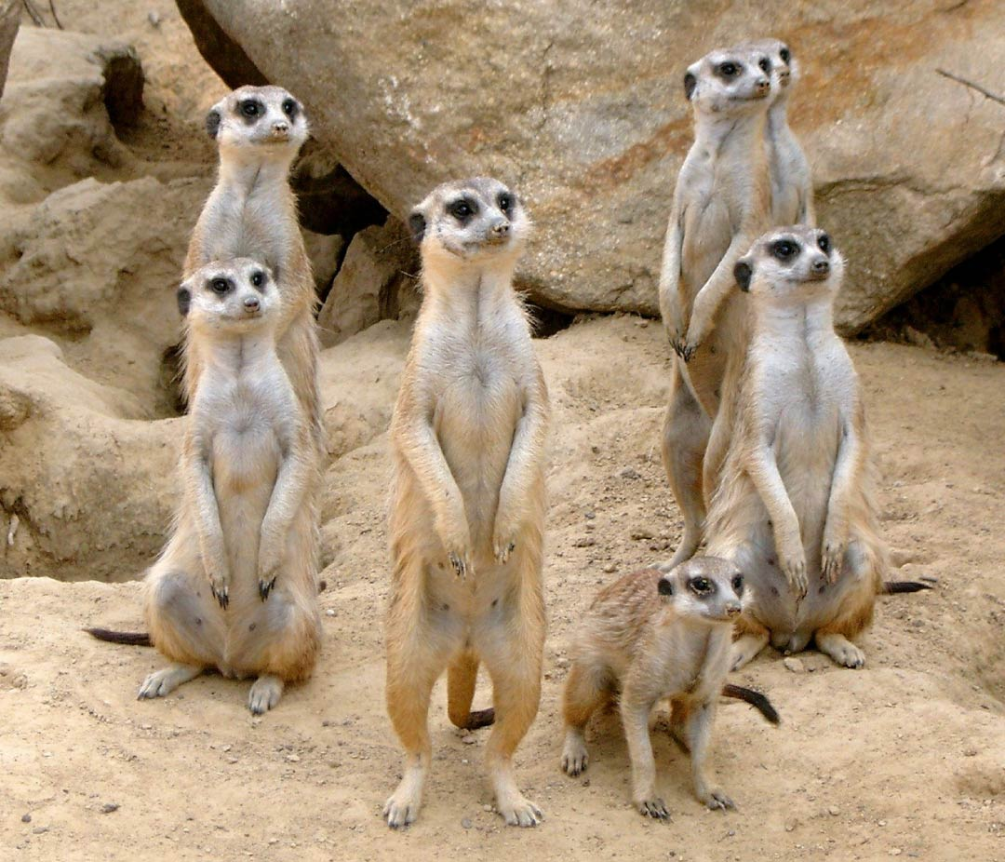
https://www.activewild.com/wp-content/uploads/2019/02/meerkat-colony.jpg
The meerkat is a carnivorous mammal that lives in family groups of 20 to 50 individuals. They forage together, use teamwork to repel predators, and are often seen grooming one another. They will even tend to an injured member of the colony. While the group is outside, one or more meerkats will act as a sentry, and call to warn others of approaching danger. Studies have shown the calls occur most frequently when the caller had relatives nearby. This evolutionary strategy that favors the reproductive success of an organism's relatives, even at a cost to the organism's own survival and reproduction is called ______ selection.
KIN
EVO-1.C.1 Natural selection is a major mechanism of evolution.
EVO-1.C.2 According to Darwin’s theory of natural selection, competition for limited resources results in differential survival. Individuals with more favorable phenotypes are more likely to survive and produce more offspring, thus passing traits to subsequent generations
EVO-1.D.1 Evolutionary fitness is measured by reproductive success.
IST-5.A.3 Responses to information and communication of information are vital to natural selection and evolution— a. Natural selection favors innate and learned behaviors that increase survival and reproductive fitness.
b. Cooperative behavior tends to increase the fitness of the individual and the survival of the population.
ILLUSTRATIVE EXAMPLES: § Predator warning § Kin selection

Slide 129
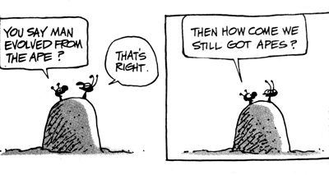
http://4.bp.blogspot.com/_pfm-EJqqL6I/TTkzSgpbTKI/AAAAAAAABVA/Qp55g7MLAUI/s1600/Evolution+-+Why+still+apes.gif
https://matthewbonnan.files.wordpress.com/2012/05/stick-evolution.jpg
COMMON MISCONCEPTION
Explain the misunderstanding about evolution depicted in this cartoon.
Humans didn’t turn into apes or vice versa. Evolution doesn’t work that way! Modern apes are not our ancestors, they are our cousins. We share a common ancestor with modern apes, but that doesn’t mean we evolved from them.
See a 2 min video Why are there
still Monkeys?
EVO-1.C.2 According to Darwin’s theory of natural selection, competition for limited resources results in differential survival. Individuals with more favorable phenotypes are more likely to survive and produce more offspring, thus passing traits to subsequent generations
SP 1.B Explain biological concepts and/or processes.
SP 1. C Explain biological concepts, processes, and/or models in applied contexts.

Slide 130
FROM: http://serranohighschoolapbiology.weebly.com/uploads/6/7/9/9/6799747/ap_biology_evolution_unit_practice_test_1.pdf
The diagram above shows an outcrop of sedimentary rock whose strata are labeled A–D.
If x indicates the location of fossils of two closely related species, then fossils of their most-recent common ancestor are most likely to occur in which stratum?
A B C D
EVO-1.M.1 Evolution is supported by scientific evidence from many disciplines (geographical, geological, physical, biochemical, and mathematical data).
EVO-1.N.1 Molecular, morphological, and genetic evidence from extant and extinct organisms adds to our understanding of evolution—
a. Fossils can be dated by a variety of methods. These include:
i. The age of the rocks where a fossil is found
EVO-3.A.2 All species have evolved and continue to evolve—
b. Continuous change in the fossil record.

Slide 131
FROM: http://serranohighschoolapbiology.weebly.com/uploads/6/7/9/9/6799747/ap_biology_evolution_unit_practice_test_1.pdf
Which of the following is a true statement concerning genetic variation?
A) It is created by the direct action of natural selection.
B) It arises in response to changes in the environment.
C) It must be present in a population before natural selection can act upon the population.
D) It tends to be reduced by the processes involved when diploid organisms produce gametes.
E) A population that has a higher average heterozygosity has less genetic variation than one with a lower average heterozygosity
EVO-1.E.1 Natural selection acts on phenotypic variations in populations.
EVO-1.J.1 Mutation results in genetic variation, which provides phenotypes on which natural selection acts

Slide 132
FROM: http://serranohighschoolapbiology.weebly.com/uploads/6/7/9/9/6799747/ap_biology_evolution_unit_practice_test_1.pdf
Certain proteins of the complex motor that drives bacterial flagella are modified versions of proteins that had previously belonged to plasma membrane pumps. This evidence supports the claim that
A) some structures are so complex that natural selection cannot, and will not, explain their origins. B) the power of natural selection allows it to act in an almost predictive fashion, producing organs that will be needed in future environments. C) the motors of bacterial flagella were originally synthesized abiotically. D) natural selection can produce new structures by coupling together parts of other structures. E) bacteria that possess flagella must have lost the ability to pump certain chemicals across their plasma membranes.
EVO-2.B.1 Many fundamental molecular and cellular features and processes are conserved across organisms.
EVO-2.B.2 Structural and functional evidence supports the relatedness of organisms in all domains EVO-2.C.1 Structural evidence indicates common ancestry of all eukaryotes—
.

Slide 133
Image from: http://68.media.tumblr.com/tumblr_m467vffaOR1r4zy85o1_1280.jpg
TRANSITIONAL
Tiktaalik is called a ______________ fossil because it shares characteristics from two different types of animals (amphibians and fish).
Why are fossils like these
important in providing evidence for evolution?
Transitional fossils exhibit traits common to both an ancestral group and its derived descendant group. They show the evolutionary steps between species.
EVO-1.M.1 Evolution is supported by scientific evidence from many disciplines (geographical, geological, physical, biochemical, and mathematical data).
EVO-1.N.1 Molecular, morphological, and genetic evidence from extant and extinct organisms adds to our understanding of evolution—
EVO-2.B.2 Structural and functional evidence supports the relatedness of organisms in all domains
EVO-3.A.2 All species have evolved and continue to evolve—
b. Continuous change in the fossil record.
SP 1.B Explain biological concepts and/or processes.
SP 1. C Explain biological concepts, processes, and/or models in applied contexts.

Slide 134
FROM: http://serranohighschoolapbiology.weebly.com/uploads/6/7/9/9/6799747/ap_biology_evolution_unit_practice_test_1.pdf
Which species is most closely related to species W?
V is most closely related to species W.
B) X is most closely related to species W.
C) Y and Z are equally closely related to W.
D) It is not possible to say from this tree.
.
EVO-3.C.1 Phylogenetic trees and cladograms can be used to illustrate speciation that has occurred. The nodes on a tree represent the most recent common ancestor of any two groups or lineages.
EVO-3.C.2 Phylogenetic trees and cladograms can be constructed from morphological similarities of living or fossil species and from DNA and protein sequence similarities.

Slide 135
A change in relative frequency of alleles in a population
evolution
Membrane-bound organelles, linear chromosomes, and genes that contain introns all indicate ___________ share a common ancestry.
eukaryotes
prokaryotes eukaryotes
EVO-1.L.1 Changes in allele frequencies provide evidence for the occurrence of evolution in a population EVO-2.B.1 Many fundamental molecular and cellular features and processes are conserved across organisms. EVO-2.B.2 Structural and functional evidence supports the relatedness of organisms in all domains EVO-2.C.1 Structural evidence indicates common ancestry of all eukaryotes— a. Membrane-bound organelles b. Linear chromosomes c. Genes that contain introns

Slide 136
https://create.kahoot.it/details/review-for-ap-bio-evolution-test-2018/c0f621ad-6518-43a9-a8f9-4872c97ad743
DNA from a human and chimpanzee is 99% the same.
This means a) all organisms have similar DNA
b) humans evolved from chimpanzees
c) chimpanzees evolved from humans
d) humans and chimpanzees are closely related
EVO-1.M.1 Evolution is supported by scientific evidence from many disciplines (geographical, geological, physical, biochemical, and mathematical data).
EVO-3.A.2 All species have evolved and continue to evolve—
a Genomic changes over time.
EVO-1.N.2 A comparison of DNA nucleotide sequences and/or protein amino acid sequences provides evidence for evolution and common ancestry
EVO-2.B.1 Many fundamental molecular and cellular features and processes are conserved across organisms.
EVO-2.B.2 Structural and functional evidence supports the relatedness of organisms in all domains

Slide 137
TAKE A STUDY BREAK

Slide 138
FROM: http://serranohighschoolapbiology.weebly.com/uploads/6/7/9/9/6799747/ap_biology_evolution_unit_practice_test_1.pdf
If Darwin had been aware of genes, and of their typical mode of transmission to subsequent generations, with which statement would he most likely have been in agreement?
A) If natural selection can change one gene's frequency in a population over the course of generations then, given enough time and enough genes, natural selection can cause sufficient genetic change to produce new species from old ones.
B) If an individual's somatic cell genes change during its lifetime, making it more fit, then it will be able to pass these genes on to its offspring.
C) If an individual acquires new genes by engulfing, or being infected by, another organism, then a new genetic species will be the result.
D) A single mutation in a single gene in a single gamete will, if perpetuated, produce a new species within just two generations
.
EVO-1.C.1 Natural selection is a major mechanism of evolution.
EVO-1.C.2 According to Darwin’s theory of natural selection, competition for limited resources results in differential survival. Individuals with more favorable phenotypes are more likely to survive and produce more offspring, thus passing traits to subsequent generations

Slide 139
FROM: http://serranohighschoolapbiology.weebly.com/uploads/6/7/9/9/6799747/ap_biology_evolution_unit_practice_test_1.pdf
The upper forelimbs of humans and bats have fairly similar skeletal structures, whereas the corresponding bones in whales have very different shapes and proportions. However, genetic data suggest that all three kinds of organisms diverged from a common ancestor at about the same time. Which of the following is the most likely explanation for these data?
A) Humans and bats evolved by natural selection, and whales evolved by Lamarckian mechanisms.
B) Forelimb evolution was adaptive in people and bats, but not in whales.
C) Natural selection in an aquatic environment resulted in significant changes to whale forelimb anatomy.
D) Genes mutate faster in whales than in humans or bats.
E) Whales are not properly classified as mammals.
EVO-1.D.2 Biotic and abiotic environments can be more or less stable/fluctuating, and this affects the rate and direction of evolution; different genetic variations can be selected in each generation
EVO-1.E.2 Environments change and apply selective pressures to populations.
EVO-1.E.3 Some phenotypic variations significantly increase or decrease fitness of the organism in particular environments.
.

Slide 140
https://www.biologyexams4u.com/2012/12/how-to-solve-hardy-weinberg-equilibrium.html#.Xt7IHDpKjIU
In a plant species, the ability to grow in soil contaminated with nickel is determined by a dominant allele. If 60% of the seeds in a randomly mating population are able to germinate in contaminated soil, what is the frequency of the nickel resistance allele?
q2 = 0.4
q = √0.4 = 0.63
p = 1- 0.63 = 0.37 = frequency of dominant allele
What is the frequency of plants that are homozygous dominant?
What is the frequency of plants that are heterozygous?
p² = (0.37)² = 0.14 = frequency of homozygous dominant plants
2pq = 2 (0.37) (0.63) = 0.47 = frequency of heterozygous plants
EVO-1.K.2 Allele frequencies in a population can be calculated from genotype frequencies
SP 5 A. Perform mathematical calculations including: a. Mathematical equations in the curriculum

Slide 141
http://animalwise.files.wordpress.com/2011/09/convergent-evolution-marine-all-about-reptiles-com.gif
Process by which unrelated organisms independently evolve similarities when adapting to similar environments
Convergent evolution
EVO-1.G.1 Convergent evolution occurs when similar selective pressures result in similar phenotypic adaptations in different populations or species.

Slide 142
Modified from: https://quizlet.com/169562643/biology-chapter-22-multiple-choice-flash-cards/
Which one of the following statements about mass extinctions is FALSE? A. The five major mass extinctions were all followed by a rebound in species diversity. B. By definition, in mass extinctions all major groups are affected equally. C. Extinction provides newly available niches that can then be exploited by different species.
D. The five major mass extinctions were caused mainly by geological events.
EVO-3.G.1 Extinctions have occurred throughout Earth’s history.
EVO-3.I.1 The amount of diversity in an ecosystem can be determined by the rate of speciation and the rate of extinction.
EVO-3.J.1 Extinction provides newly available niches that can then be exploited by different species.

Slide 143
FROM: http://serranohighschoolapbiology.weebly.com/uploads/6/7/9/9/6799747/ap_biology_evolution_unit_practice_test_1.pdf
Which of the following is NOT an observation or inference on which natural selection is based?
A) There is heritable variation among individuals.
B) Poorly adapted individuals never produce offspring.
C) Species produce more offspring than the environment can support.
D) Individuals whose characteristics are best suited to the environment generally leave more offspring than those whose characteristics are less well suited.
E) Only a fraction of an individual's offspring may survive.
.
EVO-1.C.2 According to Darwin’s theory of natural selection, competition for limited resources results in differential survival. Individuals with more favorable phenotypes are more likely to survive and produce more offspring, thus passing traits to subsequent generations
EVO-1.D.1 Evolutionary fitness is measured by reproductive success.

Slide 144
http://www.serranohighschoolapbiology.weebly.com/uploads/6/7/9/9/6799747/ap_biology_evolution_unit_practice_test_1.pdf
If the bacterium Staphylococcus aureus experiences a cost for maintaining one or more antibiotic–resistance genes, then what should happen in environments from which antibiotics are missing?
A. These genes should continue to be maintained in case the antibiotics ever appear.
B. These bacteria should be outcompeted and replaced by bacteria that have lost these genes.
C) The bacteria should try to make the cost worthwhile by locating, and migrating to, microenvironments where traces of antibiotics are present.
D) The bacteria should start making and secreting their own antibiotics.
SYI-3.D.1 The level of variation in a population affects population dynamics c. Alleles that are adaptive in one environmental condition may be deleterious in another because of different selective pressures
EVO-1.E.3 Some phenotypic variations significantly increase or decrease fitness of the organism in particular environments.

Slide 145
FROM: http://serranohighschoolapbiology.weebly.com/uploads/6/7/9/9/6799747/ap_biology_evolution_unit_practice_test_1.pdf
Over time, the movement of people on Earth has steadily increased. This has altered the course of human evolution by increasing
A) nonrandom mating.
B) geographic isolation.
C) genetic drift.
D) gene flow.
.
EVO-1.H.1 Evolution is also driven by random occurrences—
c. Migration/gene flow can drive evolution.

Slide 146
Modified from: https://teachers.stjohns.k12.fl.us/lyons-s/files/2014/11/AP-Evolution-Practice-Test-2.pd
Image from: https://evolutionisntscience.files.wordpress.com/2009/05/evolutionhorse.gif?w=510
Fossil evidence indicates that horses have gradually increased in size over geologic time. Which of the following terms best describes this?
A. artificial selection
B. directional selection
C. stabilizing selection D. disruptive selection E. sexual selection
IST 4.A.1 b. Mutations are the primary source of genetic variation
EVO-1.J.1 Mutation results in genetic variation, which provides phenotypes on which natural selection acts

Slide 147
FROM: http://serranohighschoolapbiology.weebly.com/uploads/6/7/9/9/6799747/ap_biology_evolution_unit_practice_test_1.pdf
In the United States, the parasite that causes malaria is not present, but African–Americans whose ancestors were from equatorial Africa are present. What should be happening to the sickle–cell allele in the United States, and what should be happening to it in equatorial Africa?
stabilizing selection; disruptive selection
B) disruptive selection; stabilizing selection
C) disruptive selection; directional selection
D) directional selection; disruptive selection
E) directional selection; stabilizing selection
SYI-3.D.1 The level of variation in a population affects population dynamics— c. Alleles that are adaptive in one environmental condition may be deleterious in another because of different selective pressures. EVO-1.E.3 Some phenotypic variations significantly increase or decrease fitness of the organism in particular environments. ILLUSTRATIVE EXAMPLES § Sickle cell anemia
.

Slide 148
http://goldiesroom.org/AP%20Biology/AP%20Review%20pdf/AP%20Review%20-%20EVOLUTION%20v2015.pdf Image from https://cdn.hswstatic.com/gif/dinosaur-images-130-resize.jpg
The sudden disappearance of the dinosaurs some 65 mya may have been the result of
Earth's collision with a large meteorite.
B) slow climate changes due to planetary cooling.
C) competition from better-adapted organisms.
D) the rise of birds and mammals.
EVO-3.G.1 Extinctions have occurred throughout Earth’s history.
EVO-3. G.2 Extinction rates can be rapid during times of ecological stress. EVO-3.J.1 Extinction provides newly available niches that can then be exploited by different species.

Slide 149
https://www.varsitytutors.com/ap_biology-help/understanding-biological-fitness?page=2
Recently a nursing home had an increase in the number of Staph infections. Doctors began treating the infections with methicillin, but within a few months over 75% of infections were resisting this treatment. What is the most likely cause of this phenomenon?
A new patient brought a methicillin-resistant strain of the bacteria to the nursing home.
A small number of bacteria were resistant to methicillin from the start. These bacteria survived treatment with methicillin and reproduced, eventually comprising most of the bacteria.
The bacteria built up an immunity to methicillin over time.
Some bacteria were able to survive treatment by changing the structure of their membrane to keep methicillin from penetrating it.
EVO 3.A.1 Populations of organisms continue to evolve.
EVO-3.A.2 All species have evolved and continue to evolve—
a. Genomic changes over time.
c. Evolution of resistance to antibiotics, pesticides, herbicides, or chemotherapy drugs.

Slide 150
TAKE A STUDY BREAK
https://www.pinterest.com/pin/50313720817119447/

Slide 151
http://larryfrolich.com/Evolution/NaturalSelection/founder.jpg
http://biology.gsu.edu/houghton/2107%20'08/Figures/Chapter22/bottleneck.jpg
The change in a gene pool that is NOT due to natural selection but due to random chance is called _____________________
Genetic drift has the greatest affect on populations that are ________
Give example of a kind of genetic drift
GENETIC DRIFT
SMALL
LARGE SMALL
Founder effect
Bottleneck effect
EVO-1.L.2 Small populations are more susceptible to random environmental impact than large populations.
EVO-1.H.1 Evolution is also driven by random occurrences—
a. Mutation is a random process that contributes to evolution.
b. Genetic drift is a nonselective process occurring in small populations—
i. Bottlenecks.
ii. Founder effect.
c. Migration/gene flow can drive evolution.

Slide 152
From Released 2013 AP BIOLOGY Practice Exam
Undersea landslides can disrupt marine habitats by burying organisms that live on the ocean floor. The graph above shows the size of a population of a certain organism that lives on the ocean floor. The population was affected by a recent landslide at the time indicated on the graph. Which of the following best predicts how the population will be affected by the landslide?
A) The surviving organisms will evolve into a new species.
B) The reduced populations will likely have allelic frequencies that are different from the initial population
C) The population will adapt to deeper waters to avoid future landslides.
D) The reduced population will have a greater number of different genes that the initial population.
EVO-1.H.1 Evolution is also driven by random occurrences—. b. Genetic drift is a nonselective process occurring in small populations— i. Bottlenecks.
SYI-3.D.1 The level of variation in a population affects population dynamics— a. Population ability to respond to changes in the environment is influenced by genetic diversity. Species and populations with little genetic diversity are at risk of decline or extinction.
.

Slide 153
What happens in the Bottleneck Effect?
A. certain alleles are over represented due to chance
B. recessive alleles are masked
C. heterozygous alleles disappear
D. few individuals colonize an isolated area
All of the following are homologous structures EXCEPT
A . human arm
B. bat wing
C. penguin flipper
D . butterfly wing
EVO-1.H.1 Evolution is also driven by random occurrences—
b. Genetic drift is a nonselective process occurring in small populations—
i. Bottlenecks.
EVO-1.N.1 Molecular, morphological, and genetic evidence from extant and extinct organisms adds to our understanding of evolution—
b. Morphological homologies, including vestigial structures, represent features shared by common ancestry.

Slide 154
Which of the following appears earliest in the fossil record?
A. mammals
B. reptiles
C. birds
D . amphibians
E. fish
The ultimate source of all genetic variation is
A. natural selection
B. genetic drift
C. mutations
D. the environment
E. sexual recombination
IST 4.A.1 b. Mutations are the primary source of genetic variation.

Slide 155
MODIFIED FROM: https://www.varsitytutors.com/ap_biology-help/understanding-biological-fitness?page=2
In an ecosystem, factors such as food supply, climate, and predator population are known as which of the following?
A. Survival of the fittest
B. Inheritance of Acquired Traits
C. Mendel’s Law of Segregation
D. Selective pressures E. Evolutionary catalysts
.
EVO-1.E.2 Environments change and apply selective pressures to populations.

Slide 156
FROM: http://serranohighschoolapbiology.weebly.com/uploads/6/7/9/9/6799747/ap_biology_evolution_unit_practice_test_1.pdf
Natural selection is based on all of the following except
A) genetic variation exists within populations.
B) the best–adapted individuals tend to leave the most offspring.
C) individuals who survive longer tend to leave more offspring than those who
die young.
D) populations tend to produce more individuals than the environment can support.
E) individuals adapt to their environments and, thereby, evolve.
Populations evolve. . . NOT INDIVIDUALS!
EVO 3.A.1 Populations of organisms continue to evolve EVO-1.C.1 Natural selection is a major mechanism of evolution.
EVO-1.C.2 According to Darwin’s theory of natural selection, competition for limited resources results in differential survival. Individuals with more favorable phenotypes are more likely to survive and produce more offspring, thus passing traits to subsequent generations
EVO-1.D.1 Evolutionary fitness is measured by reproductive success. EVO-1.E.1 Natural selection acts on phenotypic variations in populations.
EVO-1.E.2 Environments change and apply selective pressures to populations.
EVO-1.E.3 Some phenotypic variations significantly increase or decrease fitness of the organism in particular environments.
.

Slide 157
FROM: http://serranohighschoolapbiology.weebly.com/uploads/6/7/9/9/6799747/ap_biology_evolution_unit_practice_test_1.pdf
The rise of methicillin–resistant Staphylococcus aureus (MRSA) can be considered to be an example of artificial selection because
humans purposefully raise MRSA in large fermenters in an attempt to make the bacteria ever–more resistant.
S. aureus is cultivated by humans to replenish the soil with nutrients.
humans synthesize methicillin and create environments in which bacteria frequently come into contact with methicillin.
D) Humans are becoming resistant to bacteria by taking methicillin
EVO-1.F.1 Through artificial selection, humans affect variation in other species
EVO-3.A.2 All species have evolved and continue to evolve—
c. Evolution of resistance to antibiotics, pesticides, herbicides, or chemotherapy drugs.
d. Pathogens evolve and cause emergent diseases.

Slide 158
FROM: https://www.highschooltestprep.com/ap/biology/unit-7-practice-test/
It is hypothesized that eukaryotic features evolved from prokaryotic cells when smaller prokaryotic cells, the precursors of mitochondria and plastids, began living within larger cells. This model is referred to as:
A. Endosymbiosis
B. Adaptive radiation
C. simple metabolism
D. The Cambrian explosion
EVO-1.A.1 Membrane-bound organelles evolved from once free-living prokaryotic cells via endosymbiosis.
EVO-1.B.1 Membrane-bound organelles evolved from previously free-living prokaryotic cells via endosymbiosis.

Slide 159
http://academic.brooklyn.cuny.edu/biology/bio4fv/page/cell-movement.html Diagram modified by Kelly Riedell
The Endosymbiotic theory suggest which 2 organelles evolved via serial endocytosis of existing prokaryotes by an early eukaryotic cell?
Mitochondria & chloroplasts
Scientific theories are supported by evidence. Give some examples of evidence that supports the idea that mitochondria have prokaryotic ancestors.
Mitochondria reproduce independently of nucleus using binary fission like bacteria
Mitochondrial chromosome is circular like bacterial chromosomes.
Mitochondria are surrounded by a double membrane: cristae corresponds to original bacterial membrane and contains phospholipids like bacterial plasma membranes; outer mitochondrial membrane corresponds to endosymbiotic vesicle and has phospholipids like cell plasma membrane
ETC proteins are located in bacterial plasma membranes and cristae membranes in eukaryotes
If you need a refresher watch this video
EVO-1.B Describe the relationship between the functions of endosymbiotic organelles and their free-living ancestral counterparts.
EVO-1.B.1 Membrane-bound organelles evolved from previously free-living prokaryotic cells via endosymbiosis.
SP 6.B Support a claim with evidence from biological principles, concepts, processes, and/or data.

Slide 160
https://akm-img-a-in.tosshub.com/indiatoday/images/story/201811/baby_chimp_humans_smile_alike_0-647x363.jpeg?8mxCEdXjDsWfEWHYC_xtxL6uXotcZjAo
Humans and chimpanzees share 98.6% of their DNA. In fact most of their proteins (Ex: hemoglobin beta chain) are exactly identical. How is it possible for these 2 organisms to look so different if their DNA is so alike?
The differences are predominately due to differences in the regulation of genes rather than to differences in the sequence of the genes themselves. Most of the big differences between human and chimpanzee DNA lie in regions near genes that control how gene-coding regions are “turned on” and "turned off." The timing and duration of gene expression are responsible for the differences.
IST 2.A.3 The phenotype of a cell or organism is determined by the combination of genes that are expressed and the levels at which they are expressed—
IST 2.D.1 Gene regulation results in differential gene expression and influences cell products and function.
SP 1.B Explain biological concepts and/or processes.
SP 1. C Explain biological concepts, processes, and/or models in applied contexts.

Slide 161
2013 Released AP BIOLOGY Practice Exam
Data regarding the presence (+) or absence (-) of five derived traits in several different species are shown in this table.
Which of the following cladograms provides the simplest and most accurate representation of the data in the table?
EVO-3.B.1 Phylogenetic trees and cladograms show evolutionary relationships among lineages—
b. Traits that are either gained or lost during evolution can be used to construct phylogenetic trees and cladograms—
iii. The out-group represents the lineage that is least closely related to the remainder of the organisms in the phylogenetic tree or cladogram.
c. Molecular data typically provide more accurate and reliable evidence than morphological traits in the construction of phylogenetic trees or cladograms.
EVO-3.C.1 Phylogenetic trees and cladograms can be used to illustrate speciation that has occurred. The nodes on a tree represent the most recent common ancestor of any two groups or lineages.
EVO-3.C.2 Phylogenetic trees and cladograms can be constructed from morphological similarities of living or fossil species and from DNA and protein sequence similarities.
EVO-3.C.3 Phylogenetic trees and cladograms represent hypotheses and are constantly being revised, based on evidence
.

Slide 162
FROM: http://serranohighschoolapbiology.weebly.com/uploads/6/7/9/9/6799747/ap_biology_evolution_unit_practice_test_1.pdf
Logically, which of these should cast the most doubt on the relationships depicted by an evolutionary tree?
A) None of the organisms depicted by the tree ate the same foods.
B) Some of the organisms depicted by the tree had lived in different habitats.
C) The skeletal remains of the organisms depicted by the tree were incomplete (in other words, some bones were missing).
D) Transitional fossils had not been found.
E) Relationships between DNA sequences among the species did not match relationships between skeletal patterns.
EVO-3.B.1 Phylogenetic trees and cladograms show evolutionary relationships among lineages—
c. Molecular data typically provide more accurate and reliable evidence than morphological traits in the construction of phylogenetic trees or cladograms.

Slide 163
Image from BIOLOGY by Miller and Levine; Prentice Hall Publishing©2006
Name the type of selection shown in the diagram below.
Directional selection
EVO-1.E.1 Natural selection acts on phenotypic variations in populations.
EVO-1.E.2 Environments change and apply selective pressures to populations.
EVO-1.E.3 Some phenotypic variations significantly increase or decrease fitness of the organism in particular environments
EVO-1.K.2 Allele frequencies in a population can be calculated from genotype frequencies
ILLUSTRATIVE EXAMPLE Graphical analysis of allele frequencies in a population

Slide 164
TAKE A STUDY BREAK
http://www.quantamagazine.org/wp-content/uploads/2014/01/BacteriaComic-01_clear.png

Slide 165
http://ksuweb.kennesaw.edu/~jdirnber/Bio2108/Lecture/LecPhylogeny/25-11-Cladogram-AL.jpg
https://sciencenotes.files.wordpress.com/2008/05/monotreme_cladogram.jpg
Phylogenetic trees and cladograms both represent a hypothesis about actual evolutionary history and show relationships between lineages. How are these different?
Cladograms represent a hypothesis about evolutionary history, but the branch lengths DO NOT represent evolutionary time.
In phylogenetic trees the branch lengths represent evolutionary time calibrated by fossils or a molecular clock.
EVO-3.B.1 Phylogenetic trees and cladograms show evolutionary relationships among lineages—
Phylogenetic trees and cladograms both show relationships between lineages, but phylogenetic trees show the amount of change over time calibrated by fossils or a molecular clock.
SP 1.B Explain biological concepts and/or processes.
SP 1. C Explain biological concepts, processes, and/or models in applied contexts.

Slide 166
Sickle cell anemia is the result of a single base-pair mutation in DNA. Individuals that are homozygous for the sickle cell allele have painful episodes that occur when sickle-shaped red blood cells (RBCs) block blood vessels. Blood and oxygen cannot get to your tissues, causing pain. A sickle cell crisis can also damage tissues and cause liver or kidney failure. However, individuals who are heterozygous for the sickle cell allele are resistant to a disease that claims the lives of millions of people worldwide. Name this disease
malaria
The increased survival of an individual that is heterozygous for a deleterious genetic trait helps to maintain the allele in the population. This is called
heterozygote advantage
SYI-3.D.1 The level of variation in a population affects population dynamics
c. Alleles that are adaptive in one environmental condition may be deleterious in another because of different selective pressures
EVO-1.E.3 Some phenotypic variations significantly increase or decrease fitness of the organism in particular environments.
ILLUSTRATIVE EXAMPLES § Sickle cell anemia

Slide 167
FROM: http://serranohighschoolapbiology.weebly.com/uploads/6/7/9/9/6799747/ap_biology_evolution_unit_practice_test_1.pdf
Certain proteins of the complex motor that drives bacterial flagella are modified versions of proteins that had previously belonged to plasma membrane pumps. This evidence supports the claim that
A) some structures are so complex that natural selection cannot, and will not, explain their origins.
B) the power of natural selection allows it to act in an almost predictive fashion, producing organs that will be needed in future environments.
C) the motors of bacterial flagella were originally synthesized abiotically
D) natural selection can produce new structures by coupling together parts of other structures.
E) bacteria that possess flagella must have lost the ability to pump certain chemicals across their plasma membranes.
.
EVO-2.B.1 Many fundamental molecular and cellular features and processes are conserved across organisms.
EVO-2.B.2 Structural and functional evidence supports the relatedness of organisms in all domains

Slide 168
FROM: http://serranohighschoolapbiology.weebly.com/uploads/6/7/9/9/6799747/ap_biology_evolution_unit_practice_test_1.pdf
Evolutionary trees such as this are
properly understood by scientists
to be
A) theories.
B) hypotheses.
C) guesses.
D) dogmas.
E) facts.
.
EVO-3.C.3 Phylogenetic trees and cladograms represent hypotheses and are constantly being revised, based on evidence

Slide 169
WHAT’s the DIFFERENCE BETWEEN: FOUNDER EFFECT
and BOTTLENECK EFFECT?

Slide 170
http://larryfrolich.com/Evolution/NaturalSelection/founder.jpg
http://biology.gsu.edu/houghton/2107%20'08/Figures/Chapter22/bottleneck.jpg
FOUNDER EFFECT vs BOTTLENECK EFFECT
Changes in gene pool NOT due to natural selection
~ Due to random chance ~ Start a new population
When disaster strikes an ecosystem and most individuals in population die suddenly, allele frequencies in population change drastically
Small group colonizes a new habitat New population has different allele frequency than original population
FOUNDER EFFECT:
BOTTLENECK EFFECT
EVO-1.H.1 Evolution is also driven by random occurrences—
b. Genetic drift is a nonselective process occurring in small populations—
i. Bottlenecks.
ii. Founder effect.
c. Migration/gene flow can drive evolution.

Slide 171
A species that has died out is called __________
A species that is still living is called __________
EXTINCT
EXTANT
TRUE or FALSE: These two diagrams show the same evolutionary relationships between organisms.
When considering phylogenetic trees, what matters is the pattern of common ancestry. This means that you can rotate the branches around any node without changing the tree relationships.
VOCAB
EVO-1.N.1 Molecular, morphological, and genetic evidence from extant and extinct organisms adds to our understanding of evolution
EVO-3.B.1 Phylogenetic trees and cladograms show evolutionary relationships among lineages b. Traits that are either gained or lost during evolution can be used to construct phylogenetic trees and cladograms
ii. Shared, derived characters indicate common ancestry and are informative for the construction of phylogenetic trees and cladograms

Slide 172
Modified from: 2013 Released AP BIOLOGY Practice Exam
Tik-taalik image from: https://vignette.wikia.nocookie.net/fossil/images/2/2b/Tiktaalik_roseae_life_restor.jpg/revision/latest?cb=20090317153919
Fossils of lobe finned fishes, which are ancestors of amphibians, are found in rocks that are at least 380 million years old. Fossils of the oldest amphibian like vertebrate animals with true legs and lungs are found in rocks that are approximately 363 million years old. Which of the following samples of rocks might contain fossils of a transitional species between lobe-finned fishes and amphibians?
A) 350 million years old
B) 370 million years old
C) 390 million years old
JUSTIFY YOUR ANSWER
Transitional fossils would be found during the time
between when amphibians appeared (363 MYA)
and when lobe-finned fishes lived (380 MYA)
Tik-taalik is a transitional fossil between lobe-finned fish and amphibians.
What evidence from a transitional fossil like Tik-taalik can support the hypothesis that amphibians evolved from lobe-finned fishes?
Transitional fossils would have traits from both lobe-finned fish or amphibians
Bones or specific skeletal structures
legs/limbs/digits
flat skulls
vertebrae
ribs (interlocking)
flexible neck
Other homologous structures
Scales
Teeth
Found in same area/environment as lobe-finned fish/amphibians
Molecular DNA comparison
.
EVO-1.N.1 Molecular, morphological, and genetic evidence from extant and extinct organisms adds to our understanding of evolution
b. Morphological homologies, including vestigial structures, represent features shared by common ancestry.
EVO-1.N.2 A comparison of DNA nucleotide sequences and/or protein amino acid sequences provides evidence for evolution and common ancestry

Slide 173
FROM: http://serranohighschoolapbiology.weebly.com/uploads/6/7/9/9/6799747/ap_biology_evolution_unit_practice_test_1.pdf
How many separate species, both extant and extinct, are depicted in this tree?
A) two
B) three
C) four
D) five
E) six
EVO-3.B.1 Phylogenetic trees and cladograms show evolutionary relationships among lineages—
b. Traits that are either gained or lost during evolution can be used to construct phylogenetic trees and cladograms—
i. Shared characters are present in more than one lineage.
ii. Shared, derived characters indicate common ancestry and are informative for the construction of phylogenetic trees and cladograms. iii. The out-group represents the lineage that is least closely related to the remainder of the organisms in the phylogenetic tree or cladogram.
EVO-3.C.1 Phylogenetic trees and cladograms can be used to illustrate speciation that has occurred. The nodes on a tree represent the most recent common ancestor of any two groups or lineages.
EVO-3.C.2 Phylogenetic trees and cladograms can be constructed from morphological similarities of living or fossil species and from DNA and protein sequence similarities.
EVO-3.C.3 Phylogenetic trees and cladograms represent hypotheses and are constantly being revised, based on evidence
.

Slide 174
Sample MC questions from 2015 Course and Exam Description Book posted on College Board website
https://secure-media.collegeboard.org/digitalServices/pdf/ap/ap-biology-course-and-exam-description.pdf
In a hypothetical population of beetles, there is a wide variety of color, matching the range of coloration of the tree trunks on which the beetles hide from predators. The graphs below illustrate four possible changes to the beetle population as a result of a change in the environment due to pollution that darkened the tree trunks.
(A) The coloration range shifted toward more light-colored beetles (diagram I). The pollution helped the predators find the darkened tree trunks.
(B) The coloration in the population split into two extremes (diagram II) Both the lighter-colored & darker-colored beetles were able to hide on the darker tree trunks.
(C) The coloration range became narrower (diagram III) The predators selected beetles at the color extremes.
(D) The coloration in the population shifted toward more darker- colored beetles (diagram 1V) The lighter-colored beetles were found more easily by the predators than were the darker-colored beetles.
Which of the following includes the most likely change in the coloration of the beetle population after pollution and a correct rationale for the change?
EVO-1.E.2 Environments change and apply selective pressures to populations.
EVO-1.E.3 Some phenotypic variations significantly increase or decrease fitness of the organism in particular environments.

Slide 175
FROM: http://serranohighschoolapbiology.weebly.com/uploads/6/7/9/9/6799747/ap_biology_evolution_unit_practice_test_1.pdf
Which of the five common ancestors, labeled V–Z, has given rise to the greatest number of species, both extant and extinct?
A) V
B)W
C) Z
D) Both W and Z can be considered to have given rise to the greatest number of extant and extinct species.
E) Both X and Y can be considered to have given rise to the greatest number of extant and extinct species.
EVO-3.B.1 Phylogenetic trees and cladograms show evolutionary relationships among lineages—
a. Phylogenetic trees and cladograms both show relationships between lineages, but phylogenetic trees show the amount of change over time calibrated by fossils or a molecular clock.
b. Traits that are either gained or lost during evolution can be used to construct phylogenetic trees and cladograms—
i. Shared characters are present in more than one lineage.
ii. Shared, derived characters indicate common ancestry and are informative for the construction of phylogenetic trees and cladograms. iii. The out-group represents the lineage that is least closely related to the remainder of the organisms in the phylogenetic tree or cladogram.
EVO-3.C.1 Phylogenetic trees and cladograms can be used to illustrate speciation that has occurred. The nodes on a tree represent the most recent common ancestor of any two groups or lineages.
EVO-3.C.2 Phylogenetic trees and cladograms can be constructed from morphological similarities of living or fossil species and from DNA and protein sequence similarities.
EVO-3.C.3 Phylogenetic trees and cladograms represent hypotheses and are constantly being revised, based on evidence
.

Slide 176
WHICH PATTERN IS IT?
coevolution adaptive radiation divergent evolution
punctuated equilibrium mass extinction
Horse evolution shows long stable periods
of little evolution interrupted by brief
periods of rapid change
Punctuated equilibrium
Biology by Miller and Levine Pearson Publishing

Slide 177
From Released 2015 Course and Exam Description (CED)
Experimental evidence shows that the process of glycolysis is present and virtually identical in organisms from all three domains, Archaea, Bacteria, and Eukarya. Which of the following hypotheses could be best supported by this evidence?
A) All organisms carry out glycolysis in mitochondria.
B) Glycolysis is a universal energy-releasing process and therefore suggests a common ancestor for all forms of life.
C) Across the three domains, all organisms depend solely on t he process of anaerobic respiration for ATP production.
D) The presence of glycolysis as an energy-releasing process in all organisms suggests that convergent evolution occurred.
.
EVO-2.B.1 Many fundamental molecular and cellular features and processes are conserved across organisms.
EVO-2.B.2 Structural and functional evidence supports the relatedness of organisms in all domains

Slide 178
http://rjfisherjoanides.pbworks.com/f/1299793099/061%20Bird%20feet.jpg
The pattern of evolution that explains how birds have evolved so many different kinds of feet that are adapted to many different environments is _______________ evolution. A. convergent B. divergent
C. coevolution
EVO-1.E.1 Natural selection acts on phenotypic variations in populations.
.EVO-1.E.2 Environments change and apply selective pressures to populations.
EVO-1.E.3 Some phenotypic variations significantly increase or decrease fitness of the organism in particular environments
EVO-3.E.2 Divergent evolution occurs when adaptation to new habitats results in phenotypic diversification. Speciation rates can be especially rapid during times of adaptive radiation as new habitats become available

Slide 179
Which of the following increases the likelihood that a deleterious recessive allele will be maintained in the gene pool of a population?
A. polyploidy
B. death of homozygous recessive individuals
C. heterozygote advantage
D. genetic drift
E. interspecies mating
Members of the same population
A. share a common gene pool
B. cannot interbreed under natural conditions
C. share the same genotype
D. are in reproductive isolation from one another
SYI-3.D.1 The level of variation in a population affects population dynamics c. Alleles that are adaptive in one environmental condition may be deleterious in another because of different selective pressures. EVO-1.E.3 Some phenotypic variations significantly increase or decrease fitness of the organism in particular environments.
ILLUSTRATIVE EXAMPLES § Sickle cell anemia

Slide 180
TAKE A STUDY BREAK
http://www.cartoonstock.com/newscartoons/cartoonists/rbr/lowres/rbrn15l.jpg

Slide 181
Process by which related organisms evolve differences when they are isolated in different environments
Divergent evolution
During times of adaptive radiation as new habitats become available, speciation rates can be especially
_______
rapid
slow rapid
EVO-3.E.2 Divergent evolution occurs when adaptation to new habitats results in phenotypic diversification. Speciation rates can be especially rapid during times of adaptive radiation as new habitats become available

Slide 182
CONVERGENT EVOLUTION DIVERGENT EVOLUTION COEVOLUTION PUNCTUATED EQUILIBRIUM
Bees can see blue and yellow and ultra-violet, but not red. Flowers pollinated by bees are mainly colored blue and yellow with ultra-violet nectar guides (landing patterns) on their petals and flowers shaped to fit the tongue-length of the species of bee that pollinates them.
Whales, sharks, and penguins all have streamlined bodies and fins/flipper for moving in water even though they belong in different animal groups (mammals, fish, and birds)
A desert kit fox has large ears with greater surface area to prevent overheating. The red fox lives in the forest and has a coat color that keeps it camouflaged.
Cardinal flowers have a shape and length that matches a hummingbird’s beak. As the birds feed their foreheads bump against the pollen structures allowing them to fertilize the flowers.
Fish in the ocean surrounding Antarctica survive cold water by making a molecule that circulates the blood and keeps it from freezing. Certain kinds of worms that live in the Arctic ocean also make antifreeze proteins that help them live in icy water.
One species of coral-like sea organisms called bryozoans first appeared about 140 million years ago and remained unchanged for its first 40 million years. Then there was an explosion of diversification, followed by another period of stability for vast amounts of time.
Coevolution
Convergent evolution
Divergent evolution
Coevolution
Convergent evolution
Punctuated
Equilibrium
EVO-1.G.1 Convergent evolution occurs when similar selective pressures result in similar phenotypic adaptations in different populations or species.
EVO-3.E.1 Punctuated equilibrium is when evolution occurs rapidly after a long period of stasis. Gradualism is when evolution occurs slowly over hundreds of thousands or millions of years.
EVO-3.E.2 Divergent evolution occurs when adaptation to new habitats results in phenotypic diversification. Speciation rates can be especially rapid during times of adaptive radiation as new habitats become available

Slide 183
FROM: http://serranohighschoolapbiology.weebly.com/uploads/6/7/9/9/6799747/ap_biology_evolution_unit_practice_test_1.pdf
According to the concept of punctuated equilibrium, the "sudden" appearance of a new species in the fossil record means that
the species is now extinct.
B) speciation occurred instantaneously.
C) speciation occurred in one generation.
D) speciation occurred rapidly in geologic time.
E) the species will consequently have a relatively short existence, compared with other species.
EVO-3.E.1 Punctuated equilibrium is when evolution occurs rapidly after a long period of stasis. Gradualism is when evolution occurs slowly over hundreds of thousands or millions of years.
EVO-3.E.2 Divergent evolution occurs when adaptation to new habitats results in phenotypic diversification. Speciation rates can be especially rapid during times of adaptive radiation as new habitats become available
.

Slide 184
Measuring lima beans and finding beans come in different sizes is an example of __________________ in the population.
natural variation
Mutations
____________ are the primary source of this genetic variation in populations.
EVO-1.C.2 According to Darwin’s theory of natural selection, competition for limited resources results in differential survival. Individuals with more favorable phenotypes are more likely to survive and produce more offspring, thus passing traits to subsequent generations
IST 4.A.1 b. Mutations are the primary source of genetic variation.
EVO-1.J.1 Mutation results in genetic variation, which provides phenotypes on which natural selection acts

Slide 185
Which of the following is true about evolution.
Evolution is a theory about the origin of life
B) Evolution results in progress; organisms are always getting better through evolution.
C) Evolutionary theory implies that life evolved randomly or by chance.
D) Reduction of genetic variation within a given population can increase the differences between populations of the same species
EVO-1.H.1 Evolution is also driven by random occurrences— a. Mutation is a random process that contributes to evolution.
EVO-1.I.1 Reduction of genetic variation within a given population can increase the differences between populations of the same species
EVO-1.C.1 Natural selection is a major mechanism of evolution.
EVO-3.A.2 All species have evolved and continue to evolve—

Slide 186
Images from: https://whyevolutionistrue.files.wordpress.com/2016/06/pepper_moth2.jpg
BIOLOGY by Miller and Levine; Prentice Hall Publishing©2006
Lighter colored peppered moths were more
common in England prior to the Industrial
revolution. As pollution increased, the darker
colored moths were less likely to be eaten.
Over time darker colored moths become more
abundant in the population. When modern air
pollution standards were put in place and pollution decreased, the frequency of darker moths decreased in the population. These are examples of which graph pattern shown below?
EVO-1.E.1 Natural selection acts on phenotypic variations in populations.
.EVO-1.E.2 Environments change and apply selective pressures to populations.
ILLUSTRATIVE EXAMPLES § Peppered moth
EVO-1.E.3 Some phenotypic variations significantly increase or decrease fitness of the organism in particular environments
EVO-1.K.2 Allele frequencies in a population can be calculated from genotype frequencies
ILLUSTRATIVE EXAMPLE Graphical analysis of allele frequencies in a population

Slide 187
Images from: BIOLOGY by Miller and Levine; Prentice Hall Publishing©2006
All of the following are true EXCEPT:
Mass extinctions
A. open newly available niches and provide opportunities for remaining species
B. are often followed by a burst of evolution resulting
in many new species
C. are never caused by human activity
D. have occurred multiple times throughout Earth’s history
EVO-3.G.1 Extinctions have occurred throughout Earth’s history.
EVO-3. G.2 Extinction rates can be rapid during times of ecological stress.
EVO-3.H.1 Human activity can drive changes in ecosystems that cause extinctions.
EVO-3.J.1 Extinction provides newly available niches that can then be exploited by different species.
.

Slide 188
Which of the following is true about evolution.
Individual organisms can evolve during a single lifespan.
B) Speciation results in diversity of life forms.
C) Evolution only occurs slowly and gradually.
D) Because evolution is slow, humans cannot influence it.
EVO-3.H.1 Human activity can drive changes in ecosystems that cause extinctions.
EVO-3.F.1 Speciation results in diversity of life forms.
EVO-3.E.1 Punctuated equilibrium is when evolution occurs rapidly after a long period of stasis. Gradualism is when evolution occurs slowly over hundreds of thousands or millions of years.
EVO-3.A.2 All species have evolved and continue to evolve—

Slide 189
Sickle cell anemia is the result of a single base-pair mutation in DNA. Individuals that are homozygous for the sickle cell allele have painful episodes that occur when sickle-shaped red blood cells (RBCs) block blood vessels. Blood and oxygen cannot get to your tissues, causing pain. A sickle cell crisis can also damage tissues and cause liver or kidney failure.
This mutation is more common in Americans of African descent. Since individuals with sickle cell are less likely to pass on their genes to offspring explain how the frequency of an allele coding for a deleterious mutant protein like sickle cell can increase over time in a population.
Parents who are heterozygous carriers for the sickle cell allele have a ¼ chance of having a child that is homozygous for sickle cell. This child would have serious medical issues, but there is a ½ chance that their offspring would be heterozygous making them resistant to malaria, a disease that claims the lives of millions of people worldwide. This increases the chance these offspring would survive (heterozygote advantage) in an environment where the malaria parasite is common and pass the allele onto the next generation. So even though the allele is harmful to some, it increases in the population in this environment.
SYI-3.D.1 The level of variation in a population affects population dynamics
c. Alleles that are adaptive in one environmental condition may be deleterious in another because of different selective pressures
EVO-1.E.3 Some phenotypic variations significantly increase or decrease fitness of the organism in particular environments.
ILLUSTRATIVE EXAMPLES § Sickle cell anemia

Slide 190
All of the following are true about the origin of life on Earth EXCEPT
Primitive Earth provided inorganic precursors from which organic molecules could have been synthesized.
Organic molecules could have been transported to Earth by a meteorite or other celestial event.
Living things have always been on Earth since then it formed
D. The presence of available free energy and the absence of a significant quantity of atmospheric oxygen (O₂) provided conditions for the synthesis
of organic molecules like amino acids and nucleotides.
SYI-3.E.1 Several hypotheses about the origin of life on Earth are supported with scientific evidence—
a. Geological evidence provides support for models of the origin of life on Earth.
i. Earth formed approximately 4.6 billion years ago (bya). The environment was too hostile for life until 3.9 bya, and the earliest fossil evidence for life dates to 3.5 bya. Taken together, this evidence provides a plausible range of dates when the origin of life could have occurred.
b. There are several models about the origin of life on Earth—
i. Primitive Earth provided inorganic precursors from which organic molecules could have been synthesized because of the presence of available free energy and the absence of a significant quantity of atmospheric oxygen (O₂).
ii. Organic molecules could have been transported to Earth by a meteorite or other celestial event.

Slide 191
Image from: https://c2.staticflickr.com/8/7120/6904687426_4f5d9edaab_z.jpg
https://www.pbs.org/wgbh/evolution/educators/course/session7/explain_b_pop1.html
In the Heredity and Cell Structure & Function Units you learned about a genetic disorder found more frequently in individuals of Eastern European (Ashkenazi) Jewish descent. This autosomal recessive, neurodegenerative disease is cause by excessive storage and build up of Gm2 ganglioside lipids in the brain leading to mental retardation, blindness and early death.
IDENTIFY THIS DISORDER
Which cell organelle is non-functioning to cause the build up of lipids?
TAY-SACHS
LYSOSOMES
Individuals heterozygous for the Tay-Sachs allele may be protected against tuberculosis (TB). In Ashkenazim populations, up to 11 percent of the people are Tay-Sachs carriers. During World War II, Eastern European Jews were confined to ghettos and deported to concentration camps where TB was rampant. Healthy relatives of children with Tay-Sachs disease did not contact TB, even when repeatedly exposed. The mutant allele increased in frequency as TB selectively killed those who did not carry it and the carriers had children with each other.
When two different versions of a gene are maintained in a population of organisms because individuals carrying both versions are better able to survive than those who have two copies of either version alone it is called a BALANCED _______________
Give another example of a balanced polymorphism you learned about in which heterozygotes individuals have a survival advantage even though they carry a deleterious mutation.
POLYMORPHISM
Sickle Cell disease (protects against malaria) Cystic fibrosis (protects against cholera)
EVO-1.E.3 Some phenotypic variations significantly increase or decrease fitness of the organism in particular environments
SYI-3.C.3 Certain human genetic disorders can be attributed to the inheritance of a single affected or mutated allele or specific chromosomal changes, such as nondisjunction..ILLUSTRATIVE EXAMPLE: Tay-Sachs Sickle Cell

Slide 192
EVOLUTION
2013 Released Practice Exam
2019 #1
SCORING GUIDELINES
Evolutionary advantage
2016 #1 SCORING GUIDELINES
2019 #5
SCORING GUIDELINES
Effect of salinity on alleles in population
Make a cladogram
Mitochondrial DNA
Evolutionary advantage
2016 #3 SCORING GUIDELINES
Evolutionary advantage
2015 #5 SCORING GUIDELINES
2018 #4
SCORING GUIDELINES
Cladograms
Evolutionary advantage
2015 #6 SCORING GUIDELINES
2018 #7
SCORING GUIDELINES
Change in population over time
Fitness cost
2013 #2 SCORING GUIDELINES
Evolution of trait over time
2017 #1
SCORING GUIDELINES
2013 #3 SCORING GUIDELINES
Fitness cost/benefit
Transitional fossils/evidence of evolution
2017 #2 SCORING GUIDELINES
Evolutionary advantage

Slide 193
THE END . . . or is it?

