Slide 1
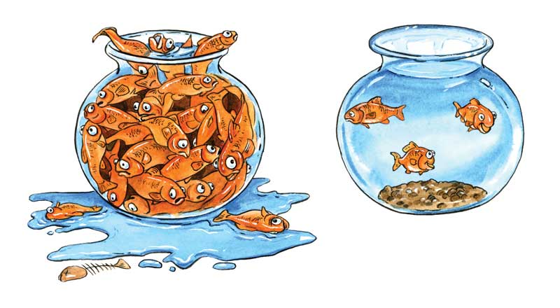
LIMITS TO GROWTH Slide show by Kelly Riedell
Image from: http://smcarthur.com/tecset/wp-content/uploads/2015/08/Carrying-Capacity-Image.jpg
2020 CED ESSENTIAL KNOWLEDGE
SYI-1.G.1 Populations comprise individual organisms that interact with one another and with the environment in complex ways.
SYI-1.H.1 A population can produce a density of individuals that exceeds the system’s resource availability
i. Reproduction without constraints results in the exponential growth of a population. SYI-1.H.2 As limits to growth due to density-dependent and density-independent factors are imposed, a logistic growth model generally ensues.
SYI-2.A.2 The availability of resources can result in uncontrolled population growth and ecological changes.
ENE-4.B.1 Communities change over time depending on interactions between populations.
ENE-1.N.1 Changes in energy availability can result in changes in population size. ENE.1.N.2 Changes in energy availability can result in disruptions to an ecosystem—
a. A change in energy resources such as sunlight can affect the number and size of the trophic levels.
b. A change in the producer level can affect the number and size of other trophic levels.

Slide 2
POPULATION group of individuals of same species living in same area at same time
DENSITY number of individuals per unit area
DISPERSION
pattern of spacing among individuals within the boundaries of the population

Slide 3
https://dr282zn36sxxg.cloudfront.net/datastreams/f-d%3Aa8070d548b03708fe12680a6c88af3ec2d39446c05176c6109d77640%2BIMAGE_THUMB_POSTCARD_TINY%2BIMAGE_THUMB_POSTCARD_TINY.1
PATTERNS OF POPULATION DISTRIBUTION
Organisms are evenly spaced over area Typical of environments in which organisms compete for a scarce resource, like water in a desert.
Organisms have an unpredictable pattern of distribution. Typical of species in which individuals don’t interact strongly.
Organisms are clustered
together in groups. May reflect a patchy distribution of resources in the environment
Most common pattern

Slide 4
https://image.slidesharecdn.com/population-ecology-1231427563650176-1/95/population-ecology-21-728.jpg?cb=1231405987

Slide 5
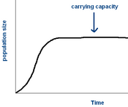
LIMITING FACTOR = factor that controls the growth of a population Acting separately or together, limiting factors determine the carrying capacity of an environment for a species.
https://sophialearning.s3.amazonaws.com/packet_logos/10334/grid/carrying%20cap.bmp?1319138715

Slide 6
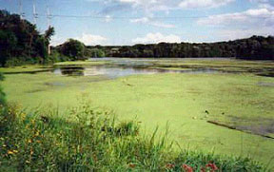
ALGAL BLOOM
REMEMBER !
When an ecosystem receives a LARGE input
of limiting nutrient (ie., fertilizer runoff) the population increases dramatically

Slide 7
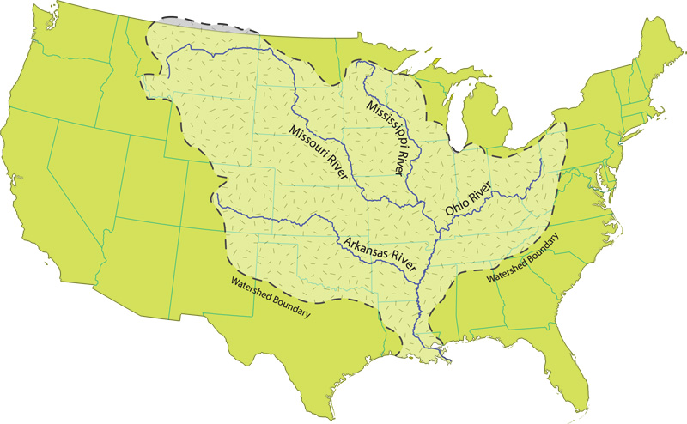
Image from: https://www.nps.gov/miss/learn/photosmultimedia/upload/watershedBG.jpg

Slide 8
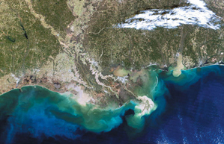
Gulf of Mexico Dead Zone
http://serc.carleton.edu/microbelife/topics/deadzone/index.html
CREATES HYPOXIC (LOW OXYGEN) ZONES At its peak, the nearly lifeless water can span
5,000 to 8,000-plus square miles, an area almost the size of New Jersey

Slide 9
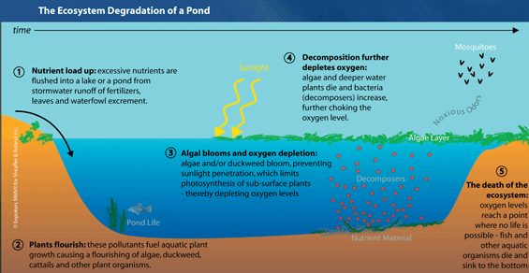
EUTROPHICATION
http://onepercentfortheplanet.org/wp-content/uploads/2012/02/Eutrophication.gif

Slide 10
EUTROPHICATION
http://onepercentfortheplanet.org/wp-content/uploads/2012/02/Eutrophication.gif

Slide 11
LIMITING FACTORS CAN BE: DENSITY DEPENDENT - Depend on population density - operate strongly only when population density reaches a certain level - Less effect on small, scattered populations EX: competition , predation, herbivory, disease parasitism, stress from overcrowding DENSITY INDEPENDENT - Does NOT depend on population density EX: natural disasters/unusual weather human activities - overhunting/habitat destruction

Slide 12
Competition
When populations become crowded, individuals compete for food, water, space, sunlight, and other essentials.
Some individuals - obtain enough to survive and reproduce.
- obtain just enough to live but not enough to enable them to raise offspring.
- may starve or die from lack of shelter
Competition can: lower birthrates, increase death rates, or both

Slide 13
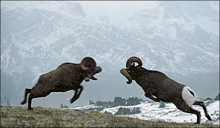
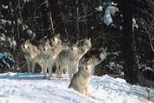
COMPETITION
- more individuals living in an area, the sooner they use up the available resources.
Between same species - male wolves fight each other for territory or access to mates.
Between different species – both hawks and snakes eat birds

Slide 14
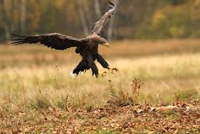
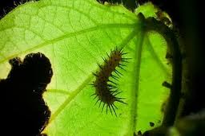
Predation and Herbivory The effects of predators on prey and the effects of herbivores on plants are two very important density-dependent population controls.

Slide 15
Predator-Prey Relationships Wolves and moose have a predator/prey relationship.
When wolf numbers increase the moose population decreases because there are more wolves eating moose. When moose populations decrease, a decrease in wolf population follows because there is less food for the wolves. When the wolf population decreases, the moose population increases because there are fewer predators to eat them.

Slide 16
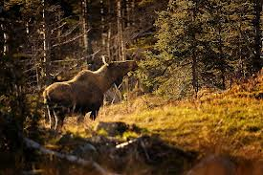
Herbivore Effects
From plant’s perspective, herbivores are predators.
On parts of Isle Royale, large, dense moose populations can eat so much balsam fir that the population of these favorite food plants drops. When this happens, moose may suffer from lack of food.

Slide 17
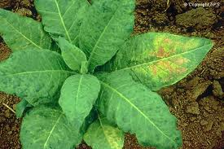
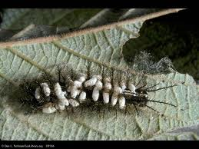
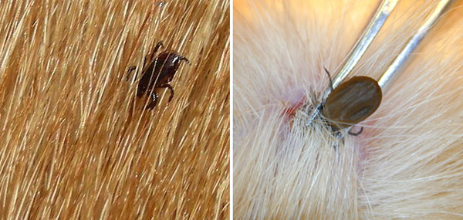
Parasitism and Disease
Parasites and disease-causing organisms - feed at the expense of their hosts
- weakening host/can cause disease or death
= density-dependent In denser host populations disease/parasites can spread more easily

Slide 18
Parasitism and Disease
Dramatic drop in Isle Royale wolf population around 1980 due to accidental introduction of canine parvovirus (CPV)
Virus killed all but 13 wolves on the island—and only three of the survivors were females.

Slide 19
Parasitism and Disease
The removal of wolves caused the moose population to skyrocket to 2400.
The densely packed moose then became infested with winter ticks that caused hair loss and weakness.

Slide 20
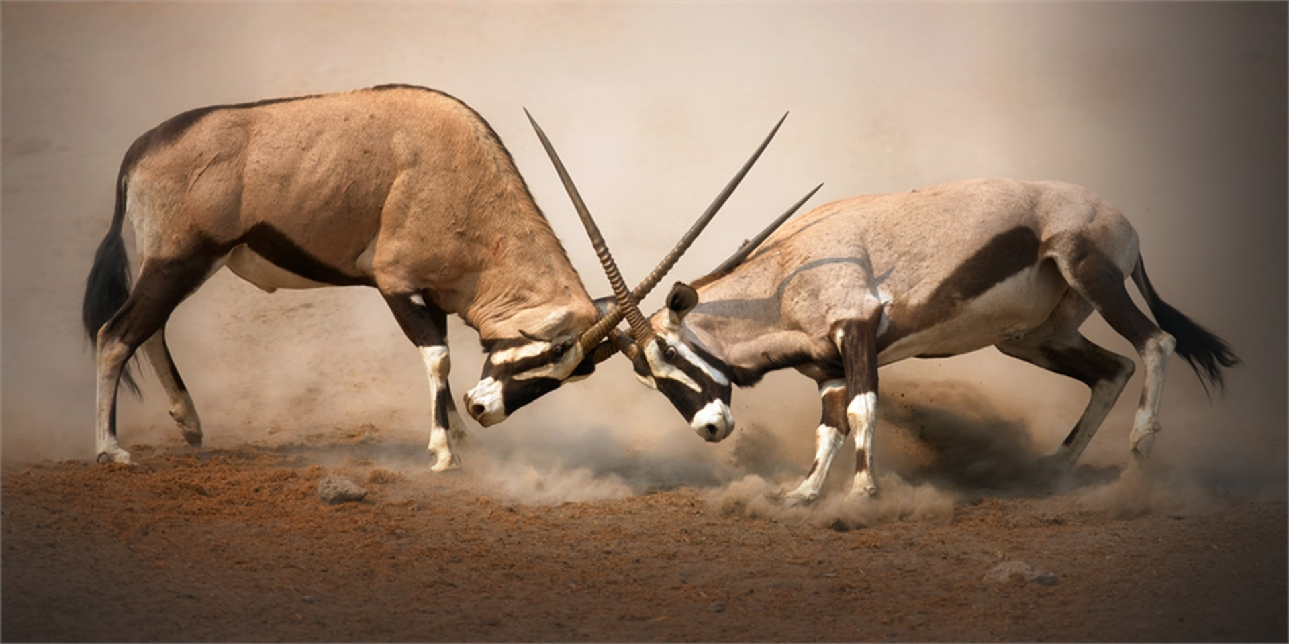
Stress From Overcrowding
Some species fight amongst themselves if overcrowded.
Causes high levels of stress can: - weaken the body’s ability to resist disease
- cause females to neglect, kill, or even eat offspring - lower birthrates
- raise death rates,
- increase rates of emigration
http://cdn.natgeotv.com.au/shows/thumbnails/Animal-fight-club%20(1).jpg?v=26&azure=false&scale=both&width=1920&height=960&mode=crop

Slide 21
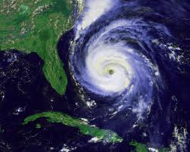
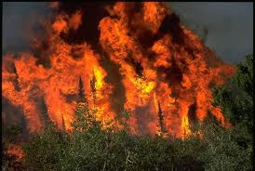
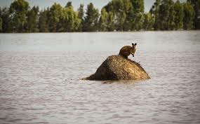
Density-Independent Limiting Factors affect all populations in similar ways, regardless of population size and density. Examples: Unusual weather/Natural disasters such as hurricanes, droughts, floods, or wildfires, Human activity- overhunting/habitat destruction Invasive species- due to climate change
In response a population may “crash.” After the crash, the population may build up again quickly, or it may stay low for some time.

Slide 22
On Isle Royale, the moose population grew exponentially for a time after the wolf population crashed.
Then, a bitterly cold winter with very heavy snowfall covered the plants that moose feed on, making it difficult for moose to move around to find food.
Because this was an island population, emigration was not possible. Moose weakened and many died.

Slide 23
True Density Independence?
Sometimes DENSITY INDEPENDENT factors may have more severe effects when population DENSITY IS HIGH.
In this case, the effects of bad weather on the large, dense population were greater than they would have been on a small population. In a smaller population, the moose would have had more food available because there would have been less competition.

Slide 24
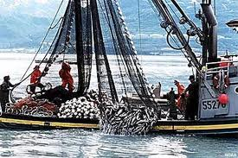
HUMAN IMPACT
OVER HUNTING/FISHING By catching more and more fish every year, humans have raised death rates in many fish populations so high that birthrates can’t keep up.
HABITAT DESTRUCTION- Loss of ecosystems due to pollution, urban sprawl, fragmentation, deforestation, building dams, fertilizer runoff, introduction of invasive species

Slide 25
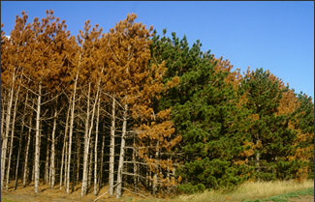
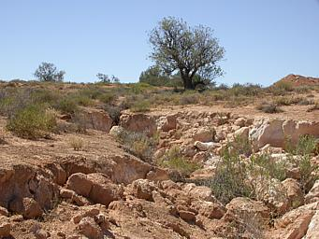
http://woodlandstewardship.org/wp-content/uploads/ch7/images/insect/bark_beetle_killed_red_pine_caption.jpg
INVASIVE SPECIES Density Dependent? Density independent?
Density Dependent? SD Pine bark beetle Infect trees and lay eggs under bark killing tree High density trees makes spread of beetles more likely
Density Independent? Rabbits in Australia Wiped out grassland ecosystems
leading to severe erosion
Led to extinction of 1/8 of mammal species
http://en.wikipedia.org/wiki/Image:Rabbit-erosion.jpg

