Slide 1
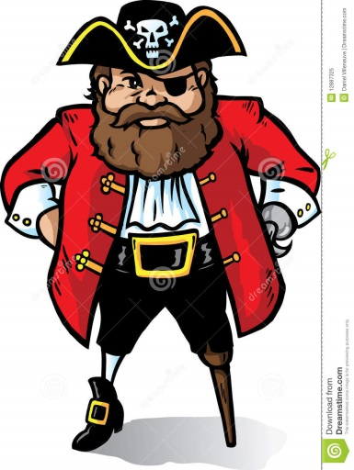
http://thumbs.dreamstime.com/z/pirate-captain-12887325.jpg
What is a pirate’s favorite amino acid?

