Slide 1
MAKING PROTEINS 3D Molecular
Slide show by Kelly Riedell

Slide 2
http://www.3dmoleculardesigns.com/bglobin/Blue%20Segement%20-%20Intro%20and%20Directions%20Teacher%20Key.pdf

Slide 3
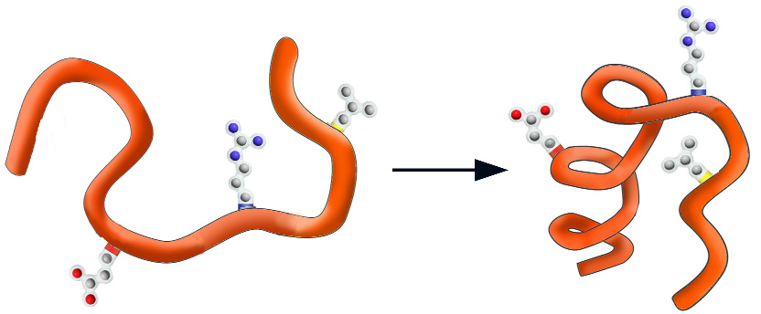
WHY FOLD?
Physics suggests the final shape should represent a low energy state for all of the atoms
in the structure.
EX: water runs downhill to reach a lower energy state.
HIGH ENERGY
LOW ENERGY

Slide 4
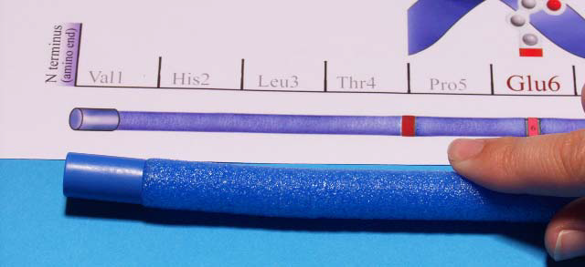
Blue cap represents the N-terminus on the polypeptide chain
Red cap represents the C-terminus on the polypeptide chain

Slide 5
Secondary structure (2°)
http://www.3dmoleculardesigns.com/AASK/AASK%20Teacher%20Notes.pdf
α-HELIX β-PLEATED SHEET
Held together by HYDROGEN BONDS between the C=O of one amino acid and the N-H of another in the BACKBONE

Slide 6
POLYPEPTIDE SEQUENCE
determined by DNA sequence
http://www.3dmoleculardesigns.com/AASK/AASK%20Teacher%20Notes.pdf

Slide 7
AMINO ACID COLOR CODE
HYDROPHOBIC NON-POLAR = YELLOW Phe + Leu
Cysteine (Cys) = GREEN
HYDROPHILIC POLAR (His) = WHITE POLAR CHARGED BASIC (Arg) = BLUE

Slide 8
FOLD FIRST 13 AMINO ACIDS (22 “ from N-terminus)
INTO A 2-STRANDED β-PLEATED SHEET

Slide 9
FOLD LAST 14 AMINO ACIDS (C-terminus end) INTO AN α-HELIX

Slide 10
http://www.3dmoleculardesigns.com/AASK/AASK%20Teacher%20Notes.pdf
WHAT HOLDS the Helices and Sheets together?
Hydrogen bonding
between BACKBONE
AMINO and CARBONYL
Groups
Side chain R groups NOT involved
http://barleyworld.org/book/export/html/20

Slide 11
TERTIARY STRUCTURE (3°)
http://www.3dmoleculardesigns.com/AASK/AASK%20Teacher%20Notes.pdf

Slide 12
What holds the TERTIARY structure together?
Stabilized by a combination of many NON-COVALENT interactions:
hydrophobic forces
hydrogen bonds between polar atoms,
ionic interactions between charged sidechains
Van der Waals forces.
http://www.3dmoleculardesigns.com/AASK/AASK%20Teacher%20Notes.pdf

Slide 13
QUATERNARY STRUCTURE (4°) (NOT ALL PROTEINS HAVE THIS)
http://www.sciencecases.org/tazswana/tazswana4.asp

