Slide 1
BIOMOLECULE MODELING
Cut and paste molecules are from Kim Foglia’s Explore Biology website
Toobers Activity is from 3D Molecular Designs AASK Kit

Slide 3
SCIENCE PRACTICE 1:
The student can use representations and models to communicate scientific phenomena and solve scientific problems.
1.1 The student can CREATE REPRESENTATIONS AND MODELS of
natural or man-made phenomena and systems in the domain.
1.2 . . . DESCRIBE REPRESENTATIONS AND MODELS of natural or man-made phenomena and systems in the domain.
1.3 . . REFINE REPRESENTATIONS AND MODELS of natural or man-made phenomena and systems in the domain
1.4 . . . Can USE REPRESENTATIONS AND MODELS to analyze situations or solve problems qualitatively and quantitatively
1.5 , , . EXPRESS KEY ELEMENTS of natural phenomena across multiple representations in the domain.

Slide 4
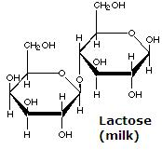
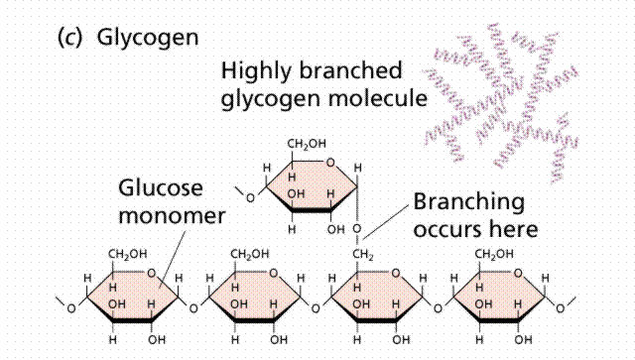
CARB CUTOUTS
Thanks to Kim Foglia @ http://www.explorebiology.com
for the molecule cutout shapes

Slide 5
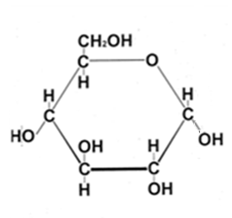
Glucose cyclization

Slide 6
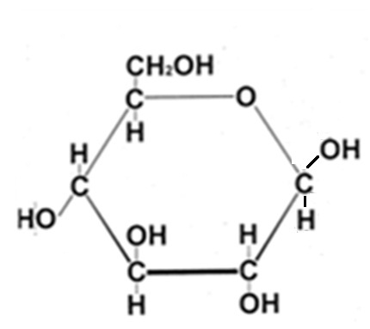

Slide 7
6
6
5
5
4
1
4
1
3
2
2
3
DEHYDRATION SYNTHESIS

Slide 8
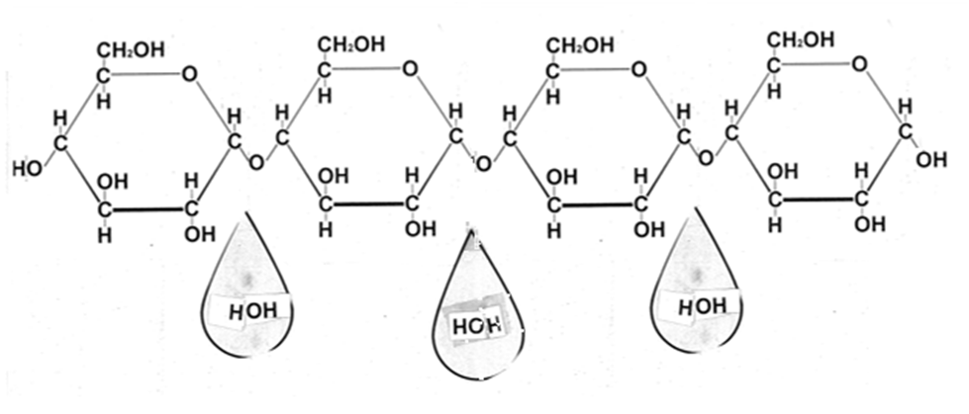
This could be the start of which polysaccharides?
BE SURE TO LABEL YOUR MODEL
α 1,4 glycosidic linkage
6
6
5
5
4
1
4
1
3
2
3
2
DEHYDRATION SYNTHESIS

Slide 9
6
6
5
5
4
1
4
1
3
2
2
3
What polysaccharide(s) could be made from this subunit?

Slide 10
How can I make a polysaccharide that branches?
6
5
1
4
3
2
6
5
1
4
2
3

Slide 11
What if subunit is modified?
http://www.ceoe.udel.edu/horseshoecrab/research/chitin.html
α or β glucose ?
Uses?

Slide 12
LO 4.1 The student is able to explain the connection between the sequence and the subcomponents of a biological polymer and its properties. [See SP 7.1]

Slide 13
LO 4.2 The student is able to refine representations and models to explain how the subcomponents of a biological polymer and their sequence determine the properties of that polymer. [See SP 1.3]

Slide 14
LO 4.3 The student is able to use models to predict and justify that changes in the subcomponents of a biological polymer affect the functionality of the molecule. [See SP 6.1, 6.4]

Slide 15
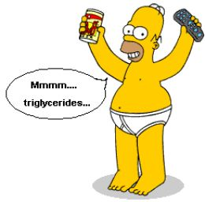
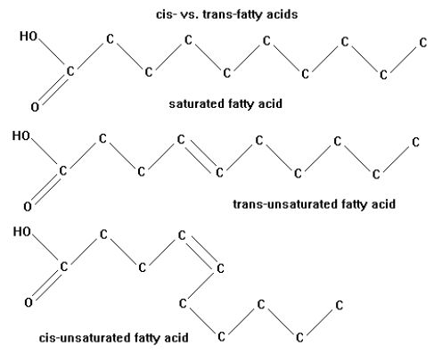
FATS
http://en.wikipedia.org/wiki/Fat
http://zrichards.hubpages.com/hub/Its-Simple-Science-Really-Fats

Slide 16
MAKE A FAT
GLYCEROL
3 FATTY ACIDS

Slide 17
Label the FAT molecule Fat /triglyceride/triacylglycerol
Label GLYCEROL and FATTY ACID parts
Circle and label the bond that makes one fatty acid unsaturated
What are some functions of fats?

Slide 18
Fatty Acids
FATTY ACID TAILS CAN BE:
Different lengths (most 13-17 Carbons)
SATURATED OR UNSATURATED
cis-isomer has kinks (liquid at room temp)
trans-isomer commercially made (rare in nature) linked to cardiovascular disease
Different fats/fatty acids have different functions
Different organisms have different kinds of fatty acids

Slide 19
PHOSPHOLIPID

Slide 20
Label the PHOSPHOLIPID molecule
Label the part that is POLAR/HYDROPHILIC
Label the part that is NONPOLAR/HYDROPHOBIC
GROUP ACTIVITY Work with others to build a cell membrane with the phospholipids you built.
How does the unsaturated fatty acid affect the structure?

Slide 21
LO 4.1 The student is able to explain the connection between the sequence and the subcomponents of a biological polymer and its properties. [See SP 7.1]

Slide 22
LO 4.2 The student is able to refine representations and models to explain how the subcomponents of a biological polymer and their sequence determine the properties of that polymer. [See SP 1.3]

Slide 23
LO 4.3 The student is able to use models to predict and justify that changes in the subcomponents of a biological polymer affect the functionality of the molecule. [See SP 6.1, 6.4]

Slide 24
PROTEINS
http://barleyworld.org/book/export/html/20

Slide 25
PROTEINS
MAKE A POLYPEPTIDE CHAIN

Slide 26
POLYPEPTIDE CHAIN
Has direction
N-terminus (amino end)
C-terminus (carboxyl end)

Slide 27
LABEL THE FOLLOWING ON YOUR CUTOUT POLYPEPTIDE CHAIN
Label N-terminus and C-terminus
identify & label the type of R group (non-polar, polar, charge basic, charged acidic, etc)
Label each amino acid as hydrophobic or hydrophilic
Draw arrows to show locations of all PEPTIDE BONDS
Label what level of protein structure your model represents
( 1° 2° . 3° , or 4° )

Slide 28
http://www.3dmoleculardesigns.com/AASK/AASK%20Teacher%20Notes.pdf
http://www.3dmoleculardesigns.com/bglobin/Blue%20Segement%20-%20Intro%20and%20Directions%20Teacher%20Key.pdf

Slide 29
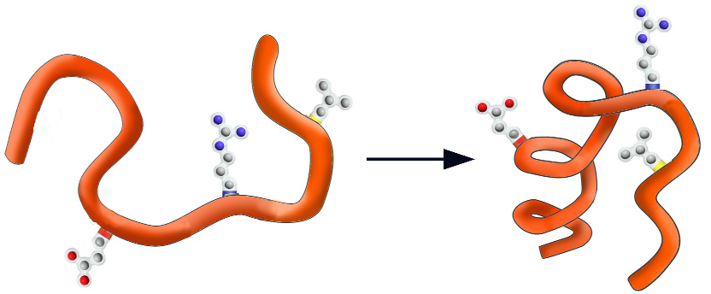
WHY FOLD?
Physics suggests the final shape should represent a low energy state for all of the atoms
in the structure.
EX: water runs downhill to reach a lower energy state.
http://www.3dmoleculardesigns.com/AASK/AASK%20Teacher%20Notes.pdf
HIGH ENERGY
LOW ENERGY

Slide 30
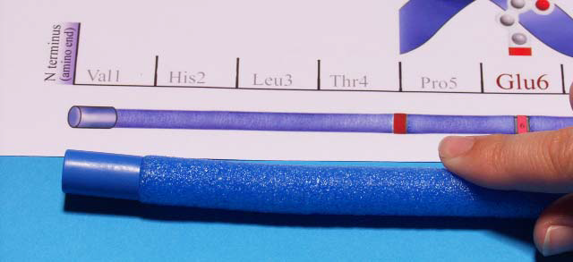
Blue cap represents the N-terminus on the polypeptide chain
Red cap represents the C-terminus on the polypeptide chain
http://www.3dmoleculardesigns.com/AASK/AASK%20Teacher%20Notes.pdf

Slide 31
Secondary structure (2°)
http://www.3dmoleculardesigns.com/AASK/AASK%20Teacher%20Notes.pdf
α-HELIX β-PLEATED SHEET
Held together by HYDROGEN BONDS between the C=O of one amino acid and the N-H of another in the BACKBONE OF THE CHAIN

Slide 32
POLYPEPTIDE SEQUENCE
determined by DNA sequence
http://www.3dmoleculardesigns.com/AASK/AASK%20Teacher%20Notes.pdf

Slide 33
AMINO ACID COLOR CODE
HYDROPHOBIC NON-POLAR = YELLOW Phe + Leu
Cysteine (Cys) = GREEN
HYDROPHILIC POLAR (His) = WHITE POLAR CHARGED BASIC (Arg) = BLUE

Slide 34
FOLD FIRST 13 AMINO ACIDS (22 “ from N-terminus)
INTO A 2-STRANDED β-PLEATED SHEET
http://www.3dmoleculardesigns.com/AASK/AASK%20Teacher%20Notes.pdf

Slide 35
FOLD LAST 14 AMINO ACIDS (C-terminus end) INTO AN α-HELIX
http://www.3dmoleculardesigns.com/AASK/AASK%20Teacher%20Notes.pdf

Slide 36
http://www.3dmoleculardesigns.com/AASK/AASK%20Teacher%20Notes.pdf
WHAT HOLDS the Helices and Sheets together?
Hydrogen bonding
between BACKBONE
AMINO and CARBONYL
Groups
Side chain R groups NOT involved
http://barleyworld.org/book/export/html/20

Slide 37
TERTIARY STRUCTURE (3°)
http://www.3dmoleculardesigns.com/AASK/AASK%20Teacher%20Notes.pdf

Slide 38
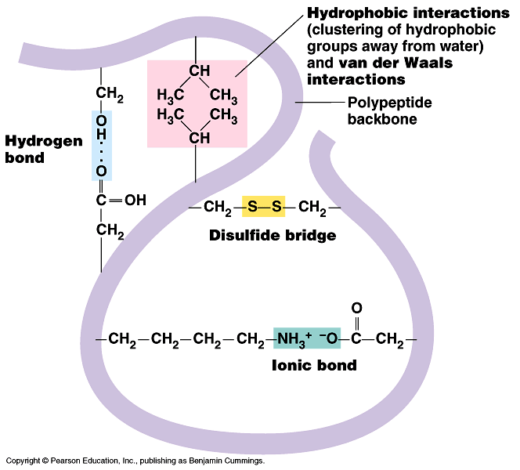
What holds the
TERTIARY
structure
together?
Stabilized by a combination of many NON-COVALENT interactions BETWEEN R GROUPS:
Hydrophobic/hydrophilic forces
hydrogen bonds between polar atoms
ionic interactions between charged sidechains
Van der Waals forces

Slide 39
QUATERNARY STRUCTURE (4°) (NOT ALL PROTEINS HAVE THIS)
http://www.sciencecases.org/tazswana/tazswana4.asp

Slide 40
LO 4.1 The student is able to explain the connection between the sequence and the subcomponents of a biological polymer and its properties. [See SP 7.1]

Slide 41
LO 4.2 The student is able to refine representations and models to explain how the subcomponents of a biological polymer and their sequence determine the properties of that polymer. [See SP 1.3]

Slide 42
LO 4.3 The student is able to use models to predict and justify that changes in the subcomponents of a biological polymer affect the functionality of the molecule. [See SP 6.1, 6.4]

