Slide 1
BIOMOLECULE MODELING Kelly Riedell Brookings Biology
Cut and paste molecules are from Kim Foglia’s Explore Biology website
Toobers Activity is from 3D Molecular Designs AASK Kit

Slide 2
SCIENCE PRACTICE 1:
The student can use representations and models to communicate scientific phenomena and solve scientific problems.
1.1 The student can CREATE REPRESENTATIONS AND MODELS of
natural or man-made phenomena and systems in the domain.
1.2 . . . DESCRIBE REPRESENTATIONS AND MODELS of natural or man-made phenomena and systems in the domain.
1.3 . . REFINE REPRESENTATIONS AND MODELS of natural or man-made phenomena and systems in the domain
1.4 . . . Can USE REPRESENTATIONS AND MODELS to analyze situations or solve problems qualitatively and quantitatively
1.5 , , . EXPRESS KEY ELEMENTS of natural phenomena across multiple representations in the domain.

Slide 3
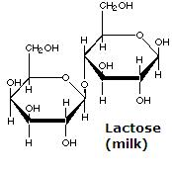
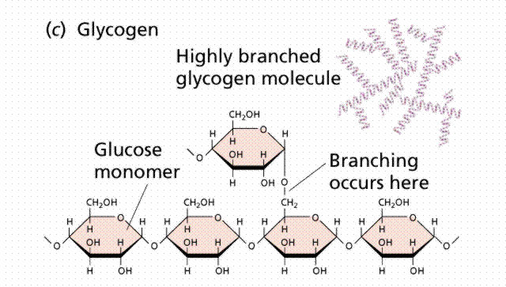
CARB CUTOUTS
Thanks to Kim Foglia @ http://www.explorebiology.com
for the molecule cutout shapes

Slide 4
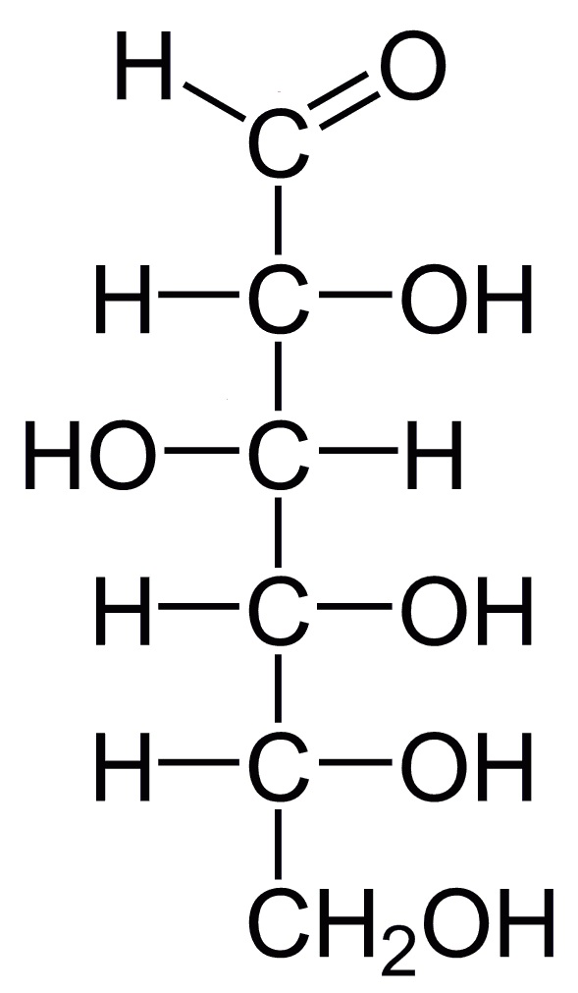
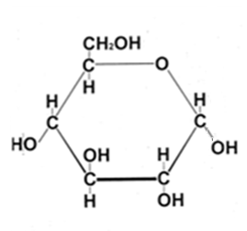
GLUCOSE C₆H₁₂O₆

Slide 5
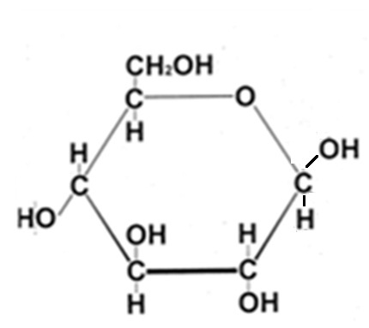
Glucose cyclization
“b”
C₁- OH hangs DOWN
C₁- OH sticks UP
ALPHA ( α ) glucose
BETA ( β ) glucose

Slide 6
6
6
5
5
4
1
4
1
3
2
2
3
~ Choose 2 glucose cutouts to join ~ Number the carbons ~ Are these α or β ?
MONOSACCHARIDES = 1 sugar
DEHYDRATION SYNTHESIS

Slide 7
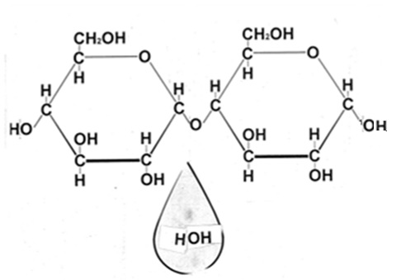
Type of saccharide? This could be the start of which polysaccharides?
α 1,4 glycosidic linkage
6
6
5
5
4
1
4
1
2
2
3
3
BE SURE TO LABEL YOUR MODEL
DEHYDRATION SYNTHESIS

Slide 8
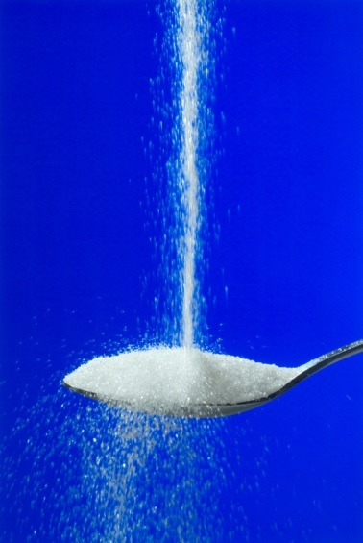
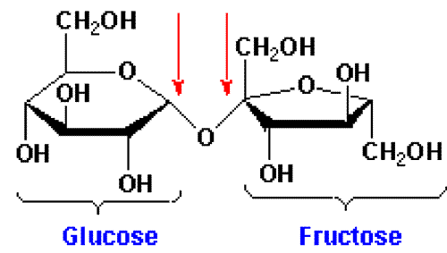
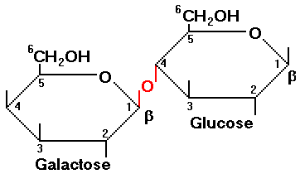
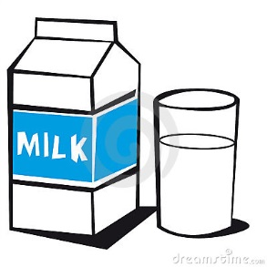
DISACCHARIDES
SUCROSE = TABLE SUGAR
LACTOSE = MILK SUGAR
http://suckitupfitnessbydebeers.com/wp-content/uploads/2013/11/sucrose.gif
http://blog.simpleposture.com/wp-content/uploads/2014/08/pouring-sugar.jpg
http://www.rpi.edu/dept/chem-eng/Biotech-Environ/FUNDAMNT/lactose.gif
http://thumbs.dreamstime.com/x/milk-1100894.jpg

Slide 9
α
α
α
α

Slide 10
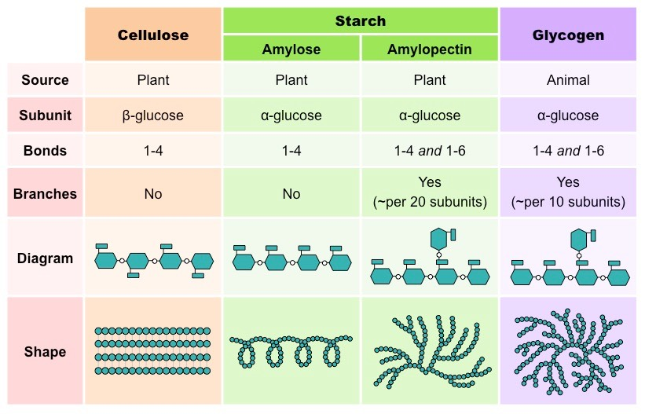
POLYSACCHARIDES 100’s – 1000’s of sugars
http://ib.bioninja.com.au/_Media/glucose-polysaccharides_med.jpeg

Slide 11
OLIGOSACCHARIDES
GLYCOPROTEINS
http://209.68.138.57/lc/archive/biology/PublishingImages/c04_03.jpg

Slide 12
6
6
5
5
4
1
4
1
3
2
2
3
Are these α or β ?
What polysaccharide(s) could be made from this subunit?

Slide 13
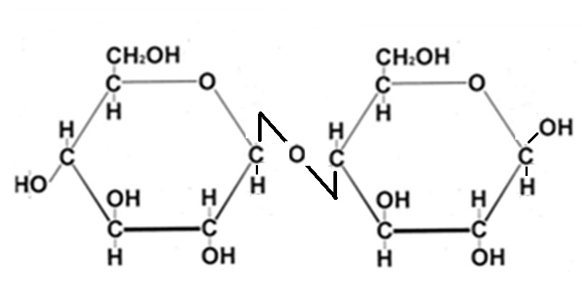
What if we used β-glucose?
NAME THE BOND

Slide 14
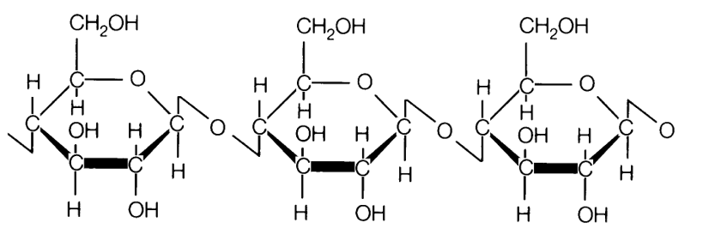
https://thebiochemsynapse.files.wordpress.com/2013/02/cellulose.gif

Slide 15
How can I make a polysaccharide that branches?
Name the bond.
6
5
1
4
3
2
6
5
1
4
2
3

Slide 16
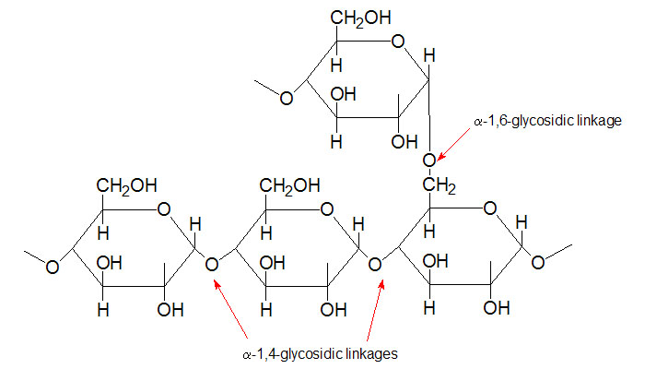
http://static1.squarespace.com/static/52668d02e4b0f593739ec2b6/t/53570be4e4b0fde8a1d5d536/1398213605501/

Slide 17
What if subunit is modified?
http://www.ceoe.udel.edu/horseshoecrab/research/chitin.html
α or β glucose ?
Polysaccharide? Uses?
N-acetyl-D-glucosamine
http://oriabure-biology.wikispaces.com/file/view/chitin2.jpg/87408319/684x318/chitin2.jpg

Slide 18
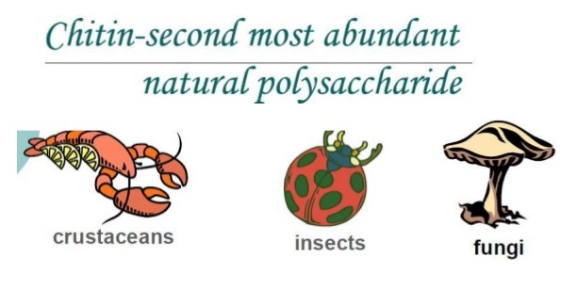
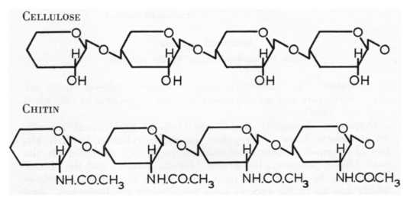
http://image.slidesharecdn.com/chitosannanoparticlesynthesis-160127064751/95/chitosan-nanoparticle-synthesis-3-638.jpg?cb=1453877318 http://oriabure-biology.wikispaces.com/file/view/chitin2.jpg/87408319/684x318/chitin2.jpg

Slide 19
SWYK
9. SHOW WHAT YOU KNOW (SWYK) Add pictures, diagrams, Compare/contrast charts, Venns, concept maps, etc.

Slide 20
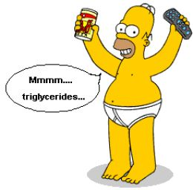
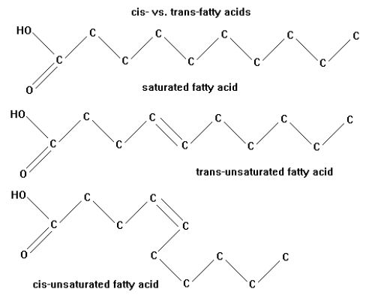
FATS
http://en.wikipedia.org/wiki/Fat
http://zrichards.hubpages.com/hub/Its-Simple-Science-Really-Fats

Slide 21
MAKE A FAT
Made of 2 kinds of subunits
ONLY macromolecule that is NOT A POLYMER!
FATTY ACID
FUNCTIONAL GROUPS? Why is it called an acid?
GLYCEROL

Slide 22
Fatty Acids
FATTY ACID TAILS CAN BE:
Different lengths (most 13-17 Carbons)
SATURATED OR UNSATURATED
cis-isomer has kinks (liquid at room temp)
trans-isomer commercially made (rare in nature) ~ linked to cardiovascular disease
Different fats/fatty acids have different functions
Different organisms have different kinds of fatty acids

Slide 23
MAKE A FAT
VIDEO
GLYCEROL
3 FATTY ACIDS
What reaction can you use to join the pieces?

Slide 24
FAT= TRIGLYCERIDE/TRIACYLGLYCEROL
LIPIDS/FATS Only macromolecule that is: ~ hydrophobic
~NOT a polymer made from many similar subunits joined in long chains
DOUBLE BOND = unsaturated
GLYCEROL
3 FATTY ACIDS

Slide 25
STRUCTURE/FUNCTION!
UNSATURATED
FA’s affect
structure.
Can’t pack as tightly.
How might this change molecule function?
GLYCEROL

Slide 26
http://www.livescience.com/images/i/000/052/230/i02/trans-fats-111111c-02.jpg?1322004031?interpolation=lanczos-none&downsize=640:*

Slide 27
Label the FAT molecule Fat = triglyceride = triacylglycerol
Label GLYCEROL and FATTY ACID parts
Circle and label the bond that makes one fatty acid unsaturated
What are some functions of fats?

Slide 28
PHOSPHOLIPID
PHOSPHATE
GYCEROL
FATTY ACID

Slide 29
PHOSPHOLIPID
R-can be different in different phospholipids
Glycerol
Phosphate

Slide 30
Label the PHOSPHOLIPID molecule
Label the part that is POLAR/HYDROPHILIC
What makes it polar?
Label the part that is NONPOLAR/HYDROPHOBIC
What makes it non-polar?

Slide 31
Phospholipids are often shown like this Find this shape in your model Outline it with pencil
Remember which parts are POLAR and which are NON-POLAR
WHAT IS THE FUNCTION OF PHOSPHOLIPIDS IN CELLS?

Slide 32
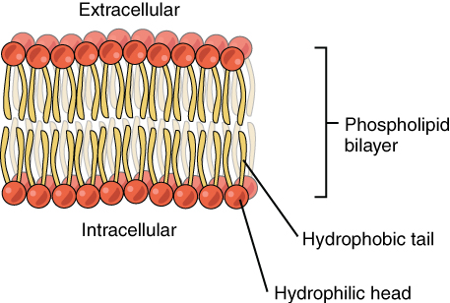
https://figures.boundless.com/19976/large/0302-phospholipid-bilayer.jpg
http://what-when-how.com/wp-content/uploads/2011/09/tmp1732_thumb2_thumb_thumb.jpg
GROUP ACTIVITY
Work with others to build a cell membrane with the phospholipids you built.
Where are the “heads” & “tails” located?
WHY?
SEE Animation

Slide 33
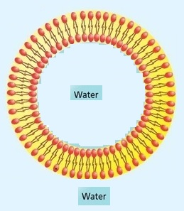
http://what-when-how.com/wp-content/uploads/2011/09/tmp1732_thumb2_thumb_thumb.jpg
STRUCTURE/FUNCTION RELATIONSHIP !
WHY is it important for cells that phospholipids behave as they do?

Slide 34
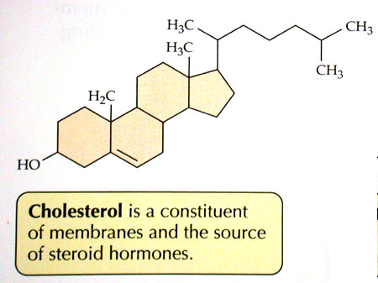
http://academic.brooklyn.cuny.edu/biology/bio4fv/page/cholesterol.JPG
Found in ANIMALS
- NOT PLANTS
three hexagons and a doghouse.

Slide 35
http://fog.ccsf.cc.ca.us/~mmalacho/physio/oll/Lesson2/images/10EndoSlide15.GIF
What makes them different?
ANOTHER
STRUCTURE/FUNCTION RELATIONSHP !!!!!
FUNCTIONAL GROUPS!

Slide 36
PROTEINS
http://barleyworld.org/book/export/html/20

Slide 37
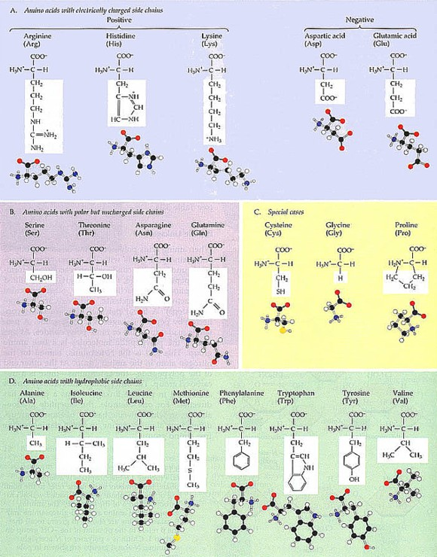
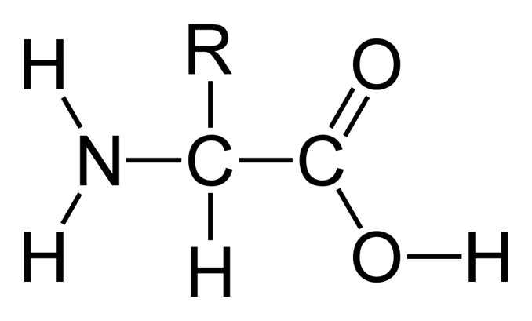
PROTEINS
What SUBUNIT is used to make PROTEINS?
What TWO functional groups do all amino acids share?
http://www.detectingdesign.com/images/Abiogenesis/Amino%20Acid%20Chart.jpg

Slide 38
MODELING
LABEL: α carbon
Circle the carboxyl group
Draw a triangle around the amino group
http://www.detectingdesign.com/images/Abiogenesis/Amino%20Acid%20Chart.jpg

Slide 39
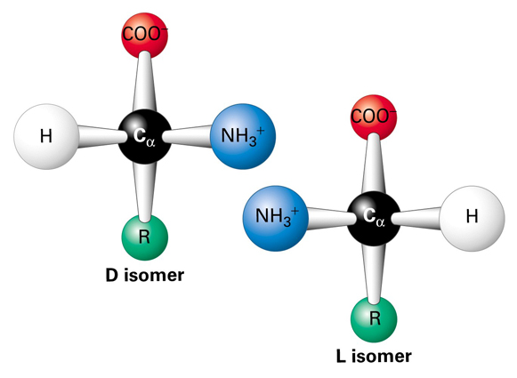
All amino acids can form mirror image (enantiomer) isomers except ?
MAKE A CONNECTION: Evidence of shared evolutionary history
Same 20 amino acids used to make proteins in all living things
Most aa’s = L-form stereoisomer

Slide 40
AMPHIPATHIC Molecules that have both hydrophilic and hydrophobic groups
AMPHOTERIC
Having the characteristics of both an acid and a base, and capable of reacting as either
ZWITTER ION molecule that has BOTH a positive and a negative charge

Slide 41
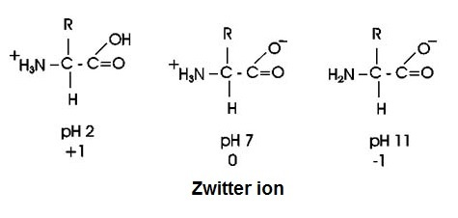
AMINO ACIDS CHANGE DEPENDING ON pH
Molecules that can act as acids (H+ donors) OR bases (H+ receivers) = AMPHOTERIC
Molecules that have separate positive (+) and negative (-) parts = ZWITTER IONS
http://www2.chemistry.msu.edu/faculty/reusch/VirtTxtJml/Images3/alatitr.gif

Slide 42
PROTEINS
MAKE A POLYPEPTIDE CHAIN
WHAT CHEMICAL REACTION CAN WE USE TO JOIN SUBUNITS?
Join your amino acid cutouts

Slide 43
ADD LABELS to your MODEL
DEHYDRATION SYNTHESIS Bond that joins subunits called a PEPTIDE bond (COVALENT bond)
Which groups are involved in this bond?
Draw arrows to identify the peptide bonds in your model

Slide 44
ADD LABELS to your MODEL
POLYPEPTIDE has direction
N-terminus (amino end)
C-terminus (carboxyl end)

Slide 45
LABEL THE FOLLOWING ON YOUR CUTOUT POLYPEPTIDE CHAIN
Label N-terminus and C-terminus
Draw arrows to show locations of all PEPTIDE BONDS
Identify what type of chemical bond this is
Put SQUARES around the R groups and use your amino acid chart to identify & label the type of R group (non-polar, polar, charge basic, charged acidic, etc)
Label each amino acid as hydrophobic or hydrophilic
Label what level of protein structure your model represents
( 1° 2° . 3° , or 4° ?)

Slide 46
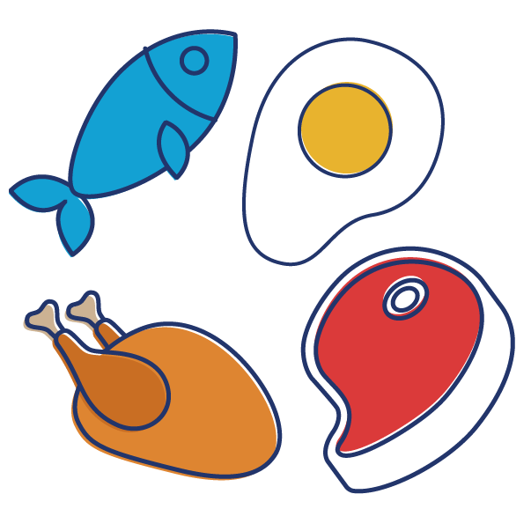
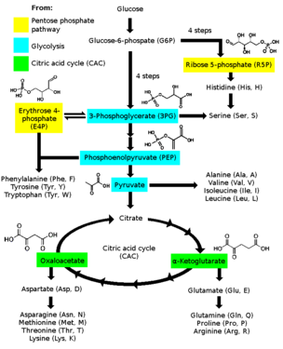
Where do amino acids come from?
“VEGGIE” ALERT ! 9 “essential” amino acids can’t be synthesized by humans; must come from diet especially Lysine and tryptophan (in low amounts in most plant proteins) Strict vegetarians need to make sure that their diet contains sufficient amounts of these
Many amino acids can be made from intermediates from glycolysis and Krebs cycle pathways
https://www.medicinehow.com/wp-content/uploads/2016/12/Protain-after-Workout-02.png

Slide 47
BIOMOLECULE MODELING
Toobers Activity from 3D Molecular Designs AASK Kit
ACTIVITY 2

Slide 48
http://www.3dmoleculardesigns.com/AASK/AASK%20Teacher%20Notes.pdf
http://www.3dmoleculardesigns.com/bglobin/Blue%20Segement%20-%20Intro%20and%20Directions%20Teacher%20Key.pdf

Slide 49
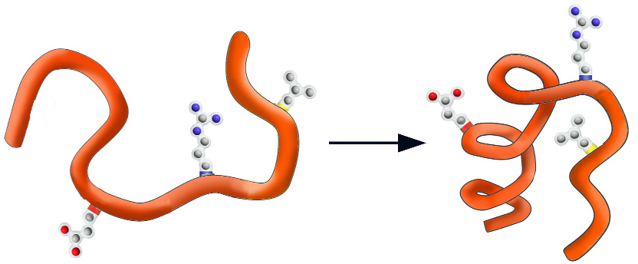
WHY FOLD?
Physics suggests the final shape should represent a low energy state for all of the atoms in the structure.
EX: water runs downhill to reach a lower energy state.
http://www.3dmoleculardesigns.com/AASK/AASK%20Teacher%20Notes.pdf
HIGH ENERGY
LOW ENERGY

Slide 50
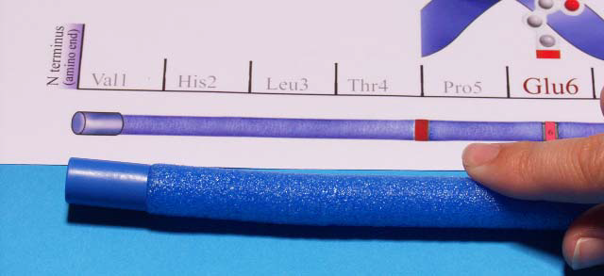
Blue cap represents the N-terminus on the polypeptide chain
Red cap represents the C-terminus on the polypeptide chain
http://www.3dmoleculardesigns.com/AASK/AASK%20Teacher%20Notes.pdf

Slide 51
POLYPEPTIDE SEQUENCE
WHAT DETERMINES THE PRIMARY STRUCTURE
OF A POLYPEPTIDE CHAIN? How is a POLYPEPTIDE different from a PROTEIN?
DNA sequence codes for AMINO ACID sequence
PROTEIN = POLYPEPTIDE FOLDED INTO 3D SHAPE
http://www.3dmoleculardesigns.com/AASK/AASK%20Teacher%20Notes.pdf

Slide 52
AMINO ACID –R groups

Slide 53
AMINO ACID COLOR CODE
HYDROPHILIC POLAR HISTIDINE (His) = WHITE
CYSTEINE (Cys) = GREEN
HYDROPHILIC POLAR CHARGED BASIC ARGININE(Arg) = BLUE
HYDROPHOBIC NON-POLAR = YELLOW Phe + Leu

Slide 54
Secondary structure (2°)
http://www.3dmoleculardesigns.com/AASK/AASK%20Teacher%20Notes.pdf
α-HELIX β-PLEATED SHEET

Slide 55
FOLD FIRST 13 AMINO ACIDS (22 “ from N-terminus)
INTO A 2-STRANDED β-PLEATED SHEET
http://www.3dmoleculardesigns.com/AASK/AASK%20Teacher%20Notes.pdf

Slide 56
FOLD LAST 14 AMINO ACIDS (C-terminus end) INTO AN α-HELIX
http://www.3dmoleculardesigns.com/AASK/AASK%20Teacher%20Notes.pdf

Slide 57
http://www.3dmoleculardesigns.com/AASK/AASK%20Teacher%20Notes.pdf

Slide 58
Secondary structure (2°)
Image from POGIL
WHAT TYPE OF BONDS HOLD 2° STRUCTURE TOGETHER?
WHICH PARTS OF THE
POLYPEPTIDE CHAIN
ARE INVOLVED?
Side chain R groups NOT involved
Held together by HYDROGEN BONDS between the C=O of one amino acid and the N-H of another in the BACKBONE OF THE CHAIN

Slide 59
http://www.3dmoleculardesigns.com/AASK/AASK%20Teacher%20Notes.pdf
This is SECONDARY STRUCTURE (2° )
NEXT the α-helices and β-pleated sheets start to fold up due to interactions between R GROUPS = TERTIARY (3°)STRUCTURE
http://barleyworld.org/book/export/html/20

Slide 60
TERTIARY STRUCTURE (3°)
http://www.3dmoleculardesigns.com/AASK/AASK%20Teacher%20Notes.pdf

Slide 61
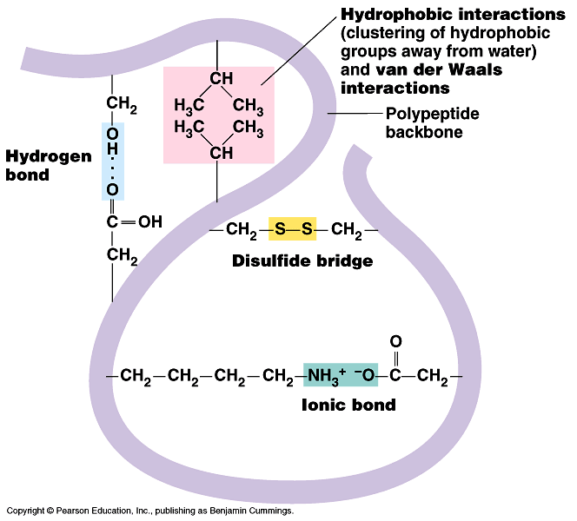
What holds the
TERTIARY
structure
together?
Stabilized by a combination of many NON-COVALENT interactions BETWEEN R GROUPS:
Hydrophobic/hydrophilic forces
hydrogen bonds between polar atoms
ionic interactions between charged side chains
Van der Waals forces
Disulfide bridges

Slide 62
QUATERNARY STRUCTURE (4°) (NOT ALL PROTEINS HAVE THIS)
http://www.sciencecases.org/tazswana/tazswana4.asp

Slide 63
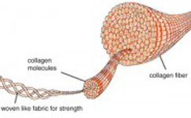
QUATERNARY STRUCTURE (4°) (NOT ALL PROTEINS HAVE THIS)
Held together by interactions between R groups in different polypeptide chains
Image from POGIL
http://cdn2.bigcommerce.com/server1100/b20f3/product_images/uploaded_images/collagen-fibers-tn.jpg

Slide 64
WHAT DO WE CALL IT WHEN A PROTEIN “UNWINDS” and LOSES ITS 3D SHAPE? WHICH BONDS ARE DISRUPTED? WHICH BONDS REMAIN INTACT? WHAT ENVIRONMENTAL FACTORS CAN DISRUPT 3D SHAPES?
REMEMBER: STRUCTURE ~ FUNCTION
See a movie
Image from POGIL
http://cdn2.bigcommerce.com/server1100/b20f3/product_images/uploaded_images/collagen-fibers-tn.jpg

Slide 65
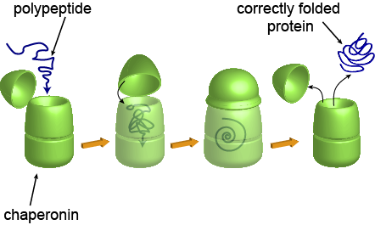
Proteins that help other proteins fold into their correct 3-D shape
CHAPARONINS
Image from POGIL
http://cdn2.bigcommerce.com/server1100/b20f3/product_images/uploaded_images/collagen-fibers-tn.jpg

Slide 66
LO 4.1 The student is able to explain the connection between the sequence and the subcomponents of a biological polymer and its properties. [See SP 7.1]
LO 4.2 The student is able to refine representations and models to explain how the subcomponents of a biological polymer and their sequence determine the properties of that polymer. [See SP 1.3]
LO 4.3 The student is able to use models to predict and justify that changes in the subcomponents of a biological polymer affect the functionality of the molecule. [See SP 6.1, 6.4]

Slide 67
Essential Knowledge 4.A.a: The subcomponents of biological molecules and their sequence determine the properties of that molecule.
a. Structure and function of polymers are derived from the way their monomers are assembled.
4. Carbohydrates are composed of sugar monomers whose structures and bonding with each other by dehydration synthesis determine the properties and functions of the molecules. Illustrative examples include: cellulose versus starch.
Essential Knowledge 4.A.a: The subcomponents of biological molecules and their sequence determine the properties of that molecule.
b. Directionality influences structure and function of the polymer
3. The nature of bonding between carbohydrate subunits determines their relative orientation in the carbohydrate, which then determines the secondary structure of the carbohydrate.

Slide 68
Essential Knowledge 4.A.a: The subcomponents of biological molecules and their sequence determine the properties of that molecule.
a. Structure and function of polymers are derived from the way their monomers are assembled.
2. In proteins, the specific order of amino acids in a polypeptide (Primary structure) interacts with the environment to determine the overall shape of the protein, which also involves secondary, tertiary, and quaternary structure and, thus, its function. The R group of an amino acid can be categorized by its chemical properties (hydrophobic, hydrophilic, and ionic), and the interactions of these R groups determine structure and function of that region of the protein.
Essential Knowledge 4.A.a: The subcomponents of biological molecules and their sequence determine the properties of that molecule.
b. Directionality influences structure and function of the polymer
2. Proteins have an amino (NH₂) end and a carboxyl (COOH) end, and consist of a linear sequence of amino acids connected by the formation of peptide bonds by dehydration synthesis between the amino and carboxyl groups of adjacent monomers.

Slide 69
Essential Knowledge 4.A.a: The subcomponents of biological molecules and their sequence determine the properties of that molecule.
b. Directionality influences structure and function of the polymer
2. Proteins have an amino (NH₂) end and a carboxyl (COOH) end, and consist of a linear sequence of amino acids connected by the formation of peptide bonds by dehydration synthesis between the amino and carboxyl groups of adjacent monomers.

Slide 70
Essential Knowledge 4.A.a: The subcomponents of biological molecules and their sequence determine the properties of that molecule.
a. Structure and function of polymers are derived from the way their monomers are assembled. 3. In general, lipids are nonpolar; however, phospholipids exhibit structural properties, with polar regions that interact with other polar molecules such as water, and with nonpolar regions where differences in saturation determine the structure and function of lipids.

Slide 71
ESSENTIAL KNOWLEDGE : 2.B.1: Cell membranes are selectively permeable due to their structure. b.2. Phospholipids give the membrane both hydrophilic and hydrophobic properties. The hydrophilic phosphate portions of the phospholipids are oriented toward the aqueous external environments, while the hydrophobic fatty acid portions face each other within the interior of the membrane itself.

Slide 72
Essential Knowledge 4.A.a: The subcomponents of biological molecules and their sequence determine the properties of that molecule.
b. Directionality influences structure and function of the polymer
1. Nucleic acids have ends, defined by the 3’ and 5’ carbons of the sugar in the nucleotide that determine the direction in which complementary nucleotides are added during DNA synthesis and the direction in which transcription occurs (from 5; to 3’)

