Slide 1
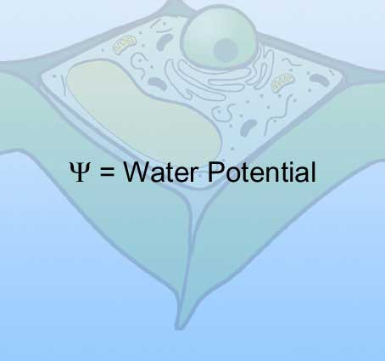
WATER POTENTIAL Kelly Riedell Brookings Biology
http://www.neosci.com/demos/10-1041_cell%20processes/Presentation%20Images/tutorials/3.01.jpg

Slide 2
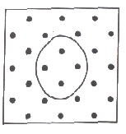
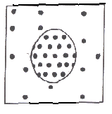
SEARCH YOUR “BIO BRAIN”
You learned about HYPERTONIC, HYPOTONIC, ISOTONIC solutions and how water will move as a result of differences in solute concentration
Dots in the diagrams below represent solute.
This cell is sitting in a _____________ solution.
SOLUTE SUCKS! Which direction will the water move?

Slide 3
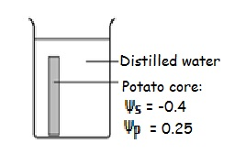
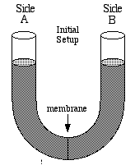
Types of water potential problems you may see
Comparing solutions in containers
A 0.2 M
B
0.4 M
Comparing a cell with the solution outside
Comparing solutions across a semi-permeable membrane in a U tube
0.5 M glucose
0 3 M starch
0.2 M glucose 0.2 M starch

Slide 4
Water potential is a way add some math to explain where and why water will move. Equations on AP Formula sheet: Ψ = pressure potential (Ψ_{p}) + solute potential (Ψ_{s}) Ψ_{s} = - iCRT
i = # of particles molecule makes in water glucose = 1 (no ionization)
NaCl = 2 (makes 2 ions Na⁺ and Cl⁻) C = molar concentration
R = pressure constant 0.0831 liter bar/mole °K T = temperature in °K = 273 + ° C

Slide 5
Solute potential (Ψ_{s})
DISTILLED WATER has a Ψs = 0
Adding solute lowers SOLUTE POTENTIAL (ALSO CALLED OSMOTIC POTENTIAL)
Makes it more ___________
Since Ψ = (Ψ_{p}) + (Ψ_{s}) Overall WATER POTENTIAL decreases too Water = more likely to flow toward areas with low water potential

Slide 6
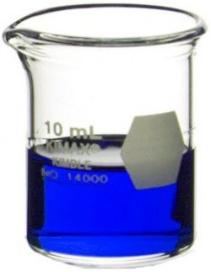
Solute potential (Ψ_{s}) = -iCRT
Calculate the (Ψ_{s}) following for a solution of 0.2 M glucose at 20 °C
Ψ_{s} = - i C R T
Ψs =
=
https://www.labsource.com/media/catalog/product/cache/1/small_image/250x/17f82f742ffe127f42dca9de82fb58b1/Kimble-Chase/kimble-chase-14000-10.jpg

Slide 7
Solute potential (Ψ_{s}) = -iCRT
Calculate the (Ψ_{s}) following for a solution of 0.5 M NaCl at 22 °C
Ψ_{s} = - i C R T
Ψs =
=
https://www.labsource.com/media/catalog/product/cache/1/small_image/250x/17f82f742ffe127f42dca9de82fb58b1/Kimble-Chase/kimble-chase-14000-10.jpg

Slide 8
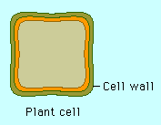
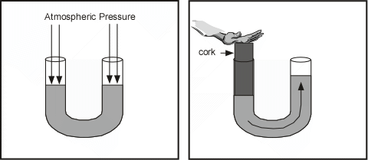
Images from: http://www.phschool.com/science/biology_place/labbench/lab1/watpot.html
PRESSURE POTENTIAL Ψp
In open system (like beaker or cell in isotonic conditions) pressure potential Ψ_{p} = O
In closed system
(like plant cell with rigid cell wall or a container with a plunger) Ψ_{p} can be a positive or negative number, or zero.

Slide 9
SI UNITS
1 Bar = 1 Atm 1 Bar = 0.1 Megapascals (Mpa)
http://www.neosci.com/demos/10-1041_cell%20processes/Presentation_4.html

Slide 10
Ψ = pressure potential (Ψ_{p}) + solute potential (Ψ_{s}) )
Calculate the following for an OPEN CONTAINER filled with PURE WATER
(Ψ_{p}) = ______ (Ψ_{s}) = ______
(Ψ_{s}) + (Ψ_{p}) = Ψ
Ψ = _________

Slide 11
Water moves from a region of HIGHER WATER POTENTIAL to a region of LOWER WATER POTENTIAL
http://www.neosci.com/demos/10-1041_cell%20processes/Presentation%20Images/tutorials/3.01.jpg

Slide 12
http://www.cetbiology.com/biology-photographs/waterpotential.jpg

Slide 13
Ψ = pressure potential (Ψ_{p}) + solute potential (Ψ_{s})
PLANT CELL Water moving into a plant cell puts pressure on the cell wall.
INCREASING THE PRESSURE POTENTIAL ALSO INCREASES THE WATER POTENTIAL
http://www.phschool.com/science/biology_place/labbench/lab1/watpot.html

Slide 14
Water enters cell until the Ψ inside cell = Ψ outside cell

Slide 15
Water enters cell until the Ψ inside cell = Ψ outside cell

Slide 17
The molar concentration of a sugar solution in an open beaker has been determined to be 0.3M. Calculate the solute potential at 22 degrees. Round your answer to the nearest hundredth.
Now that you know the Ψ_{s} you can calculate the water potential Ψ of this beaker of liquid.
Ψ = pressure potential (Ψ_{p}) + solute potential (Ψ_{s})

Slide 18
http://www.phschool.com/science/biology_place/labbench/lab1/quiz.html
What is the water potential of the distilled water?
What is the water potential of the beet core?
Which way will water move?

Slide 19
http://www.phschool.com/science/biology_place/labbench/lab1/quiz.html

