Slide 1
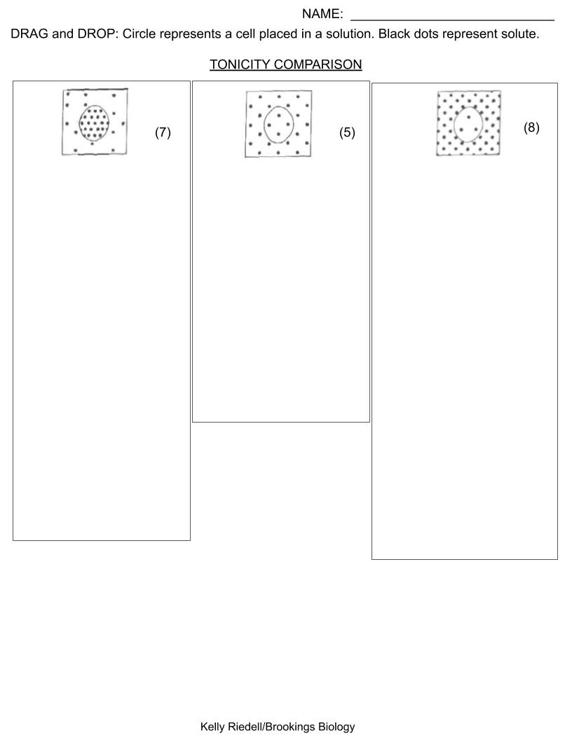
.
WATER POTENTIAL (ψ) OUTSIDE CELL IS GREATER THAN INSIDE
WATER POTENTIAL (ψ) OUTSIDE AND INSIDE CELL ARE EQUAL
HYPOTONIC
WATER POTENTIAL (ψ) INSIDE CELL IS GREATER THAN OUTSIDE
HYPERTONIC
ISOTONIC
WATER ENTERING EQUALS WATER LEAVING
PLANT CELL WILL BE FLACCID
ANIMAL CELL WILL SWELL AND COULD BURST
PLANT CELL WILL BE FLACCID
ANIMAL CELL WILL SHRINK SMALLER
MORE WATER WILL LEAVE CELL THAN ENTER
PLANT CELL WILL BE TURGID
ANIMAL CELL WILL STAY SAME SIZE
MORE WATER WILL ENTER CELL THAN LEAVE
TURGOR/OSMOTIC PRESSURE WILL INCREASE INSIDE PLANT CELL
TURGOR/OSMOTIC PRESSURE WILL DECREASE INSIDE PLANT CELL
CRENATION WILL OCCUR
IN ANIMAL CELL
CYTOLYSIS CAN OCCUR IN ANIMAL CELLS
PLASMOLYSIS WILL OCCUR IN PLANT CELL

