Slide 1
DRAW ENDOSYMBIOTIC THEORY Slide show by Kelly Riedell
Watch this video
Write a short paragraph in your BILL: EXPLAINING the ENDOSYMBIOTIC THEORY
Now let’s draw it to see the evidence!
animation

Slide 4
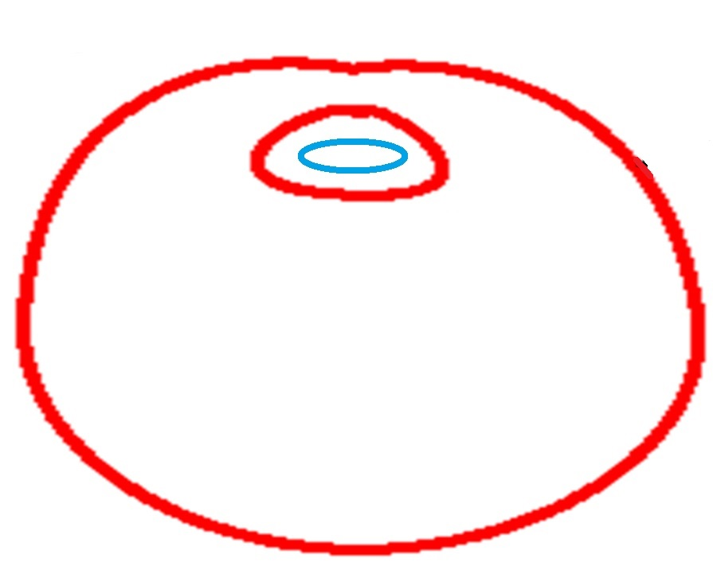
Bacterial plasma membrane

Slide 5
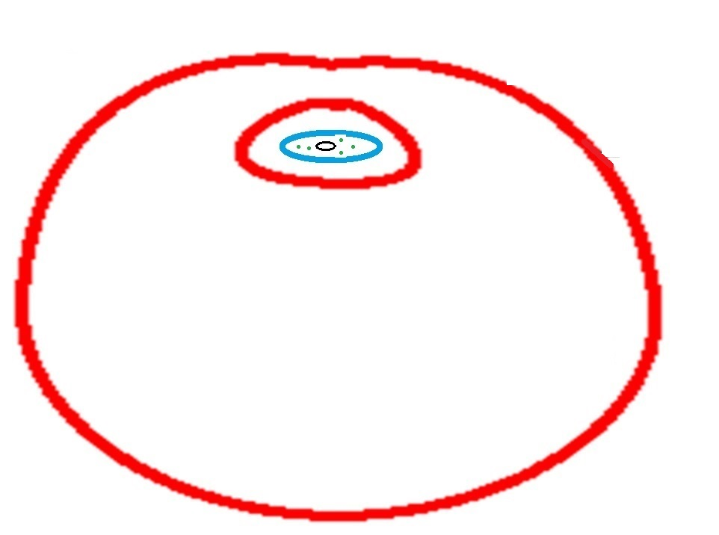
Add some bacterial ribosomes and DNA

Slide 6
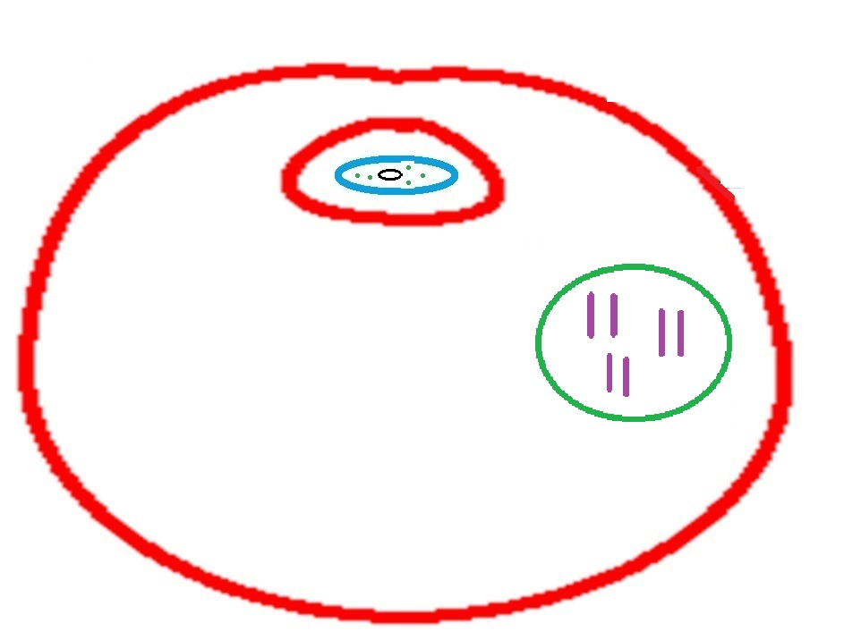
Remember host cell is a eukaryote. Add a nucleus and host DNA How is this different from bacterial DNA?

Slide 7
Add some eukaryotic host ribosomes. How are these different from bacterial ribosomes?

Slide 8
Evolved to become mitochondrion

Slide 9
WHAT’s the EVIDENCE?
Look at the colors in your picture. Which parts of mitochondria/chloroplasts have a prokaryotic bacterial origin? Which have a eukaryotic host origin?
Make a list of the evidence for the ENDOSYMBIOTIC THEORY? Find these in your picture!

