Slide 1
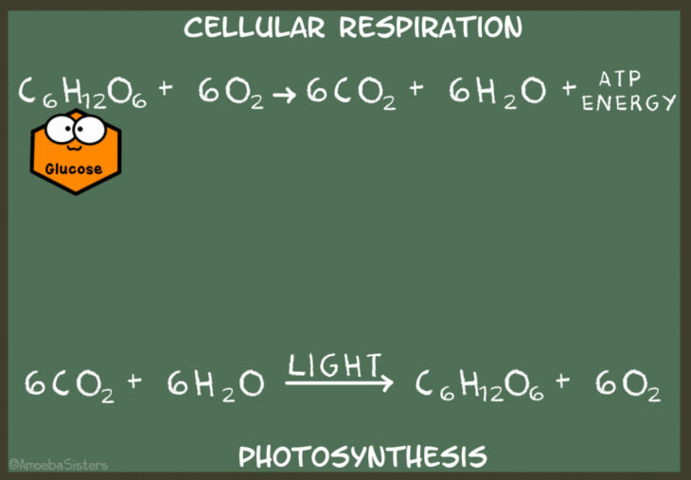
https://www.amoebasisters.com/uploads/2/1/9/0/21902384/published/photosynthesis-cellular-respiration-gif_1.gif?1588615164

Slide 2
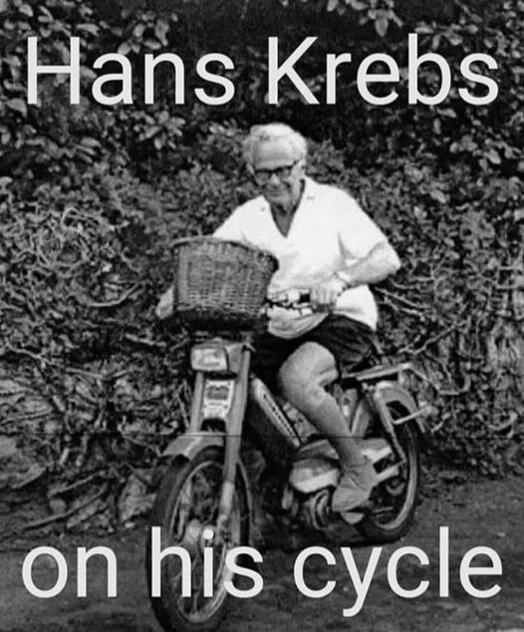
https://www.facebook.com/photo?fbid=3640518242742942&set=gm.1599348776925077

Slide 3
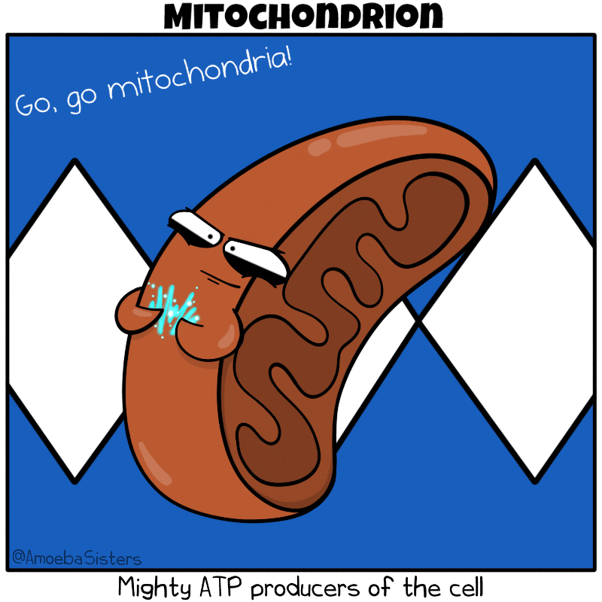
https://www.amoebasisters.com/uploads/2/1/9/0/21902384/mitochondrion-v2-gif_orig.gif

Slide 4
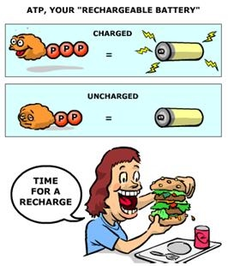
https://sites.google.com/a/graded.br/ib-biology-sl-year-1---beck/_/rsrc/1393339278902/home/core-content/topic-3---chemistry-of-life/3-7-cellular-respiration/atp_cartoon.JPG

Slide 5
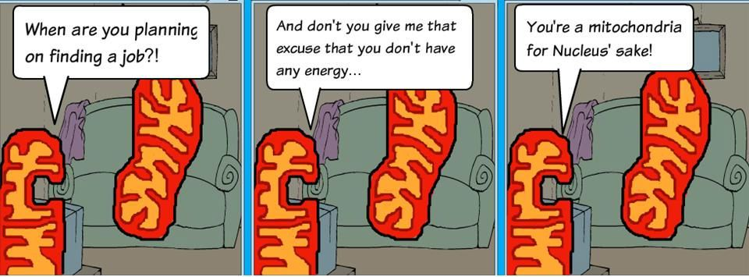
https://i.pinimg.com/564x/5e/d8/01/5ed8012d3194a0ac80a9a56d767115d9.jpg

Slide 6
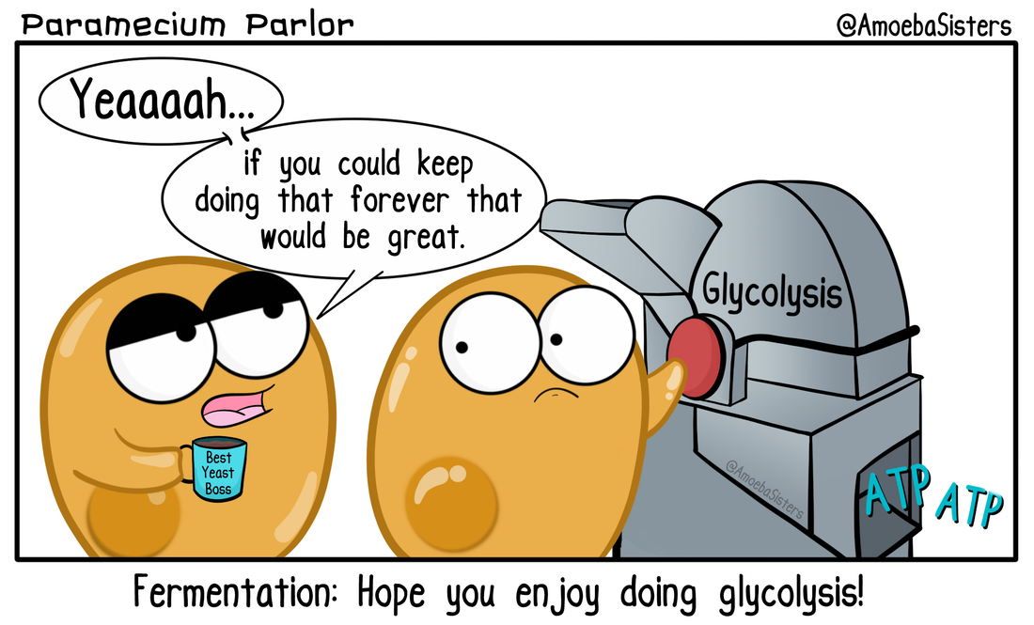
https://www.amoebasisters.com/parameciumparlorcomics/may-01st-2018

Slide 7
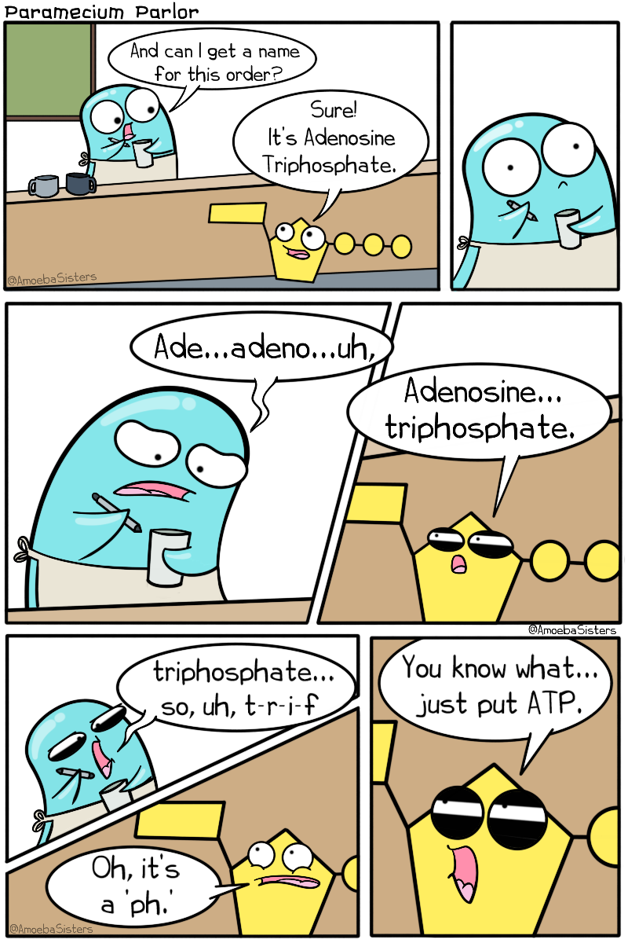
https://www.amoebasisters.com/uploads/2/1/9/0/21902384/atp-name_orig.png

Slide 8
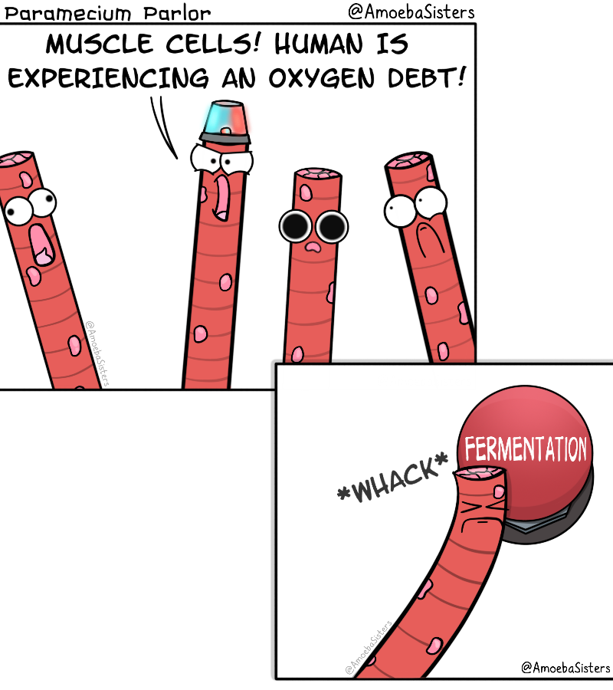
https://www.amoebasisters.com/parameciumparlorcomics/previous/13

Slide 9
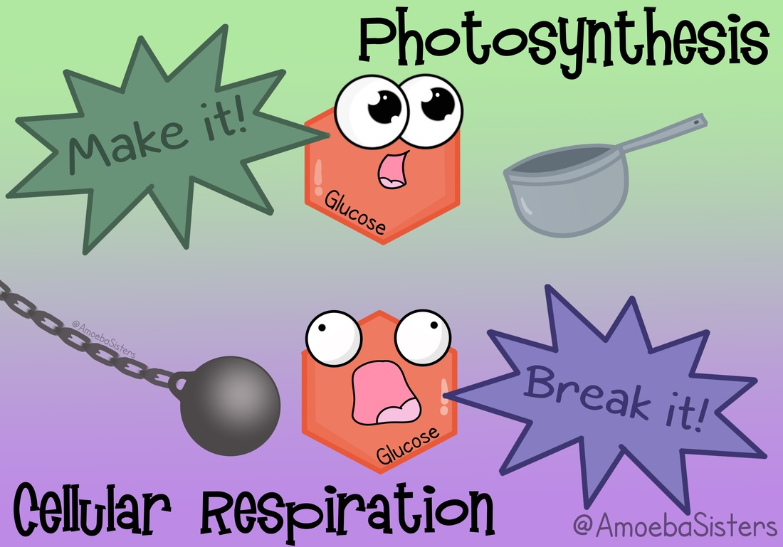
https://www.amoebasisters.com/parameciumparlorcomics/previous/40

