Slide 1
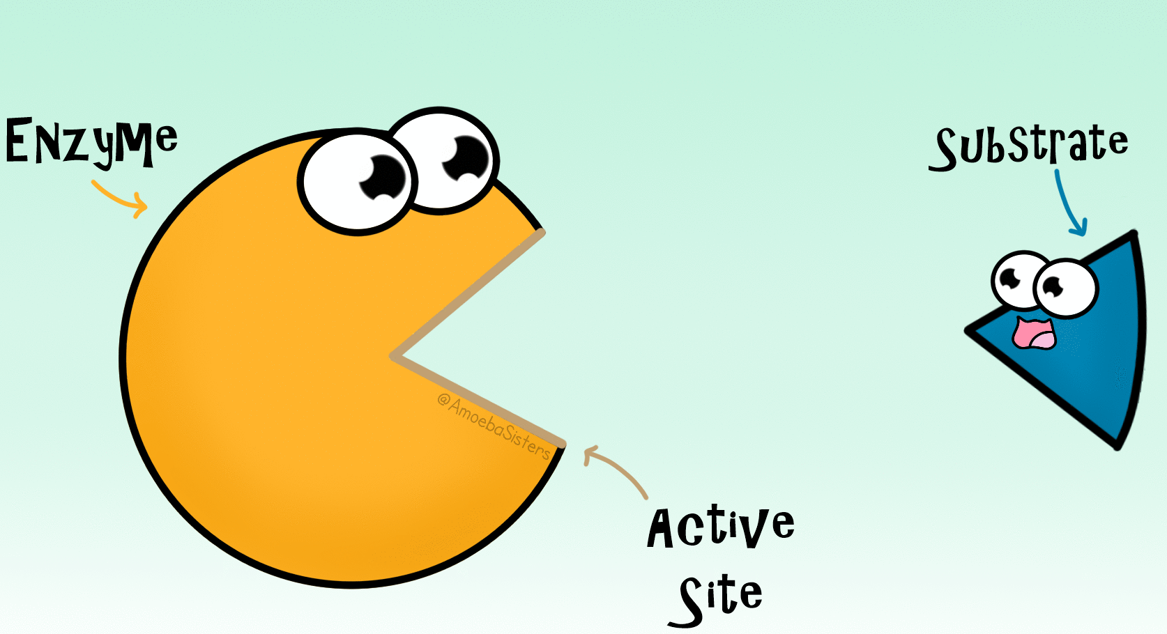
https://i.pinimg.com/originals/7f/f4/19/7ff419c23e6ac098565355a295b24737.gif

Slide 2
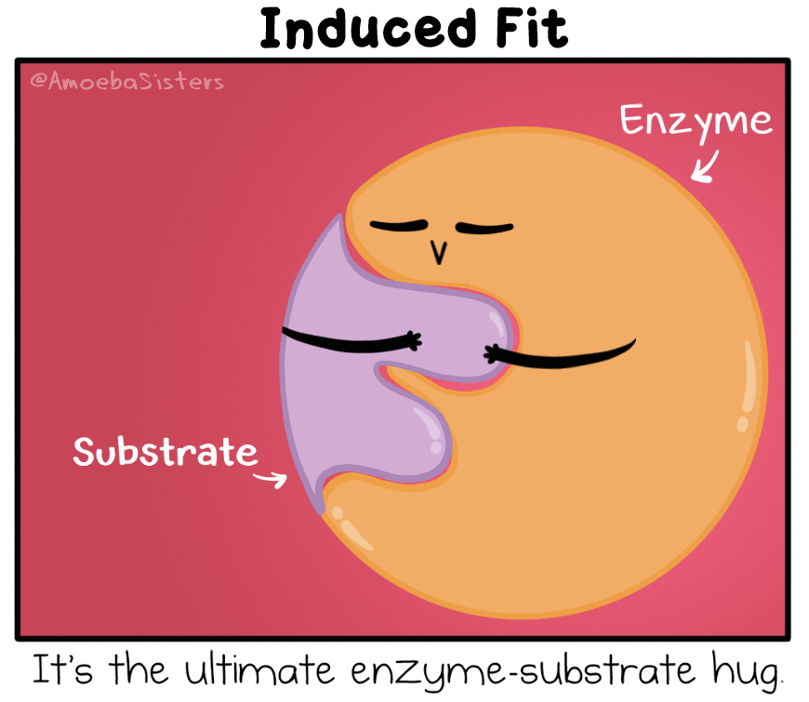
https://i.pinimg.com/originals/d7/93/84/d79384f5e0e01a986ff2ac8c4b4fa1b6.gif

Slide 3
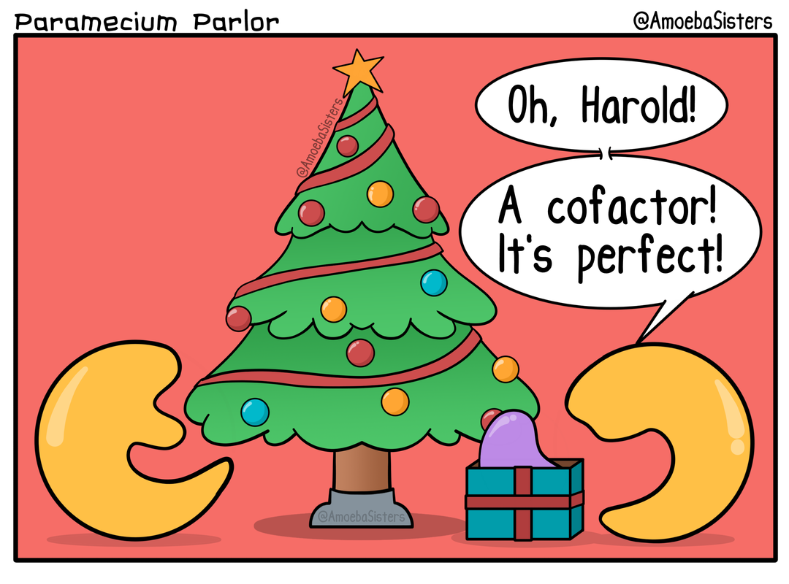
https://www.amoebasisters.com/parameciumparlorcomics/previous/25

Slide 4
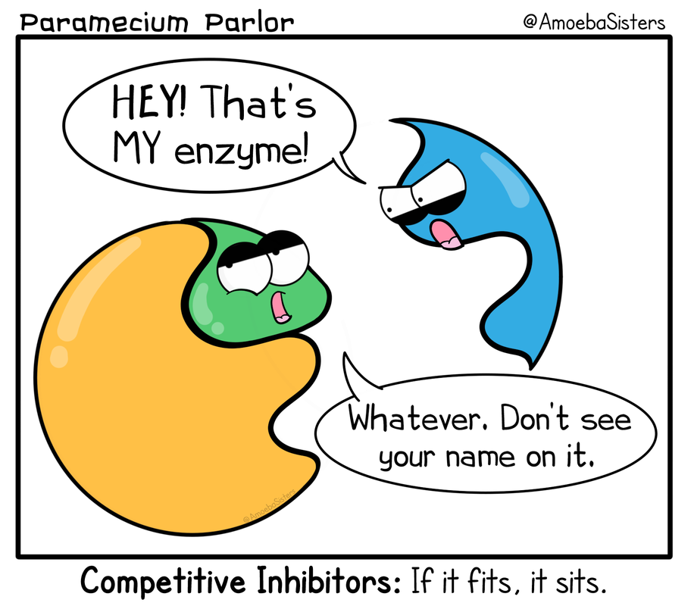
https://www.amoebasisters.com/parameciumparlorcomics/previous/23

Slide 5
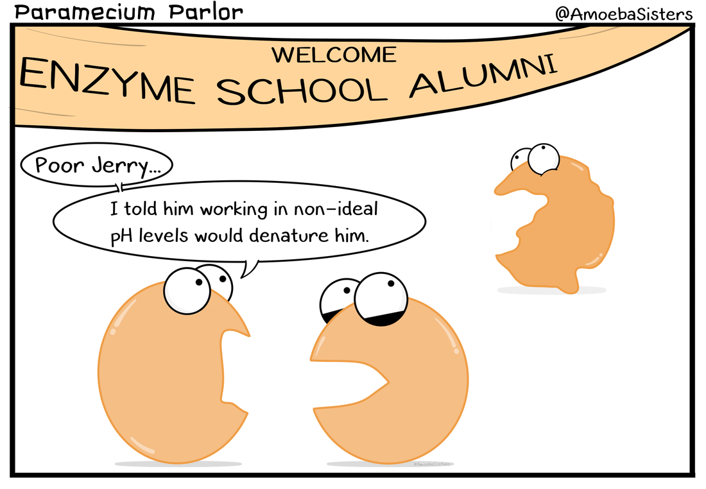
https://www.amoebasisters.com/parameciumparlorcomics/previous/44

Slide 6
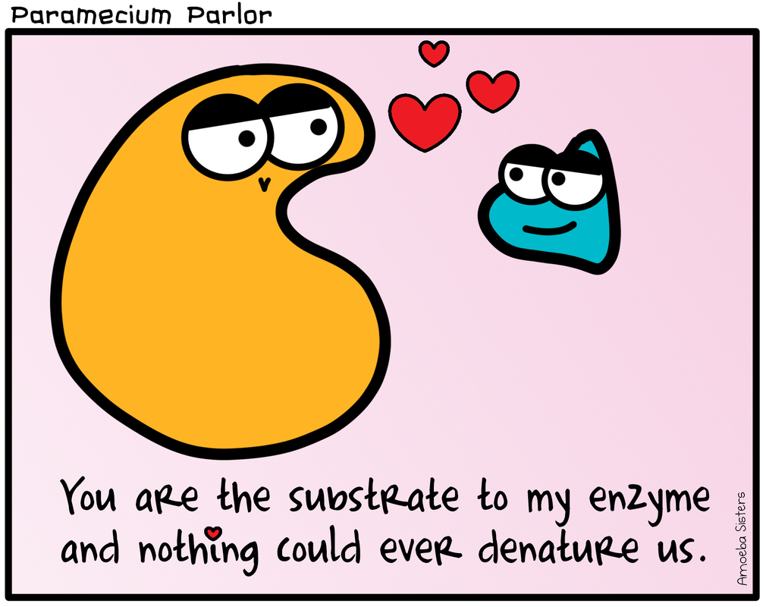
https://www.amoebasisters.com/parameciumparlorcomics/previous/55

Slide 7
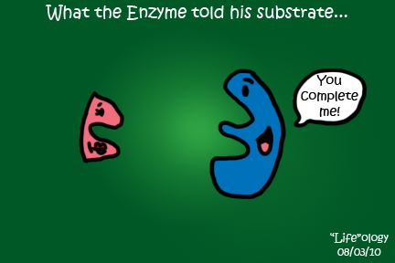
http://biochemistryisagoodthing.files.wordpress.com/2013/03/enzyme___substrate_by_bltshop.png

Slide 8
https://i.pinimg.com/736x/06/2f/cc/062fcc91bca1baa8ff929a211d8f7ca6.jpg

