Slide 1
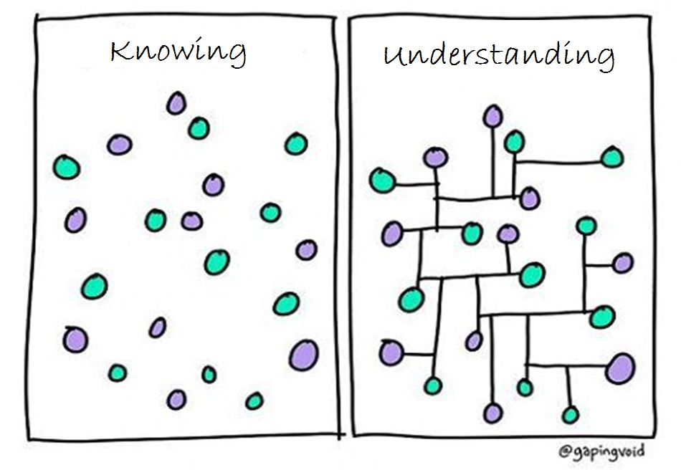
Image modified from: https://www.pinterest.com/pin/50313720815813086/

Slide 2
https://s-media-cache-ak0.pinimg.com/originals/71/4b/ba/714bba5df49188a23d9cfca24e6b114a.jpg

Slide 3
https://www.pinterest.com/pin/50313720817083952/

Slide 4
https://www.pinterest.com/pin/AchZDwm4IYPJsQLESVYqBjGVYNNxDEGYeE_rHaOisGZfy_lQHZmOCuA/

Slide 5
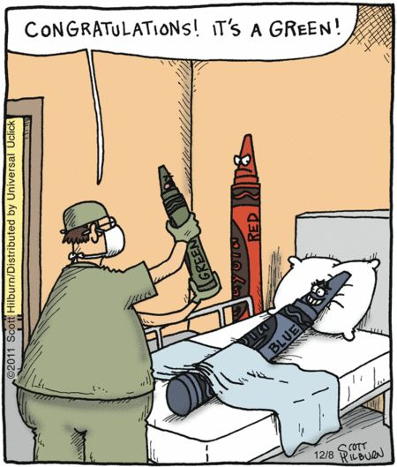
https://www.pinterest.com/pin/AVRv1r8mXbZID8e5QC5RujXT6rUcWCIwMWl5AoGTPL534cVXbbo1bN8/

Slide 6
http://i0.kym-cdn.com/photos/images/newsfeed/000/543/764/255.jpg/

Slide 7
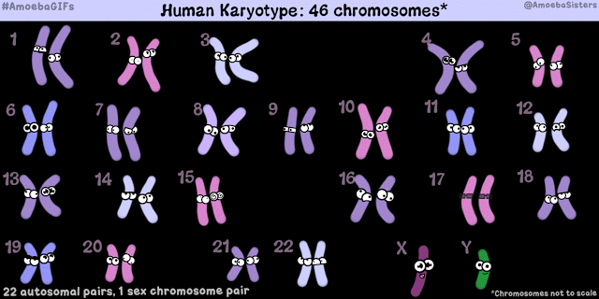
https://amoebasistersgifs.blogspot.com/

Slide 8
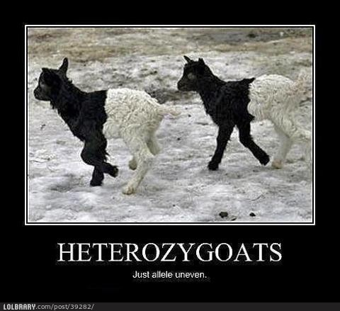
https://s-media-cache-ak0.pinimg.com/originals/1f/f7/12/1ff712469b5bdc1fe8050d4811c5d8dc.jpg

Slide 9
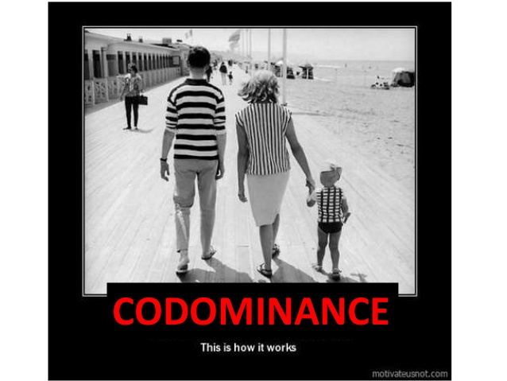
http://image.slidesharecdn.com/igcsebiologyedexcell3-140916213334-phpapp02/95/igcse-biology-edexcel-313-333-25-638.jpg?cb=1410905753

Slide 10
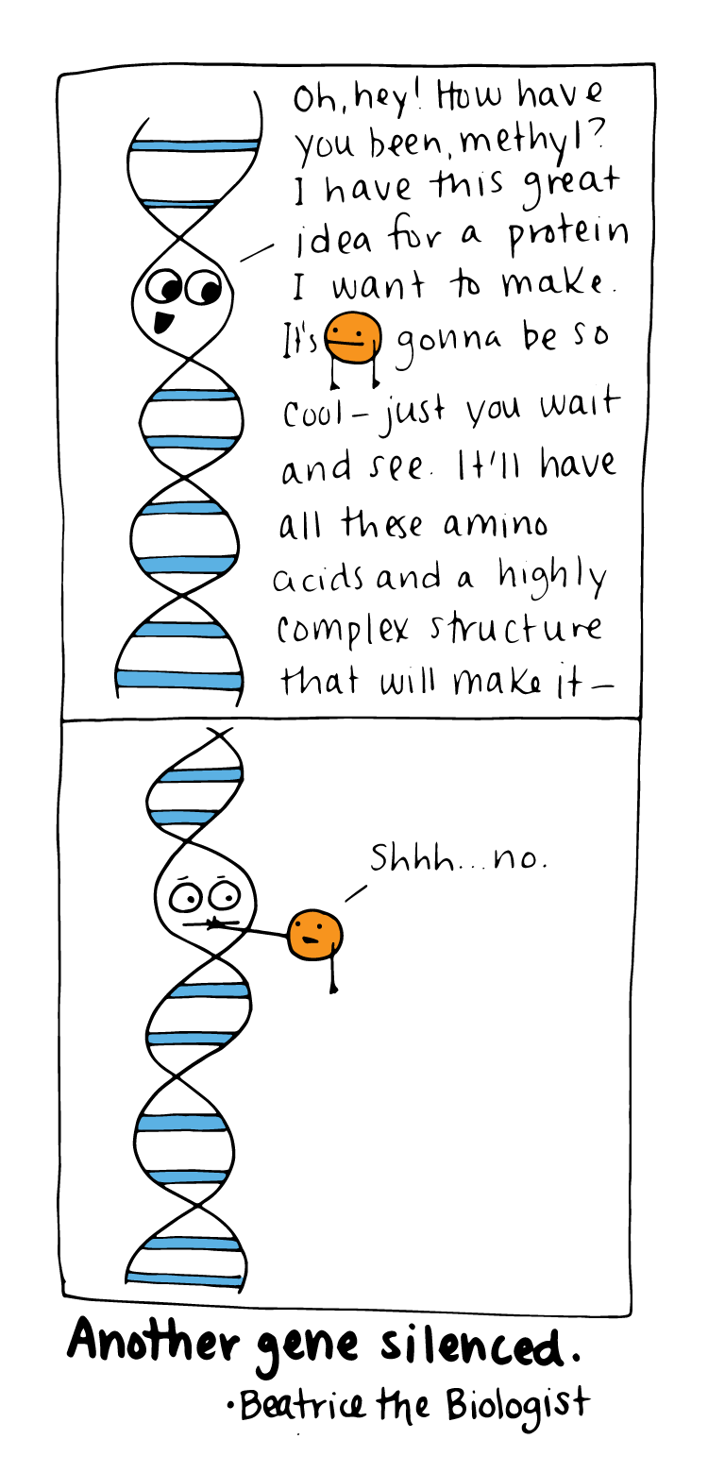
http://www.beatricebiologist.com/2016/06/gene-silencing/

Slide 11
https://www.pinterest.com/pin/50313720816586095/

Slide 12
http://www.amoebasisters.com/parameciumparlorcomics

Slide 13
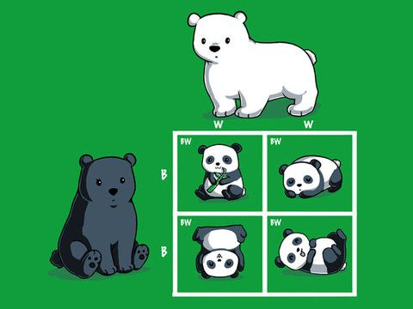
https://s-media-cache-ak0.pinimg.com/564x/e7/ba/24/e7ba24e1bb6d583e6ef58e0ff61b911f.jpg

Slide 14
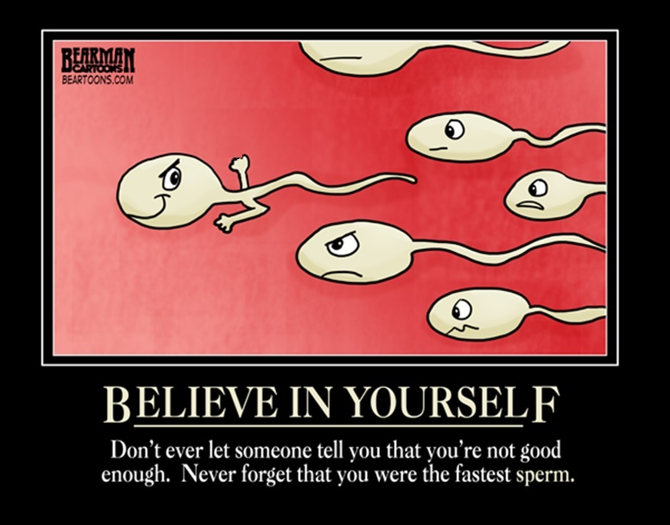
Image edited from: https://s-media-cache-ak0.pinimg.com/originals/b3/48/68/b348680b5573528b0472c3c0fad01362.jpg

Slide 15
https://www.pinterest.com/pin/50313720817037649/

Slide 16
http://www.cartoonistgroup.com/properties/fande/art_images/cg4b8fef7322dff0.jpg

Slide 17
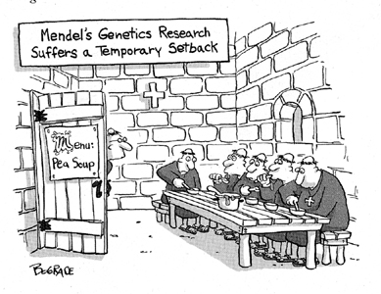
http://grade-11-biology-bethune.wikispaces.com/

Slide 18
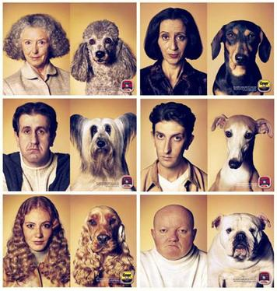
http://grade-11-biology-bethune.wikispaces.com

Slide 19
https://i.ytimg.com/vi/YJHGfbW55l0/hqdefault.jpg

Slide 20
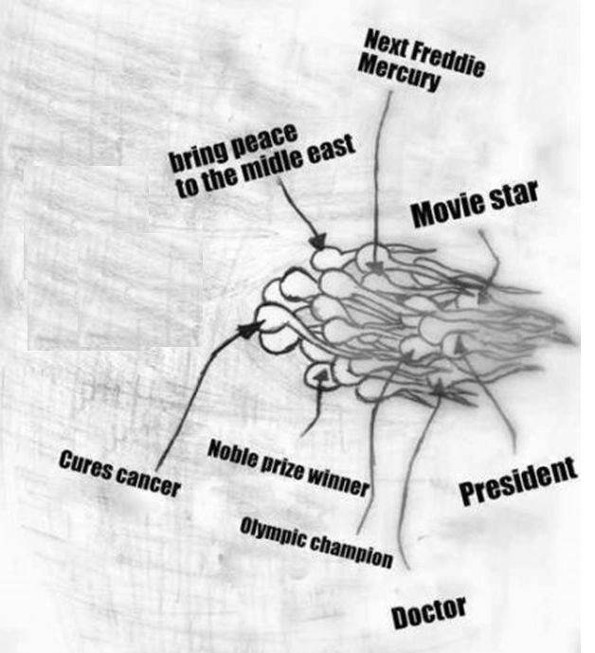
Image modified from: http://images1.tickld.com/live/183591.jpg

Slide 21
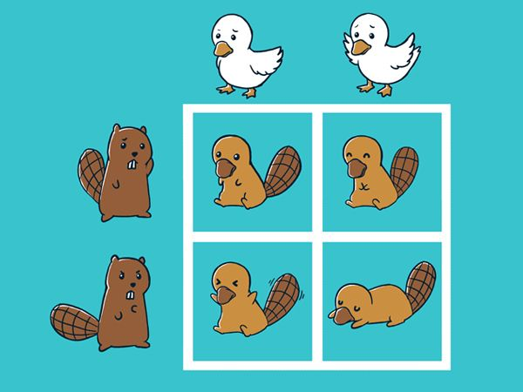
https://s-media-cache-ak0.pinimg.com/736x/1b/b3/f0/1bb3f0423a3a91b52b4e76eb528fb64e.jpg

Slide 22
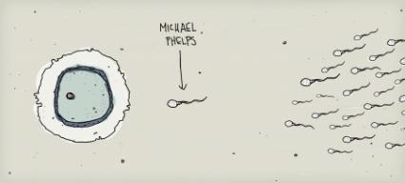
http://notaniche.com/wp-content/uploads/2008/08/michael-helps-baby-picture.jpg

Slide 23
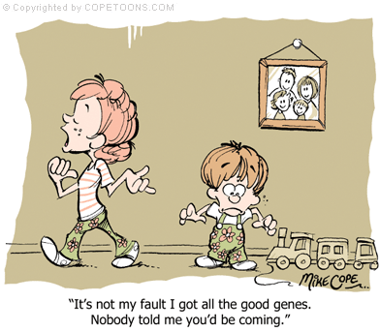
http://innolearn.weebly.com/uploads/2/5/9/3/25936499/116457590.gif

Slide 24
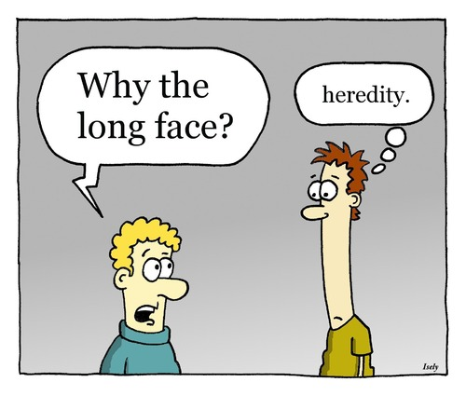
http://4.bp.blogspot.com/-wxE0HqQ8ln4/UMitjXOIttI/AAAAAAAABcM/-lS7hOjwflE/s1600/heredity.jpg

Slide 25
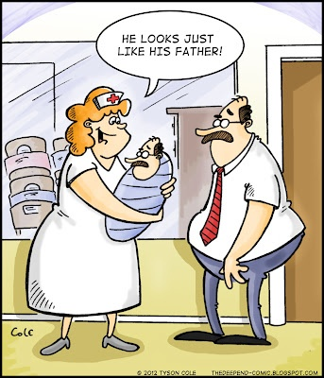
https://s-media-cache-ak0.pinimg.com/736x/e6/57/44/e6574439438564943fb320c3a5be7b76.jpg

Slide 26
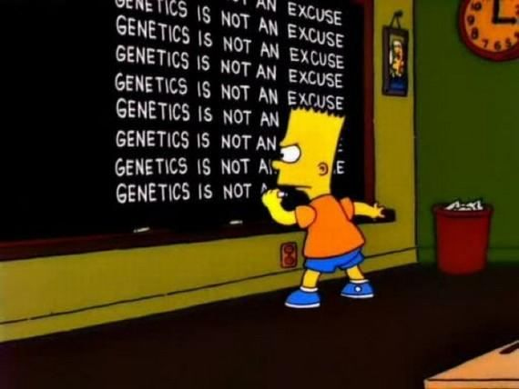
https://s-media-cache-ak0.pinimg.com/736x/7b/cb/6c/7bcb6c20635674235213dbe98e4b6573.jpg

Slide 27
RANDOM FERTILIZATION
Average male between ages 15-30 makes 200,000,000-300,000,000 sperm/day
Females born with 1-2 million immature eggs Releases 400-500 mature eggs in lifetime
Egg 2²³ = 8.4 million possible combinations
Sperm 2²³ = 8.4 million possible combinations
2²³ X 2 ²³ ~ 70 trillion diploid combinations
(This doesn’t include crossing over!)
Odds of one particular egg getting together with one particular sperm is astronomical. EVERYONE IS UNIQUE!

Slide 28
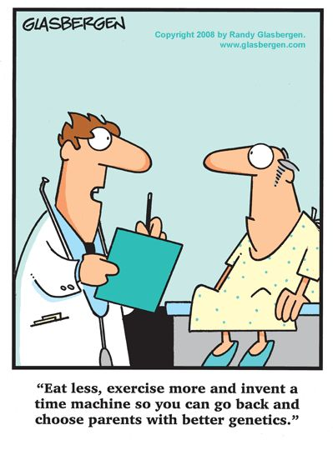
https://www.pinterest.com/pin/50313720809187358/

Slide 29
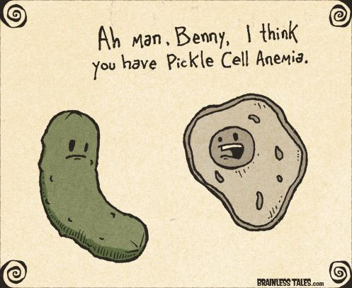
https://www.pinterest.com/pin/50313720817118197/

Slide 30
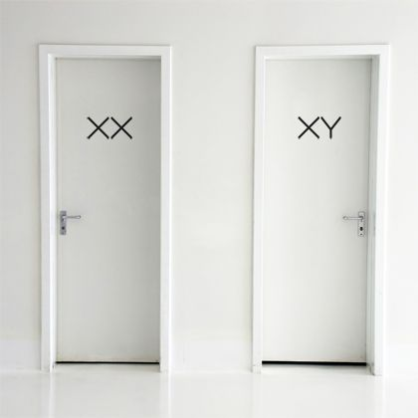
https://www.pinterest.com/pin/50313720817101314/

Slide 31
https://www.pinterest.com/pin/50313720817088499/

Slide 32
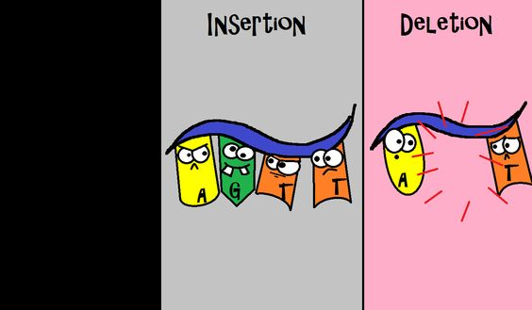
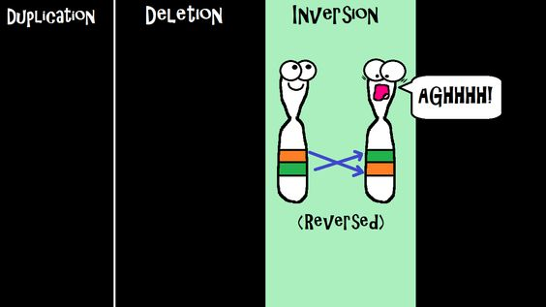
https://www.pinterest.com/pin/536772849322383541/

Slide 34
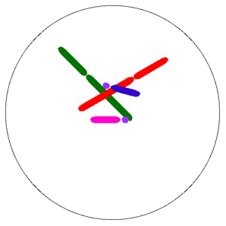
Nondisjunction
http://www.tokyo-med.ac.jp/genet/anm/domov.gif

Slide 35
Images from: http://www.bbc.co.uk/scotland/education/bitesize/higher/img/biology/genetics_adaptation/mutations/02gene_mutation.gif

Slide 36
Images from: http://www.bbc.co.uk/scotland/education/bitesize/higher/img/biology/genetics_adaptation/mutations/02gene_mutation.gif

Slide 37
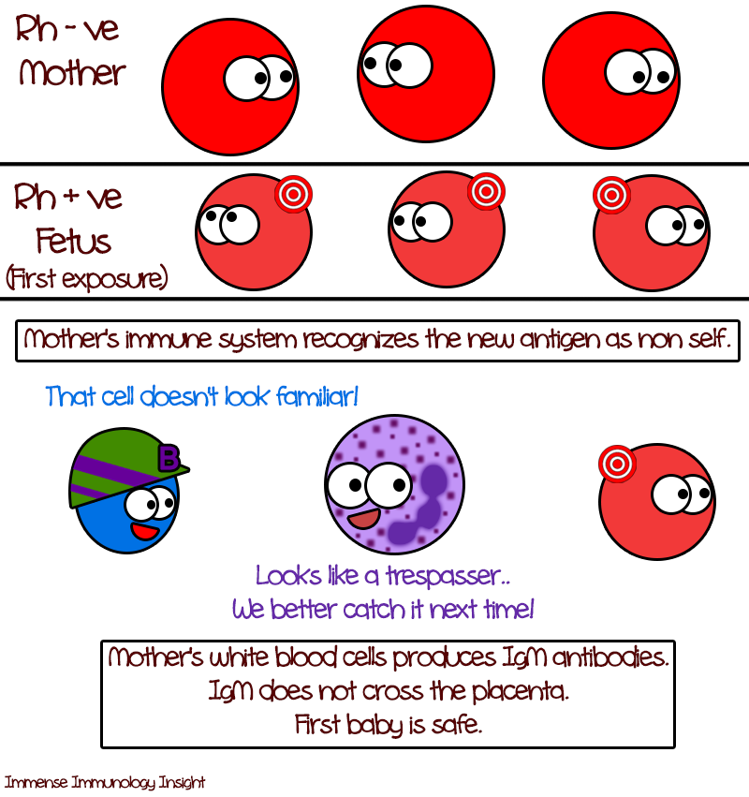
http://4.bp.blogspot.com/-TWC7uCd33JA/Uo8agNN2t_I/AAAAAAAABSM/ZcPZ7hmYdSg/s1600/rh2.png

Slide 38
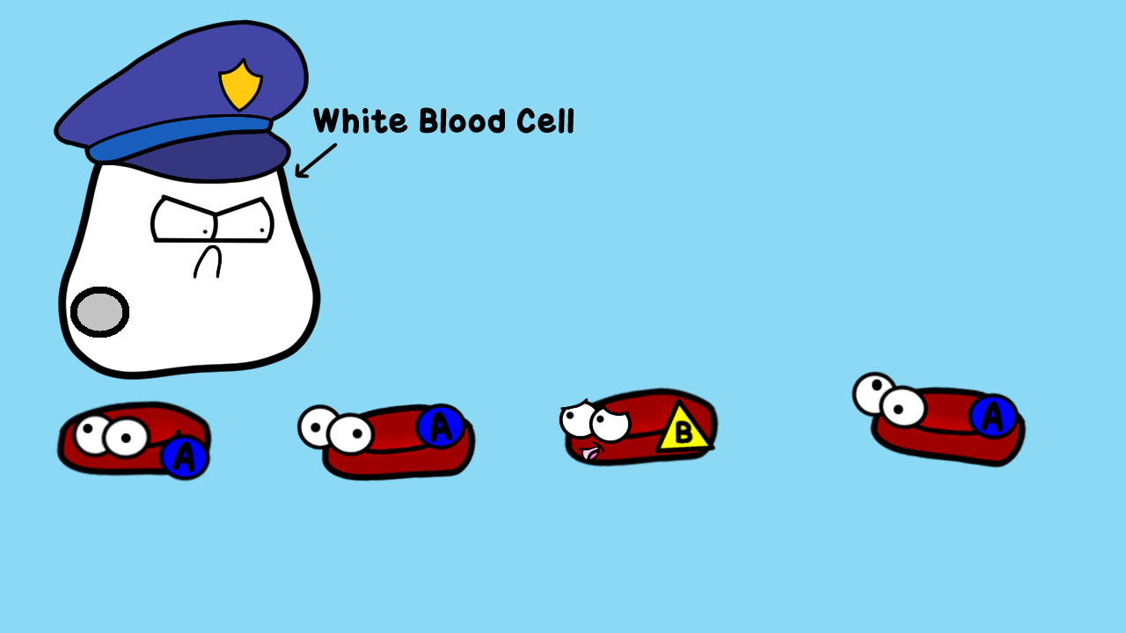
https://s-media-cache-ak0.pinimg.com/originals/4a/98/72/4a9872a36851adc4e1dc683332f4a5e0.jpg

Slide 39
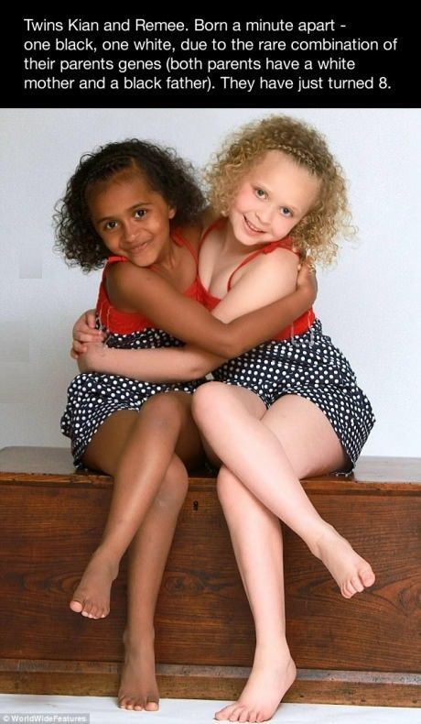
https://www.pinterest.com/pin/50313720817085606/

Slide 40
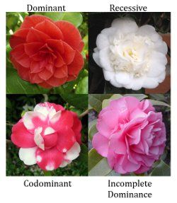
https://www.pinterest.com/pin/50313720817042644/

Slide 41
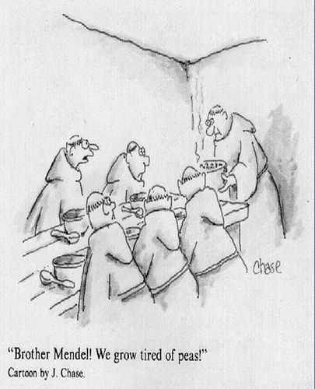
https://www.pinterest.com/pin/50313720817084940/

Slide 42
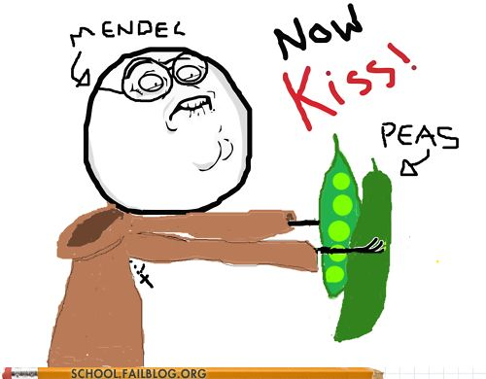
https://www.pinterest.com/pin/50313720817088802/

Slide 43
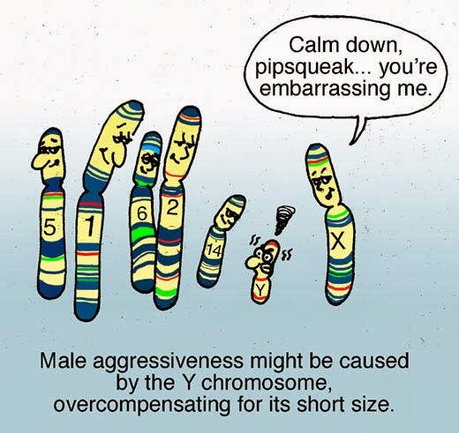
https://www.pinterest.com/pin/50313720817084956/

Slide 44
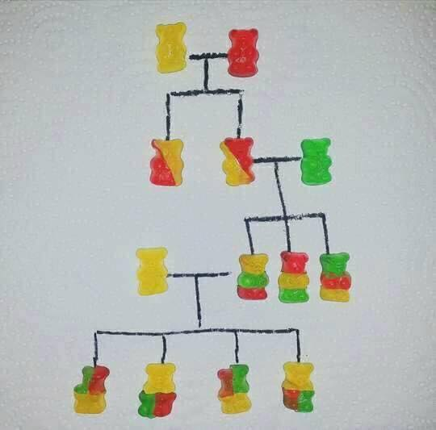
https://www.facebook.com/photo.php?fbid=10212531203819065&set=gm.1846715275594911&type=3&theater

Slide 45
https://www.amoebasisters.com/uploads/2/1/9/0/21902384/published/foil-amoeba-sisters-gif_1.gif?1547409703

Slide 46
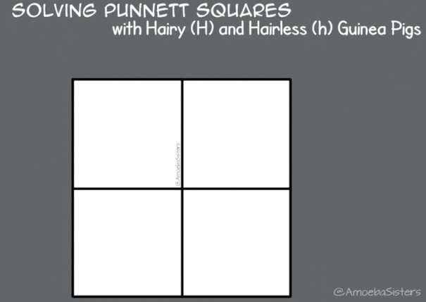
https://www.amoebasisters.com/uploads/2/1/9/0/21902384/published/punnett-square-gif_1.gif?1547324763

