Slide 1
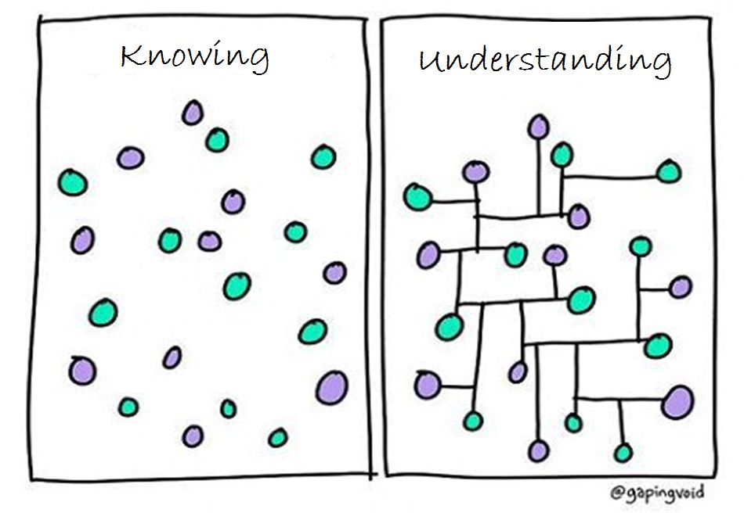
Image modified from: https://www.pinterest.com/pin/50313720815813086/

Slide 2
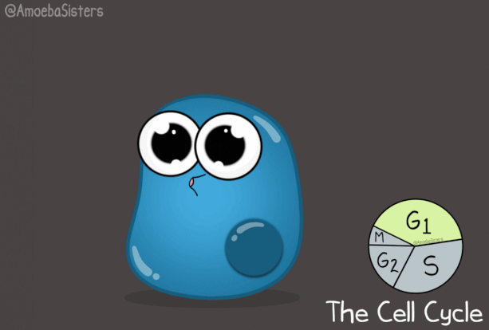
https://www.amoebasisters.com/uploads/2/1/9/0/21902384/published/cell-cycle-gif.gif?1531420726

Slide 3
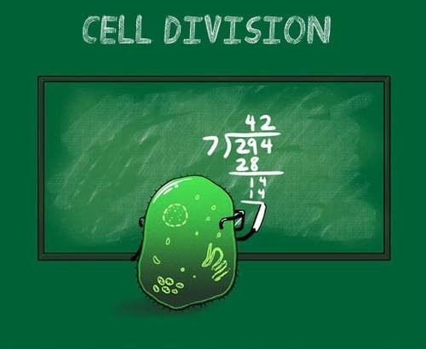
https://www.facebook.com/Carolina.Biological/photos/a.467232003653.259865.173476278653/10151636682028654/?type=1&theater

Slide 4
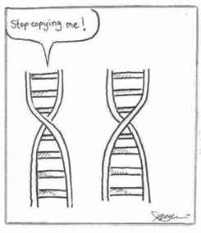

Slide 5
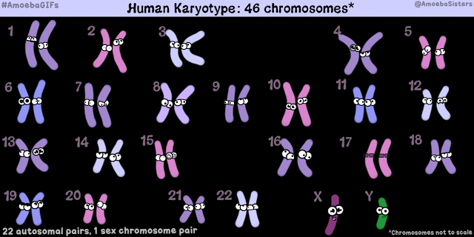
https://amoebasistersgifs.blogspot.com/

Slide 6
https://www.pinterest.com/pin/50313720816545645/

Slide 7
http://i100.photobucket.com/albums/m2/blueufoshow/mitosis.gif

Slide 9
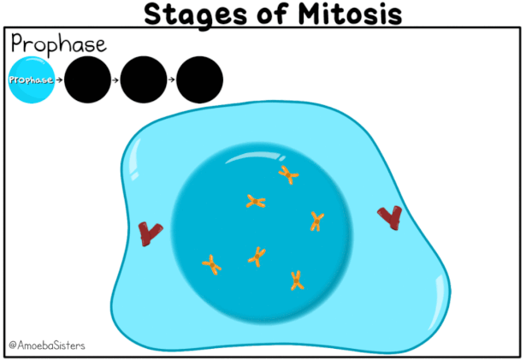
https://www.amoebasisters.com/uploads/2/1/9/0/21902384/published/stages-of-mitosis-gif.gif?1530910669

Slide 10
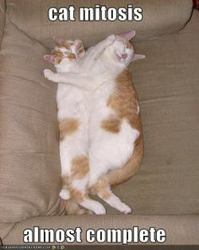
https://s-media-cache-ak0.pinimg.com/236x/f7/be/6f/f7be6fd800f3321aa921db08dad2c369.jpg

Slide 11
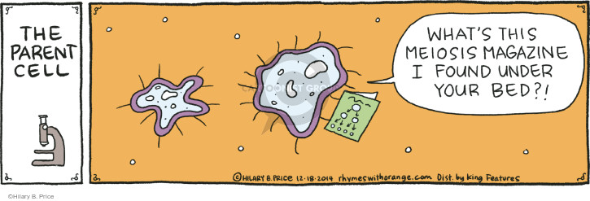
https://i2.wp.com/www.cartoonistgroup.com/properties/rhymeswithorange/art_images/cg5483ba8659eb0.jpg

Slide 12
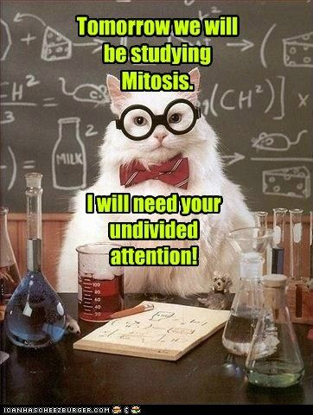
https://www.pinterest.com/pin/50313720816864615/

Slide 13
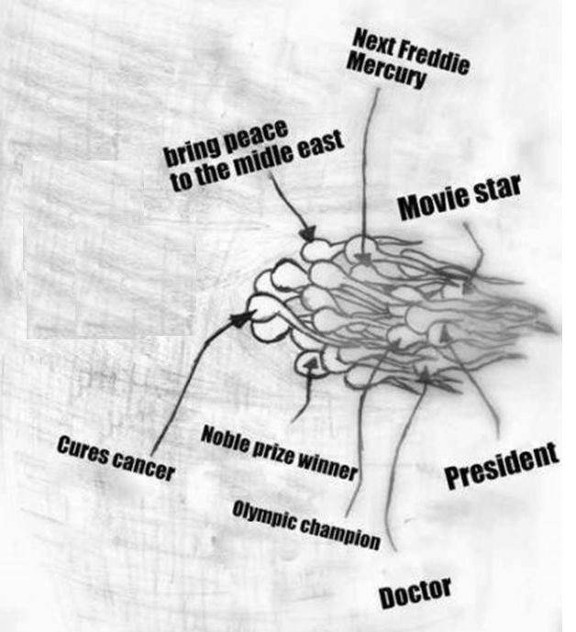
Image modified from: http://images1.tickld.com/live/183591.jpg

Slide 14
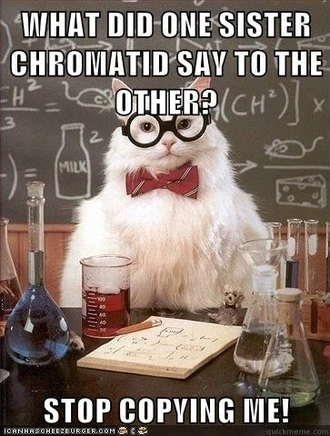
https://www.pinterest.com/pin/50313720816864616/

Slide 15
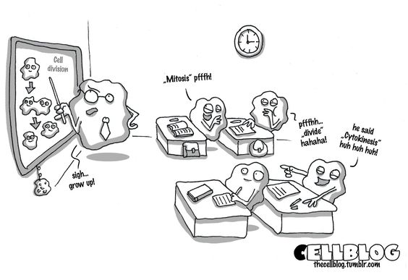
https://www.pinterest.com/pin/50313720816619807/

Slide 16
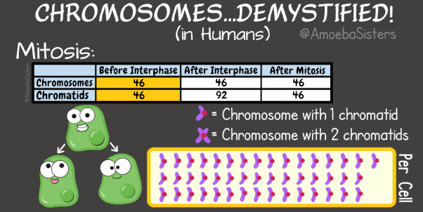
https://www.amoebasisters.com/uploads/2/1/9/0/21902384/published/chromosome-chart-mitosis-gif-version.gif?1530910678

Slide 17
https://www.amoebasisters.com/uploads/2/1/9/0/21902384/editor/chromosome-chart-meiosis-gif-version.gif?1530850945

Slide 18
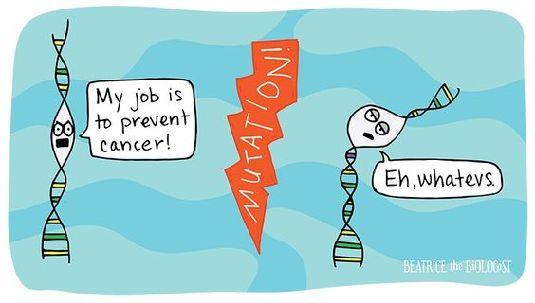
https://www.pinterest.com/pin/50313720816820318/

Slide 19
RANDOM FERTILIZATION
Average male between ages 15-30 makes 200,000,000-300,000,000 sperm/day
Females born with 1-2 million immature eggs Releases 400-500 mature eggs in lifetime
Egg 2²³ = 8.4 million possible combinations
Sperm 2²³ = 8.4 million possible combinations
2²³ X 2 ²³ ~ 70 trillion diploid combinations
(This doesn’t include crossing over!)
Odds of one particular egg getting together with one particular sperm is astronomical. EVERYONE IS UNIQUE!

Slide 20
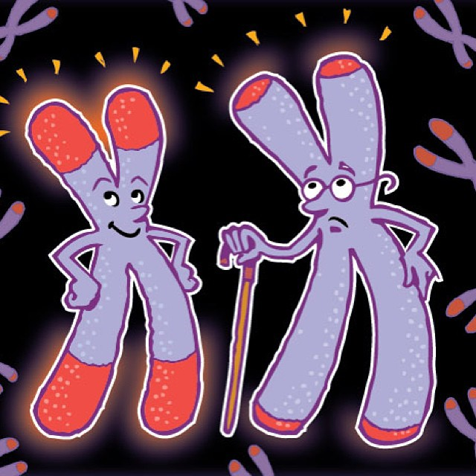
http://www.telomeretesting.net/telomeres-image-nasa.jpg

Slide 21
https://www.buzzfeed.com/kellyoakes/biology-jokes?utm_term=.xh8ZXp141#.cemkZPVWV

Slide 22
https://amoebasistersgifs.blogspot.com/

Slide 23
https://amoebasistersgifs.blogspot.com/

Slide 24
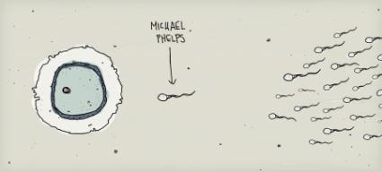
http://notaniche.com/wp-content/uploads/2008/08/michael-helps-baby-picture.jpg

Slide 25
https://www.pinterest.com/pin/Aa9QwWq96pktAEMWSFdrfc6aO1bXDZ3LbfupTAOzjH0z77KC99b4cEA/

Slide 26
https://s-media-cache-ak0.pinimg.com/736x/fd/20/0d/fd200d0cc4b0b1d334773044e8879a24.jpg

Slide 27
https://www.pinterest.com/pin/50313720817030286/

Slide 28
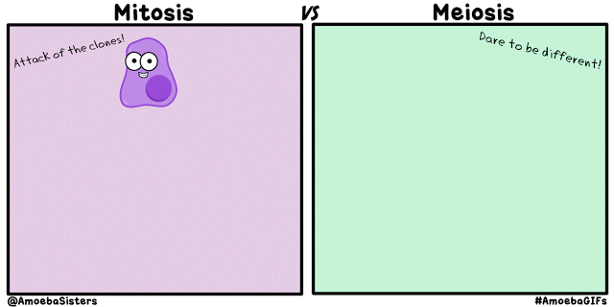
https://amoebasistersgifs.blogspot.com/2015/10/mitosis-vs-meiosis.html

Slide 29
https://s-media-cache-ak0.pinimg.com/originals/a5/0d/5c/a50d5c9476ccd13d6700c0af107d332d.jpg

Slide 30
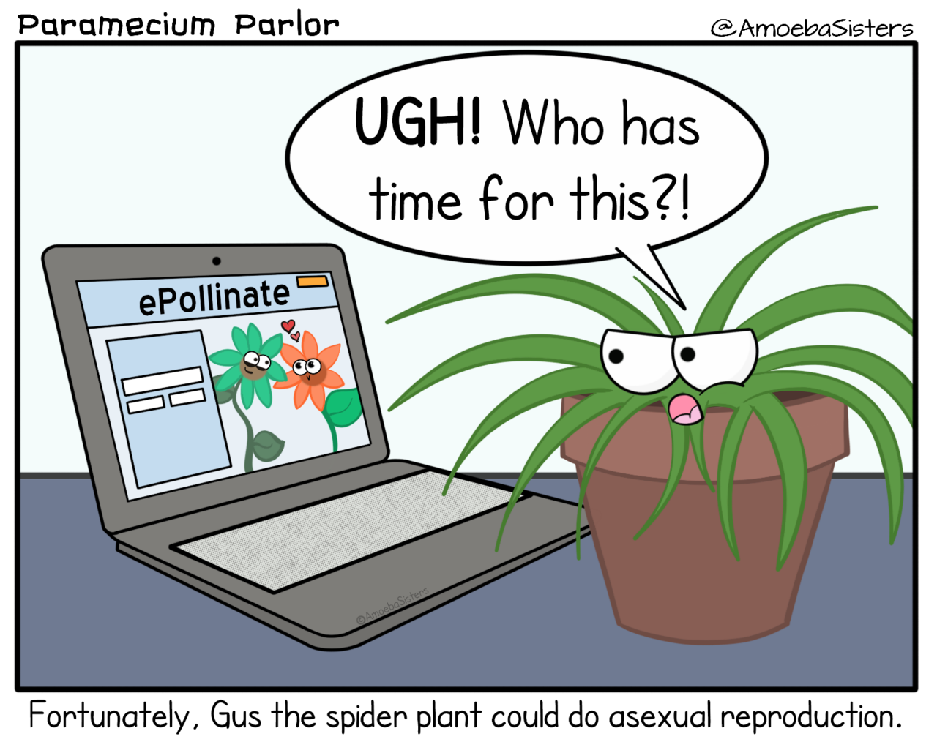
https://amoebasisters.tumblr.com/image/180123110990
WATCH VIDEO

Slide 31
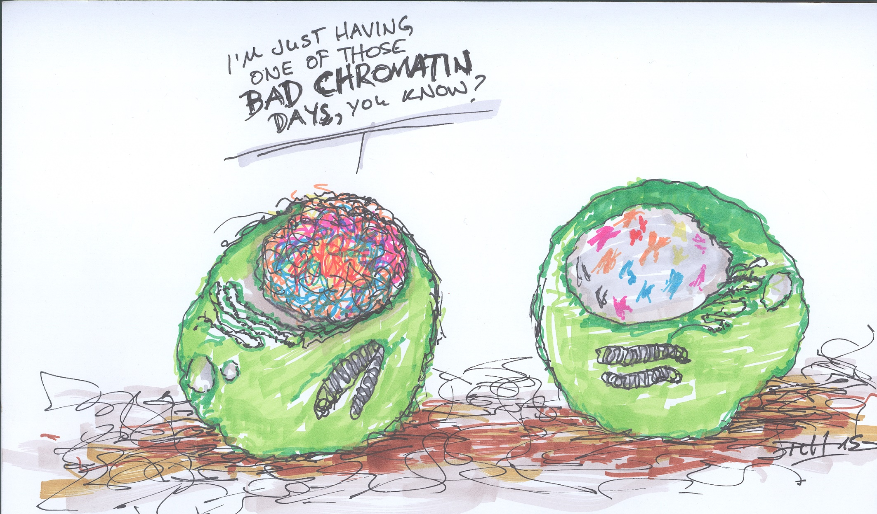
https://goodsciencewriting.files.wordpress.com/2016/01/unbenannt-15.jpg

