Slide 1
The human body System
By Spencer Wermers
Period 4

Slide 2
The Digestive System
The digestive system turns food into energy for your body to run on.
The digestive system is composed of many organs that work together to get you energy you need to survive.

Slide 3
Organs of Digestive System
Alimentary Organs
Mouth
The mouth is the beginning of the digestive tract; and, in fact, digestion starts. Chewing breaks the food into pieces that are more easily digested, while saliva mixes with food to begin the process of breaking it down into a form your body can absorb and use.
Pharynx
The pharynx is the portion of the digestive tract that receives the food from your mouth.
Esophagus
The esophagus is a muscular tube extending from the pharynx and behind the trachea to the stomach. Food is pushed through the esophagus and into the stomach by means of a series of contractions called peristalsis.

Slide 4
Organs of Digestive System
Stomach
The stomach is a sac-like organ with strong muscular walls. In addition to holding food, it serves as the mixer and grinder of food. The stomach secretes acid and powerful enzymes that continue the process of breaking the food down and changing it to a consistency of liquid or paste.
Small Intestine
Made up of three segments -- the duodenum, jejunum, and ileum -- the small intestine also breaks down food using enzymes released by the pancreas and bile from the liver. Peristalsis is also at work in this organ, moving food through and mixing it up with the digestive secretions from the pancreas and liver, including bile. The duodenum is largely responsible for the continuing breakdown process, with the jejunum and ileum being mainly responsible for absorption of nutrients into the bloodstream.

Slide 5
Organs of Digestive System
Large Intestine
The large intestine is a highly specialized organ that is responsible for processing waste so that defecation is easy and convenient. Made up of the ascending colon, the transverse colon, the descending colon and the sigmoid colon.
Rectum
Storage place where fecal matter is stored before it leaves the body.
Anus
The anus is the last part of the digestive tract. It consists of the muscles that line the pelvis and two other muscles called anal sphincters.

Slide 6
Organs of Digestive System
Accessory Organs
Salivary Glands
Liver
Pancreas
Gallbladder

Slide 7
Digestion
The digestion of large food molecules is very important. It makes it small enough to get all the way through your digestive system and to get all the nutrients your body needs.
Enzymes are a big part in digestion they break down all of the nutrients and help them absorb into your body to help you survive.

Slide 8
Physical and Chemical Digestion
Physical Digestion- Starts when you chew your food.
Chemical Digestion- Saliva starts to break down proteins in your mouth, then your stomach acids breaks down a lot of fats and your intestine finishes the job.

Slide 9
Carb and Protein Digestion
Carbohydrate Digestion and Protein Digestion both occure in the mouth when the saliva breaks down all of the simple carbs and proteins before it continues to the rest of the digestion system.

Slide 10
Disorders
Irritable bowel syndrome- a disorder that leads to abdominal pain and cramping, changes in bowel movements, and other symptoms.
Crohn’s Disease- causes inflammation of the lining of your digestive tract, which can lead to abdominal pain, severe diarrhea and even malnutrition.

Slide 11
The Circulatory System
Function:
Transport gases, like oxygen from the lungs to cells around the body and carbon dioxide from the cells to the lungs.
Transport nutrients like glucose.
Transport wastes from cells to organs that play the role of eliminating them.
It contains cells that fight infections and defend against foreign bodies.
Maintains the pH levels and ionic concentration of fluids in the body.
Helps maintain the body temperature, this is especially important in warm blooded animals like humans.

Slide 12
Structure and Function of Blood Vessels
Blood vessels form a tubular network throughout the body that allows blood to flow from the heart to every body cell and then back to the heart.
The three types of blood vessels are arteries, capillaries, and veins.

Slide 13
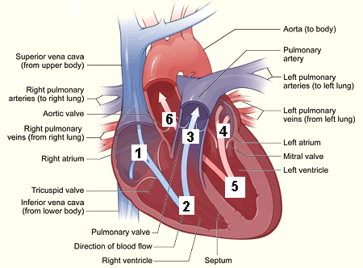
Blood Route

Slide 14
Blood Composition
Blood plasma makes 55% of total blood volume and the rest comprises the cellular components or the formed elements.

Slide 15
Erythrocytes
Also known as Red Blood Cells
Constitute 45% of blood by volume. They contain hemoglobin, that renders blood red in color. RBCs are produced in the bone marrow and they have a life cycle of 100-120 days. Mature RBCs are biconcave and flexible, lacking cell nucleus and organelles. The principle function is to deliver oxygen to different tissues of the body.

Slide 16
Open vs Closed Circulatory System
Open Circulatory System- Blood flows freely through the body and is not closed in any type of vessel.
Closed Circulatory System- Blood is contained in blood vessels that go through out the entire body and supply blood to all of the organs.

Slide 17
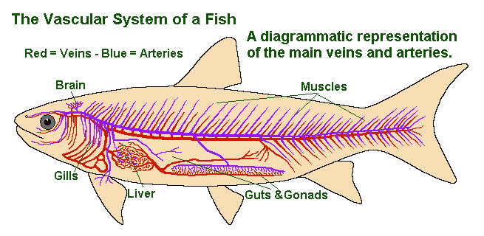
Fish Circulatory System

Slide 18
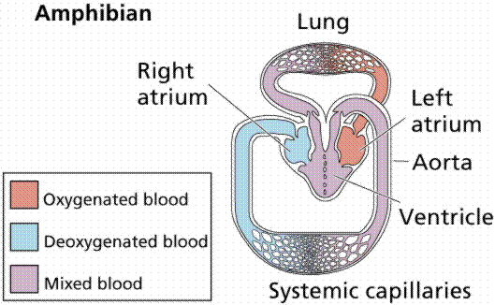
Amphibian Circulatory System

Slide 19
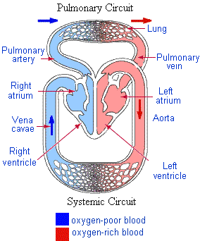
Reptile Circulatory System

Slide 20
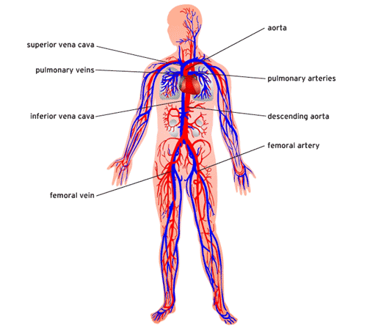
Mammal Circulatory System

Slide 21
Disorders
Abdominal Aortic Aneurysm-a localized ballooning of the abdominal aorta exceeding the normal diameter by more than 50 percent, and is the most common form of aortic aneurysm.
Cardiac arrhythmia- Abnormal electrical activity in the heart, the heart beat may be too fast or too slow, and may be regular or irregular.

Slide 22
Respiratory System
The primary function of the respiratory system is to supply the blood with oxygen in order for the blood to deliver oxygen to all parts of the body.

Slide 23
Alveoli
In the alveoli there is a net movement of oxygen into the blood and carbon dioxide out of the blood into the alveoli. 1. The alveoli is constructed of a very thin layer of cells to allow rapid diffusion of the gases. 2. They are surrounded by capillaries to bring them in contact with the blood. 3. They are small anve very numerous allowing for a large surface area to facilitate diffusion.

Slide 24
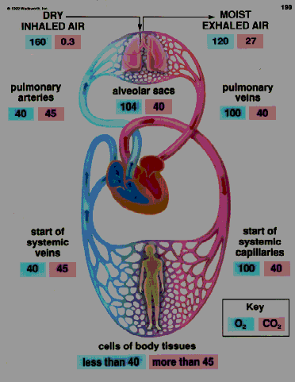
Transport of Oxygen and Carbon Dioxide

Slide 25
Oxygen Pathway
Pathway of air:
nasal cavities
pharynx
trachea
primary bronchi
secondary bronchi
tertiary bronchi
bronchioles
alveoli

Slide 26
Inhalation and Exhalation
Inhalation- Take in oxygen from the air to use in your body for your cells
Exhalation- Get rid of the carbon dioxide your body produced and give it of into the atmosphere.
The process that you use to do this is called breathing.

Slide 27
Disorders
Asthma- disorder that causes the airways of the lungs to swell and narrow, leading to wheezing, shortness of breath, chest tightness, and coughing.
Cystic Fibrosis- disease passed down through families that causes thick, sticky mucus to build up in the lungs, digestive tract, and other areas of the body.

Slide 28
Immune System
The function of the immune system is to defend you by destroying invaders (viruses and infections). one defense is to attack the invaders directly with white blood cells which contain a great amount of lysosomes.

Slide 29
Major Organs
Bone Marrow
Thymus Gland
Spleen
Lymph Nodes

Slide 30
Recognizing Pathogens
The Immune System recognizes that there is something in the body that shouldn’t be there and sends out anti-bodies to destroy the invaders.

Slide 31
Active Immunity vs Passive Immunity
Active Immunity- Active immunity refers to the process of exposing the body to an antigen to generate an adaptive immune response- can give lifelong protection.
Passive Immunity- Passive immunity refers to the process of providing IgG antibodies to protect against infection; it gives immediate, but short-lived protection.

Slide 32
Disorders
Primary Immunodeficiency- Someone is born without part of their immune system making them more susceptible to diseases.
HIV/AIDS- HIV causes the immune system to break down which will lead to AIDS and cause death almost all the time.

Slide 33
Excretory System
Get rid of wastes
Eliminates useless by-products excreted from cells
Eradicates harmful chemical build-ups
Maintains a steady, balanced chemical concentration

Slide 34
Different Types of Nitrogen Waste
Ammonia- Aquatic Animals
Urea- Mammals
Uric Acid- Birds

Slide 35
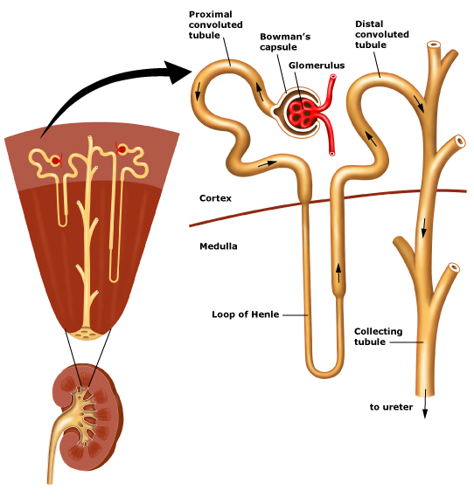
Excretory Process

Slide 36
Disorders
Nephritis- an inflammatory condition that affects a component of the kidneys called nephrons.
Cystitis- an inflammatory condition that affects the bladder. It is caused by a bacterial infection which typically enters the body through the urethra.

Slide 37
Endocrine System
The endocrine system is instrumental in regulating mood, growth and development, tissue function, metabolism, and sexual function and reproductive processes.

Slide 38
Homeostasis
Homeostasis maintain the blood temperature the water content and also the blood sugar level of your body and makes sure that it doesn’t get to high or to low for your body.

Slide 39
Negative Feed Back
Sometimes it tells your body that there is something wrong with it when its really fine. An example of this is the blood sugar level.

Slide 40
Disorders
Menopause- Natural part in a woman's life where her period stop and she can no longer get pregnant.
Diabetes I vs Diabetes II- In type one diabetes your body produces no insulin at all and in type 2 your body produces some just not enough insulin.

Slide 41
Reproductive System
Organs in both the male and female body that are used in the process of reproduction and caring for a newborn.

Slide 42
Sexual vs Asexual Reproduction
Sexual Reproduction- When a male and female have sex in order to reproduce and create offspring.
Asexual Reproduction- Only one organism is needed to produce offspring.
Fission
Budding
Spore Formation

Slide 43
Spermatogenesis
Spermatogenesis is the process and development of spermatozoa into mature sperm that can be used to produce offspring.

Slide 44
Oogenesis
The process and development of an ovum that matures the ovaries to be used in reproduction.

Slide 45
Menstrual Cycle vs Estrous Cycle
Estrous Cycle happens in almost all mammals while the menstrual cycle happens in humans and some large primates only.
Both keep the hormones in check for the females body.

Slide 46
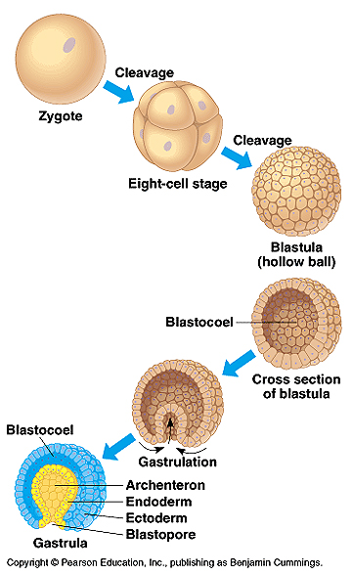
Develoment

Slide 47
Disorders
Endometriosis- Endometriosis is a female health disorder that occurs when cells from the lining of the womb (uterus) grow in other areas of the body. This can lead to pain, irregular bleeding, and problems getting pregnant.
Cervical Cancer- Cervical cancer is cancer that starts in the cervix, the lower part of the uterus (womb) that opens at the top of the vagina.

Slide 48
Nervous System
The main function of the nervous system is sending information from one cell to another cell and passing it down the line

Slide 49
Central Nervous System
The main part of the nervous system.
It is made up of the two most important organs in the human body; the brain and the spinal cord.

Slide 50
Peripheral Nervous System
Connects all of the nervous system together so it is able to communicate with itself.
Made up of sensory neurons, and nerves which connect them to each other.

Slide 51
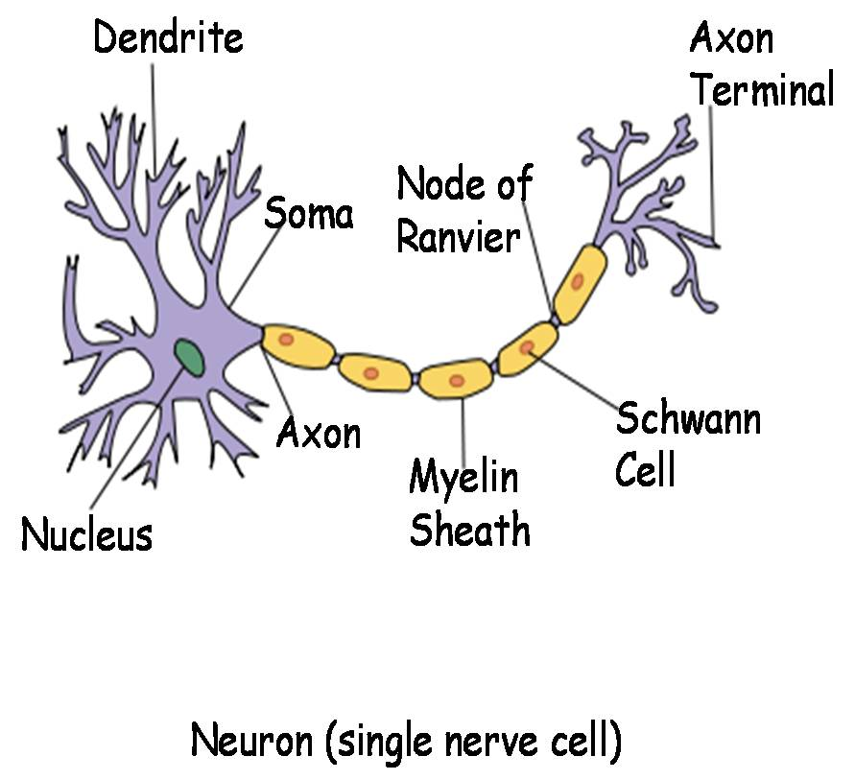
Path of a “Message”

Slide 52
Neurotransmitter
Chemicals that pass from one neuron to another that pass the information down the line until it will finally reach the brain and the information is received.

Slide 53
Disorders
Alzheimer's disease - A progressive, degenerative disease that occurs in the brain and results in impaired memory, thinking, and behavior.
Cerebral thrombosis - the most common type of brain attack; occurs when a blood clot (thrombus) forms and blocks blood flow in an artery bringing blood to part of the brain.

Slide 54
Senses System
What allows you to see, smell, touch, taste, and hear

Slide 55
Receptors
Mechanoreceptors- detect changes in pressure, position, or acceleration; include receptors for touch, stretch, hearing, and equilibrium.
Thermoreceptors- detect hot or cold temperatures.
Chemoreceptors detect ions or molecules. Smell and taste rely on chemoreceptors.
Pain receptors detect severe heat and pressure and chemicals released by inflamed tissue.

Slide 56
Rhodopsin
Rhodopsin- A purplish-red light-sensitive pigment present in the retinas.
Signals to the cells what they are seeing.

Slide 57
Muscular System
Main function of the muscular system are:
Locomotion or mobility, strength, heat production, shock absorption, shaping the body, maintaining posture, and respiration. In addition it plays a role in the digestive process by peristalsis to move the food through. It is also essential for pumping blood and plays a role in smooth muscles of the blood vessels to raise blood pressure during the stress response. Muscles help the body to have mobility through the environment, and motility inside the body for its processes.

Slide 58
3 Types of Muscle Tissue
Cardiac-Cardiac muscle tissue forms the bulk of the wall of the heart. Like skeletal muscle tissue, it is striated Unlike skeletal muscle tissue, contraction is usually not under conscious control (involuntary).
Smooth-Smooth muscle tissue is located in the walls of hollow internal structures such as blood vessels, the stomach, intestines, and urinary bladder. Smooth muscle fibers are usually involuntary.
Skeletal-Skeletal muscle tissue is named for its location - attached to bones. It is striated; the fibers (cells) contain alternating light and dark bands (striations) that are perpendicular to the long axes of the fibers. Skeletal muscle tissue can be made to contract or relax by conscious control (voluntary).

Slide 59
Disorders
Cerebral Palsy- Cerebral Palsy is one of the muscular system diseases where a persons posture, balance and motor functions are affected. Brain damage during or before childbirth causes loss of muscle tone, causing problems carrying out physical tasks in children. It is one of the most common congenital disorders.
Polymyositis- Polymyositis is an inflammatory and degenerative muscular system disease. This is a systemic connective tissue disease that causes symmetric weakness and muscle atrophy to some extent.

Slide 60
Skeletal System
The skeletal system has 5 main function to it:
Support
Protection
Mineral Storage
Blood Cell Production
Movement

Slide 61
Roles in Movement
Bones- Support the muscle and give the muscles something to attach too.
Ligaments- Provide stability to the joints.
Muscles- Main organ in making everything move.
Tendons- Connect all of your muscles together and attach themselves to bones.

Slide 62
Types of Skeletal System
Hydrostatic Skelton-A hydrostatic skeleton consists of fluid under pressure. This type of skeletal system is most common in soft, flexible animals such as hydras, planarians, and earthworms and other segmented worms.
Exoskeleton- Skeleton outside of the body cavity. Mostly found in arthropods
Endoskeleton- Skeletal system inside the body that grows throughtout the species life. Most common type of skeletal system.

Slide 63
Disorders
Osteoporosis is a very common bone problem especially in older people, and found more in women. It occurs when there isn't enough deposition of calcium in our bones. Phosphorus and mainly calcium are required for a number of processes in our body. Bones are the main source of these minerals. If the loss of these minerals is not compensated, the bones become weak and susceptible to fractures. Osteoporosis may be caused due to old age, hormonal imbalance, genetic disposition, certain diseases like bone cancer, and lack of proper diet.
Scoliosis refers to the abnormal bending of the spinal colum to one side. Depending on the degree of curvature, a back brace may be used or the vertebrae may surgically be fused to remove the curvature. Scoliosis may be a birth defect or it may be caused due to connective tissue disorders, metabolic diseases or muscular dystrophy.

Slide 64
Sources
www.webmd.com
www.phschool.com
www.buzzle.com
www.ncbi.nlm.nih.gov
www.occmed.oxfordjournals.org
www.brianmac.co.uk
Mr. Caldwells Note Taking Guide

