Slide 1
Immune system

Slide 2
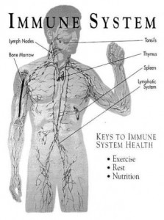
The function of the immune system is to defend the body against organisms and substances that invade body systems and cause disease

Slide 3
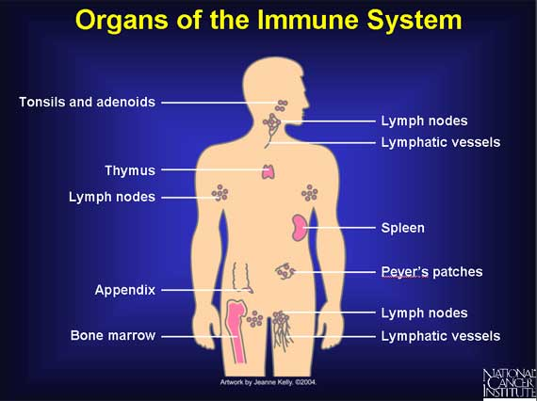
The organs of the immune system either make the cells that participate in the immune response or act as sites for immune response. The major organs of the immune system are bone marrow which produces immune cells, spleen where white blood cells gather to fight pathogens, thymus where t-lymphocytes mature.

Slide 4
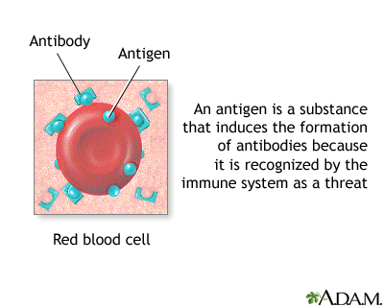
An antigen is a substance that reacts with antibody molecules and antigen receptors on lymphocytes. Chemically they are complex proteins and polysaccharides found on the outer membranes of bacteria, viruses, and other invaders

Slide 5
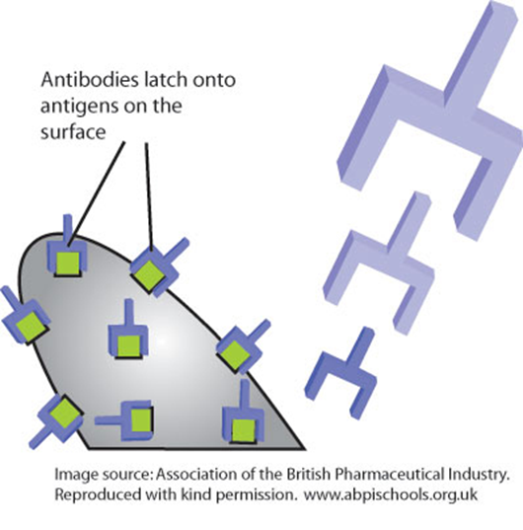
When an antigen is detected, several types of cells work together to recognize and respond to it. These cells trigger the B lymphocytes to produce antibodies. Antibodies recognize antigens and lock onto them, marking them for destruction Antibodies can also neutralize toxic substances produced by different organisms.

Slide 6
INNATE IMMUNITY Present from birth. Non-specific Does not become more efficient on repeated exposure works by: Prevention of entry of organisms by skin barriers, antibacterial secretions, and stomach acids Non-specific elimination of micro-organisms with phagocytes, fever INFLAMMATORY RESPONSE when vessels dilate to allow phagocytes access to microbes

Slide 7
Acquired immunity on the other hand, occurs in response to infection as the body must learn to eliminate previously unknown molecules. Following recovery from certain infections with a particular micro-organism, individuals are protected against one micro-organism. Immunity can be acquired from vaccines, infection or through the mother.

Slide 8
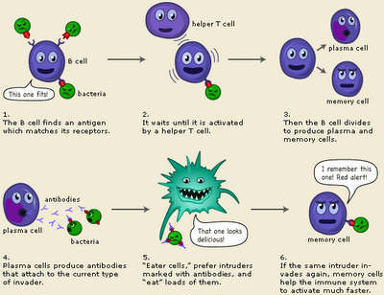
Active acquired immunity is produced when the body responses to a disease-causing agent and develops immunological memory, in the form of B-memory cells.

Slide 9
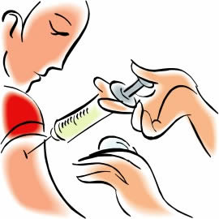
Passive immunity, unlike active immunity, is acquired through intake of antibodies, through vaccines or the placenta or through breastfeeding

Slide 10
Humoral immunity is a specific immunity which: is mediated by B lymphocytes involves the binding of antibodies to antigens together with cell-mediated ,constitutes acquired immunity. Cell-mediated immunity relies on MHC (major histocompatibility complex): markers on the surfaces of native cells. Cells lacking MHC are phagocytosed by macrophages. Cells too large to be phagocytosed, such as cancer cells, are destroyed by cytotoxic T-cells, when macrophages alert the body to the presence of invaders by releasing cytokines.

Slide 11
T-cells (named for the thymus where they mature
B-cells
Helper T cells are the main force of the immune defense:they activate B cells and killer T cells. However, the helper T cells themselves must be activated. This happens when a macrophage presents antigens at the nearest lymph node. When the receptor of a helper T cell recognizes the antigen, it is activated. The killer T cell is specialized in attacking cells of the body infected by viruses and sometimes also by bacteria. It can also attack cancer cells. The killer T cell has receptors that are used to search each cell that it meets. If a cell is infected, it is swiftly killed. Infected cells are recognized because tiny traces of the intruder, antigen, can be found on their surface.
The B-lymphocyte cell is activated when its antigen receptors are activated. It divides again and again to produce plasma cells, which produce antibodies that respond to the same antigen that matched the parent B-cell’s receptors, and b-memory cells

Slide 12
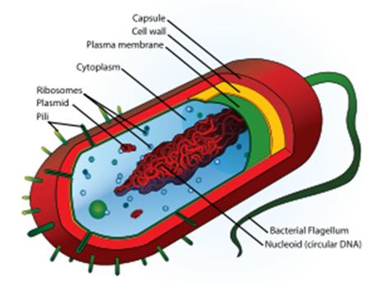
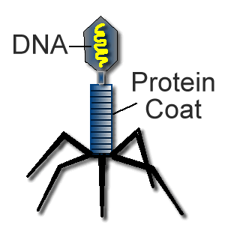
Most Anti-BIOTICS are ineffective against viruses because antibiotics interfere with the cell walls of bacteria. Viruses have protein coats, not peptidoglycan.

Slide 13
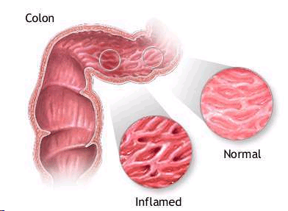
Inflammatory bowel disease (IBD). The immune system attacks the lining of the intestines, causing episodes of diarrhea, rectal bleeding, urgent bowel movements, abdominal pain, fever, and weight loss. Oral and injected immune-suppressing medicines can treat IBD. It is estimated that as many as 1.4 million persons in the United States suffer from this disease

Slide 14
HIV is a sexually transmitted disease that can also be spread by contact with infected blood, or from mother to child during pregnancy, childbirth or breast-feeding. It can take years before HIV weakens the immune system to the onset of AIDS.
The virus infects and kills cells of the immune system, destroying the ability to fight off secondary diseases like colds, fungi infections, pneumonia.
Many people do not develop symptoms after getting infected with HIV. Some people have a flu-like illness within several days to weeks after exposure to the virus. They complain of fever, headache, tiredness, and enlarged lymph glands in the neck. These symptoms usually disappear on their own within a few weeks.
The aim of antiretroviral treatment is to keep the amount of HIV in the body at a low level. This stops any weakening of the immune system and allows it to recover from any damage that HIV might have caused already.
At the end of 2008, an estimated 1,178,350 persons aged 13 and older were living with HIV infection in the United States.

Slide 15
http://kidshealth.org/parent/general/body_basics/immune.htm lhttp://flowproductions.org/tag/immune-system/ http://www.thebody.com/content/art6319.html http://www.thebody.com/content/art6319.html#slide5 http://www.microbiologybytes.com/iandi/1b.html http://nfs.unipv.it/nfs/minf/dispense/immunology/immun.html http://apbio82007.blogspot.com/2008/02/since-someone-did-not-post-sherpa-last.html http://drmmkapur.blogspot.com/2011/04/immune-system.html http://faculty.stcc.edu/AandP/AP/AP2pages/Units21to23/immune/cellmedimm.htm http://www.nobelprize.org/educational/medicine/immunity//immune-detail.html http://www.bronchitissymptomsinadults.org/ http://doctorsarathis.blogspot.com/2011/02/inflammatory-bowel-disease.html http://www.cdc.gov/hiv/topics/surveillance/basic.htm

