Slide 1
senses

Slide 2
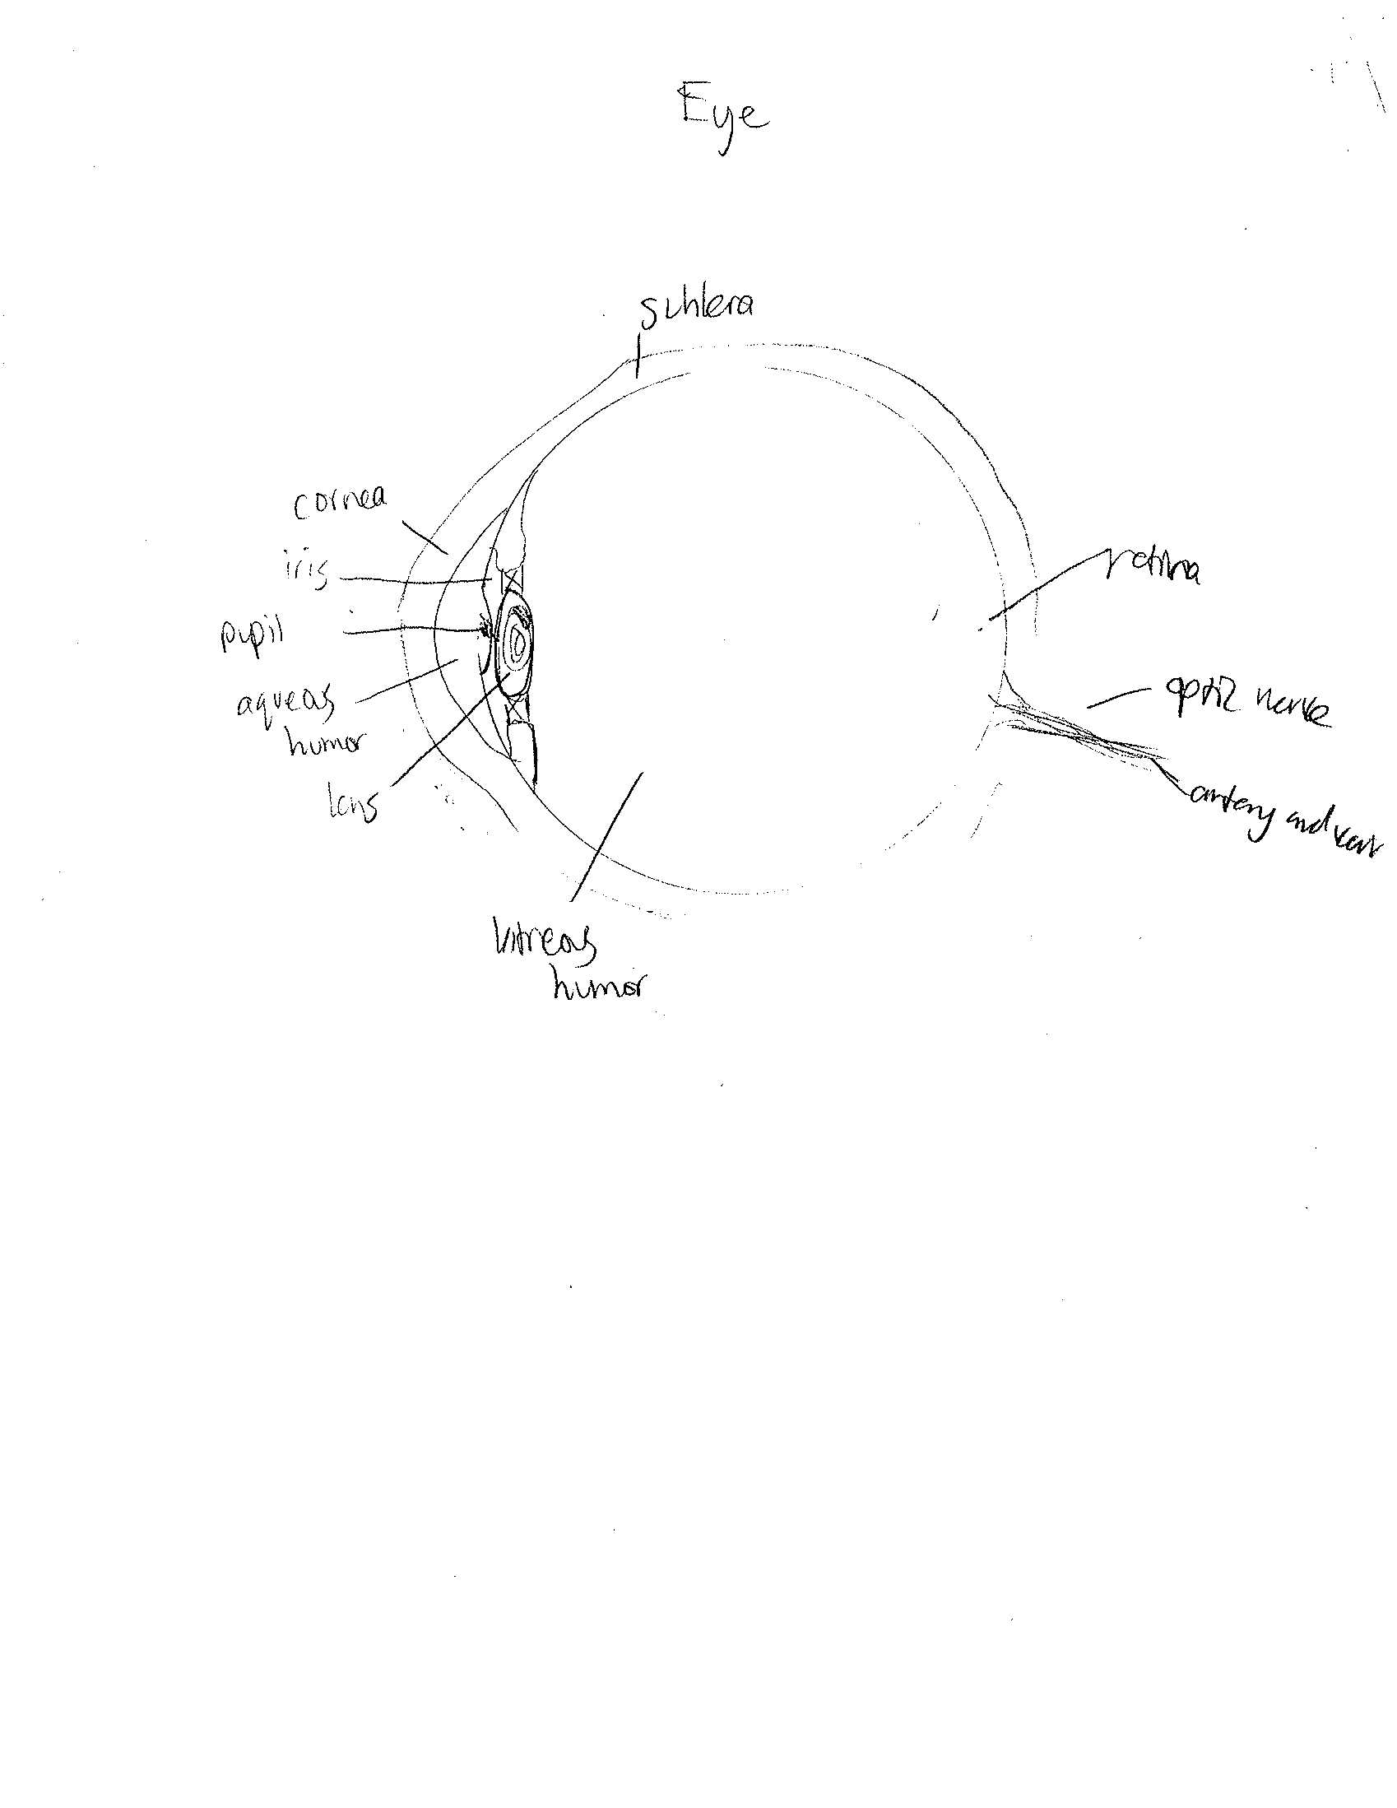

Slide 3
Three types of mechanoreceptors found in the skin:
Pacinian Corpuscles - rapidly adapting mechanoreceptors in your skin , often the most sensitive cells to very small changes in the stimulus, such as the tactile force.
Meissner's Corpuscles and hair follicle receptors - good examples of mechanoreceptors with moderate adaptation rates. These receptors can be located near the surface of the skin. Often used to sense insects landing on skin
Ruffini Endings, Merkel's Cells, and Tactile Disks - examples of slow adapting mechanoreceptors. These receptors are generally located near the surface of the skin, and are responsible for much of the static perceptive capabilities. For example, the sensitivity to temperature at the skin is generally of a slow-adapting type, as are many tactile sensors useful for maintaining grip on an object.

Slide 4
As their name suggests, Thermoreceptors perceive temperature sensations of objects the skin feels. They are found in the dermis layer of the skin.
Cold receptors start to perceive cold sensations when the surface of the skin drops below 95 º F. They are most stimulated when the surface of the skin is at 77 º F and are no longer stimulated when the surface of the skin drops below 41 º F. Hence why feet or hands start to go numb when they are submerged in icy water for a long period of time.
Hot receptors start to perceive hot sensations when the surface of the skin rises above 86 º F and are most stimulated at 113 º F. But beyond 113 º F, pain receptors take over to avoid damage being done to the skin and underlying tissues.
Thermoreceptors are found all over the body, but cold receptors are found in greater density than heat receptors. The highest concentration of thermoreceptors can be found in the face and ears, hence why those areas feel the coldest, quickest on a chilly, windy day.

Slide 5
Pain receptors: detect pain or stimuli that can cause damage to the skin and other tissues of the body. They are found in skin, muscles, bones, blood vessels, and some organs. Pain Receptors play an important part in keeping the body safe from serious injury or damage by sending these early warning signals to the brain.

Slide 6
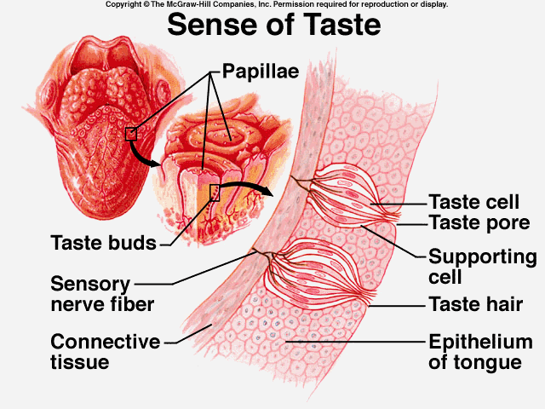
Chemoreceptors are specialized nerve cells which are designed to respond to chemical stimuli. Cells located on the tongue are an example of direct chemoreceptors. They are also located in the nose and brain, the former to sense odors and the latter to alert the brain of substances are ingested.

Slide 7
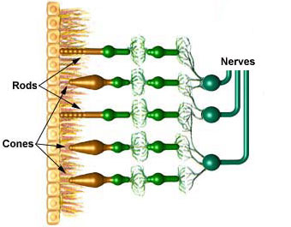
The retina contains two types of photoreceptors, rods and cones, that detect light and send information and images to the brain.

Slide 8
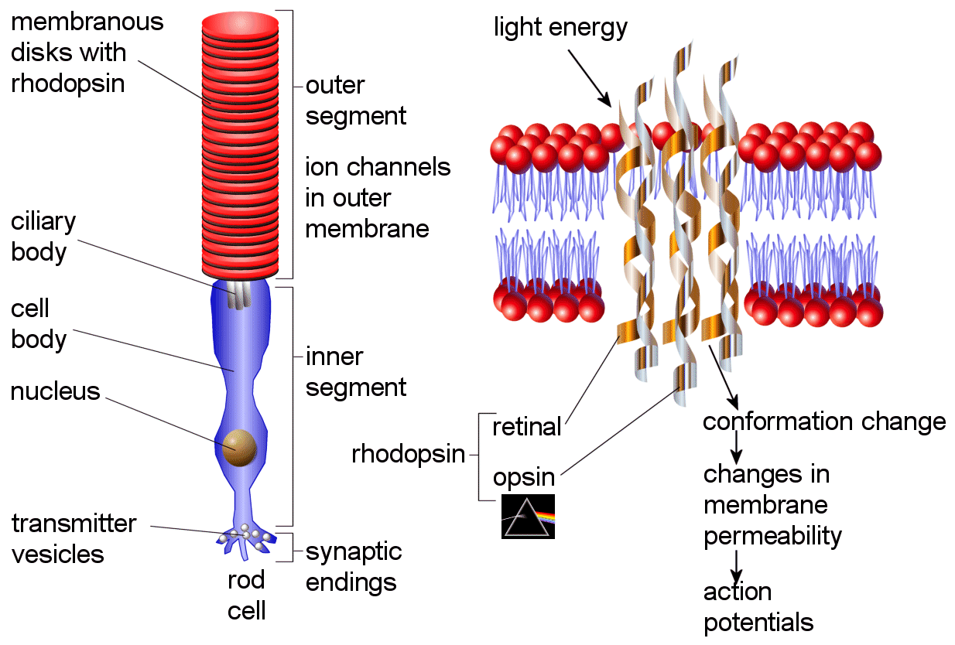
Rod cells detect the degree of lightness entering the eye and their sensitivity is dependent on the amount of the protein Rhodopsin present which is generated within the cells. However, Rhodopsin is destroyed by bleaching on exposure to light and therefore rod cells only work in low light. Photo-excited Rhodopsin triggers an enzymatic cascade process resulting in the hydrolysis of GMP. This in turn closes cation-specific channels within the rod cell membrane which are naturally open to influx of Na⁺ in the dark, and due to the effect of hyperpolarization, the inner synaptic body sends a nerve signal to other neurons in the Retina.

Slide 9
http://www.stanford.edu/class/me220/data/lectures/lect01/mechanorec.html
http://www.hometrainingtools.com/skin-touch/a/1388/
http://cpamomva.blogspot.com/2010_12_01_archive.html
http://www.wisegeek.com/what-are-chemoreceptors.htm
http://legacy.owensboro.kctcs.edu/gcaplan/anat/notes/API%20Notes%20N%20Senses-%20Pain%20&%20Touch.htm
http://hyperphysics.phy-astr.gsu.edu/hbase/vision/rodcone.html
http://facweb.cs.depaul.edu/sgrais/color_perception.htm
http://www.chm.bris.ac.uk/webprojects2003/rogers/998/Rhoeye.htm
http://justinpamute.wordpress.com/

