Slide 1
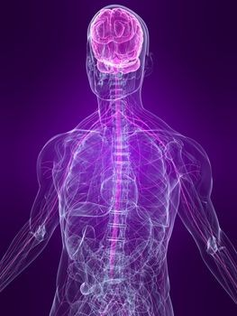
Nervous system

Slide 2
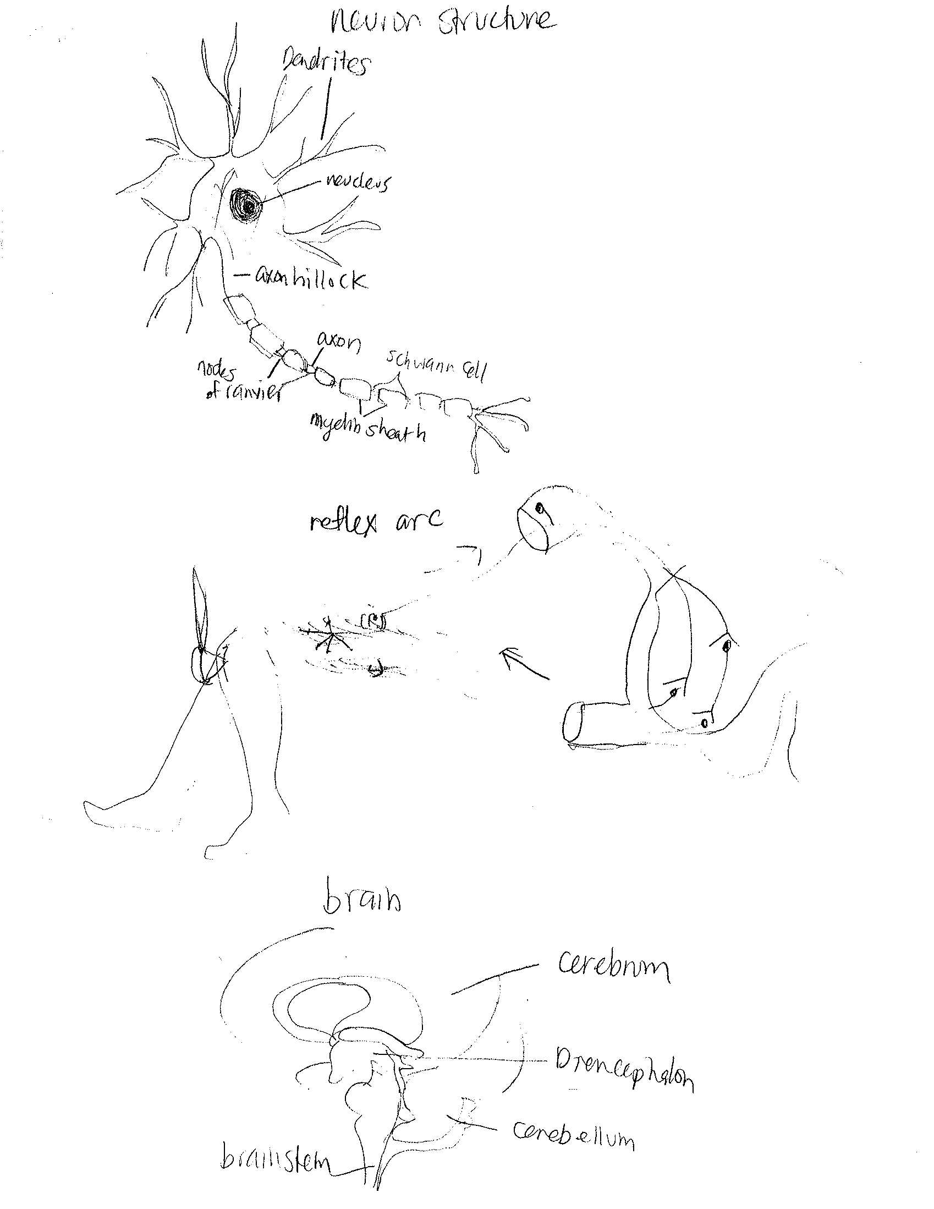
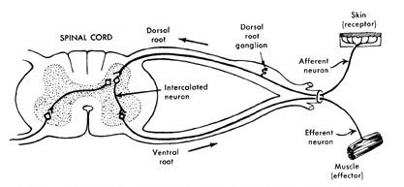
The function of the nervous system is to control the body by sending signals from cell to another. “cell communication”

Slide 3
The Knee-Jerk response
The muscles in the leg
have stretch receptors.
They react to a change in
length of the muscle.
When the hammer hits the
tendon at the knee, it
makes a muscle in the
front of your thigh longer
(stretches it). That
stimulates the stretch
receptors in that muscle.
• When the stretch receptors
are stimulated, they send a
message to the muscles of
your thigh.
• The muscles in the front of
your thigh contract.
• The muscles in the
back of your thigh relax.
• Your foot jerks.
Nerve cells (neurons)
carry the message from
the stimulated receptors
to the correct effectors.
• A sensory neuron carries
the message from the receptor
to the central nervous system
(the spinal cord and brain).
• A motor neuron carries the
message from the central
nervous system to the effector.
• This is a reflex arc

Slide 4
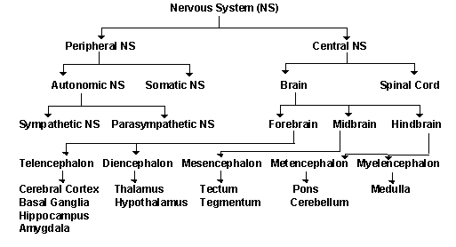
Central Nervous System (CNS) – consists of brain and spinal cord
Spinal cord
Peripheral Nervous System (PNS) – somatic nervous system and the autonomic nervous system
Somatic(body) nervous system consists of peripheral nerve fibers and motor nerve fibers
Cerebrum
Cerebellum
Medulla oblongata
Pons
Midbrain
diencephalon
Autonomic Nervous system is divided into three parts: the sympathetic nervous system, the parasympathetic nervous system and the enteric nervous system. The autonomic nervous system controls smooth muscle of the viscera (internal organs) and glands.

Slide 5
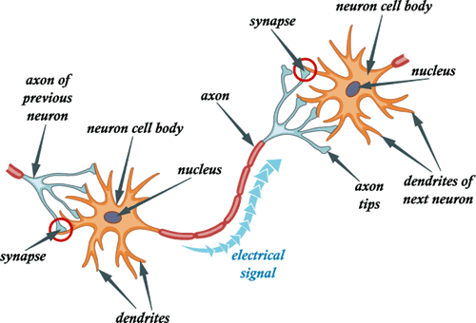
Neurons communicate by sending impulses through an action potential., This takes place from the dendrite and all the way to the axon ends.
An action potential is a change of voltage within the axon. In other words, the negative state off the inner axon turns positive when the impulses comes by. This happens by the use of a sodium and potassium pump. Sodium [Na] surrounds the axon with a positive charge, while the potassium [K] is within the axon.
As an impulse enters at the axon hillock, the sodium, potassium pump puts positive sodium into the axon while it puts negative potassium out of the axon. As more sodium enters the potential of the impulse changes from -70 mV to +30 mV, (a difference of 100 mV) This change is called an action potential.
The sodium, potassium pump works furiously to pass the impulse through the axon. As the impulse leaves the axon, it depolarizes and reverts to a normal state which is called the resting potential.
The refractory period in a neuron occurs after an action potential.
At the end of the axon, the impulse or stimulus enters the synapses and is called a post synaptic potential. From here, the impulse is transferred into neurotransmitters, some of which are chemicals called epinephrine and dopamine. These neurotransmitters flow into the fluid filled gap called the synaptic cleft and enter the dendrites. And, again, the process is repeated.

Slide 6
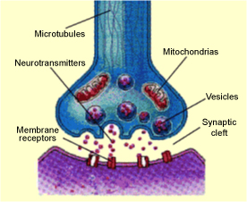
Neurotransmitters are chemicals in the brain that neurons use to communicate with each other and they are released from nerve endings. Neurotransmitters are stored in vesicles and they are released into the synaptic cleft and the action potential occurs at the same time

Slide 7
Multiple sclerosis (MS) affects women more than men. The disorder is most commonly diagnosed between ages 20 and 40, but can be seen at any age. MS is caused by damage to the myelin sheath, the protective covering that surrounds nerve cells. When this nerve covering is damaged, nerve signals slow down or stop.
The nerve damage is caused by inflammation. Inflammation occurs when the body's own immune cells attack the nervous system. This can occur along any area of the brain, optic nerve, and spinal cord. Episodes can last for days, weeks, or months. These episodes alternate with periods of reduced or no symptoms (remissions).
Fever, hot baths, sun exposure, and stress can trigger or worsen attacks.
It is common for the disease to return (relapse). However, the disease may continue to get worse without periods of remission.
4. Symptoms include decreased attention span and difficulty reasoning, as well as muscle spasms and decreased visual acuity. Medication, therapy, and a healthy lifestyle can all slow the progression of MS. MS affects more than 350,000 people in the United States and 2.5 million worldwide

Slide 8
Tourette Syndrome
This syndrome begins in childhood and manifests itself through various forms of tics. These tics include frequent, irregular movements of the head, neck, or shoulders. They also may be more complicated behaviors such as snorting, sniffing, and involuntary vocalization.
As the syndrome progresses repetitive behaviors such as touching others, obsessive compulsive symptoms, and explosive involuntary cursing can be more common.
The cause of Tourette syndrome is not known, but it is believed to have a genetic component. The rate of tourette’s syndrome incidence has been estimated at 6 per 1,000 children. Medications like neuroleptics can be prescribed for cases in which symptoms interfere with everyday life.

Slide 9
http://www.news-medical.net/health/Function-of-the-Nervous-System.aspx
http://www.spiritvoyage.com/blog/index.php/kundalini-yoga-for-the-nervous-system/
http://mcb.berkeley.edu/courses/mcb135e/central.html
http://faculty.washington.edu/chudler/nsdivide.html
http://www.freewebs.com/soaring_sphincter_travel_agency/nervoussystem.htm
http://library.thinkquest.org/2935/Natures_Best/Nat_Best_Low_Level/Nervous_page.L.html
http://www.ncbi.nlm.nih.gov/pubmedhealth/PMH0001747/
http://www.clevelandclinicmeded.com/medicalpubs/diseasemanagement/neurology/multiple_sclerosis/#s0015
http://www.cdc.gov/ncbddd/tourette/data.html
http://www.medicinenet.com/tourette_syndrome/page4.htm#toci
http://outreach.mcb.harvard.edu/teachers/Summer05/JerryHalpern/Reflexes.pdf

