Slide 1
Human Body Systems
By Marie Gengler

Slide 2
Table Of Contents
Respiratory System
Immune System
Excretory System

Slide 3
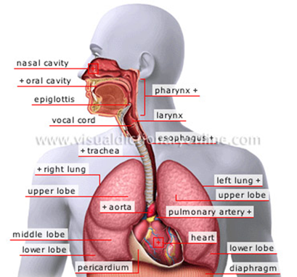
Respiratory System

Slide 4
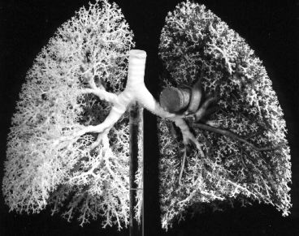
Respiratory System
The function of the respiratory system is to inhale oxygen and exhale carbon dioxide, control body temperature, and to control the pH and body fluids.

Slide 5
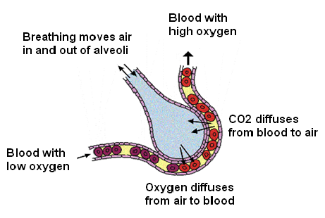
Respiratory System
The lungs surface area is covered with millions of alveoli for gas exchange.
Through the alveoli oxygen and blood are exchanged.
Alveoli have a very high surface tension, so the lungs produce surfactant to counter the tension.

Slide 6
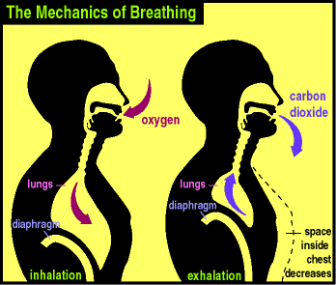
Respiratory System
Oxygen and carbon dioxide are exchanged between the alveoli and the blood through diffusion.
Carbon dioxide is moved from the blood into the alveoli and oxygen is moved from the alveoli into the blood.

Slide 7
Respiratory System
When the diaphragm contracts oxygen is breathed in.
Then it is picked up by the hemoglobin of a red blood cell through the exchange in the alveoli.

Slide 8
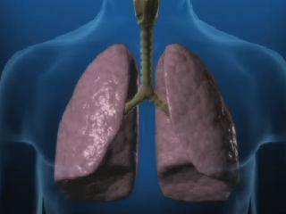
Respiratory System
Inspiration is when the diaphragm contracts down causing a decrease in pressure, bringing air in.
Expiration is when the diaphragm relaxes causing an increase in the pressure, sending air out.

Slide 9
Respiratory System
Asthma
Asthma is when the bronchi and bronchioles constrict.
Asthma attacks can occur by breathing in substances that someone is allergic to.
Symptoms of asthma are difficulties in breathing especially in exhaling.
Asthma is a very common.
Treatments are the use of inhalers and avoiding the substance.

Slide 10
Respiratory System
Emphysema
Emphysema is when the alveoli break down causing reduced gas-exchange in the lungs is reduced.
Symptoms for emphysema are difficulties in breathing, coughing, wheezing, and respiratory infections.
Statistics show people who smoke, breath in certain gases, and lack a protein called alpha-1 antitrypsin are the ones at risk.
There is no cure, but by not smoking and taking medications you can help lesson the symptoms.

Slide 11
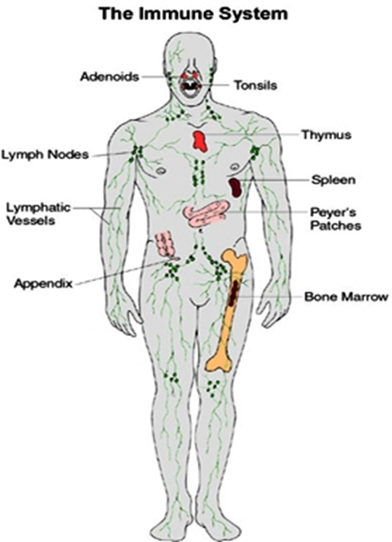
Immune System

Slide 12
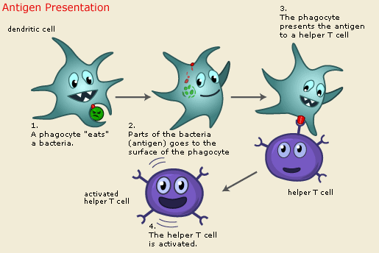
Immune System
The function of the immune system is that it protects the body from bacterial, viral, fungal, and parasitical infections.
Notes:
bacterial

Slide 13
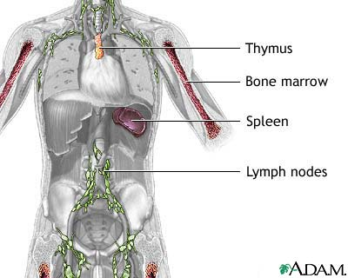
Immune System
He Immune System
Thymus
Bone Marrow
Lymph Nodes
Spleen

Slide 14
Immune System
In the immune system the body recognizes pathogens by using antigens and antibodies.
Antibodies attack foreign structures called antigens.

Slide 15
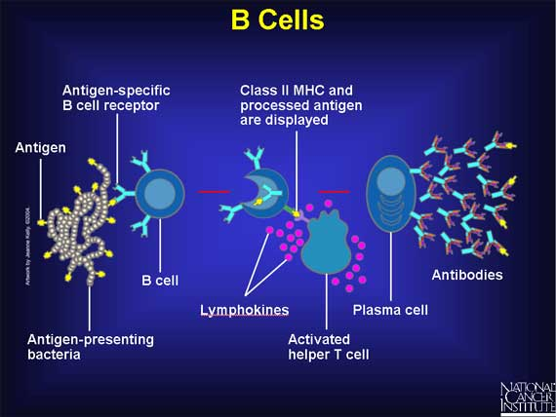
Immune System
Innate immunity isn’t the first responder to damage, it’s the second.
Acquired immunity is immunological memory.
Both immunities aid in damage and control.
Examples include apoptotic sensors within cells and chicken pox.

Slide 16
Immune System
Active immunity is when the body has antibodies that it received through previous encounter with the infection.
Passive immunity is when the body already has the antibodies through receiving it from something else..
Both immunities are similar in that both protect the body through acquiring antibodies from outside sources.
Examples include vaccines and antibodies acquired from birth through mother.

Slide 17
Immune System
Humoral immunity is when the body’s antibodies mark antigens for destruction.
Cell mediated immunity is when cells do not produce antibodies. They kill on the spot.
Both immunities have parts in the destruction of antigens.

Slide 18
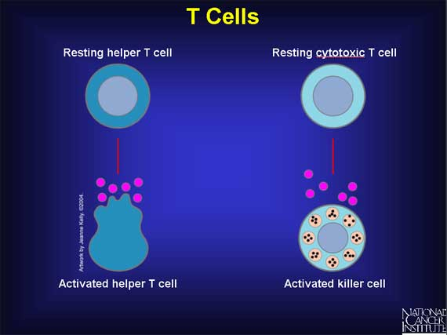
Immune System
T lymphocytes when activated are the ones that kill antigens on the spot. So they are activated by immune responses.
B lymphocytes produce antigens that mark substances for destruction by other cells. They don’t eat anything.

Slide 19
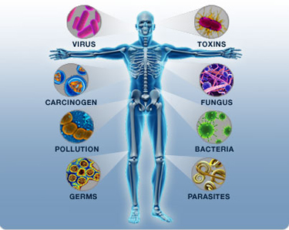
Immune System
Bacteria are living organisms existing as single cells while viruses are nonliving. Since viruses are not alive antibiotics can’t do anything against them.

Slide 20
Immune System
HIV/AIDS
HIV/AIDS is when the immune system fails.
Systems include cold and flu symptoms, pneumonia, and cancer.
You can get it through sex and blood transfusions.
It is life threatening and
chances of survival are almost
zero. There is a better chance
for survival if it is diagnosed
early.

Slide 21
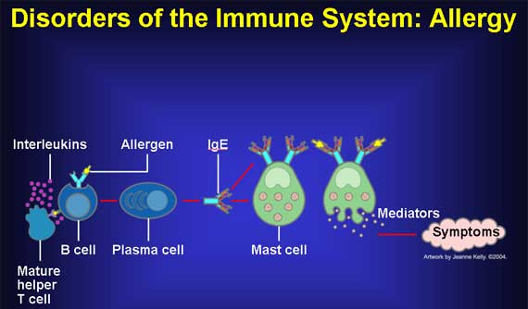
Immune System
Allergies
Allergies are when the immune system responses to a normal harmless substance and attacks it.
There are myriad allergens such as pollen grains, mold spores, latex rubber and certain food items like peanuts or drugs.
Symptoms include sneezing,
running nose, cough, headaches,
and pneumonia.
Allergies are extremely common.
Allergies can be treated through
avoidance, inhalers, epee pens,
and medicines.

Slide 22
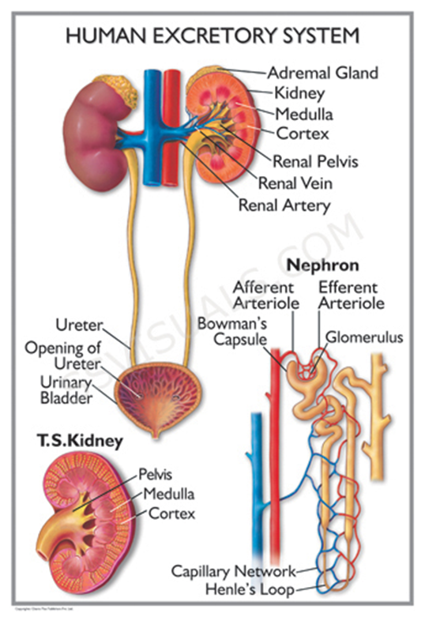
Excretory System

Slide 23
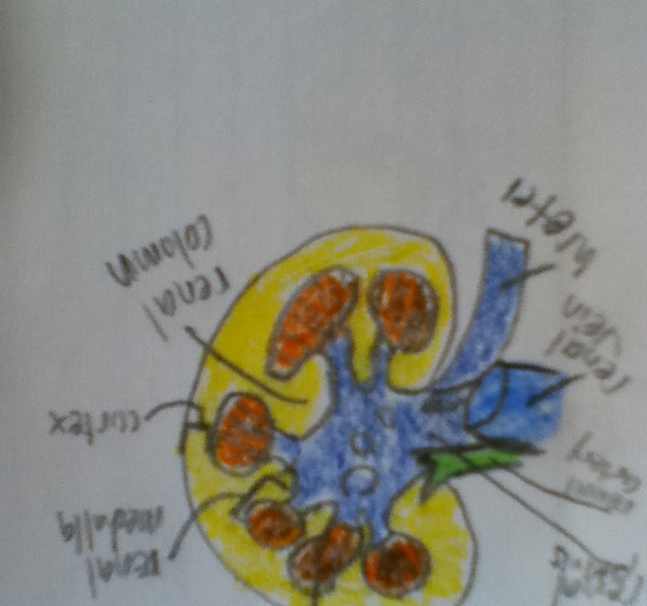
Excretory System
The function of the excretory system is to regulate the ions in the body and to excrete wastes.

Slide 24
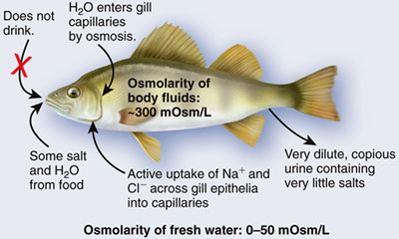
Excretory System
The three categories of nitrogenous waste are ammonia, urea, and uric acid.
Ammonia is found in amphibians and aquatic invertebrates because it is very soluble and toxic.
Urea is found in terrestrial amphibians and animals because it can be concentrated to conserve water.
Uric acid is found in birds reptiles and insects because it isn’t really toxic and isn’t soluble.

Slide 25
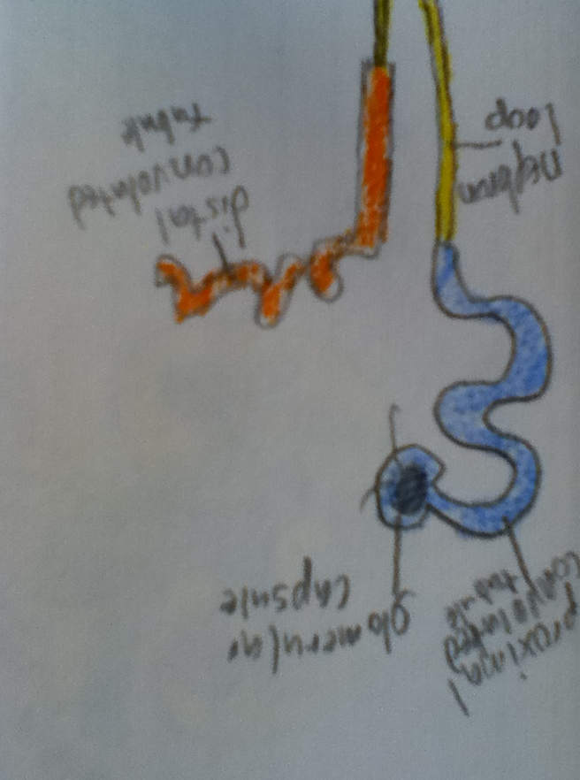
Excretory System
Glomerulus
Filters the blood.
Nephron Loop
Bowman’s Capsule
Collects filtrate from the glomerulus.
Distal Convoluted Tubule
Proximal Convoluted Tubule
Main sight for reabsorbing ions.
Collecting Duct
Receives urine and sends it to the renal pelvis.
Absorbs some ions.
The Nephron loop consists of the proximal and distal convoluted tubule.

Slide 26
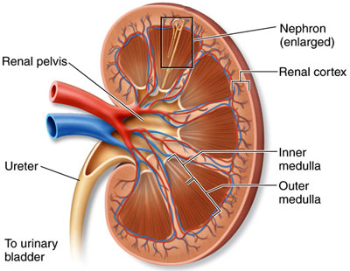
Excretory System
The glomerulus filtrates, it is the first step in urine formation.
The secretion of renin is done by the juxtaglomerular apparatus.
Through the process of tubular reabsorption the kidney gains electrolytes, water, and glucose.
Urea is then excreted from the body, to finally get rid of the nitrogenous waste.

Slide 27
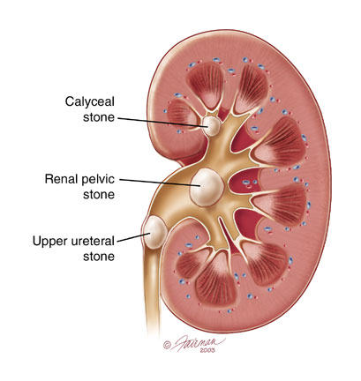
Excretory System
Kidney Stones
Kidney stones are small crystals of substances that block the passageways.
Symptoms include extreme pain, fever, and nausea.
If you have gout or a disease of the small
intestine your chances of a kidney stone
greatly increase.
You can treat kidney stones
with antibiotics, diuretics,
shock waves, and sometimes surgery.

Slide 28
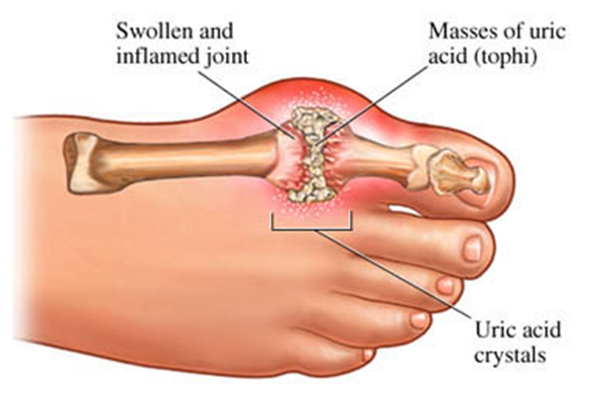
Excretory System
Gout
Gout is when uric acid builds up in a joint. The main joint is the big toe.
Symptoms include throbbing and tender joints, and fever.
Gout occurs if you have too much uric acid, so sickness that cause this may increase your chance of getting gout.
Treatments include medicines and
some life style changes.

Slide 29
Works Cited
Human Anatomy Book
http://hes.ucfsd.org/gclaypo/repiratorysys.html
http://users.rcn.com/jkimball.ma.ultranet/BiologyPages/P/Pulmonary.html
http://ibbiology.wetpaint.com/page/Describe+the+features+of+alveoli+that+adapt+them+to+gas+exchange
http://people.eku.edu/ritchisong/301notes6.htm
http://health.howstuffworks.com/human-body/systems/respiratory/function-respiratory-system.htm
http://www.thebody.com/content/art1788.html
http://www.cs.unm.edu/~immsec/html-imm/affmat.html
http://www.buzzle.com/articles/immune-system-diseases-list-of-immune-system-disorders.html
http://www.nlm.nih.gov/medlineplus/ency/imagepages/8932.htm
http://www.beltina.org/health-dictionary/immune-system-healthy-diseases.html
http://www.cancer.gov/cancertopics/understandingcancer/immunesystem/AllPages
http://www.nobelprize.org/educational/medicine/immunity/immune-detail.html
http://faculty.clintoncc.suny.edu/faculty/michael.gregory/files/bio%20102/bio%20102%20lectures/excretory%20system/excretor.htm
http://www.ncbi.nlm.nih.gov/pubmedhealth/PMH0001493/
http://www.ncbi.nlm.nih.gov/pubmedhealth/PMH0001459/
http://www.urologyhealth.org/urology/index.cfm?article=32
http://uvahealth.com/services/Inflammatory%20and%20Infectious%20Diseases/conditions-and-treatments/11825
http://www.doctortee.com/dsu/tiftickjian/bio101/excretory-system.html

